Slide 1
Instrument maintenance within the Bunker
28-9-2016
Iain Sutton
On behalf of the Neutron Technologies Division

Slide 2
Intro
Why is having a coherent maintenance strategy important ?
Because it contributes to;
Instrument availability for science
Operating costs
Minimizing exposure of personnel
The facilities overall reputation

Slide 3
Context
ESS specific context
Long source instruments
Components@ R6
Shielding common volume
Vertical access
HPower source issues
Neutron activation
Neutron damage
Project constraints
Minimise initial investment
Notes:
Large open shielding volume reminisant of reactor beamlines ILL FRM2
As a spallation source shielding thicknesses are consequent and it tightly surrounded by instrument
Contrany to rIt does not contain only neutron guides
But Large quantities of mechanical components

Slide 4
Equipment within Shielding Bunker
Component
Type Numbers
Choppers 98 axis
Optics 300 m (150 sections)
Shutters 30
Collimators 10
Monitors 30
Supports 200
Service supplies
Vacuum
Fluids
Cables
22 instruments assumed (13L-9S)
2 -3 times more mechanical devices on a ‘long pulse instrument’ than at existing types
60-70% of all ‘mechanical’ components on instruments are within bunker volume
Notes:
As 2 or 3

Slide 5
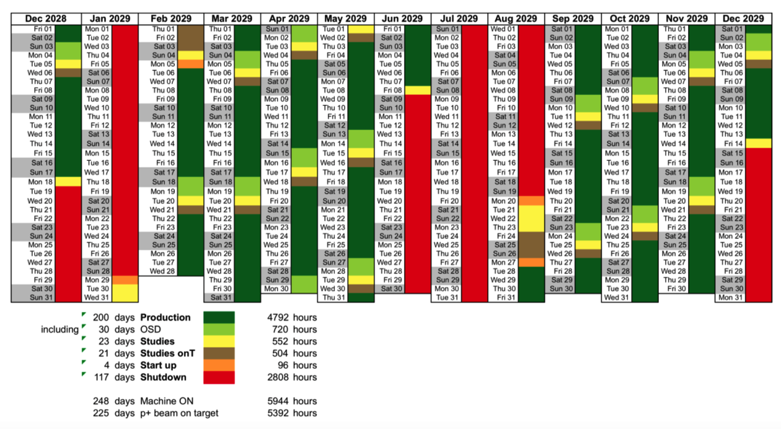
ESS Schedule Steady-State Operation
No maintenance during beam production !
Shut downs
2 long 30-50days
Maintenance
18 short shut downs <3days
Cool down period for components inside bunker
Notes:
Basic constraint
No maintenance on any during beam production
Maintenance will be carried out during shutdowns
Short shutdowns currently considered too short to use – cool off , cranage

Slide 6
Interventions
Scheduled activities
Type 1A: Periodic
(Once in the life of an instrument ( >10yrs))
Installation / Decommissioning
Type 1B: Regulars
(Periodicity 2-5yrs)
Inspection
re-alignment
Overhaul (preventive maintenance)
Unscheduled activities
Type 2: Breakdown
INTERVENTIONS
within Bunker
SCHEDULED
Type 1(A)
PERIODIC
Type 1(B)
REGULAR
UNSCHEDULED
Type 2
BREAKDOWN
5-10 interventions p.a.
6 interventions p.a.
60 interventions p.a.
(interventions in steady state operation for 22 instruments
post burn-in)
Notes:
Interventions may be considered as two types;
Type 1: Scheduled activities
Type 1A: Long periodicity events
Installation / Decommissioning
Type 1B: Short periodicity events
Inspection/ Adjustment /Replacement
Type 2: Unscheduled activities
(‘random’ events with 5-20 incidents p.a.)
Breakdown repair
Inspection / Adjustment / Replacement
Accident scenario

Slide 7
Activation after short cool down period (24 hrs)
Activation
Integrated beam
Personnel access prohibited
Personnel access severely restricted
MIXED REGIME
Removal of hotspots required prior to access
Beam power
Personnel access restricted
Beam days
Personnel access unrestricted

Slide 8
Activation after cool down period (7-14 days)
Integrated beam
Personnel access prohibited
Cool down
Personnel access severely restricted
MIXED REGIME
Activation
Removal of hotspots required prior to access
Beam power
Personnel access restricted
Beam days
Personnel access unrestricted

Slide 9
Activation
Time after beam off
Component 24hrs 7days
T0 choppers 10 0.3
Monolith face 1 1
H. shutters 2 0.1
BP shutter 0.1-1 0.05
Collimator (Cu)0.2 0.02
Guide (Al) 1 0.01
Estimated dose at 30cm in mSv
Activation of the monolith face is likely to severely restrict work in proximity
REMOVE or SHIELD

Slide 10
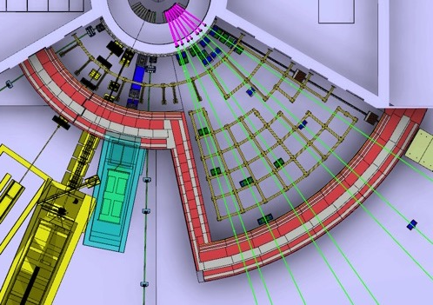
Dose limits & Zones
Target maximum annual dose 10mSv
> 1 mSv/h
Strictly controlled access
Zone I
Requirement;
All systems shall be remote handling installation compatible
0.1 -1 mSv/h
Restricted access
Zone II
Requirement;
All systems shall be vertical handling installation compatible.
‘Hot’ components shall be remote handling installation compatible
Notes:
Access will be controlled
Removal of hot spots
Installation of tempory shielding
Time limited
Increasingly over time
Forward area particularly unpleasant
Remote handling obligatory

Slide 11
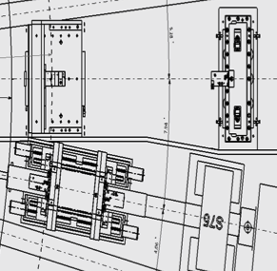
@ monolith face ready for remote handling
Sequence
Remove roof
Install platform
Install guide frame
Un fasten components with long tools
Cask (if required)
Remove
“Make space”
Notes:
Remove highly active components
Activity of monolith

Slide 12
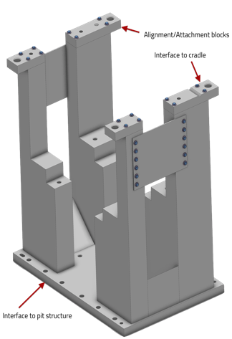
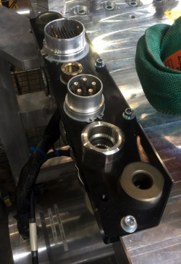
Remote handling ready
Don’t reinvent the wheel !
Support structures
Fixations
Alignment 3 point
Guide rods
Service connections
Developed in collaboration with
Chopper are ready
Neutron guides are next !
Notes:
A lot of thinking has already gone into this area
Internally
Also at other centers and more broadly in industry
We are not interested in re-inventing the wheel
Neither technical
Nor operationaly
Studied what has been done

Slide 13
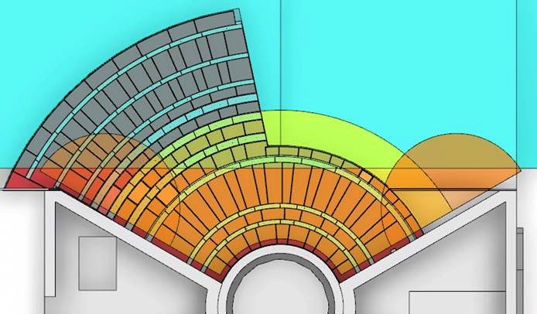
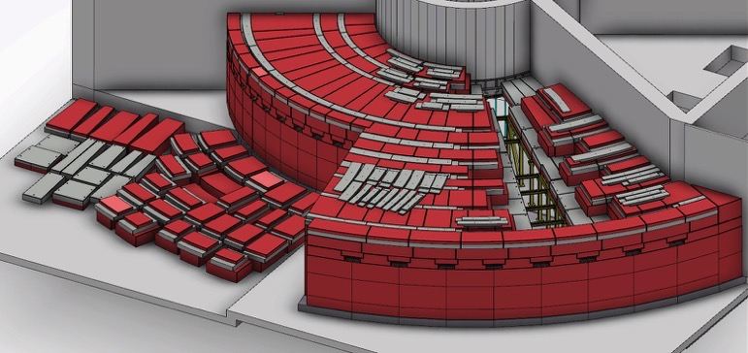
Logistics
(external to Bunker)
Hall Crane
Bunker crane
20t winch
2t winch (requesting)
Coverage Acceptable
Hall Crane
30t winch
5t winch
Coverage Acceptable
Issues
Roof complexity = Many lifts
Storage within the hall is limited
Multiple handovers increase time required.
Hand over zone
Bunker Crane

Slide 14
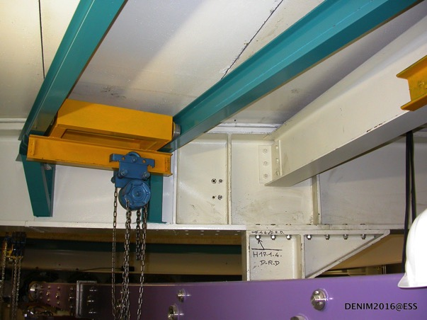
Logistics “in bunker logistics”
Transport systems
Circumferential cranes number 2
Type : mono rail
Capacity 500kg
+ radial crane on an beam
‘C’ crane
Personnel access
Notes:
Making the bunker work
Maintenance activities
Repair
Exploring
On the floor Activites

Slide 15
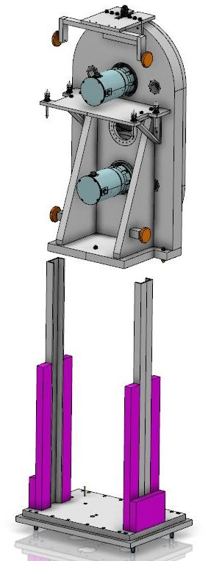
Summing up
Strategy headlines
High reliability
Long service intervals
Standard interfaces
All designed for vertical removal
‘Critical’ systems equipped for remote handling
Common tooling
Notes:
Starts with having a plan
Push for reliability
Building in Maintainability , manage risk
Priority on critical systems
Operational Integration
Tooling
Schedules
Spares
Work with experienced parters
It not going to be perfect use the precious early years to Learn
don't reinvent the wheel SNS
ISIS
Ensure future compatibility
upgrade path

Slide 16
Thanks you for your attention !
Many thanks for contribution from the Bunker group and the Neutron Chopper Group

Slide 17
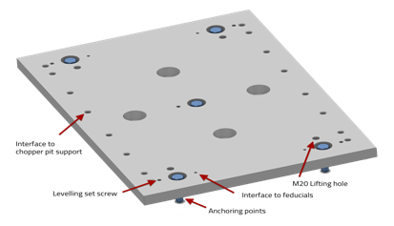
Vibration mitigation
Reduce source terms
Balance
Magnetic bearings
Avoid coupling
Rigid structures
Rigid fixation
Isolate sources
Support – Base
Separate base plates (PPSc)
Attenuate
Bolted & grouted base plate
Spring loaded fixation
Rigid support
Reservation for Thin isolator
Bolted & grouted baseplate
Notes:
don't reinvent the wheel SNS
ISIS
Ensure future compatibility
upgrade path

Slide 18
Target Safety related instrument failure
Current strategy “a layered and graded approach.”
Beam port a ‘thick’ window (Rated for normal safety case)
BP shutter a ’thick-ish’ window (v50)
Upstream side of high speed choppers a ’complimentary’ window
@ 11.5m a ’thick-ish’ window ‘fire break’
Metallic guides only upstream of ‘fire break’
Common shielding
Safety related equipment
Fire break
Normal equipment
BEAM PORT
SHUTTER
GUIDE
GUIDE
1
2
3
4

Slide 19
Which equipment should be equipped to be remote handled ?
Equipment which represents a significant hazard to personnel during interventions (due to activation).
PPS choppers
Shutters & collimators
Some supports (?)
Equipment which requires regular intervention.
Overhaul or inspect period < 10 years.
Removed frequently i.e. is installed between R6 – R11.5
Equipment presenting a significant risk of breakdown. Reliability < 98%

Slide 20
Which operation should be carried out using remote handling ?
Operations
Disconnection
Beamline components, hold down and Services
Removal
Fitment of cask if required
(Re)insertion
Repositioning or alignment (if required)
Reconnection

Slide 21
Crane route
Bunker crane
Exchange zone
Storage zone
Hall crane

Slide 22
Roof removal

Slide 23
Full Short

Slide 24
Full Short (Best case)
Number of Lifts 42
Shielding mass 180
Lift duration 16hr
Activities
Beam port activation
Instrument installation

Slide 25
Full short (worst case)
Number of Lifts 47
Shielding mass 200
Lift duration 19hr
Activities
Beam port activation
Instrument installation

Slide 26
R6-R9 (Front end)

Slide 27
R6-R9 (Front End)
Number of Lifts 93
Shielding mass 80t
Lift duration 8h
Activities
Maintenance
Repairs
Choppers
Optics

Slide 28
R9-R11.5 (Short Rear End)

Slide 29
R9-R11.5 Short rear end
Number of Lifts 17
Shielding mass 100t
Lift duration 7hr
Activities
Maintenance
Repair
all components

Slide 30
Full Long

Slide 31
Full long
Number of Lifts 93
Shielding mass 500t
Lift duration 16h
Activities
Instrument installation
Full overhaul

Slide 32
Interventions - type 1A - Scheduled, PERIODIC (?)

Slide 33
Type 1A Once in an (instrument) life time (10yrs) aka bunker annual events !
These activities are expected to be infrequent (periodicity >10yrs) when considered on a beam line by beam line basis.
Note when each bunker is considered as a system of 8-12 beam lines interventions become annual.
Interventions
Beam port activation
Instrument installation
Beam port deactivation
Instrument removal
Installation of neighboring instrument

Slide 34
Interventions -type 1(b) schedule Regular (every shut-down

Slide 35
Type 1B ‘the regulars’
These activities will be regular occurrences
These events will predominate work load of tech support during operation
Systems must be in place to enable these activities to be carried out minimising exposure to personnel
– ie minimising hands on.

Slide 36
Scheduled & Regular
Activity Incidence over 10yr period
Beam port systems inspection 40
Neutron chopper maintenance 100
Optics realignment 20
Instrument shutter maintenance 20
Other component maintenance 60
Removal neighboring & Hot 80
Total 320

Slide 37
Interventions - Type II unscheduled (BREAKDOWNS)
Breakdown, Screw ups, and other stuff that just happens

Slide 38
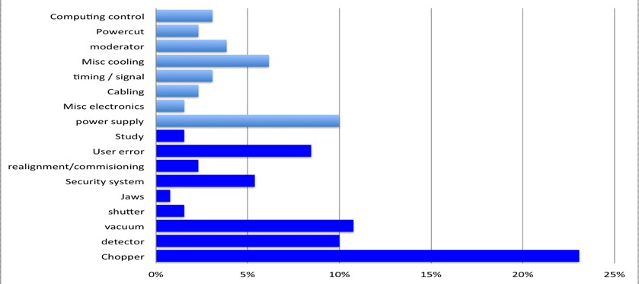
Sub system level breakdown data
CAUSE OF STOPPAGE
BLUE Chopper system
RED Other component
GREEN At request of I.S.
Cycles (Normalized to 35 day)
Beam interruptions
Note: excluding - Sample environments, Computing & Motion control
Causes not requiring access within heavy shielding for repair
~ 3 ‘significant’ interruption per 100 beam days
+3.5 uses of shutters to effect ‘running repairs’
Causes often requiring access within heavy shielding for repair
Source: ISIS
Notes:
Calculated failure rates for existing instruments and equipment
And from that
Factoring in the increase comlexity of ESS instruments tried to come up with some estimates for our own instruments
Failure of a specific instruments every 3 or 4 years
Failure of ‘An’ instrument each 35day cycle

Slide 39
Unscheduled (breakdowns & unforseen)
Activity Incidence over 10yr period
Beam-port systems breakdown 4
Neutron chopper failure 40
Optics breakdown 20
Instrument shutter breakdown 20
Other component breakdown 60
Removal of hot components (neighboring work) 30
Accident scenarios (H2) 2
NOTE : Indicative figures – work in progress

Slide 40
Availability & Source Schedule
Lengthening short breaks 3 > 5 days enables them to be used for repair.
Results in increased overall availability
Notes:
As a general rule unscheduled shut downs for repair are restricted to GREEN zones
Access to components in other zones must await scheduled ‘short shutdown’ – to cope with more complex interventions.
Longer interventions will be dealt with in two steps, with removal of equipment during one S-SD, repair off line and replacement at the next S-SD.
In the case of interventions requiring extended SD then shutters can be held close after start up of the facility.

Slide 41
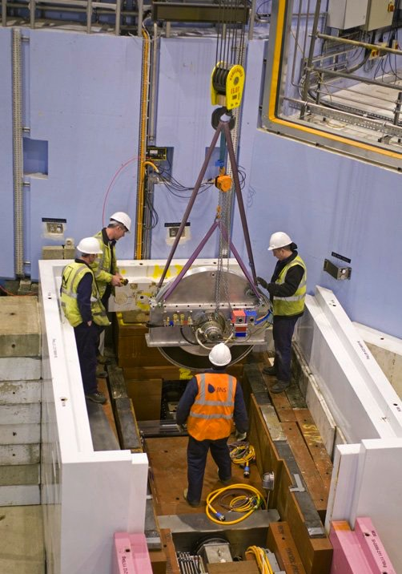
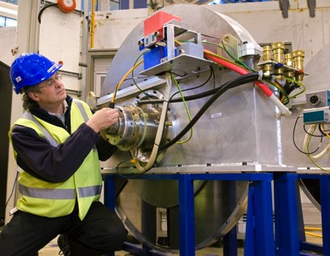
DC-LR installation
.2.1m
1.4m

Slide 42
Worst case
Disc chopper Large rotor
Odin, Freia, (4-6 units)
Assuming a rotor of 1800mm
The height of the unit is 2100mm
Assuming a lifting tool of 300mm
Gap to floor of 200mm
Free height require > 2600mm
300
2100
N
200 gap

Slide 43
Hook height
300mm (20t hook)
~2300
~1800 (700mm disc)
N BEAM
Gap 200mm

Slide 44
Components and their placement
(with respect to the instrument in the beam line allocation document)
Components | Total number | In bunker | In bunker and serviced by monolith crane | Serviced by monolith crane but not in bunker
Over/Under Chopper | 23 | 16 | 16 | 0
Single Chopper | 33 | 19 | 16 | 2
Face-to-Face chopper | 26 | 20 | 19 | 0
Large rotor choppers (1-1.4m) | 7 | 7 | 5 | 0
Large rotor choppers (>1.4m) | 3 | 2 | 1 | 0
PPS | 6 | 4 | 4 | 0
Guide module | 218* | 201 | 165 | 10
Other | 12 | 3 | 2 | 2
Total | 391 | 272 | 228 | 14
*Every instrument is considered to have a single guide module from m30 onwards

Slide 45
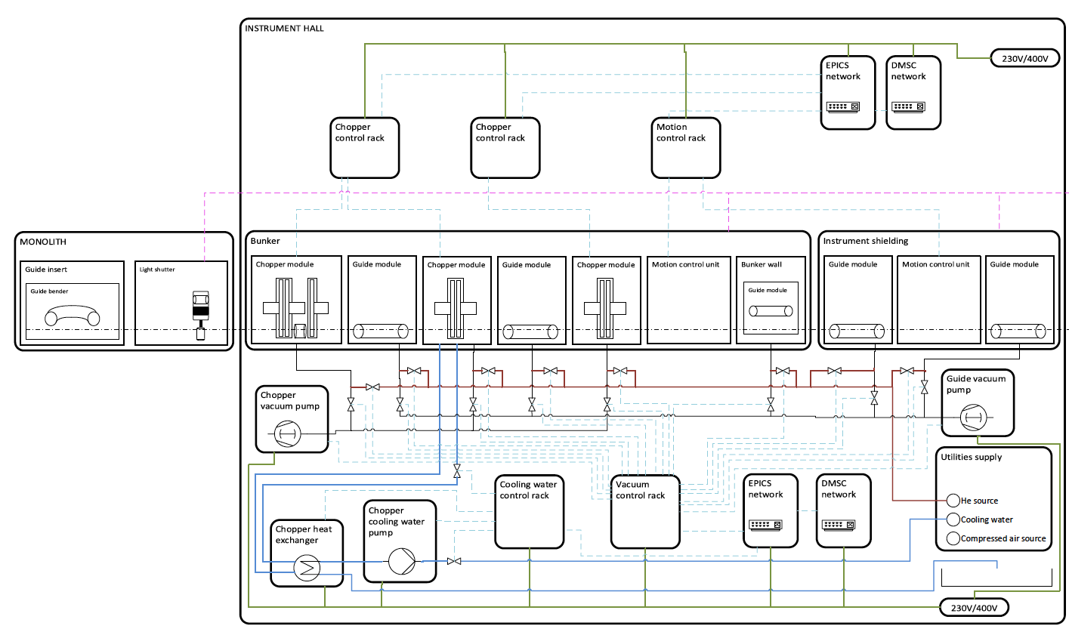
Installed systems What
Insert schematic of bunker components here

Slide 46
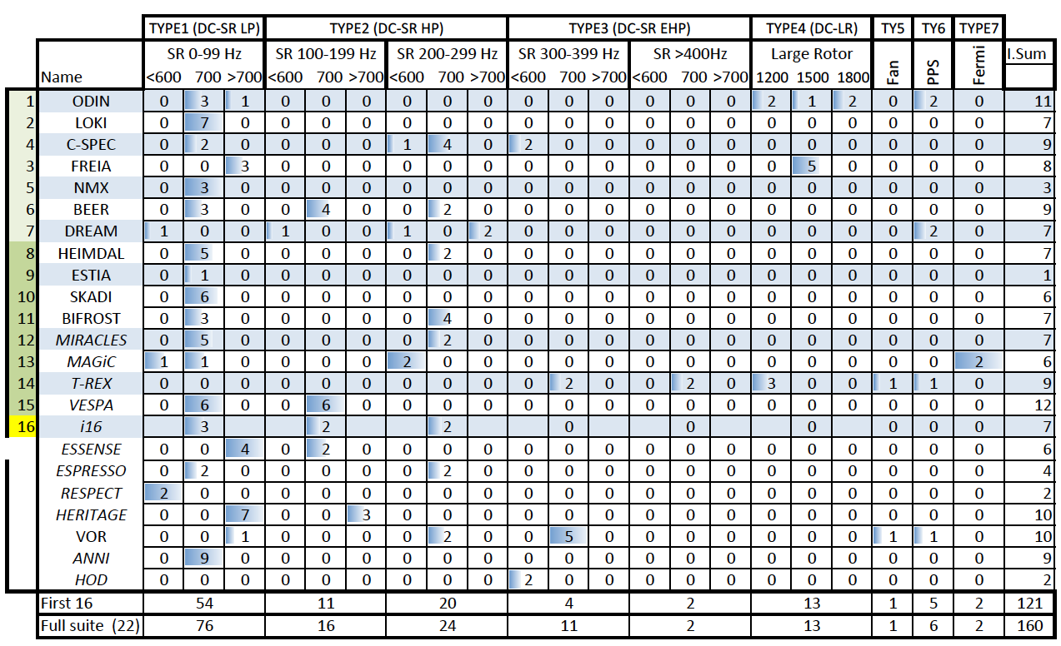
Installed systems Neutron choppers
High or Hot equipment
High speed double choppers 8-10 assemblies
PSS = 5 assemblies

Slide 47
DCSR (2PA-1-CRD) Conclusions
A hook height of 2.5m is a minimum for current equipment
2.7m prefered
2t – 5t lifting equipment would be strongly preferred.
Special mountings will be required to ensure installation compatibility

