Slide 1
ESS Instrument Integration Project and ICS Status Update
David Brodrick
(and many others)
Fourth ESS Experiment Control Workshop
Copenhagen, December 2016

Slide 2
ESSIIP Objectives
To,
catalyse interaction and workflow development between ESS internal groups;
facilitate integration of actual ESS instrument control technologies;
provide an environment for testing ICS controls deployment technologies;
enable full vertical development, from technology groups through to DMSC.
first step toward having a proven instrument control framework ready before commissioning of the first ESS instruments.

Slide 3
ESSIIP High Level View
NICOS
'Data Aggregator'
Components
Timing
Kafka
Boot Server
EEE
EPICS
IOCs
Channel Finder
CCDB
Archiver
IOC Factory
Neutron
Chopper
Motion
Control
Sample
Environment
Detector
Environment

Slide 4
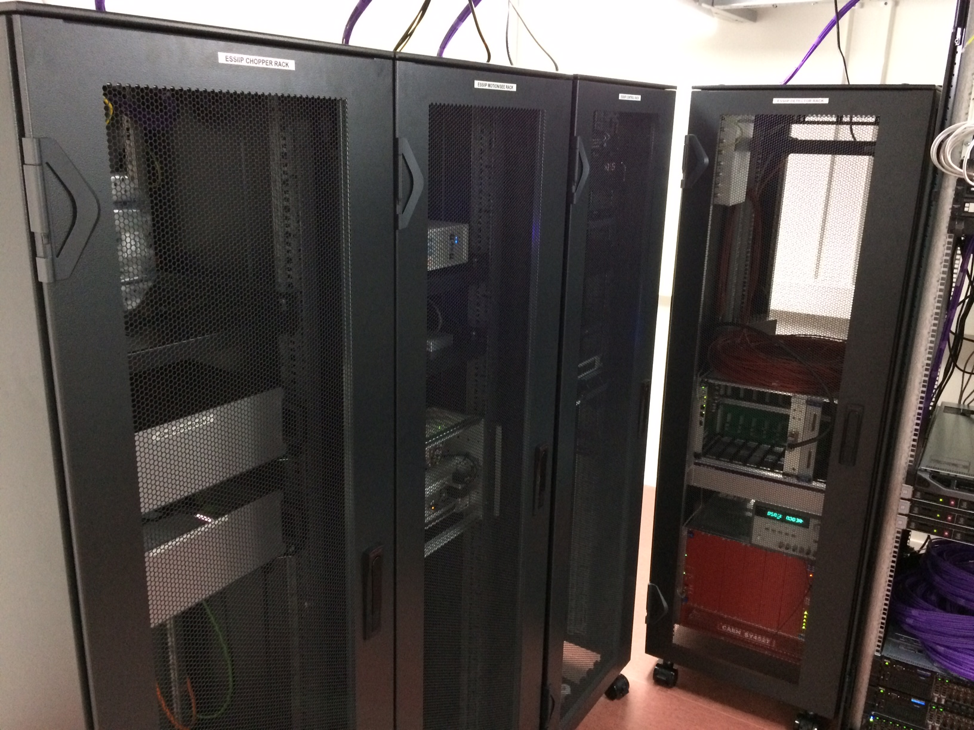
ESSIIP High Level View
NICOS
'Data Aggregator'
Components
Timing
Kafka
Boot Server
EEE
EPICS
IOCs
Channel Finder
CCDB
Archiver
IOC Factory
Neutron
Chopper
Motion
Control
Sample
Environment
Detector
Environment

Slide 5
ESSIIP Detector Controls
CAEN SY4527 power supply with integrated EPICS IOC.
CAEN Integration Manual produced.
Wiener mPOD power supply IOC developed.
Wiener Integration Manual produced.
Both power supply manufacturers will be available to ESS instrument teams in production.
Both power supplies connected to ESSIIP HV test box.
Detector Group are preparing readout electronics demonstrator for ESSIIP, which may be used with He3 tubes to provide data events.
This is expected around March 2017.

Slide 6
ESSIIP Detector Controls
CAEN SY4527 power supply with integrated EPICS IOC.
CAEN Integration Manual produced.
Wiener mPOD power supply IOC developed.
Wiener Integration Manual produced.
Both power supply manufacturers will be available to ESS instrument teams in production.
Both power supplies connected to ESSIIP HV test box.
Detector Group are preparing readout electronics demonstrator for ESSIIP, which may be used with He3 tubes to provide data events.
This is expected around March 2017.

Slide 7
ESSIIP Motion Control
Beckhoff TwinCAT motion controller.
IO via EtherCAT terminals.
Custom communication interface with PLC, using model 3 driver on the EPICS side.
Integrated with EEE.
ESSIIP runs a single axis, with limit switches and home position sensor.

Slide 8
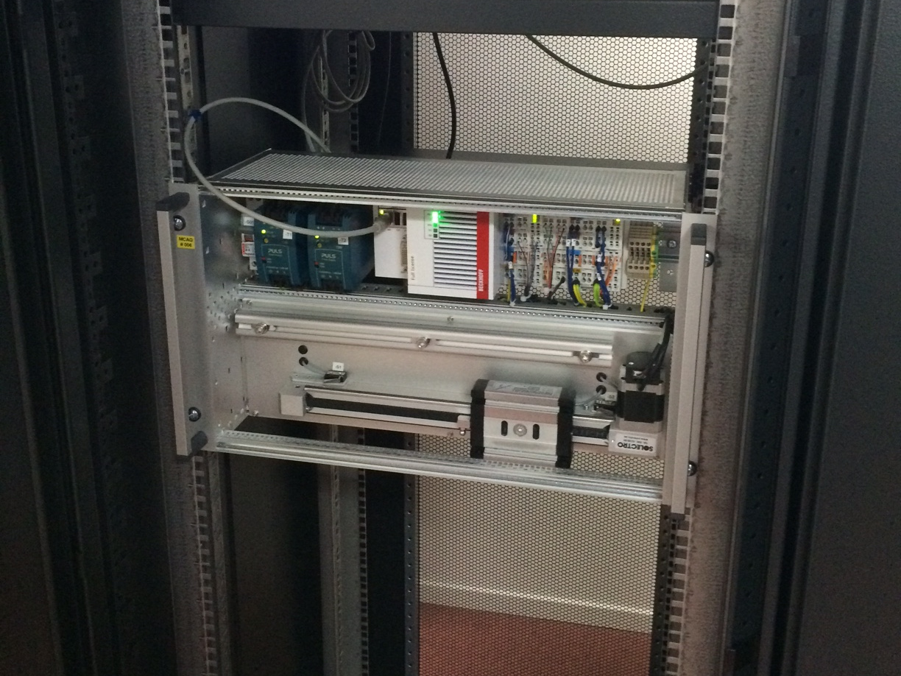
ESSIIP Motion Control
Beckhoff TwinCAT motion controller.
IO via EtherCAT terminals.
Custom communication interface with model 3 driver on EPICS side.
Integrated with EEE.
ESSIIP runs a single axis, with limit switches and home position sensor.

Slide 9
ESSIIP Chopper Controls
First ESS CHopper Integration Controller (CHIC) prototype.
Beckhoff drive controller for mechanical 'mini-chopper'.
Modbus interface with EPICS IOC.
Preliminary ICD agreed and implemented.
Chopper 'Top Dead Centre' pulsetrain timestamped by MRF timing system (EPICS).
Precision timestamps available to DMSC for software chopper veto.
Timing system provides synchronisation reference pulses to chopper drive (yet to be implemented).

Slide 10
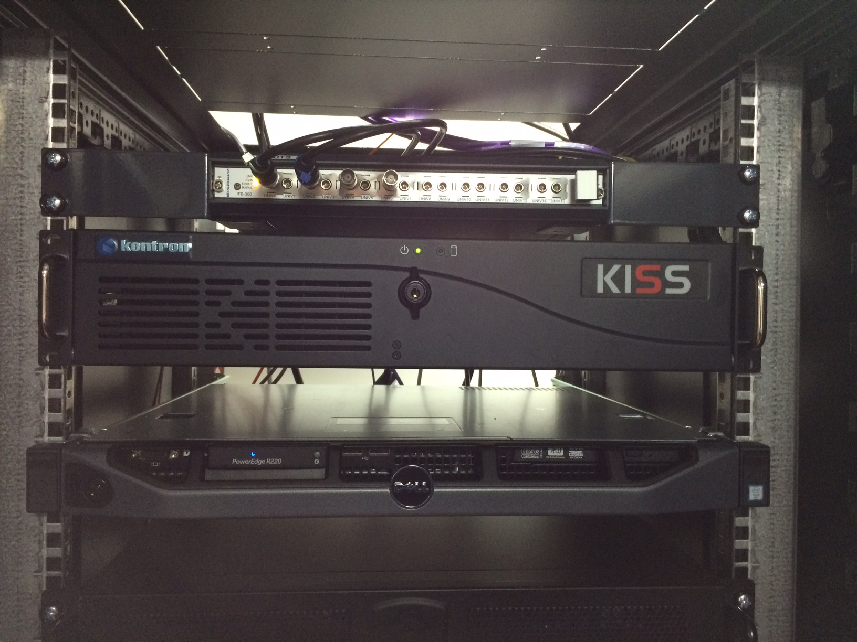
ESSIIP Chopper Controls
First ESS CHopper Integration Controller (CHIC) prototype.
Beckhoff drive controller for mechanical 'mini-chopper'.
Modbus communication with EPICS IOC.
Preliminary ICD agreed and implemented.
Chopper 'Top Dead Centre' pulsetrain timestamped by MRF timing system (EPICS).
Precision timestamps available to DMSC for software chopper veto.
Timing system provides synchronisation reference pulses to chopper drive (yet to be implemented).

Slide 11
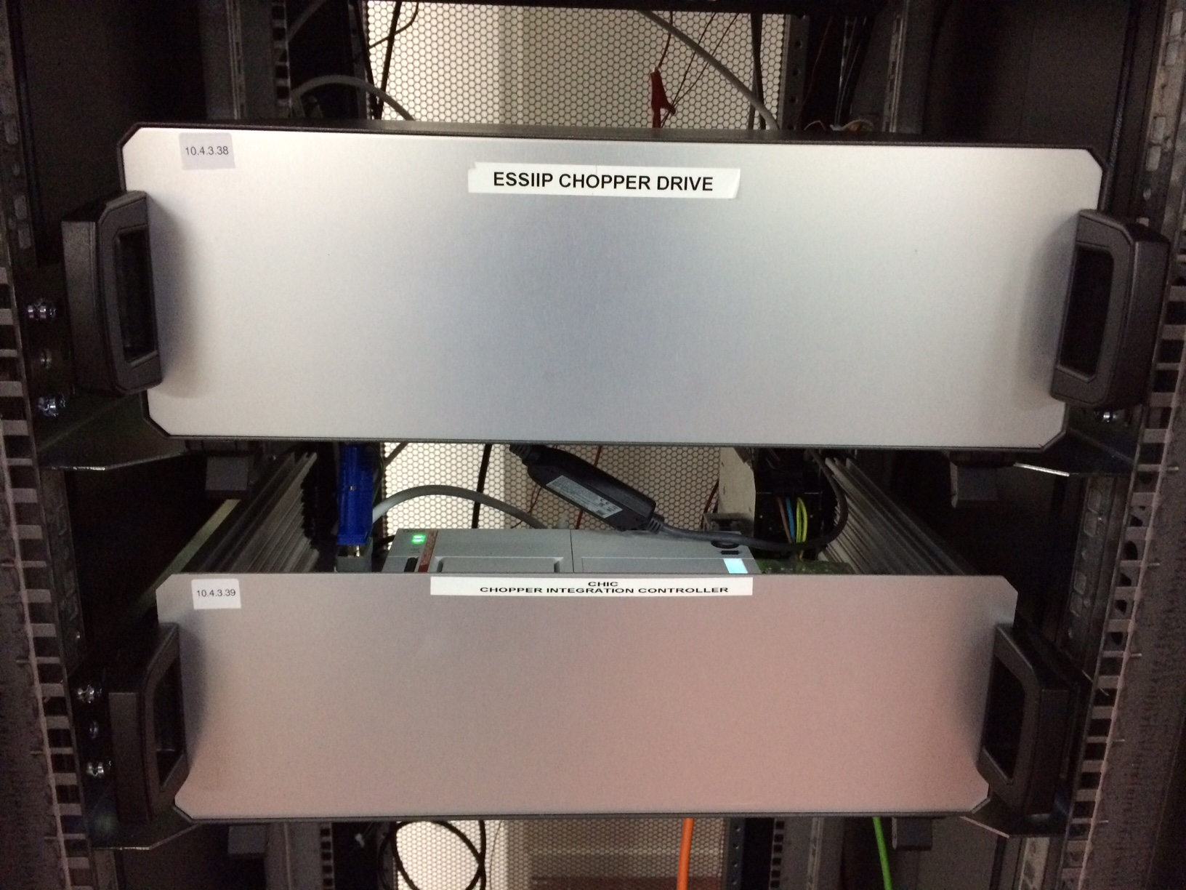
ESSIIP Chopper Controls
First ESS CHopper Integration Controller (CHIC) prototype.
Beckhoff drive controller for mechanical 'mini-chopper'.
Modbus communication with EPICS IOC.
Preliminary ICD agreed and implemented.
Chopper 'Top Dead Centre' pulsetrain timestamped by MRF timing system (EPICS).
Precision timestamps available to DMSC for software chopper veto.
Timing system provides synchronisation reference pulses to chopper drive (yet to be implemented).

Slide 12
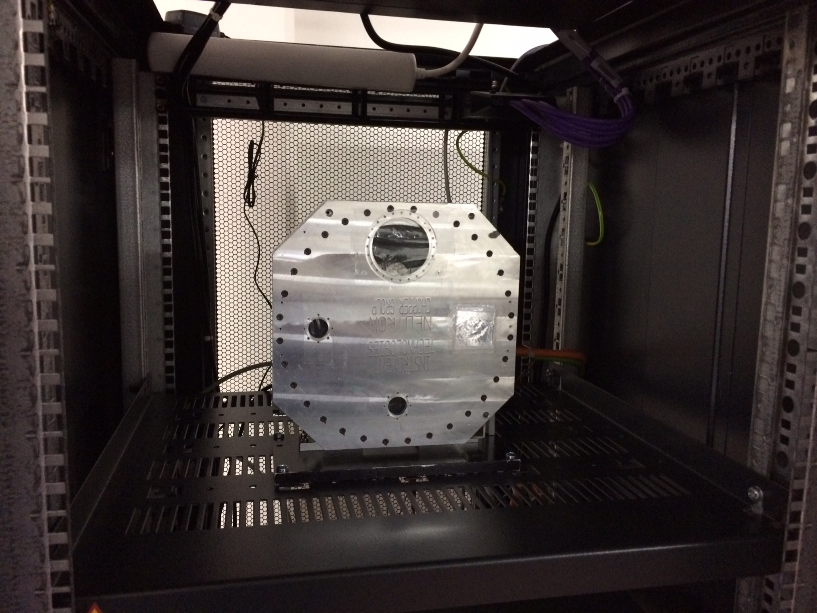
ESSIIP Chopper Controls
First ESS CHopper Integration Controller (CHIC) prototype.
Beckhoff drive controller for mechanical 'mini-chopper'.
Modbus communication with EPICS IOC.
Preliminary ICD agreed and implemented.
Chopper 'Top Dead Centre' pulsetrain timestamped by MRF timing system (EPICS).
Precision timestamps available to DMSC for software chopper veto.
Timing system provides synchronisation reference pulses to chopper drive (yet to be implemented).

Slide 13
ESSIIP Sample Environment
Lakeshore LS336 installed for ESSIIP.
EPICS integration with IOC Factory deployment, etc..
IOC running on network boot mobile mini computer.
Integration with Channel Finder for 'plug and play' SEE discovery.

Slide 14
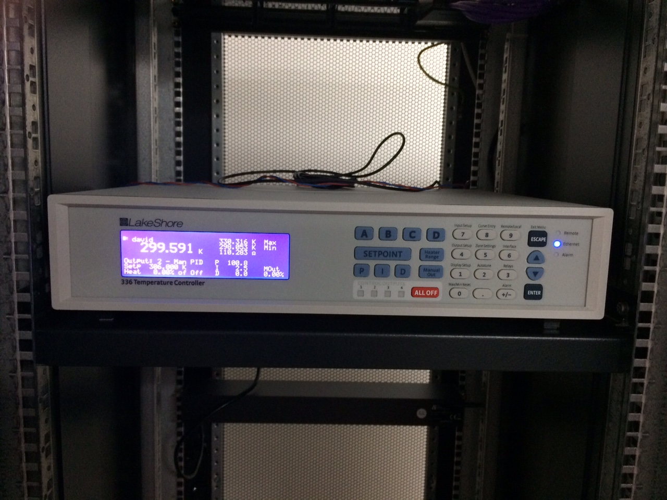
ESSIIP Sample Environment
Lakeshore LS336 installed for ESSIIP.
EPICS integration with IOC Factory deployment, etc..
IOC running on network boot mobile mini computer.
Integration with Channel Finder for 'plug and play' SEE discovery.

Slide 15
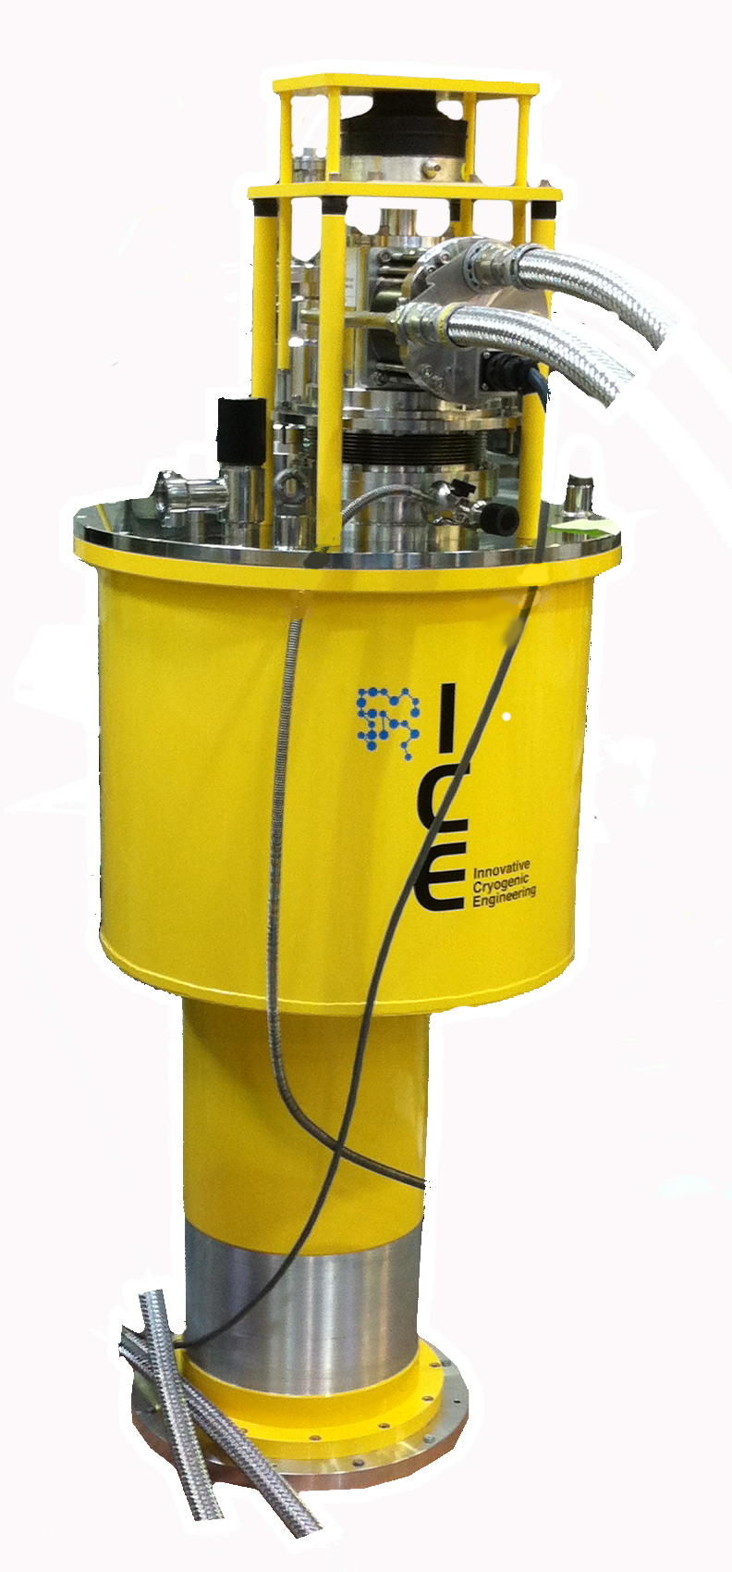
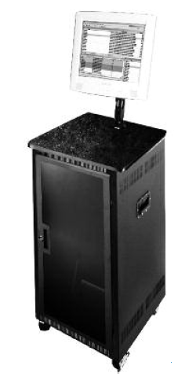
'Plug and Play' SEE Discovery
IOC on mobile mini computer
recceiver
REST
Channel Finder
REST
NICOS

Slide 16
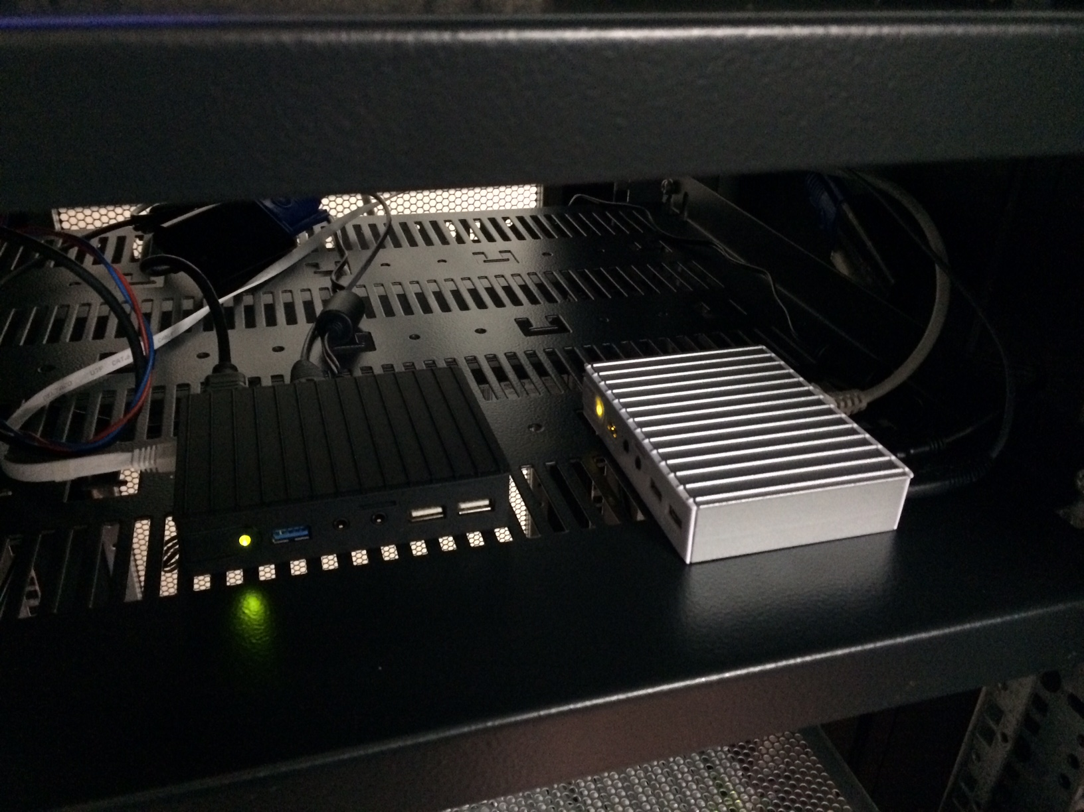
'Plug and Play' SEE Discovery
IOC on mobile mini computer
recceiver
REST
Channel Finder
REST
NICOS

Slide 17
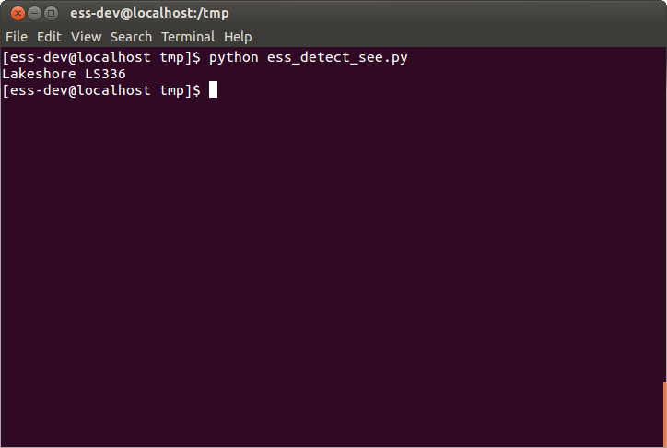
'Plug and Play' SEE Discovery
IOC on mobile mini computer
recceiver
REST
Channel Finder
REST
NICOS

Slide 18
ESSIIP DMSC Integration
DMSC Instrument Data Group's server installed.
Some devices already integrated with NICOS.
DMSC Data Management have three high-end servers installed.
Streaming Area Detector image data over pv Access for ingest and streaming via Kafka.
Plans to set up high speed stream of digitised analog data.

Slide 19
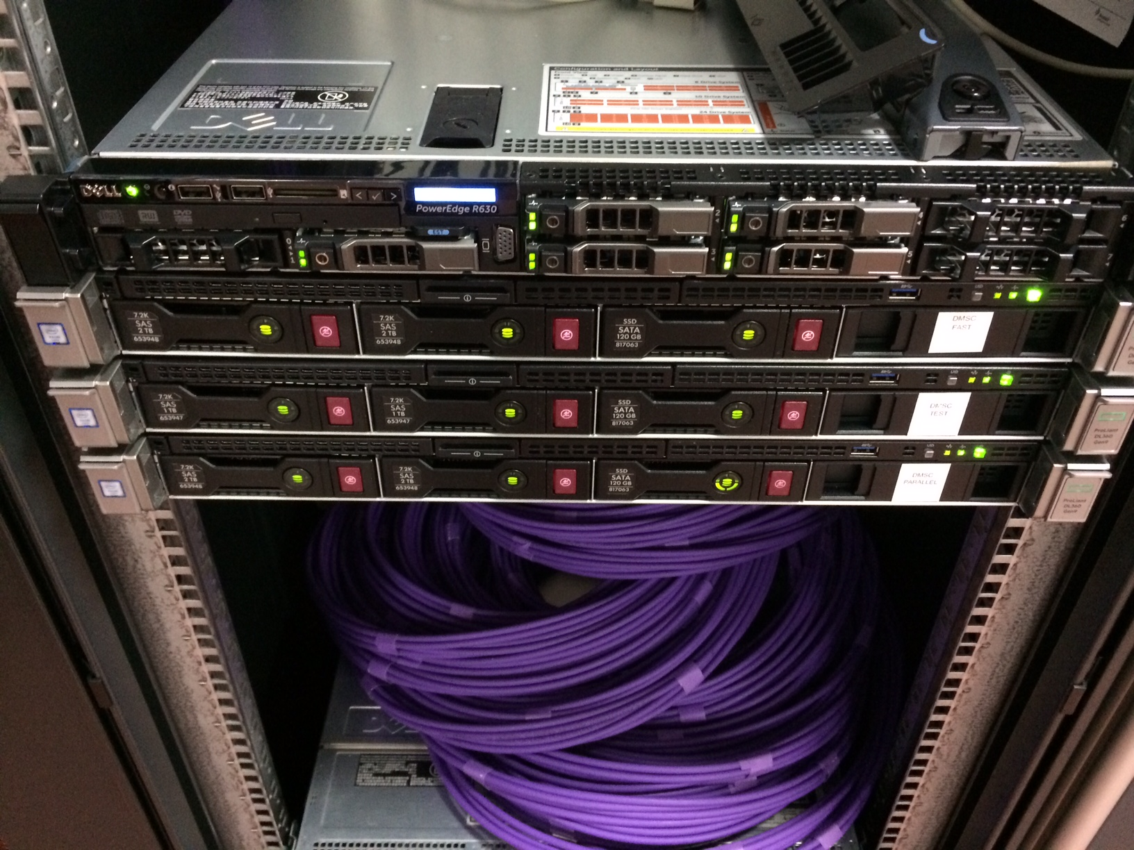
ESSIIP DMSC Integration
DMSC Instrument Data Group's server installed.
Some devices already integrated with NICOS.
DMSC Data Management have three high-end servers installed.
Streaming Area Detector image data over pv Access for ingest and streaming via Kafka.
Plans to set up high speed stream of digitised analog data.

Slide 20
ESSIIP Quick Demo

Slide 21
ESSIIP Next Steps
Further integration of devices into NICOS.
Detector demonstrator hardware integration.
Further integration of DMSC D.M. software and Kafka.
Roll out more realistic network architecture.
And where to from there??
PLC for Sample Environment Utility Supplies at Utgård.
Detector gas handling integration with Utgård PLC.
SKF chopper integration with CHIC at Embla.
Prospect of receiving first hardware from instrument projects?
Our main priority is to focus controls integration activities around a common theme, with actual instrument components and real users of the software:
Proposed test beamline controls integration project.

Slide 22
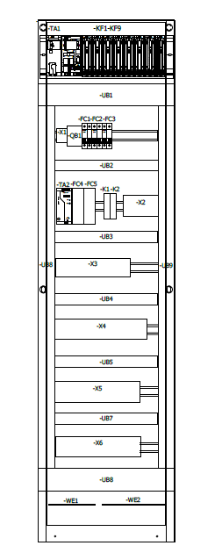
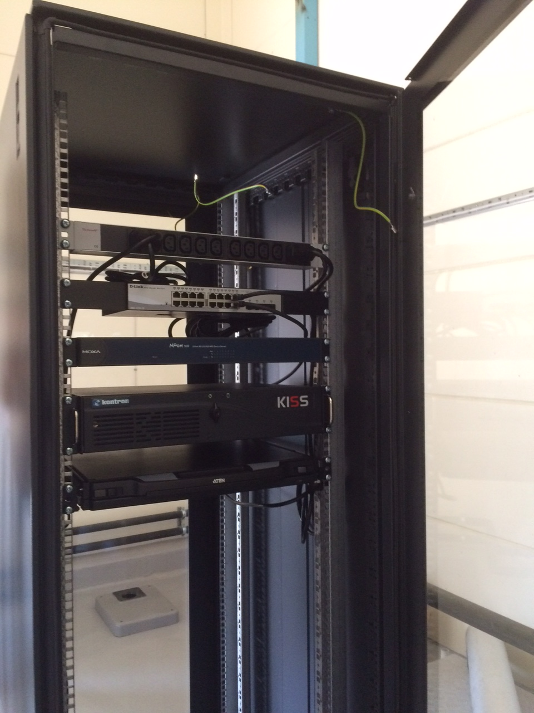
ESSIIP Next Steps
Further integration of devices into NICOS.
Detector demonstrator hardware integration.
Further integration of DMSC D.M. software and Kafka.
And where to from there??
PLC for Sample Environment Utility Supplies at Utgård.
Detector gas handling integration with Utgård PLC.
SKF chopper integration with CHIC at Embla.
Prospect of receiving first hardware from instrument projects?
Our main priority is to focus controls integration activities around a common theme, with actual instrument components and real users of the software:
Proposed test beamline controls integration project.

Slide 23
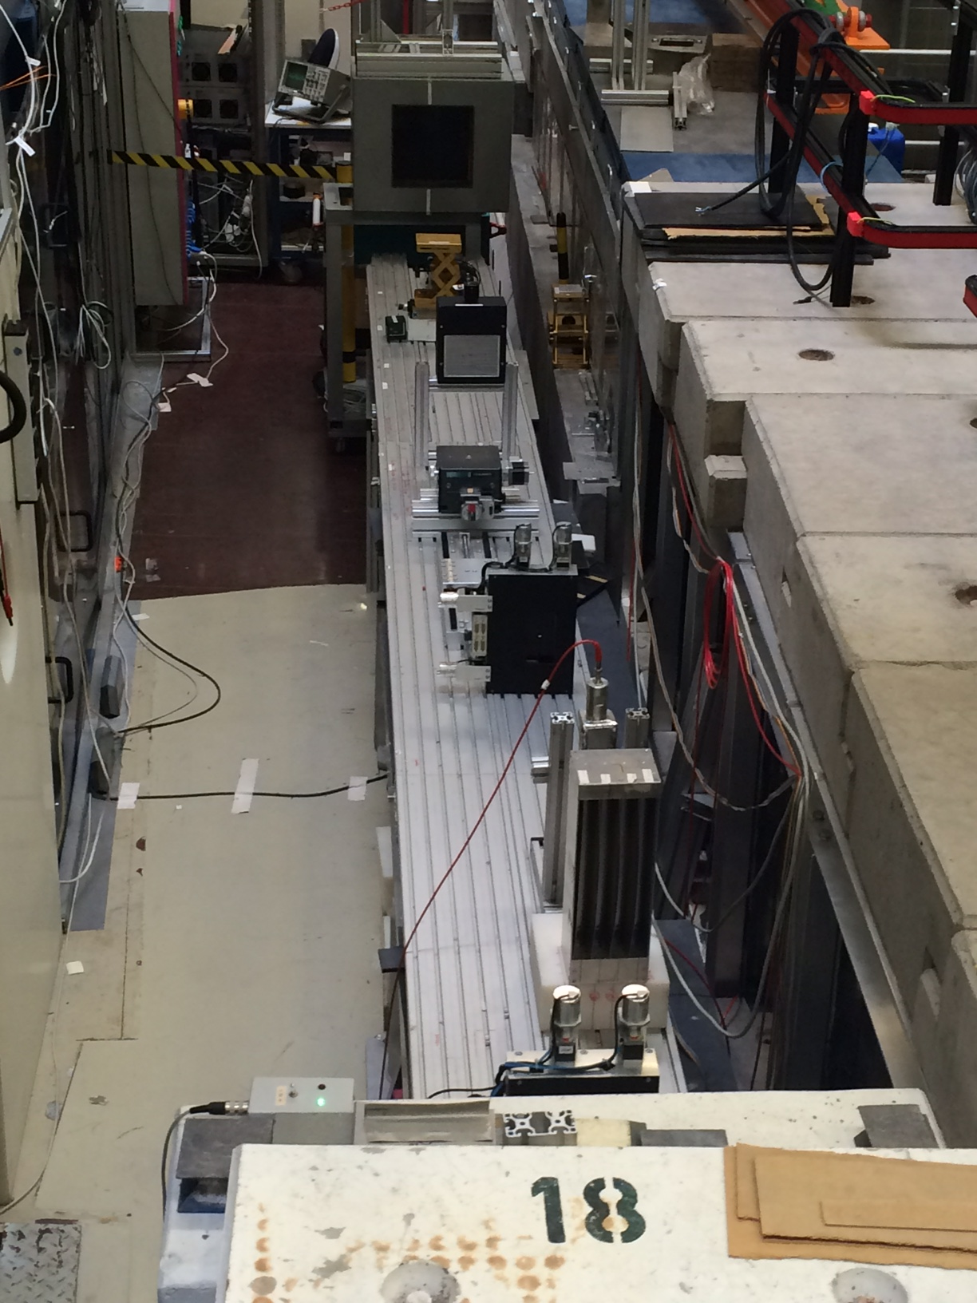
ESSIIP Next Steps
Further integration of devices into NICOS.
Detector demonstrator hardware integration.
Further integration of DMSC D.M. software and Kafka.
And where to from there??
PLC for Sample Environment Utility Supplies at Utgård.
Detector gas handling integration with Utgård PLC.
SKF chopper integration with CHIC at Embla.
Prospect of receiving first hardware from instrument projects?
Our main priority is to focus controls integration activities around a common theme, with actual instrument components and real users of the software:
Proposed test beamline controls integration project.

Slide 24
Some Other Relevant ICS News
Expecting to soon fill a second position dedicated to instrument controls.
Currently working to identify controls interfaces on each ESS instrument.
Work package may be rescoped to reduce budget during ESS construction phase (shift to initial operations early 2019).
Activities ramping up for SEE development.
Good progress in seeking to rationalise the number of PLCs on each instrument.
In-kind project underway with IFE (Norway) for Operator Logbook development.
IFE also conducting in-kind project for Alarm System development.
Archive Appliance packaging underway.
Detailed network design for Accelerator progressing well. Instruments will follow later.
IOC Service proposal to allow remote starting/stopping of IOCs.

Slide 25
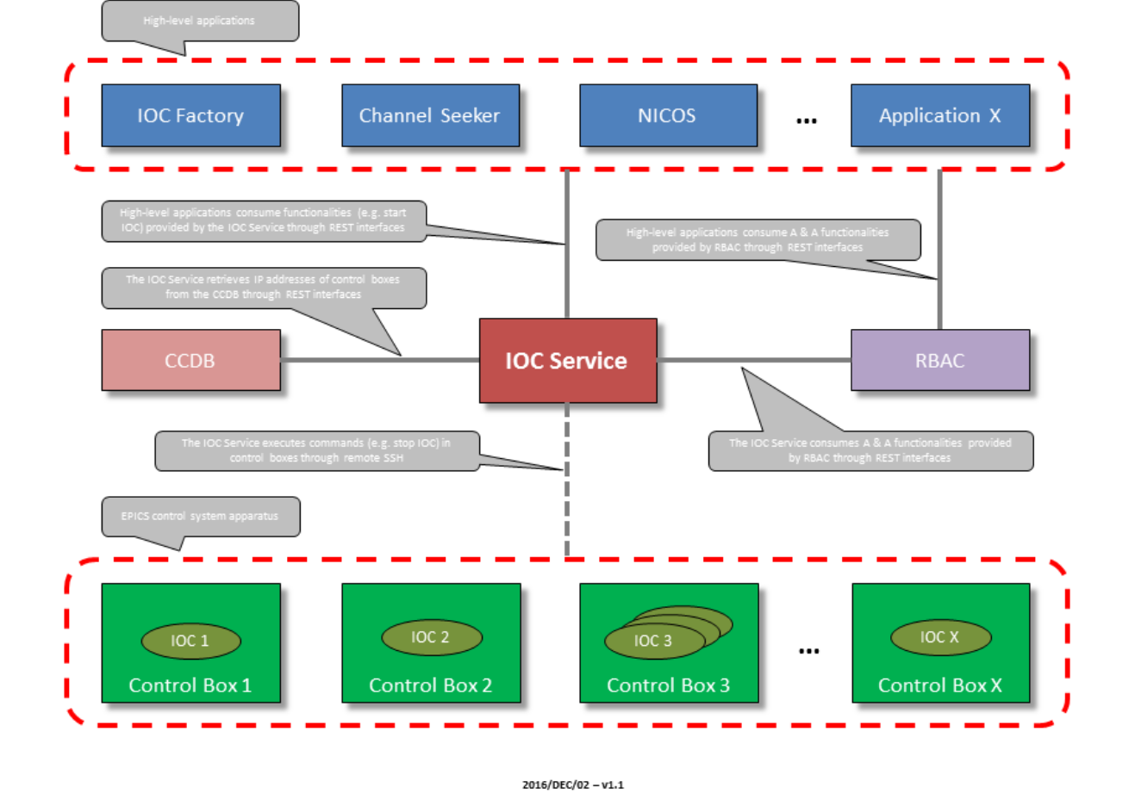
Some Other Relevant News

