Slide 1
Commissioning - Safety
Lali Tchelidze
Monika Hartl
Stuart Birch
Peter Jacobsson
www.europeanspallationsource.se
2 October 2016

Slide 2
Readiness Reviews &
Commissioning Steps
Step | Commissioning Scope | Readiness Review date (Accelerator/ICS) | Commissioning Start date (Accelerator/ICS)
1 | Ion Source & Low Energy Beam Transport (LEBT) | Oct-17/Dec -17 | Nov 2017/Jan 2018
2 | RFQ & Med Energy Beam Transport (MEBT) | Jun-18 | Jul-18
3 | Drift Tube Linac 1 (DTL 1) | Sep 2018 | Nov-18/Oct-18
4 | DTL 2-4 | Dec-18/Feb-19 | Jan-19/Feb-19
5 | DTL 5, Spoke and Med-β Cryomodules, HEBT & Beam Dump | Mar 2019 | May-19/Mar-19
6 | Accel to Target (A2T), HEBT, Target, Instrument bunker, & test beamline | Jun-19 | End Jun-19

Slide 3
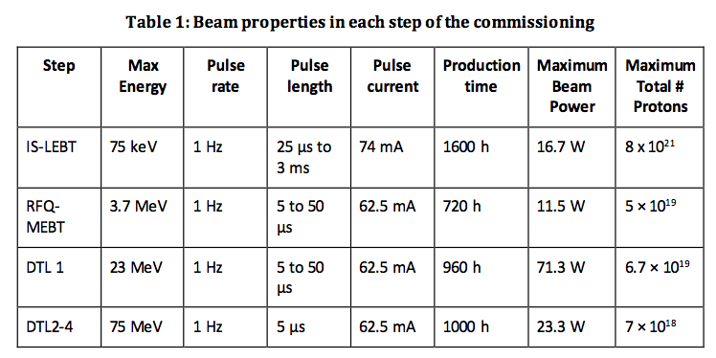
1st Stage of Proton Beam Commissioning
Fist stage of the beam commissioning will take place in several steps:
  Ion Source and LEBT commissioning
  RFQ and MEBT commissioning
  DTL1 commissioning
  DTL2 to DTL 4 commissioning

Slide 4
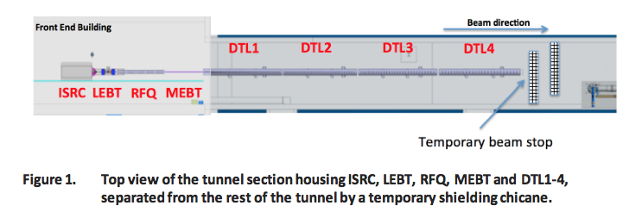
1st Stage of Proton Beam Commissioning
Top view of tunnel section housing ion source, LEBT, RFQ, MEBT and DTL 1-4, separated from the rest of the tunnel by a temporary shielding chicane.
At each step of commissioning, a temporary beam stop (Linac4/CERN design) will be used to safely absorb the beam.

Slide 5
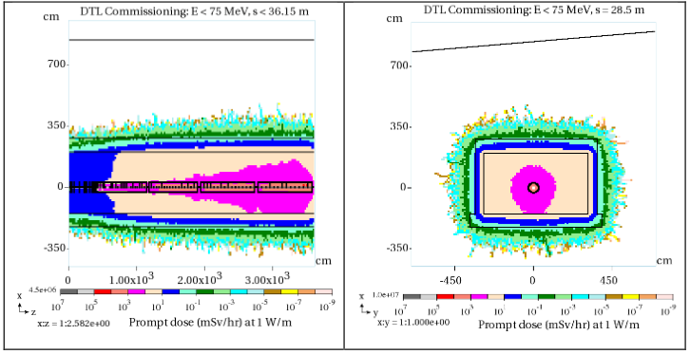
1st Stage of Proton Beam Commissioning
Prompt total dose rate maps up to DTL tank 4, for an operational 1 W/m uniform beam loss rate.

Slide 6
1st Stage of Proton Beam Commissioning
Fault studies for shielding verification.
  A series of predefined verification studies will be conducted with the beam at the output of the RFQ and DTL tanks.
  A limited power beam will be sent to a specific location and a set of measurements will be made, using radiation monitoring system, to compare the measured radiation dose rate levels to those from calculations.
  The beam power will be increased in small steps and measurements will be repeated and recorded at each step.
  Additionally, X-ray dose rates will be measured during RF conditioning.

Slide 7
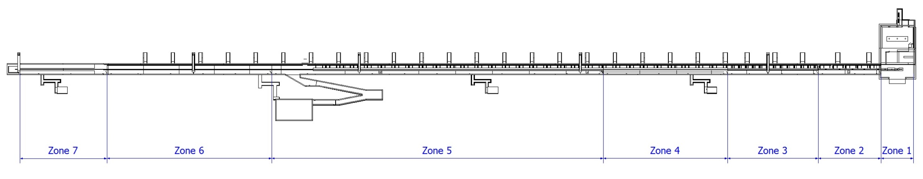
Accelerator Tunnel PSS Zones
To facilitate the search procedure in accelerator tunnel, PSS has considered 7 zones in the tunnel which are separated from each other by
6 fences. The position of these fences will be continuously monitored through two safety switches installed on each fence. (It should also be
noted that the emergency exit routes are also considered as independent search zones)
Zone 1 includes: Proton Source, LEBT, RFQ, MEBT
Zone 2 includes: DTLs
Zone 3 includes: Spoke cavities
Zone 4 includes: Elliptical cavities
Zone 5 includes: Elliptical cavities
Zone 6 includes: HEBT
Zone 7: A2T

Slide 8
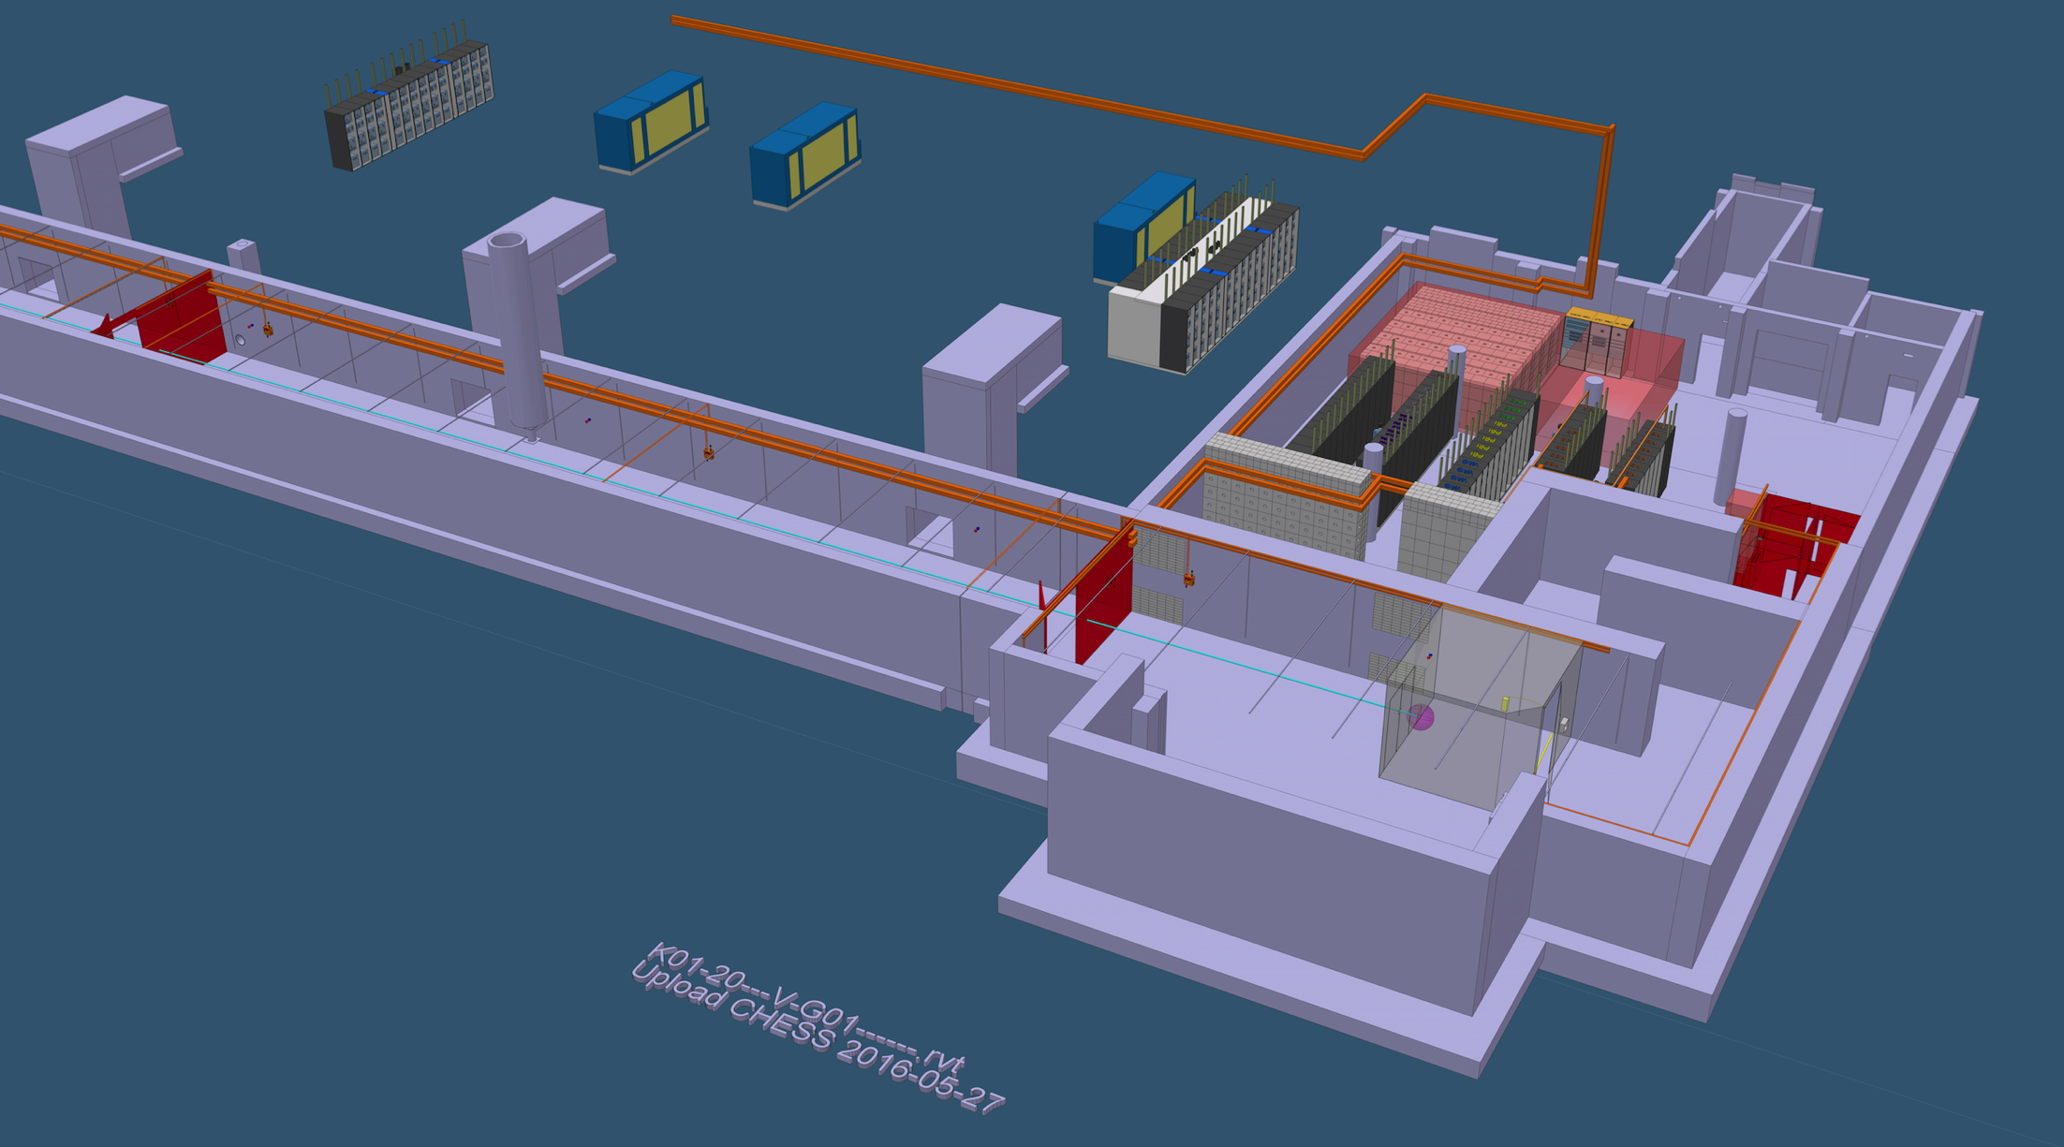
Accelerator Tunnel PSS1

Slide 9
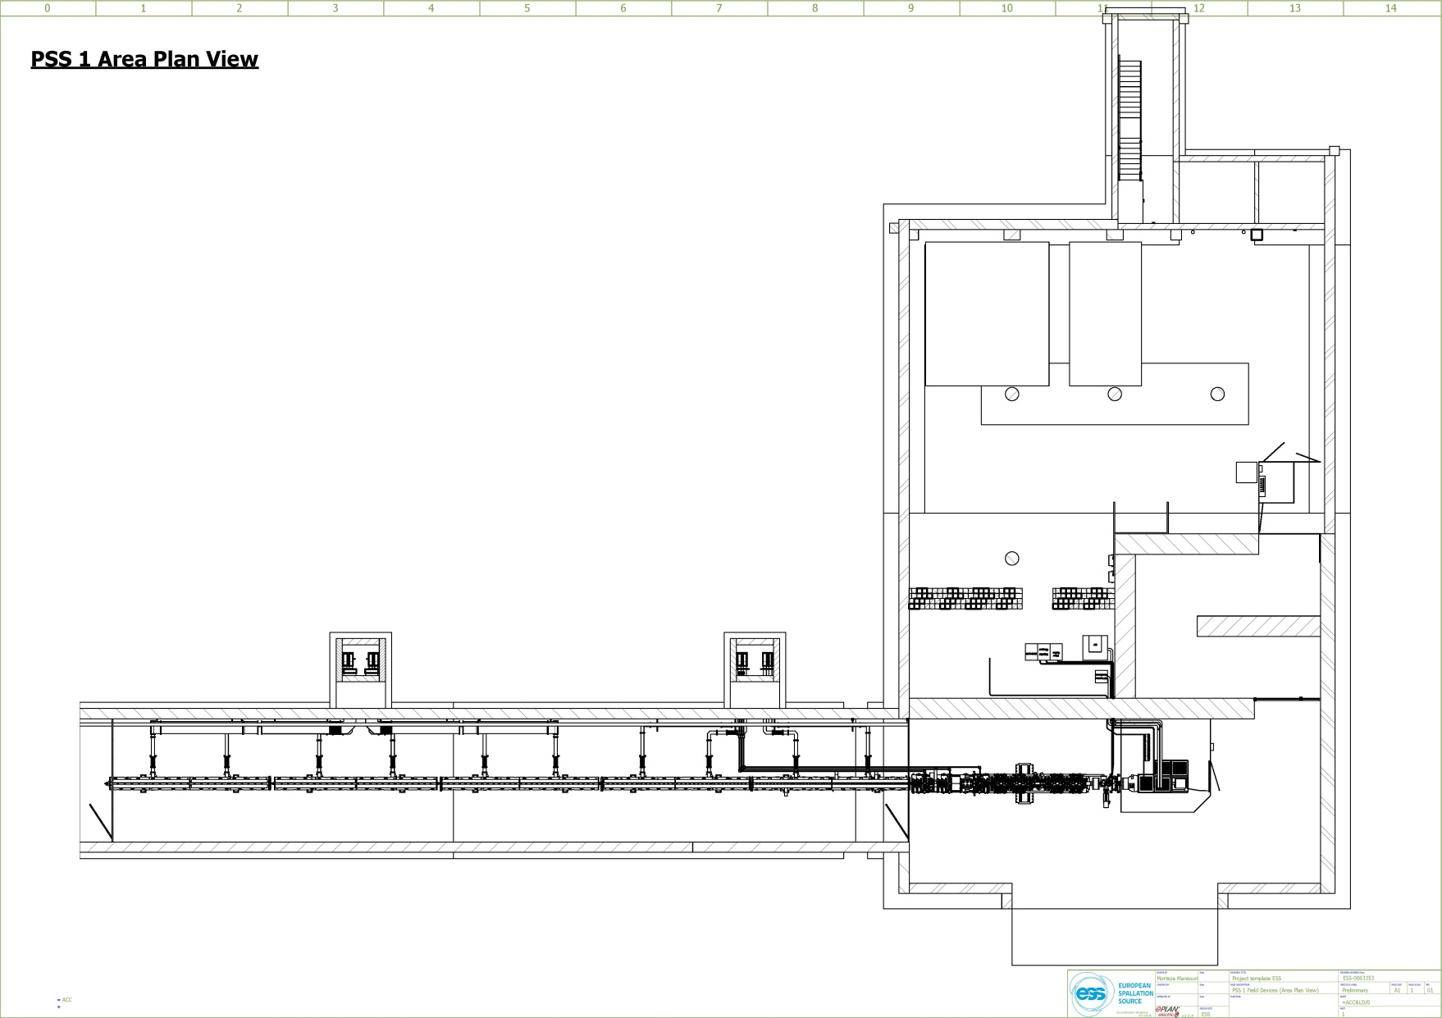
PSS 1 Hardware: Beam-off Stations
PSS 1 Area Plan View
Beam-off Stations
Zone 1
BOS 3
Zone 1
BOS 1
Zone 1
BOS 2
Zone 2
BOS 1
Zone 2
BOS 2
Zone 2
BOS 3

Slide 10
PSS 1 Hardware: Radiation Monitors
PSS 1 Area Plan View
Radiation Monitors
Beam-off Station
Zone 1
RM 2
BOS
Zone 2
RM 2
Zone 2
RM 3
Zone 1
RM 1
Zone 2
RM 1
BOS
BOS
BOS
BOS
BOS

Slide 11
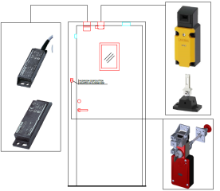
PSS 1 Hardware: Access & E-exit Doors
PSS 1 Area Plan View
Access/E-exit Doors
Beam-off Station
Radiation Monitor
+
RM
E-Exit
Door
E-Exit Door
Access System
FEB
BOS
RM
RM
RM
RM
BOS
BOS
BOS
BOS
BOS

Slide 12
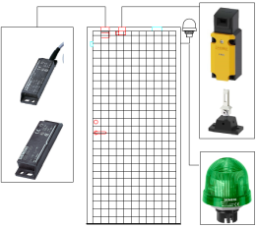
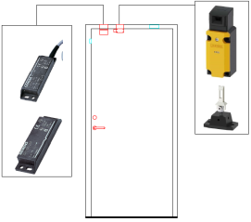
PSS 1 Hardware: Fire Door & Zone Fences
PSS 1 Area Plan View
Fire Door/Zone Fence
Beam-off Station
+
Radiation Monitor
E-exit Door
Access Doors
RM
E-Exit
Door
PSS Zone Fences
Fire Door
BOS
RM
RM
RM
Fire
Door
RM
Zone 2
Fence
Zone 3
Fence
BOS
BOS
BOS
BOS
BOS

Slide 13
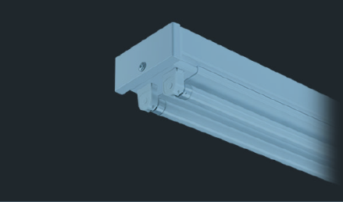
PSS 1 Hardware: PSS Blue & Red Lights
PSS 1 Area Plan View
PSS Blue/Red Lights
+
Beam-off Station
Radiation Monitor
E-exit/Fire Door
Access Doors
Zone Fence
RM
Kanby 2 batten luminaries
Separately switched, 2x58W
E-Exit
Door
PSS B/R Light
BOS
RM
RM
RM
PSS B/R Light
Fire
Door
RM
PSS B/R Light
PSS B/R Light
PSS B/R Light
PSS B/R Light
Fence
PSS B/R Light
Fence
PSS B/R Light
PSS B/R Light
PSS B/R Light
PSS B/R Light
BOS
BOS
BOS
BOS
BOS

Slide 14
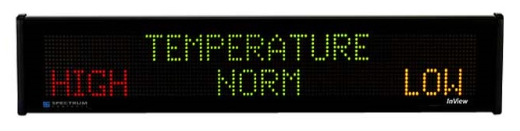
PSS 1 Hardware: Message Display
+
PSS 1 Area Plan View
Message Display
Beam-off Station
Radiation Monitor
E-exit/Fire Door
Access Doors
Message Display
Zone Fence
Message Displays will be installed at the entry and E-exit points to tunnel as a pre-warning for radiation hazards, ODH, access status, etc.
The potential solutions are: LED signage interfacing Siemens S7-1500 PLC and/or LED TV.
RM
B/R Light
E-Exit
Door
PSS B/R Light
BOS
RM
RM
RM
PSS B/R Light
Fire
Door
RM
PSS B/R Light
PSS B/R Light
PSS B/R Light
PSS B/R Light
Fence
PSS B/R Light
Fence
PSS B/R Light
PSS B/R Light
PSS B/R Light
PSS B/R Light
BOS
BOS
BOS
BOS
BOS

Slide 15
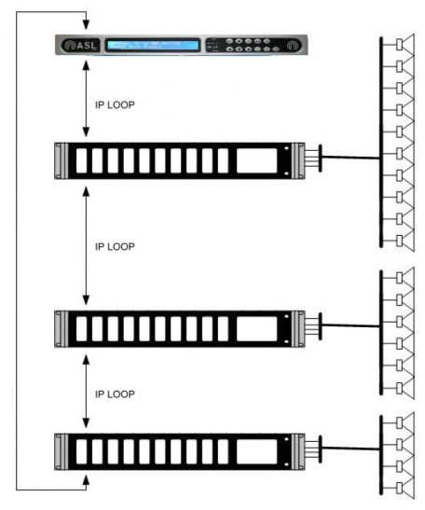
PSS 1 Hardware: Public Address System
PSS 1 Area Plan View
PA System
Beam-off Station
Radiation Monitor
+
E-exit/Fire Door
Currently no PA system has been foreseen by CF for accelerator tunnel and target buildings.
PSS PA system will be installed to broadcast messages during ODH, search, etc.
PA system will be triggered by PSS PLC(s).
Access Doors
Zone Fence
RM
B/R Light
E-Exit
Door
Message Display
PA System
PSS B/R Light
BOS
RM
RM
RM
PSS B/R Light
Fire
Door
RM
PSS B/R Light
PSS B/R Light
PSS B/R Light
PSS B/R Light
Fence
PSS B/R Light
Fence
PSS B/R Light
PSS B/R Light
PSS B/R Light
PSS B/R Light
BOS
BOS
BOS
BOS
BOS

Slide 16
Licensing View
SSM will handle the commissioning after finalisation of the installation permit; (Q2/Q3 2017)
ESS has all the requirements concerning radiation protection, ESS will finalise
  Necessary hardware installations (temporary and permanent)
  Necessary rules & regulation
  Staff plan
Before start-up, ESS will conduct an Accelerator Readiness Review
Set-up of the team has to be done Q1 2017.

Slide 17
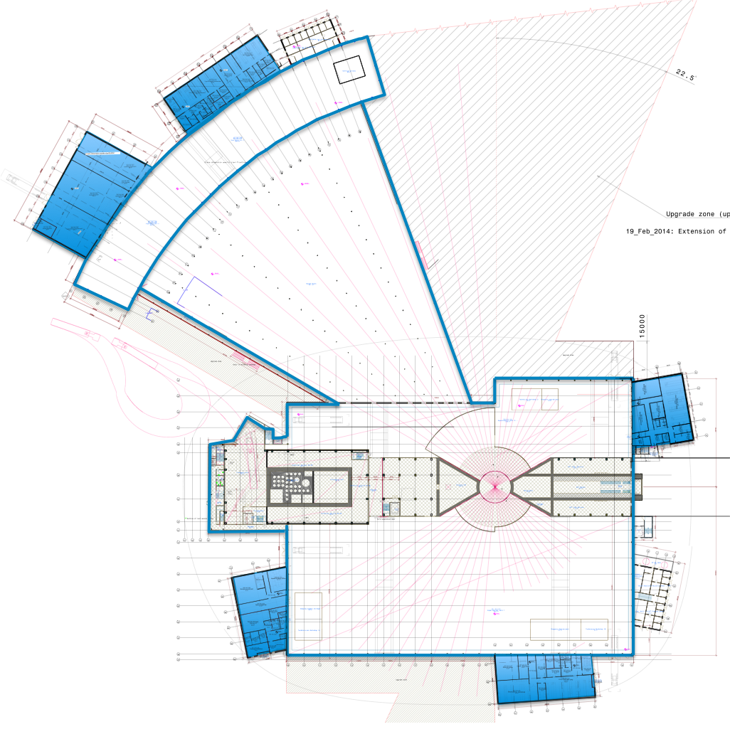
Science Directorate (SD) work areas
Hall3
Instr. NMX / Beer / C-Spec / Bifrost
Miracles / Magic / T-Rex / Heimdal
E03 workshops, labs (1 × Engineering)
E04 labs (1 × Life Science, 1 × Chemistry,
+ characterization/specialized labs)
E04
Hall 3
E03
D04
Hall 2
Instr. Freia / Loki / HR-NSE
D04 Labs (1 × Life Science, + specialized labs)
Hall 2
Hall 1
Instr. Estia / Vespa / Skadi / Odin / Dream / Vor
D07 labs (1 × Life Science+specialized)
D08 labs (1 × Chemistry, 1 x Radioactive Mat. L.
+specialiced)
D08
Hall 1
D07
RML laboratory and central ESS sample
storage facility in D08
17
Notes:
The room fit out has been aligned with instrument layout. Each hall has access to a basic laboratory. Main labs not included in construction are the basic chemistry in D04 and instrument rooms in D07, D08 and E04.
No large ticket, capital equipment is included in construction budget scope.

Slide 18
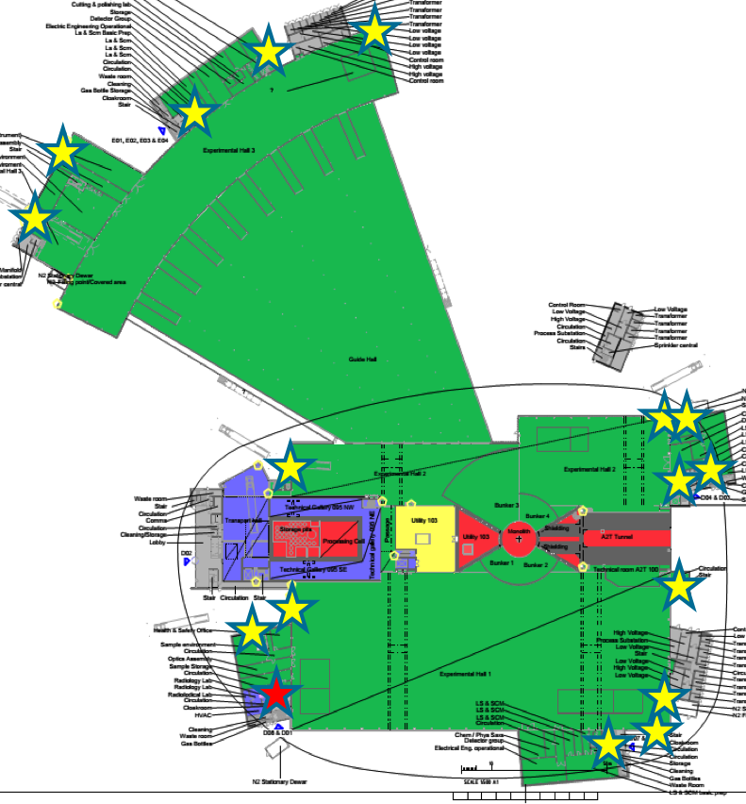
Zoning for experimental hall & labs:
one supervised zone
Supervised
Unrestricted controlled
Restricted controlled
Highly restricted controlled
FLEXIBLE ZONING
Experimental
Cave -
Closed
Shutter
sample
beamline
access control,
radiation monitor.
Shielding with active
Personal Safety System (PSS)
Rad. Mat. Lab.
RML
Experimental
Cave –
Open
Shutter
sample
beamline

Slide 19
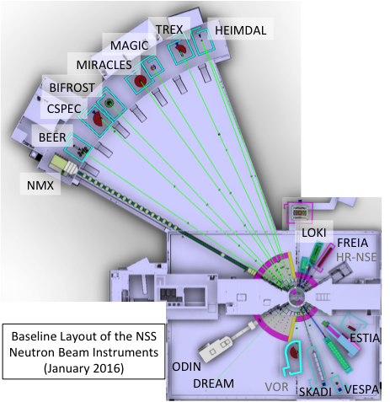
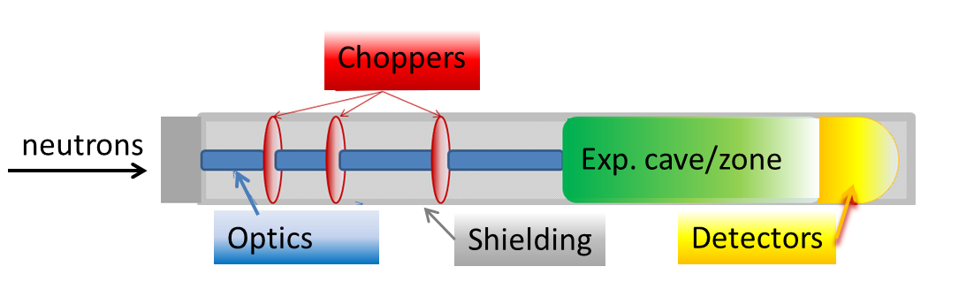
Science Directorate: Experimental Facilities
Experimental Halls host instruments and bunker
Laboratories & Workshops support instrument operation and user program –sample handling, equipment maintenance
Generic Instrument used to estimate dose rates, activation, inventory, hazards …
Individual instrument requires operational readiness review prior hot commissioning.

Slide 20
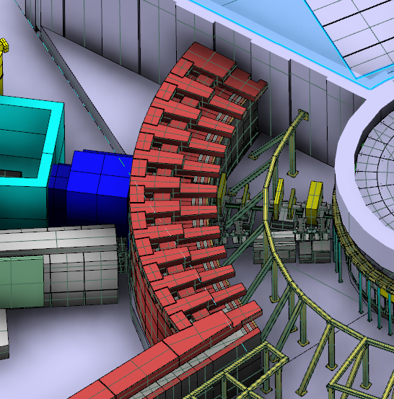
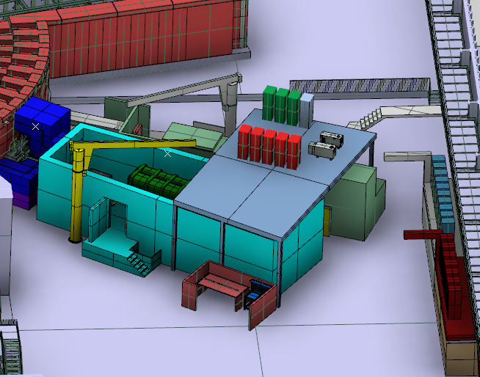
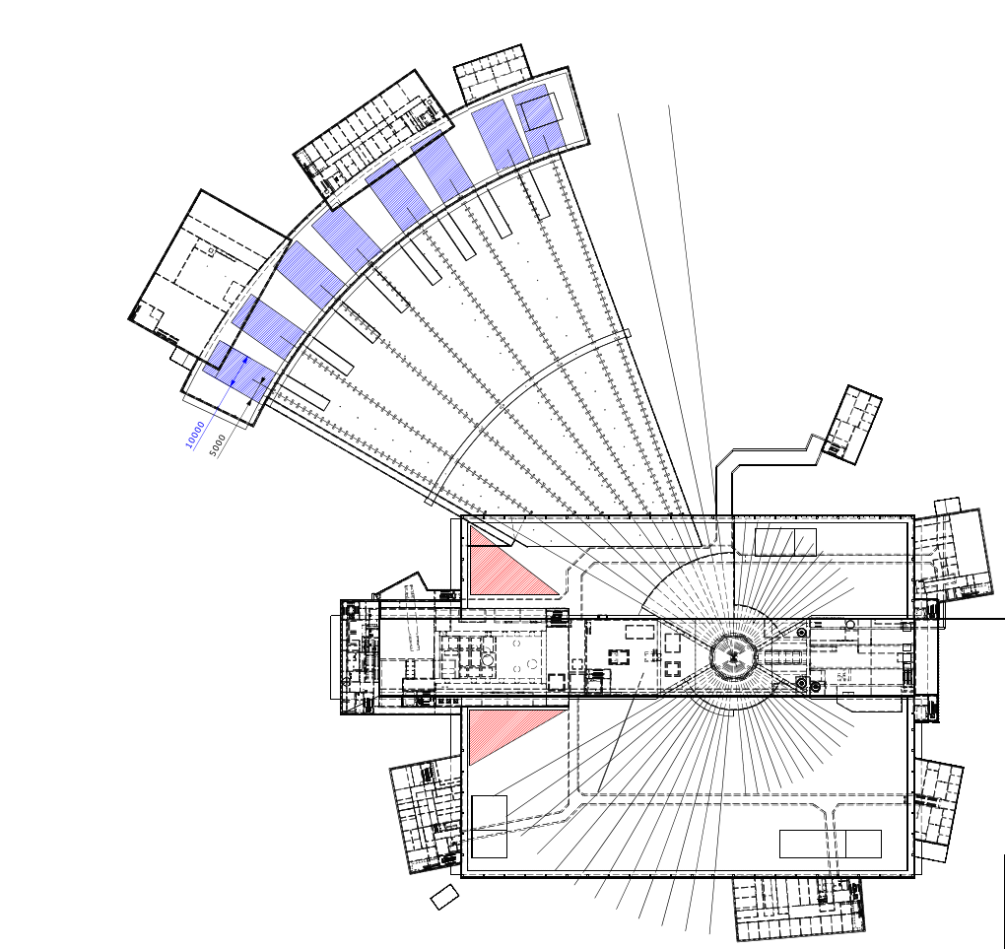
Instrument in the short hall Loki
beamline
bunker
exp. cave
Instrument specific lab

Slide 21
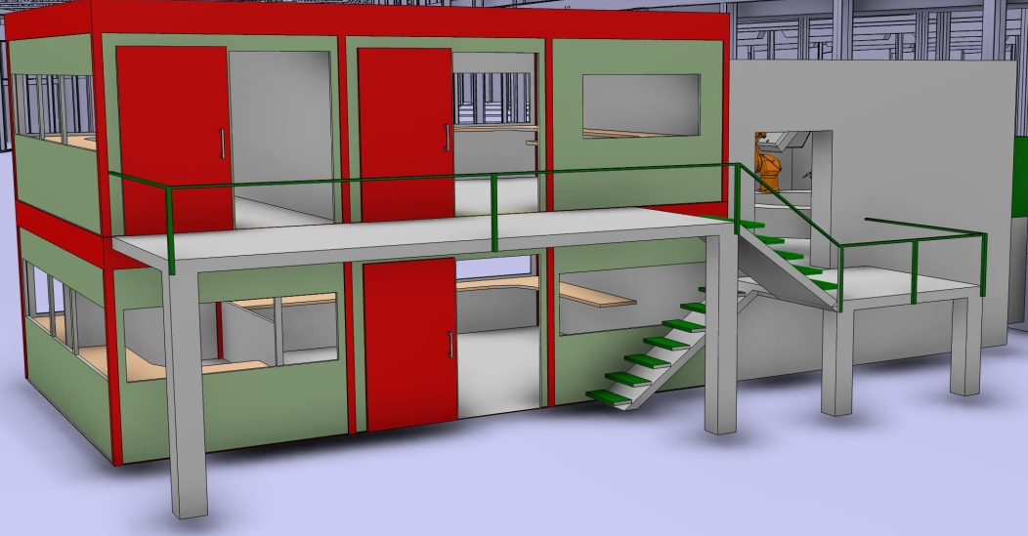
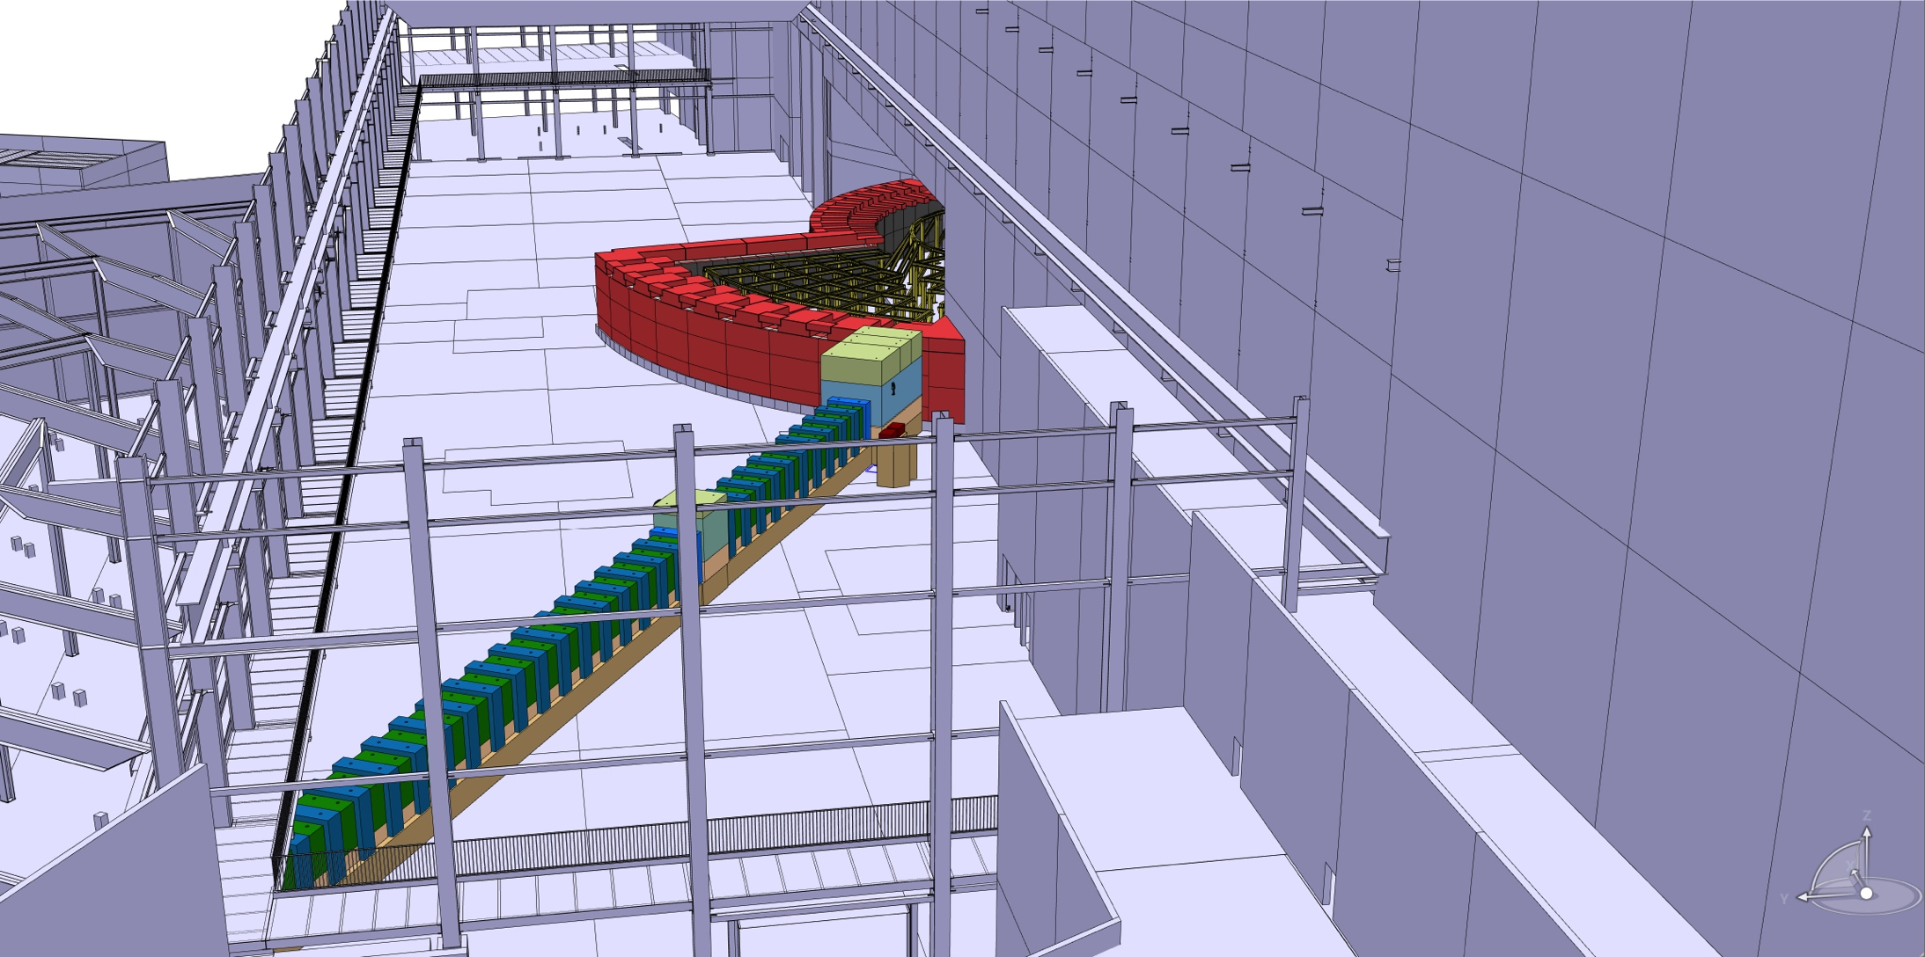
Instrument in the long hall - NMX
Instrument hutch
exp. cave
bunker
Instrument specific lab
beamline

Slide 22
Safety Acceptance Review (SAR)
Safety Acceptance Review (SAR) will occur for each instrument before installation & commissioning and when instruments are modified
SAR-committee will consist of subject matter experts from within ESS as well as experts from other facilities
Each review will include:
  Radiological Safety (shielding assessment including activation, functionality of PSS/shutters, radiation monitoring for the instrument and more)
  General Safety (mechanical, electrical,…)
  Instrument Specific Hazard Analysis
  ...
During hot-commissioning : verification of radiological performance by measurements
During instrument lifetime: regular surveys

