Slide 1
ESS – Sustainability Program
Some issues
ESHAC #5
Peter Jacobsson
Head of Environment, Safety & Health

Slide 2
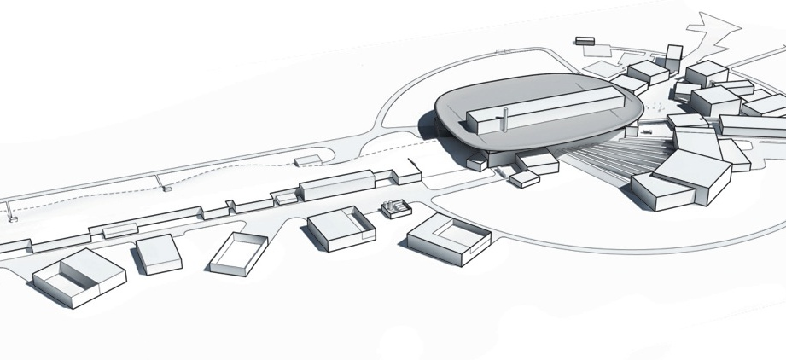
ESS core values
The core values of ESS are:
Community and collaboration
Service
Openness
Sustainability
Credibility
Notes:
Sustainability is one of ESS core values.
Minimizing the environmental impact has been one of the keystones of the Swedish proposal for ESS and also one of the main reasons for the decision to locate ESS in Lund.
Originally, three possible ESS sites were under consideration: Bilbao (Spain), Debrecen (Hungary) and Lund (Sweden).
The ambition is to create a sustainable research facility.
Hope is that the results of the research will be the main (positive) sustainability aspect but we also know that we do have some issues to work with during design and construction as well as operations…such as
Ionizing radiation,
Energy and excess heat,
Waste,
Built-in material,
Releases to soil and water,
etc

Slide 3
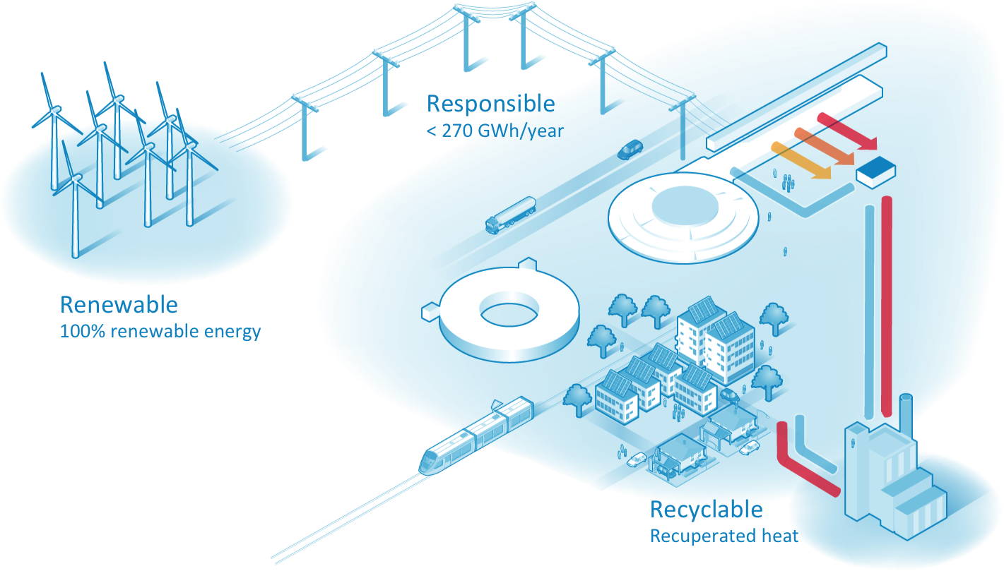
Energy Policy – 3R
Notes:
ESS har förbundit sig till att implementera energikonceptet 3R “Responsible, Renewable, Recyclable”, vilket innebär att anläggningen måste vara energieffektiv, endast använda förnybara energikällor och elen vi stoppar in ska kunna återvinnas. Dessa åtaganden gjordes av värdländerna till partnerländerna I samband att ESS placering I Lund bestämdes.
Ansvarsfullt
Förnybart
Återvinningsbart

Slide 4
On-going work
Renewable
  Contract for electricity in place for the construction of ESS up until 2018-12-31.
  Procurement will start for a contract 2019-2023
Energy efficiency (reduction of electricity consumption)
  The accelerator
  The target
  The buildings
Recovery of energy
  Recuperated heat solutions is under way
  Has to be a solution that is beneficial for both ESS and its counterpart

Slide 5
Electricity market in Sweden
A common market for the Nordic and Baltic countries; NordPool
Possible for customers to choose a supplier (although the owner of the local grid has a monopoly)
Production in Sweden – 2015; 158,5 TWh
  Hydropower; 74 TWh (47 %)
  Nuclear Power; 54,4 TWh (34 %)
  Wind Power; 16,6 TWh (10 %)
  Other; 13,5 TWh ( 9 %)
A very low electricity market price for 2015
A good opportunity for purchasing electricity

Slide 6
Why try to be as efficient as possible?
More resources for research
Environmental friendly
The differences on the electricity market price will have less effect on the operation budget
The stakeholders are satisfied
A good margin in the design gives a possibility of future investments in a sustainable facility

Slide 7
Electricity consumption of ESS – current estimate
Estimated annual electricity consumption [GWh]
Part of facility | 2012* | 2013* | 2013 | 2014 | 2014
Accelerator | 189 | 191,5 | 119 | 109,6 | 110,3
Target | 34 | 34,6 | 21,1 | 3,2 | 3,8
Cryo |  |  | 44,4 | 42,5 | 41,1
CF** | 4 | 8,9 | 7,2 | 4,9 | 5,3
Neutron Scattering Systems | 14 | 10,5 | 10,5 | 29,5 | 29,5
Integrated Control Systems |  |  | 3,2 | 4,1 | 4,1
CUB | 49 | 71 | 60 | 96 | 34,4
Total [GWh] | 290 | 317 | 265 | 290 | 229
* Cryo was included in Accelerator
** Cooling/HVAC not included
Notes:
Well below our goal of 270 GWh it seems, right?

Slide 8
Reusing the excess heat
Originally, the intention was to send back/sell/give the excess heat to the district heating system of Lund.
However, the district heating company demanded that they would only accept an inlet temperature of 90 °C while the outlet temperature from the water cooled accelerator components would be 50 °C.
What to do
  Use the energy for heating up the ESS buildings
  Use the energy for a new local district heating system
  Find a partner who can take care of the 50 °C water

Slide 9
Different solutions for cooling – Base line

Slide 10
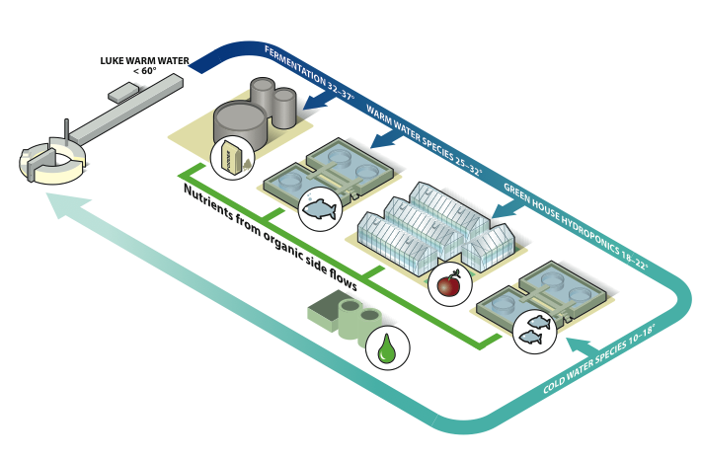
Different solutions for cooling - REC
Notes:
DH recycling and agricultural recycling
Presenting only the Baseline results

Slide 11
Summary
Best estimate of the electricity consumption is 229 GWh.
Uncertainties still exist for the calculated electricity consumption still exist. Some overlap between accelerator/target/CF exist.
A new solution for the recuperated heat solutions heat are under way that will lower the electricity consumption
Many open possibilities for improvements regardless of chosen cooling solution
Notes:
Unknown
NSS instruments are generic guesses
Cooling solution
Improvements
Delta T
Cutting cooling equipment
Better estimates and efficiency work from projects

Slide 12
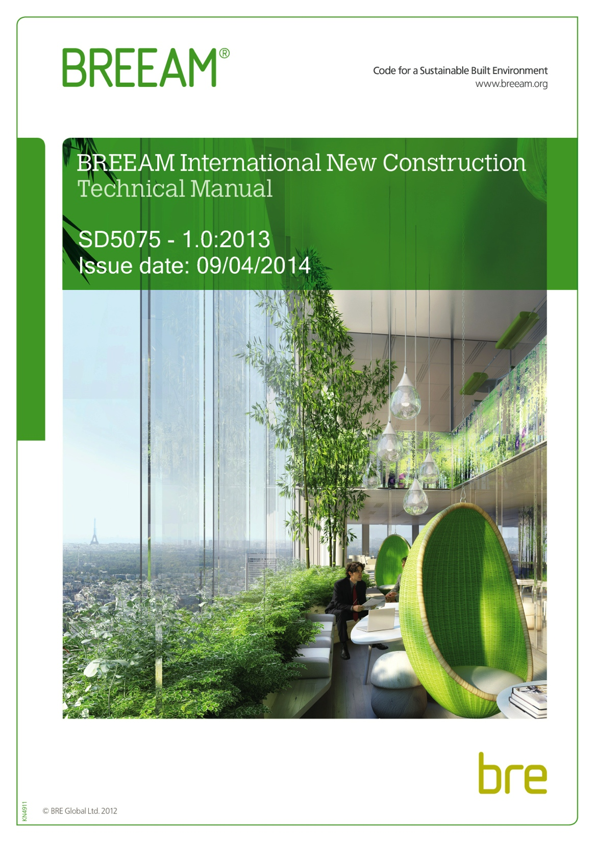
BREEAM
BREEAM = Building Research Establishment Environmental Assessment
BREEAM is an environmental performance certification system that can be applied at building and/or community level
Management
Health & Wellbeing
Energy
Transport
Water
Material
Waste
Land use & Ecology
Pollution
Notes:
BREEAM is an environmental performance certification system that can be applied at building and/or community level. In order to gain maximum benefit from implementing BREEAM in a project a suitible credit strategy is set in early design phase. The manual is then allowed to enrich the project as a design guideline for environmental best practices, performance benchmarking, quality control and innovation catalyst. The manual contains practices that has been proven cost effective for most projects.

Slide 13
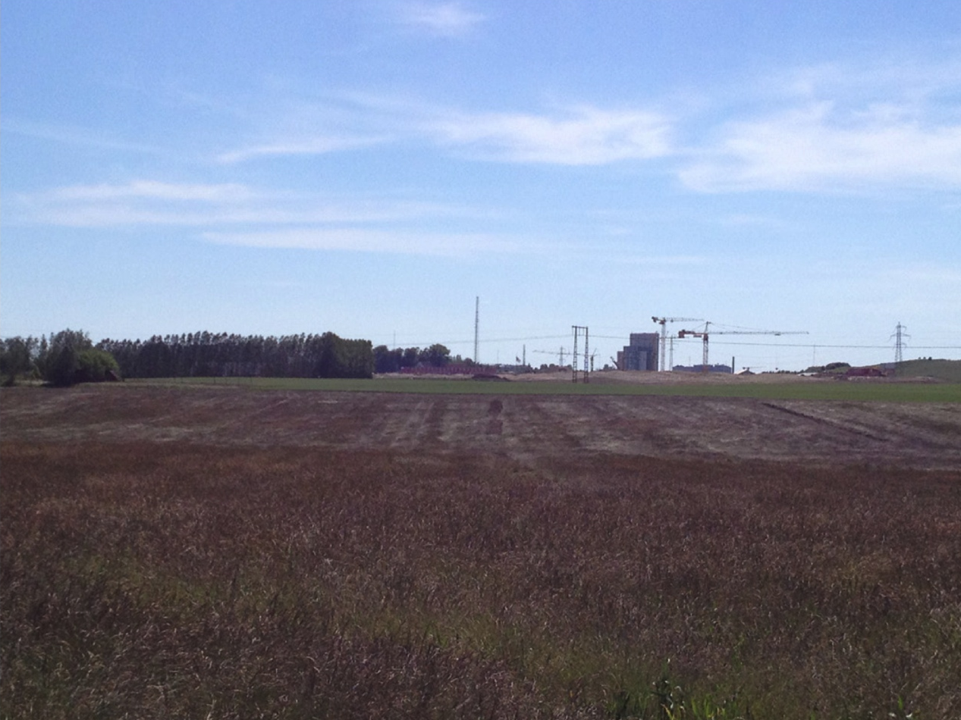
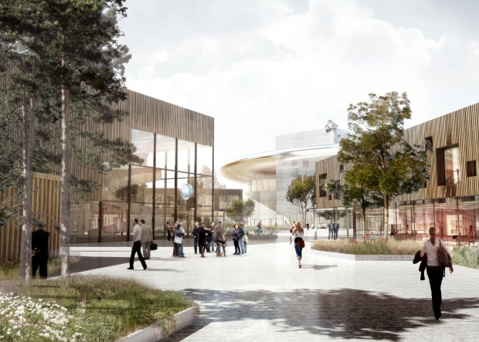
Green field project
High grade arable land (class 10)
  Ambition to restore the land to the quality that is regulated in the detailed plan currently applicable during decommissioning. Technically it is possible to restore the land to be arable or for residential development.
Impact on open agricultural landscape
  Facility is designed so that its impact on the open agricultural landscape is not greater than necessary and so that it, despite its size, may be perceived as a positive addition to the skyline.
Natural values in cultivated arable land are generally low
  The property is going to be designed to promote biodiversity.
Notes:
Pictures 2014
As beeing a green field project ESS uses one of the world’s best arable land for a research facility. The rhetorics from ESS has been that we will restore the land (to the use being specified in the “detaljplan” at the time of decommissioning).
The ambition is also to increase the biodiversity on site.
“Nuvarande utgångspunkt är att marken inom verksamhetsområdet ska återställas till den kvalitet som krävs för att möjliggöra den markanvändning som regleras i den vid avveck- lingstillfället gällande detaljplanen, om en sådan föreligger. Ett tänkbart scenario är att en sådan detaljplan skulle avse någon typ av mindre känslig markanvändning, exempelvis industriverksamhet. Tekniskt sett bedöms det även vara möjligt att återställa området för känslig markanvändning, såsom åkerbruk eller bostadsbebyggelse.”
The objective is to restore the land to the quality that is regulated in the detailed plan currently applicable during decommissioning. Technically it is possible to restore the land to be arable or for residential development.
Promote biodiversity.
The facility shall be designed so that its impact on the open agricultural landscape is not greater than necessary and so that it, despite its size, may be perceived as a positive addition to the skyline.
The objective is to restore the land to the quality that is regulated in the detailed plan currently applicable during decommissioning. Technically it is possible to restore the land to be arable or for residential development.
The property is going to be designed to promote biodiversity.
The facility is designed so that its impact on the open agricultural landscape is not greater than necessary and so that it, despite its size, may be perceived as a positive addition to the skyline.

Slide 14
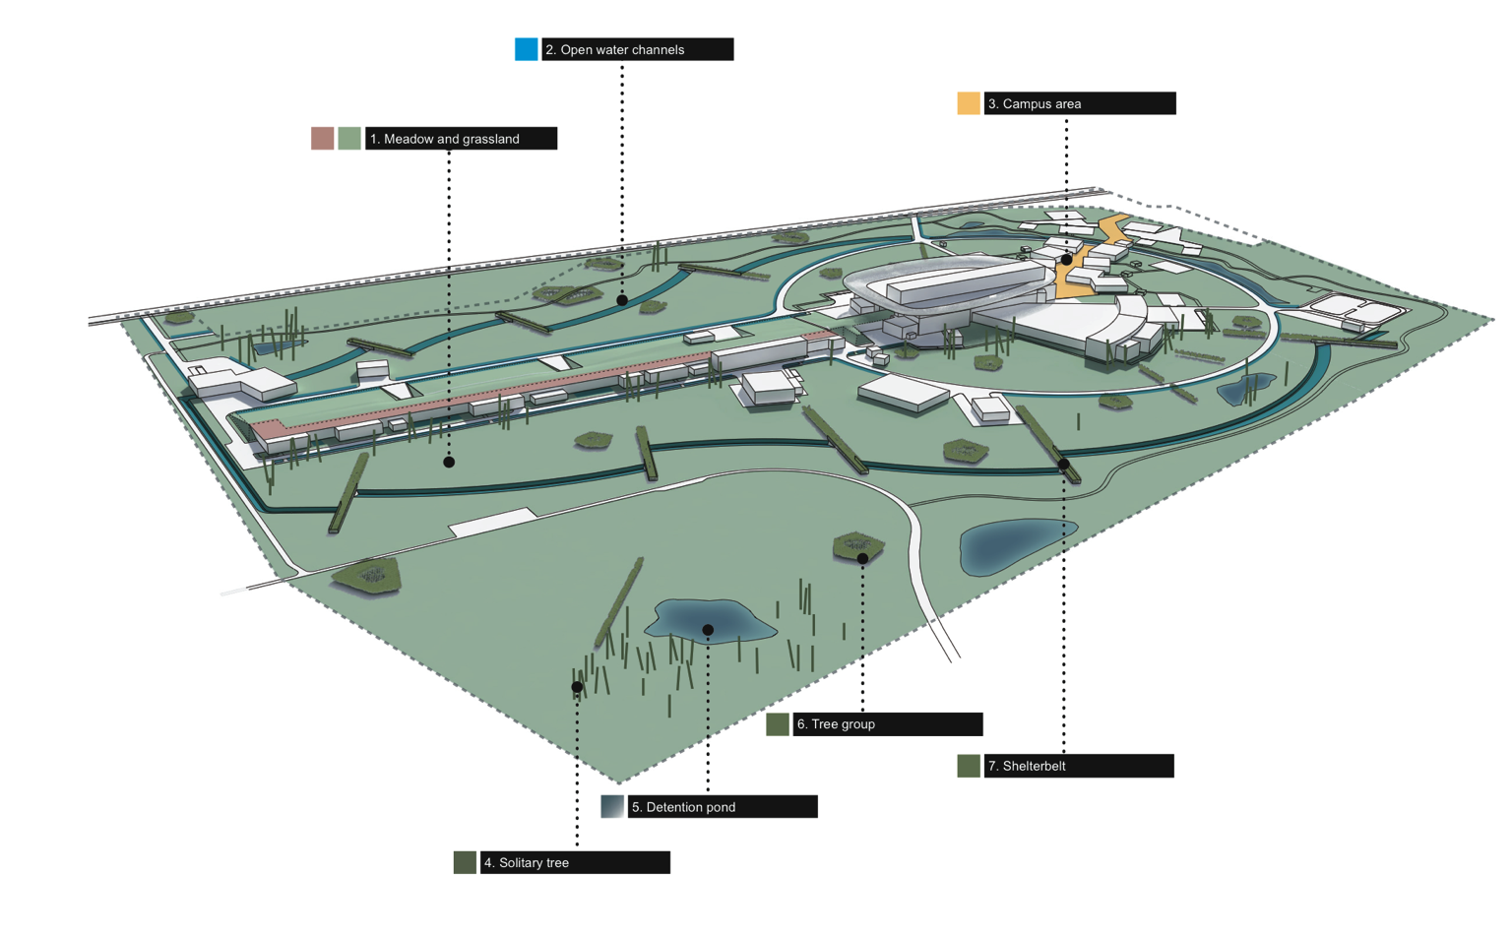
Landscape design
Notes:
The landscape is designed to promote biodiversity.
Meadow and grassland
The meadow and grassland will consist of a selection of native herb and gras species in character comparable to the meadow areas of the nearby reservate and EU Natura 2000 site – Kungsmarken.
2. Open water channels
TBD
3. Campus area
TBD
4. Solitary trees
As a freestanding element the solitary tree is provided unobstructed growth without competition from adjacent tree’s allowing it to reach it’s full potential.
5. Detention ponds
Storm water is managed through infiltration as a basic principle (i.e. grass reinforcement). On the area we also have 4 detentiuon ponds which are designed to accommodate a 100-year rain and designed for water purification. Functioning not only as storage for rainwater the detention ponds create a unique habitat for fauna and flora, allowing for a wider range of animals and plants to prop- agate.
6. Tree group and shelter belts
Especially a wide range of birds are drawn to the more dense plantings or thickets which can support nesting.

Slide 15






Sustainable material selection
Phase out of hazardous substances by using BVB, SundaHus, BASTA
Avoiding materials containing
  halogens (F, Cl, Br)
  sulfur hexafluoride (SF6)
  high VOC-emissions
  zinc/copper in materials situated outdoors and in contact with water
Life cycle perspective
Responsible Sourcing
  Wood originates from sustainably managed forests
Notes:
Built in materials are assessed in BVB, Sunda Hus and BASTA in order to phase out hazardous substances.
Life cycle perspective
the possibility to use locally produced materials and products or mode of transport with low environmental impact
construction method
the service-life of the material or product,
the need for maintenance and consumables during the operation phase,
the possibility to disassemble the constituent materials in the product at refurbishments and/or at the decommissioning phase, and
the possibility to reuse or recycle the material or product at refurbishments and/or at the decommission.
Materials shall be procured with responsible sourcing. Materials with elevated risks of negative environmental and/or social impacts during material production shall undergo investigations to ensure that environmental and social issues in the production of materials are followed up in procurement.

Slide 16
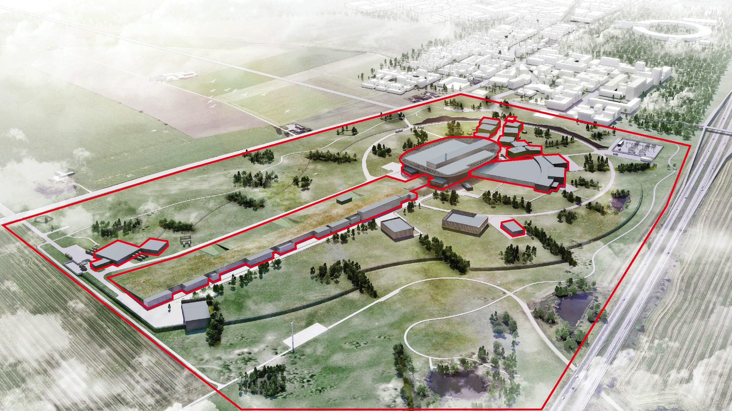
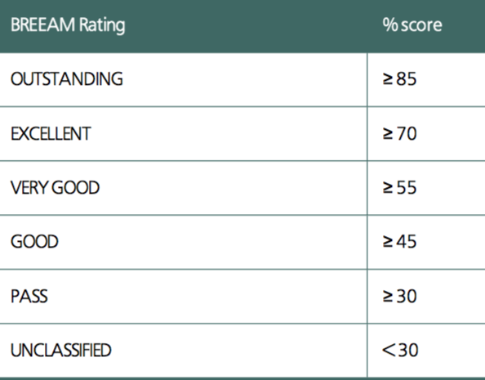
BREEAM buildings
GUARD HOUSE
LABORATORY
OFFICES
TARGET
EXPERIMENTAL HALLS
SHIPPING & RECEIVING
WASTE BUILDING
ACCELERATOR (not tunnel)

Slide 17
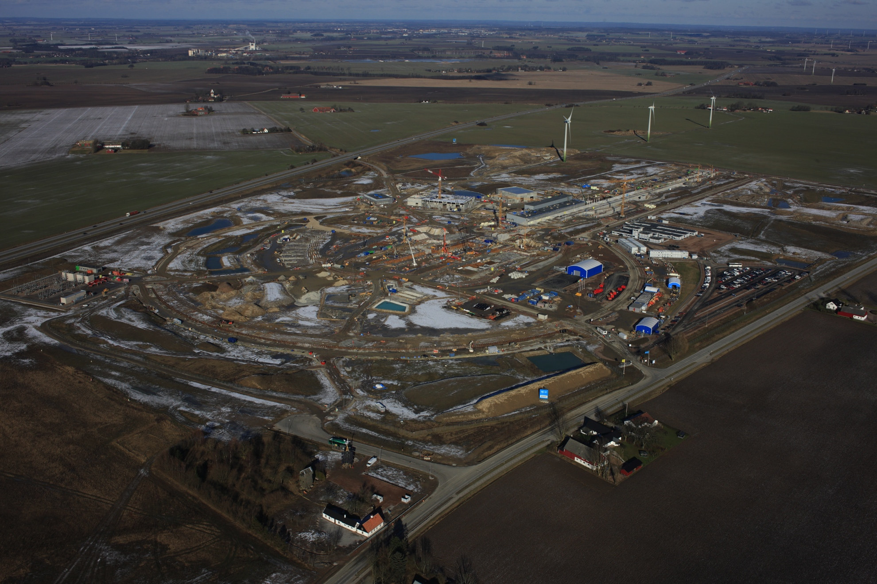
Construction site impact
Handling of chemicals
Noise
Air pollution
Water
Groundwater
Spill and leakage
Excavated soil
Dust
Road sweeping
Light emissions
Waste
Energy
Notes:
February 2016
There is a Natura 2000 area south of our property, the protection of which is one of the main focus areas for the supervising authority. For that reason, we have committed ourselves not to use the drainage company going to the Natura 2000 area during the construction phase.
As for construction activities, we know that we will generate noise, and even though we don’t have many neighbours our estimations show that we will probably exceed the EPA guiding principles for noise from construction sites, and since we are bound by a license we will have to handle this issue in a responsible way.
These issues have been identified as significant environmental aspects in the environental management system of ESS, which is under development. Objectives and plans of action have not been defined yet; the EC commitments and CF requirements can be regarded as our answer to the significant environmental aspects.

Slide 18
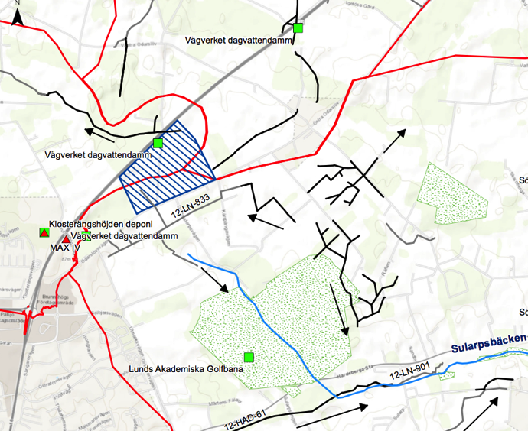
Catchment areas

Slide 19
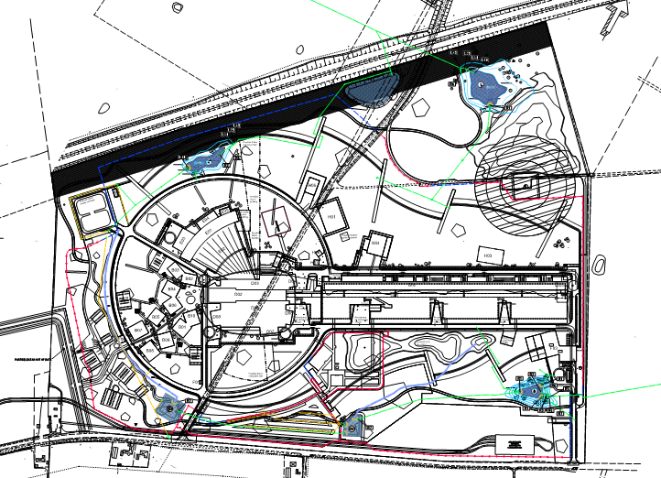
Water management system
Hoby
Outgoing flow
pH
Suspended solids
Oil
Igelösa
Puggängarna

Slide 20
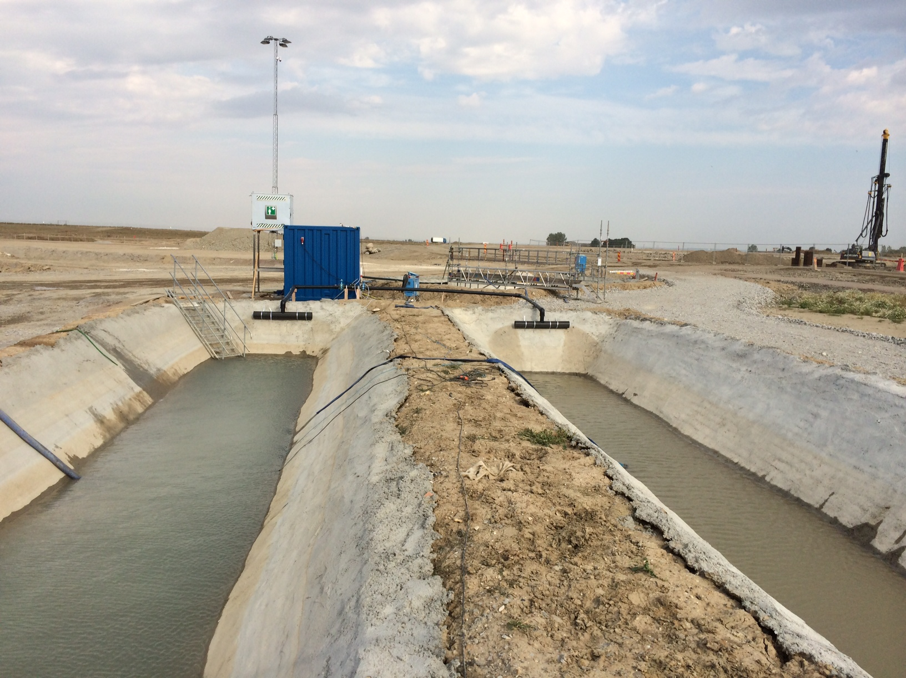
Mobile water treatment plant

