Slide 1
Work Environment Responsibility Shared Workplace
Peter Jacobsson Head of Environment, Safety & Health Bertil Winér
OHS Engineer, ESH Div
www.europeanspallationsource.se

Slide 2
Present situation at ESS – Work Environment
The ESS offices in Lund together with 6 (small) laboratories in the University area, the Linköping laboratory and the DMSC in Copenhagen
ESS (ESH Div)
The construction site
Skanska (the construction company)
Original plan was that Skanska finishes a building and officially turns it over to ESS
Scrutinising the project plan shows that installation of equipment has to be done in parallel with construction work
Who is responsible for the work environment?

Slide 3
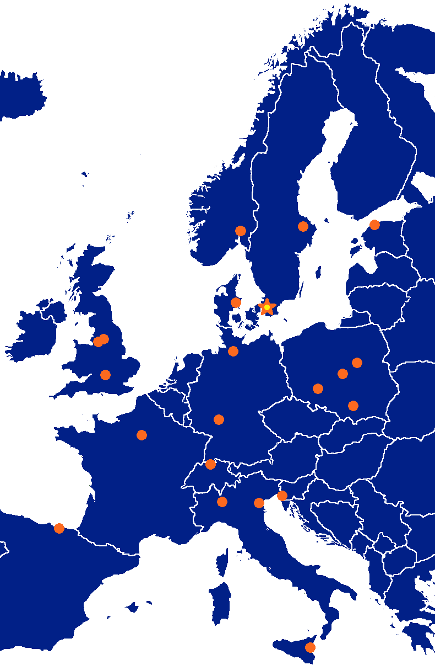
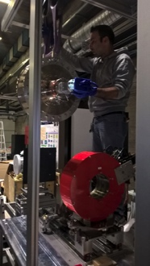
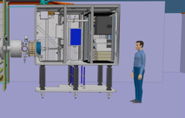
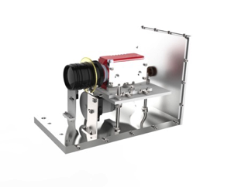
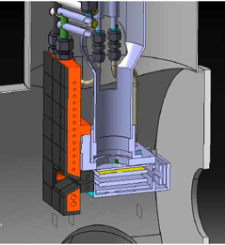
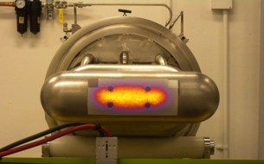
Accelerator Collaboration - Accelerator
352.21 MHz
704.42 MHz
2.4 m
4.6 m
3.8 m
39 m
56 m
77 m
179 m
Target
Source
LEBT
RFQ
MEBT
DTL
Spokes
Medium β
High β
HEBT & Contingency
75 keV
3.6 MeV
90 MeV
216 MeV
571 MeV
2000 MeV

Slide 4
Legal aspects
Work Environment Act in order to appoint a work environment coordinator (Samordningsansvarig)
Planning and Building Act in order to appoint construction safety officer (BAS-U)
Electrical Safety Legislation in order to appoint a electrical safety officer (Eldriftledare)
Accident Prevention Act in order to appoint a fire safety responsible officer (Brandskyddsansvarig)
Intention from the top management is/was to use the construction company organisation (Skanska) and their existing rules and requirements BUT

Slide 5
Summary of Swedish legislation (Work Environment Act)
Swedish legislation was changed in 2008 to make it more clear who has the responsibility in shared workplace.
Changed because a new European directive concerning building activities.
Shared workplace coordination responsible (SWOCOR)
ESS must appoint a “Area Coordination Manager” for each Shared Workplace – the same rule is applicable for Labs, Test Stands etc.

Slide 6
Installation at site
Building A
Coordination Manager A
Building B
Coordination Manager B
Building C
Coordination Manager C
Site Coordination Manager

Slide 7
For the site
ESS is responsible for writing an overall safety plan for the installation at site which can be presented to the Work Environment Authority
ESS appoints an Area Coordinator Manager
ESS appoints persons acting for:
Construction safety (BAS-U)
Electrical Safety
Fire Safety
General safety rules apply for the site
Specific safety rules may apply for the area/building.

Slide 8
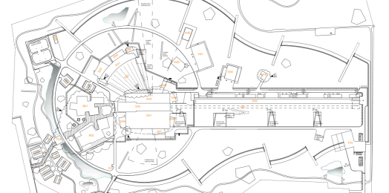
Site today, i.e. only CF installations
C101/Skanska is fully responsible for
Site management
Safety
Site services
Entrance
Reception
....
Responsible for the coordination of the safety work (Samordningsansvarig)
Construction & building (BAS-U)
Electrical Operation Leader (Eldriftledare)
Installation Coordinator
Skanska safety can stop any work
The individual can stop any work
Installation coordination
C101/Skanska

Slide 9
Parallel access
C101/Skanska is fully responsible for
Site management
Safety
Site services
Entrance
Reception
....
Installation coordination
Responsible for the coordination of the safety work (Samordningsansvarig)
Construction & building (BAS-U)
Electrical Operation Leader (Eldriftledare)
Installation Coordinator
Skanska safety can stop any work
The individual can stop any work
C101/Skanska

Slide 10
Full access-ESS has received full ownership of a Building/Area.
C101/Skanska is fully responsible for
Site management
Safety
Entrance
Reception
Note:
Site services are delivered by C101/Skanska and/or ESS Installation/Commissioning support in some areas.
For the ESS Area
ESS is the SWOCOR
Installation manager
Electrical safety responsible
Fire safety responsible
Notes
Skanska safety can stop any work that affect the site safety
ESS can stop any work on site that affect the safety of the owned building
Installation coordination with full access
Schedule focus
ESS Installation manager
AD Installation manager
TD Installation manager
ICS Installation manager
NSS Installation manager
CF Installation manager

Slide 11
Installation Plan
As part of the installation plan from an In-kind partner as well as supplier, the contributing part has to provide documentation regarding:
Risk Assessments
Staff
Necessary conditions
Necessary (safety) equipment provided at site
List of material (consumables)
Etc.
Basic Training is mandatory for all contributing parts

Slide 12
Safety Culture
Safety Culture
Management Commitment
Rules and regulations
Hazard Prevention/Control
Planning
Risk Analysis
Participation from staff
Training

Slide 13
Your workplace or mine?

