Slide 1

STATUS OF CRYOGENIC HAZARD AT ESS SINCE ESHAC#3
D.Phan with the contribution of S.Birch, E.Lundh, J.Fydrych, IK-partners and others
ESHAC#5 – 3rd and 4th October 2016
Contact: duy.phan@esss.se

Slide 2
AGENDA
1
Status of the ESS ODH Safety process and implementation ESS-0038692
2
Safety studies and concept against Oxygen Deficiency Hazard in the accelerator buildings
3
Results and lessons learnt from the Computational Fluid Dynamics (CFD) simulations in the accelerator tunnel
4
Upcoming activities and challenges

Slide 3
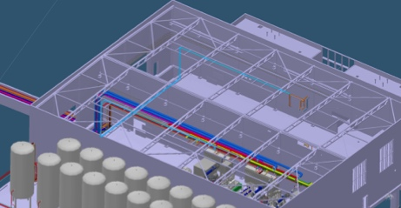
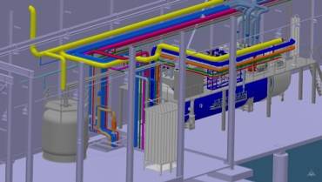
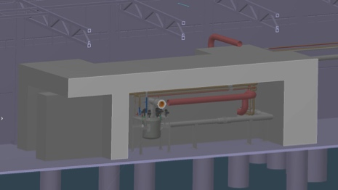
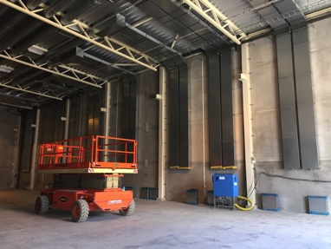
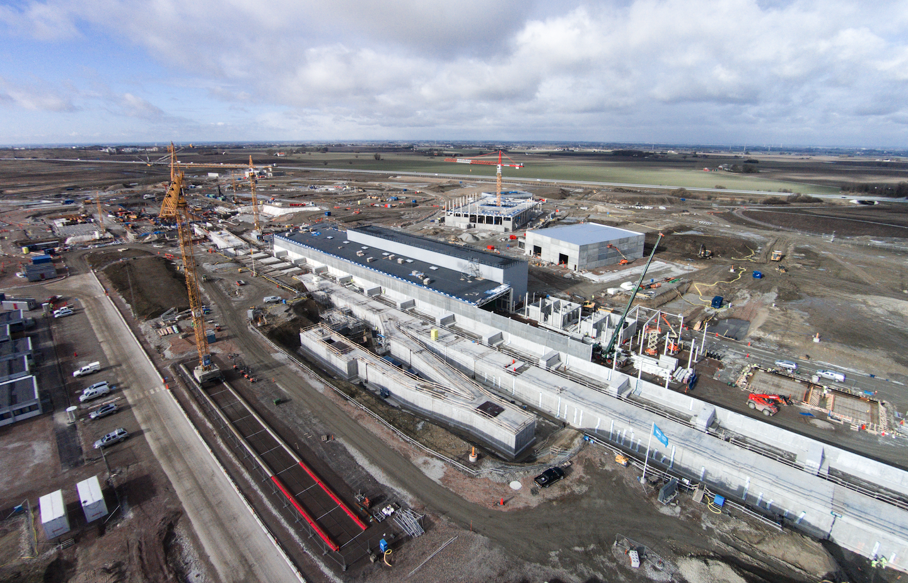
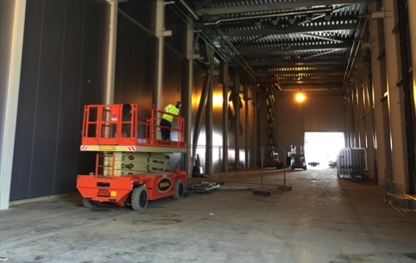
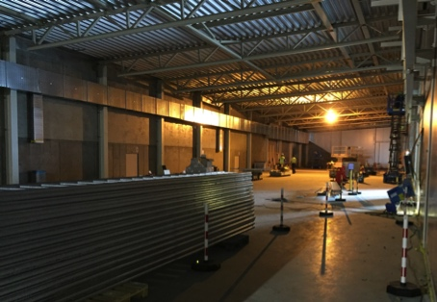
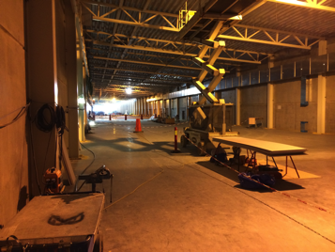
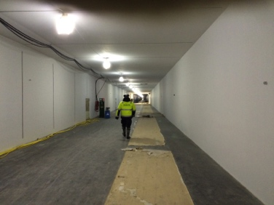
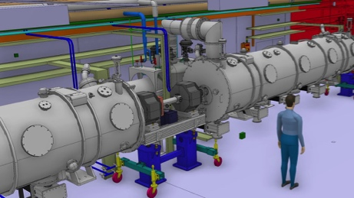
Introduction
ESS ODH Safety process and implementation
ODH in the accelerator tunnel
Results from CFD simulations
Upcoming activities and challenges
Introduction
View of the accelerator buildings
Helium Compressor building (HCB)
Coldbox Building (CXB)
Gallery Technical Area (GTA)
Klystron Gallery (KG)
Accelerator Tunnel (AT)
Acknowledgement : R.ERIKSSON
February 2016

Slide 4
Introduction
ESS ODH Safety process and implementation
ODH in the accelerator tunnel
Results from CFD simulations
Upcoming activities and challenges
ESHAC – Environment, Health and Safety Advisory Committee June 2015
1
ESS has developed an ODH safety process for the accelerator which is based on regulatory requirements; the DRAFT has been circulated in May, 2015, and the revised version will be approved by ES&H. The concept will be expanded to all ODH areas at ESS.
2
ESS shall consider starting the modeling of the premises in order to carry CFD simulations on cryogenic spills, fire risk assessment as well as air/smoke management. […]
As part of the CFD analysis, ESS should pay particular attention to the elevated section at the end of the accelerator tunnel.

Slide 5
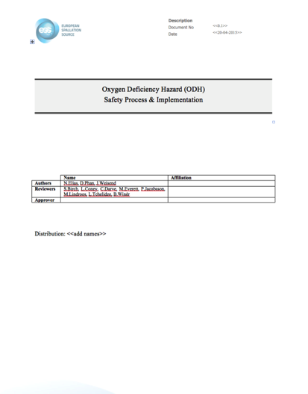
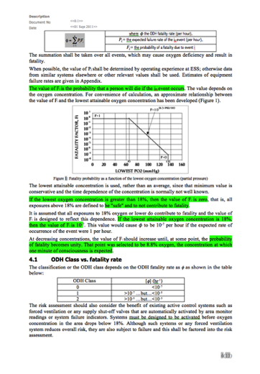
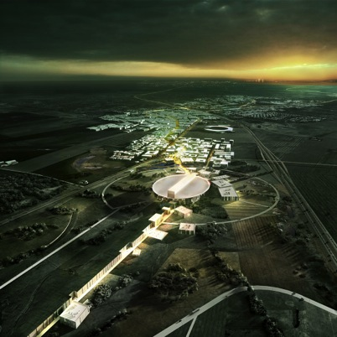
Introduction
ESS ODH Safety process and implementation
ODH in the accelerator tunnel
Results from CFD simulations
Upcoming activities and challenges
ODH Safety process & implementation
Overview and progress
Objectives
- Enforcement of the ODH safety process at ESS
- Description of the following:
  Applicable rules (EU, Swedish, ESS)
  ODH calculation methodology
  List of control measures (training, PPE, ventilation, etc.)
  Cryogenic Safety Committee
  Content of the Safety File
Mainly inspired by
FESHM 4240: Oxygen Deficiency Hazard
HANDED OVER TO ES&H DIVISION IN FEBRUARY 2016
ESS wide
ESS-0038692

Slide 6
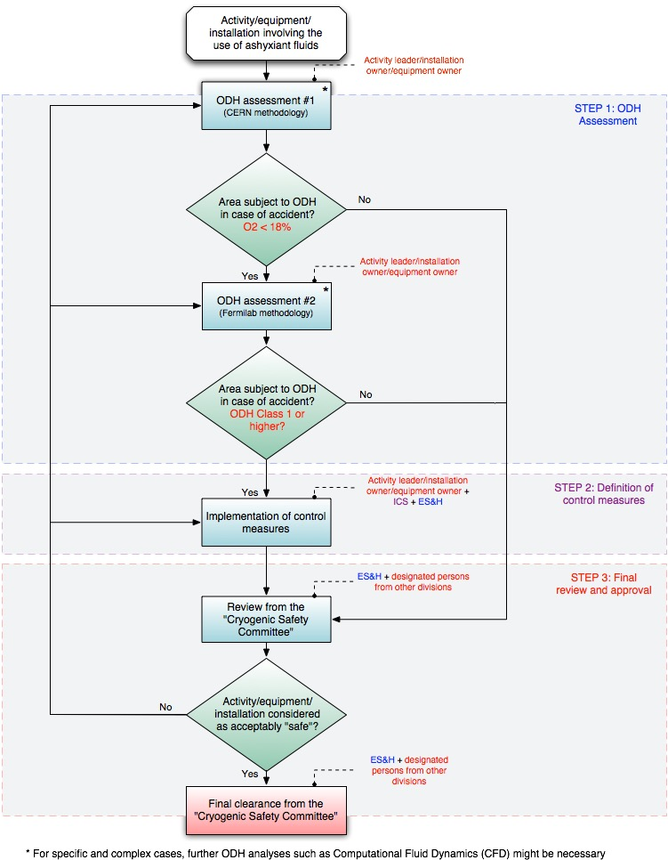
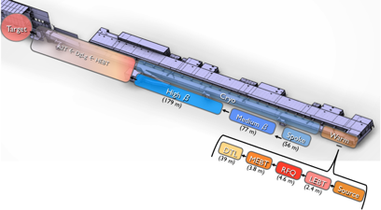


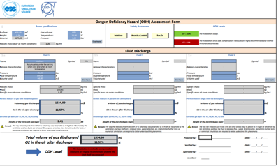
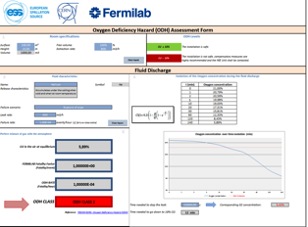
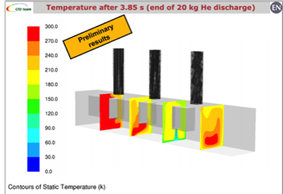

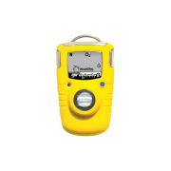







Introduction
ESS ODH Safety process and implementation
ODH in the accelerator tunnel
Results from CFD simulations
Upcoming activities and challenges
ODH Safety process & implementation
Example of implementation
1
Accelerator buildings
Area responsible
2
ODH assessment
Safety support for ODH assessment
3
ODH detection
Control measures
4
Control measures
Review & approval
September 16th 2016
Cryo. Safety Review Committee

Slide 7
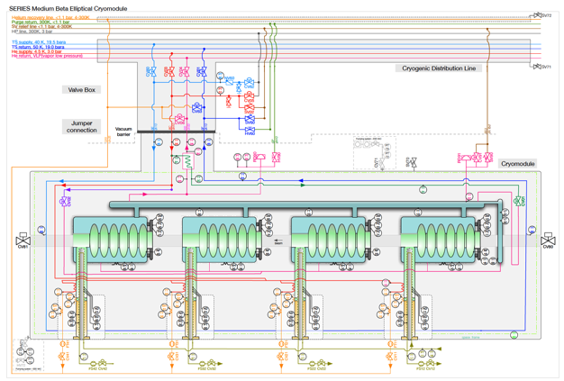
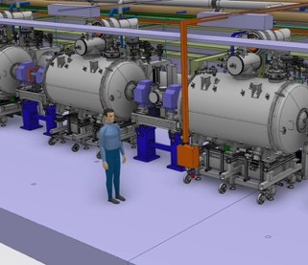
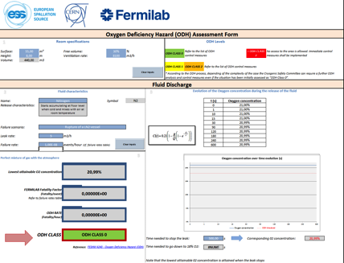
Introduction
ESS ODH Safety process and implementation
ODH in the accelerator tunnel
Results from CFD simulations
Upcoming activities and challenges
ODH working group
Overview
Objectives
Collect missing information for ODH studies
Discuss the failure scenarios chosen for the on-going ODH assessments
Tailor the ODH safety process & strategy to ESS’ needs
Discuss the implementation of control measures such as ventilation, training, etc.
Frequency: once every 2 months
Working Group:
1 representative from AD RP & Safety
1 representative from Cryomodules
1 representative from Cryogenics
1 representative from ES&H
1 representative from ICS
1 representative from Target Safety
1 representative from Science
5 Sessions carried out so far

Slide 8
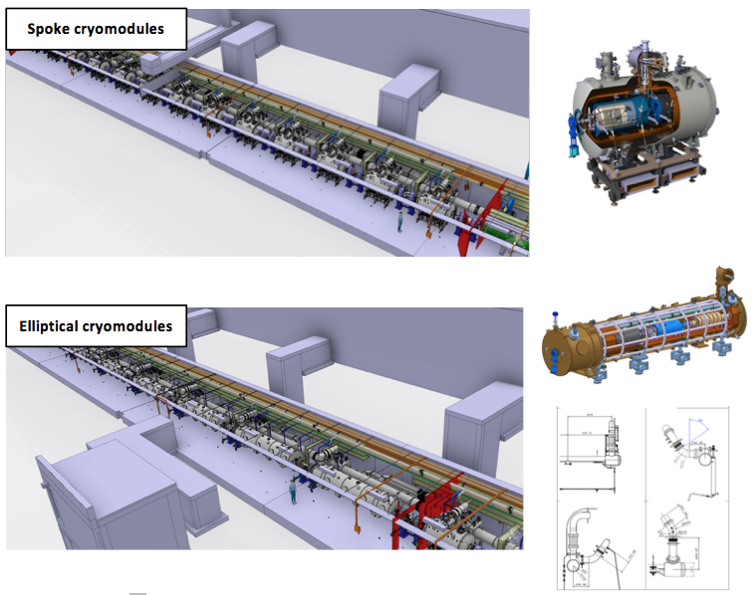
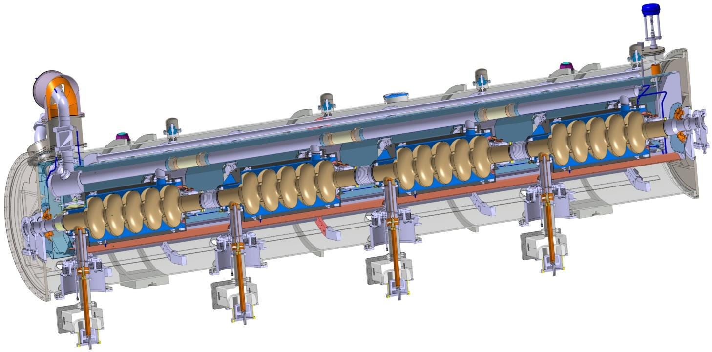
Introduction
ESS ODH Safety process and implementation
ODH in the accelerator tunnel
Results from CFD simulations
Upcoming activities and challenges
Results from the preliminary ODH assessment ESS-0063324
Most credible accidental scenario
sudden loss of the beam vacuum leading to the release of the full helium inventory from one cryomodule (e.g. rupture of one of the power coupler ceramic windows)
Ground surface | Height | Volume | Temperature | Pressure | Ventilation rate
3600 m² | 3.5 m | 12 600 m³ | 18°C | 1 atm | 25 200 m³/h

Slide 9
Introduction
ESS ODH Safety process and implementation
ODH in the accelerator tunnel
Results from CFD simulations
Upcoming activities and challenges
Results from the preliminary ODH assessment ESS-0063324
Step 1: steady-state calculation model
Fluid | State | Volume | Operational pressure | Temperature
Helium (High-β elliptical cryomodule) | Liquid | 0.226 m³ | Max 1.43 bara | 2 K
Volume of gas discharged: 203 m³
O₂ in the air after discharge: 20%
ODH CLASS 0
Special case: due to the particular geometry (low height and presence of a dead-end in the A2T area) of the tunnel and the numbers of helium discharge points in the tunnel, it was decided to perform a CFD simulation in order to estimate the temperature, the oxygen concentration as well as the pressure evolution at various locations and times in the tunnel in case of a release of helium

Slide 10
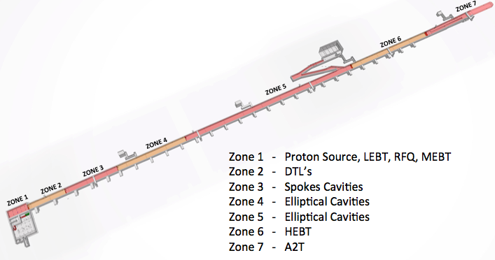
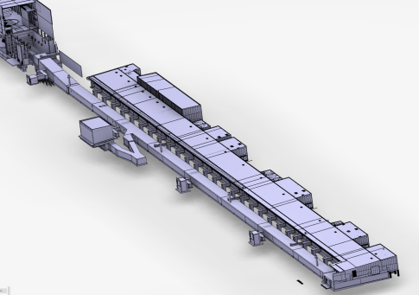
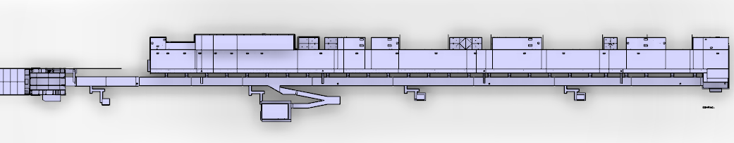
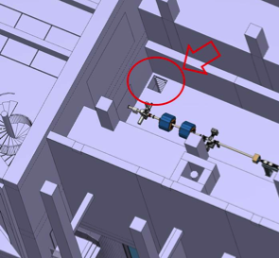
Introduction
ESS ODH Safety process and implementation
ODH in the accelerator tunnel
Results from CFD simulations
Upcoming activities and challenges
Accelerator tunnel
Layout of the ODH monitoring system
Overview
HEBT entrance
(chicane)
FEB entrance (chicane)
51 m
132 m
130 m
133 m
135 m
A2T egress
Emergency exits
Acknowledgement : S.BIRCH

Slide 11
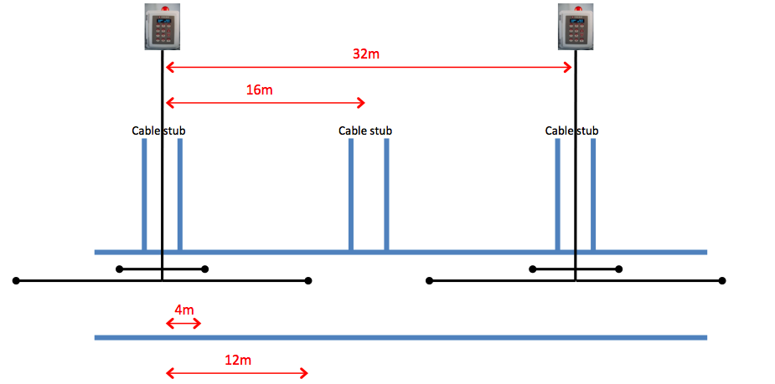
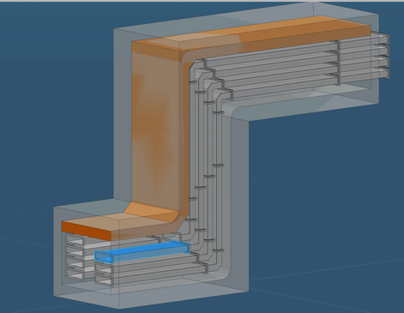

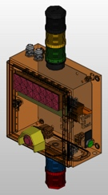
Introduction
ESS ODH Safety process and implementation
ODH in the accelerator tunnel
Results from CFD simulations
Upcoming activities and challenges
Accelerator tunnel
Layout of the ODH monitoring system
Stub
Accelerator tunnel 14 x 4 port Oxigraf Model O2iM oxygen deficiency Monitors mounted at high level.
Accelerator Tunnel exits and entrances 6 x 1 port Oxigraf Model O2iM oxygen deficiency Monitors mounted at high level.
50 Accelerator Beam Off Stations + 30 strobes and sirens.
Acknowledgement : S.BIRCH

Slide 12
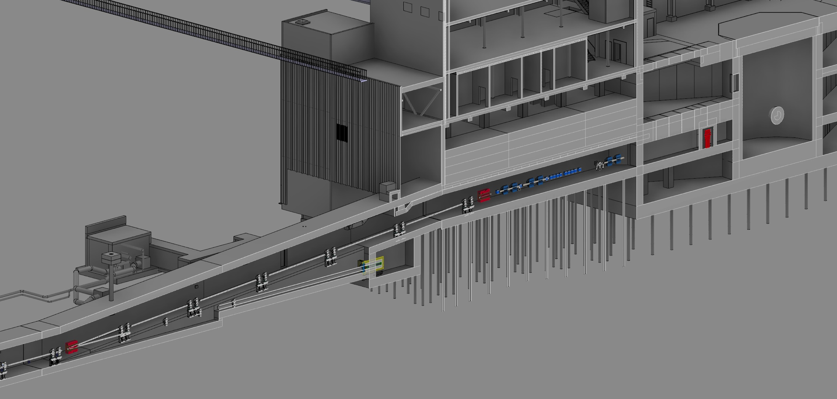

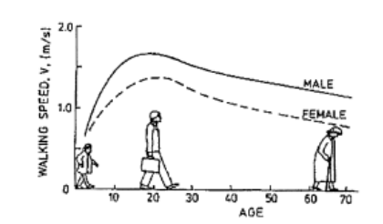
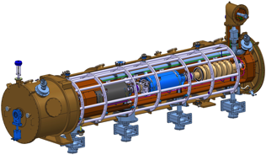
Introduction
ESS ODH Safety process and implementation
ODH in the accelerator tunnel
Results from CFD simulations
Upcoming activities and challenges
Accelerator tunnel
Safety issue in the A2T area
51 m to the nearest exit
64 seconds (30+34) to reach the nearest exit
219 m to the last cryomodule
Acknowledgement : N.GAZIS

Slide 13
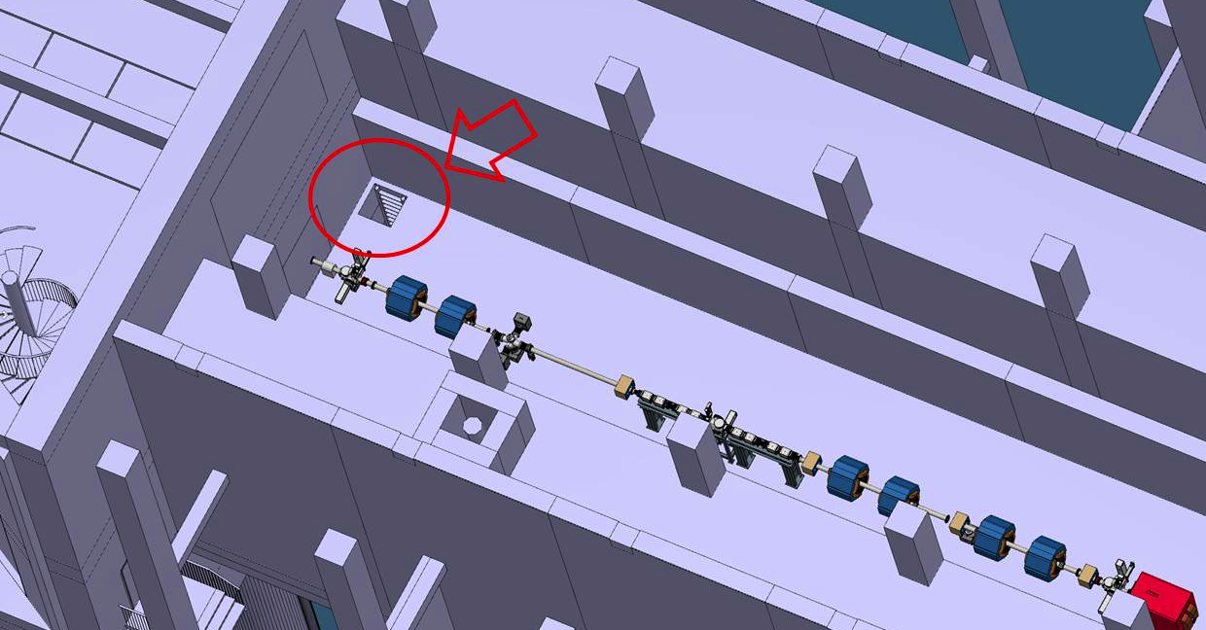
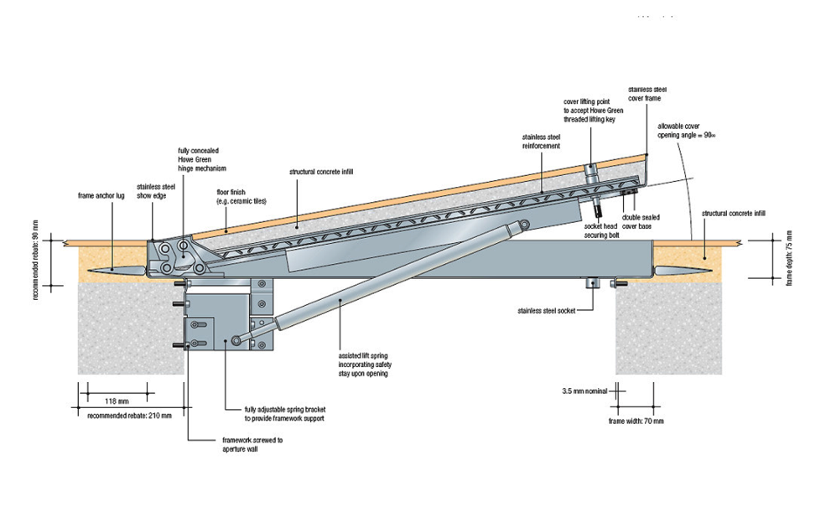
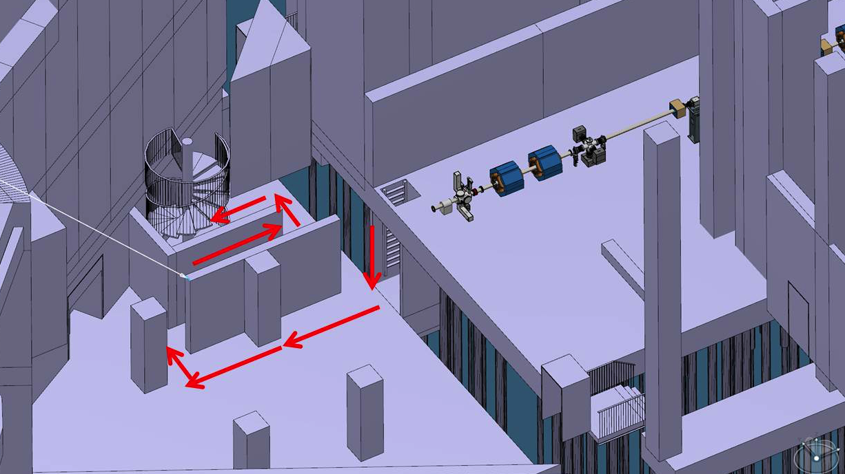
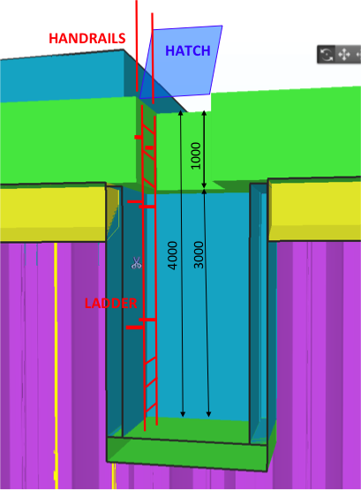
Introduction
ESS ODH Safety process and implementation
ODH in the accelerator tunnel
Results from CFD simulations
Upcoming activities and challenges
Accelerator tunnel
Safety issue in the A2T area
Decision taken on December 2015 to implement a safety hatch in the A2T area
Acknowledgement : N.GAZIS

Slide 14

Introduction
ESS ODH Safety process and implementation
ODH in the accelerator tunnel
Results from CFD simulations
Upcoming activities and challenges
Accelerator tunnel
CFD simulations
Failure scenarios considered (during access)
Scenario 1
Rupture of the power coupler’s window or beam line
Loss of the content of 1 High-β* cryomodule (28,4 kg at 2 K and 2.04 bara)
Discharge of GHe through the 2 rupture disks located on the LHe line (1,9 s)
Max. mass flow rate = 15,2 kg.s⁻¹
*the loss of 2 High-Beta cryomodules has not been considered thanks to the CLOSE position of the gate valves in-between cryomodules during access
Acknowledgement : J.P THERMEAU – WP5_SAFETYSIZING_SAFETY_DEVICES

Slide 15
Introduction
ESS ODH Safety process and implementation
ODH in the accelerator tunnel
Results from CFD simulations
Upcoming activities and challenges
Accelerator tunnel
CFD simulations
Failure scenarios considered (during access)
Scenario 2
Rupture of the insulation vacuum vessel of 1 High-β cryomodule
Loss of the content of 1 High-β* cryomodule (28,4 kg at 2 K and 2.04 bara)
Discharge of GHe through the 2 rupture disks located on the LHe line (11,8 s)
Max. mass flow rate = 2,4 kg/s
*the loss of 2 High-Beta cryomodules has not been considered thanks to the CLOSE position of the gate valves in-between cryomodules during access
Acknowledgement : J.P THERMEAU – WP5_SAFETYSIZING_SAFETY_DEVICES

Slide 16
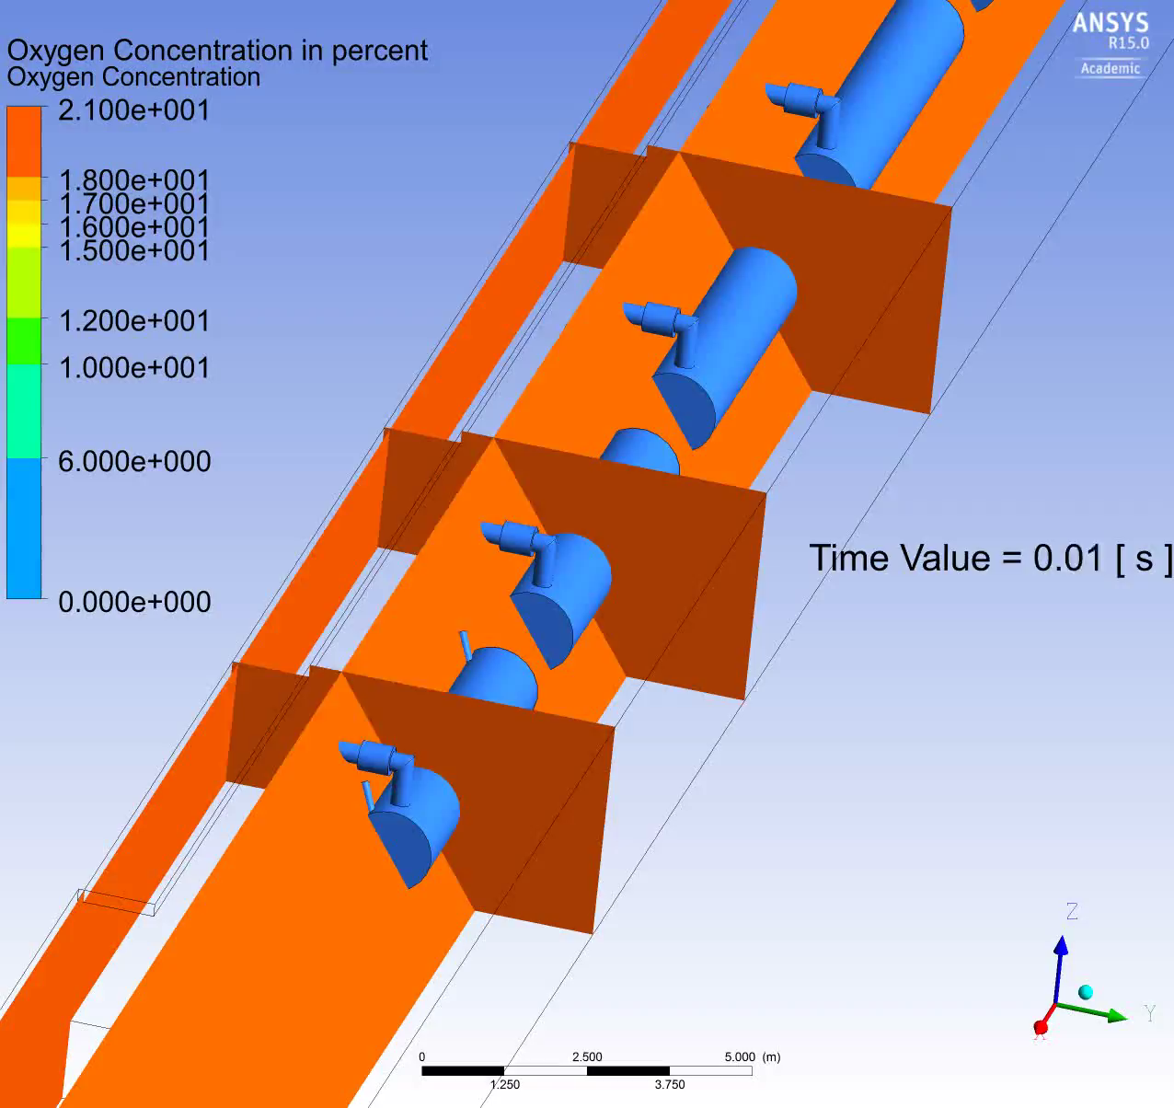
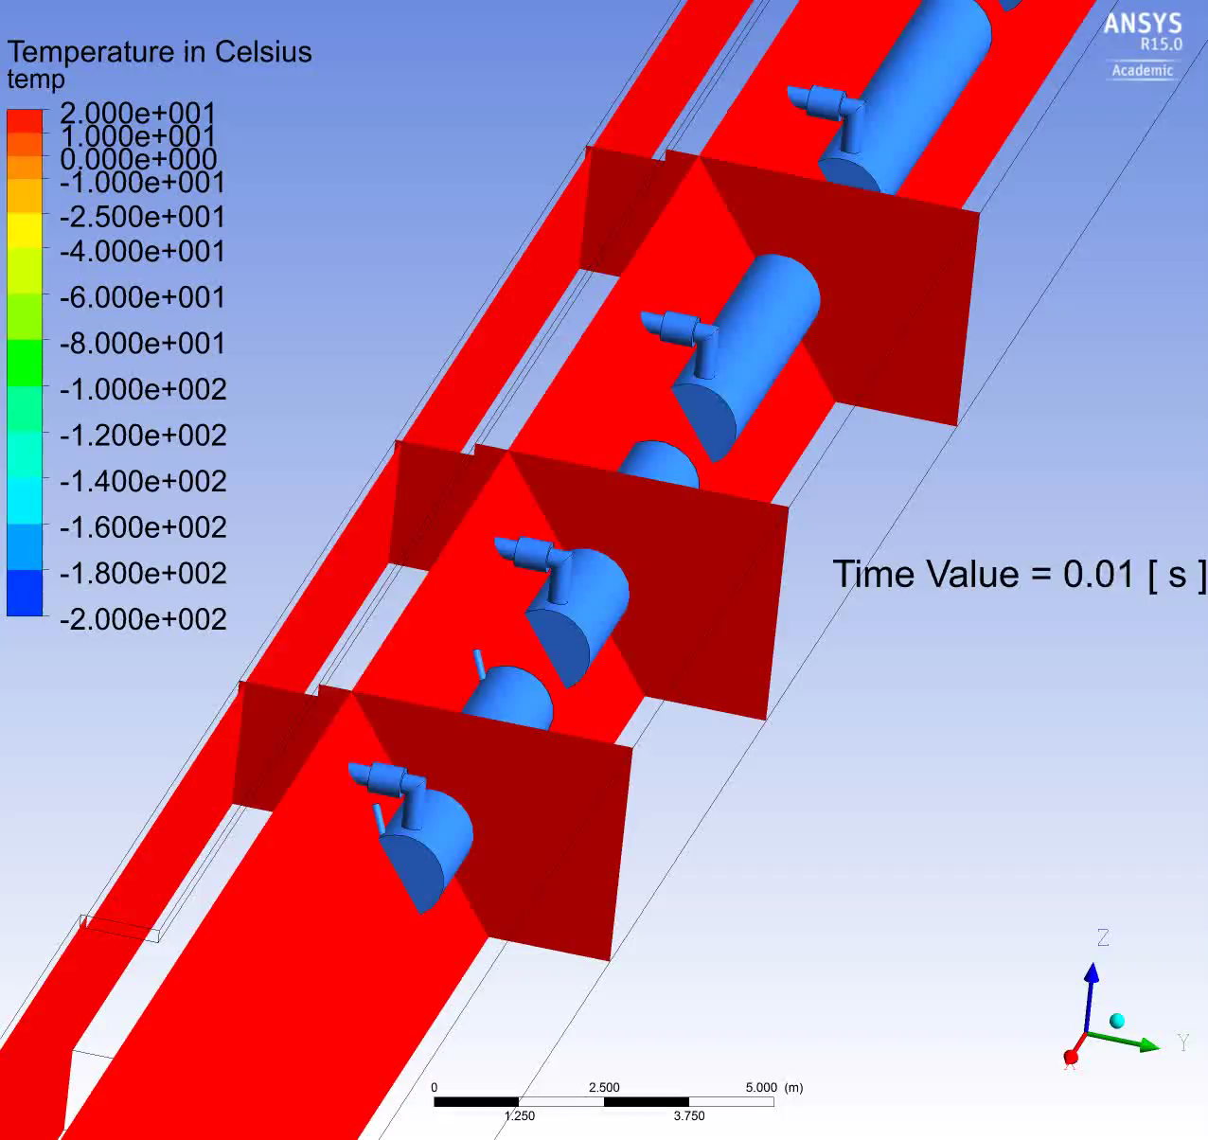
Introduction
ESS ODH Safety process and implementation
ODH in the accelerator tunnel
Results from CFD simulations
Upcoming activities and challenges
Accelerator tunnel
CFD simulations
Scenario 1 (15.2 kg.s⁻¹ during 2 s) – rupture of the beam line
ESS Threshold
Acknowledgement : E.LUNDH

Slide 17
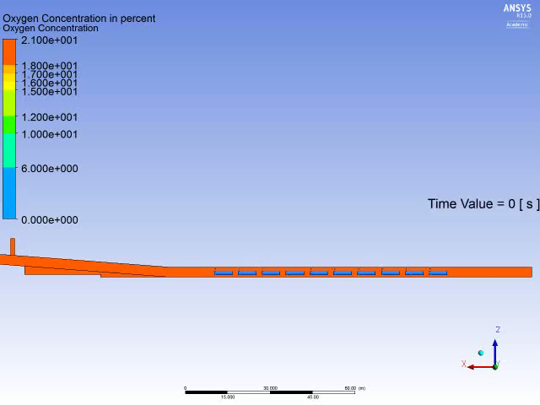
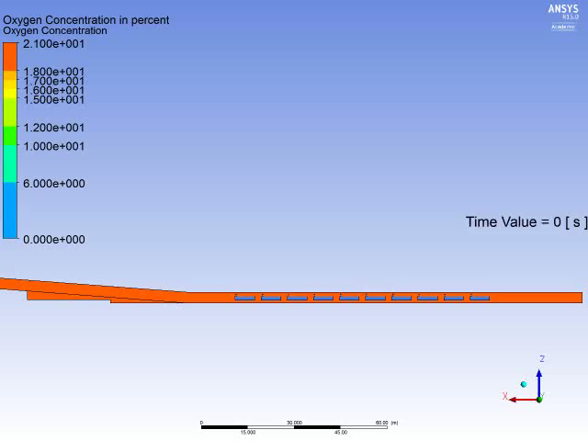
Introduction
ESS ODH Safety process and implementation
ODH in the accelerator tunnel
Results from CFD simulations
Upcoming activities and challenges
Accelerator tunnel
CFD simulations
Scenario 2 (2.4 kg.s⁻¹ during 2 s) – rupture of the vacuum vessel of a High-β
ESS Threshold
ESS Threshold
Mass flow rate: 2,4 kg.s⁻¹
Mass: 28,4 kg
Leak duration: 12 s
Location: contingency space (A2T area)
Ventilation mode: ON – 25 200 m³/h
Mass flow rate: 2,4 kg.s⁻¹
Mass: 28,4 kg
Leak duration: 12 s
Location: contingency space (A2T area)
Ventilation mode: OFF
Acknowledgement : E.LUNDH

Slide 18
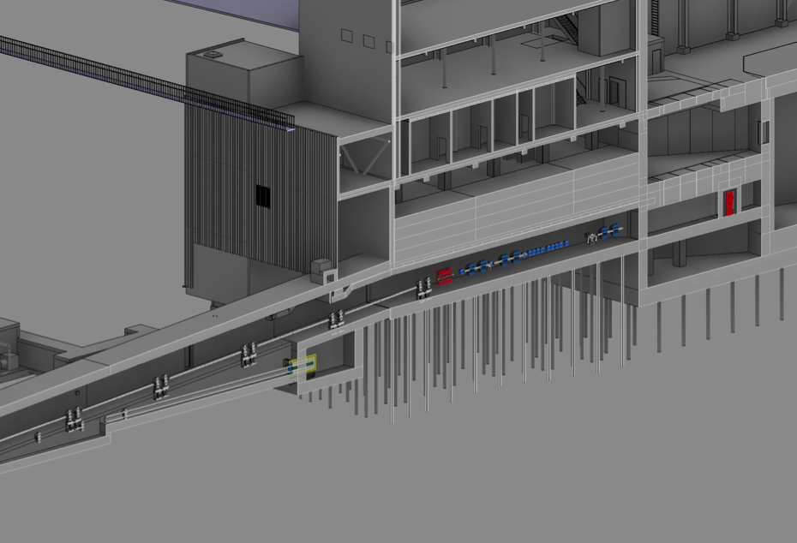

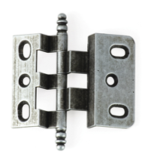
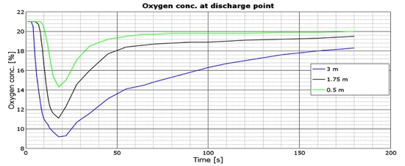
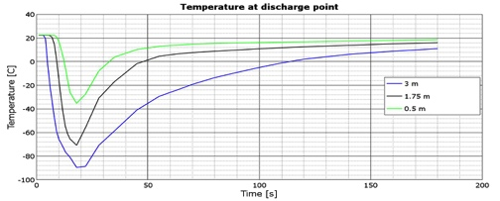
Introduction
ESS ODH Safety process and implementation
ODH in the accelerator tunnel
Results from CFD simulations
Upcoming activities and challenges
Accelerator tunnel
CFD simulations – Preliminary conclusions
1
Implementation of a safety hatch in the A2T area to facilitate evacuation
→ The minimum time needed to reach the nearest exit from the A2T area (64 seconds) does not allow a safe evacuation
A2T area
2
Reinforcement of the hinges and frame of the emergency exit doors
→ The force applied on the doors in case of a failure of a cryomodules would be around 50 kN.m⁻² (500 kg.m⁻²)
Safety hatch
3
Investigation on compensatory measures close to the discharge points (e.g. helium collection header)
Lowest attainable O2 concentration = 6%
Lowest attainable temperature = -135°C

Slide 19







Introduction
ESS ODH Safety process and implementation
ODH in the accelerator tunnel
Results from CFD simulations
Upcoming activities and challenges
ESS Cryogenic Safety Workshop February 10-11, 2016
Highlights
Objective: share experience and technical expertise with cryogenic and safety experts regarding cryogenic safety in accelerator tunnels
7 institutes represented
2-days workshop
10 recommendations addressed to ESS
Presentations available here: https://indico.esss.lu.se/event/438/

Slide 20
Introduction
ESS ODH Safety process and implementation
ODH in the accelerator tunnel
Results from CFD simulations
Upcoming activities and challenges
ESS Cryomodules Safety Review June 9, 2016
Highlights
Objective: evaluate the design of the Spoke and Elliptical
cryomodules against failures and risks to humans and equipment during operation
The design of the collector is however still in a preliminary state, and it is was not possible for the committee to review the solution in depth. The committee supports the continuation of this work with high priority, as well as the evaluation of the impact of this system on the cryomodule design and integration aspects in the tunnel.
Presentations and report from the committee available here: https://indico.esss.lu.se/event/542/

Slide 21
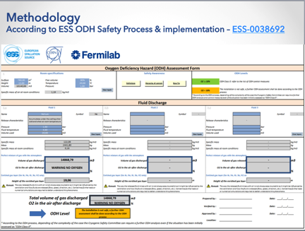
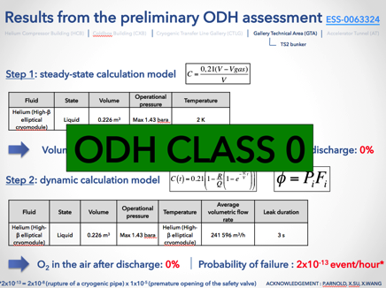
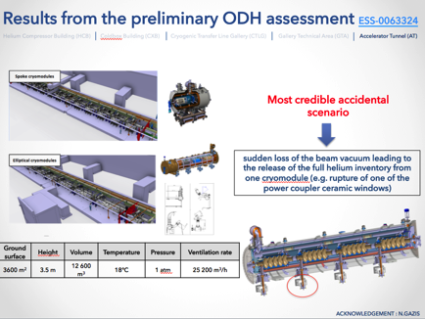
Introduction
ESS ODH Safety process and implementation
ODH in the accelerator tunnel
Results from CFD simulations
Upcoming activities and challenges
ESS ODH Safety Review September 16, 2016
Highlights
Objective:
Review the ODH scenarios of the accelerator buildings (relevancy, calculation model, etc.)
Review the strategy and layout of the ODH monitoring system
Advice on control measures to be put in place to guarantee the safety of the activity/equipment/installation
Provide a formal recommendation on whether the ODH monitoring system should proceed to procurement and installation phases
Presentations and report from the committee available here: https://indico.esss.lu.se/event/625/

Slide 22
Introduction
ESS ODH Safety process and implementation
ODH in the accelerator tunnel
Results from CFD simulations
Upcoming activities and challenges
ESS ODH Safety Review September 16, 2016
Top 5 recommendations
1
The methodology presented to assess ODH is globally satisfying and seems to be adequate and rather complete but a complementary evaluation of the evacuation time in the event of a helium/nitrogen release should be performed for each accelerator building in order to identify potential additional control measures.
2
ESS should re-evaluate the needs to carry personal oxygen monitors in each building potentially subject to oxygen depletion.
3
In case of on an ODH event, the cryogenic and main control room will be informed upon trigger of the ODH detection system but there is no formal ESS emergency procedure at the moment. Therefore ESS, in particular ES&H Division, needs to clarify as soon as possible the alert procedure of the rescue team in the event of an ODH.

Slide 23
Introduction
ESS ODH Safety process and implementation
ODH in the accelerator tunnel
Results from CFD simulations
Upcoming activities and challenges
ESS ODH Safety Review September 16, 2016
Top 5 recommendations
4
Efforts should be made to align the ODH and fire alarms and strobe lights, and to reduce the number of lights of the beam-off stations in order not to confuse the operators in case of an emergency situation, especially in the accelerator tunnel. In the same context, ESS should also consider implementing evacuation push buttons in the accelerator tunnel in order to manually trigger the evacuation in case of an ODH event.
5
The review committee acknowledges the decision to have ODH monitors with multiport sampling in the accelerator tunnel but recommends also considering the implementation of ODH monitors with fast sampling (single port) and a longer distance between monitors as well as reducing the number of sirens/strobes which might has been overestimated.

Slide 24

Introduction
ESS ODH Safety process and implementation
ODH in the accelerator tunnel
Results from CFD simulations
Upcoming activities and challenges
Accelerator tunnel
Conceptual design of the Helium collection header
Access Mode
Most credible accidental scenario: loss of one High-β cryomodule
Flap valve in CLOSED position
Flap valve in CLOSED position
Flap valve in CLOSED position
7.25 kg/s
7.25 kg/s
Gate valve in CLOSED position
Gate valve in CLOSED position
Gate valve in CLOSED position

Slide 25

Introduction
ESS ODH Safety process and implementation
ODH in the accelerator tunnel
Results from CFD simulations
Upcoming activities and challenges
Accelerator tunnel
Conceptual design of the Helium collection header
Beam Mode
Most credible accidental scenario: loss of six High-β cryomodules
Flap valve in OPEN position
Flap valve in OPEN position
Flap valve in OPEN position
7.25 kg/s
7.25 kg/s
7.25 kg/s
7.25 kg/s
Proton beam
Gate valve in OPEN position
Gate valve in OPEN position
Gate valve in OPEN position
Design report expected for mid-November

Slide 26
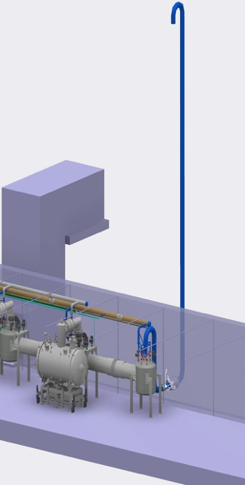



Introduction
ESS ODH Safety process and implementation
ODH in the accelerator tunnel
Results from CFD simulations
Upcoming activities and challenges
Accelerator tunnel
Conceptual design of the Helium collection header
CDS vent line
Cold box room vent line
CTL gallery
L = 55 m
Total length of the collector < 400 m
Accelerator tunnel
310 m
Acknowledgement : J.FYDRYCH

Slide 27

Introduction
ESS ODH Safety process and implementation
ODH in the accelerator tunnel
Results from CFD simulations
Upcoming activities and challenges
Accelerator tunnel
Conceptual design of the Helium collection header
1
2
Location 1 – clashes with the
CM vacuum pumping units;
difficulties in the CM installation
Location 2 – clashes with the valve box side process lines;
difficulties in repair and maintenance work on valve box
Acknowledgement : J.FYDRYCH

Slide 28

?
ANY QUESTIONS
Contact: duy.phan@esss.se

Slide 29
BACK-UP SLIDES

Slide 30
Introduction
ESS ODH Safety process and implementation
ODH in the accelerator tunnel
Results from CFD simulations
Upcoming activities and challenges
Accelerator tunnel
CFD simulations
Assumptions
GHe released at 5 K (coldest value from the designer)
Constant mass flow rates from the burst disks
Atmospheric pressure in the tunnel
100% leak tightness in the tunnel
Walls and equipment held at a constant temperature of 22.5 °C
Constantly forced ventilation (about 0.3 – 0.4 m.s⁻¹ in the tunnel)
Simplified geometry
CDS and cryomodules installed in the contingency space
Cryogenic helium properties from the NIST Chemistry WebBook
The simulation software CFX (ANSYS) is used
Acknowledgement : E.LUNDH

Slide 31


Introduction
ESS ODH Safety process and implementation
ODH in the accelerator tunnel
Results from CFD simulations
Upcoming activities and challenges
Introduction
View of the accelerator buildings (3D model)
Coldbox Building (CXB)
Helium Compressor building (HCB)
Target Moderator CryoPlant Hall (TCH)
Accelerator CryoPlant Hall (ACH)
High Pressure Gas Storage (HPGS)
Cryogenic Transfer Line Gallery (CTLG)
Gallery Technical Area (GTA)
TS2 bunker
Accelerator Tunnel (AT)
Acknowledgement : N.GAZIS

Slide 32

Introduction
ESS ODH Safety process and implementation
ODH in the accelerator tunnel
Results from CFD simulations
Upcoming activities and challenges
Accelerator tunnel
Conceptual design for the air management system
Air exhaust
Air supply
O2
O2
O2
O2
Proton beam
Fire damper
O2
O₂ detector – Oxigraf 4 port multiport sampling (laser diode technology)
ODH is not relevant during beam operation

Slide 33




Introduction
ESS ODH Safety process and implementation
ODH in the accelerator tunnel
Results from CFD simulations
Upcoming activities and challenges
Accelerator tunnel
Conceptual design for the air management system
≈140 hours of maintenance/year
Air exhaust
Air supply
O2
O2
O2
O2
O2
O2
O2
O2
25 200 m³/h
25 200 m³/h
If a Helium discharge occurs, it will be partly handled by the ventilation system…
Lesson learnt from CERN’s visit (2 July 2015)
→ air speed from the ventilation should not exceed 1 m.s⁻¹ to facilitate evacuation

Slide 34




Introduction
ESS ODH Safety process and implementation
ODH in the accelerator tunnel
Results from CFD simulations
Upcoming activities and challenges
Accelerator tunnel
ODH studies – CFD simulation of helium discharge
Temperature and O₂ concentration need to be evaluated locally (close to the He discharge points) as well as pressure rise
Assessment of human evacuation (pathway, time) in case of a helium release
Help in the decision-making to CF for the design of the ventilation system
Help in the definition of the access procedure to the LINAC (warm-up, cool-down, steady-state)
Acknowledgement : E.LUNDH

Slide 35
Introduction
ESS ODH Safety process and implementation
ODH in the accelerator tunnel
Results from CFD simulations
Upcoming activities and challenges
Accelerator tunnel
Proposed control measures
Technical Safety measures
Warning signs
Fixed area oxygen monitoring with audible alarm(s) and flashing light(s)
Safety hatch in the A2T area to facilitate evacuation in case of ODH event
Feasibility study of a helium collection header connected to the burst disks of the CM
Organizational Safety measures
ODH training (e-learning)
Closing of the gate valves located in-between the CM prior to any access to the accelerator tunnel
Personal oxygen monitors
Presence of minimum two persons
Administrative Safety measures
Access restricted to authorized personnel only
Emergency procedure
Access procedure
Working procedure

Slide 36


Accelerator tunnel
Integration and Verification – Warm linac
Access to the installations (north) tunnel wall is possible under the DTL
Access to the installations (north) tunnel wall could be possible under the LEBT/RFQ/MEBT (t.b.d.)
Acknowledgement : N.GAZIS

Slide 37


Accelerator tunnel
Integration and Verification – Spoke
SPK CM do not allow for access route to the installations (north) tunnel wall
Access to the installations (north) tunnel wall is possible under the LWU (through the LWU support table)
Temporary ladders can be installed on top of the LWU for access around it
Acknowledgement : N.GAZIS

Slide 38



Accelerator tunnel
Integration and Verification – Medium and High-β Linac
Access to the installations (north) tunnel wall is possible under the LWU (through the LWU support table)
Temporary ladders can be installed on top of the LWU for access around it
Acknowledgement : N.GAZIS

Slide 39



Accelerator tunnel
Integration and Verification – HEBT, Dog-Leg and A2T
Access to the installations (north) tunnel wall is facilitated throughout HEBT, Dog-Leg and A2T

Slide 40


Accelerator tunnel
CFD simulations
Failure scenarios considered (during access)
Scenario 3
Helium leakage from the VLP line in the insulation vacuum of the Cryogenic Distribution System (CDS)
Loss of the content of the CDS in the contingency space (60 kg at 3 K and 6 bara )
Discharge of GHe through the pressure relief device on the insulation vacuum jacket (4 s)
Max. mass flow rate = 15 kg/s
Acknowledgement : J.FYDRYCH

Slide 41

Accelerator tunnel
CFD simulations
Scenario 2 (2.4 kg.s⁻¹ during 2 s) – rupture of the vacuum vessel of a High-β
ESS Threshold
ESS Threshold
Mass flow rate: 2,4 kg.s⁻¹
Volume: 28,8 kg
Leak duration: 12 s
Location: contingency space (A2T area)
Orientation of the burst disks: towards IS
Mass flow rate: 2,4 kg.s⁻¹
Volume: 28,8 kg
Leak duration: 12 s
Location: contingency space (A2T area)
Ventilation mode: towards target
Acknowledgement : E.LUNDH

Slide 42

Accelerator tunnel
CFD simulations
Scenario 2 (2.4 kg.s⁻¹ during 2 s) – rupture of the vacuum vessel of a High-β
Ventilation ON
25 200 m³/h
Discharge point
B
Nearest exit from the A2T
A
C
Notes:
Punkter I mitten av gången….Ska bara visa resultat från de närmsta punkterna, de 15 m bakåt och närmsta exit från A2T
Punkterna är på 0.5m, 1.75m och 3m

Slide 43


A
Ventilation ON
25 200 m³/h

Slide 44


B
Ventilation ON
25 200 m³/h

Slide 45


C
Ventilation ON
25 200 m³/h

Slide 46

Introduction
ESS ODH Safety process and implementation
ODH in the accelerator tunnel
Results from CFD simulations
Upcoming activities and challenges
Accelerator tunnel
CFD simulations
Failure scenarios considered (during access)
Scenario 1
Rupture of the power coupler’s window or beam line
Loss of the content of 1 High-β* cryomodule (28,4 kg at 2 K and 2.04 bara)
Discharge of GHe through the 2 rupture disks located on the LHe line (1,9 s)
Q
Q
Q
Q
P
P
P
P
Max. mass flow rate = 15,2 kg.s⁻¹
Air inlet
*the loss of 2 High-Beta cryomodules has not been considered thanks to the CLOSE position of the gate valves in-between cryomodules during access
Acknowledgement : J.P THERMEAU – WP5_SAFETYSIZING_SAFETY_DEVICES

Slide 47

Accelerator tunnel
CFD simulations
Scenario 3 (15 kg.s⁻¹ during 4 s) – rupture of the VLP line
Acknowledgement : E.LUNDH

Slide 48




Accelerator tunnel
CFD simulations
Geometry
Notes:
Berätta att geometrin har ändrats
Orientation of the burst disks…

Slide 49

Accelerator Air Management System
On-going Safety studies
CFD Project Request
Objective: Define the boundary conditions necessary for the CFD simulation
Responsibility: Accelerator Division
Time frame: finalized
Hazardous scenarios
Leak, abrupt rupture, discharge from safety device, etc.
Tunnel dimensions and characteristics
Length, width, height, internal volume, helium escape routes, etc.
Environmental conditions
Pressure and temperature in the tunnel
Description of the cryogenic circuit
Mass of helium, operating pressure and temperature, safety device, etc.
Description of the cryomodules
Mass of helium, operating pressure and temperature, safety device, etc.
Description of the HVAC system
Ventilation rate, location of the air inlet and outlet, etc.

Slide 50



ODH case-study
Accelerator tunnel
Case 1: full length – normal ventilation
During release:
600 m
After release:
Volume available: 4410 m3
Ventilation rate: 12 600 m3/h (1 ACH)
Acknowledgement : N.GAZIS (ESS)

Slide 51
ODH case-study
Accelerator tunnel
Case 2: section between 2 exits – normal ventilation
During release:
After release:
135 m
Volume available: 992 m3
Ventilation rate: 12 600 m3/h (1 ACH)
Acknowledgement : N.GAZIS (ESS)
31,2 s after the release started
1,2 s
02 ≥ 18%
02 < 18%

Slide 52
ODH case-study
Accelerator tunnel
Case 3: section between 2 exits – 1 smoke extractor*
During release:
After release:
135 m
Volume available: 992 m3
Ventilation rate: 18 000 m3/h (1,4 ACH)
Acknowledgement : N.GAZIS (ESS)
22,3 s after the release started
1,2 s
02 ≥ 18%
02 < 18%
*considering a quasi-immediate trigger of the smoke extraction

Slide 53
ODH case-study
Accelerator tunnel
Case 4: section between 2 exits – 2 smoke extractors*
During release:
After release:
135 m
Volume available: 992 m3
Ventilation rate: 36 000 m3/h (2,8 ACH)
Acknowledgement : N.GAZIS (ESS)
11,5 s after the release started
1,2 s
02 ≥ 18%
02 < 18%
*considering a quasi-immediate trigger of the smoke extraction

Slide 54
ODH case-study
Accelerator tunnel
Case 5: section between 2 exits – 1 smoke extractor*
During release:
After release:
135 m
Volume available: 992 m3
Ventilation rate: 18 000 m3/h (1,4 ACH)
Acknowledgement : N.GAZIS (ESS)
50,5 s after the release started
1,2 s
02 ≥ 18%
02 < 18%
*considering a trigger of the smoke extraction after 30 s

Slide 55
ODH case-study
Accelerator tunnel
Case 6: section between 2 exits – 2 smoke extractors*
During release:
After release:
135 m
Volume available: 992 m3
Ventilation rate: 18 000 m3/h (1,4 ACH)
Acknowledgement : N.GAZIS (ESS)
40,9 s after the release started
1,2 s
02 ≥ 18%
02 < 18%
*considering a trigger of the smoke extraction after 30 s

Slide 56
ODH case-study
Accelerator tunnel
Summary table
Case | Length of the tunnel | Ventilation system | Trigger time | Time needed to reach 18% O2
1 | 600 m | Normal | N/A | Always above 18%
2 | 135 m | Normal | N/A | 31,2 s
3 | 135 m | 1 smoke extractor | immediate | 22,3 s
4 | 135 m | 2 smoke extractors | immediate | 11,5 s
5 | 135 m | 1 smoke extractor | After 30 s | 50,5 s
6 | 135 m | 2 smoke extractors | After 30 s | 40,9 s
NOT REALISTIC

Slide 57

ODH Safety process
Preliminary ODH assessment
Method n°1 (CERN approach)
Objective: assess in a simple way consequences of the full loss of an asphyxiant fluid in a given volume without considering any ventilation and time parameter
Room parameters
Fluid parameters
O2 concentration
(perfect mixture)
+
Height of the gas layer
(stratification)
ODH Level
(O2≥18% OR O2<18%)

Slide 58


ODH Safety process
Preliminary ODH assessment
Method n°2 (Fermilab approach)
Objective: assess in a simple way the consequences of a leak of an asphyxiant fluid in a given volume considering the ventilation rate and the time evolution
Part 1/2
Room parameters
Fluid + scenario characteristics
O2 evolution during fluid discharge
ODH parameters:
Fatality rate
Probability of fatality
ODH class

Slide 59


ODH Safety process
Preliminary ODH assessment
Method n°2 (Fermilab approach)
Objective: assess in a simple way the consequences of a leak of an asphyxiant fluid in a given volume considering the ventilation rate and the time evolution
Part 2/2
Contact persons
O2 evolution after fluid discharge

Slide 60

ODH control measures
Which ones are relevant?
  “If this approach is taken, the ventilation system must now be treated as a safety system with appropriate controls and redundancies” – John Weisend, January 2015
PSS? IEC 61508?
OK
Simplication
of the approach to meet ESS needs…
ES&H?
Applicable?
To be discussed

Slide 61

ODH control measures
Other possible solutions…
Solution 1
Solution 2

Slide 62



Practical cases
Accelerator tunnel – Method n°1
Scenario: Helium discharge from the safety relief device of the insulating vacuum vessel from 1 High-β Cryomodule
Cause: leak from junctions/welds from the cavities
Volume of LHe: 1 x 4 x 0.048 m3
Temperature of LHe: 2K
Pressure: 1,9 bara
Tunnel: 12 600 m3 x 35% (full volume)
Steady state
Volume of gas discharged: 174 m3
O2 concentration after discharge (homogeneous mixture): 20,17%
Height of gas layer (stratification): 0,05 m
ODH level: “SAFE”
Acknowledgement : J.FYDRYCH (ESS)

Slide 63
Practical cases
Accelerator tunnel – Method n°1
Scenario: Helium discharge from the safety relief device of the insulating vacuum vessel from 1 High-β Cryomodule
Cause: leak from junctions/welds from the cavities
Volume of LHe: 1 x 4 x 0.048 m3
Temperature of LHe: 2K
Pressure: 1,9 bara
Tunnel: 4200 m3 x 35% (1/3 of the total volume)
Volume of gas discharged: 174 m3
O2 concentration after discharge (homogeneous mixture): 18,52%
Height of gas layer (stratification): 0,14 m
ODH level: “SAFE”
200 m
Acknowledgement : N.GAZIS, J.FYDRYCH (ESS)

Slide 64


Practical cases
Accelerator tunnel – Method n°2
Scenario: Helium discharge from the safety relief device of the insulating vacuum vessel from 1 High-β Cryomodule
Cause: leak from junctions/welds
Leak rate: 475 200 m3/h (ref. WP5_SafetySizing__nt-safety-devices-2015-01-14.docx)
Duration of the leak: infinite (not realistic)
Ventilation rate: 1 vol/h (12600 m3/h)
Tunnel: 12 600 m3 x 35% (full volume)
Steady state
FORBIDDEN AREA
Control measures need to be taken
Acknowledgement : J.FYDRYCH (ESS)

Slide 65

Practical cases
Accelerator tunnel – Method n°2
Scenario: Helium discharge from the safety relief device of the insulating vacuum vessel from 1 High-β Cryomodule
Cause: leak from junctions/welds
Leak rate: 475 200 m3/h (ref. WP5_SafetySizing__nt-safety-devices-2015-01-14.docx)
Duration of the leak: infinite (not realistic)
Ventilation rate: 1 vol/h (12600 m3/h)
Tunnel: 4200 m3 x 35% (1/3 of the total volume)
Worst case scenario but maybe not realistic
FORBIDDEN AREA
Control measures need to be taken
200 m
Acknowledgement : N.GAZIS, J.FYDRYCH (ESS)

Slide 66

CERN LHC spill test
Lessons learnt (from a Safety point of view)
The drop of O2 content cannot be related to the visible formation of mist in the flow
Exclusions zones have been increased
No personnel access to the tunnel while sectors are cooled down or warmed up or powering tests are performed of He cooled magnets
Access conditions for personnel redefined such that no exposure to a MCI larger than 0,1 kg/s
At kneeling height (0,5 m) O2 can drop to 11%
No safe zone available to put on the self-rescue mask
 | CERN LHC | ESS
Distance between rupture disks | 200 m | ?
Exclusion zones | Yes | Not applicable?
Acknowledgement : T.KOETTIG (CERN) – REFERENCE: Controlled cold helium spill test in the lhc tunnel at CERN

