Slide 1
EFU
Pipeline Prototype
Architecture, Demo, Source Code
Morten Jagd Christensen
www.europeanspallationsource.se
30 January 2017

Slide 2
Architecture

Slide 3
System overview
Two data streams per instrument
  Detector Data / EPICS Data
Event Formation processes Detector data
Events are streamed to Aggregator (kafka) for later filewriting to persistent storage

Slide 4
System overview

Slide 5
Event Formation Unit (EFU)
One EFU per detector panel
Direct fiber connection (10G)
EFU is pure multi core software processing (if possible)
Switched Ethernet on the output side

Slide 6
EFU Pipeline and Stages

Slide 7
EFU Pipeline and Stages
input
distributor
distribute data to multiple processing cores (load balancing)
validator
detect invalid data (crc errors, etc.)

Slide 8
EFU Pipeline and Stages
input
distributor
distribute data to multiple processing cores (load balancing)
validator
detect invalid data (crc errors, etc.)
processing
collection
pick up data until enough to process
rejection
reject data (noise, artifacts, simultaneous, ...)
clustering
determine a dataset suitable for event calculation
event calculation
generate <time, detector pixel id> tuple

Slide 9
EFU Pipeline and Stages
input
distributor
distribute data to multiple processing cores (load balancing)
validator
detect invalid data (crc errors, etc.)
processing
collection
pick up data until enough to process
rejection
reject data (noise, artifacts, simultaneous, ...)
clustering
determine a dataset suitable for event calculation
event calculation
generate <time, detector pixel id> tuple
output
serialization
convert data structures to buffers for transmission
sorting
sort data by time or pixel id
producer
transmit data to Kafka cluster

Slide 10
Processes, plugins and pipelines
EFU is a single Linux/Mac process with pthreads
Detectors are loadable modules
Contains the input, processing and output functions

Slide 11
Pipeline SW Architecture
Prototype Pipeline Process v2
Ethernet RingBuffer <9000> (length)
Lockless FIFO <unsigned int, length>
Event RingBuffer <12> (length)
Lockless FIFO <unsigned int, length>
pthread
pthread
pthread
input
processing
output
UDP
TCP
input thread writes data to buffers by socket receive()
processing thread reads data from RingBuffer, writes (event) data to event RingBuffer
output thread reads (event) data from RingBuffer and appends to Kafka transmit buffer. Sends when full.
No dynamic allocation of memory, no mutexes, small data structures, minimal copying.

Slide 12
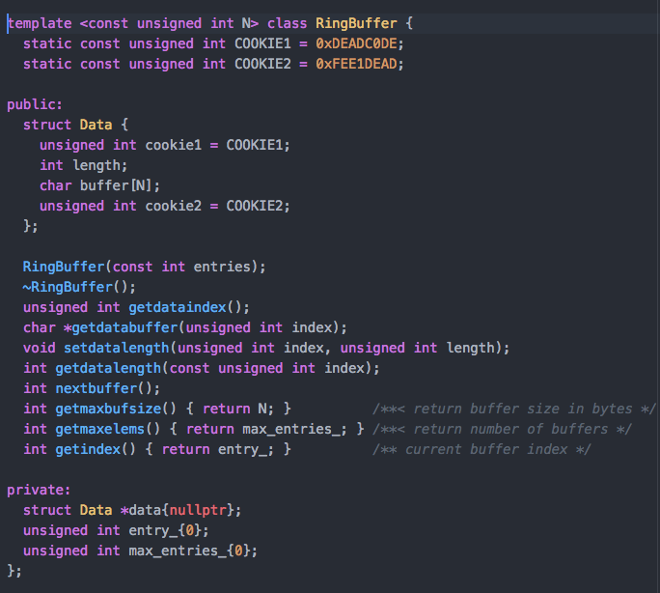
RingBuffer.h

Slide 13
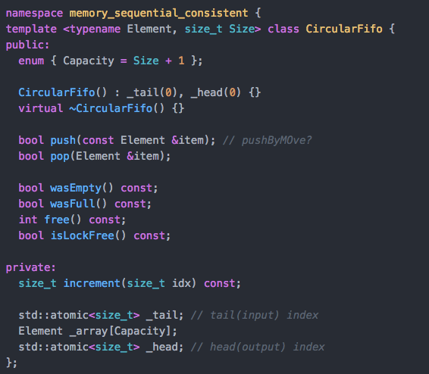
SPSCFifo.h

Slide 14
Producer
Producer
Continuous memory of N buffers of size S
0
1
2
3
4
5
6
7
6
7
Lock less FIFO of N unsigned ints (index)
0
1

Slide 15
Producer
Producer
  idx = getindex() // idx is now 2
Continuous memory of N buffers of size S
0
1
2
3
4
5
6
7
6
7
Lock less FIFO of N unsigned ints (index)
0
1

Slide 16
Producer
Producer
  idx = getindex() // idx is now 2
  buffer = getbufferdata(idx)
  rx = receive(buffer, getmaxbuffersize())
Continuous memory of N buffers of size S
0
1
2
3
4
5
6
7
6
7
Lock less FIFO of N unsigned ints (index)
0
1

Slide 17
Producer
Producer
  idx = getindex() // idx is now 2
  buffer = getbufferdata(idx)
  rx = receive(buffer, getmaxbuffersize())
  setdatalength(rx)
  push(index)
Continuous memory of N buffers of size S
0
1
2
3
4
5
6
7
6
7
Lock less FIFO of N unsigned ints (index)
0
1
2

Slide 18
Producer
Producer
  idx = getindex() // idx is now 2
  buffer = getbufferdata(idx)
  rx = receive(buffer, getmaxbuffersize())
  setdatalength(rx)
  push(index)
  nextbuffer()
Continuous memory of N buffers of size S
0
1
2
3
4
5
6
7
6
7
Lock less FIFO of N unsigned ints (index)
0
1
2

Slide 19
Producer
Producer
  idx = getindex() // idx is now 2
  buffer = getbufferdata(idx)
  rx = receive(buffer, getmaxbuffersize())
  setdatalength(rx)
  push(index)
  nextbuffer()
Consumer
Continuous memory of N buffers of size S
0
1
2
3
4
5
6
7
6
7
Lock less FIFO of N unsigned ints (index)
0
1
2

Slide 20
Consumer
Producer
  idx = getindex() // idx is now 2
  buffer = getbufferdata(idx)
  rx = receive(buffer, getmaxbuffersize())
  setdatalength(rx)
  push(index)
  nextbuffer()
Consumer
  idx = fifo.pop() // idx is now 6
  buffer = getbufferdata(idx)
  createevent(buffer)
Continuous memory of N buffers of size S
0
1
2
3
4
5
6
7
7
0
Lock less FIFO of N unsigned ints (index)
1
2

Slide 21
Current status
Software event processing pipeline
  From System Architecture document
  Current is prototype 2
  Implements Multi Grid demo detector
Data sources
  MG From raw data files or generated
  Transmit as UDP over Ethernet
  Single packets or continuous transmission
Kafka producer
  Buffers event data into 1MB, then transmits
  No timeout

Slide 22
Summary
Working prototype ready to accept real Multi Grid data
Further Information
Event processing software
  https://bitbucket.org/europeanspallationsource/event-processing-sw-experiments.git
Continuous Integration
  https://jenkins.esss.dk/dm/job/event-processing-sw-experiments/
System Architecture
  https://ess-ics.atlassian.net/wiki/display/DMSC/Event+Formation+Files

Slide 23
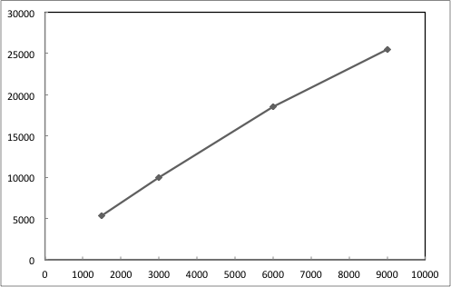
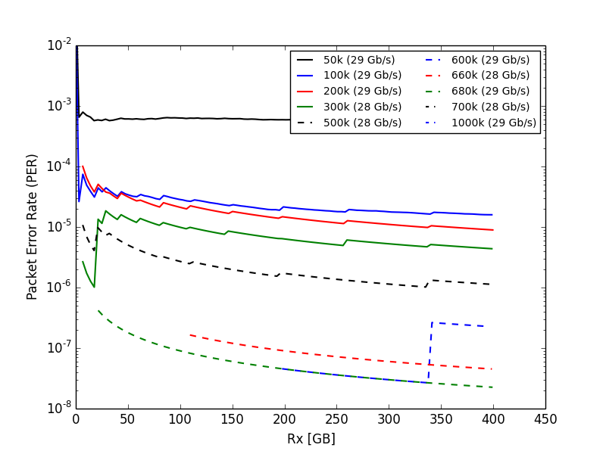
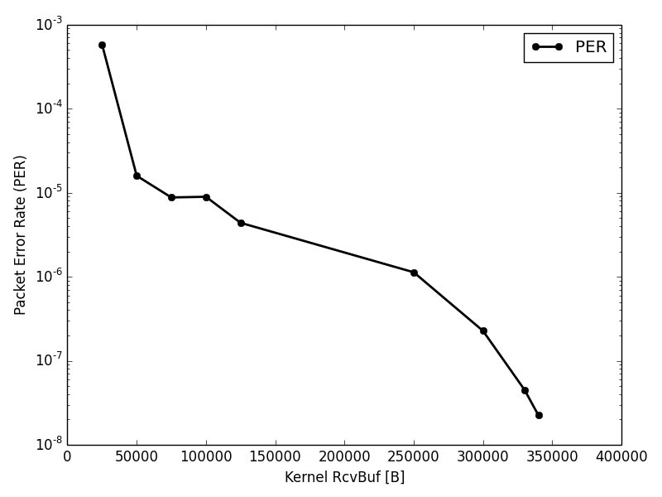
Network Performance
(Ethernet packet) size matters!
  x5 throughput difference
  readout data ‘must’ support jumbo frames
Packet loss happens for UDP
  even on localhost
  Default kernel buffer sizes too small for high performance

Slide 24
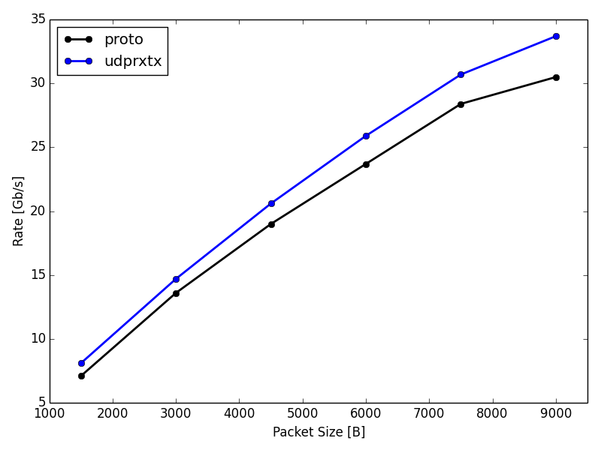
Application Rx Performance
Best current performance (~20M Events/s)
  9K packet sizes
  using time stamp counter (TSC) for time polling
  use thread sleep() when rx fifos are empty
  zero copy architecture (shared memory)
  thread locality
  core affinity

Slide 25
Demo

Slide 26
What to endure
‘Experimental’ setup
Starting the EFU Process
Demonstrate command interface
  TCP Socket Driver
  EFUShell
Demonstrate data streamed from files
  See stats on livestats.py
Demonstrate loadable calibration data
  See effect on livestats.py
Demonstrate monitor view

Slide 27
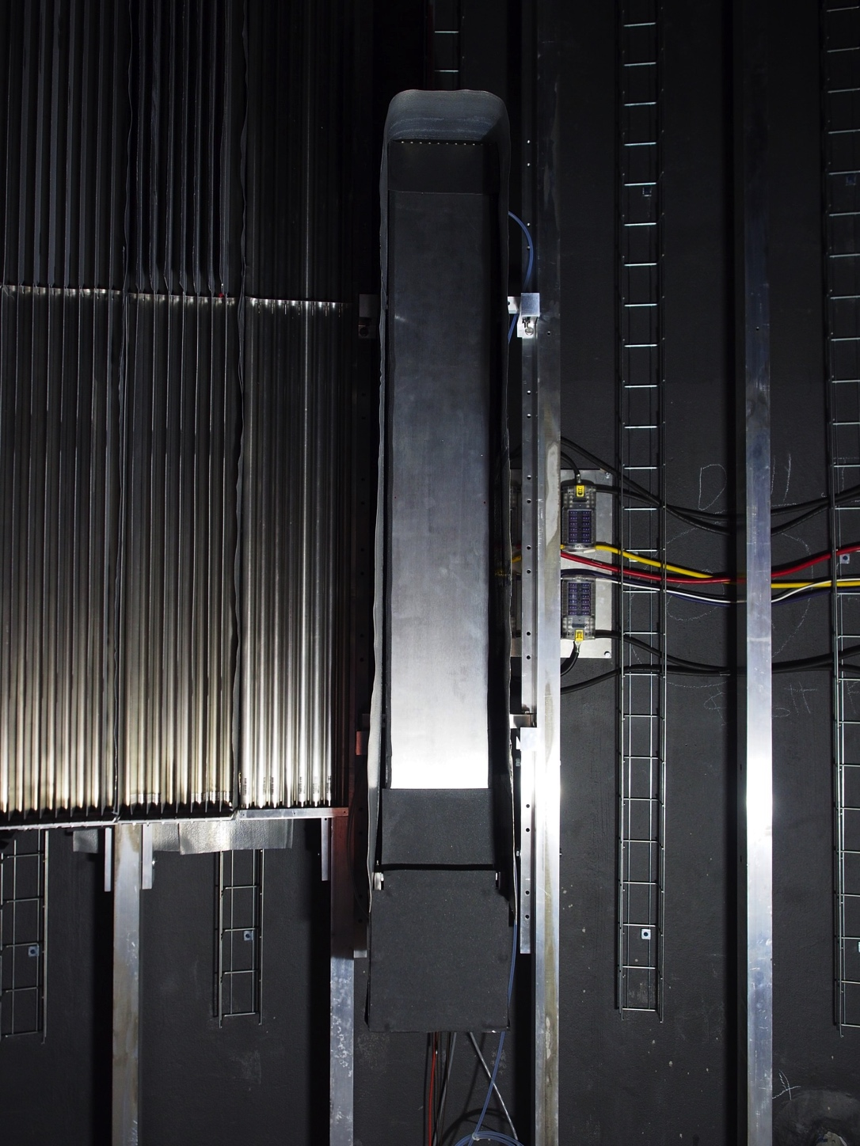
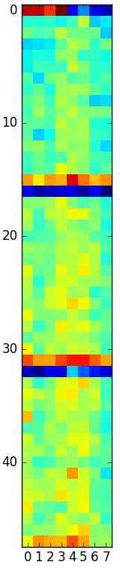

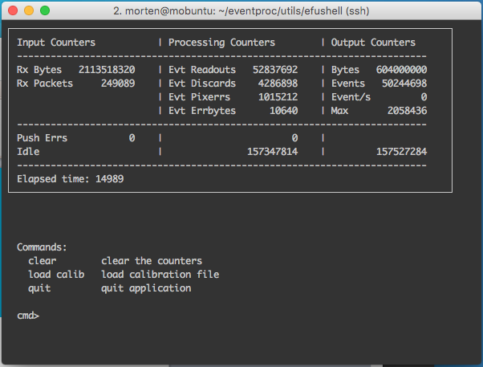
Delayed ‘Live’ Data Monitoring
Detector and readout
Event formation
Aggregation
Detector
Live Monitor
NFS Storage
Raw data streamer
~210.000 raw files
~500M Events
Application Monitoring

Slide 28
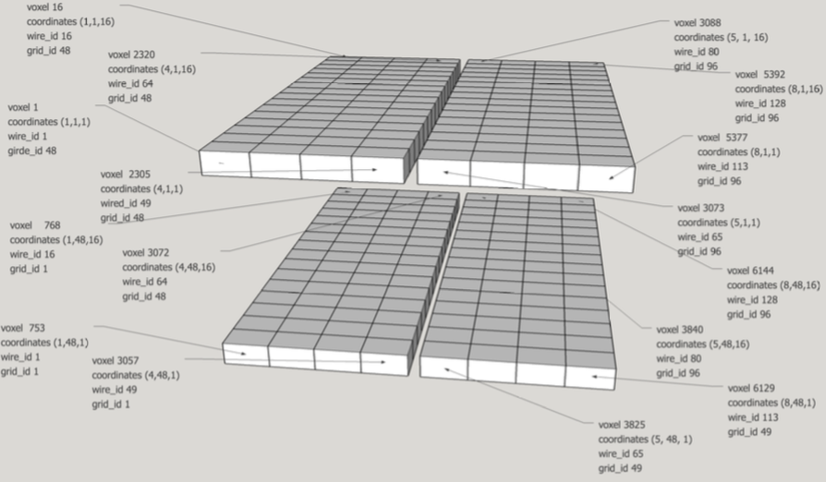
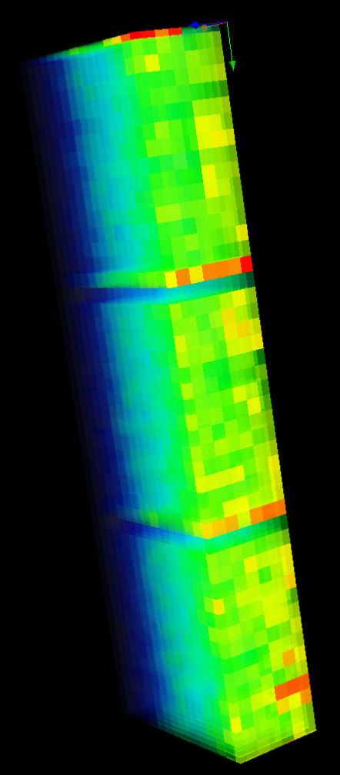
Geometry

Slide 29
Test Setup
Input
  Raw datafiles from SNS experiments
  [login.esss.dk] /nfs/groups/multigrid/data/raw/MG_CNCS/
  Read from NFS and sent over UDP/Ethernet to EFU
Processing
  EFU running as Linux process on my workstation
  Convert raw data to wire and grid id’s
  filter noisy data and invalid events
  convert to agreed geometry conventions
  create events (time, pixel_id)
Output
  Sending events to Kafka broker on my workstation
  Bundled in 1M events

Slide 30
Code Walkthrough

Slide 31
Walkthrough
Adding a new detector/instrument
  Obey the Detector Interface
  Implement pipeline stages as needed
The real code, except trimmed
  removed assert()
  removed statistics counters
  removed TRACES()
  removed periodic printout
  removed empty branches and unused code (caused by above)

Slide 32
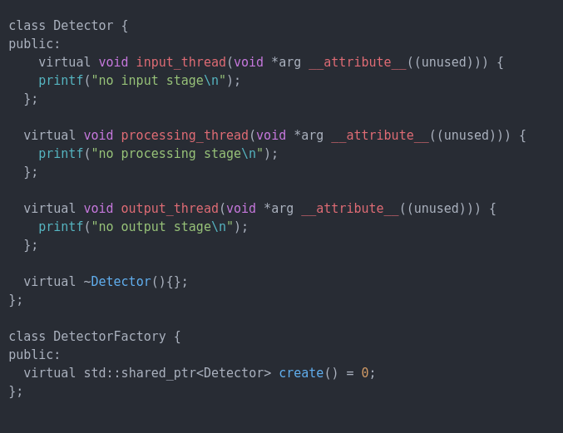
Detector Interface

Slide 33
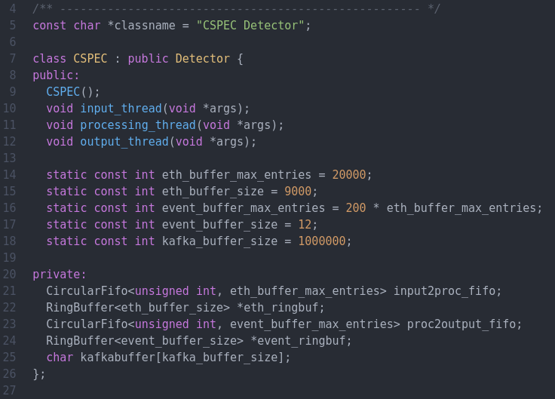
Create Detector

Slide 34
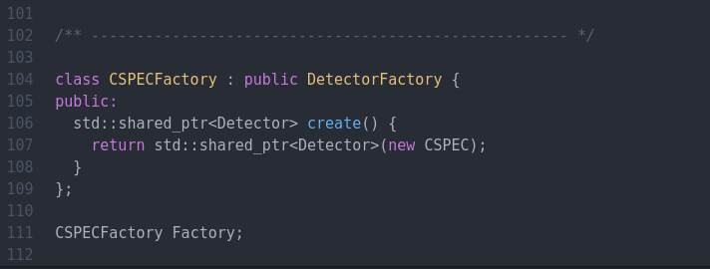
Create Detector

Slide 35
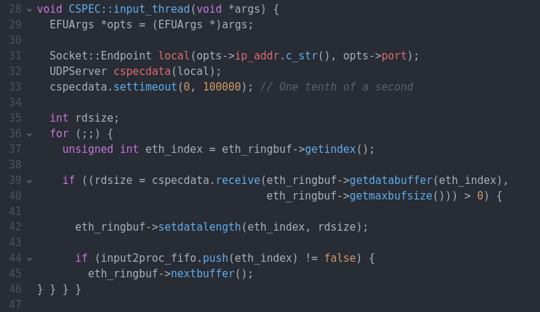
Input Thread

Slide 36
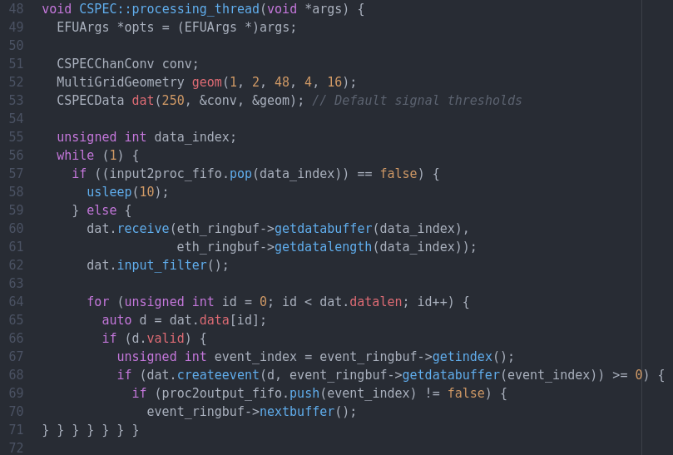
Processing Thread

Slide 37
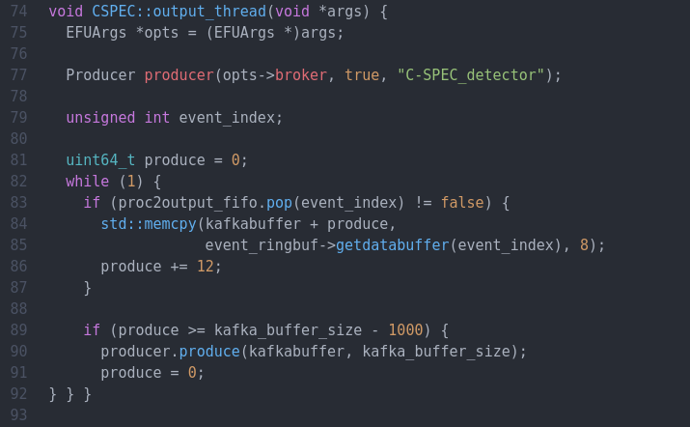
Output Thread

Slide 38
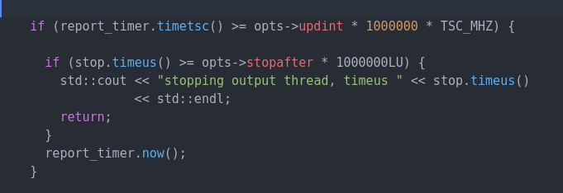
Timers
chrono class is expensive
  using time stamp counter register to determine the need to call std::chrono::high_resolution_clock::now()
  uint64_t rdtsc() (inline assembler)

Slide 39
The End

