Slide 1
Accelerating Processing
Stig Skelboe
Niels Bohr Institute

Slide 2
Outline
GEM detector
Data
  APV25
  VMM
Analysis
  Clustering
  Neutron location
Computer architecture (Intel Core i7)
Parallel computing
  SIMD
  Distributed processing

Slide 3
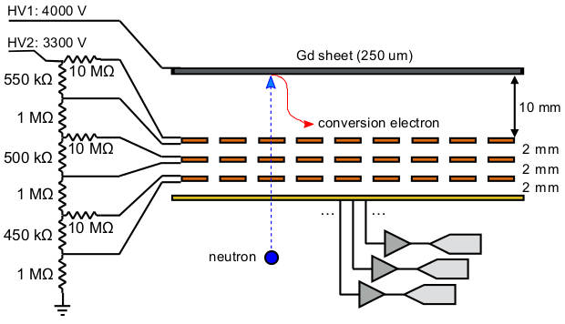
Gas Electron Multiplier (GEM) detector
cathode
.t
Charge from the conversion electrons is collected
on the x and y anode strips with 0.4 mm pitch.
The VMM chip amplifies and detects peak charge
and time for every strip.
Data collection is triggered by a charge pulse on
the lowest GEM copper sheet.
D. Pfeiffer et al. ” First measurements with new high-resolution gadolinium-GEM neutron detectors”, J. Instrumentation, Vol. 11, May 2016.

Slide 4
Data
APV25 data color coded. Shaper filter has impulse response h(t)=t exp(-t/𝝉) where
𝜏=50 ns.
VMM data samples marked by o.
256 x-strip location stored as 16 bit each,
VMM time, 20 bit value stored as 32 bit and
a 10 bit amplitude stored as 16 bit.
A typical event has 50 x-strip samples,
a total of 50 x 8B = 400B
The same for the y-strips.
A typical neutron event requires appr. 800B
25 ns bins
Strip number
Strip 24 above has 3 charge maxima recorded by the APV25 chip.
The VMM chip may record 1, 2 or 3 maxima in this case.
All data from: run_166_Franz_G_3330V_D_3948V_back_2p00A_unf_APZ_280_sca.h5

Slide 5
Clustering
X-strips
Y-strips
Two events recorded at the same time. Large distance between the traces. Maxima at different times.
Two sets of ”equal” charge sums.

Slide 6
Neutron location
X-strips
Y-strips
In more complicated situations the correct location of the neutron may be difficult to determine.

Slide 7
Computer architecture (Intel Core i7)
One core: 2 threads, L1 cache 32kB + 32kB, L2 cache 256kB
Advanced vector extension (AVX-512), 32 ZMM registers, each with 512b,
rich set of parallel instructions operating on ZMM register data
Jim Turley, ”Introduction to Intel Architecture”, White Paper, 2014.

Slide 8
Parallel computing
One thread of one core for a neutron event
Use of vector instructions (AVX) whenever possible
Multicore processors added as necessary
Client/server architecture with the client handling allocation of tasks (neutron event data) and forwarding of results: neutron impact location and time
Scalable architecture

