Slide 1
Gamma Blockers Kick-off Meeting
High level project overview & schedule
Iñigo Alonso
Linac Integration Section
www.europeanspallationsource.se
9 November 2016

Slide 2
Outline
Accelerator Overview
Accelerator Collaboration
High Level Schedule – ACCSYS Project
Civil Construction Status
Installation Schedule Overview
Team Members

Slide 3
Accelerator Overview
Key parameters:
    -2.86 ms pulses
    -2 GeV
    -62.5 mA peak
    -14 Hz
    -Protons (H+)
    -Low losses
    -Minimize energy use
    -Flexible design for mitigation and future upgrades
Design Drivers:
High Average Beam Power
5 MW
High Peak Beam Power
125 MW
High Availability
352.21 MHz
704.42 MHz
2.4 m
4.6 m
3.8 m
39 m
56 m
77 m
179 m
Target
Source
LEBT
RFQ
MEBT
DTL
Spokes
Medium β
High β
HEBT & Contingency
75 keV
3.6 MeV
90 MeV
216 MeV
571 MeV
2000 MeV
First beam at 572 MeV in June 2019
5 MW capacity for 2023

Slide 4



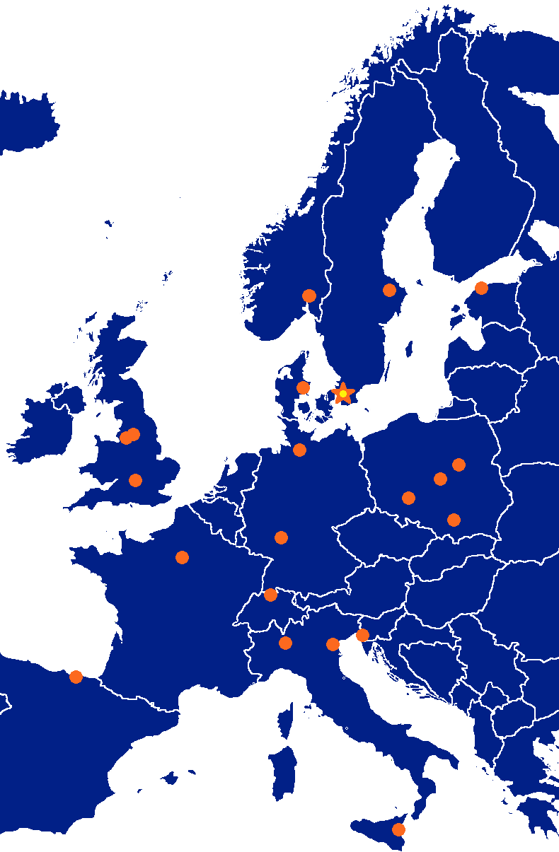



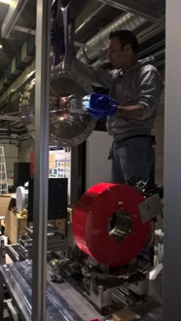




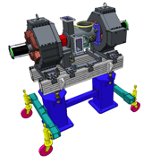


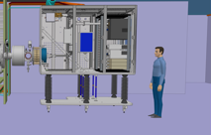



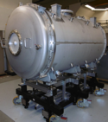
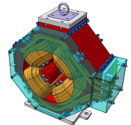

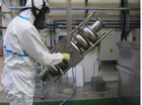

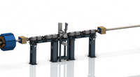





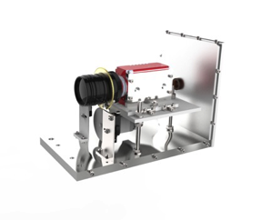
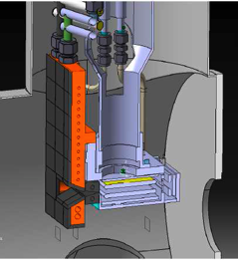
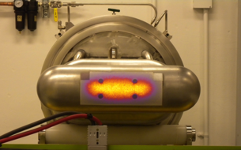

Accelerator Collaboration
352.21 MHz
704.42 MHz
2.4 m
4.6 m
3.8 m
39 m
56 m
77 m
179 m
Target
Source
LEBT
RFQ
MEBT
DTL
Spokes
Medium β
High β
HEBT & Contingency
75 keV
3.6 MeV
90 MeV
216 MeV
571 MeV
2000 MeV

Slide 5
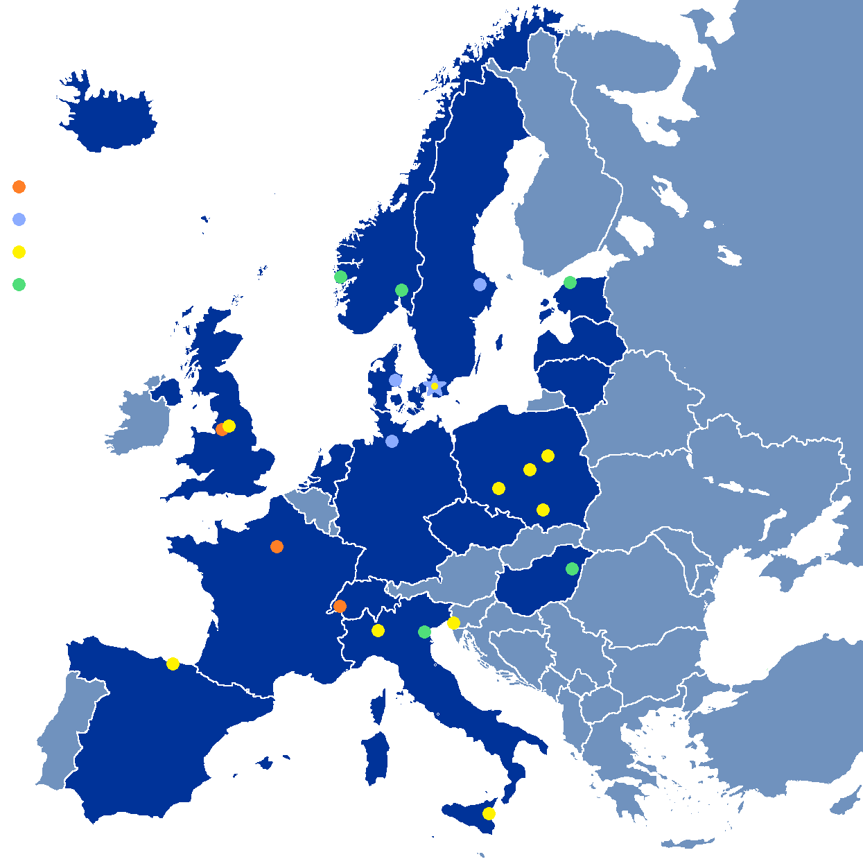
In-Kind Project Turned Into In-House Project
In steady state, all knowledge has been transferred from in-kind partners to ESS in Lund, expertise has been acquired in all areas, technical capabilities for maintenance and repair of all systems have been developed.
In some cases, as for repair of super-conducting cavities and cryomodules, it may take 10 years to reach such capability.
Maintenance of technical expertise is clearly of vital importance.
In-kind (main contributions)
ATOMKI (RF-LPS)
CEA (RFQ, SRF, Diagn)
CNRS (SRF, Cryo distrib)
Daresbury Lab (SRF, Vacuum)
Elettra (RF, Magn, PS, Diagn)
EPFL (Modulators)
ESS-Bilbao (MEBT, RF)
Huddersfield Univ (RF distrib)
IFJ PAN (Installations)
INFN Catania (Source, LEBT)
INFN Legnaro (DTL)
INFN Milan (SRF)
Lodz UT (LLRF)
NCBJ (LLRF, gamma blockers)
Tallinn UT (RF)
Univ Bergen (Seconded staff)
Univ Oslo (Diagn)
Warsaw UT (LLRF)
Wroclaw UT (Cryo distrib)
Paid contracts
Aarhus Univ (Beam delivery)
DESY (Diagn)
Lund Univ (LLRF, RF)
Uppsala Univ (Tests)

Slide 6
High Level Schedule – ACCSYS Project
2016
2017
2018
2019
2020
2021
2022
NCFE
RFI ISRC & LEBT
RFI
MEBT
START RFQ MACHINING
RFI
RFQ
RFI
DTL5
SC LINAC
2 GeV
READY
SPOKE CM
TESTING STARTS
Spoke & Elliptical
cavities and cryomodules
SPOKE & MB CM
PRODUCTION
LAUNCHED
MB CM
TESTING STARTS
1-11 HB CM INSTALLED
12-21 HB CM INSTALLED
SC LINAC
570 MeV
READY
TOSHIBA/CPI/THALES KLYSTRON
PROTOTYPE DELIVERED
TECHNICAL STOP
TECHNICAL STOP
RF
CPI/THALES AND L3 IOT
PROTOTYPES DELIVERED
DECISION IOT OR
KLYSTRON FOR HB LINAC
RF SYSTEM
FOR MB
READY
CDS INSTALLATION
STARTS
Cryogenics
ACCELERATOR
CRYOPLANT
COMM./READY
CDS COMMISSIONED
BEAM COMM. COMPLETED FOR NCFE but DTL5
Commissioning
START RFQ COMMISIONING
BEAM COMM. COMPLETED FOR ISRC-> MEBT
FIRST PROTONS ON TARGET
1370 MeV PROTONS
AVAILABLE
2 GeV PROTONS AVAILABLE

Slide 7
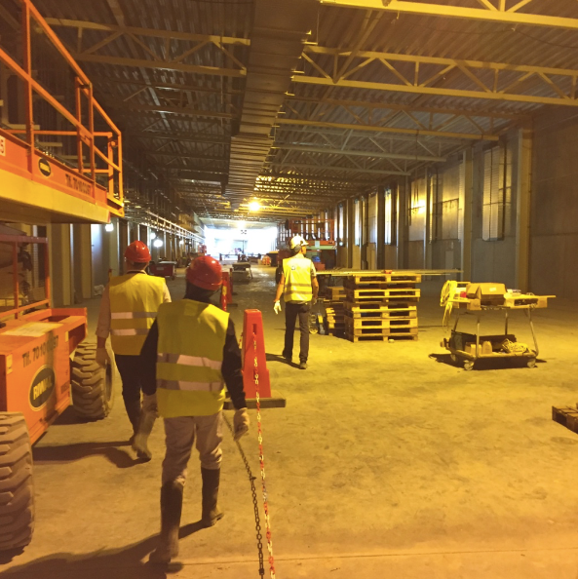
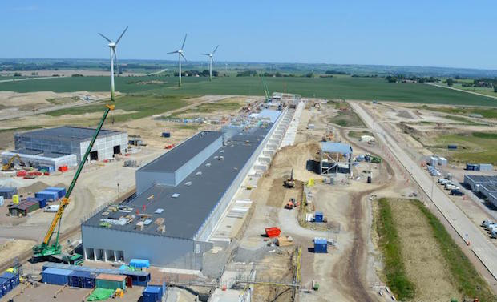
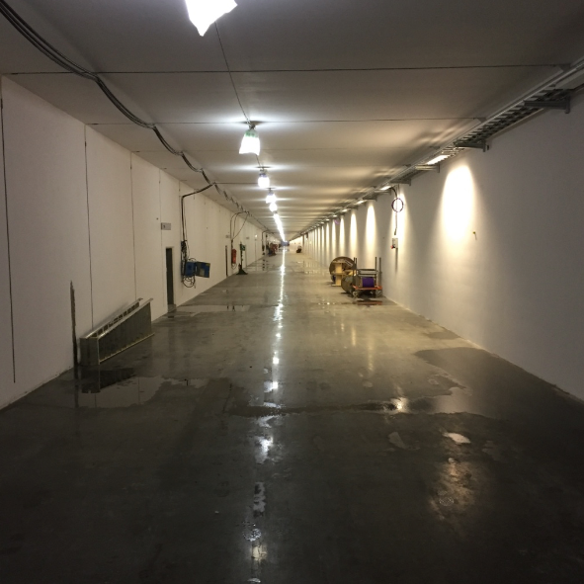
Civil Construction Status
Klystron Gallery
Accelerator Tunnel

Slide 8
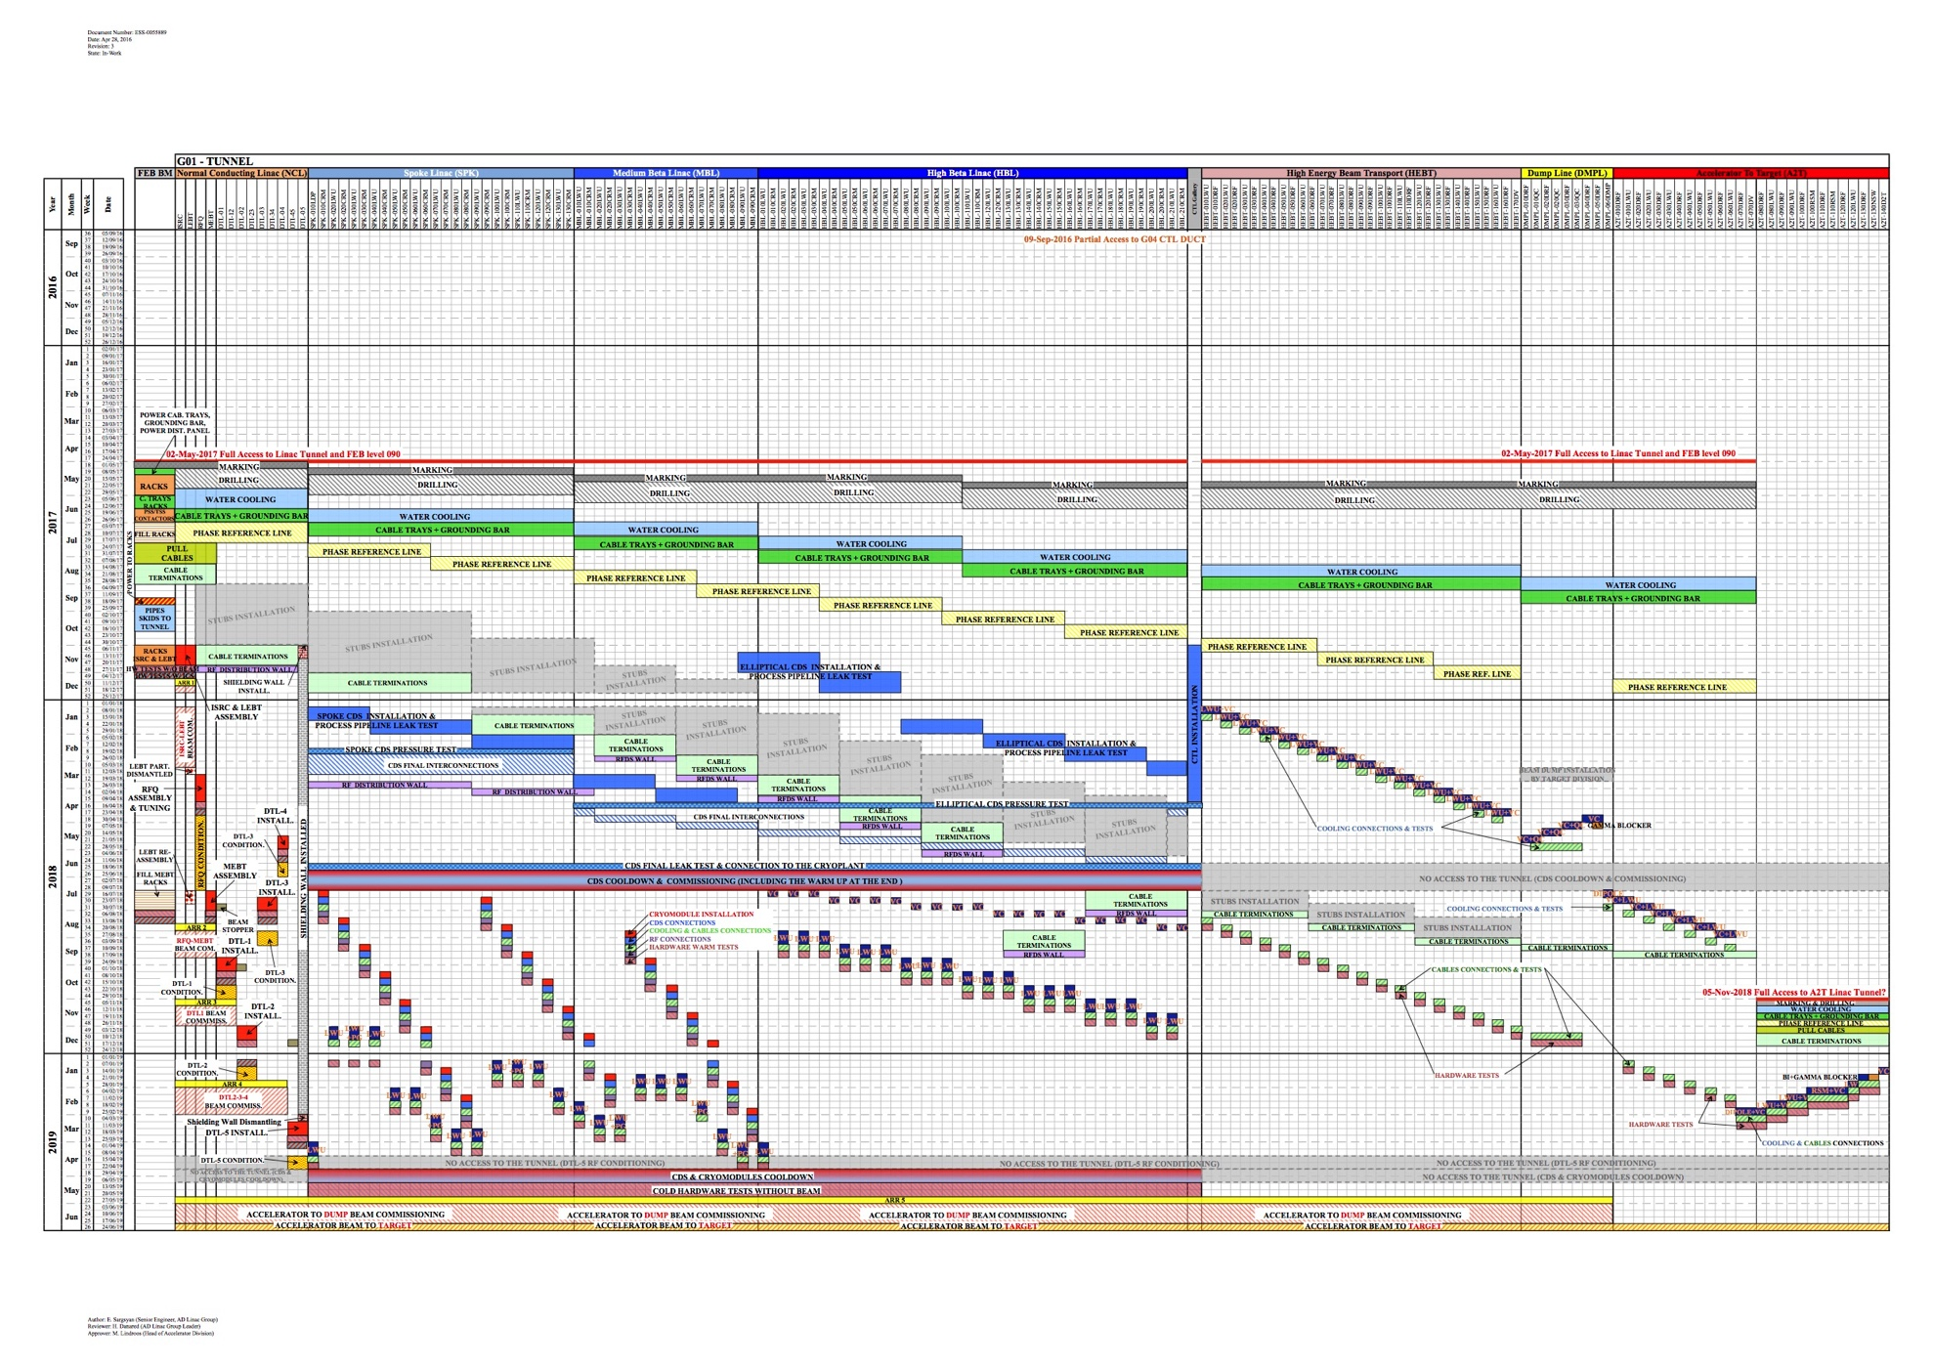
Installation Schedule Overview
Tunnel length
Time
DMPL
A2T
Notes:
Under development

Slide 9
Team Members
Name | Role regarding the Gamma Blockers
Iñigo Alonso Fernandez | Work Unit manager
Stephen Molloy | Integration Section Leader
Lali Tchelidze | Accelerator Safety Group Leader
Timo Korhonen | ICS Chief Engineer
Daniel Piso | ICS Hardware Integration Group Leader
Annika Nordt | Protection Group Leader (MPS)
Stuart Birch | PSS
Fabio Ravelli | Vacuum Engineer
Edgar Sargsyan | Installation Planning
Nick Gazis | Interface to Conventional Facilities
Fabien Rey | Survey and Alignment Group Leader

