Slide 1
Considerations for Gamma Blocker design related to radiation safety
Lali Tchelidze
Group leader
AD Safety and RAMI Group
November 9, 2016

Slide 2
Overview
Hands-on maintenance conditions
ESS Procedure for designing shielding for safety
FTD conversion factors
Report review procedure
Additional requirements from safety point of view

Slide 3
Hands-on maintenance conditions
ESS-0008351 – was defined mainly to support determination of normal operational beam loss limit
Can be interpreted in various ways
Mentions couple values at various distances from a proton beam center-line

Slide 4
Hands-on maintenance conditions
Recommendation is to consider the following as design criteria:
For gamma blocker in the line of target: 100 μSv/h on contact for 5 years of irradiation of target (max 2 GeV, 5 MW beam) and no cool-down
For gamma blocker in the line of beam dump: 100 μSv/h on contact for xx years of irradiation of beam dump (max 2 GeV, 12 kW beam) and no cool-down
Please, provide residual dose rate maps for 0, 1 hour, 4 hours and 1 month of target cool-down times

Slide 5
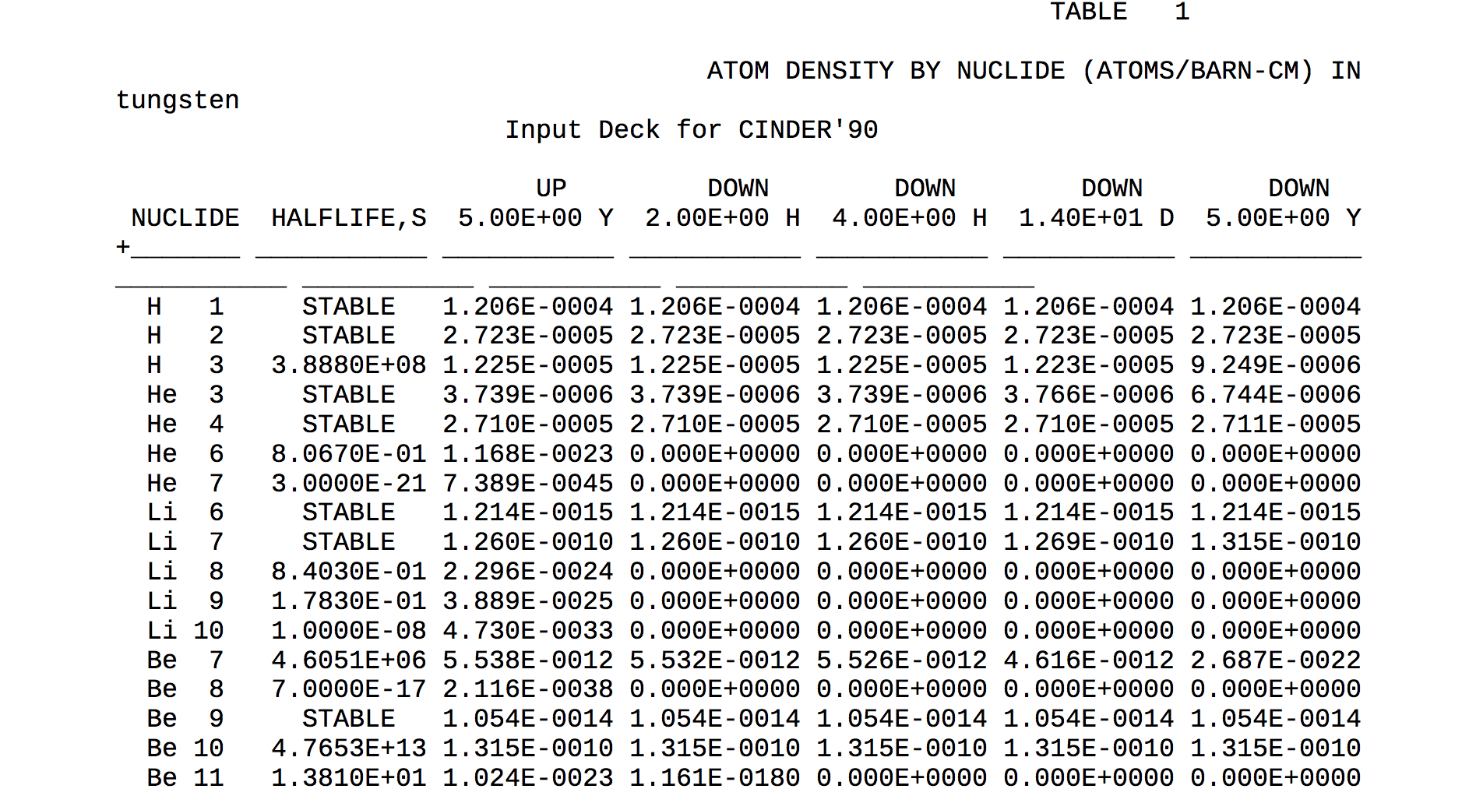
Target activation data
The following data can be provided to support gamma blocker design
Inventory in ESS target after 5 years of irradiation and various cool-down times ESS-0048608
Inventory in ESS tuning beam dump (ASCII file)
It is highly recommended that this data is used, since these are validated and approved calculations

Slide 6
Shielding design procedure
ESS Procedure for designing shielding for safety can be found in ESS-0019931
It is mandatory to follow the procedure for all shielding design, including GB design
Flux-to-dose conversion factors (see ESS-0019931)
Review process
Report needs to be reviewed by a MC expert
Report needs to be approved by ESS Shield Design Coordinator and head of ESH division

Slide 7
Additional requirements
Additional requirements from safety point of view:
Provide a hazard analysis report - a report including identified hazards and evaluation of the likelihood of incidents occurring during operation and maintenance and severity of potential consequences on personnel, as well as the list of control measures). Examples of hazard analysis studies can be made available upon request.

Slide 8
Thank you!

