Slide 1
Gamma Blockers and ESS Machine Protection and Personnel Safety Systems Interfaces
Annika Nordt
Group Leader Protection and Safety Systems / ICS
Lund, Sweden, 2016-11-09

Slide 2
Overview
Introduction to Machine Protection
Introduction to Personnel Safety Systems
Interfaces with Gamma Blockers

Slide 3
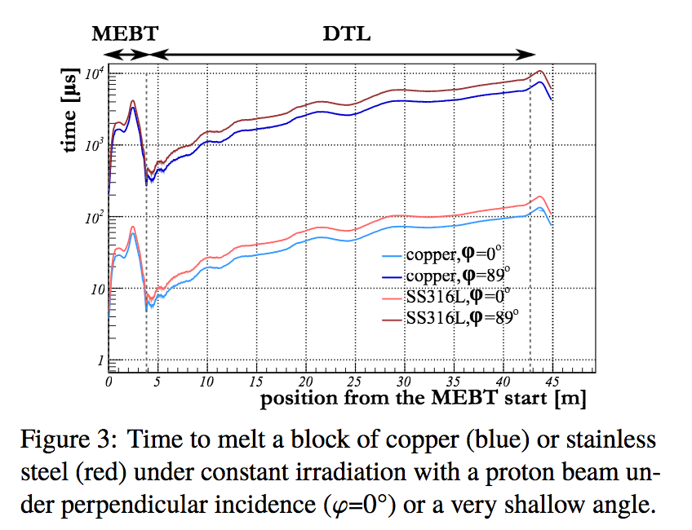
Why Do We Need Machine Protection at ESS?
Because things can melt very quickly…
Worst case scenario: Proton beam impinging perpendicularly on copper or steel.
90° beam impact in the MEBT scrapers is possible.
Fastest reaction time required to stop proton beam is 1-5μs (in the first 50m).
This includes detecting, processing and actual stopping of the proton beam.
It’s a challenging task, requiring fast systems!
Courtesy of I. Kittelmann/ HB2016 THAM6Y01

Slide 4
Machine Protection Introduction
Role of Machine Protection at ESS: [ESS-0035197]
Achieve high operational availability of the ESS facility.
Machine Protection Goals at ESS [ESS-0057251]:
Prevent damage & unnecessary beam-induced activation according to beam and facility availability requirements.
Means to Achieve Machine Protection at ESS
Design and operate systems with high inherent reliability and overall low damage potential.
Minimize mean down time by introducing Interlock systems, maintenance procedures, analysis and recovery tools.

Slide 5
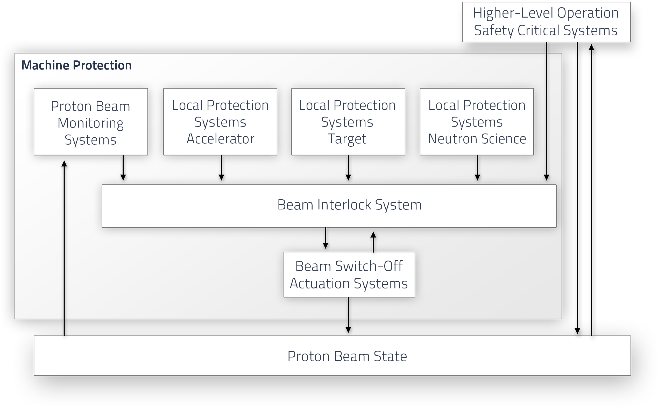
MP-SoS Architectural Framework

Slide 6
Scope, Requirements and Functions for Personnel Safety Systems
Scope
Ensure safe and efficient operation of ESS.
Prevent personnel from being harmed by exposure to prompt ionising radiation.
Mitigate against conventional hazards like cryogen, high voltage, magnetic fields, vacuum, lasers, mechanical motion hazards.
Means to Achieve Personnel Safety at ESS
Controlling access to accelerator, test stands, target and neutron instruments controlled areas and switching OFF hazardous equipment upon entry.
All Personnel Safety Systems will be operational 24/7.
Systems to be operated/maintained/supported/optimized
Safety Interlock system, Access System, Radiation Monitoring Interlock System, ODH Monitoring and Alarm system
These systems span over the accelerator, test stands, target and neutron instruments controlled areas.

Slide 7
Machine Protection Functions Related to Gamma Blockers
Before starting beam operation, we must ensure that all devices intercepting the beam pipe are configured correctly (the gamma blocker must have been moved OUT and must be in parking position).
As soon as its being detected that the gamma blocker is moving IN (whilst beam is ON), beam operation should be stopped
How do we want to implement these functions?

Slide 8
Personnel Safety Functions Related to Gamma Blockers
Before starting maintenance, (potentially) the ESS Radiation Protection Team must ensure that the gamma blocker is in the right position (IN)
Before finalizing a maintenance period, (potentially) the ESS Radiation Protection Team must ensure that the gamma blocker is OUT
As soon as its being detected that the gamma blocker is NOT IN during maintenance, an alarm must be raised
How do we want to implement these functions?
It seems that these functions are not covered in the scope of PSS?

