Slide 1
Introduction to
Integrated Control Systems
Timo Korhonen
ICS
ESS/ICS
Date: 2016-04

Slide 2
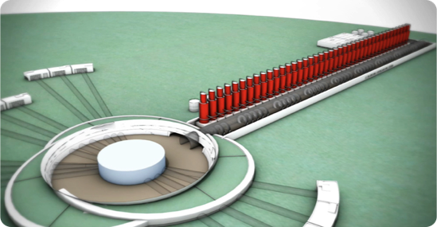
How will ESS work when ready?
2.
A 500 meter long linear accelerator accelerating a proton beam
1.
An ion source producing protons
4.
Neutron beam guides connected to:
5.
22 experiment stations with instruments detecting the neutrons being scattered when hitting the studied sample material.
6.
In Copenhagen - A data management centre providing the data to be further analysed by the researchers
3.
A target station where the proton beam hits a metal which is then releasing neutrons (“spallation”)

Slide 3
What is ICS about?
The ESS Control System is a complex network of hardware, software and configuration databases that integrates the operations of all the various parts of the Accelerator, Target, Instruments and Conventional Facility infrastructures. It is essential for the synchronization and day-to-day running of all the equipment responsible for the production of neutrons for the experimental programs.
For this purpose almost all equipment at the ESS facility is connected to the Integrated Control System
The control system is the ”central nervous system of ESS”
Examples:
  RF systems
  Power supplies for magnets
  Vacuum systems
  Cryogenic equipment
  Site infrastructure (water cooling, etc.)
An estimated 1.5 million
control points will be needed

Slide 4




ICS Work breakdown structure
Work package 01 Management and administration
Work package 02 Software Applications
Work package 03 Software core
Work package 04 Hardware core
Work package 05 Machine protection system
Work package 06 Equipment
Work package 07 Control system infrastructure
Work package 08 Physics
Work package 09 Personnel safety system
Work package 10 Integration - Accelerator
Work package 11 Integration - Target
Work package 12 Integration - Instruments
Work package 13 Integration - Conventional facilities
Work package 14 Test Stands
Work package 20 Installation
Software
Electronics
Infrastructure
Safety & protection

Slide 5
Technology scope for ICS
The span of technical scope and the competencies needed in ICS is enormous
From analog signals to Java-based high-end, big-data GUI:s in high performance, high availability
PLC systems
Mechanics and Safety/protection systems
Systems integration, Installation
Applicatoins (GUI, Web, Services)
Databases
Industrialization, maintenance
EPICS
Availability, performance
Kernel drivers
Development environments
Operating systems (RT)
CSS/Eclipse
Digital communication
Test and validation
PCB, packaging
Analog electronics
Test and validation
Digital electronics
FPGA firmware
Electronics hardware
Software
PLC
Mechanics
Safety and protection

Slide 6
The ICS Handbook
All essential standards and systems provided by ICS are described in the ICS Handbook
  A collection of the most essential standards and services of ICS
  Contains references to more details
  Still a draft but essentially complete
  Revised and approved version targeted by end of 2016
  Will be updated semi-annually
  CHESS: ESS-0067637
    Please ask me if you have trouble accessing it, or have any questions

Slide 7
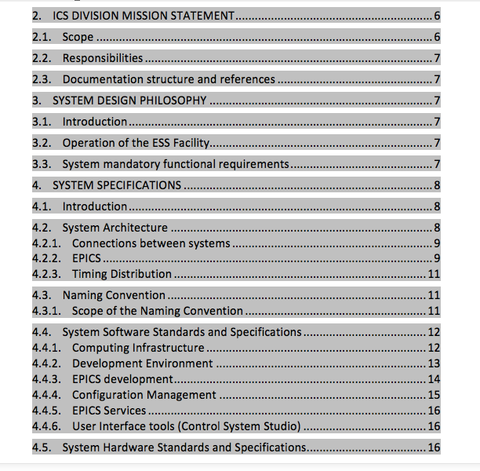
Contents #1
Overview of central requirements
System architecture description
Naming convention
Software standards
Computing infrastructure
User Interface tools

Slide 8
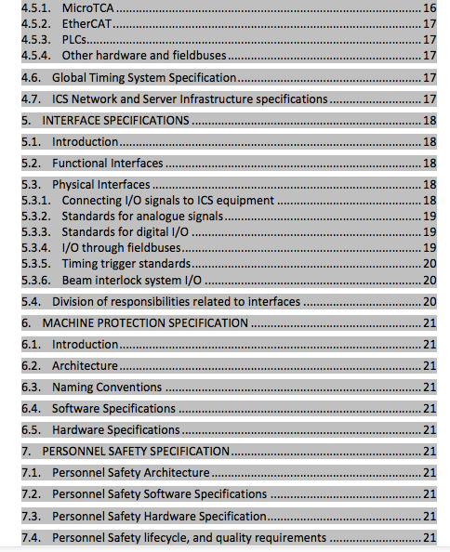
Contents #2
Hardware standards
Timing system description
System interfaces
  Functional
  Hardware
Machine protection standards
  Architecture
  Interfaces
Personnel Safety System
  Architecture, SW, HW

Slide 9
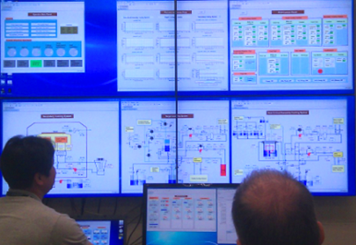
ICS SOFTWARE ACTIVITIES

Slide 10
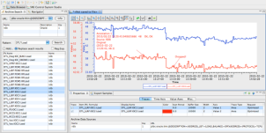
Software team scope description
Controls configuration tools
  Controls Configuration Database (CCDB)
  Naming Server for naming convention
  Cable Database (CDB)
  IOC Factory
  CS Entry
  Role Based Access Control (RBAC)
Clients
  Alarm Handling
  E-logbook
  Archiving System
  Save, Compare & Restore
  Scenario management
  GUI/HMI (Control System Studio)
Core controls software
  Development/contributions to core EPICS
  Timing applications
  Post-mortem diagnostics
Physics modelling
  Open XAL
  ESS Linac Simulator
  Beam Physics Applications
Operation tools – Scripting frameworks
  iPython
  Scripting Execution Environment
  Macroserver
Software development environment
  Vagrant for virtualization
  Ansible for automation of deployment and configuration of our software infrastructure
  Jenkins for continuous integration support

Slide 11
ICS Hardware platforms

Slide 12


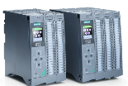
Three layer strategy - control systems at ESS
Signal speed
A custom made microTCA board with a powerful FPGA and a CPU. A FPGA framework constitutes the development environment. The CPU runs EPICS
ICS has adopted a three layer strategy for implementing the control system based on signal speed
  A custom made platform based on microTCA for applications with data acquisition exceeding 100 kHz
  The CPU will run EPICS and the FPGA will have a complete application development environment
  For slower signals, EtherCAT will be used as a real-time fieldbus with good price/performance ratio
  Synchronization and event information are key for applications where a full custom platform solution would be too costly
  Low speed signals are handled with commercially available PLC systems from Siemens
  This is a cost-effective solution that addresses ESS reliability and maintainability requirements
  The PLC:s will be connected to EPICS for further integration into the control system
10 MHz
1 MHz
100 kHz
Electronic front-end platform
10 kHz
1 kHz
EtherCAT I/O modules that are connected to commercial or open-source EtherCAT master controllers which are in turn connected to the EPICS based control system
100 Hz
EtherCAT
10 Hz
Slower signals are handled by industrial automation (PLC) for reliability and cost reasons. The standardized platform for ESS applications comes from Siemens
1 Hz
0.1 Hz
Industrial automation (PLC)

Slide 13
Functions
The ESS timing system (aka event system) can:
Distribute synchronous triggers to a (very) large number of devices
  Triggers can be pulses, electrical or optical, with different properties that can be programmed at the receiving end
  Triggers can also be software, triggering some action in the IOC (Control Box)
    By “processing” EPICS channels that read out data, write values, calculate, whatever the IOC is able to do. Can also be non-EPICS actions.
Distribute (limited amounts of) data to many receivers synchronously and simultaneously
  This happens in parallel to the trigger distribution, no effect on accuracy.
  Limited amount = 2 kilobytes in one transmission. The raw speed depends on setup but can be up to 125 MB/sec (even faster in the ESS generation hardware)
  A single transmission takes some microseconds (~2 us for the raw transmission)
Distribute synchronous timestamps (long story to explain how this works)
Generate (programmable) sequences of triggers (events), RF synchronized
Accept asynchronous inputs to generate events
Synchronize to an external input trigger with optional phase adjustment
And many more things…(distribute clock signals, take in interlock inputs,…)

Slide 14
Structure of the system
RF Generator
88 MHz
Master Event Generator
fanout
Event
receiver
Event
receiver
fanout
Event
receiver
Event
receiver
Triggers
Software synch (IRQ)
Timestamps
Data
Control & setup
Event
receiver
Event
receiver
Event
receiver
Event
receiver
Fan-out system can (and will) have many levels. Synchronization accuracy will not be affected by how many levels there are (assuming the latest generation fanout system)
The (accelerator) synchronization frequency (of 88 MHz) will be fed into the master event generator and used as the system clock. Downstream will be synchronized to that.
The 14 Hz operating frequency will be generated by downconversion from RF in the event generator
Events and (limited amounts of) data can also flow upstream (optionally)
Notes:
Remember: eye pattern
14 Hz will be generated internally in the EVG. De facto decision.

Slide 15
Control SYSTEM
INFRASTRUCTURE

Slide 16
Control system infrastructure
The scope of this work package is to design, develop and procure the IT infrastructure required for the Control System to operate
A centralized ESS Control Room, which allows the entire facility to be controlled from the same location
Operations consoles, servers and file storage required for operation
Networks between IO Controllers, Timing system units, Control Room, Data Centre and other control equipment
Efforts and material required for connecting devices to the ICS

Slide 17
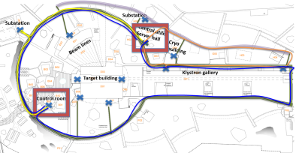
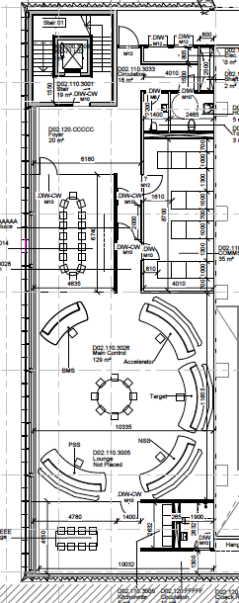
Control system infrastructure

Slide 18
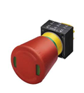
SAFETY AND PROTECTION

Slide 19
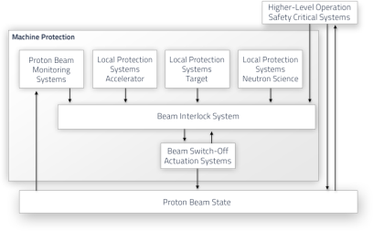
Personnel safety and Machine protection
Machine protection shall prevent and mitigate damage to the machine in accordance with beam and facility related availability requirements
Machine protection shall protect the machine from unnecessary beam-induced activation having a potential to cause long-term damage to the machine or increase maintenance times
The Personnel safety system shall prevent and mitigate any risk for damage or danger to personnel as identified by risk analyses and assessments
The Personnel safety system shall be designed and implemented in compliance with safety standards such as IEC61508

Slide 20
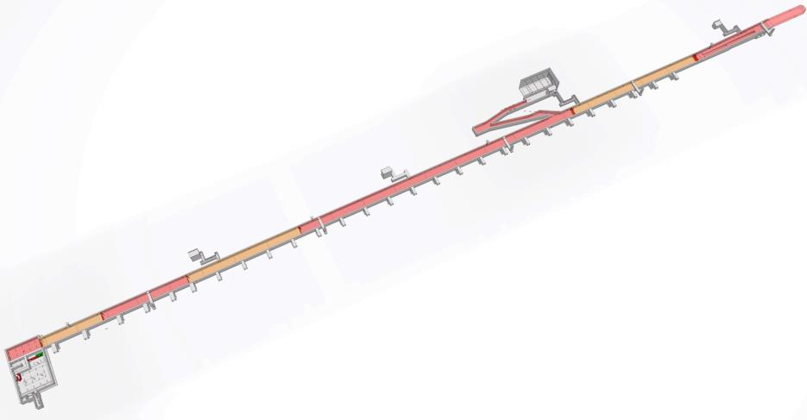
Personnel Safety System
PSS is nearing design completion and implementation of subsystems has started.
Commissioning in stages for the Accelerator PSS:
ZONE 7
ZONE 6
ZONE 5
ZONE 4
Zone 1 - Proton Source, LEBT, RFQ, MEBT
Zone 2 - DTL’s
ZONE 3
ZONE 2
PSS 1. [Zone 1 and 2] Fully Commissioned and validated in line with accelerator programme
ZONE 1
PSS 2. [remaining zones] Fully commissioned and validated by October 2017.

Slide 21
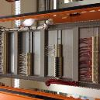
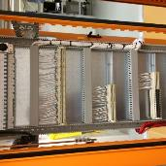
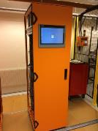
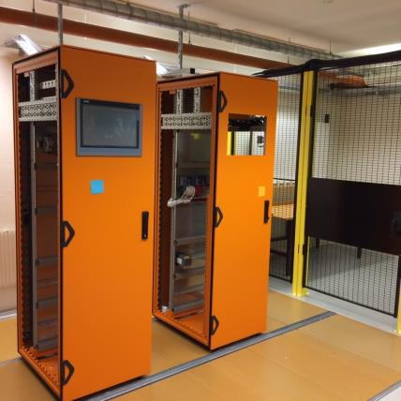
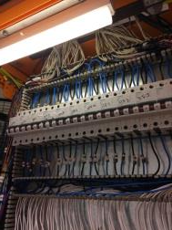
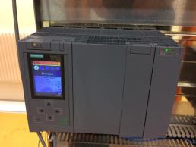
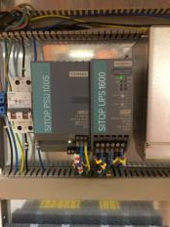
PSS Test Stand
System should be ready for a PSS PDR in mid June 2016.

Slide 22
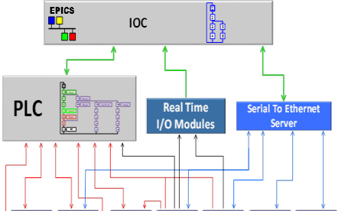
Integration ACTIVITIES

Slide 23
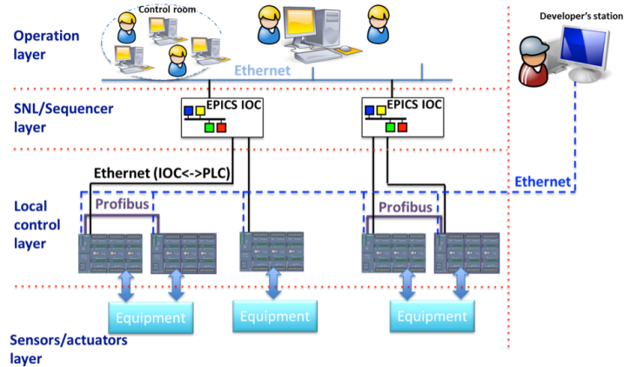
Integration overview
The Control System itself is a distributed system that is organized in multiple layers. The ICS control strategy is based in EPICS in order to provide monitoring and operational capabilities for the plant.

Slide 24
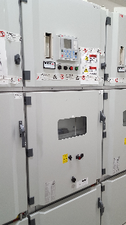
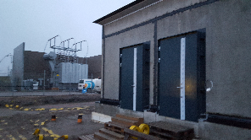
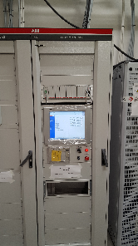
Conventional Facilities Integration
CF provides ICS the detailed design of the buildings, regarding I&C, enabling ICS to start the integration activities.
CF and ICS agree on when it is possible to access into the buildings to setup the control infrastructure.
  Ideally, ICS should work along with CF contractors while on-site.
H05 CF-ICS interface design is under review.
The control system will be deployed soon.

Slide 25
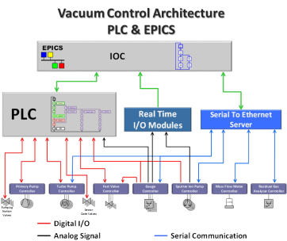
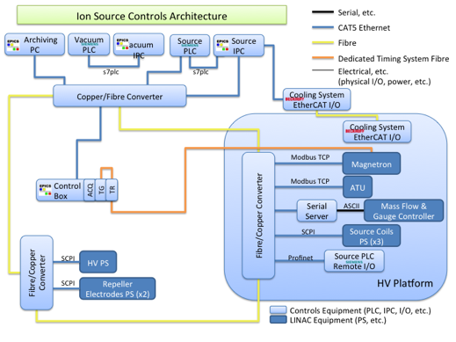
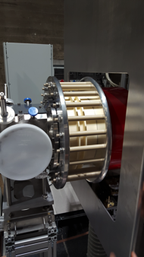
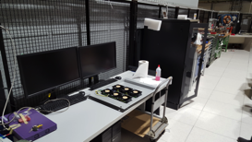
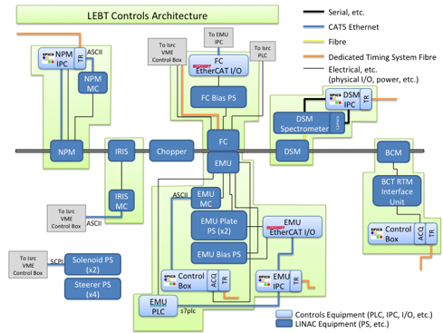
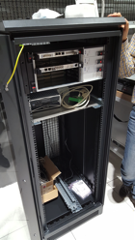
Accelerator Integration

Slide 26
Target Integration

Slide 27
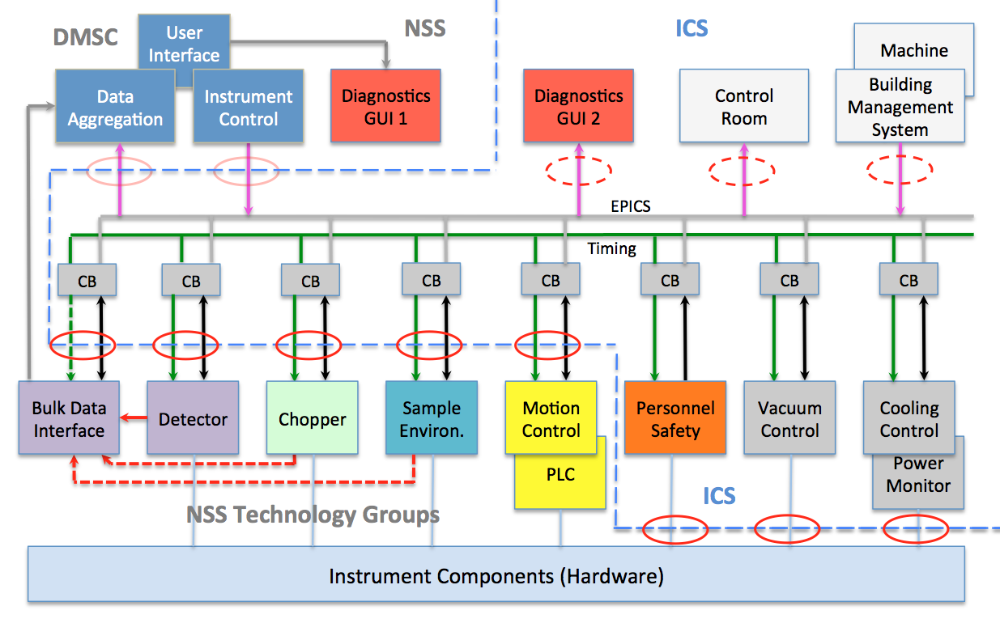
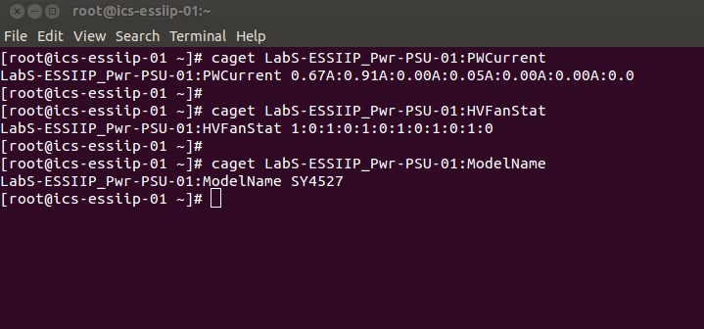
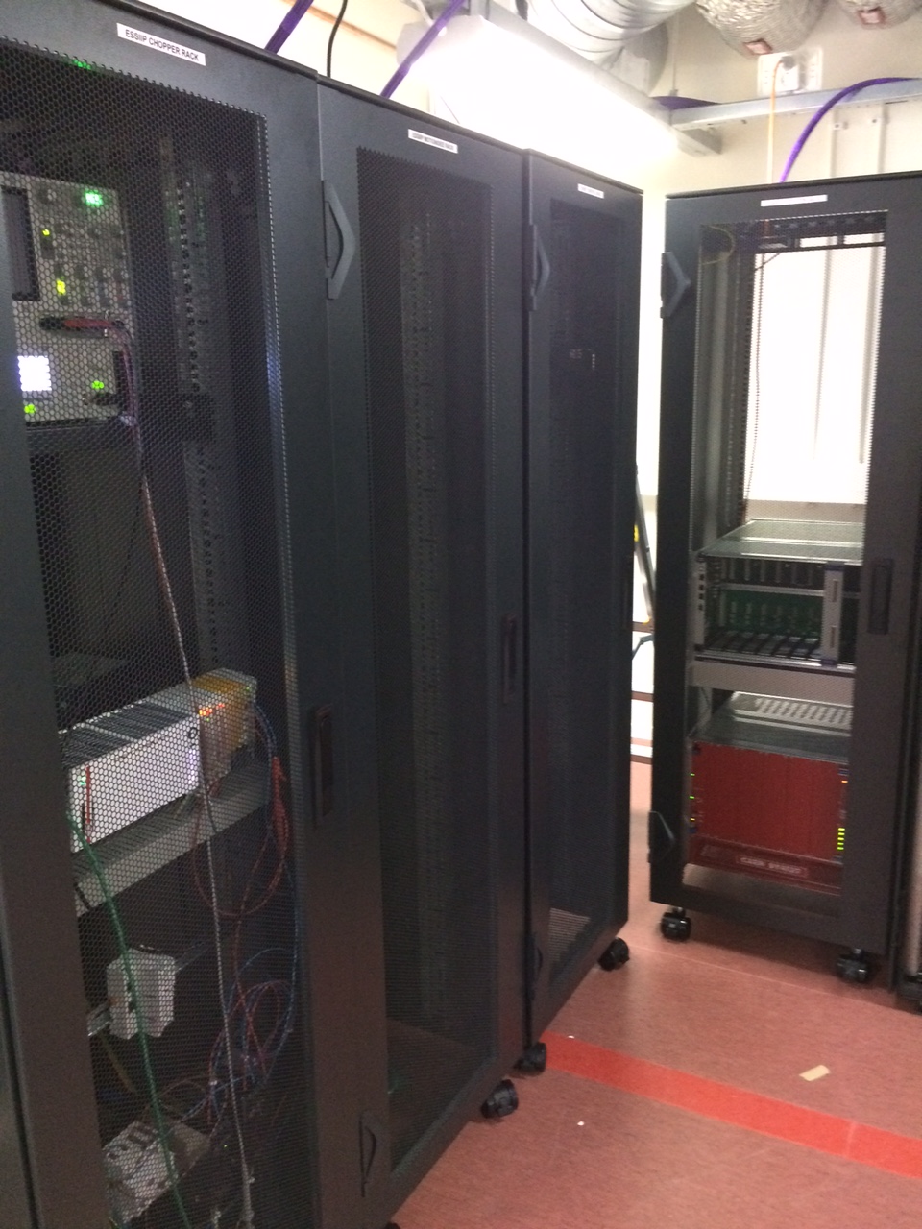
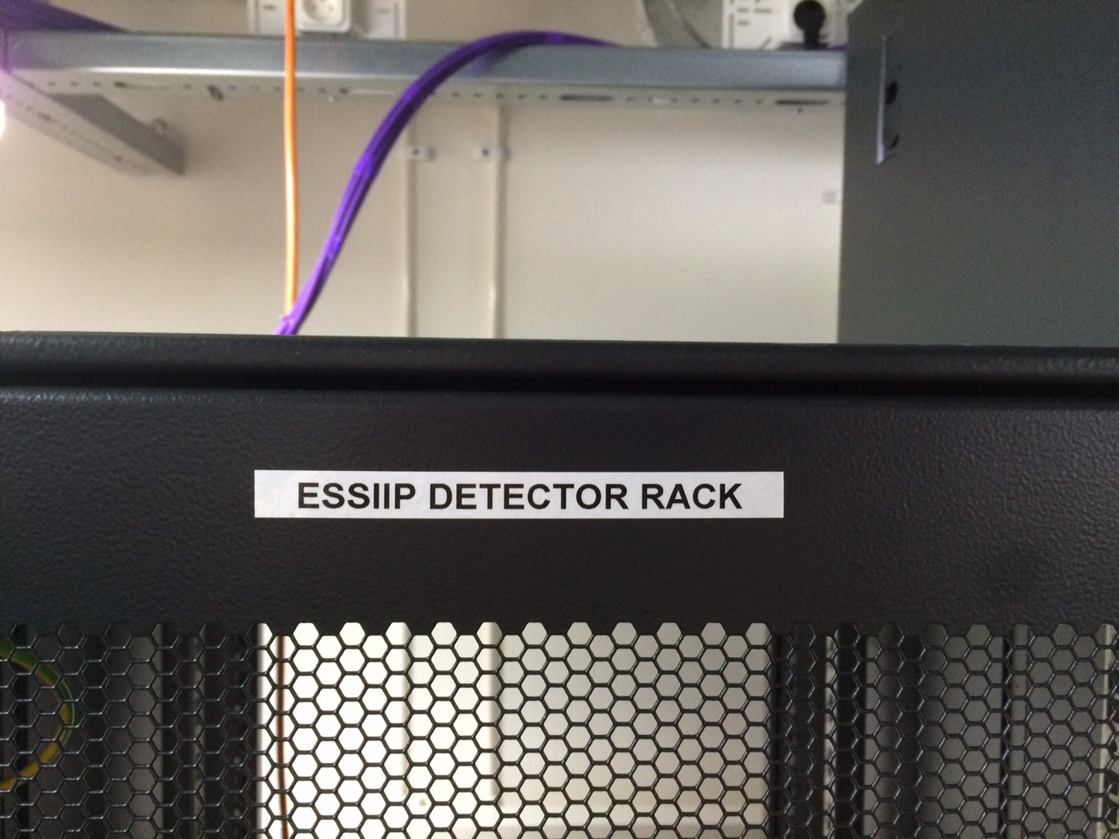
Instruments Integration
ESSIIP is a lab project to integrate real equipment from NSS technology groups (Detectors, Motion, Sample Environment, Choppers) into ICS control system.
Full vertical integration from PLCs through DMSC Experiment Control Software.
Provides an environment to facilitate integrated development for all groups.

Slide 28
Thank you!

