Slide 1
Challenges and Deadlines for Production
Marcin Wojciechowski Nov. 09, 2016

Slide 2
Gamma Blocker overview
GB core:
Stainless steel block, ø200x200 [mm]
Two secure positions: on-axis and off-axis
Functional elements:
Vacuum chamber
Beamline flanges
Positioning device
Support

Slide 3
Gamma Blocker overview
Vacuum chamber
Pressurized UHV-class vessel
Beamline flanges
Compatible with beamline dimensions, UHV compatible
Positioning device
Manual operation,
Electric/pneumatic actuator
Self locking (forces: gravity, vacuum)
UHV compatible: sealed with welded bellow

Slide 4
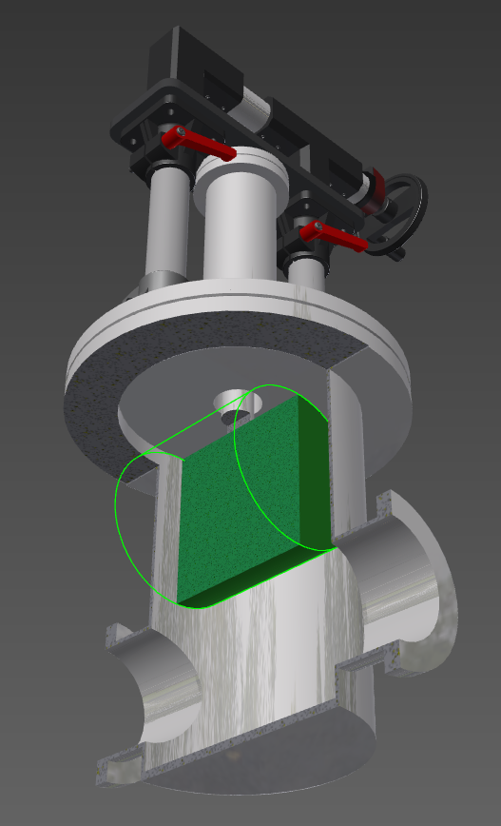
Gamma Blocker Proposed solution:
Cylindrical vacuum chamber, with two CF DN160 ports for beamline
DN350, CF type flange mounted positioning module
Welded bellow
Industry-standard linear motion system
Trapesoidal thread and nut based
Manually driven
Position indication
Independent position locking
Outline: max 1m from axis

Slide 5
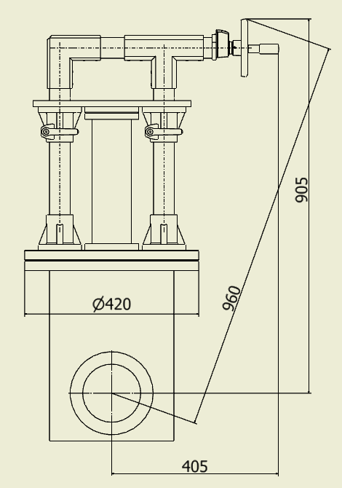
Gamma Blocker Proposed solution:
Cylindrical vacuum chamber, with two CF DN160 ports for beamline
DN350, CF type flange mounted positioning module
Welded bellow
Industry-standard linear motion system
Trapesoidal thread and nut based
Manually driven
Position indication
Independent position locking
Outline: max 1m from axis

Slide 6
Gamma Blocker challenges:
Keeping the schedule in preliminary stage
Recalculation of doses
Changes in construction idea
Additional interfaces to MPS/PPS
Requirements on actuator materials (radhard)

Slide 7
Gamma Blocker production schedule & deadlines:
KickOff
Preliminary Design
2016.12.09
Preliminary Design Report
2016.12.30
Detailed Design
2017.03.31
Purchases
2017.09.29
Critical Design Report
2017.04.21
Production & deliveries
2018.01.31
Factory tests
2018.03.09
FAT Report
2018.03.30
GB Facility Elements delivery
2018.04.29
SAT Report
2018.06.01
Installation Readiness Report
2018.11.30
Final assembly
2018.02.14
Note: deadlines for NCBJ

Slide 8
Gamma Blocker workflow:
Machining and assembly @NCBJ
Purchases of standard/prefabricated components
UHV components
Positioning devices
Support components

Slide 9
NCBJ experience:
Production:
Accelerators:
Small machines for medicine, industry and science (i.e. GBAR)
Large machine accelerating cavities (PIMS modules for Linac4)
Components for nuclear reactor Maria @NCBJ (i.e. for cooling systems)
Nuclear medicine facilities equipment (bunker doors, treatment tables)

Slide 10
NCBJ resources:
CNC milling/turning centres
WaterJet cutting machine
Sheet metal bending press
Welding facility
Clean rooms
Vacuum ovens
Chemical treatment facility
Precision welding facility
Quality control witch 3D geometry measurement
Vacuum testing facility

