Slide 1
Cryogenics at the European Spallation Source
Target Project Work Unit 12.3.9
Target Moderator Cryoplant (TMCP)
John Jurns
TMCP Project Engineer
www.europeanspallationsource.se
April 6, 2017

Slide 2
Outline
System Overview
  1.1 Partners
  1.2 Technical main figures
  1.3 Physical location, interfaces
Status
  2.1 Overall schedule
  2.2 Reviews
  2.3 Installation and commissioning plan
  2.4 Risks and mitigation plan
Summary

Slide 3























1.1 Target cryogenic system partners
Participants –
Target moderator cryogenic hydrogen cooling system contributed by in-kind partners from Germany
Target helium cryoplant supplied under contract with Linde Kryotechnik AG

Slide 4
1.2 Target Cryogenic Systems Overview
Pure Helium
Gas Storage
Standalone Helium Purifier
Helium Recovery System
  Target Moderator Cryoplant (TMCP) – Provides cooling to the H₂/He heat exchanger to remove heat from the hydrogen circuit. He circuit operates at approximately 15 K and 2.1 MPa.
  Cryogenic Moderator System (CMS) – Cryogenic hydrogen system that circulates sub cooled liquid hydrogen to cold moderators, and removes heat through a heat exchanger to a cold helium circuit
  Cold Moderators – Cryogenic hydrogen moderators use sub cooled liquid hydrogen at 17 K and 1.1 MPa to reduce the energy of the neutrons
Target Moderator
Cryoplant
Accelerator
Cryoplant
20 m³ LHe Tank
5 m³
LHe Tank
Test & Instrument Cryoplant
Target Cryodistribution System
LHe Mobile Dewars
Test Stand Cryodistribution System
Cryodistribution System for Elliptical Linac
Cryodistribution System for
Spoke Linac
LN2 Storage Tanks
Hydrogen Circulation Box
Elliptical
Cryomodules
Spoke
Cryomodules
LN2 Mobile Dewars
Instruments & Experiments
Test Stand Lund 2
Hydrogen Moderator
Notes:
ACCP: 3kW @ 2K, 11kW @ 40K, 270 l/h Liquefaction → special plant, power consumption in MW range, big industrial compressors, sophisticated CC system
TICP: 76W @ 2K, 420W @ 40K, 6 l/h Liquefaction → plant well in the standard range
TMCP: 32kW @ 15-20K → very large again, some challenges but not terribly sophisticated process, compared to ACCP
Large and sophisticated cryo-distribution system for all plants and their consumers

Slide 5
1.2 TMCP system overview – function and features
  Primary Functions
To remove heat from CMS hydrogen circuit
  Operational Functions
Circulate cold helium through Cryogenic Transfer Line (CTL)
Operate between maximum and minimum heat loads
Function efficiently under defined operational modes
Manage TMCP helium inventory
Features of the TMCP
High maximum heat load: 30 kW at 15 K
Wide range of dynamic heat loads: 5-30 kW
6 years from 1st protons on target to full power operation
Multiple operating modes
  Steady state – 15-100% of capacity
  Transient – Cool down and warm up
  Switching – Short term fast changes

Slide 6
1.2 TMCP system overview – function and features
3
He cryoplant capacity | 30.3 kW @ 15K
He mass flow rate | 1125 g/s
H₂ mass flow rate | ~ 1000 g/s
1
2
Closed loop modified Brayton cycle

Slide 7
1.2 TMCP system overview – components
Helium buffers with “low” and “high” pressure region
2 parallel screw compressors
2 parallel expansion turbines
Cryogenic Transfer Line
Jumper spool box
Hydrogen CMS cryostat
300 K
21K
15K

Slide 8
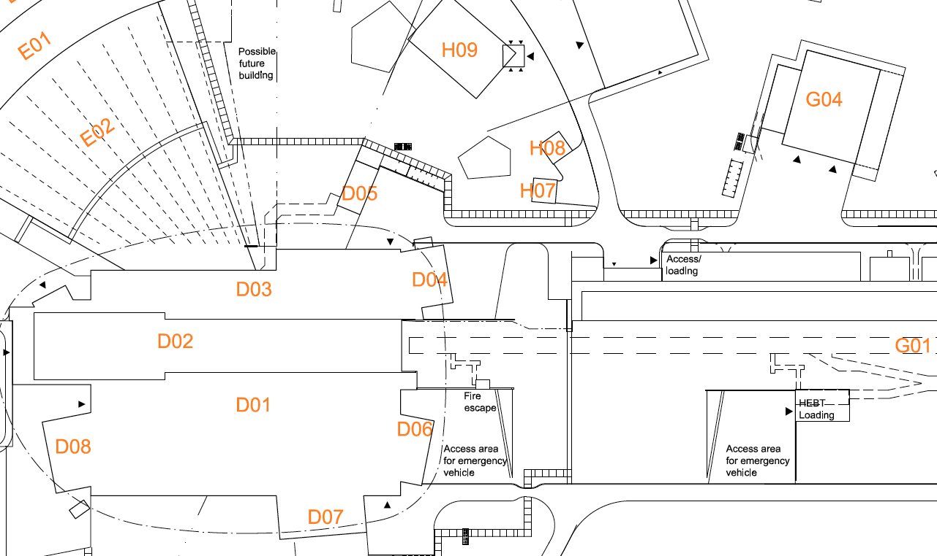
1.3 Integrated Target cryogenic system overview – location
Underground duct from cold box room to D04 basement
Cryogenic Helium lines from TMCP to CMS, (2) VJ pipes, DN80/150
TMCP WCS
Pipe routing in D04, D02 90 / 100 levels, then vertical rise to D02 150 level
Hydrogen cryostat room 150 level D02
Cold box room
G02
TMCP Cold box

Slide 9
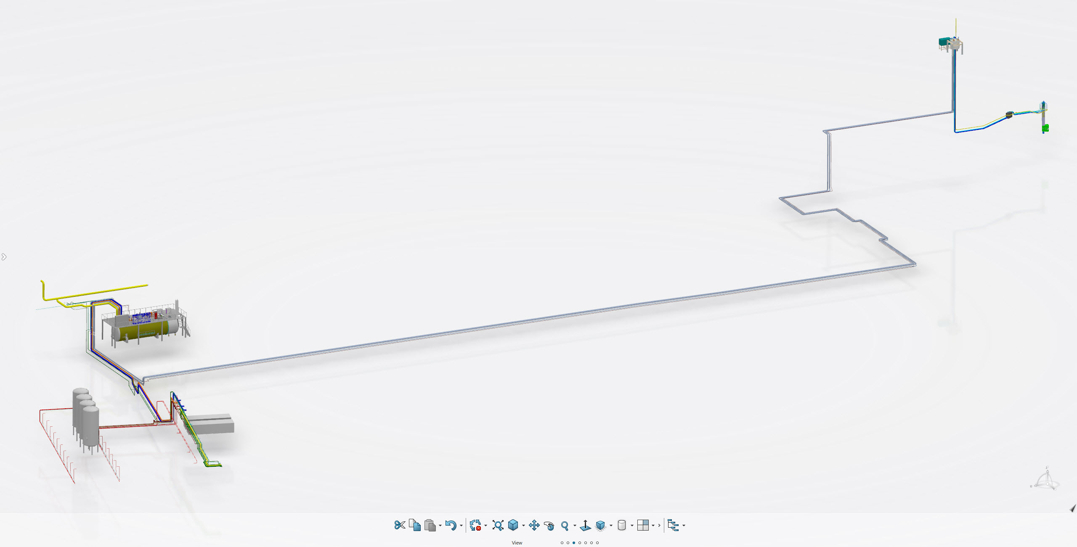
1.3 Integrated Target cryogenic system overview – isometric
D02
CMS
TMCP
He transfer lines
Cold box
G02
Compressors
G04
Buffer
tanks

Slide 10
1.3 TMCP Interfaces
Physical/process interfaces:
  TMCP to CTL
  CTL to CMS
  TMCP to SI systems (fluids, ventilation, cooling, power) in buildings G02, G04, D02
Project interfaces:
  TMCP to CMS
  TMCP to ACCSYS WP11 cryogenic systems
  TMCP to ICS
  TMCP to TMCP and CTL suppliers
Interfaces managed through:
  Interface Control Documents (ICD) for internal interfaces
  Confluence wiki pages for cryogenic systems interfaces
  Project reviews and meetings with TMCP, CTL suppliers
  CHESS

Slide 11
2.1 TMCP Schedule
 | 2014 |  | 2015 |  |  |  | 2016 |  |  |  | 2017 |  |  |  | 2018 |  |  |  | 2019
 | Q3 | Q4 | Q1 | Q2 | Q3 | Q4 | Q1 | Q2 | Q3 | Q4 | Q1 | Q2 | Q3 | Q4 | Q1 | Q2 | Q3 | Q4 | Q1 | Q2 | Q3
Target Moderator Cryoplant
OCT |  |  |  |  | x
Contract award |  |  |  |  |  |  |  | x
TMCP PDR |  |  |  |  |  |  |  |  | x
TMCP CDR |  |  |  |  |  |  |  |  |  |  |  | x
Installation |  |  |  |  |  |  |  |  |  |  |  |  |  |  | x | x
Commissioning |  |  |  |  |  |  |  |  |  |  |  |  |  |  |  |  | x | x
Cryo Transfer line
OCT |  |  |  |  |  |  |  |  |  |  |  |  | x
Contract award
CTL PDR |  |  |  |  |  |  |  |  |  |  |  |  |  | x
CTL CDR
Installation |  |  |  |  |  |  |  |  |  |  |  |  |  |  |  |  |  | x | x
CMS installation |  |  |  |  |  |  |  |  |  |  |  |  |  |  |  |  |  | x |  | x
Integrated CMS/TMCP commissioning |  |  |  |  |  |  |  |  |  |  |  |  |  |  |  |  |  |  |  | x | x
PDR
PDR
PDR
PDR
PDR
PDR
PDR
PDR
PDR
PDR
PDR
PDR
PDR
PDR
PDR
PDR
PDR
PDR
Procurement
PDR
PDR
PDR
CDR
PDR
Delivery

Slide 12
2.2 TMCP reviews
Kick-off meeting June 2016
Preliminary Design Review September 2016
HAZOP/FMEA review November 2016
Warm compressor station Critical Design Review May 2017
Cold box Critical Design Review – 1 May 2017
Cold box Critical Design Review – 2 July 2017
Logic Design Review July 2017
Installation Readiness Review January 2018
Site Acceptance Review December 2018
✔
✔
✔

Slide 13
2.3 TMCP Installation & commissioning
Installation and commissioning plan
  Target cryogenic system will be commissioned in three stages
    TMCP alone commissioning – verify functionality of cryoplant
    TMCP & CTL commissioning – verify capability with full inventory of helium for all operating modes
    Integrated commissioning with TMCP, CTL, and CMS – verify capability of TMCP to respond to CMS

Slide 14
2.4 TMCP Risks & mitigation
Risks and mitigation plan
  TMCP risks
    A HAZOP analysis has been performed by Linde as part of their contractual obligation. Hazards have been identified and mitigations proposed to the design
    A FMEA analysis has also been performed by Linde to address possible failure modes. Recommended designs have been proposed to the failure modes identified
  CMS risks
    A HAZOP has been performed by FZJ/TUD/ESS for the CMS. As with the TMCP, the hazards have been identified and mitigations proposed to the design

Slide 15
3.0 Summary
TMCP contract award made to Linde Kryotechnik June 2016
TMCP design is well under way
CTL procurement planned for 2017
Project on schedule
  TMCP commissioning complete 4Q2018
  CMS installation complete 2Q2019
  Integrated testing 2-3Q2019
Open issues
  Final routing of CTL in Target building not fixed
  Potential delayed access to D02 for CMS installation
  ICS integration of CMS and TMCP

