Slide 1
Safety Functions Identified via Accident Analyses
Francois Javier, Linda R. Coney, Per Nilsson
European Spallation Source (ESS)
www.europeanspallationsource.se

Slide 2
Outline
Intro
  SSM perspective concerning safety functions and defence in depth
  ESS process for radiation safety analysis an safety functions identification
  Hazard Analysis & Accident Analysis Procedure
Accident Analyses Results
  (Monolith)
  (Utility block)
  Active Cells Facility
Safety Function identification
  Safety SSC selection
  Defense in Depth analysis
Conclusions

Slide 3
Why Radiation safety analysis ?
The facility generates radiological hazards and it is mandatory to protect people’s health and the environment from harmful effects of ionizing radiation.
The protection level is defined through dose limits and reference values provided by the national regulation and SSM conditions.
ESS-0000004 rev 5 (January 2017)
Operating conditions Initiative event likelihood | Workers limit (effective dose) | Public limit (effective dose)
Normal operation - H1 | 2 mSv/year (average) 10 mSv/year (max) | 0.1 mSv/year (0.05 mSv/year GSO)
Anticipated events - H2 F > 10⁻² | 10 mSv/event | 0.1 mSv/occurrence
Unanticipated events - H3 10⁻⁴ < F < 10⁻² | 20 mSv/event | 1 mSv/occurrence
Improbable events (DBA) – H4 10⁻⁶ < F < 10⁻⁴ | 20 mSv/event | 20 mSv/occurrence
Highly improbable events – H5 F < 10⁻⁶ | 250 mSv/event | 100 mSv/occurrence
The safety functions are the functions implemented to fulfil these requirements
Events and circumstances that affect the facility shall be divided in 5 event classes based on frequencies
The safety functions are identified through the radiation safety analysis
Notes:
Made font bigger in the three side boxes and in the dose box

Slide 4
Defence in Depth and safety functions grouping according to SSM
The DiD shall be tailored to the activities and associated safety stakes
A failure of one level shall not be able to propagate to a subsequent level
DiD level 3 shall be independent of DiD level 1 and 2
DiD level 4 shall be independent of DiD level 1-3
Notes:
Made font bigger in the bottom box

Slide 5
Radiation safety analysis and safety functions identification process
Step 1 :
Radiological hazard induced by the facility and its operation
  Safety functions to be performed for normal/planned operation
  Additional safety functions or
  additional requirements on the safety functions identified in step 1
Step 2 :
Accident analysis
  The set of functions identified in steps 1 and 2 must show, as far as practical and reasonable, a proper implementation of a number of consecutive and independent levels of protection that would have to fail before harmful effects could be caused to people or environment
Step 3 :
Robustness of defence in depth
Notes:
Made font bigger which required making the boxes bigger

Slide 6
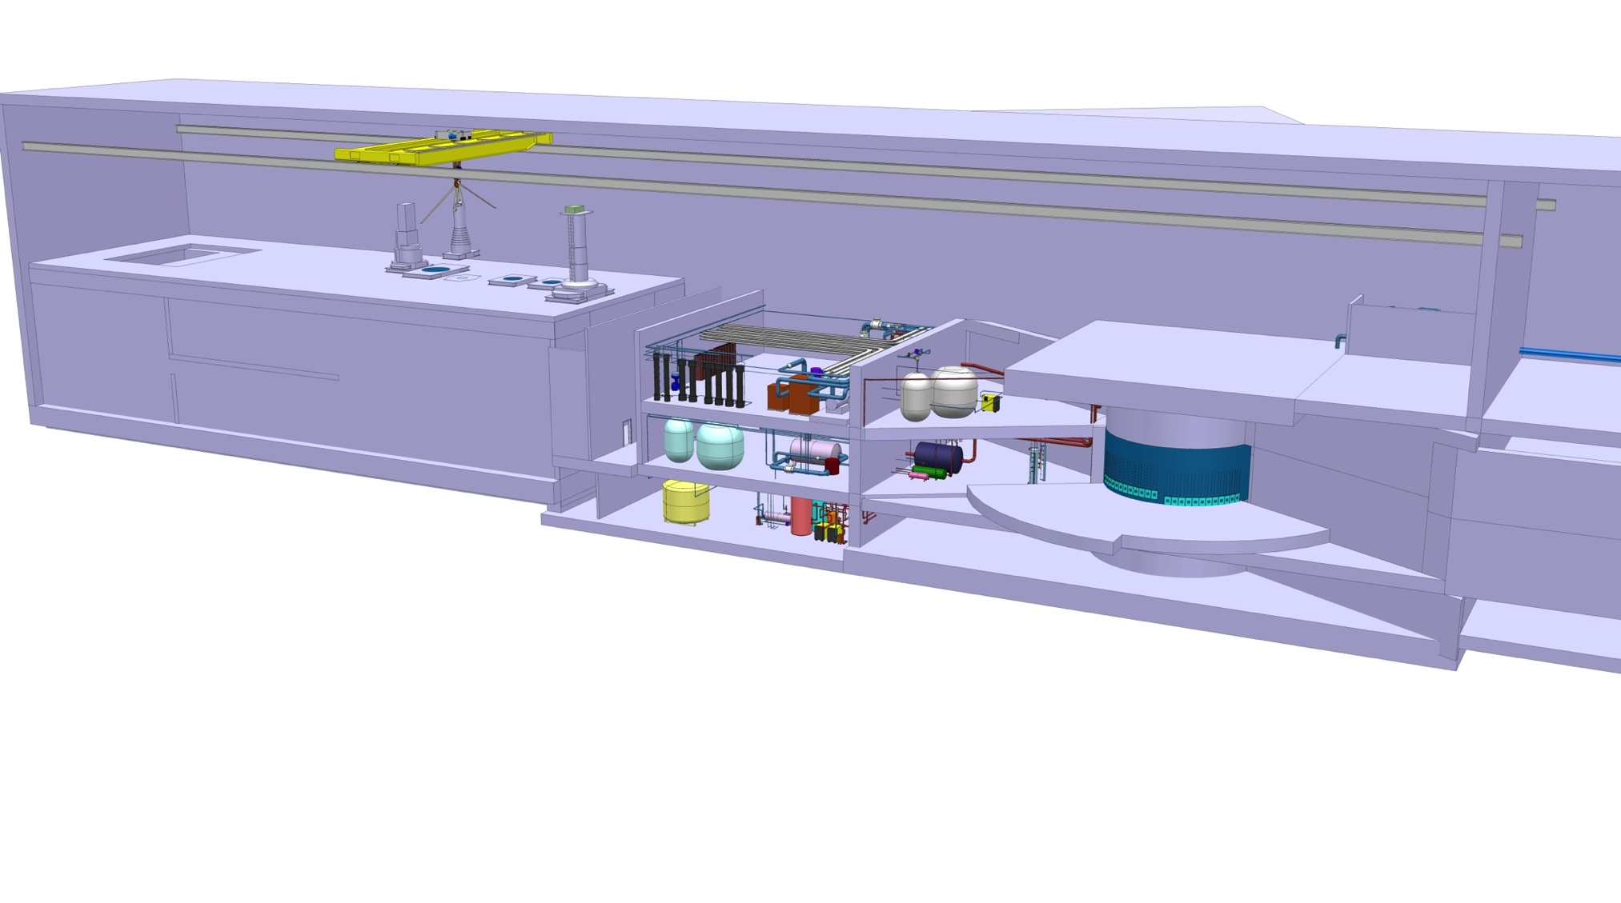
Step 1:
Target station radiological hazards and basic safety functions for normal operation
Radioactive inventory generated inside monolith and partially transferred to cooling/purification circuits and active cells.
Residual radiation
Radioactive inventory
Residual radiation
Radioactive inventory
Prompt radiation
Residual radiation
Radioactive inventory
Active cells facility
Shield
Manage access
Confine
Utility area
Shield
Manage access
Confine
Monolith area
Shield
Manage access
Confine
Cool
Manage spallation process
Inputs:
Facility design description
Modes of operation
Performances
Radiological hazards identification (qualitative & quantitative)
Safety functions needed
for normal operation
Notes:
Made text in boxes at the bottom bigger

Slide 7
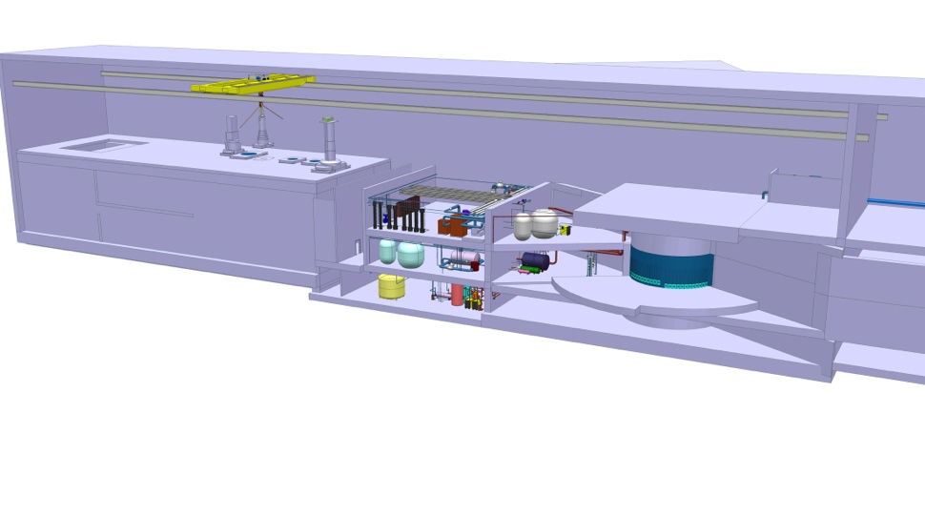


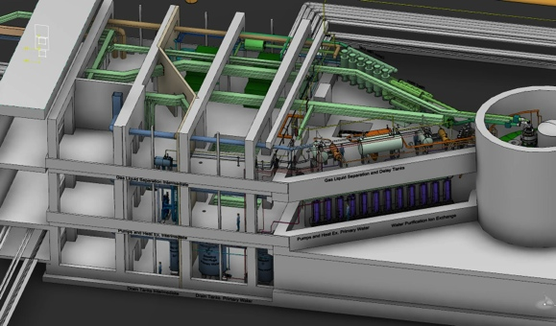
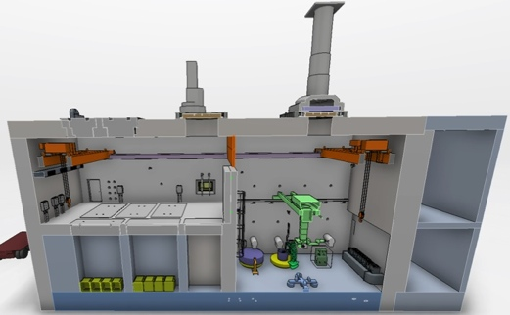
Step 1 orders of magnitude
Radioactive inventory– Prompt and residual radiation
Monolith area
∼ 4.10¹⁷ Bq
Utility area
shielding
Designed to attenuate with a criterion of 3 μSv/h
∼ 4.10¹²Bq
Dose map of the target wheel (irradiated 5 years + 14 days of cooling time) in the active cell.
(2000 Sv/h contact)
Active cells facility
∼ 8.10¹⁶ Bq
Notes:
Made text box font bigger

Slide 8
Step 1 : safety functions(RSF)/SSCs needed in normal operation
Area Radiological hazard | Active cell | Utility area | Monolith area
Prompt radiation | Not concerned | Not concerned | Shielding in monolith vessel (RSF 105) Shielding around mon. vessel (RSF105) Monolith concrete structure(RSF105) Bunker shielding(RSF105) Control access to areas (RSF 102)
Residual radiation from activated components | Shielding in outer walls and openings of active cell (RSF 105,39,40)) Shielding in intrabay doors and wall (RSF105); Casks Shielding blanket on wheel (RSF 105) Intrabay door drive system & controls including γ monitoring (RSF 38) Access control system for ACF (RSF 37) | Triangular utility rooms walls, floors and doors (RSF 105) Shielding for filters getters and ion exchangers (RSF 105) Local system and component shielding(RSF105) Access control system (RSF 35,102) | Shielding in monolith vessel (RSF 105) Shielding around mon. vessel(RSF 105) Monolith concrete structure(RSF 105) Bunker shielding(RSF 105) Light shutters(RSF 105) casks(RSF 105)
Spread of contamination | Active cell enclosure (RSF83,85) Active cell HVAC and controls (RSF 85) Access, hatches and openings control system for active cell (RSF37,39,40) | Primary cooling systems and associated boundaries + normal control system (RSF-55,57,59,60,61,63,64,103) Purification systems in cooling systems (filters, getters, ion exchangers)(RSF56) Connection cell leak rate, HVAC & controls (RSF106) Utility rooms leak rate, HVAC, controls(RSF106) High bay leak rate, HVAC and controls (RSF106) Control access to areas(RSF102) | Primary cooling systems and associated boundaries + normal control system (RSF-55,57,59,60,61,63,64,66,103) Purification systems in cooling systems (filters, getters, ion exchangers)(RSF56) Monolith vessel up to isolation components (RSF 76) Atmosphere system & controls(RSF 67) Choppers and beam guides (RSF 53)
28 RSF in DiD L1 for target station
Notes:
Made the font as big as possible in the table and shortened some RSF descriptions to fit

Slide 9
Step 2:
Accident analysis – qualitative assessment
Events and circumstances :
Identification : external aggressors to the site, internal aggressors on site, component failures and human errors
Characterization : likelihood, threat level and corresponding physical parameters
Consequences assessment (qualitatively) on :
the already identified radiological hazard
the already identified safety functions
350 Top Events from qualitative HAs
At least one event from each of the major types identified in HA
If prevented or mitigated, the group does not require additional safety functions
22 enveloping accidents identified for target station for further study
(some maintenance phases still to be treated)

Slide 10
STEP 2:
Accident Analyses
Bounding Events for Operations
Monolith/Utility Block Events
Active Cells Facility Events
Target wheel rotation stop during beam on
Beam Event: Focused & non-rastered beam
Loss of target wheel cooling during beam on
Leakage from target cooling circuit into monolith
Global bypass or local blockage of wheel cooling
Increased radiation level in target helium cooling system
Leakage between target He cooling system & intermediate water system
Loss of confinement in target He system – release into utility rooms
Moderator hydrogen combustion
Water leakage in monolith
Water leakage in connection cell and utility rooms
NBG/Chopper failure – projectile effect on monolith system
High power beam on beam dump
Earthquake scenario – monolith
Fire in He purification getters
Active Cells: Worker inside maintenance cell when intrabay door opens
Active Cells: Worker exposed to worst case inventory in process cell
Active Cells: Worker exposed to worst case inventory in maintenance cell
Active Cells: Loss of HVAC (loss of dynamic confinement)
Active Cells: Loss of confinement – open doors/hatches
Active Cells: Fire
Active Cells: Earthquake scenario
Target & He Cooling
350 Top Events from qualitative HAs
- At least one event from each of the major types identified in HA
- If prevented or mitigated, the group does not require additional safety functions

Slide 11
STEP 2:
Accident Analyses: quantitative assessment Evaluate unmitigated events
Describe system & event evolution
  Calculate effect on local & neighboring systems
  Quantitatively determine probability for occurrence (H2,H3,H4,H5)
Identify inventory
  Determine amount of material released during accident
  Source term = MAR_{(material at risk)}* DR _{(damage ratio)}* ARF_{(airborne release fraction)}
Identify all leak paths & point of emission for released material
  Identify flow rates and areas with risk of dose to workers along leak path
  Emission at 10 m or 45 m (default unmitigated 10 m)

Slide 12
STEP 2:
Accident Analyses: quantitative assessment
Evaluate unmitigated events
Calculate dose consequence to worker
  Consider inhalation (ex. Helium release), prompt dose (ex. wheel in ACF)
  Apply conservative assumptions for dose calculations
    HVAC assumed not to function when calculating worker dose
    Worker exposure time = 4h
Calculate dose consequence to public reference person
  Apply point of emission (10m or 45m)
  Duration based on release & flow rates
  Apply conservative assumptions for dose calculations
    Most direct leak path & operational HVAC – increases emission rate
    Apply “worst case” weather conditions
  Risk ranking for unmitigated event
  Compare to GSO & identify need for provisions to prevent and/or mitigate event

Slide 13
Outline
Intro
  SSM perspective concerning safety functions and defence in depth
  ESS process for radiation safety analysis an safety functions identification
  Hazard Analysis & Accident Analysis Procedure
Accident Analyses Results
  Monolith
  Utility block
  Active Cells Facility
Safety Function identification
  Safety SSC selection
  Defense in Depth analysis
Conclusions

Slide 14
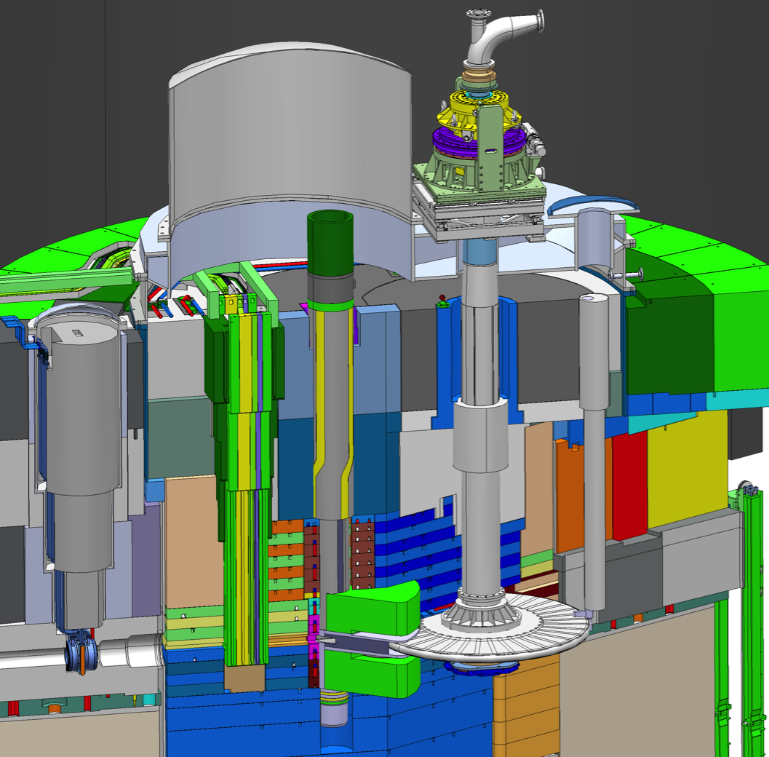
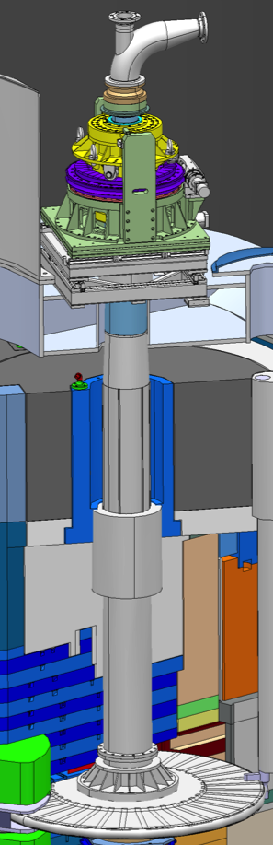
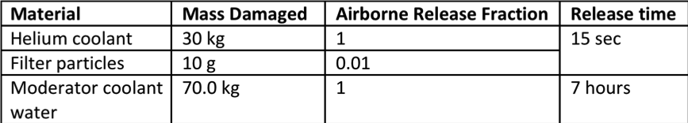
Step 2: Results from Monolith Events
Wheel
  Stops rotating (AA1)
  Beam as aggressor (AA2)
  Loses cooling
    AA4 – leak in monolith
    AA3 – fail HEX, int H₂0 system
    AA3 – loss flow
    AA5 – blockage
H2 event
Worker 4 h
Emission 10 m
Helium leaks into monolith
Increased pressure g loss of monolith confinement, release into surrounding areas
Water release takes several hours
Limited increase in temperature
– no damage to shroud
g No Mitigation required
 | Configuration | Dose
Worker | w/ or w/o PBW | 800 mSv
Public | w/ or w/o PBW | 0.2 mSv
 | Configuration | Dose
Worker | w/ or w/o PBW | 800 mSv
Public | w/ or w/o PBW | 0.2 mSv
Worker limit 10 mSv
Public limit 0.1 mSv
Worker limit 10 mSv
Public limit 0.1 mSv
gMitigation required

Slide 15
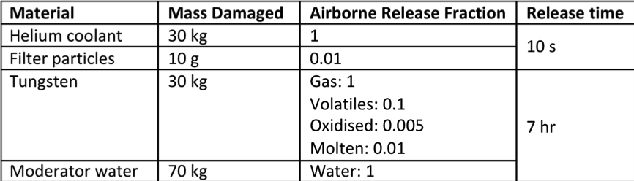
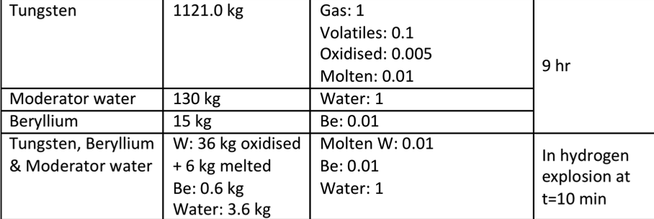
Step 2: Results from Monolith Events
Wheel
  Stops rotating (AA1)
  Beam as aggressor (AA2)
  Loses cooling (AA3)
    Leak in system
    Fail HEX, int H₂0 system
    Loss flow
H2 event
Worker 4 h
Emission 10 m
Temperature increases, shroud melts, helium released g loss of monolith confinement
Moderator water released/evaporated
Part of spallation material spills into monolith, oxidizes & released
Part of spallation material melts
 | Configuration | Dose
Worker | w/o PBW | 28 Sv
 | w/ PBW | 580 Sv
Public | w/o PBW | 4 mSv
 | w/ PBW | 75 mSv
 | Configuration | Dose
Worker | w/o PBW | 28 Sv
 | w/ PBW | 580 Sv
Public | w/o PBW | 4 mSv
 | w/ PBW | 75 mSv
Worker limit 10 mSv
Public limit 0.1 mSv
Worker limit 10 mSv
Public limit 0.1 mSv
gMitigation required

Slide 16
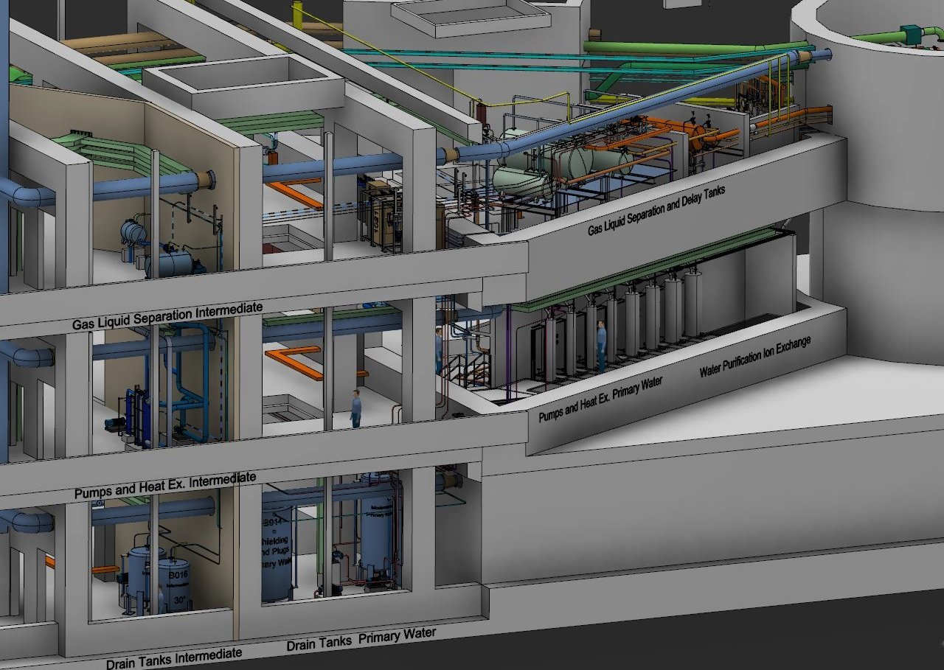
Utility Block:
Helium Cooling, He Purification, Fluid Systems

Slide 17
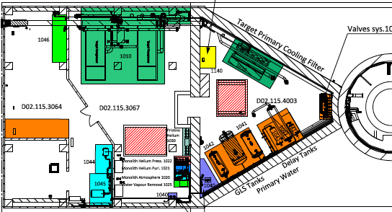
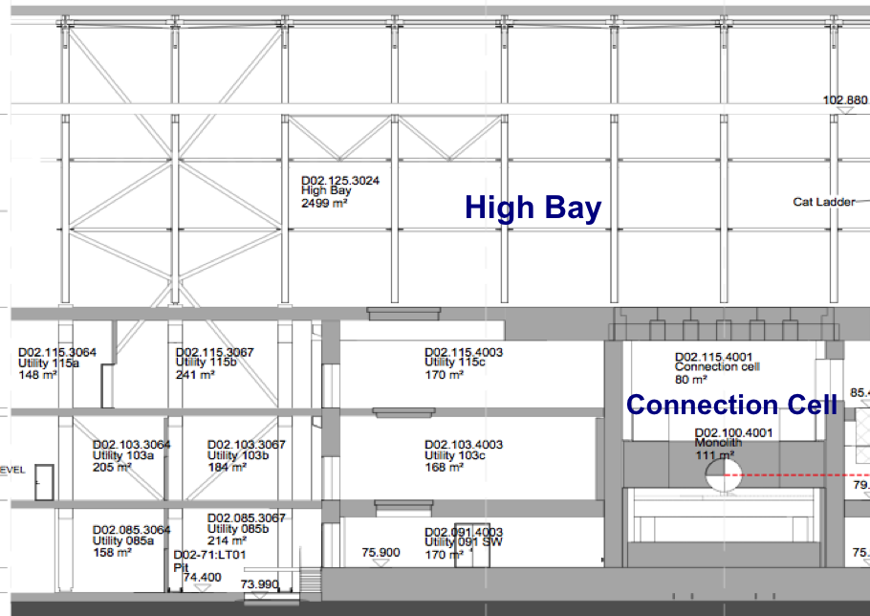

Step 2: Results from Utility Block events
Loss of confinement in target He system – release into rooms (AA8)
H2 event
Worker 4 h
Emission 10 m
Helium system pipe rupture
Helium, other gases & smallest particulates, plus fraction of system filter contents leak from helium pipe system at large flow rate, empty system
 | Dose
Worker | 250 mSv
Public | 0.05 mSv
 | Dose
Worker | 250 mSv
Public | 0.05 mSv
Worker limit 10 mSv
gMitigation required

Slide 18
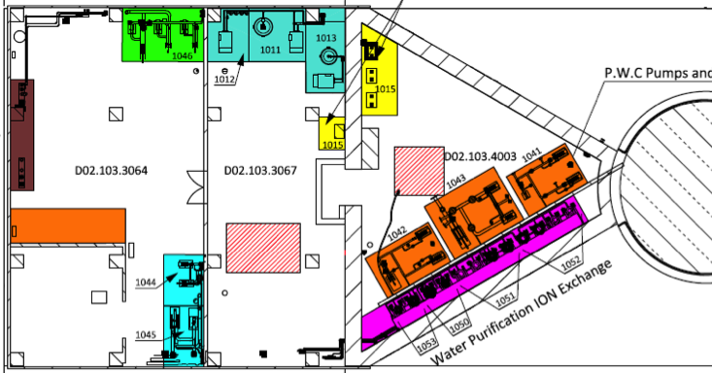


Step 2: Results from Utility Block events
Loss of confinement in target He system – release into rooms (AA8)
Leakage between He cooling system & intermediate water system (AA7)
Water leakage in connection cell and utility rooms (A11)
H2 event
Worker 4 h
Emission 10 m
Pipe in primary water cooling loop breaks
Water leaks out into room, evaporates & emitted from building
 | Dose
Worker | 1700 mSv
Public | 0.17 mSv
 | Dose
Worker | 1700 mSv
Public | 0.17 mSv
Worker limit 10 mSv
Public limit 0.1 mSv
gMitigation required

Slide 19

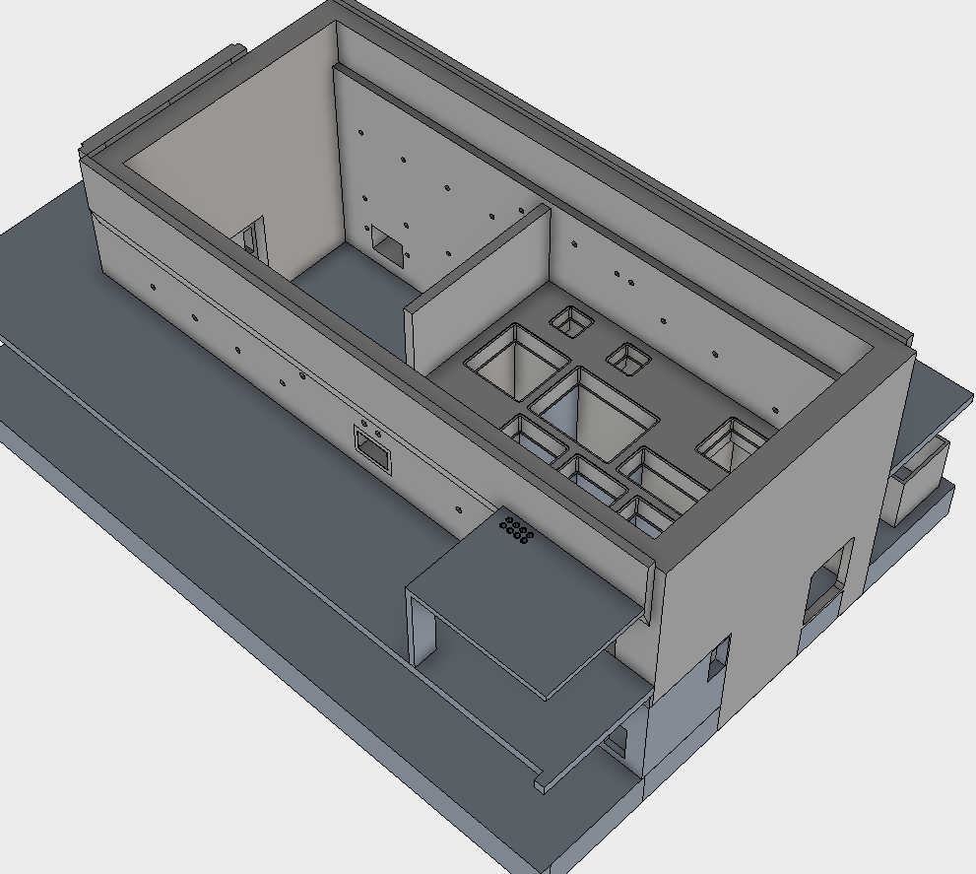
Active Cells
Floor
Valve
Maintenance Cell (MC)
Intrabay Doors
Process Cell (PC)
Galleries
Airlock

Slide 20
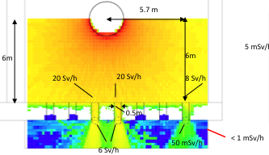
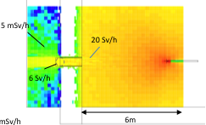
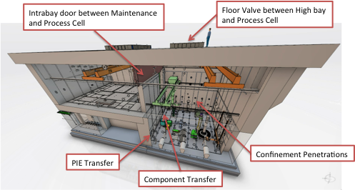
Step 2: Active Cells Facility
Worker exposed to worst case inventory in process cell (AA16)
H2 event
Worker 10 min
Confinement door/floor valve/plug or hatch opens unintentionally between Process Cell and surrounding areas
Worker in technical gallery or high bay receives direct dose from spent wheel
 | Opening | Dose
Worker | Floor Valve | 170 mSv
 | Component Transfer | 330 mSv
 | PIE Transfer | 330 mSv
 | Confinement Penetrations | 1170 mSv
Public |  | 0.0 mSv
 | Opening | Dose
Worker | Floor Valve | 170 mSv
 | Component Transfer | 330 mSv
 | PIE Transfer | 330 mSv
 | Confinement Penetrations | 1170 mSv
Public |  | 0.0 mSv

Slide 21
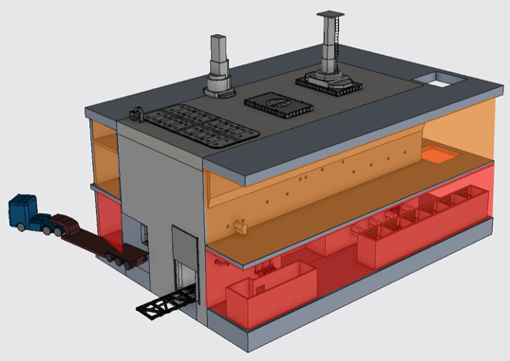
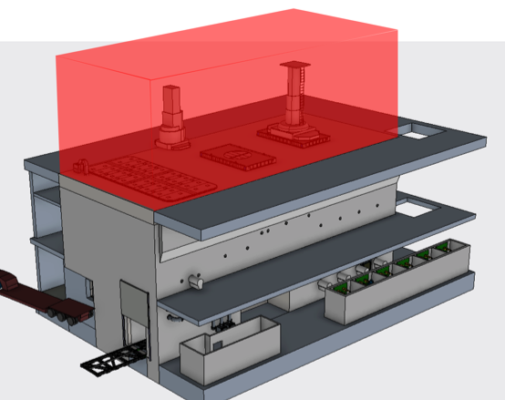

Step 2: Active Cells Facility
Loss of confinement – open doors/hatches (AA19)
H2 event
Worker 4 h
Emission 10 m
Opening creates direct communication between ACF volume and surrounding areas
Confinement lost – airborne contamination spreads toward technical galleries or high bay
Airborne contamination emitted from building via HVAC of control volumes
Inventory from dismantling of wheel & shaft
 | Dose
Worker | 116 mSv
Public | 0.3 mSv
 | Dose
Worker | 116 mSv
Public | 0.3 mSv

Slide 22
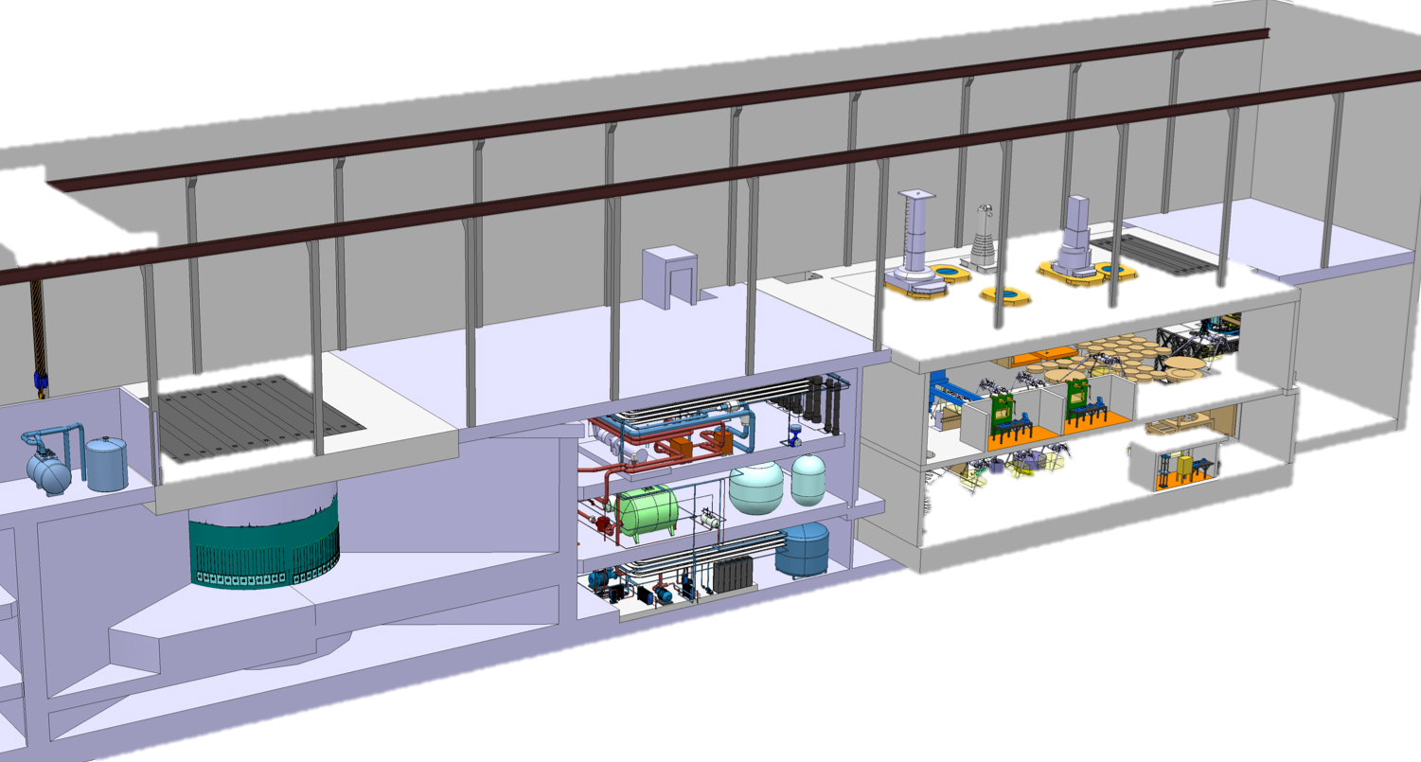
Step 2:
External Event – Earthquake (AA14, AA21)
Earthquake of varying severity and probability hits ESS
Initiates all possible events in all areas – Many share inventories
  AA3 – loss of wheel cooling – dominates dose
  AA11 – water leaks (3 systems) in utility block
  AA22 – getter fire
ACF doors, hatches, floor valves open, HVAC fails, confinement lost, fire
H2, H3, H4 event
Worker 4 h
Emission 10 m
 | AA14 | AA21 ACF | Total Dose
Worker | 600 Sv | 1.3 Sv | 601.3 Sv
Public | 80 mSv | 0.5 mSv | 80.5 mSv
 | AA14 | AA21 ACF | Total Dose
Worker | 600 Sv | 1.3 Sv | 601.3 Sv
Public | 80 mSv | 0.5 mSv | 80.5 mSv
Active cells
Target monolith
Utility Block

Slide 23
Outline
Intro
  SSM perspective concerning safety functions and defence in depth
  ESS process for radiation safety analysis an safety functions identification
  Hazard Analysis & Accident Analysis Procedure
Accident Analyses Results
  Monolith
  Utility block
  Active Cells Facility
Safety Function identification
  Safety SSC selection
  Defense in Depth analysis
Conclusions

Slide 24
Step2:
Safety Function Selection
Prevent or Control events
Determine required safety functions
  Hierarchy applied with preference to passive engineered safety features over active, engineered over active or administrative controls, and preventative over mitigative
Consider several options and optimize
  Technical feasibility, reliability, efficiency, impact on operations, impact on other systems, cost
Specify safety SSCs (structures, systems and components) for each event
Reassess evolution and dose consequences with safety measures implemented, check compliance with GSO

Slide 25
Step 2: Selection of Safety Functions:
Monolith – Public
Event | Class | Emission point | Public Dose
AA1 | H2 | 10 m | 0.5, 18 mSv
AA2 | H2 | 10 m | 0.4 mSv
AA3 HEx | H2 | 10 m | 4.0, 75 mSv
AA3 flow | H2 | 10 m | 4.0, 75 mSv
AA3 leak | H2 | 10 m | 4.0, 75 mSv
AA4 | H2 | 10 m | 0.2 mSv
Event | Class | Emission point | Public Dose
AA1 | H2 | 10 m | 0 mSv
AA2 | H2 | 10 m | 0.4 mSv
AA3 HEx | H2 | 10 m | 0 mSv
AA3 flow | H2 | 10 m | 0 mSv
AA3 leak | H2 | 10 m | 4.0, 75 mSv
AA4 | H2 | 10 m | 0.2 mSv
Event | Class | Emission point | Public Dose
AA1 | H2 | 10 m | 0 mSv
AA2 | H2 | 10 m | 0.4 mSv
AA3 HEx | H2 | 10 m | 0 mSv
AA3 flow | H2 | 10 m | 0 mSv
AA3 leak | H2 | 10 m | .08, .2 mSv
AA4 | H2 | 10 m | 0.2 mSv
Event | Class | Emission point | Public Dose
AA1 | H2 | 10 m | 0 mSv
AA2 | H2 | 45 m | 0.04 mSv
AA3 HEx | H2 | 10 m | 0 mSv
AA3 flow | H2 | 10 m | 0 mSv
AA3 leak | H2,3 | 45, 10 m | .02, .08 mSv
AA4 | H2 | 45 m | 0.02 mSv
Event | Class | Emission point | Public Dose
AA1 | H2 | 10 m | 0 mSv
AA2 | H2 | 45 m | 0.04 mSv
AA3 HEx | H2 | 10 m | 0 mSv
AA3 flow | H2 | 10 m | 0 mSv
AA3 leak | H2,3 | 45, 10 m | .02, .08 mSv
AA4 | H2 | 45 m | 0.02 mSv
Event | Class | Emission point | Public Dose
AA7, 8 | H3 | 10 m | 0.08, .05 mSv
AA9 | H2 | 10 m | 0 mSv
AA10 | H2 | 10 m | 0.07 mSv
AA11 | H3 | 10 m | 0.2 mSv
AA22 | H3, 4 | 45, 10 m | 0.6, 6.2 mSv
AA13 | H2 | 45 m | 0.03 mSv
Event | Class | Emission point | Public Dose
AA7, 8 | H2 | 10 m | 0.08, .05 mSv
AA9 | H2 | 10 m | 0.8 mSv
AA10 | H2 | 10 m | 0.07 mSv
AA11 | H2 | 10 m | 0.2 mSv
AA22 | H3 | 10 m | 6.2 mSv
AA13 | H2 | 10 m | 0.3 mSv
Event | Class | Emission point | Public Dose
AA7, 8 | H3 | 10 m | 0.08, .05 mSv
AA9 | H2 | 10 m | 0 mSv
AA10 | H2 | 10 m | 0.07 mSv
AA11 | H3 | 10 m | 0.2 mSv
AA22 | H3 | 10 m | 6.2 mSv
AA13 | H2 | 10 m | 0.3 mSv
Event | Class | Emission point | Public Dose
AA7, 8 | H3 | 10 m | 0.08, .05 mSv
AA9 | H2 | 10 m | 0 mSv
AA10 | H2 | 10 m | 0.07 mSv
AA11 | H3 | 10 m | 0.2 mSv
AA22 | H3, 4 | 45, 10 m | 0.6, 6.2 mSv
AA13 | H2 | 45 m | 0.03 mSv
Prevent release
Primary cooling systems (He, water) confinement in connection cell and utility rooms (AA7,AA8, AA11: H2 g H3)
Projectile stop on instrument beamlines/monolith – prevent H2 event (AA9)
TSS stops beam on low wheel speed, high temperature and low flow in He cooling (AA1, AA3)
Limit event progression/limit release
TSS stops beam on high monolith pressure & low He cooling pressure (AA2, AA3)
Control release
Monolith confinement (AA4, AA2), getter fire box (AA22)
Controlled relief path to stack (45 m) (AA4, AA13, AA22)

Slide 26
Step 2: Selection of Safety Functions:
Monolith – Workers
Event | Class | Exposure time | Worker Dose
AA1 | H2 | 4 h | 40 Sv
AA2 | H2 | 4 h | 1190 mSv
AA3 HEx | H2 | 4 h | 580 Sv
AA3 flow | H2 | 4 h | 580 Sv
AA3 leak | H2 | 4 h | 580 Sv
AA4 | H2 | 4 h | 800 mSv
Event | Class | Exposure time | Worker Dose
AA1 | H2 | 4 h | 0 mSv
AA2 | H2 | 4 h | 1190 mSv
AA3 HEx | H2 | 4 h | 0 mSv
AA3 flow | H2 | 4 h | 0 mSv
AA3 leak | H2 | 4 h | 580 Sv
AA4 | H2 | 4 h | 800 mSv
Event | Class | Exposure time | Worker Dose
AA1 | H2 | 4 h | 0 mSv
AA2 | H2 | 4 h | 1190 mSv
AA3 HEx | H2 | 4 h | 0 mSv
AA3 flow | H2 | 4 h | 0 mSv
AA3 leak | H2 | 4 h | 580 Sv
AA4 | H2 | 4 h | 800 mSv
Event | Class | Exposure time | Worker Dose
AA1 | H2 | 4 h | 0 mSv
AA2 | H2 | 4 h | 1190 mSv
AA3 HEx | H2 | 4 h | 0 mSv
AA3 flow | H2 | 4 h | 0 mSv
AA3 leak | H2 | 4 h | 800 mSv
AA4 | H2 | 4 h | 800 mSv
Event | Class | Exposure time | Worker Dose
AA1 | H2 | 4 h | 0 mSv
AA2 | H2 | 4 h | 0 mSv
AA3 HEx | H2 | 4 h | 0 mSv
AA3 flow | H2 | 4 h | 0 mSv
AA3 leak | H2 | 4 h | 250 mSv
AA4 | H2 | 4 h | 0 mSv
Event | Class | Exposure time | Worker Dose
AA1 | H2 | 4 h | 0 mSv
AA2 | H2 | 4 h | 0 mSv
AA3 HEx | H2 | 4 h | 0 mSv
AA3 flow | H2 | 4 h | 0 mSv
AA3 leak | H2 | 2min | 2.8 mSv
AA4 | H2 | 4 h | 0 mSv
Event | Class | Exposure time | Worker Dose
AA1 | H2 | 4 h | 0 mSv
AA2 | H2 | 4 h | 0 mSv
AA3 HEx | H2 | 4 h | 0 mSv
AA3 flow | H2 | 4 h | 0 mSv
AA3 leak | H2 | 2min | 2.8 mSv
AA4 | H2 | 4 h | 0 mSv
Event | Class | Exposure time | Worker Dose
AA7, 8 | H3 | 4 h | 250 mSv
AA9 | H2 | 30 min | 0 mSv
AA10 | H2 | 4 h | 722 mSv
AA11 | H3 | 4 h | 1700 mSv
AA22 | H3 | 4 h | 28 Sv
AA13 | H2 | 4 h | < 10 μSv
Event | Class | Exposure time | Worker Dose
AA7, 8 | H3 | 4 h | 250 mSv
AA9 | H2 | 30 min | 0 mSv
AA10 | H2 | 4 h | 722 mSv
AA11 | H3 | 4 h | 1700 mSv
AA22 | H3 | 4 h | 28 Sv
AA13 | H2 | 4 h | < 10 μSv
Event | Class | Exposure time | Worker Dose
AA7, 8 | H3 | 4 h | 250 mSv
AA9 | H2 | 30 min | 0 mSv
AA10 | H2 | 4 h | 0 mSv
AA11 | H3 | 4 h | 1700 mSv
AA22 | H3,4 | 4 h | 28 Sv
AA13 | H2 | 4 h | < 10 μSv
Event | Class | Exposure time | Worker Dose
AA7, 8 | H3 | 2 min | 2.8 mSv
AA9 | H2 | 30 min | 0 mSv
AA10 | H2 | 4 h | 0 mSv
AA11 | H3 | 2 min | 0.2 mSv
AA22 | H3,4 | 0 min | 0 mSv
AA13 | H2 | 4 h | < 10 μSv
Event | Class | Exposure time | Worker Dose
AA7, 8 | H3 | 2 min | 2.8 mSv
AA9 | H2 | 30 min | 0 mSv
AA10 | H2 | 4 h | 0 mSv
AA11 | H3 | 2 min | 0.2 mSv
AA22 | H3,4 | 0 min | 0 mSv
AA13 | H2 | 4 h | < 10 μSv
Event | Class | Exposure time | Worker Dose
AA7, 8 | H2 | 4 h | 250 mSv
AA9 | H2 | 30 min | 90 mSv
AA10 | H2 | 4 h | 722 mSv
AA11 | H2 | 4 h | 1700 mSv
AA22 | H3 | 4 h | 28 Sv
AA13 | H2 | 4 h | < 10 μSv
Prevent release
Primary cooling systems (He, water) confinement in utility rooms (H2 g H3)
Projectile stop on beamlines, prevent AA9
TSS stops beam on low wheel speed, high temperature and low flow in He cooling (AA1, AA3)
Prevent access
Beam ON – no tunnel access (AA4,AA10, AA13)
Beam OFF – isolation device between monolith and accelerator closed before access (AA4, AA10)
Limit event progression/limit release
TSS stops beam on high monolith pressure & low He cooling pressure (AA2, AA3)
Control release
Monolith confinement(AA4, AA10, AA2), getter fire box (AA22)
Controlled relief path (AA4, AA13, AA22)
Detect – alarm – evacuate
Detect He, water, fire g alarm & workers evac (AA7, AA8, AA11, AA22)

Slide 27
Step 2: Selection of Safety Functions:
Active Cells Facility – Public
Event | Class | Emission point | Public Dose
AA15 | H2 | N/A | 0 mSv
AA16 | H2,H3 | N/A | 0 mSv
AA17 | H2 | N/A | 0 mSv
AA18 | H2,H3 | 10 m | 0.0003 mSv
AA19 | H3 | 10 m | 0.3 mSv
AA20 | H3 | 10 m | 0.26 mSv
Event | Class | Emission point | Public Dose
AA15 | H2 | N/A | 0 mSv
AA16 | H2,H3 | N/A | 0 mSv
AA17 | H2 | N/A | 0 mSv
AA18 | H2,H3 | 10 m | 0.00007 mSv
AA19 | H3 | 10 m | 0.3 mSv
AA20 | H3 | 10 m | 0.26 mSv
Event | Class | Emission point | Public Dose
AA15 | H2 | N/A | 0 mSv
AA16 | H2,H3 | N/A | 0 mSv
AA17 | H2 | N/A | 0 mSv
AA18 | H2,H3 | 10 m | 0.00007 mSv
AA19 | H3 | 10 m | 0.3 mSv
AA20 | H3 | 10 m | 0.26 mSv
Event | Class | Emission point | Public Dose
AA15 | H2 | N/A | 0 mSv
AA16 | H2,H3 | N/A | 0 mSv
AA17 | H2 | N/A | 0 mSv
AA18 | H2,H3 | 10 m | 0.0003 mSv
AA19 | H2 | 10 m | 0.3 mSv
AA20 | H3 | 10 m | 0.26 mSv
Prevent release
Safety interlock control to prevent incorrect opening of doors, hatches, floor valves (AA19) H2 g H3
Sealing bolts on plugs, confinement penetrations (AA19) H2 g H3
Limit release
Defined leak rate for ACF enclosure (AA18)

Slide 28
Step 2: Selection of Safety Functions:
Active Cells Facility – Workers
Event | Class | Exposure time | Worker Dose
AA15 | H3 | 1 hr | 20 mSv
AA16 | H3,H4 | 10 min | 170, 330, 330, 1170 mSv
AA17 | H4 | 10 min | 250, 0, 0, 0 mSv
AA18 | H2,H3 | 4 h | 120 mSv
AA19 | H3 | 4 h | 120 mSv
AA20 | H3 | 4 h | 270 mSv
Event | Class | Exposure time | Worker Dose
AA15 | H3 | 1 hr | 20 mSv
AA16 | H3,H4 | 10 min | 170, 330, 330, 1170 mSv
AA17 | H4 | 10 min | 250, 0, 0, 0 mSv
AA18 | H2,H3 | 4 h | 120 mSv
AA19 | H3 | 4 h | 120 mSv
AA20 | H3 | 4 h | 270 mSv
Event | Class | Exposure time | Worker Dose
AA15 | H3 | 5 min | 1.67 mSv
AA16 | H3,H4 | 1 min | 17, 10, 0.8, 10 mSv
AA17 | H4 | < 1 min, 0, 0, 0 min | 8 μSv, 0, 0, 0 mSv
AA18 | H2,H3 | 4 h | 120 mSv
AA19 | H3 | 4 h | 120 mSv
AA20 | H3 | 4 h | 270 mSv
Event | Class | Exposure time | Worker Dose
AA15 | H3 | 5 min | 1.67 mSv
AA16 | H3,H4 | 1 min | 17, 10, 0.8, 10 mSv
AA17 | H4 | < 1 min, 0, 0, 0 min | 8 μSv, 0, 0, 0 mSv
AA18 | H2,H3 | 2 min | 0.02 mSv
AA19 | H3 | 2 min | 1.23 mSv
AA20 | H3 | 0 min | 0 mSv
Event | Class | Exposure time | Worker Dose
AA15 | H3 | 5 min | 1.67 mSv
AA16 | H3,H4 | 1 min | 17, 10, 0.8, 10 mSv
AA17 | H4 | < 1 min, 0, 0, 0 min | 8 μSv, 0, 0, 0 mSv
AA18 | H2,H3 | 2 min | 0.02 mSv
AA19 | H3 | 2 min | 1.23 mSv
AA20 | H3 | 0 min | 0 mSv
Event | Class | Exposure time | Worker Dose
AA15 | H2 | 1 hr | 20 mSv
AA16 | H2,H3 | 10 min | 170, 330, 330, 1170 mSv
AA17 | H2 | 10 min | 250, 250, 830, 1700 mSv
AA18 | H2,H3 | 4 h | 120 mSv
AA19 | H2 | 4 h | 120 mSv
AA20 | H3 | 4 h | 270 mSv
Prevent release
Safety interlock control to prevent incorrect opening of doors, hatches, floor valves (AA15, AA16, AA17, AA19)
Sealing bolts on plugs, confinement penetrations (AA15, AA16, AA17, AA19)
Limit release
Defined leak rate for ACF enclosure (AA18)
Detect – alarm – evacuate
Door, floor valve, hatch, or airlock opening (AA15, AA16, AA17)
Gamma monitor in MC (AA15, AA17) or when plugs, penetrations open (AA16)
Loss of dynamic confinement (AA18, AA19) with fire (AA20)

Slide 29
Step 2: Safety Functions – Earthquake
Event | H2 | H3 | H4
AA14 – Public | 0.08 mSv | 80 mSv | 80 mSv
AA21 – Public | 0.00007 mSv | 0.48 mSv | 0.48 mSv
Event | H2 | H3 | H4
AA14 – Public | 0.08 mSv | 0.59 mSv | 6.8 mSv
AA21 – Public | 0.00007 mSv | 0.48 mSv | 0.48 mSv
Event | H2 | H3 | H4
AA14 – Public | 80 mSv | 80 mSv | 80 mSv
AA21 – Public | 0.48 mSv | 0.48 mSv | 0.48 mSv
Event | H2 | H3 | H4
AA14 – Worker | 600 Sv | 600 Sv | 600 Sv
AA21 – Worker | 1.3 Sv | 1.3 Sv | 1.3 Sv
Event | H2 | H3 | H4
AA14 – Worker | 0 mSv | 600 Sv | 600 Sv
AA21 – Worker | 0.02 mSv | 1.3 Sv | 1.3 Sv
Event | H2 | H3 | H4
AA14 – Worker | 0 mSv | 2 mSv | 2 mSv
AA21 – Worker | 0.02 mSv | 20 min 14.3 mSv | 20 min 14.3 mSv
Target building functional in H2, and all other safety SSCs functional in H2 g mitigated AA3 and AA18 values
Monolith Civil Structure (MCS) and ACF available up to and including H4, building not threaten safety SSCs in these areas
H3 – Helium purification getter firebox, evacuation alarms, TSS, shielding function in ACF maintained
H4 – Evacuation alarms functional, TSS functional or fail-safe, shielding function in ACF maintained

Slide 30
Step 2: Summary of Safety Functions
– Monolith & Utility
Target Safety System (TSS) stops beam on:
  Low pressure, High temperature, Low flow (helium cooling), Low wheel speed, Increased pressure (in Monolith)
Monolith confinement, including neutron beam windows
System confinement in connection cell and utility block
  All primary fluid systems – helium and water
Controlled reliefs of monolith and systems
  Burst disk in monolith, offgas system & path to stack (H2)
  HVAC & relief path to stack (tunnel – AA13)*
Some structural requirements
Prevent access – Tunnel and connection cell
Detectors/alarm evacuate workers

Slide 31
Step 2: Summary of Safety Functions
– Active Cells Facility
Controlled opening mechanisms
Confinement – defined leak rate
Some structural requirements
Prevent access
Detectors/alarm evacuate workers

Slide 32
Step 3:
Overview of SF and DiD for target station
A set of safety functions with a unique ID number (RSFxxx), the scenarios (AA1 to AA22) in which they play a role, and at what level of DiD they act.
19 RSF in DiD L2
18 RSF in DiD L3
No RSF in DiD L4 (public perspective)

Slide 33
STEP 3: Robustness of defense in depth
Holistic approach to optimize selection of safety functions and SSCs
  Collect all safety functions identified in accident analyses
  Evaluate how different options fit with other analyses
  Check consistency in approach and balance between prevention and mitigation
  Based on outcome optimize choice and combination of safety functions and ranking within DiD
DiD analysis example – Spread of contamination from ACF
Notes:
Explain SF for normal ops
Events – unmitigated consequences
Additional safety functions – mitigated consequences
Why no need for DiD level 4

Slide 34
Conclusions
The Hazard Analysis process is a well-defined, systematic way to identify, evaluate, and control potential radiation hazards and accidents related to the Target Station.
  It is in alignment with the overall ESS process and regulatory body (SSM) conditions
All 22 Accident Analyses for Operations of the target station systems have been completed – event evaluated, impact assessed, Safety SSCs and supporting safety-related SSCs defined, first iteration of DiD analysis done
  Need to refine safety function & defense in depth analysis
  Are the selected safety SSCs feasible?
    HVAC in accelerator for Beam Dump event
    Quality class for TSS components – wheel rotation
Next: close the loop with original qualitative analysis, equivalent analyses for Maintenance activities, understand implications for non-radiation workers, understand implications for contamination

Slide 35


Many thanks to:
Per Nilsson, Leif Spanier, Jan Espen Presteng, Kristoffer Sjögreen, Jens Harborn, Arezou Firouzi, Andrea Polato, Magnus Göhran, Naja de la Cour, Mattias Wilborgsson and
Thank you!

