Slide 1
Bunker Project
Zvonko Lazic
www.europeanspallationsource.se
30 March 2017

Slide 2
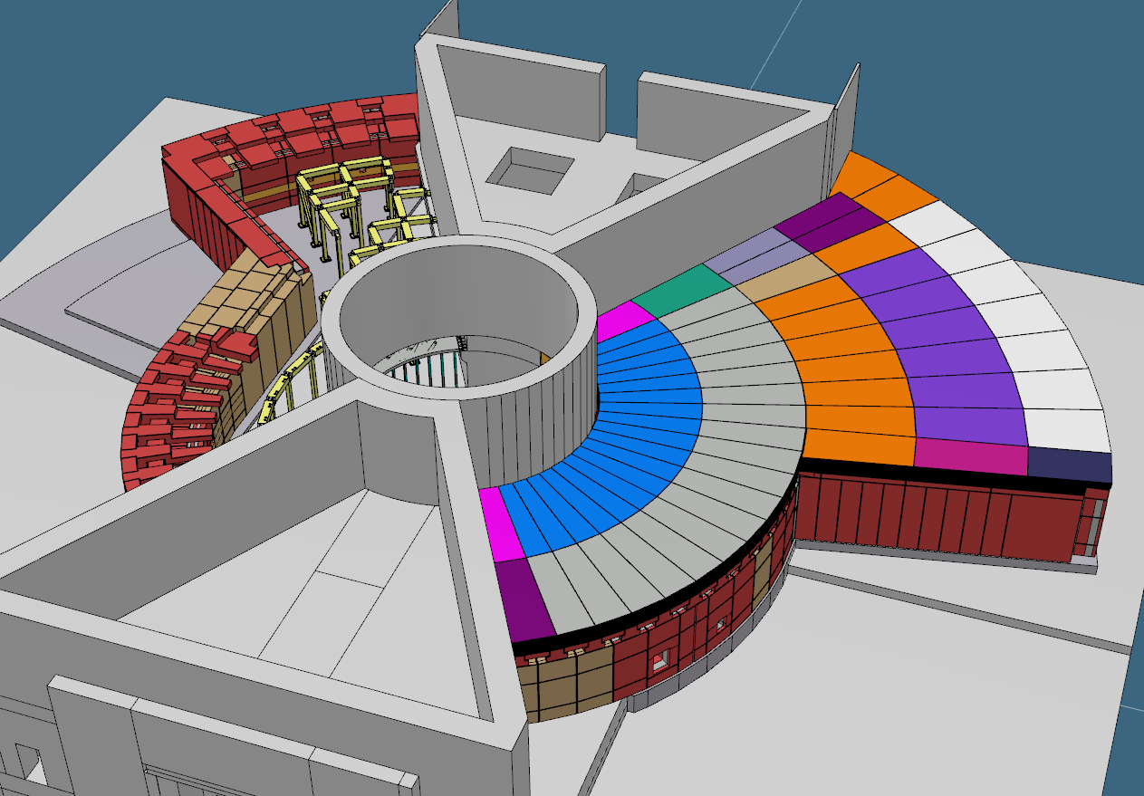
The bunker
Each bunker side measures approx. 40m long x 26m wide x 5m high
10,000 tones total mass
~1400 wall & roof blocks

Slide 3
Introduction
Benjamin D.
A successful bunker PDR took place 15th – 16th Decemeber 2016
The project is now in the detailed design phase

Slide 4
High level Installation Schedule
Sofie O.
R6
(Jan 2019)
LS & Insert (with Target)
installation
(Feb-Sep 2019)
Bunker Pillars
& Beams
(June-Oct 2019)
First 8 instruments should plan for
“In-Bunker instrument installations” within this 6 month period.
Bunker walls & first roof layer
(Aug-Nov 2019)
Instrument & TBL installation
(Nov 2019 – May 2020 )
Bunker roof
outer layer
(June-Aug 2020)
BoT
Oct
2020
Utilities/Infrastr. & ICS installation & test
(Sep-Oct 2020)
Installations assumes normal working hours and summer/Christmas holidays

Slide 5
Access dates to Bunker areas drives the Installation schedule
Sofie O.

Slide 6
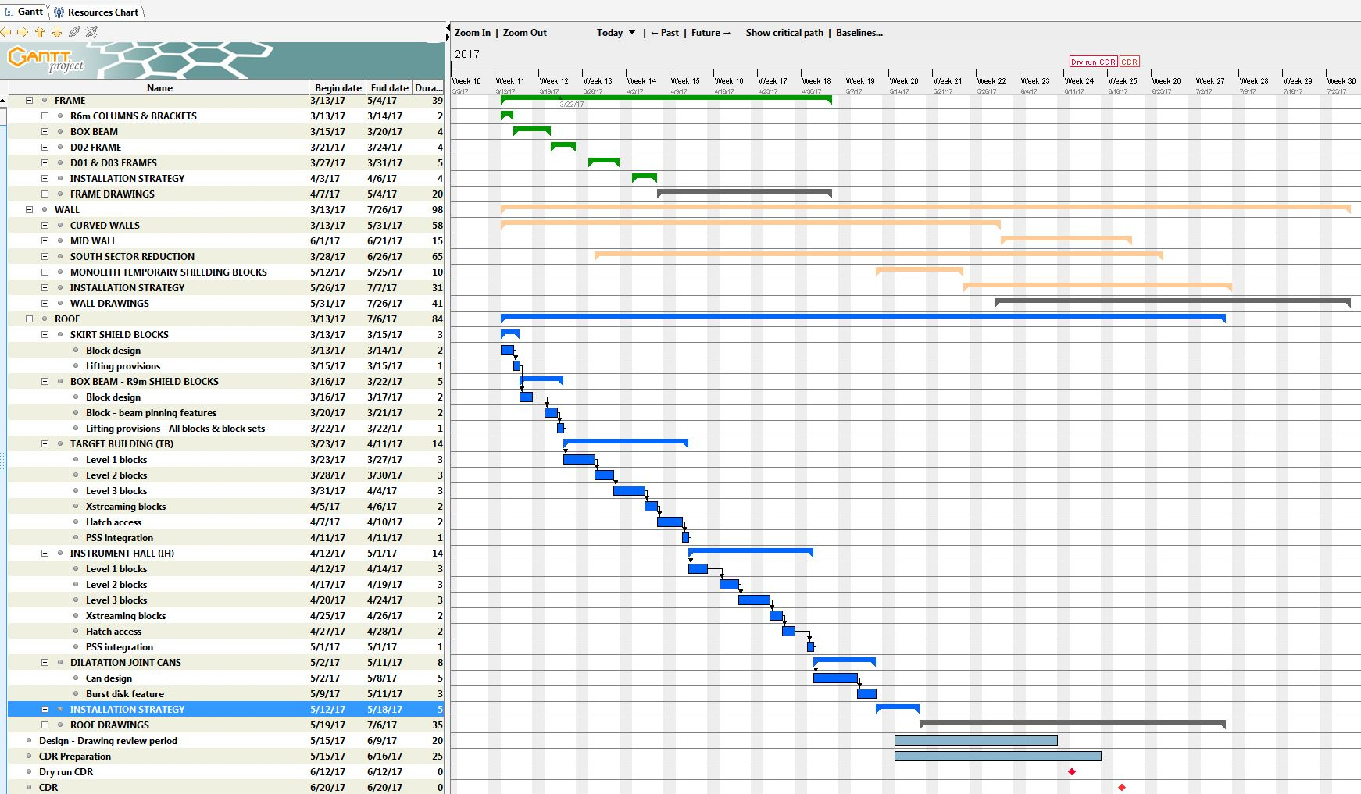
Bunker – detailed design plan (short term)
Benjamin D.

Slide 7
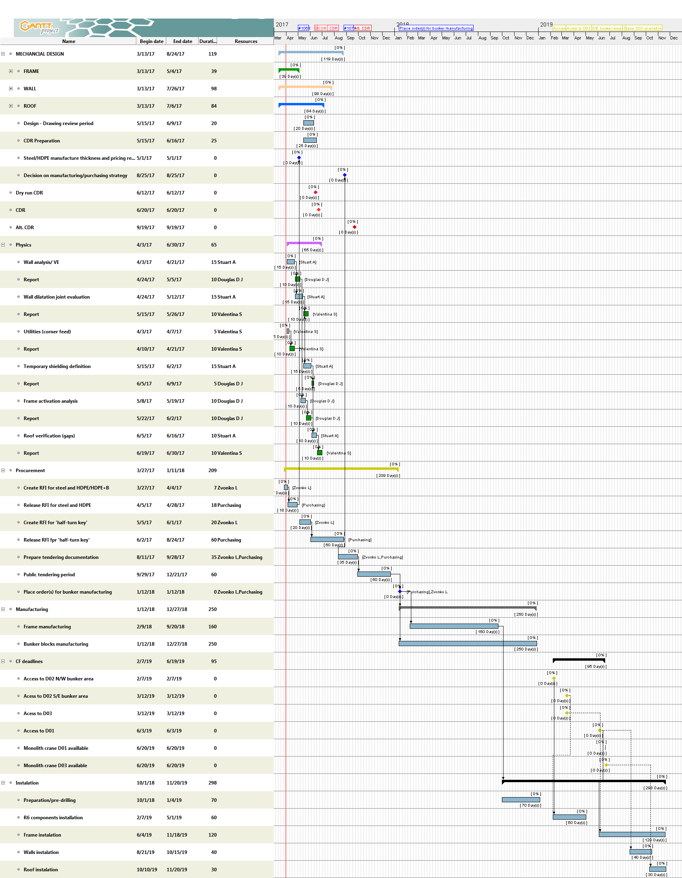
Bunker – project (long term)
Bunker project deadlines
CDR (design completed) Sep ’17
Tendering/PO placed Jan ’18
Frame delivered Dec ’18
R6 components installed May ’19
Frame installed Nov ’19
Bunker installed Dec ’19
CF deadlines
Access to D02 bunker N and W Feb ’19
Access to D02 bunker S and E Mar ’19
Access to D03 bunker W Jun ’19
Access to D01 bunker S Aug ’19
Schedule is heavily integrated with the Target and Instrument projects.
There are assumptions concerning numbers of crews working at any given time.
Further coordination and alignment of different installation plans is required

Slide 8
Neutronics - Bunker shielding concept simulations
Günter M.
Simplified bunker model, neutrons tallied exiting the bunker wall:
Straight beamline:
Open bunker versus closed bunker
Curved beamline: 2 guide widths offset at the bunker wall (i.e. once out of line of sight of the monolith exit at the bunker wall)
open bunker
open bunker with a single un-optimized collimator in the middle of the bunker
perfectly filled bunker

Slide 9
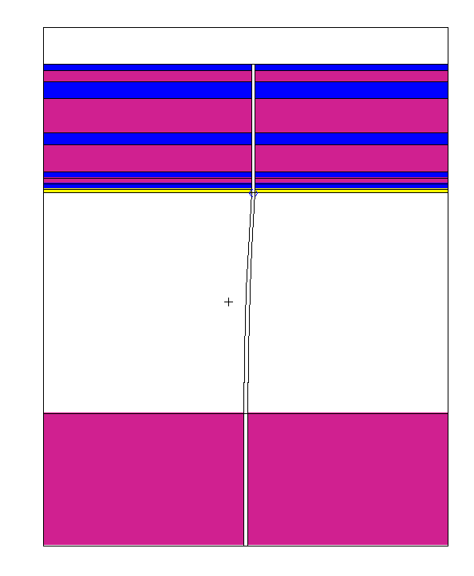
MCNP Simplified Bunker Model
Günter M.
Point Detector
Bunker wall: Composite
3.5 m
DXTRAN
Bunker
6.0 m
Monolith: Iron
3.5 m
9

Slide 10
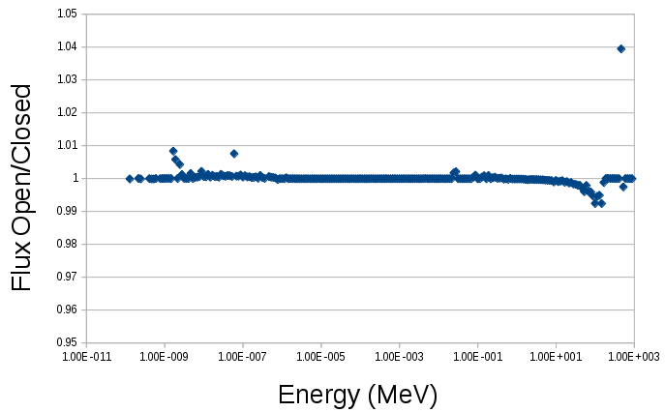
Straight Beamlines
Günter M.
Direct beam dominates, no difference between open and closed bunker design

Slide 11
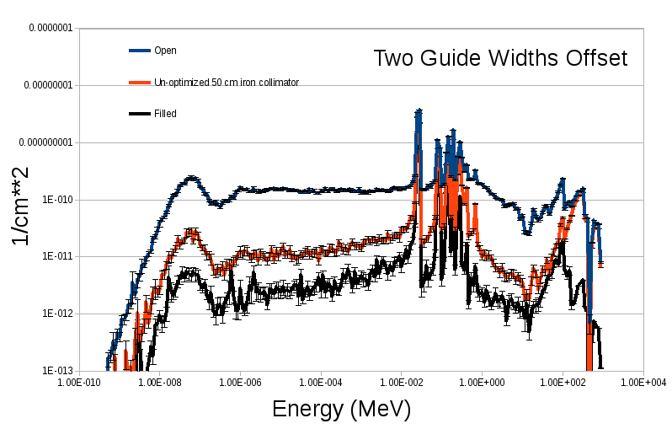
Curved Beamlines (Two Guide width offest at bunker wall)
Günter M.
Filled bunker offers best performance, but a single 50 cm un-optimized collimator
shows good improvement.

Slide 12
Curved Beamlines (Two Guide width offest at bunker wall)
Günter M.
Resonances can be eliminated with laminated collimator/other materials

Slide 13
Curved Beamlines (Two Guide width offest at bunker wall)
Günter M.
High-energy particles can be reduced with more collimators/more bending

Slide 14
Neutronics – Bunker Concept verification - Conclusions
Günter M.
Straight beamlines are dominated by the direct beam contribution
Curved beamlines should look into tradeoffs with bending and optimizing the placement/material of collimators inside the bunker
14

Slide 15
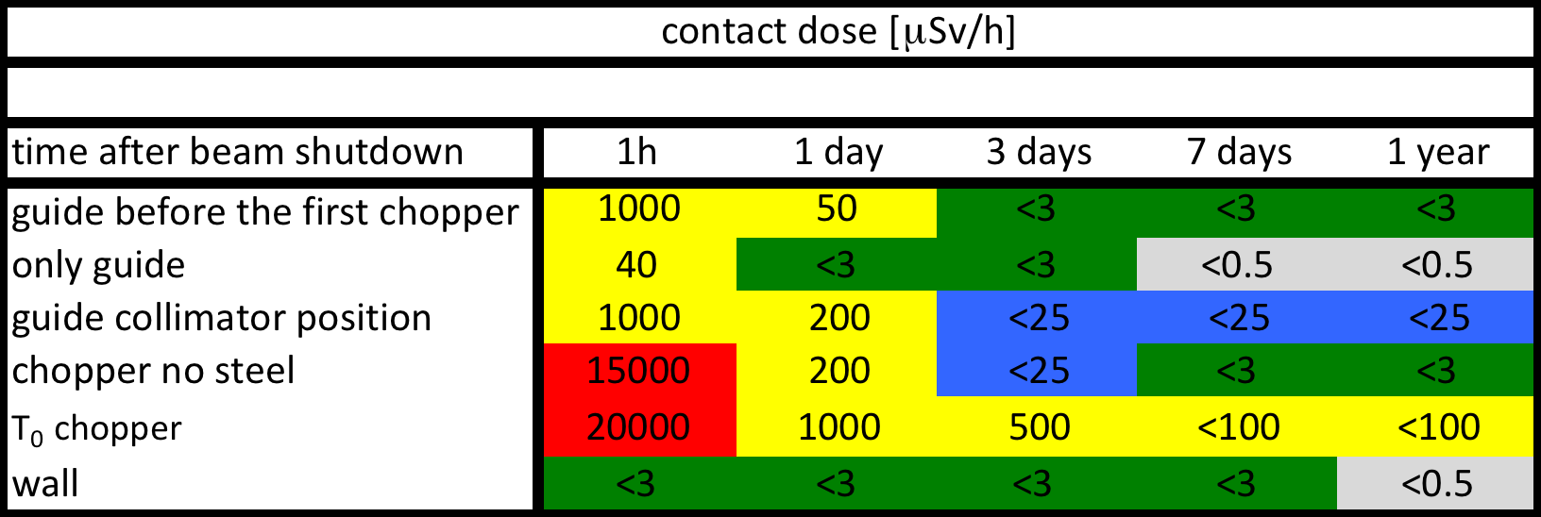
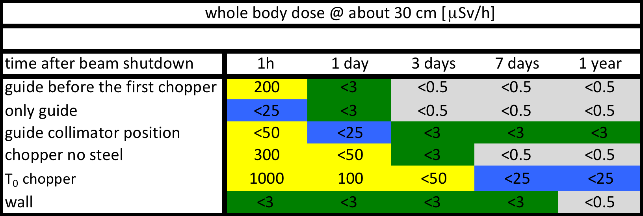
Neutronics - Access conditions
Günter M.

Slide 16
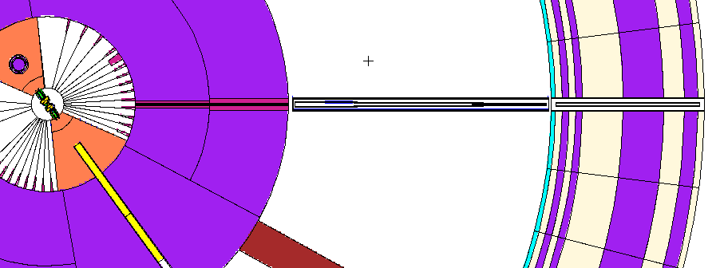
Beam line overview
Günter M.
Guide in the Monolith
Width 3.0 cm (@2m) 3.0 cm @ 5.5 m
Height 3.0 cm (@2m) 4.5 cm @ 5.5 m
Copper Substrate
Guide in the Bunker
Width 10.0 cm (@5.5m) 1.0 cm @ 11.5 m
Height 10.0 cm (@5.5 m) 1.0 cm @ 11.5 m
Aluminium Substrate

Slide 17
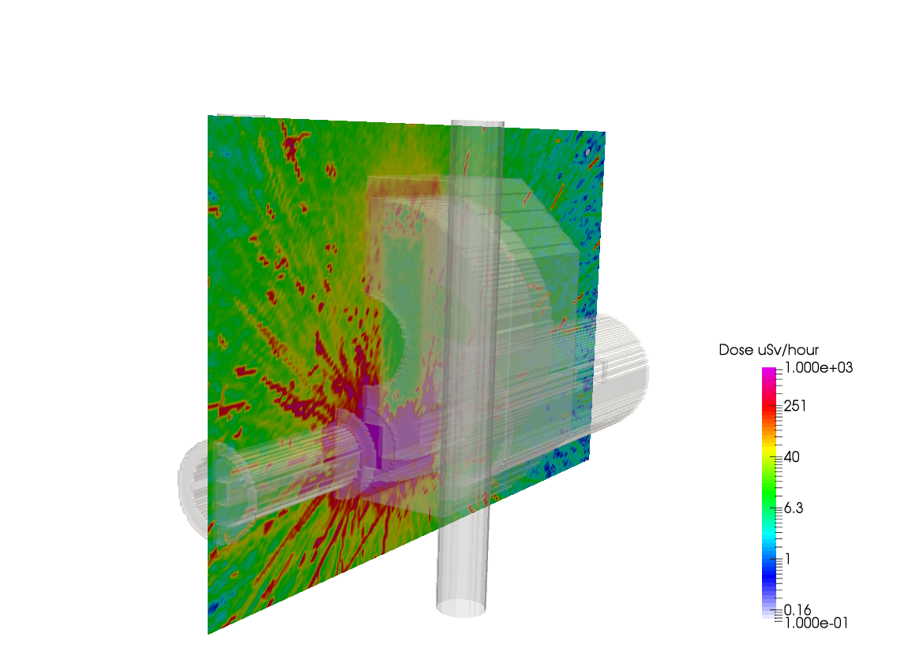
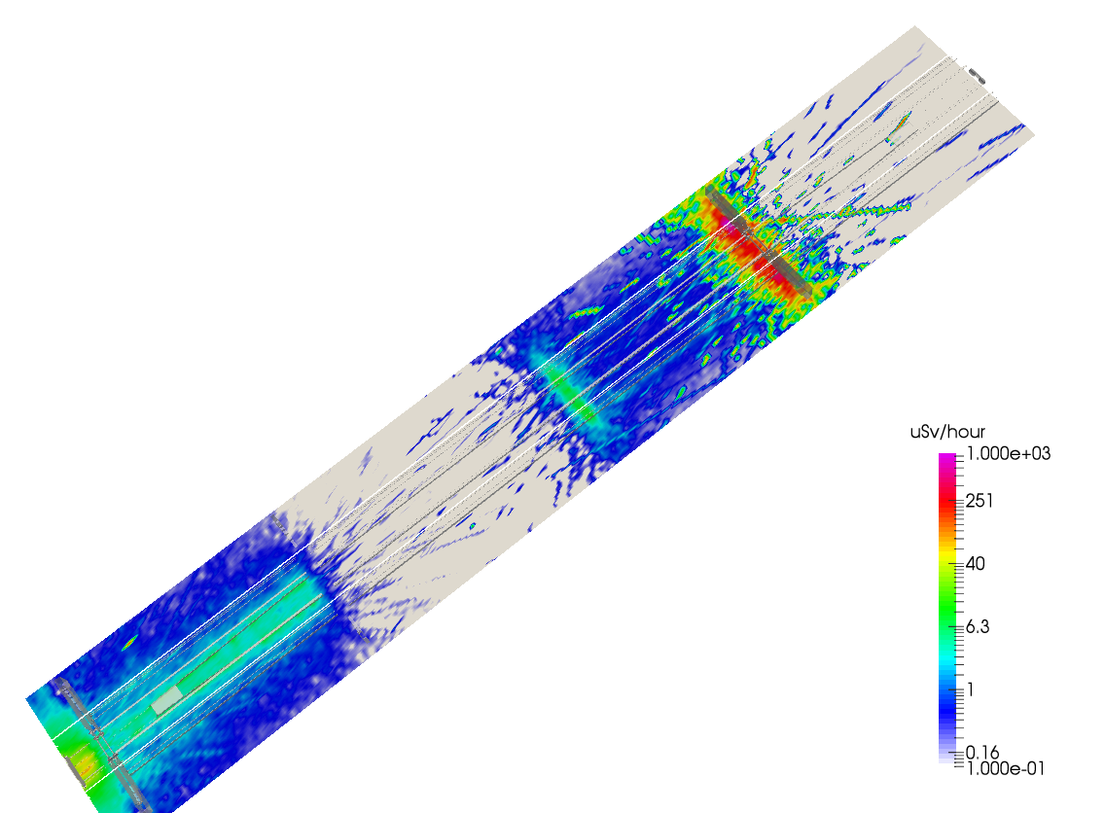
Examples: Dose rates after 1 day of cool down
Günter M.
Guide
T₀ chopper

Slide 18
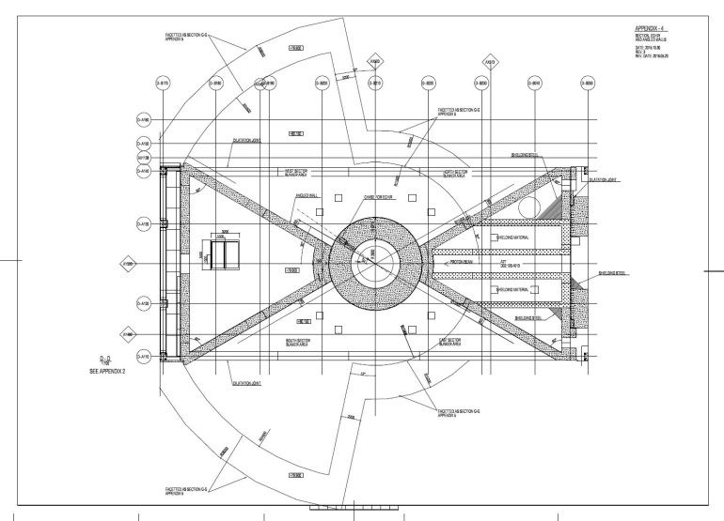
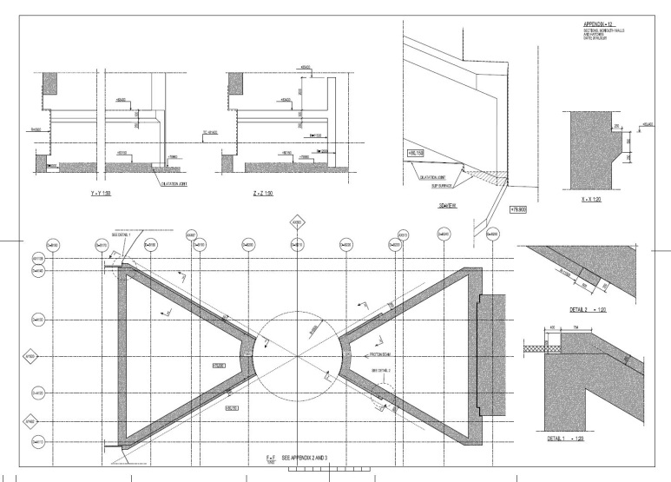
Conventional facilities_1
Benjamin D.
Baseline geometry & dimensions approved 10 June 2016
Detailed design review of D02 building (up to bunker base) approved 14 Nov 2016
Bunker base integrated with CF floor in D02 target building
Bunker base in instrument halls D01 and D03 poured by CF at time of floor slab casting (Dark grey)
Target building
Bunker base
CF floor and bunker base
Instrument hall floor (D03)
Baseline geometry document ESS-0042957, Appendix ESS-0051605

Slide 19
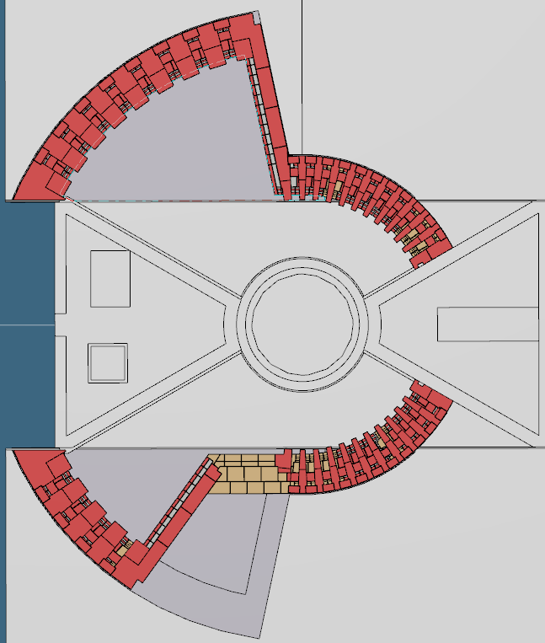
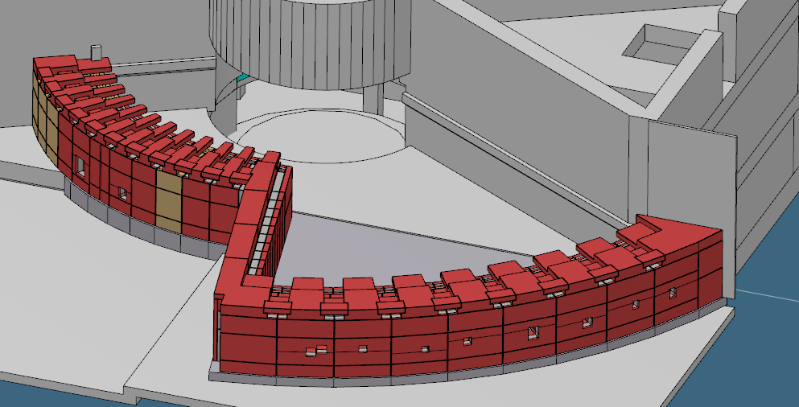
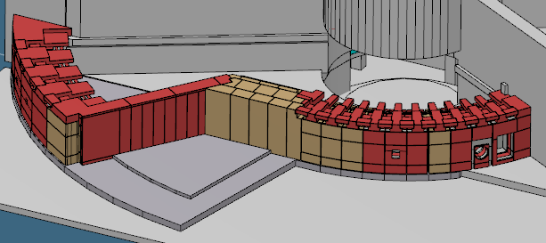
Wall structure_1
Benjamin D.
Wall structure consists of:
Short sector wall segments - covering North & East sectors
Long sector wall segments – covering West & South sectors
Mid wall
Temporary shielding
Long sector wall segments (R28m)
Mid wall
Short sector wall segments (R15m)
West
North
East
South
Temporary shielding
Short sector wall segments (R15m)
Long sector wall segments (R28m)
Mid wall

Slide 20
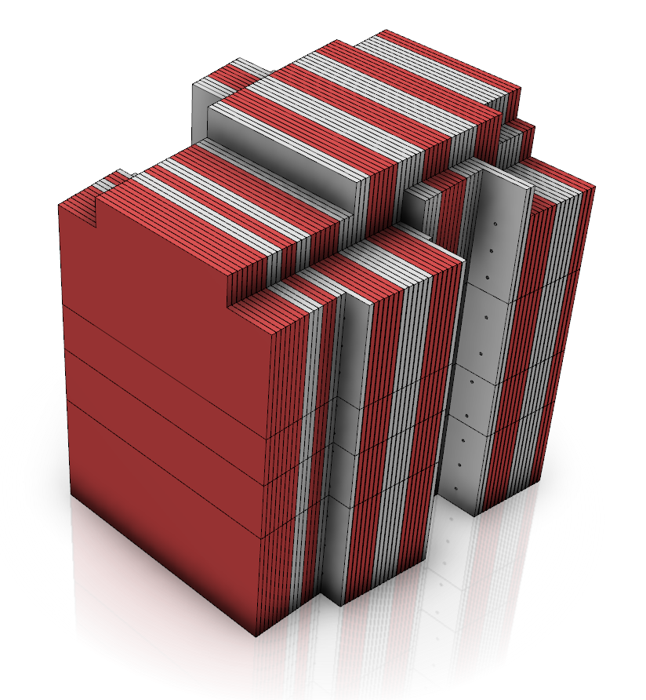
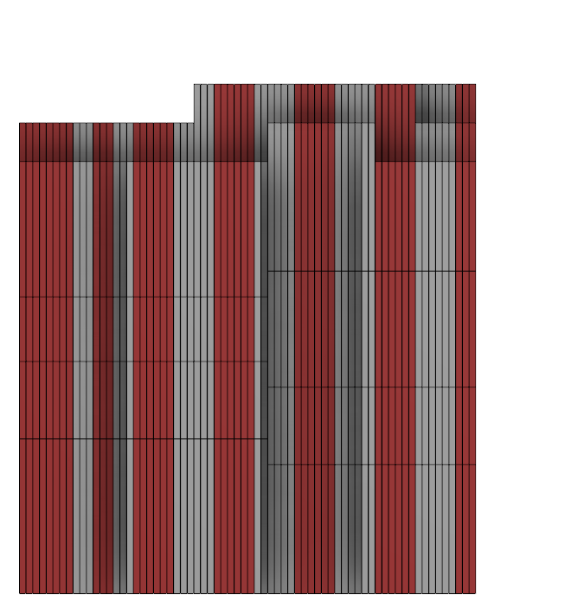
Wall structure_2
Benjamin D.
Composite wall structure due to floor load limit & space constraints
Short & long sector wall segments have same composite structure
Shine path underneath floor mitigated by 250mm bunker base step-down
Chicane step provided in roof
Steel
Chicane step
Roof level
HDPE - Borated (Layer 1)
Bunker base

Slide 21
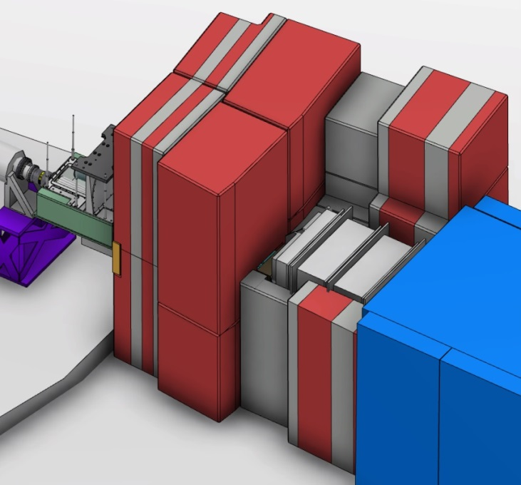
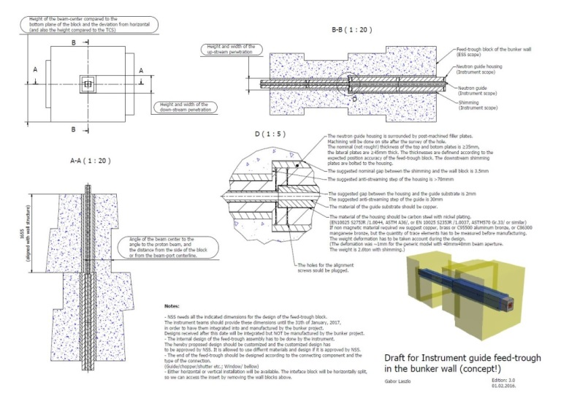
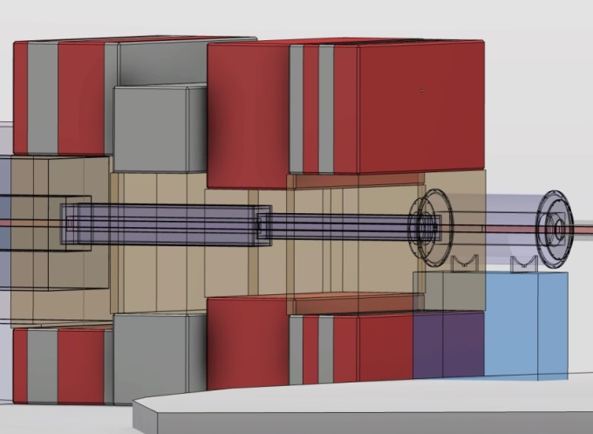
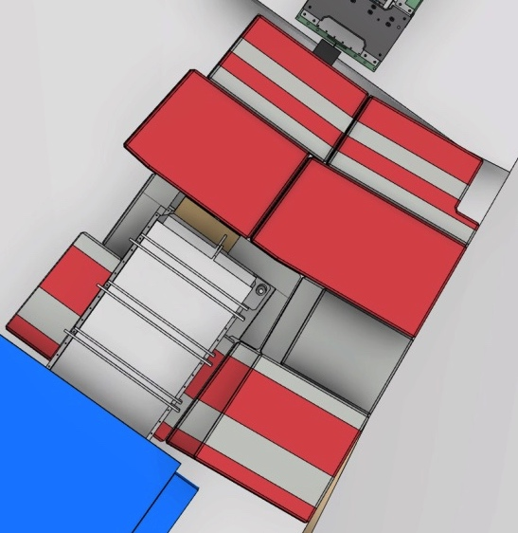
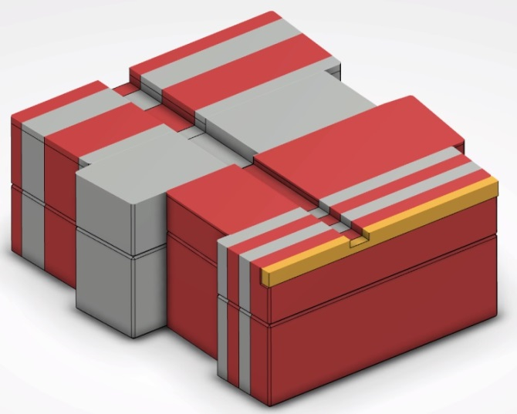
Wall structure – Instrument integration
Benjamin D.
At least 2 require modification of adjacent wall blocks
In 1 case large sections of bunker wall removed to allow integration
Simple feed through
Complex feed through

Slide 22
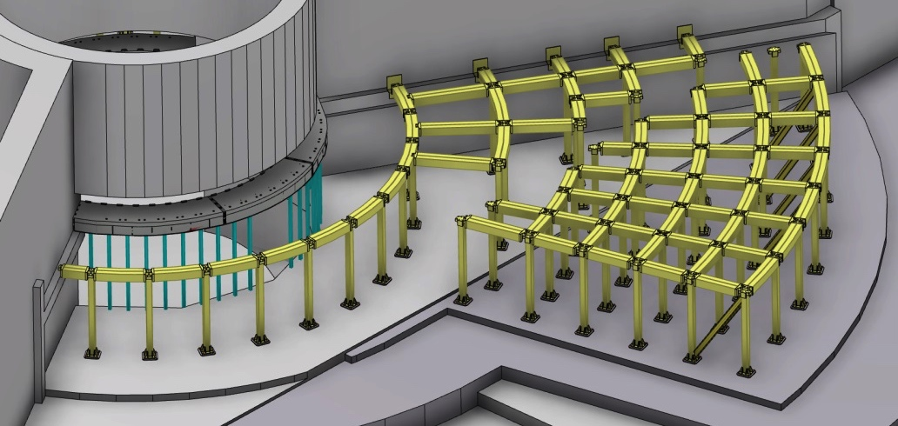
Support frame
Benjamin D.
Bunker geometry consists of large internal cavity - support structure is required.
Design considerations:
Support bunker roof load
Support additional load for removed roof block placement during maintenance
Prevent roof blocks impacting monolith during an H4 seismic event
Maintain open cavity characteristics of internal bunker volume
Provide minimal spatial constraints for beamlines & equipment
All elements to be removable as needed during maintenance
Supporting frame elements:
R6m frame - columns attached to large radial box beam
Target building frame - columns & top beams
Instrument hall frame - columns, top beams & angled brace beams
R6m frame
Target building frame
Instrument hall frame
North & West sector

Slide 23
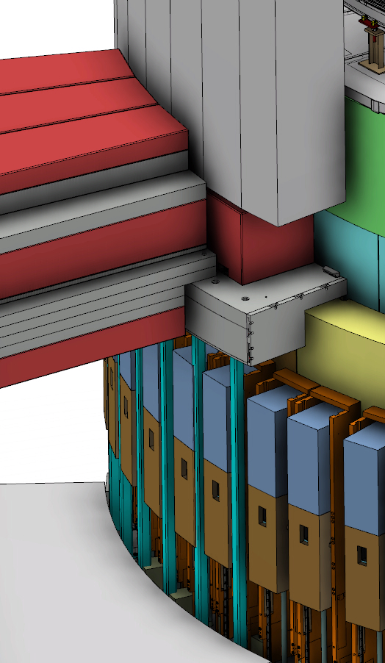
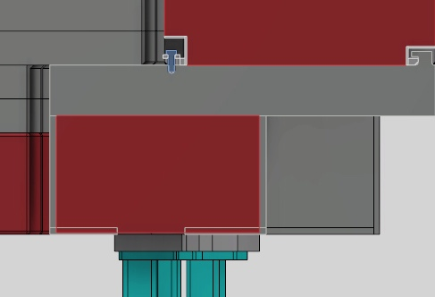
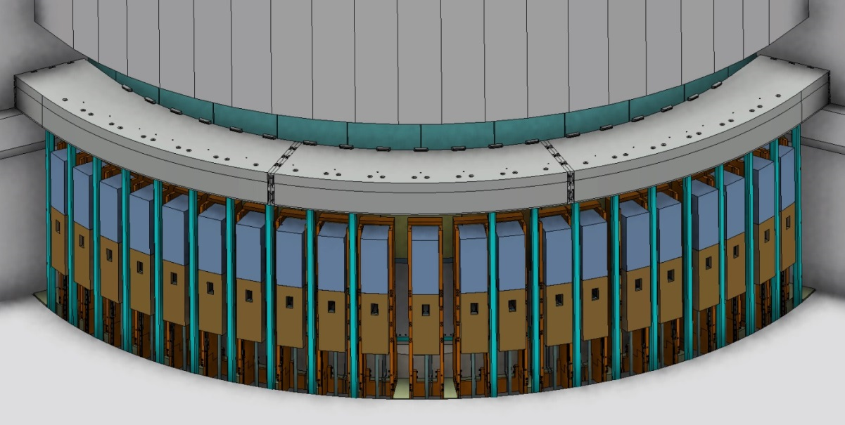
Support frame – R6m
Benjamin D.
A box beam and vertical support columns selected at R6m due to severe spatial constraints & tight interfaces in this area
Anchoring beam into side walls at each end allows transfer of large loads into wall structure
Box beam provides shielding
PDR recommendation to review weakened shielding in R6m area
Redesign/alterations underway
Top beam plate 150mm of steel
Box beam front face R6.2m (from TCS)
Anchoring to side wall
Box beam
Beam filled with Borated wax
Vertical columns

Slide 24
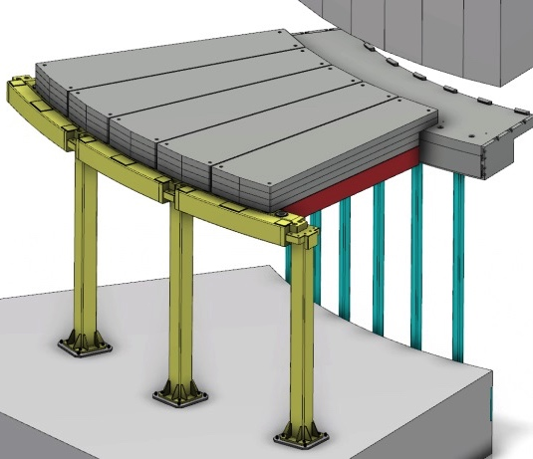
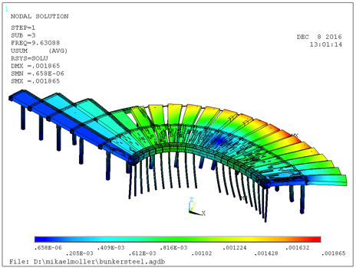
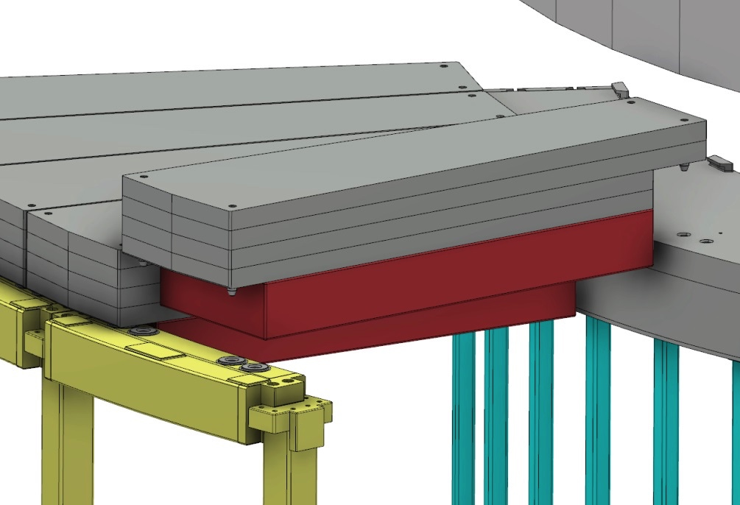
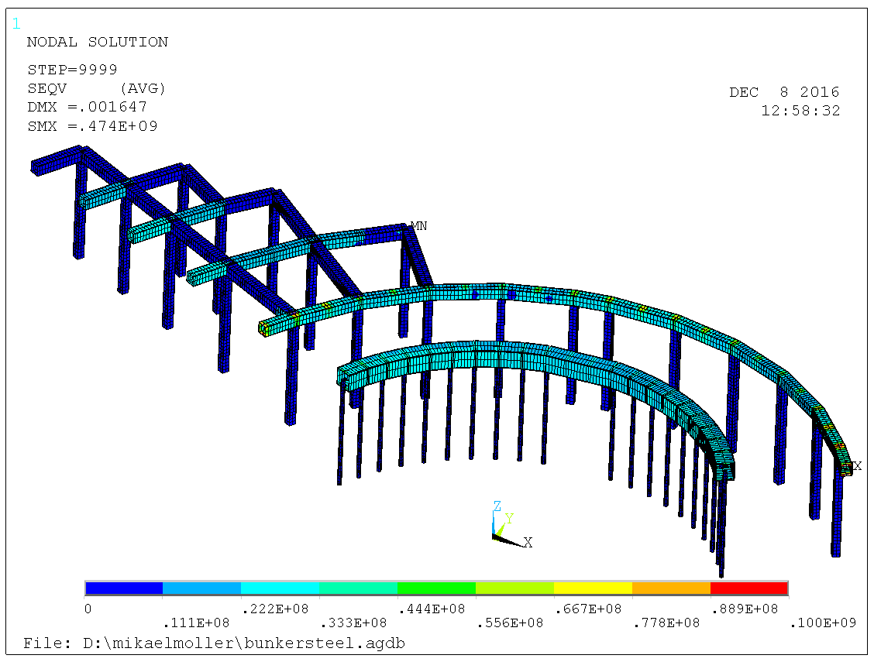
Support frame – Target building
Benjamin D.
Structural analysis performed to evaluate loads during different load cases
Most prominent load case is that for an H4 seismic event
Must resist these loads and remain standing
Analysis shows requirement for connection between R6m and R9m frame elements in horizontal plane (for H4 event)
R6m – R9m area most densely populated
Second (steel) layer of roof blocks utilized to provide connection
Pins used to transfer horizontal loads
Steel layer of first block
Pins in block
Corresponding pockets in beam
Corresponding pockets in box beam
Detailed preliminary analysis can be found in report ESS-0087554

Slide 25
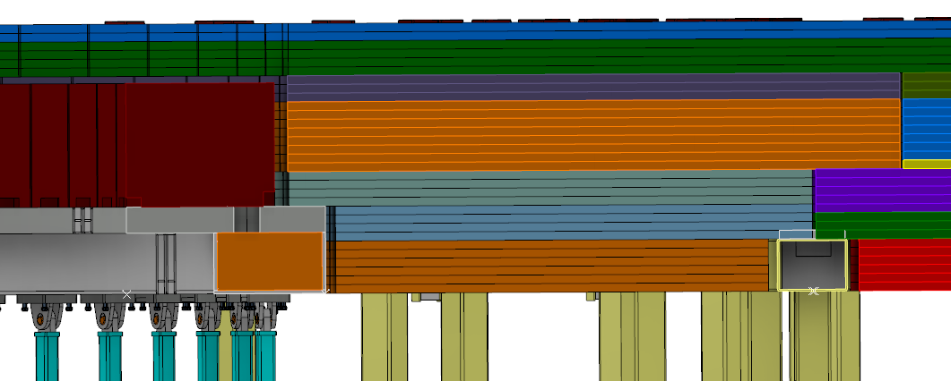
Roof
Benjamin D.
Composite roof structure chosen from necessity to minimize overall thickness (Crane height restrictions) and to minimize total mass
All streaming paths mitigated following 10:1 chicane rule
Roof blocks must not impact monolith during H4 seismic event
CF requirements demand propogation of dilatation gap through roof to minimize interaction of loads
Minimize access times
Monolith Outer face (R5.86m)
Roof layer description
Layer | Material | Thickness (mm)
1 | HDPE + B | 100
2 | Steel | 350
3 | HDPE | 400
4 | Steel | 400
5 | HDPE+B | 300
Total roof thickness of 1.55m
Inside bunker

Slide 26
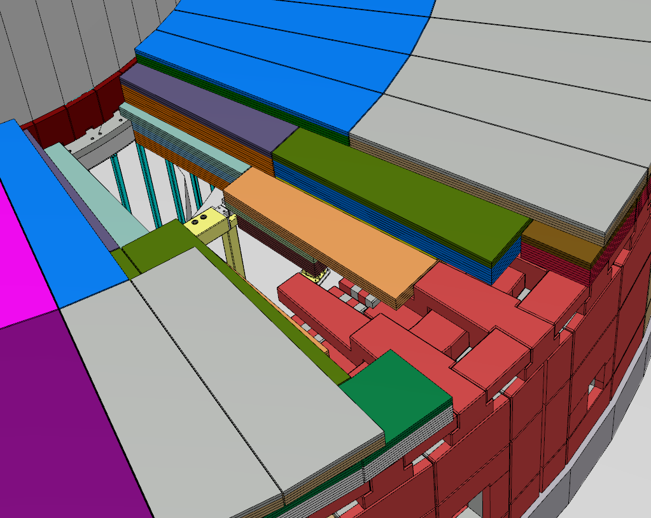
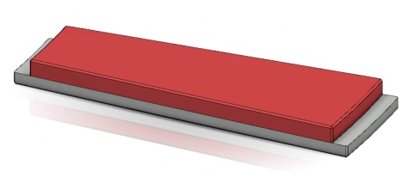
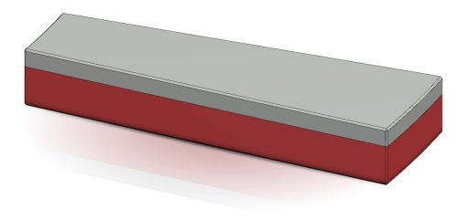
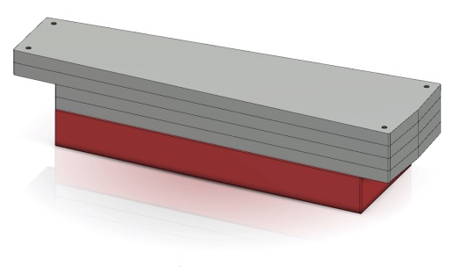
Roof
Benjamin D.
3 level overlapping concept chosen
Level 1 provides base for support of subsequent block layers
All 3 block levels overlap to mitigate streaming paths
Overlapping optimized to create minimum block ‘lock-up’
Xstreaming blocks on top layer mitigate small streaming path at intersection between level 1 blocks
Simple block geometries
Level 3 block
Level 2 block
Level 3
Level 1 block
Level 2
Level 1
Utilities block

Slide 27
Q/A
Benjamin D.
Thank you!
Q/A time

Slide 28
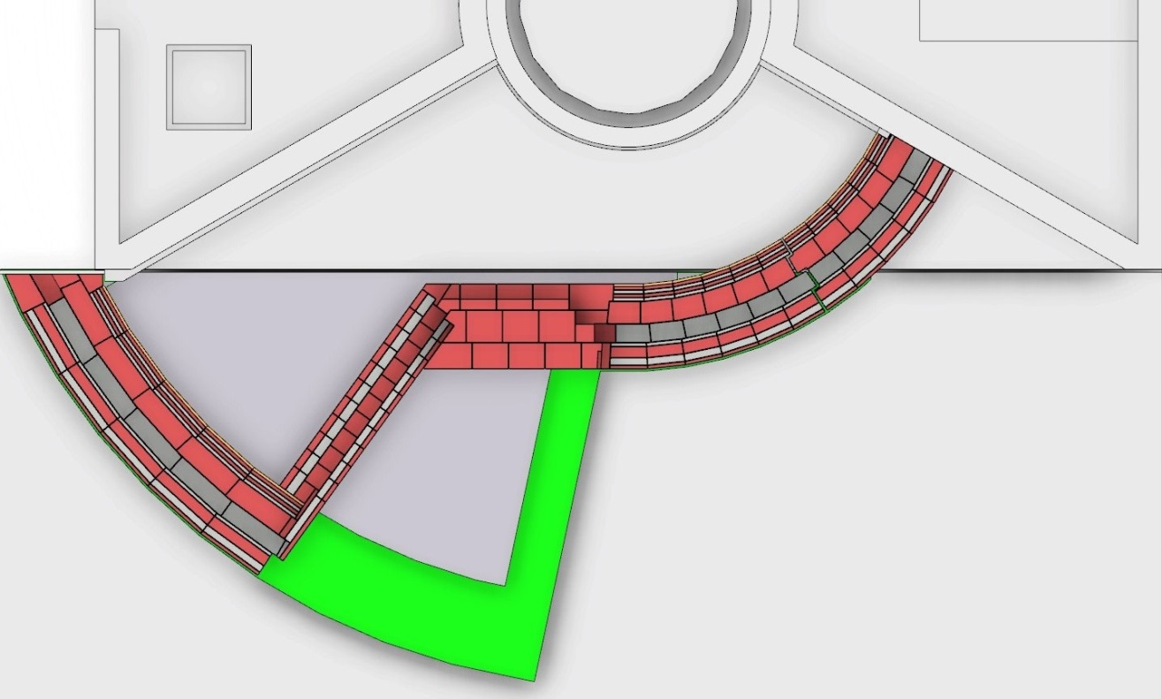
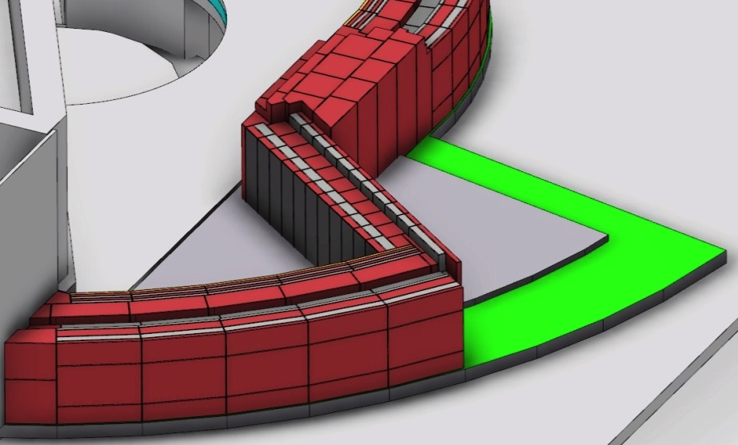
Wall structure – Reduced south sector
Benjamin D.
First 4 usable beamport wall blocks initially installed in the long sector (S1-S4)
Use of standard mid wall blocks (as used for full South sector)
Temporary shielding implemented in remaining beamport positions
Concept accomodates extension to full South Sector with minimal block replacement
Short segment interface with temporary shielding
Mid wall interface with temporary shielding
S1
E9
E8
S2
S11
E10
S3
Temporary shielding
S4
Standard mid wall geometry
Area showing upgrade potential to full south sector

Slide 29
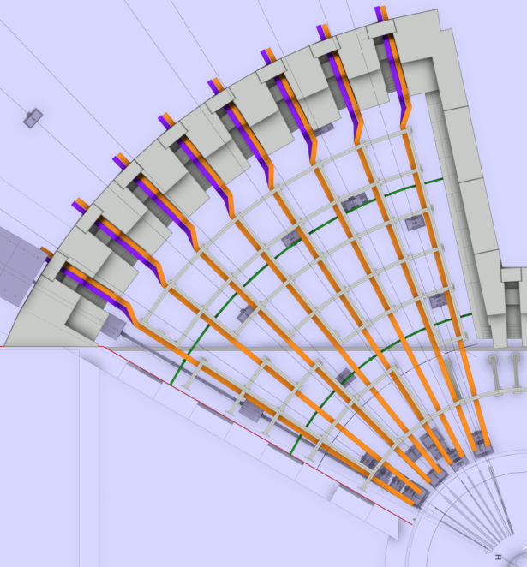
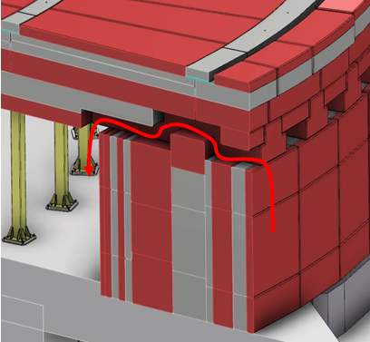
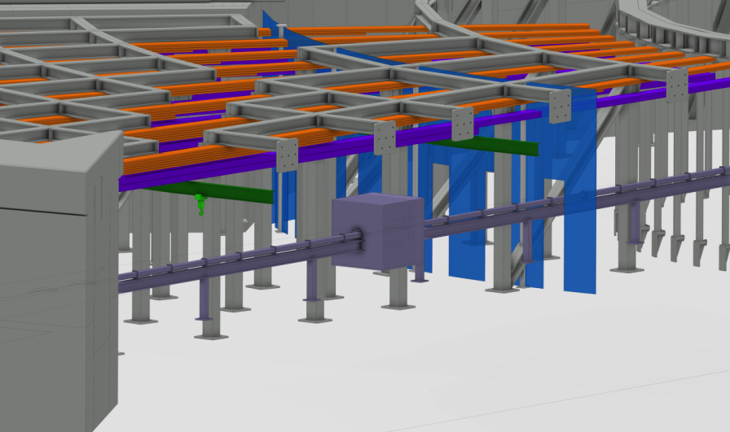
Wall structure – Utilities feed through
Benjamin D.
Utilities routing inside the bunker with cable trays attached to columns
Columns have provisions for mounting trays in various positions
Trays to be mounted high for easy access & removal
Umbilical concept to be employed
Overhead cable trays facilitate connection & disconnection of cords outside the bunker
Umbilical
Cable trays
Trays sit directly below beams
Trays attached to columns
Images courtesy of Erik Nilsson

