Slide 1
Neutron Beam Extraction System Design status for TAC-15
Jarich Koning
Sara Ghatnekar, Naja de la Cour, Bengt Jönsson
www.europeanspallationsource.se
6th April 2017

Slide 2
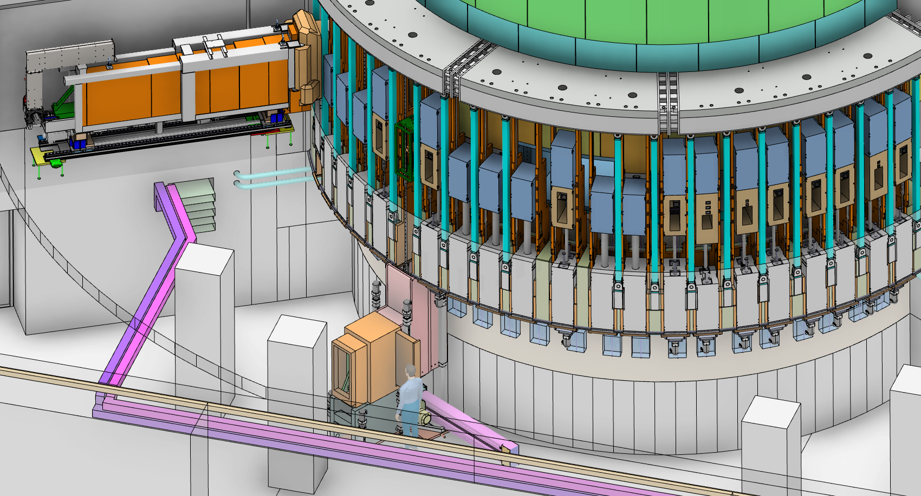
NBEX overview
Breakdown
Neutron Beam Port Insert
Neutron Beam Window
Light Shutter System
Handling & Installation Tooling
Test stands

Slide 3
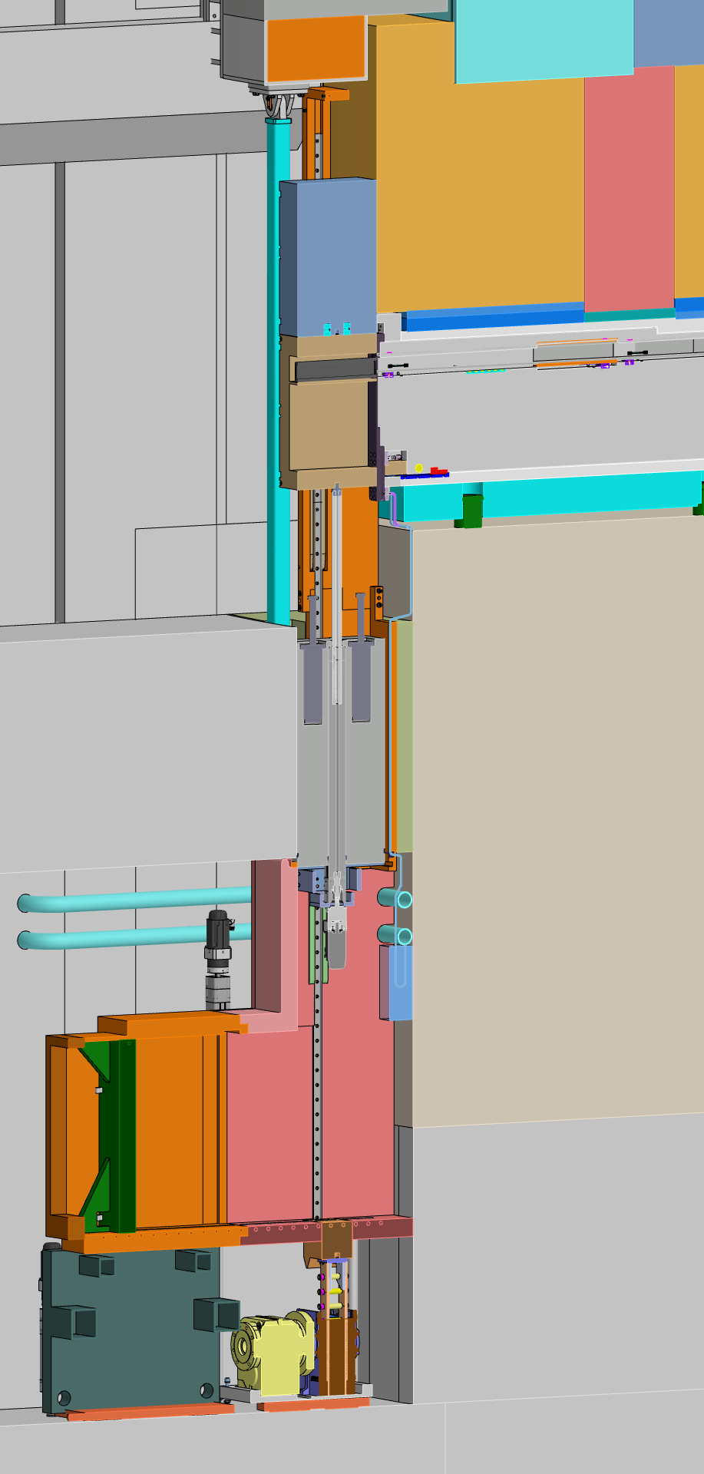
Light Shutter System
GBS
Gamma-Beam-Shutter (GBS) on top of Bridge-Beam-Guide (BBG).
“Light shutter” comprises GBS+BBG
BBG internals are up to instrument
Each ‘Shutter’ has ballscrew-style actuator
Brake is ‘normally open’ → no power means GBS closes by gravity descent
Actuator pushes BBG up to mount against NBW
During maintenance, GBS will stay in front of beam port on dedicated hooks
Bunker-floor-to-Vessel gap shielded as much as possible
All handling from basement, except:
NBPI exchange: from Bunker
Rescue scenarios: from Bunker
BBG
NBPI
Bunker roof support
GBS hooks
NBW
Floor fill shielding
Bunker floor
Floor filler block
Handling tooling
Shutter actuator
Rigid chain actuator

Slide 4
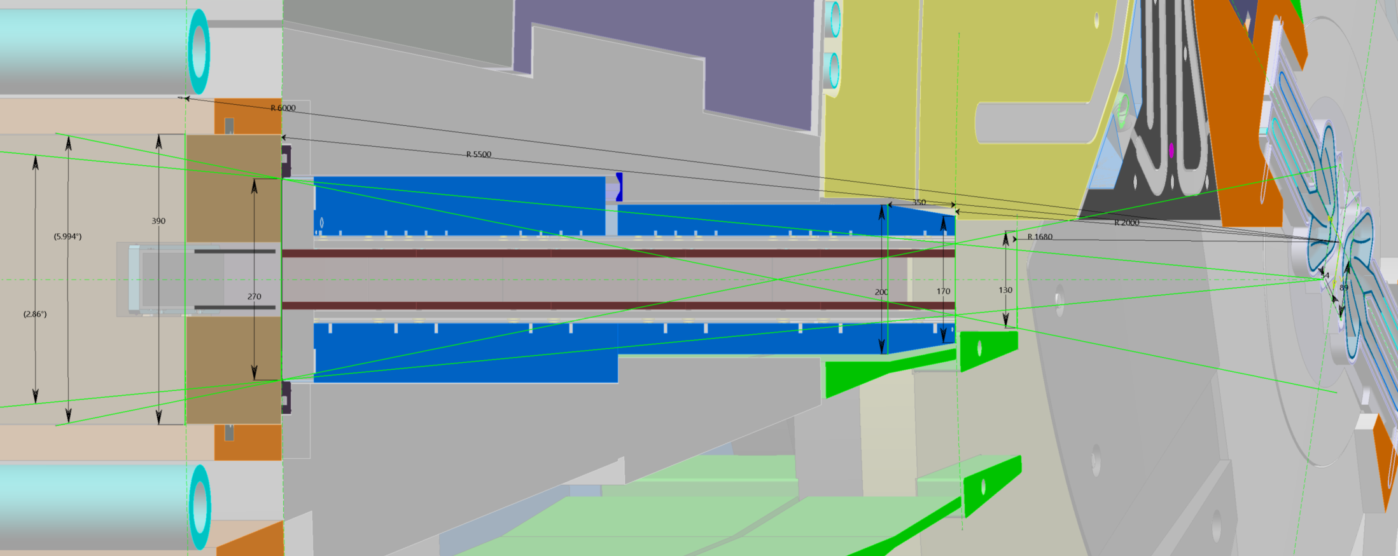
Optic envelope up to R6m
Horizontal cross-section
NBPI: ~130mm @ ~R1.68m, 170mm @ R2m, 200mm @ R2.35m, 270mm @ R3.75m
NBW max width could be 270mm
Light shutter width available is 390mm max (from R5.5m to R6.0m)
Max opening: from focal point 2.86°, a pinhole in NBPI yields 6.00°

Slide 5
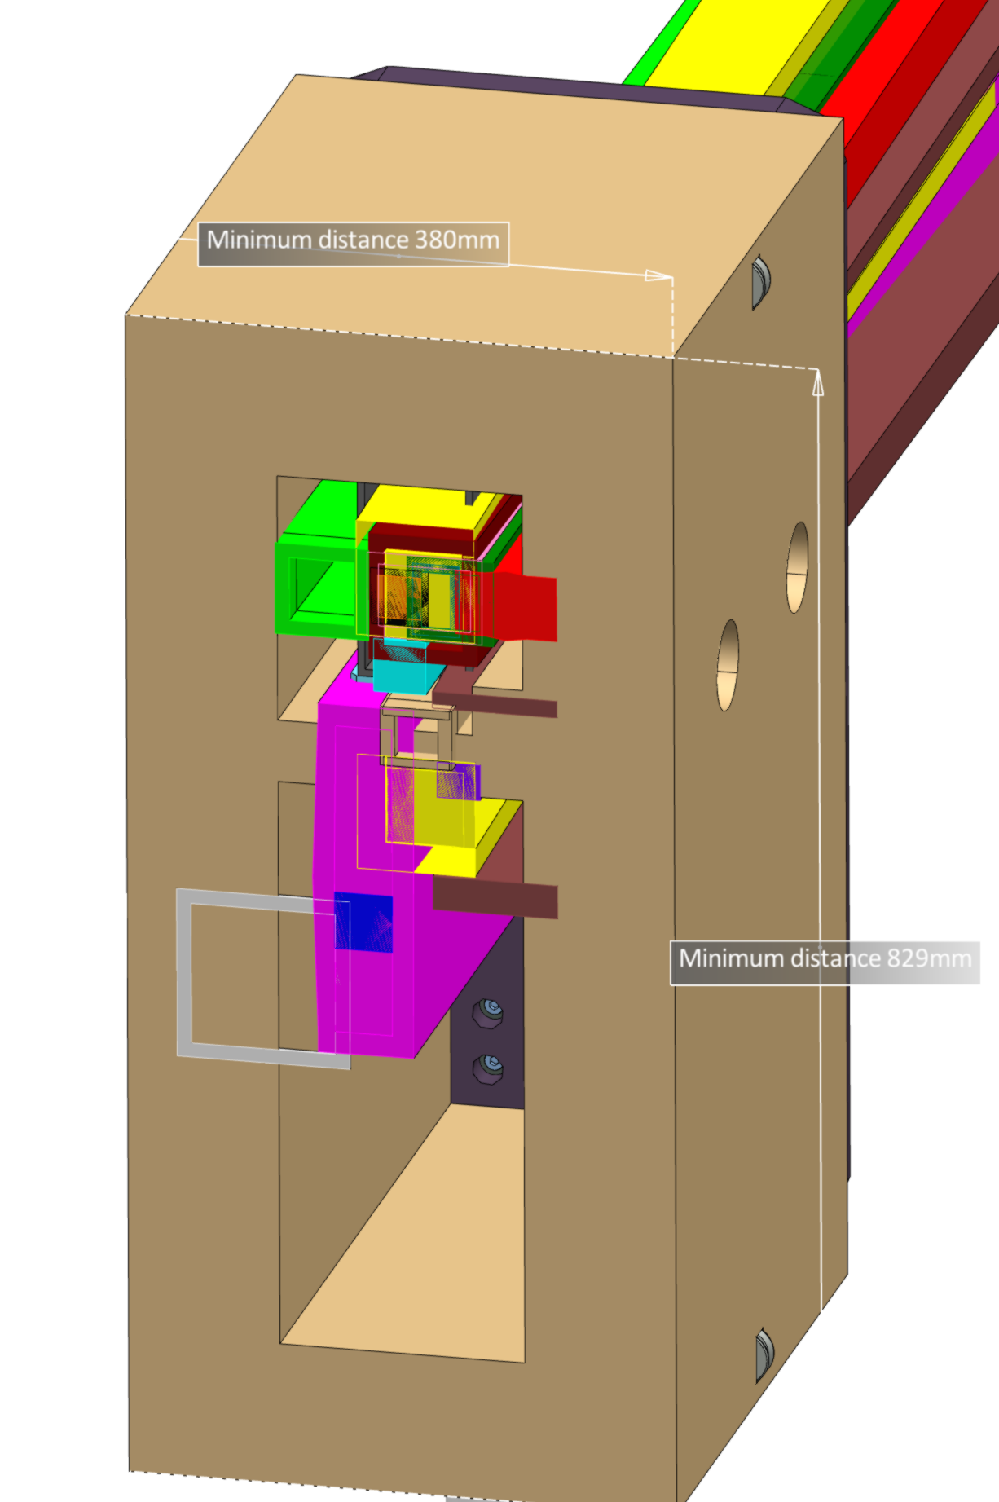
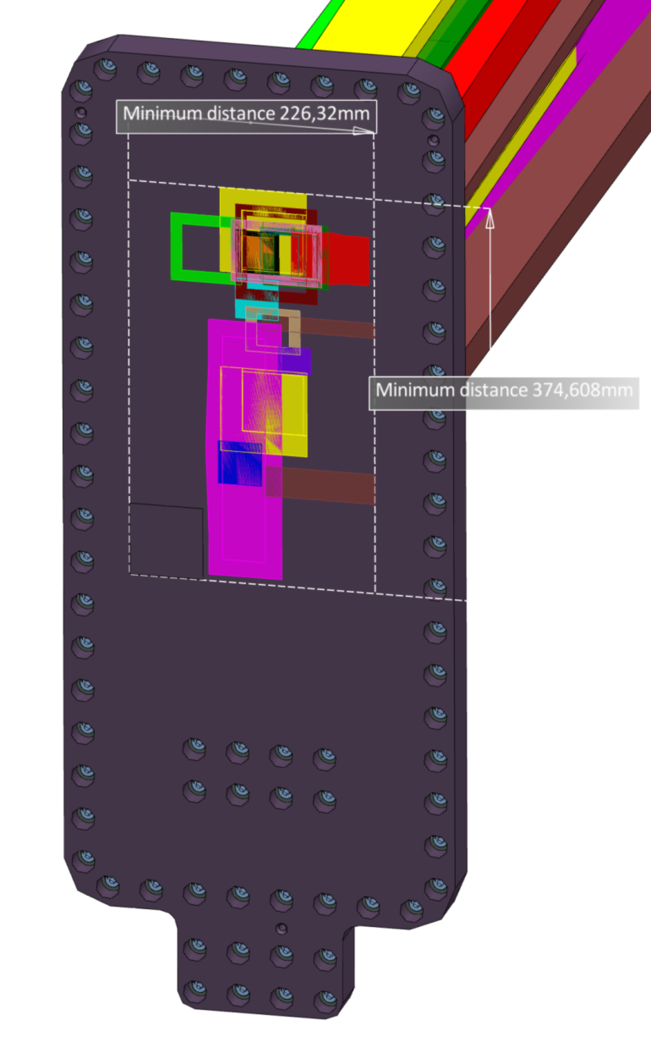
Beamlines in BBG and NBW
This status is 12-2016, much has changed!
FREIA (pink)
HEIMDAL (red&blue)
LOKI (purple)
NMX (green)
ESTIA (yellow)
SKADI (light brown)
MAGIC (cyan)
BIFROST (dark green)
T-REX (light pink)
TEST (brown)
ODIN (white)
DREAM (dark cyan)
BEER (orange)
C-SPEC (dark red)
VESPA (black)
Beamline geometries up to R6m are frozen per 31-03-2017
Instrument models (G. László)
NBEX baseline geometries (J.F. Koning)
Instrument NBOA (I. Sutton)

Slide 6
Installation
Ports for NBPI: ±1mm, budgeted at ±0.5mm for shape, and ±0.5mm for alignment
NBOA aligned w.r.t. NBPI mounts ±0.05mm
NBPI mounts aligned per direction with ± 0.05mm
After all ports are done, TCS X&Y are defined
Values w.r.t. TCS (absolute) if not otherwise noted
GBS
BPCS
NBW
TNBA = Theoretical Neutron Beam Axis
BBG
Z
X
NBPI
Bunker beam line
NBOA
Mounts
Mounts
Mounts
Mounts
Port blocks
Light shutter blocks on rails and vertical ballscrew with servo repeat to ±0.05mm
Baseplate
Experiment Hall
floor
Target building
Bunker floor
Filling
Monolith concrete
FFB
Flat and level on topside within ± 0.2 after alignment. Grouting fill keeps shape under loading.
TCS Z value derived from central ‘vessel support (not shown)
Pillar/walls
Supports Bi-spectral switch in BBG
NBW w.r.t. port
±0.3mm (bolts)
Light shutter structure ±0.5mm
NBPI shape ±1mm
Feedback to correct absolute position needs to come from instrument
Target building base slab
Notes:
TNBA=Theoretical Neutron Beamline Axis
BPCS = Beam Port Coordinate System. Definition: X=downstream, Z=up. Location: 5500mm from TCS at the respective port angle looking at the respective focal point

Slide 7
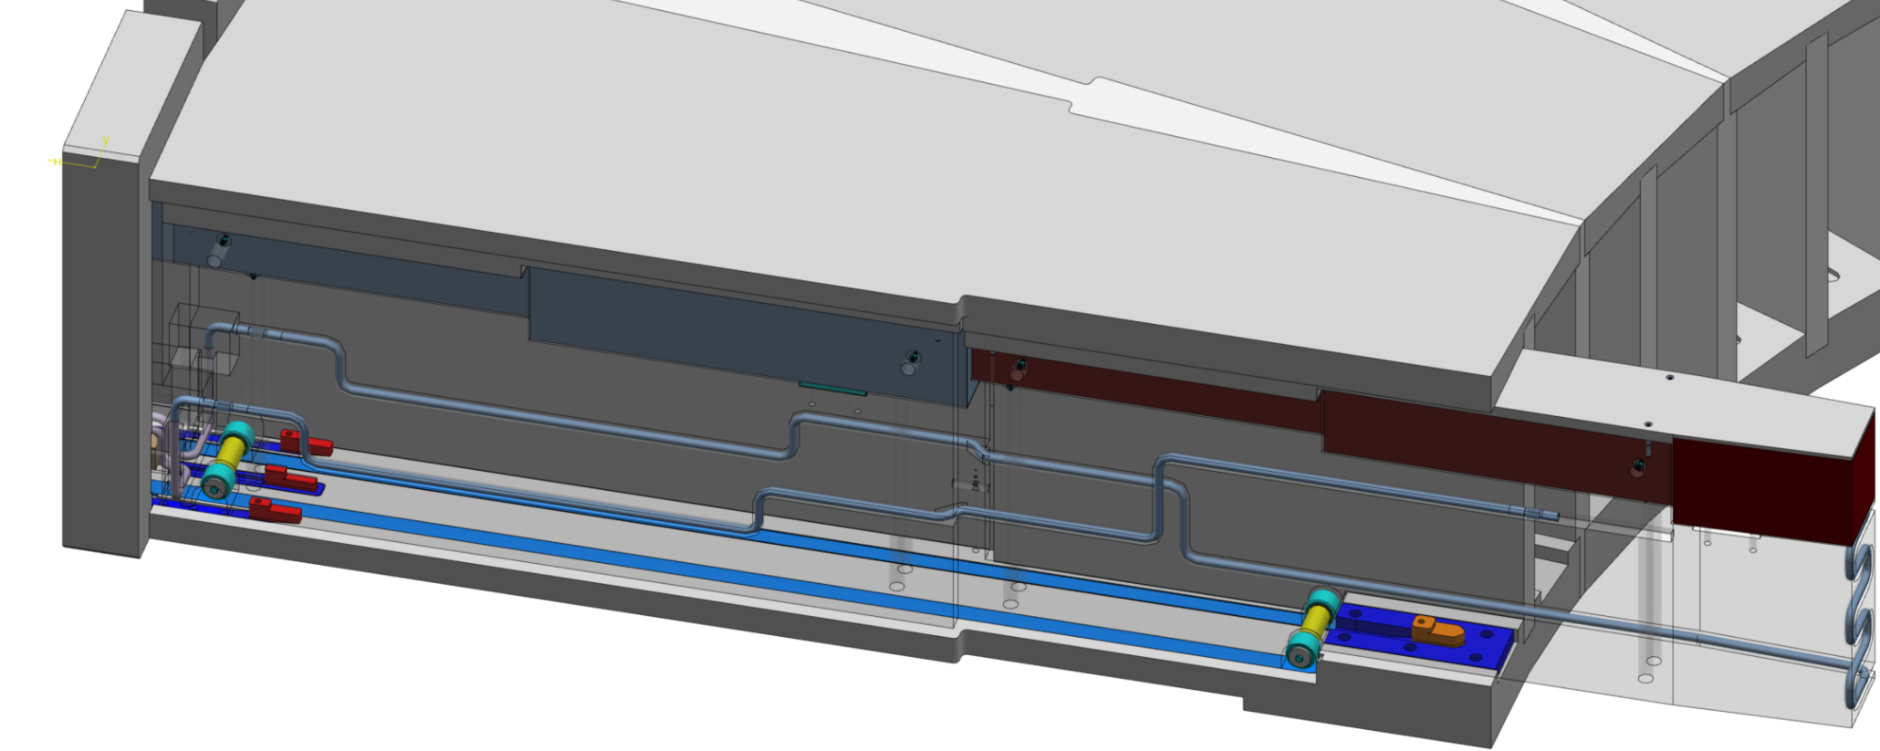
Alignment system for NBPI
All Final Alignment units (blue) to be adjusted and assembled after Port Block installed in Monolith.
X
BPCS
Y
Guide rails
(no alignment)
Alignment
Y (side)
Z (one foot)
Alignment
Z, two feet
Alignment
Y (side)
X (end-stop)
Z
X
BPCS
Y
NBPI
CoG
Full kinematic mount

Slide 8
NBW: one-piece Al6061T6
Vacuum seals milled into NBW
One piece of Al6061T6
NBW Surface (link):
Max: H 562 x W 270mm
Variant 1: H 380 x W 240mm Vertically TCS -183mm to +197mm
RH features integrated
NBPI engaging force integrated
Water connectors integrated
Helium leak-testing integrated
Test for multiple use
NBW area
Vacuum sealing edge
Max NBW area
Cooling connections
Proto to be delivered 10-04-2017
Helium leak-testing line

Slide 9
Window thicknesses
Monolith NBW
Hazard of projectile impacting NBW, then MR, drives thickness (ESS-0064402), based on projectile definition (ESS-0061754)
NBW Height x Width irrelevant for projectile impact: 4.0mm Al necessary
Common 380x240 area captures known instruments
For 1bar Δp 4.0mm thickness (ESS-0064402) needed, results 1.8mm deflection max.
In BBG (light shutter) to enclose air:
2 x ‘foil’, e.g. 0.5mm
Up to instruments
NBPI windows
Unknown yet, as thin as possible for area of specific instrument
Common sealing edge to NBPI if possible
Can further constrain optical envelopes

Slide 10
NBPI Windows
From Target perspective the NBPI does not need windows
Not needed for ‘looking holes’ (TEST, MAGIC)
Off normal monolith atmosphere: still risk on nitric acid → NBPI windows
Windows have to survive pressure vessel testing 175kPa and/or 1bar Δp
Integrate Helium loop -> under review
NBPI lid
NBOAs
Monolith
NBW
NBPI window (upstream)
NBPI body
NBPI window (downstream)

Slide 11
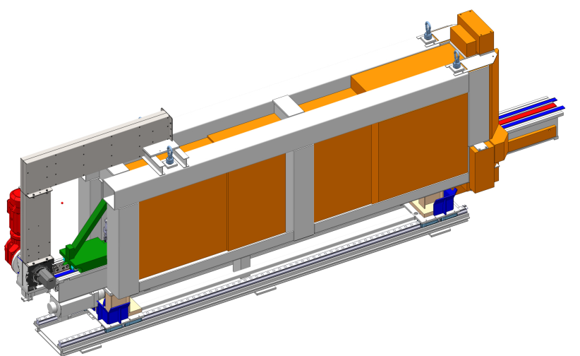
NBEX Handling Strategy
Lower shielding
Shutter cask on cart
Lower shielding cart
Light Shutter blocks handling
Remove shutter actuator
Remove blocks one by one in basement using
Rigid chain actuator from basement
Block locking system in lower shielding assembly
Radiating blocks
Shall use lower shielding vault in basement
Shall use shutter cask
NBPI handling
Clear light shutter blocks and NBW
Clear beamline (possibly adjacent beamlines’ equip.)
Install and use NBPI exchange tool
NBW handling
Use several tools from basement like the shutter blocks
Move in vertical vault only, except for rescue: bunker access needed
Support table
NBPI Exchange
Floor Unit
One of the NBW handling tools

Slide 12
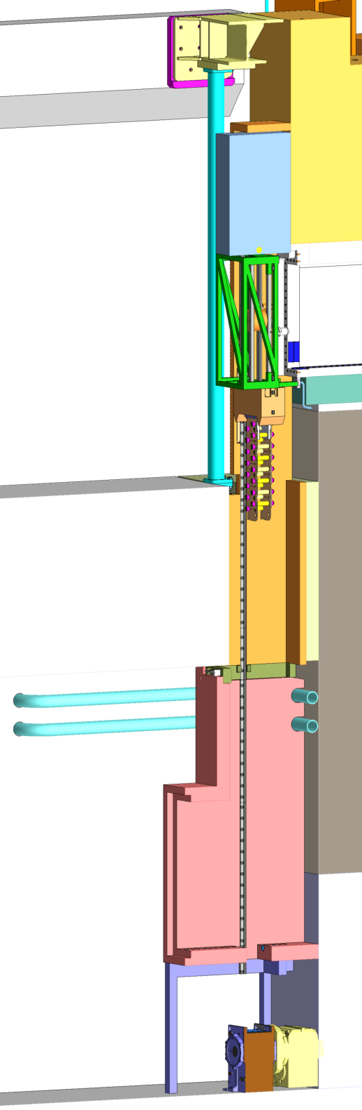
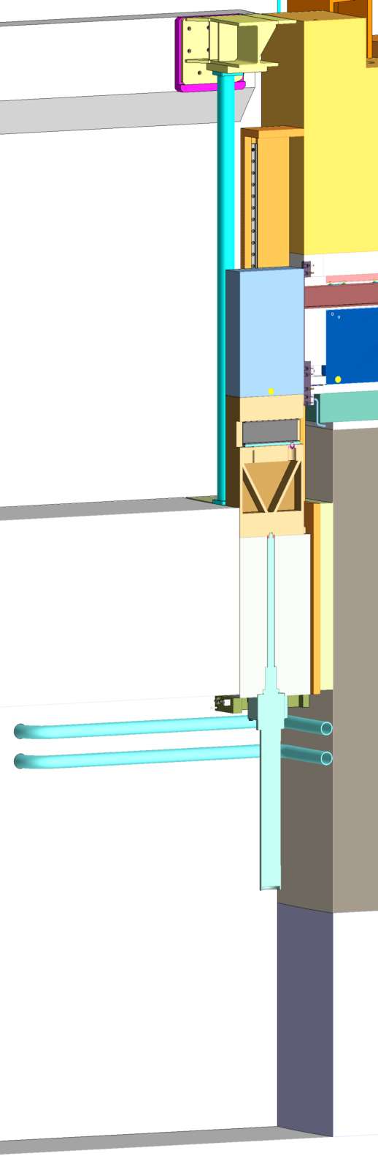
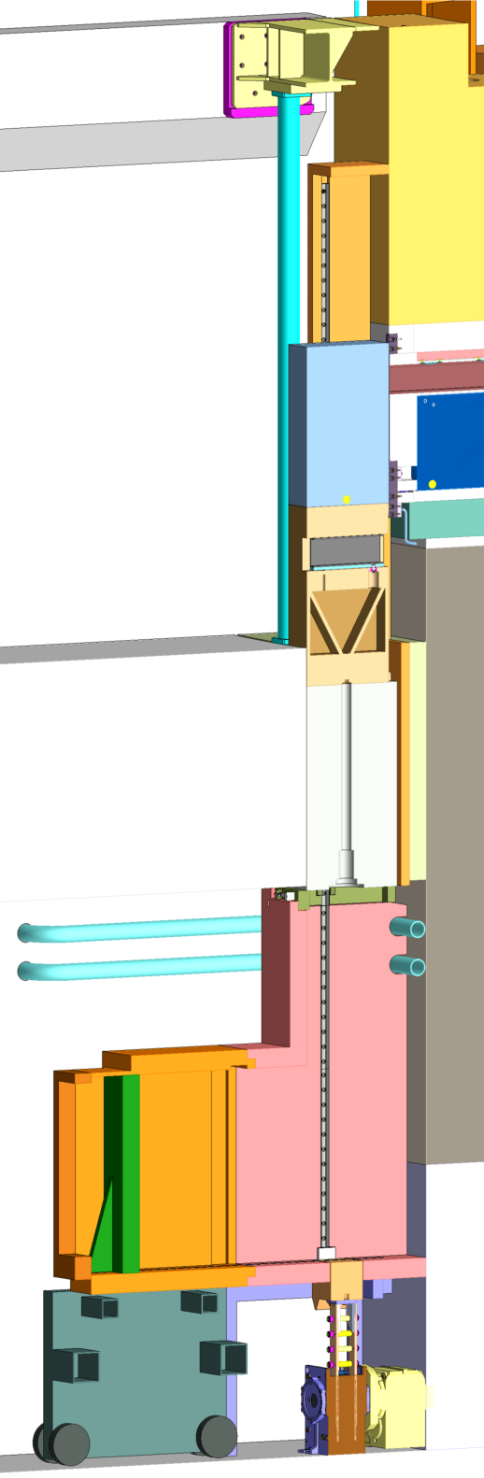
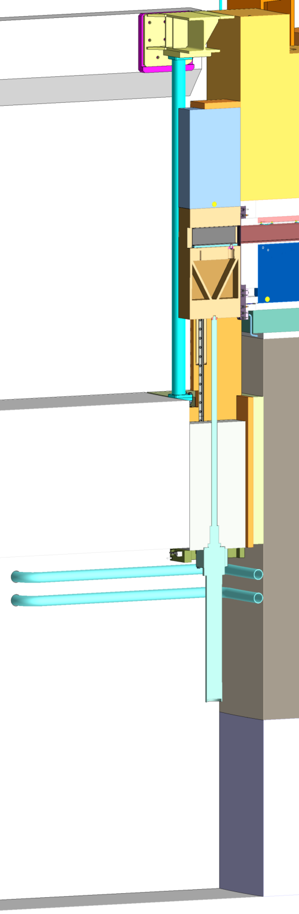
NBEX Handling Tasks
Operational ‘on-off’:
Open beamlines
Closed beamlines
Bi-spectral switch = extra positions defined by ballscrew positioning
Operational ‘on-off’:
Open beamlines
Closed beamlines
Bi-spectral switch = extra positions defined by ballscrew positioning
For all maintenance:
Remove ballscrew actuator, install shield, tools in basement
Use rigid-chain actuator with locking system bringing blocks down
BBG block can be brought to ACF for scrapping
Normally GBS remains on locking hooks – with a mechanical override this can be removed as well
Operational ‘on-off’:
Open beamlines
Closed beamlines
Bi-spectral switch = extra positions defined by ballscrew positioning
For all maintenance:
Remove ballscrew actuator, install shield, tools in basement
Use rigid-chain actuator with locking system bringing blocks down
BBG block can be brought to ACF for scrapping
Normally GBS remains on locking hooks – with a mechanical override this can be removed as well
Then:
NBPI maintenance (replacement)
Use NBPI exchange tool (next slide)
NBW maintenance (replacement)
Use several tools from vertical vault (2 slides further)
Sealing surface refurbishment
Use tool from vertical vault (after NBW removal)
NBEX maintenance carts
NBEX block removal
Operational
Shutdown

Slide 13
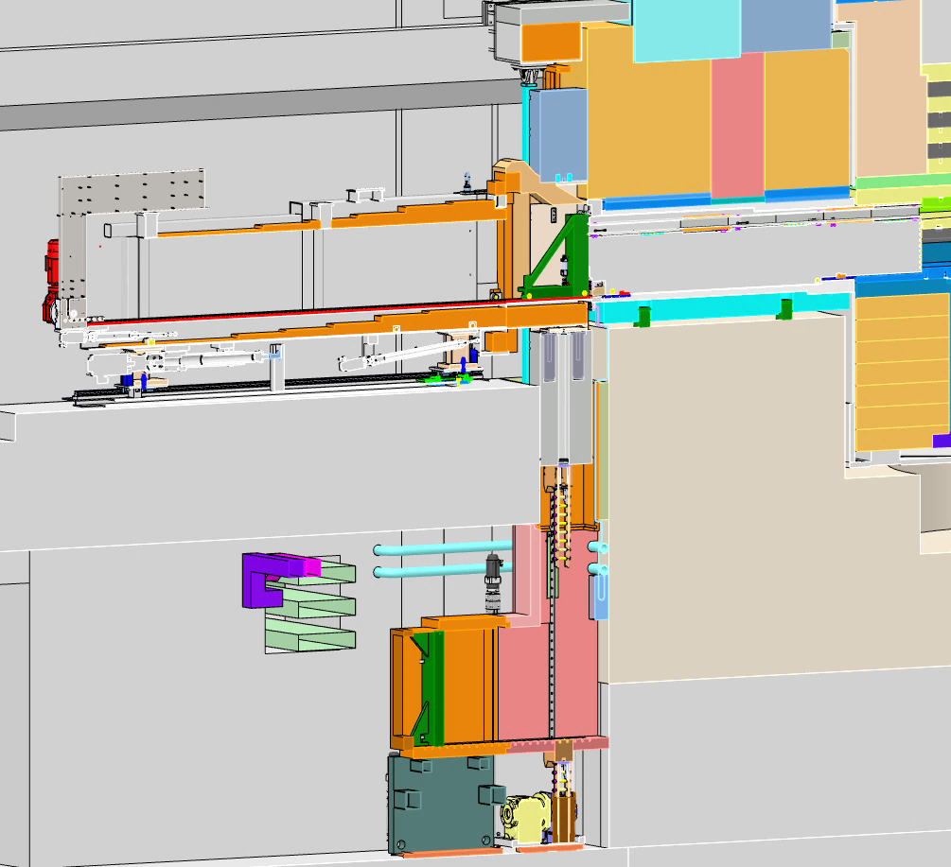
Insert exchange
Hoist floor unit in
Hoist tool in
Lower door
Push tool FW
Bring carriage FW
Pick up NBPI
(and bring to ACF)
NBPI extraction tool
Handling carriage forward
Extra shielding installed

Slide 14
Handling the NBW
Uses rigid chain actuator from Basement
Unbolts/collects/moves NBW into shutter cask
Polishes/refurbishes vacuum sealing surface
Bolting
Handling
Polishing / Inspection

Slide 15
NBEX schedule
30-04-2017: NBEX-NSS interface closed
30-04-2017: NBW vacuum test completed
15-05-2017: NBEX internal requirements
31-05-2017: Other NBEX interfaces closed
NBEX CDR coupled to Bunker CDR (Sept 2017)
01-01-2018: NBW handling test stand
01-12-2018: in-monolith optics on site
01-03-2018: NBEX horizontal test stand, location in target building?
01-10-2018: NBEX vertical test stand, location needs high floor load, 7m high, target building?
21-01-2019: Start of assembly of bunker R6 structure
R6 pillar flanges w.r.t. port blocks - ports in port blocks have to be ready & aligned
01-03-2019: 1st instrumented NBPIs ready for installation
Start of LSS installation, too
09-2019: SATs on NBEX installated systems: NBPIs, LSS (water, shutter motion etc)
10-2019: Handover bunker area to NSS
15-11-2019: Bunker installation starts, NBEX finished

Slide 16
NBEX schedule
Open issues for NBEX CDR
No radiation fields information yet
Interfaces not finalized
Manufacturing method of large components not yet adjusted to supplier possibilities
Delivery lead time
Suggesting CDR scope to be tailored
RH Casks are deferred so defer nuclear aspects of NBEX shielded tools
Outsource all NBEX tools as functional spec instead of manufacturing drawings
Get NBW, horizontal and vertical test stands timely to enable tool SATs
Notes:
Blocking detailing handling scenarios and tooling design
BBG activation is potential risk to Bunker
Important for on-time delivery and cost
Manufacturers need to be able to advise without disqualifying themselves from quotation
Develop NBPI extraction tool as installation tool only, rebuild 1 tool as cask after installation
Develop lower shielding as installation tool
Defer shutter cask but develop design with lower shielding assembly
Exclude test stands from this CDR scope, align with outsourced tools Oct 2018

Slide 17
Neutron Beam Extraction System
Model reference: ESS-0065135
Notes:
Extra slides follow

