Slide 1
Test and Instruments Cryoplant (TICP) and Auxiliaries at the European Spallation Source
Work Units 11.11.4, 11.11.8, 11.11.9
Philipp Arnold
Section Leader & Work Package Manager Cryogenics
www.europeanspallationsource.se
29 March 2017

Slide 2
Outline
System Overview & Technical Main Figures
  Test and Instruments Cryoplant
  Pure Helium Storage Tanks
  Warm Interconnecting Piping and Installation
Current Status
  Schedules and reviews
Conclusion

Slide 3
1.1 TICP and Auxiliary Equipment
TICP by ALAT (3 lots)
Pure Helium
Gas Storage
Standalone Helium Purifier
Helium Recovery System
Target Moderator
Cryoplant
Accelerator
Cryoplant
20 m³ LHe Tank
5 m³
LHe Tank
Test & Instrument Cryoplant
Helium tanks by UBH
Target Cryodistribution System
Warm piping by Powerheat
LHe Mobile Dewars
Test Stand Cryodistribution System
Cryodistribution System for Elliptical Linac
Cryodistribution System for
Spoke Linac
LN2 Storage Tanks
Hydrogen Circulation Box
LN2 tanks by Air Liquide AB
Elliptical
Cryomodules
Spoke
Cryomodules
LN2 Mobile Dewars
Instruments & Experiments
Test Stand Lund 2
Hydrogen Moderator

Slide 4
(1.2) TICP scope – duty spec
Liquefier Coldbox
  Cooling for CM Teststand: 76W @ 2K, 420W @ 40K, 6 l/h Liquefaction
  Liquefaction for Neutron Instruments / Sample Environments: 7500 l/month
  Recovery of evaporating helium in linac when ACCP stops
  Potentially providing liquid helium to MAX IV
Recovery System
  Helium returning from instruments
  Flash gas from mobile dewar filling, helium transfer operations
  Dewar boil off, internal purifier regeneration, purge operations
  CM safety valve discharge
  Compression, storage, distribution of impure helium
External Purifier
  Emptying HP buffer when internal purifier not available
  Make-up and back-up

Slide 5
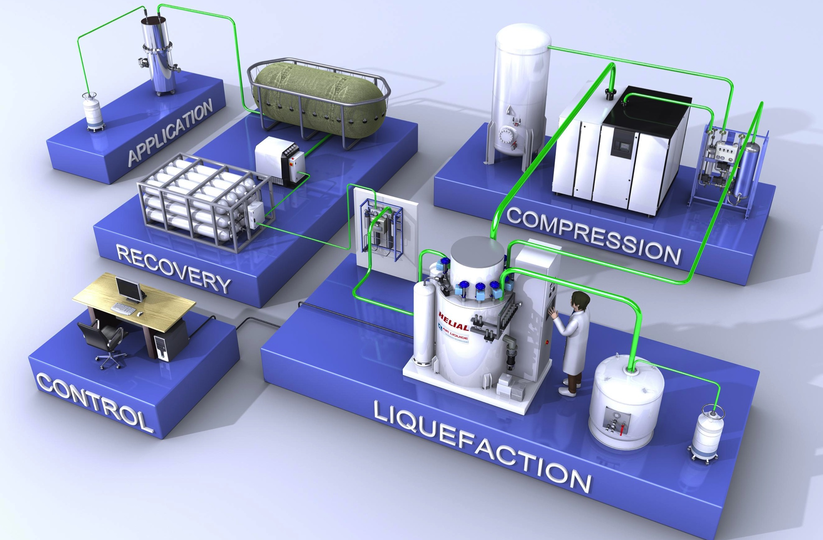
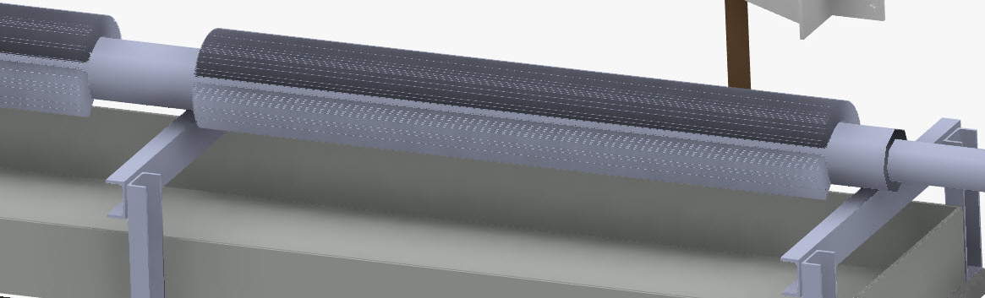
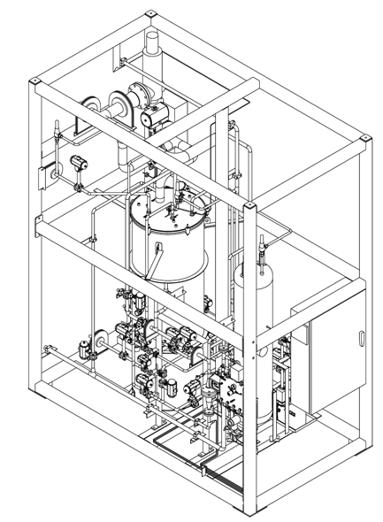
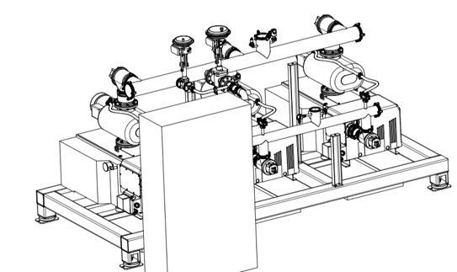
(1.3) TICP realization and assembly
Kaeser DSDX 305 SFC (>50 g/s incl VFD)
ORS with 3rd coalescer
Coldbox incl. 4.5K sub-cooler, additional valves, cold interface for 4.5K supply, 4K VLP return, shield supply and return
5’000l LHe tank from Wessington
2 parallel filling stations with scale
100 m³ gas bag, 2 parallel recovery compressors
Special designed ambient heater for VLP
PVPS from Leybold: RUTA 3 x (rotary vane + roots with VFD on one skid)
External helium purifier (additional to internal purifier)
EPICS used as SCADA, all controls on PLCs

Slide 6
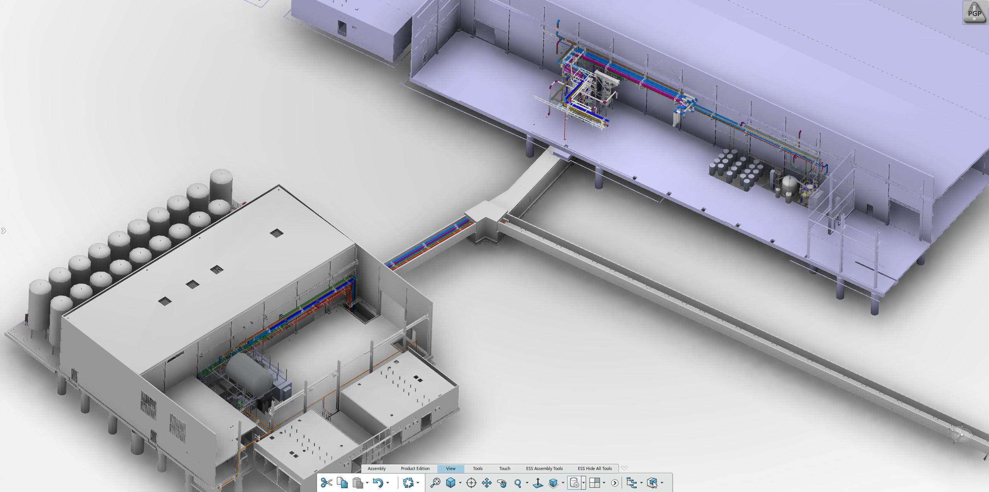
(1.4) TICP physical location
Gas bag, recovery compressors, recycle compressor, PVPS, external purifier etc.
TICP coldbox, dryer, dewar, filling station, process heaters etc.

Slide 7
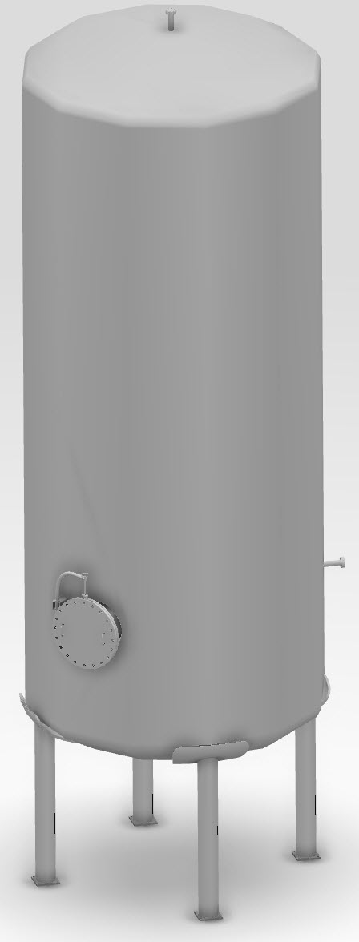
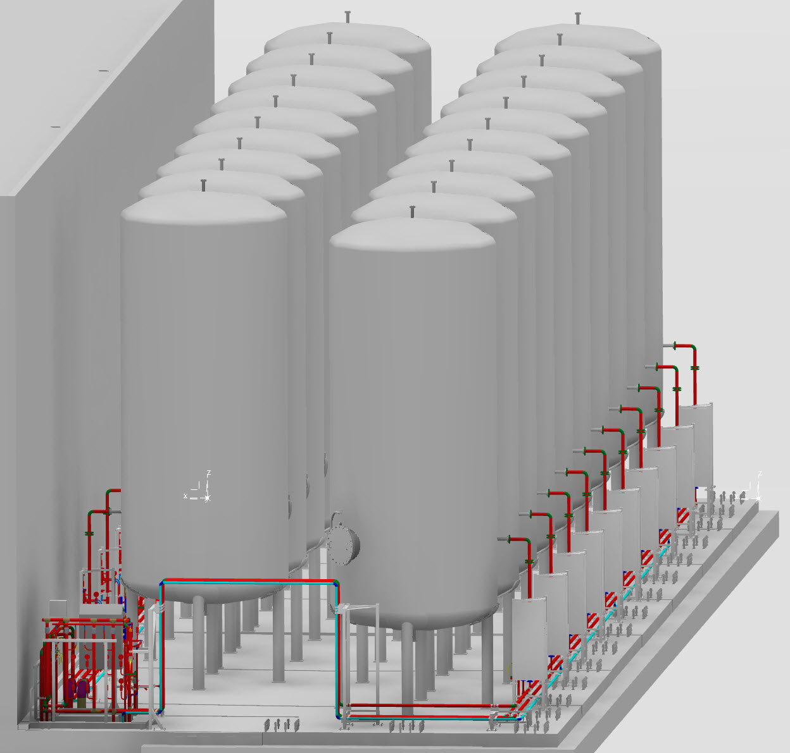
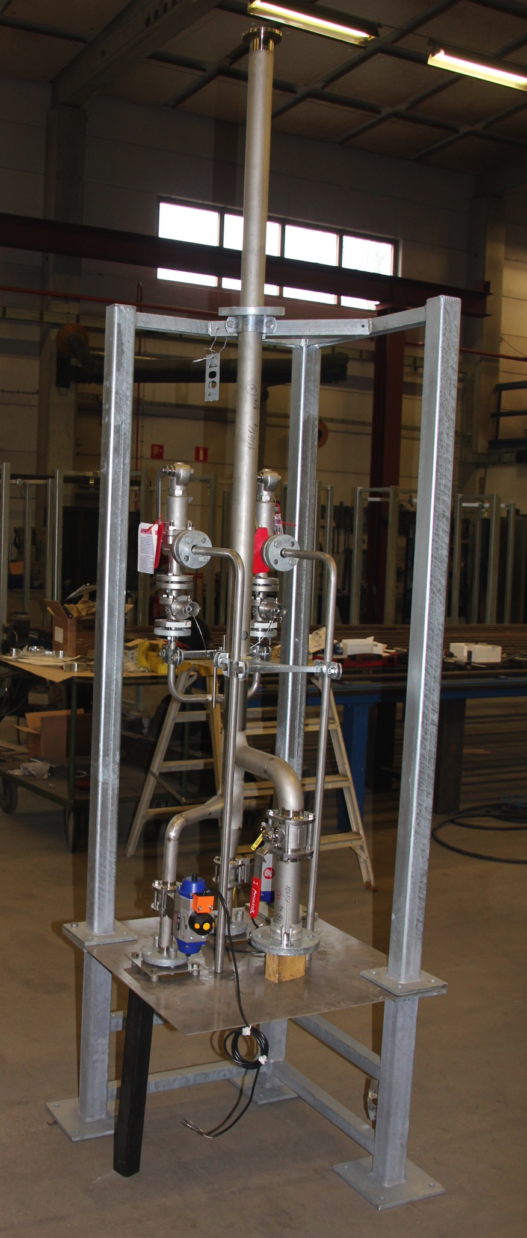
(1.4) PHS – Pure Helium Storage Tanks
  19 Storage tanks
  To store entire linac inventory (from 57 cryo modules + related CDS) → 14 tanks
  To store inventory of TMCP-CMS transfer lines and related equipment at different pressure levels → 4 tanks
  To store inventory of CM test stand including related CDS and TICP → 1 tank
Helium
70 m³
25 bar
Versatile interconnection possibilities
  Each tank connected to two lines
  Each gas management panel (ACCP, TICP, TMCP) has two discharge valves to different tank lines
  Additional interconnection possibility in dog-shed valve panel

Slide 8
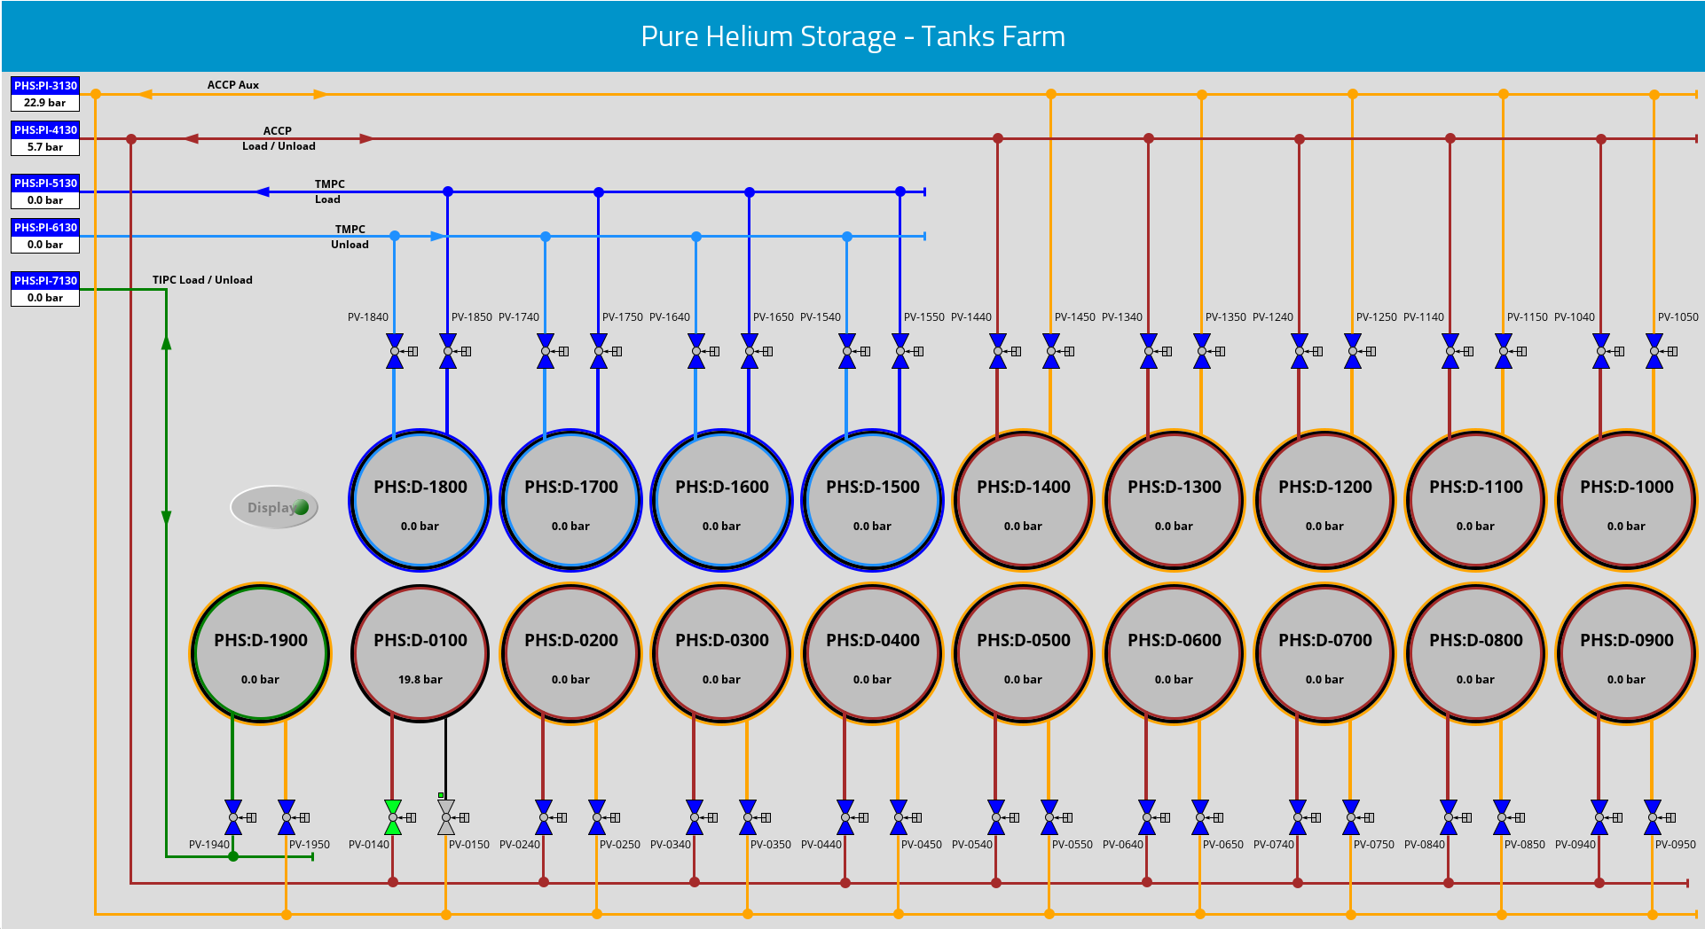
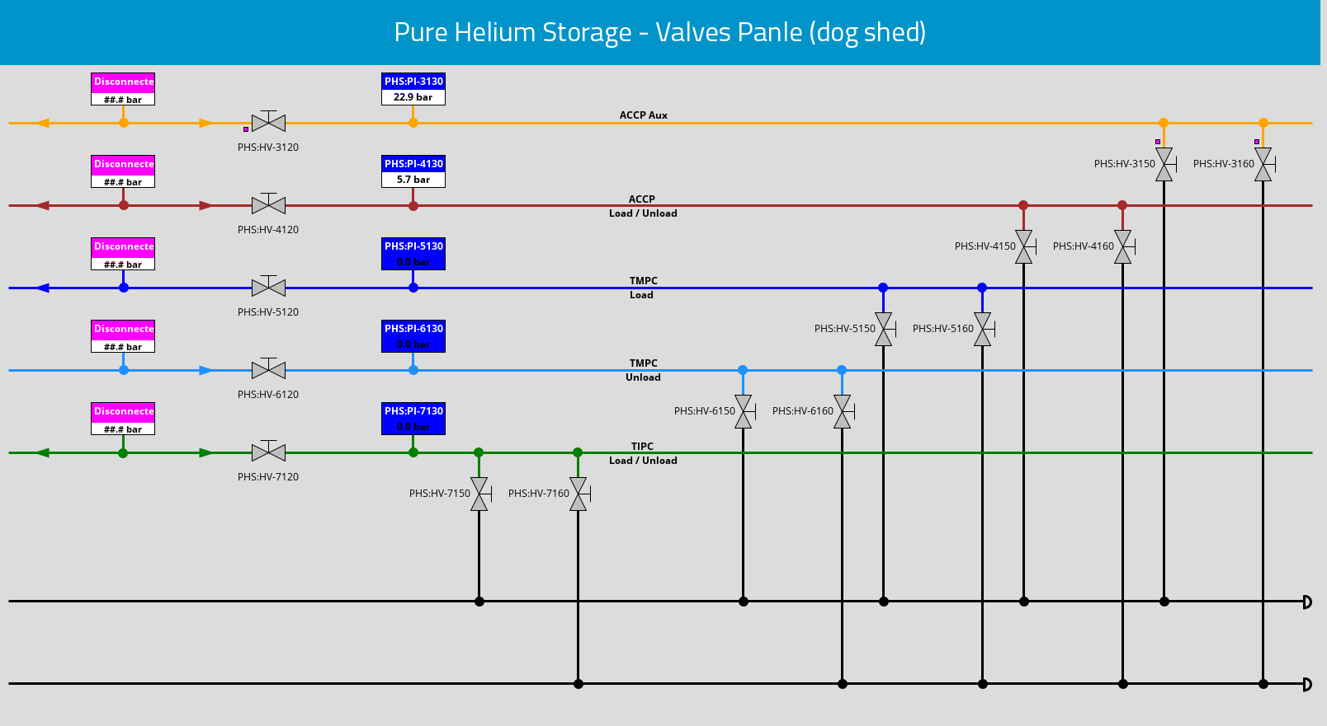
(1.4) PHS controls

Slide 9
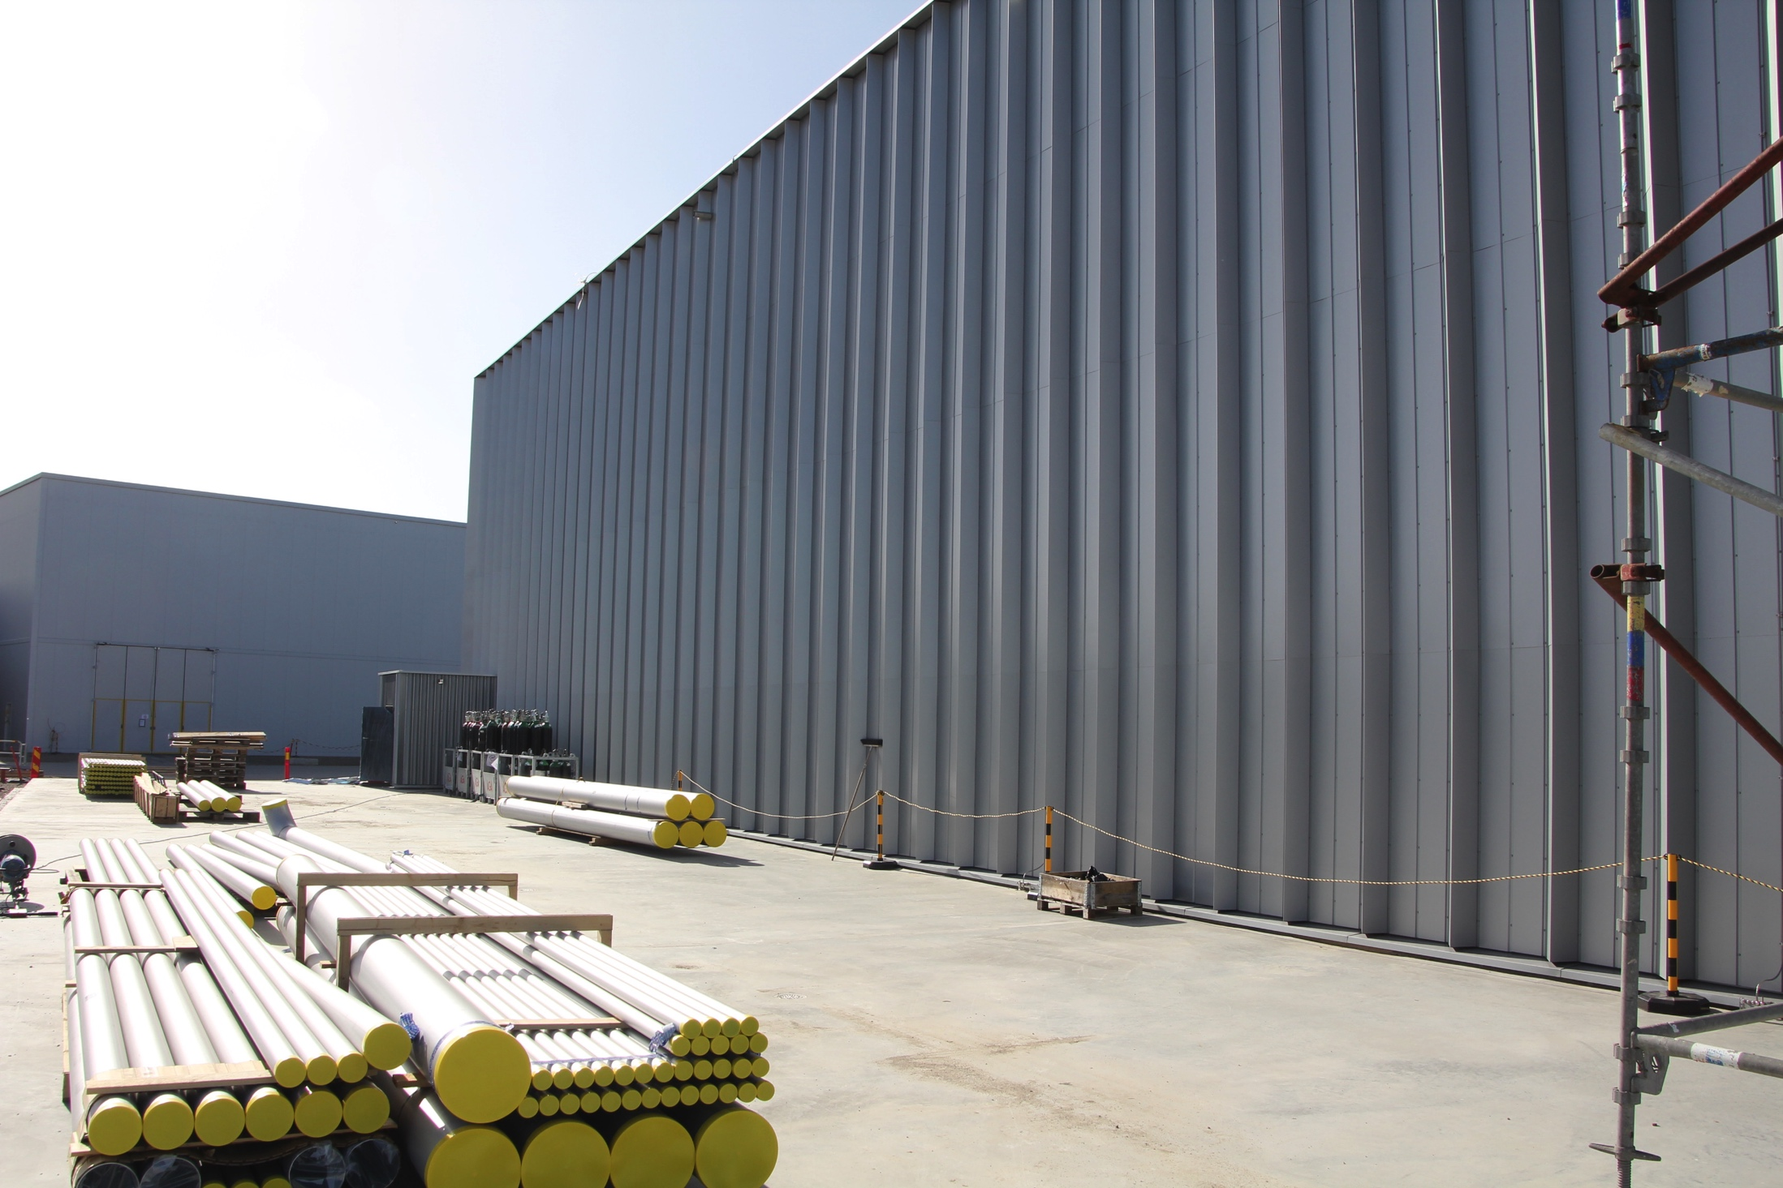
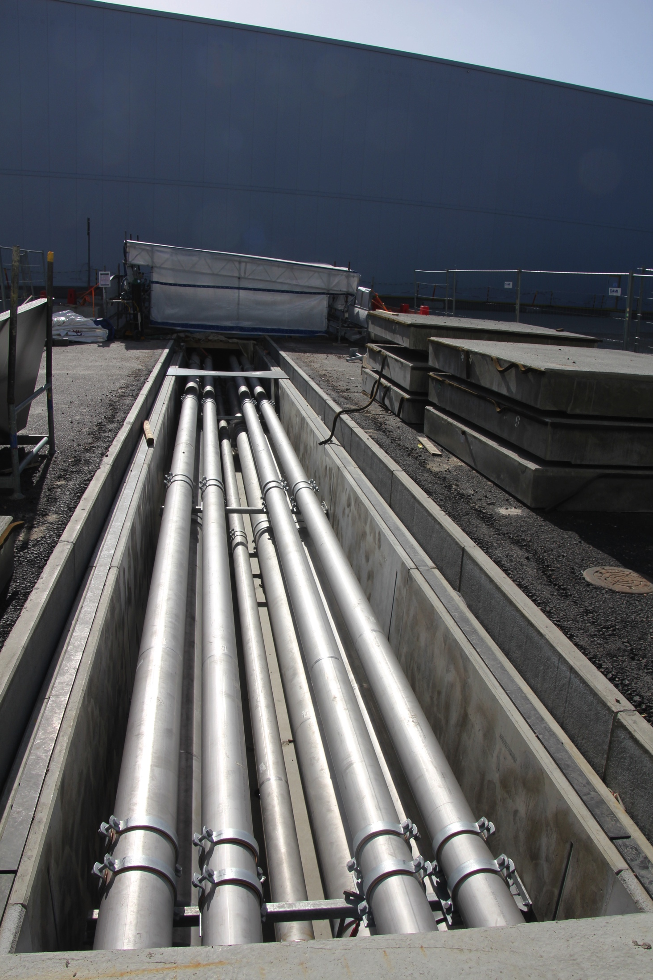
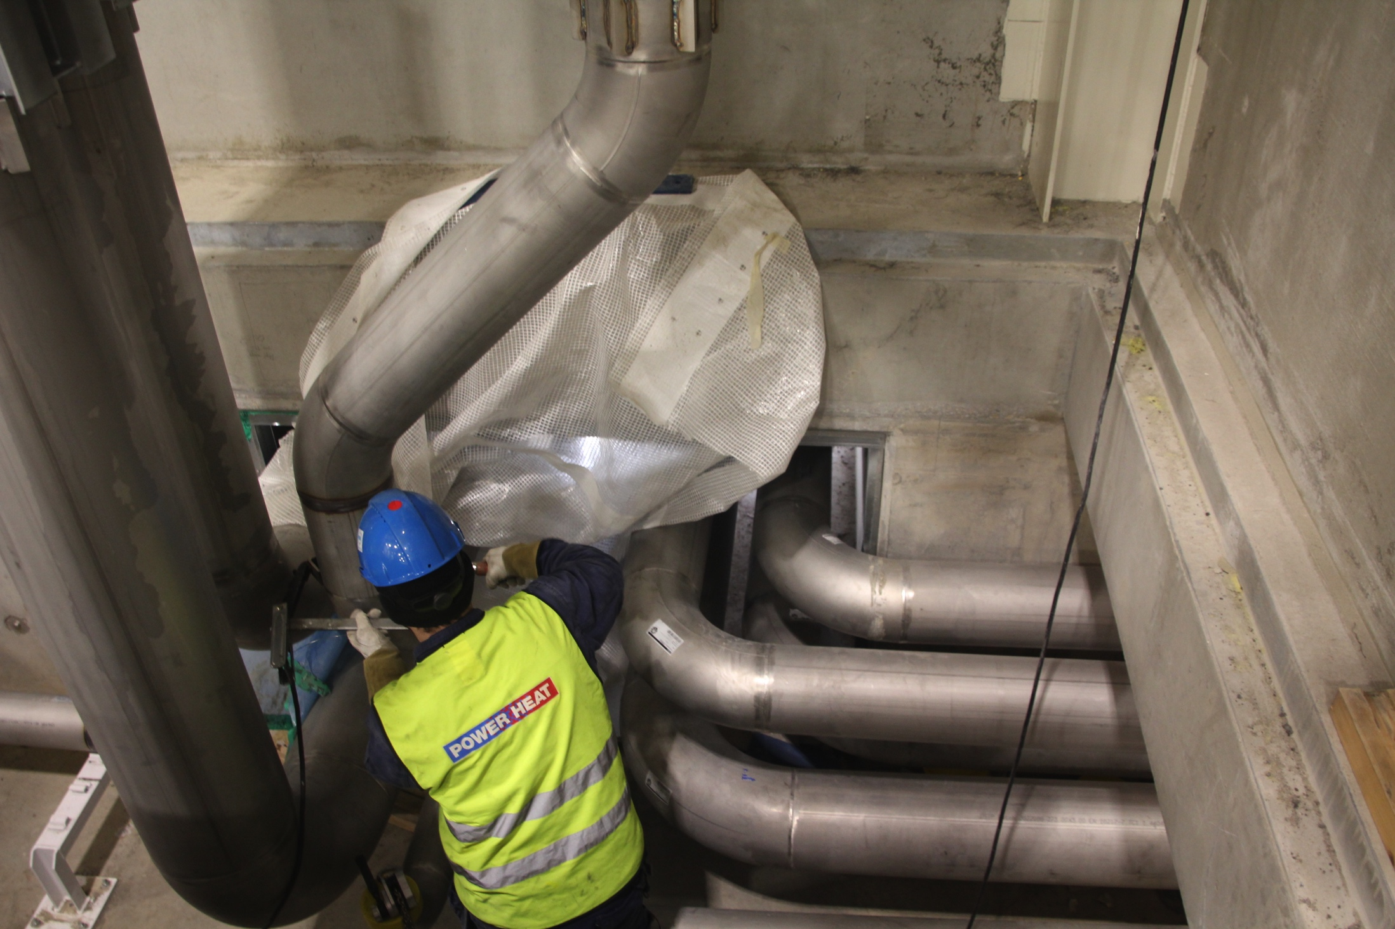
(1.5) Warm interconnecting piping

Slide 10
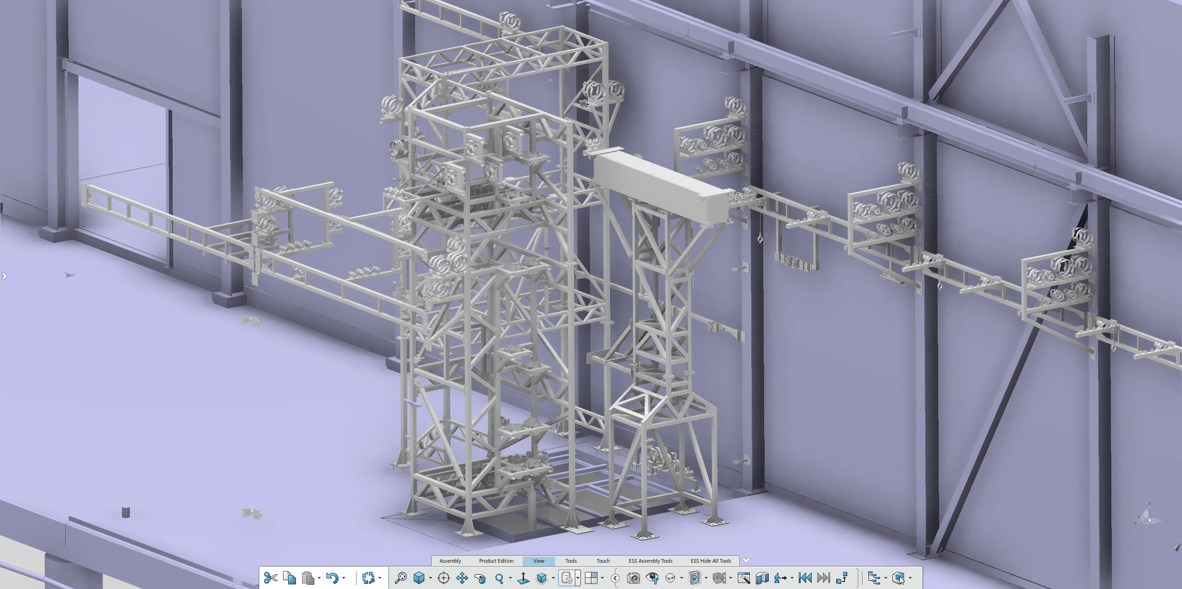
(1.6) Warm interconnecting piping
L-shaped hole support structures in CXH

Slide 11
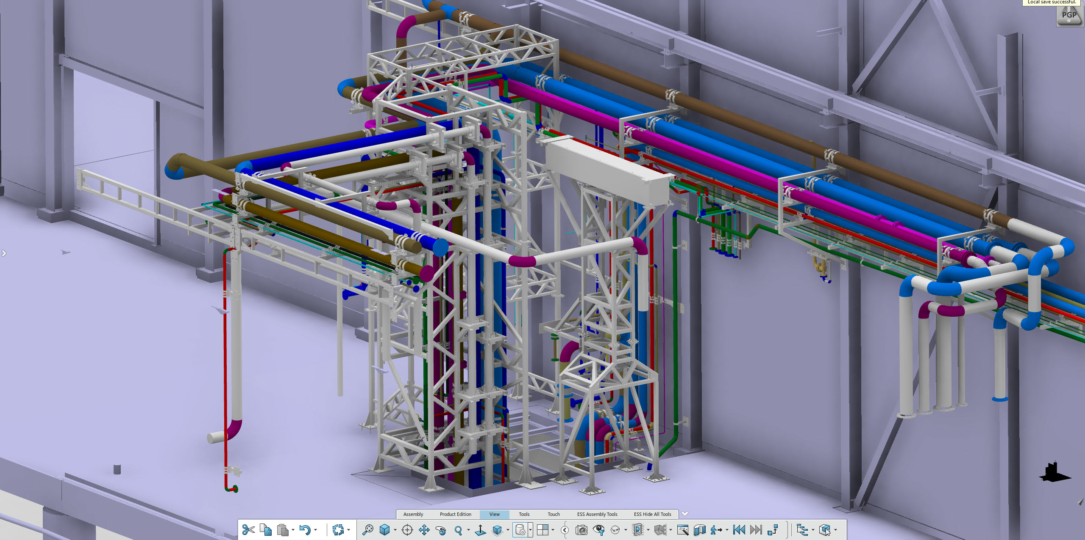
(1.6) Warm interconnecting piping
L-shaped hole support structures in CXH … incl. piping

Slide 12
Outline
System Overview & Technical Main Figures
  Test and Instruments Cryoplant
  Pure Helium Storage Tanks
  Warm Interconnecting Piping and Installation
Current Status
  Schedules and reviews
Conclusion

Slide 13
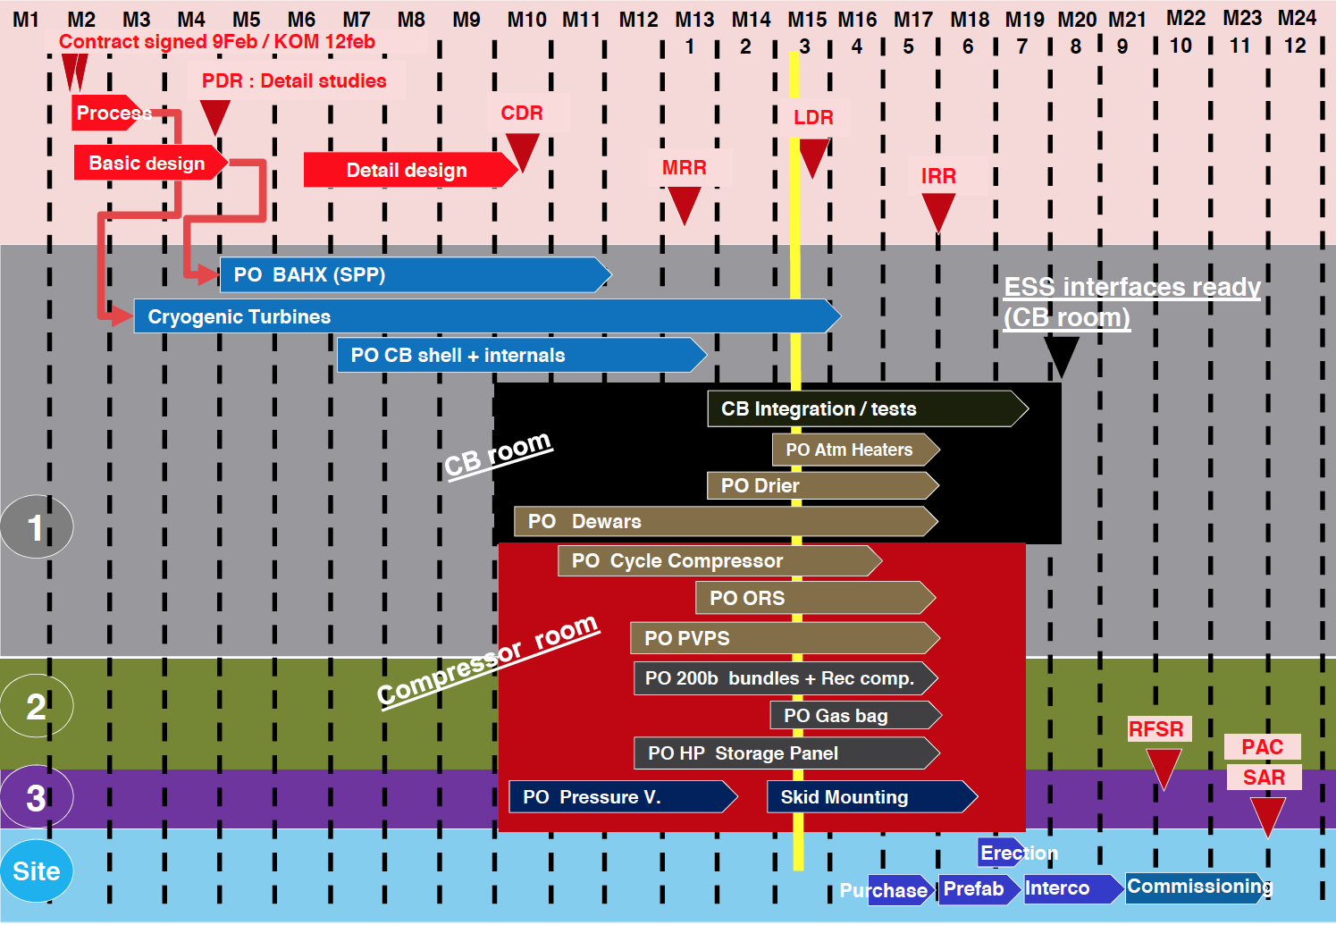
(2.1) TICP Schedule
Reviews
Kick-off meeting
Preliminary Design Review
HAZOP
Critical Design Review
Logic Design Review
Installation Readiness Review
Site Acceptance Review
✔
✔
✔
✔

Slide 14
(2.2) PHS Schedule
☹
3 months delay for the first tank, but not (yet) critical

Slide 15
(2.3) Piping, integration and reviews
Conceptual and preliminary design ESS in-house
Functionality, safety, integration
Process calculations
PFDs, P&IDs
Line lists, interface lists, instrument lists
Helium filling procedures
3d model and preliminary routing
Conceptual installation sequence and commissioning concept
Reviews
Preliminary Design Review (ESS internally)
Risk Assessment (ESS internally)
Kick-off meeting with contractor
Critical Design Review 1 – instrumentation and components
Critical Design Review 2 – duct and gallery piping
Critical Design Review 3 – G.04, tanks and dog shed piping
Critical Design Review 4 – G.02 piping and open issues
✔
✔
✔
✔
✔
✔
Particular interfaces for cryoplants
Electrical power → Electrical sub-stations almost exclusively for cryoplants
Cooling water → cooling water substation exclusively for cryoplants (medium temperature supply, medium and high temperature return)
Liquid nitrogen in a separate contract
Local control room for early operation for cryogenics, shared with test stand and beam commissioning

Slide 16
(2.4) Warm piping schedule
Predecessor of ACCP compressor installation
Predecessor of TICP (minus Cbx) installation
Predecessor of start of equipment and full TICP, ACCP installation

Slide 17
(3) Conclusions
Technically viable solutions with inbuilt redundancies, upgrade-abilities, thorough integration
Test & Instruments Cryoplant – within original budget, reasonably well in schedule
Helium storage tanks – considerably under original budget, behind schedule but still manageable
Nitrogen and Helium supply – within budget, on schedule
Warm piping and installation – considerably over original budget, behind schedule, mitigations of impact ongoing, now good on track

