Slide 1
Conventional Facilities update
Kent Hedin
Head of Conventional Facilities
www.europeanspallationsource.se
17-04-04

Slide 2
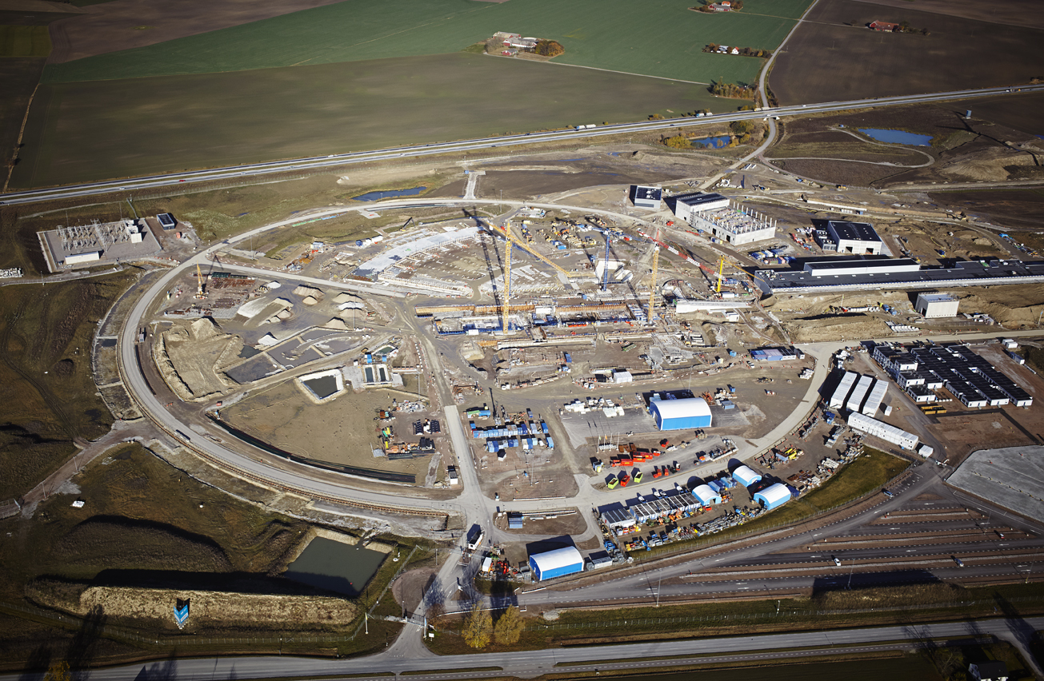
November 2016

Slide 3
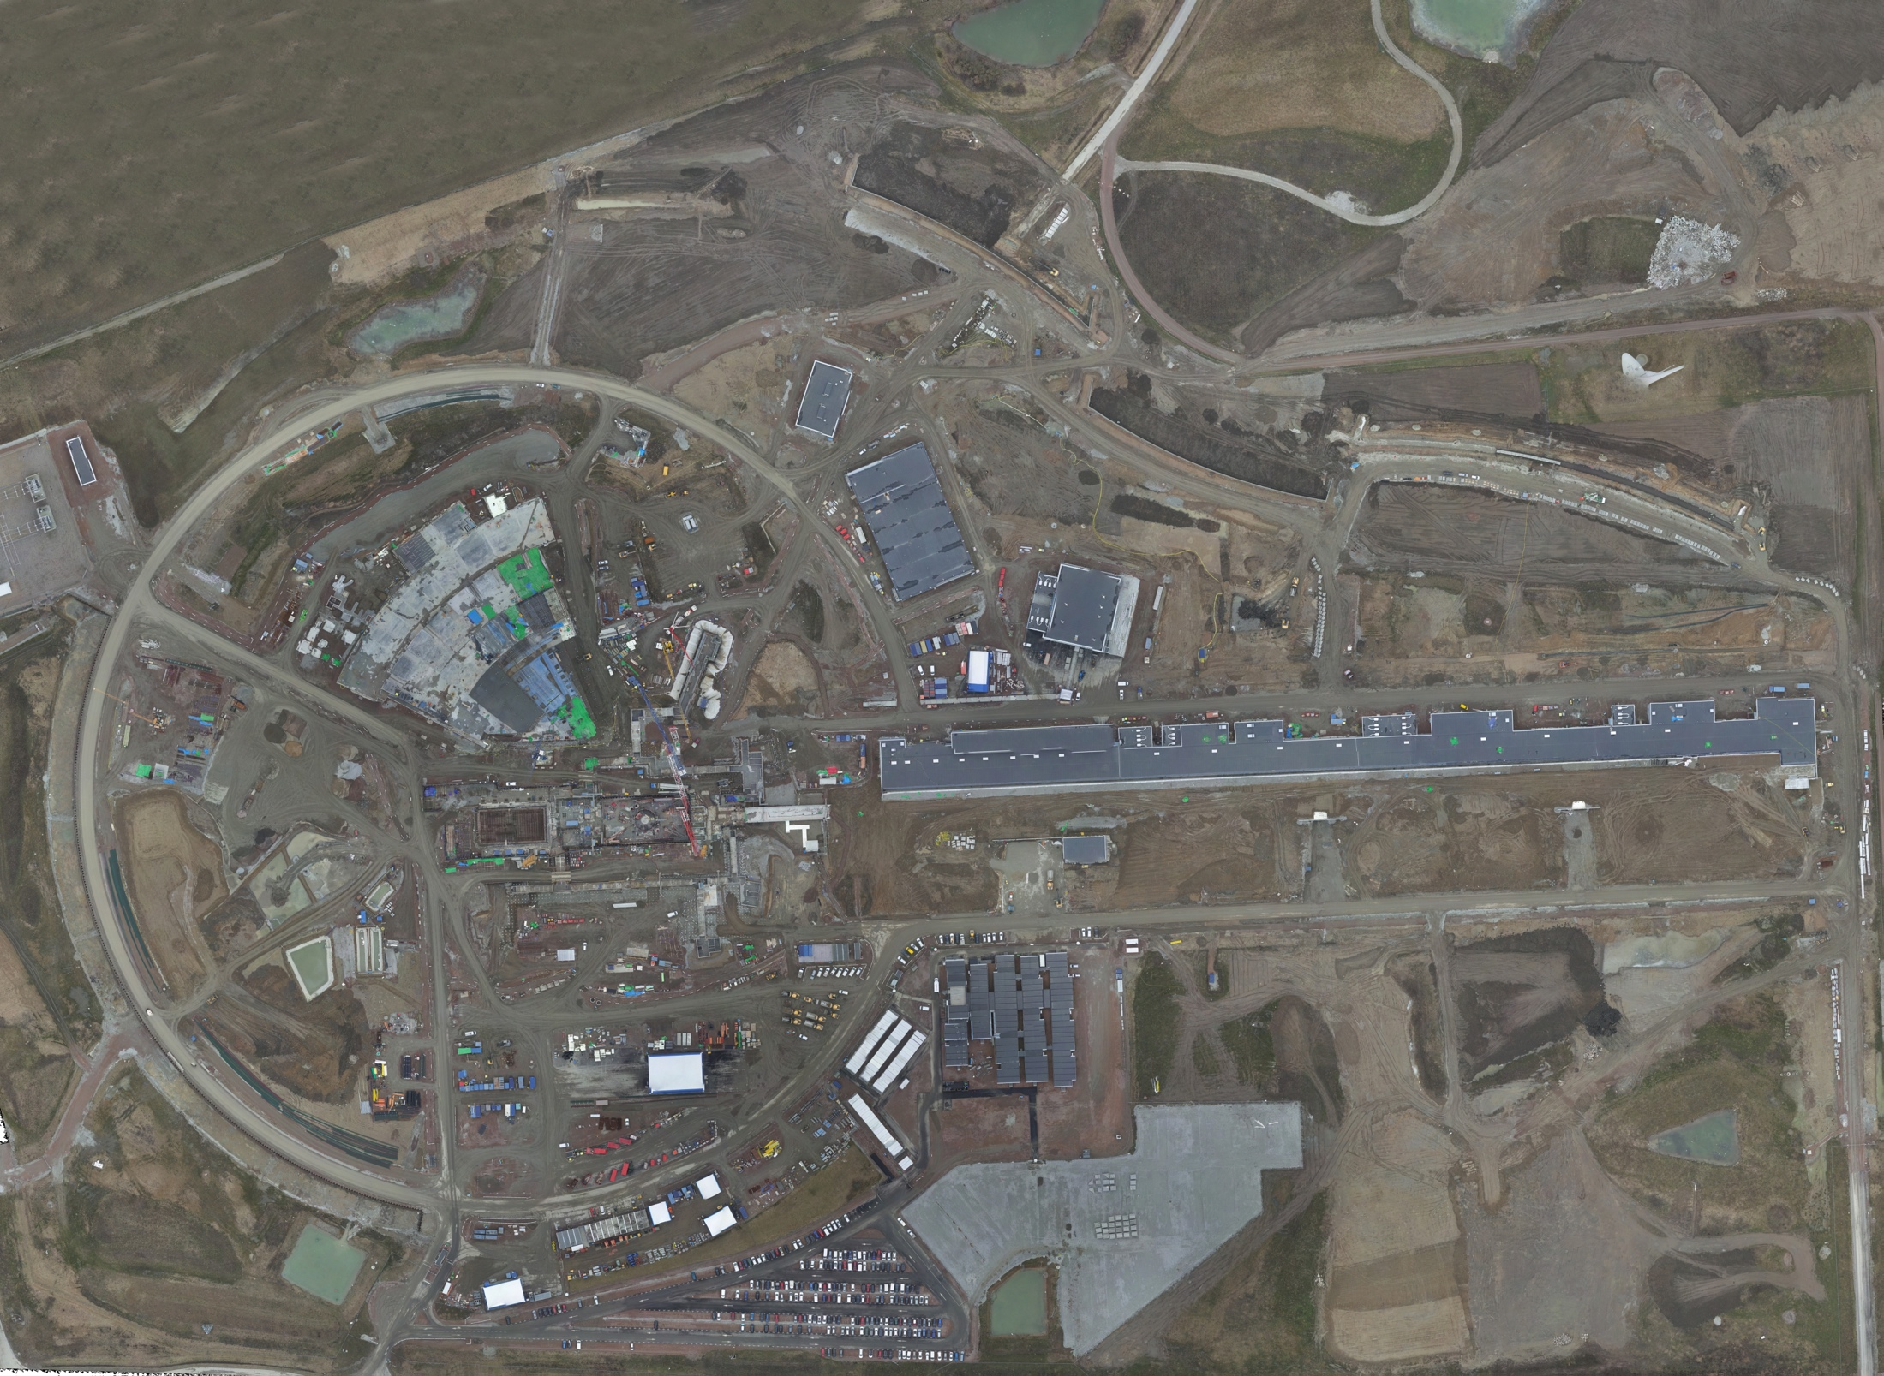
Aerial view February 2017

Slide 4
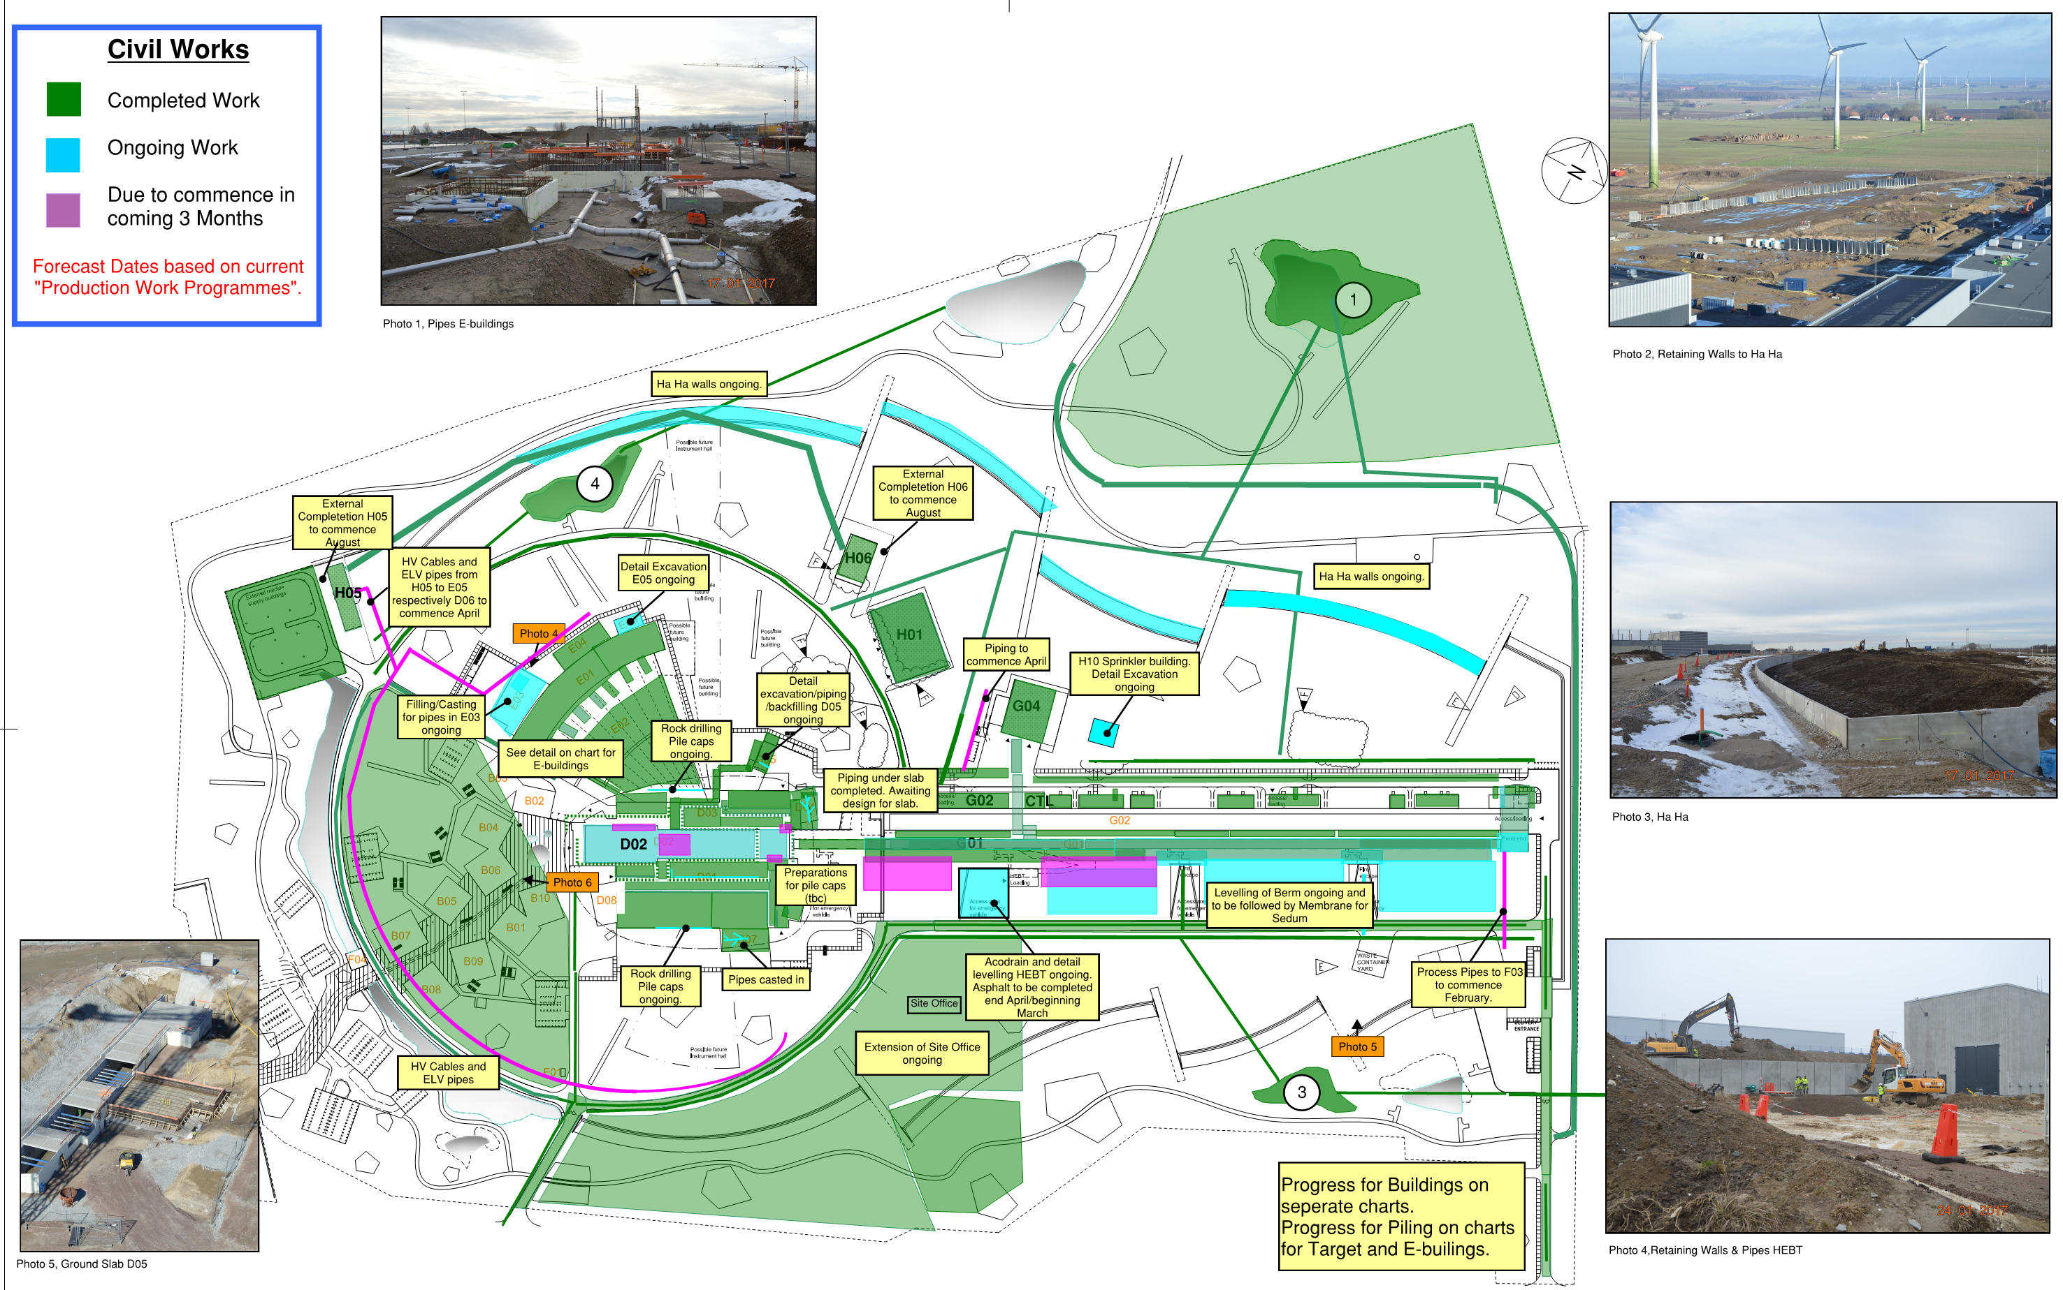
Civils– 3 Month Lookahead

Slide 5
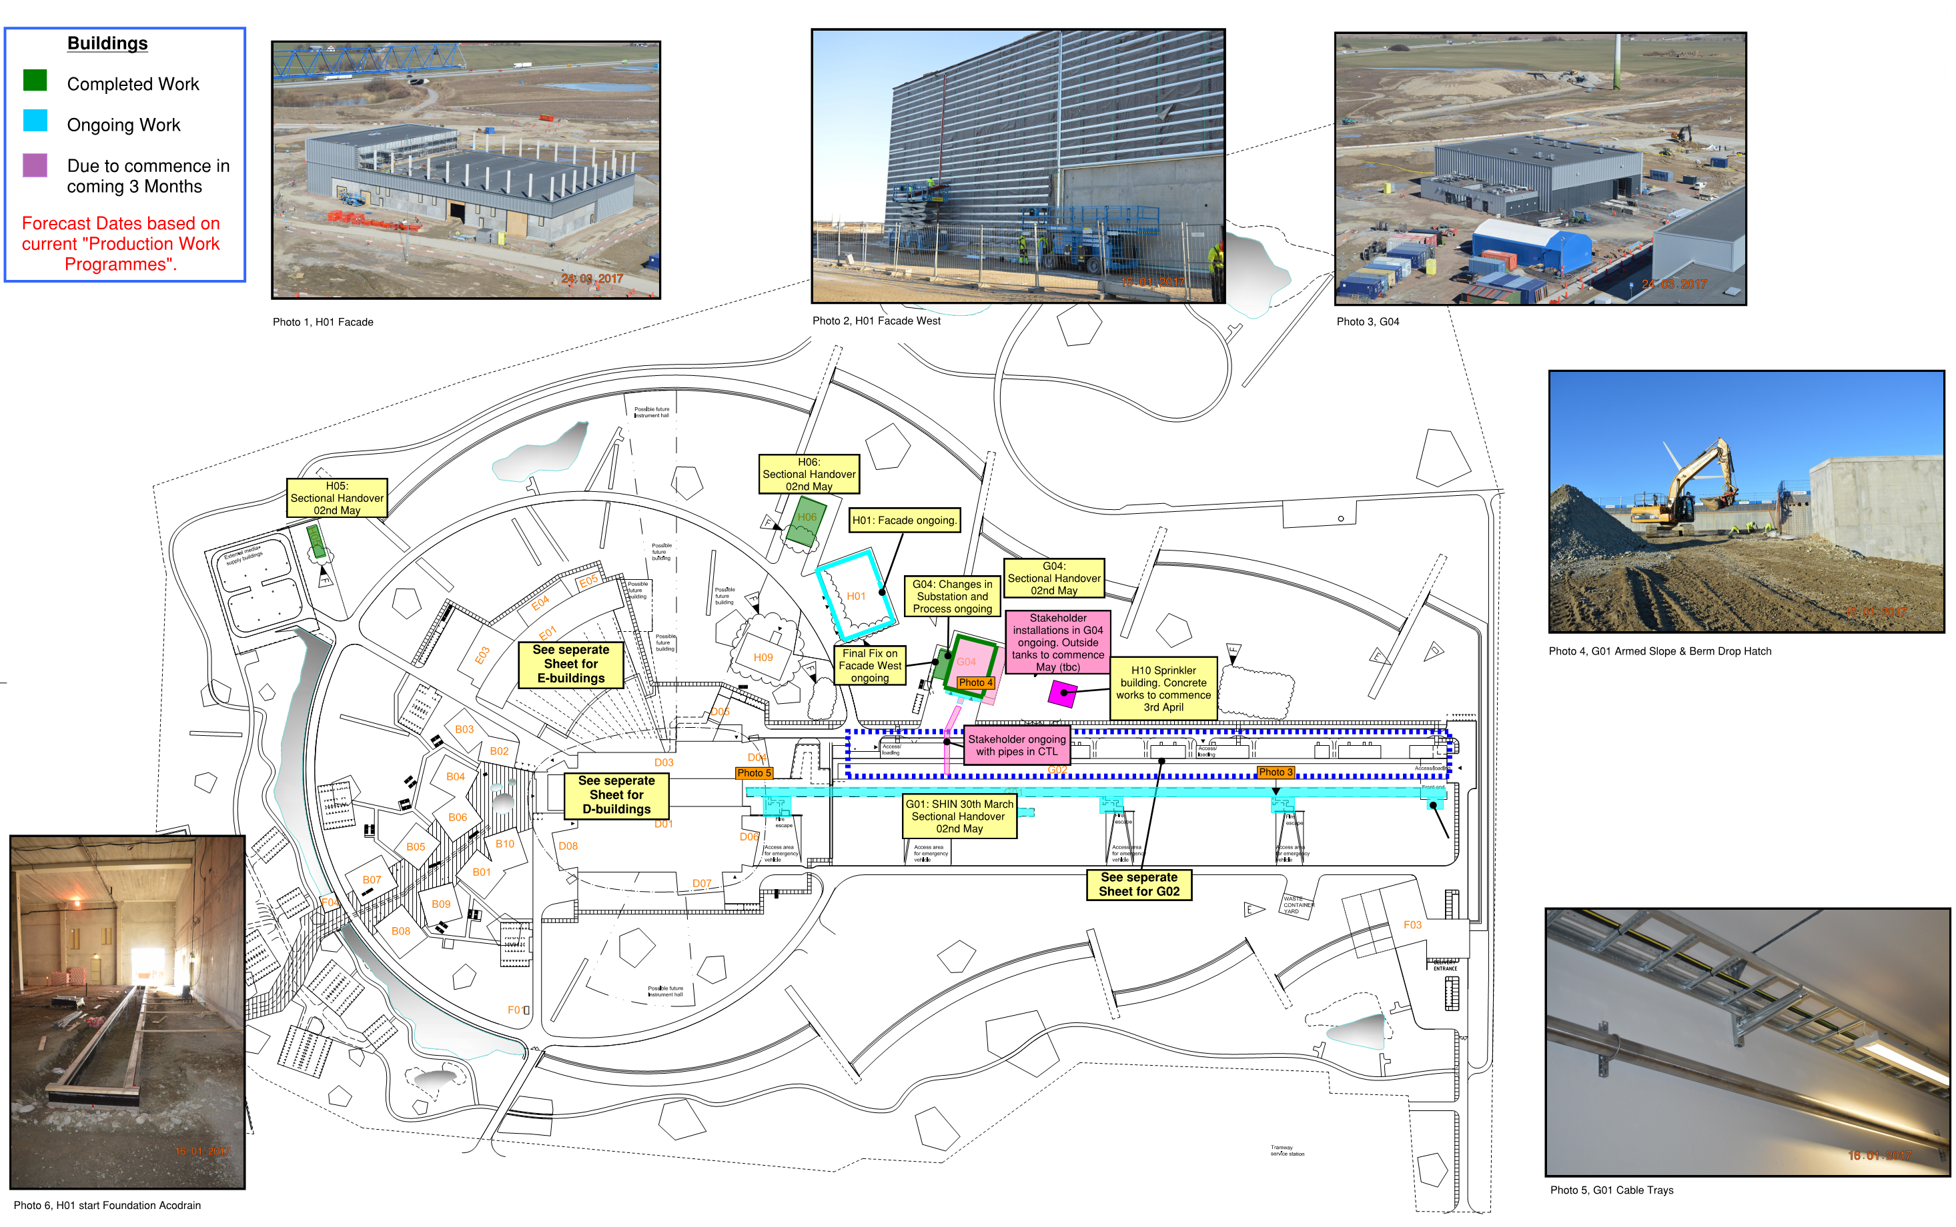
Remaining Buildings – 3 Month Lookahead

Slide 6
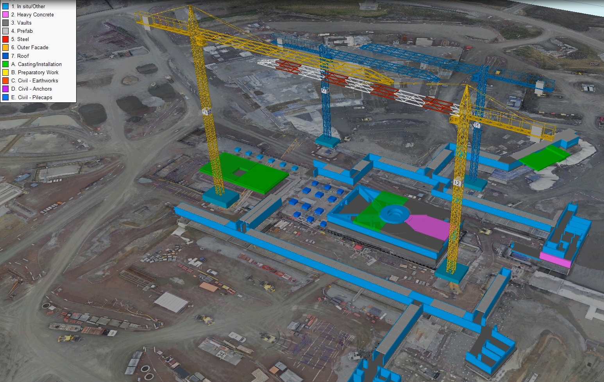
Synchro Target end March
28th February
Working Programme dat 09-Feb-17

Slide 7
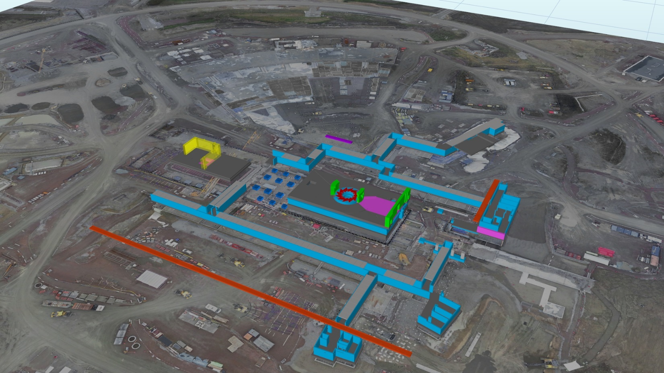
Synchro Target 1st May
28th February
Working Programme dat 09-Feb-17

Slide 8
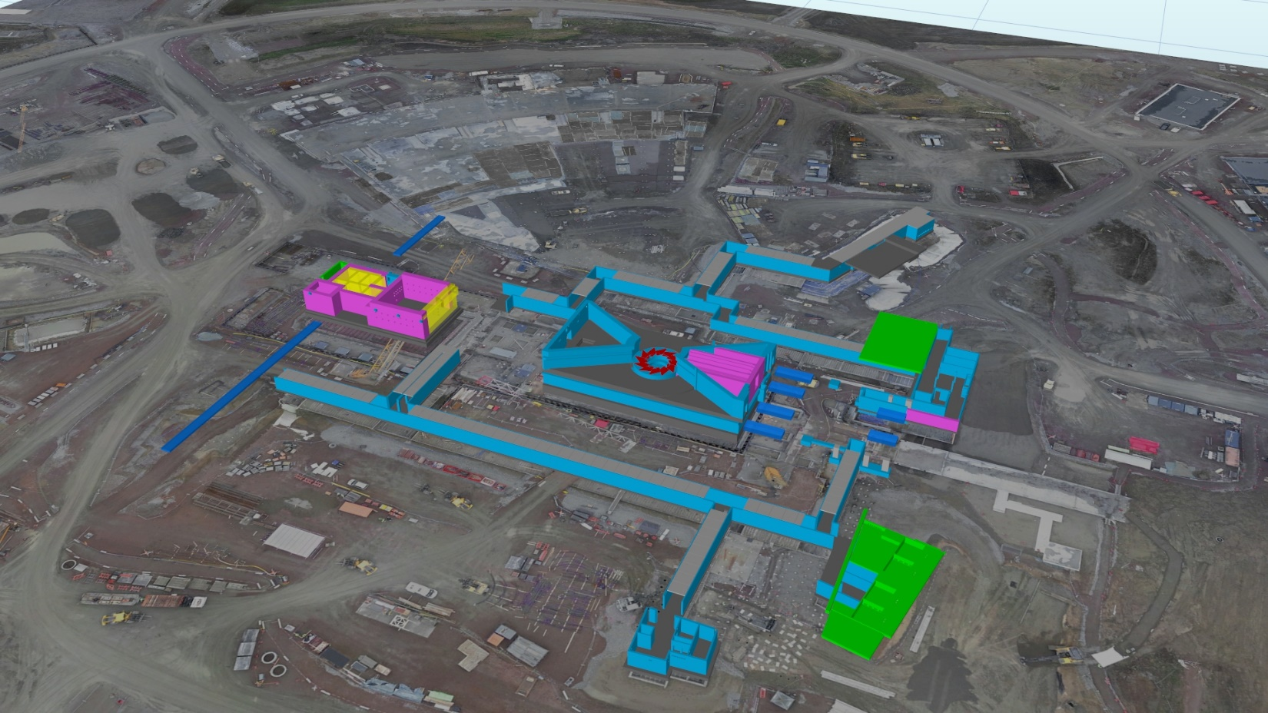
Synchro Target 1st July
28th February
Working Programme dat 09-Feb-17

Slide 9
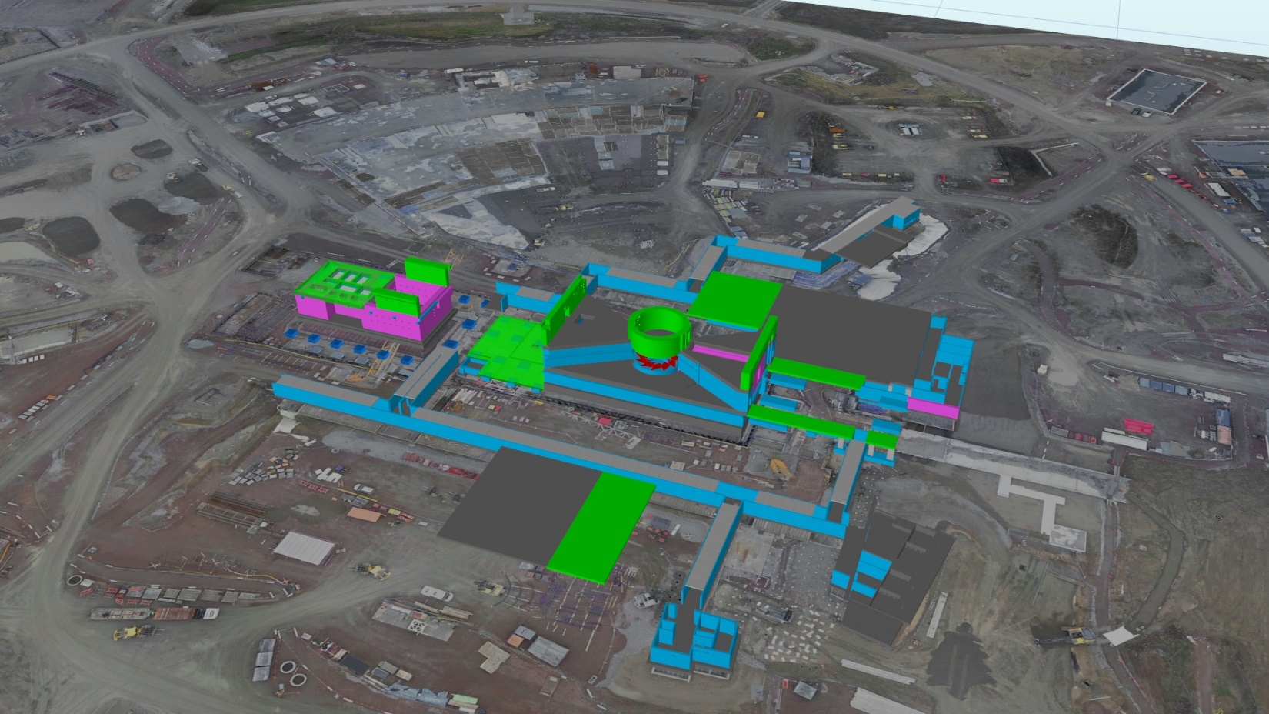
Synchro Target 1st September
28th February
Working Programme dat 09-Feb-17

Slide 10
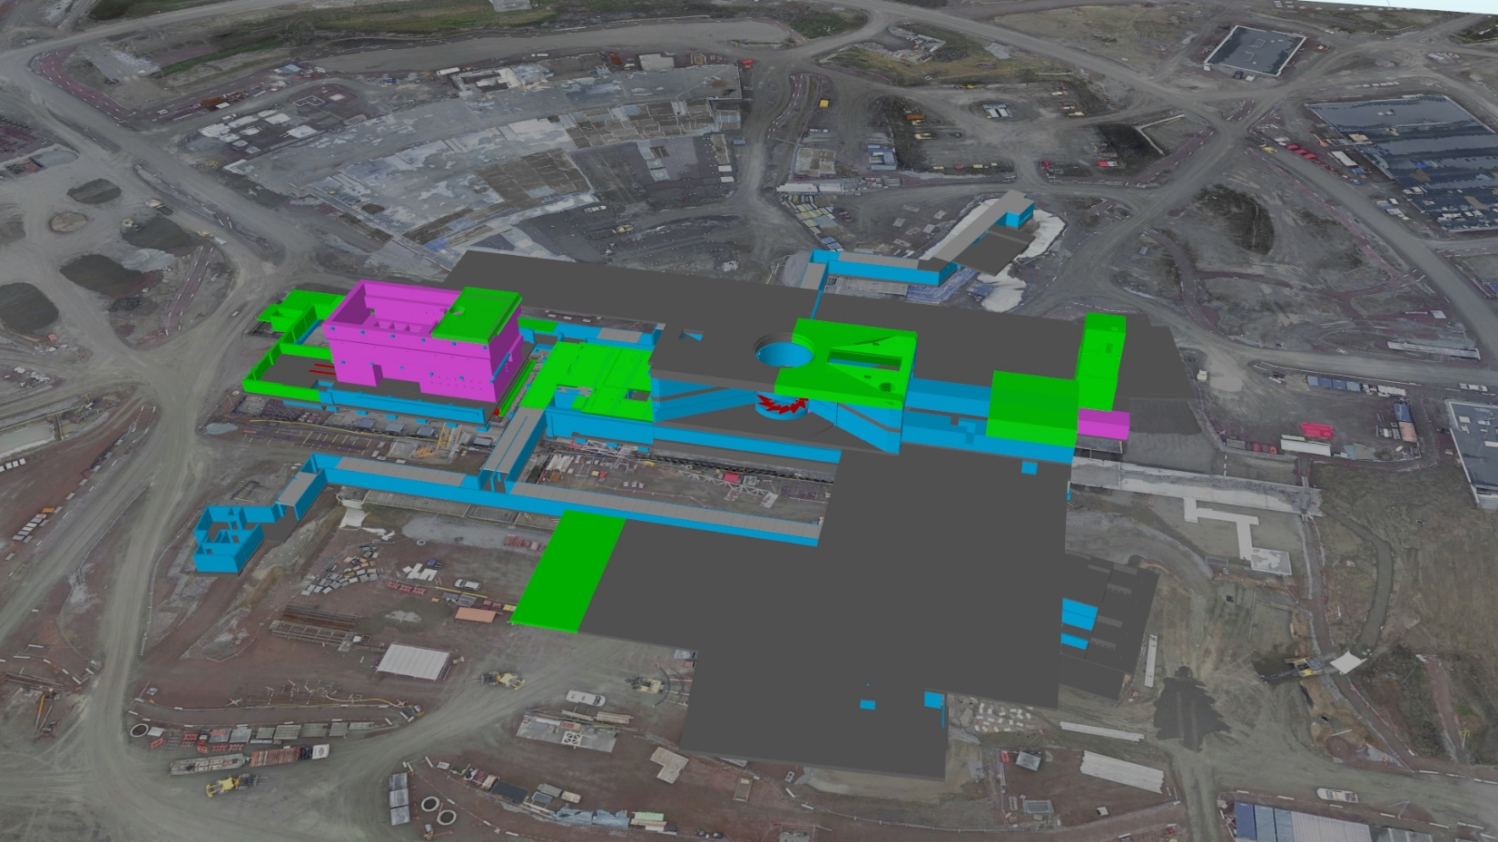
Synchro Target 1st January 2018
28th February
Working Programme dat 09-Feb-17

Slide 11
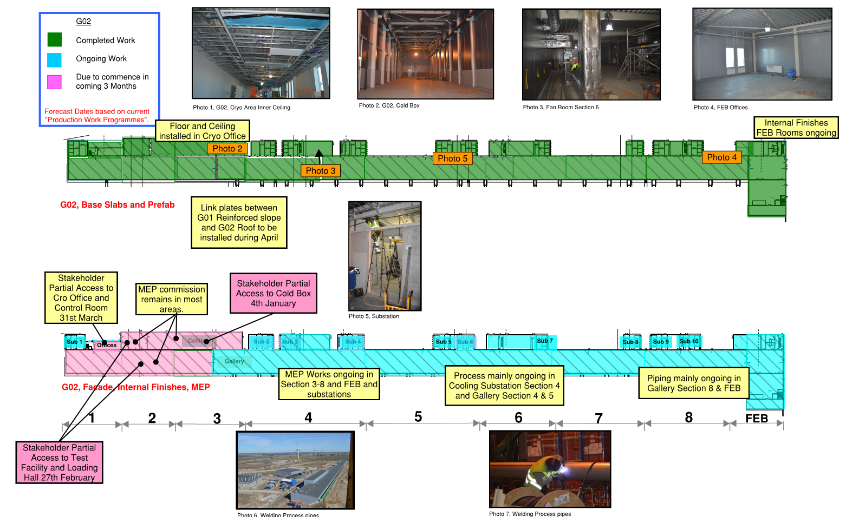
G02 3-Month Lookahead

Slide 12
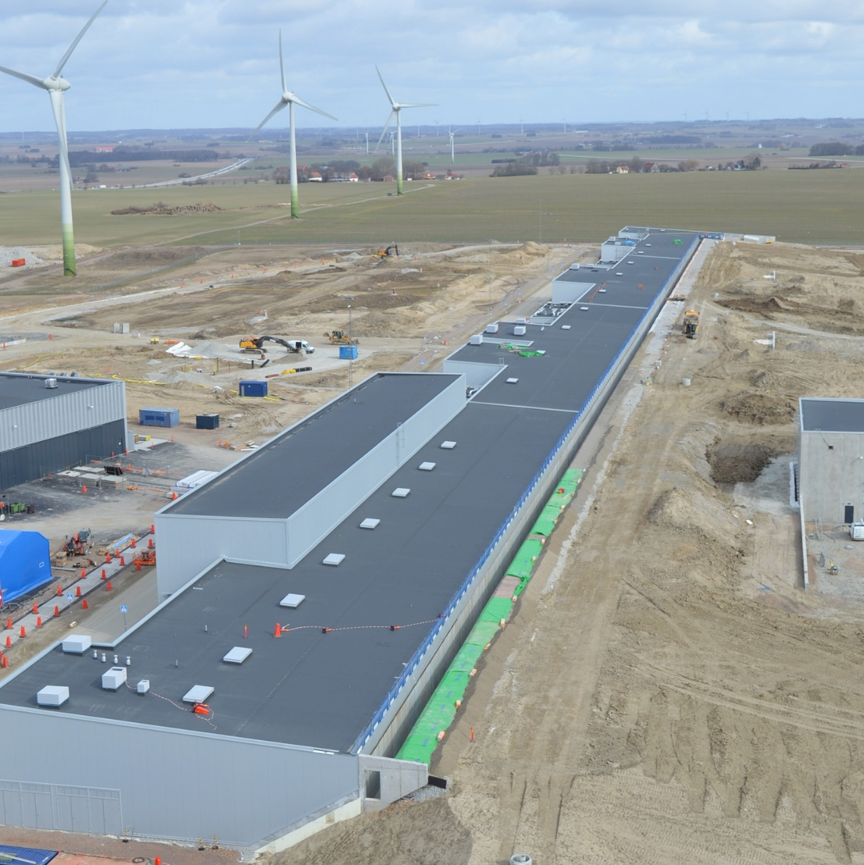
G02 Gallery & G01 backfill
Starting installation of link plates between G02 roof and G01 armed slope on April 3rd.

Slide 13
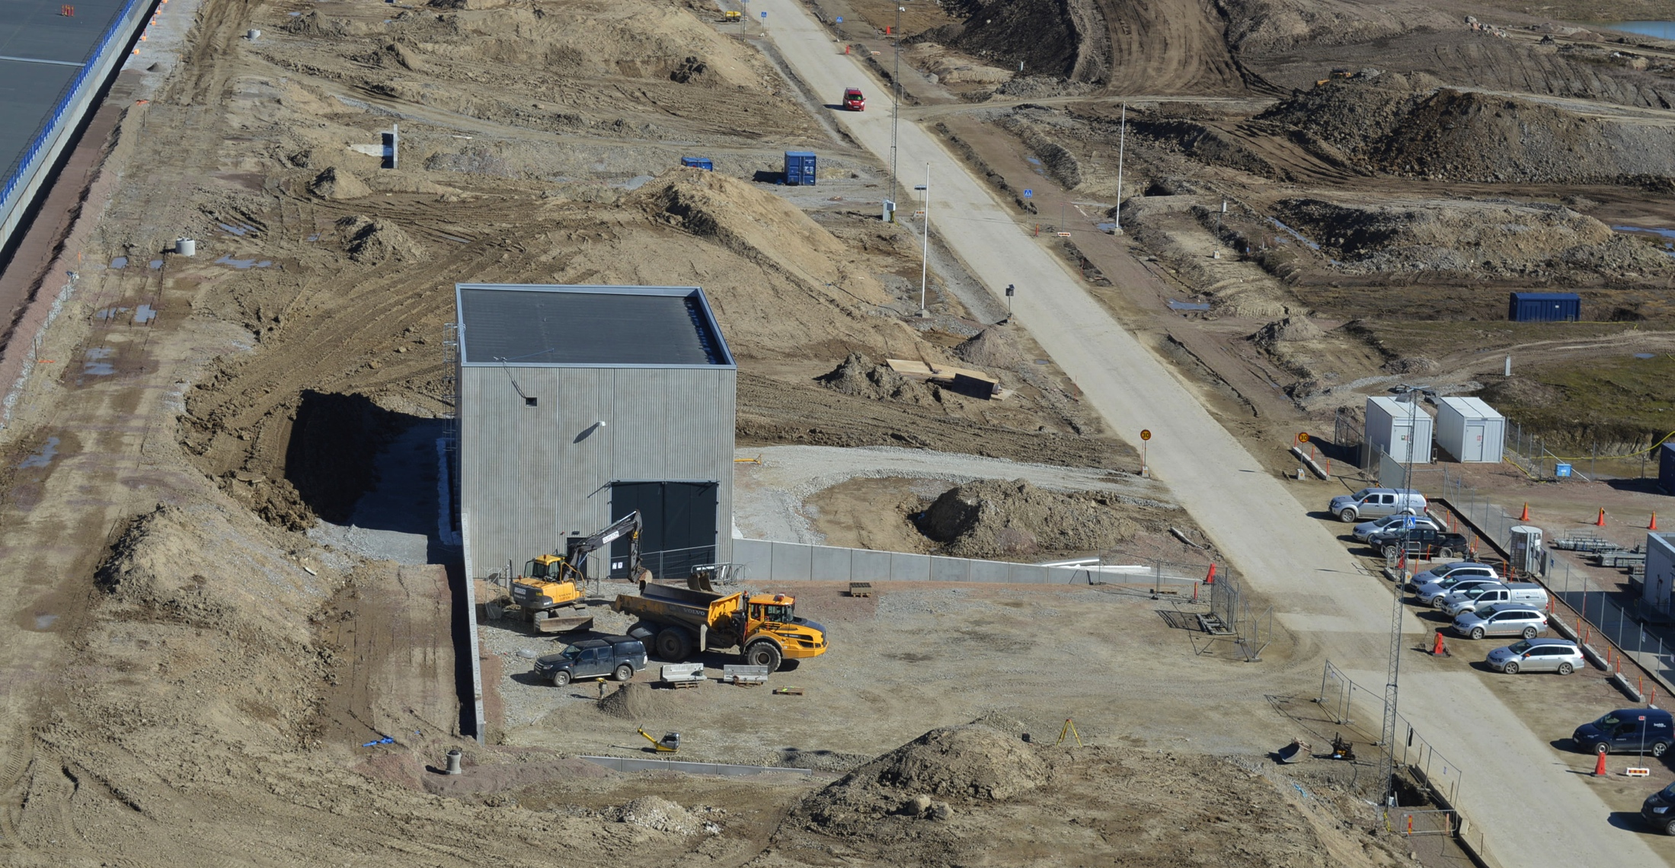
G01, HEBT Loading Bay
Exterior works, preparing for asphalt

Slide 14
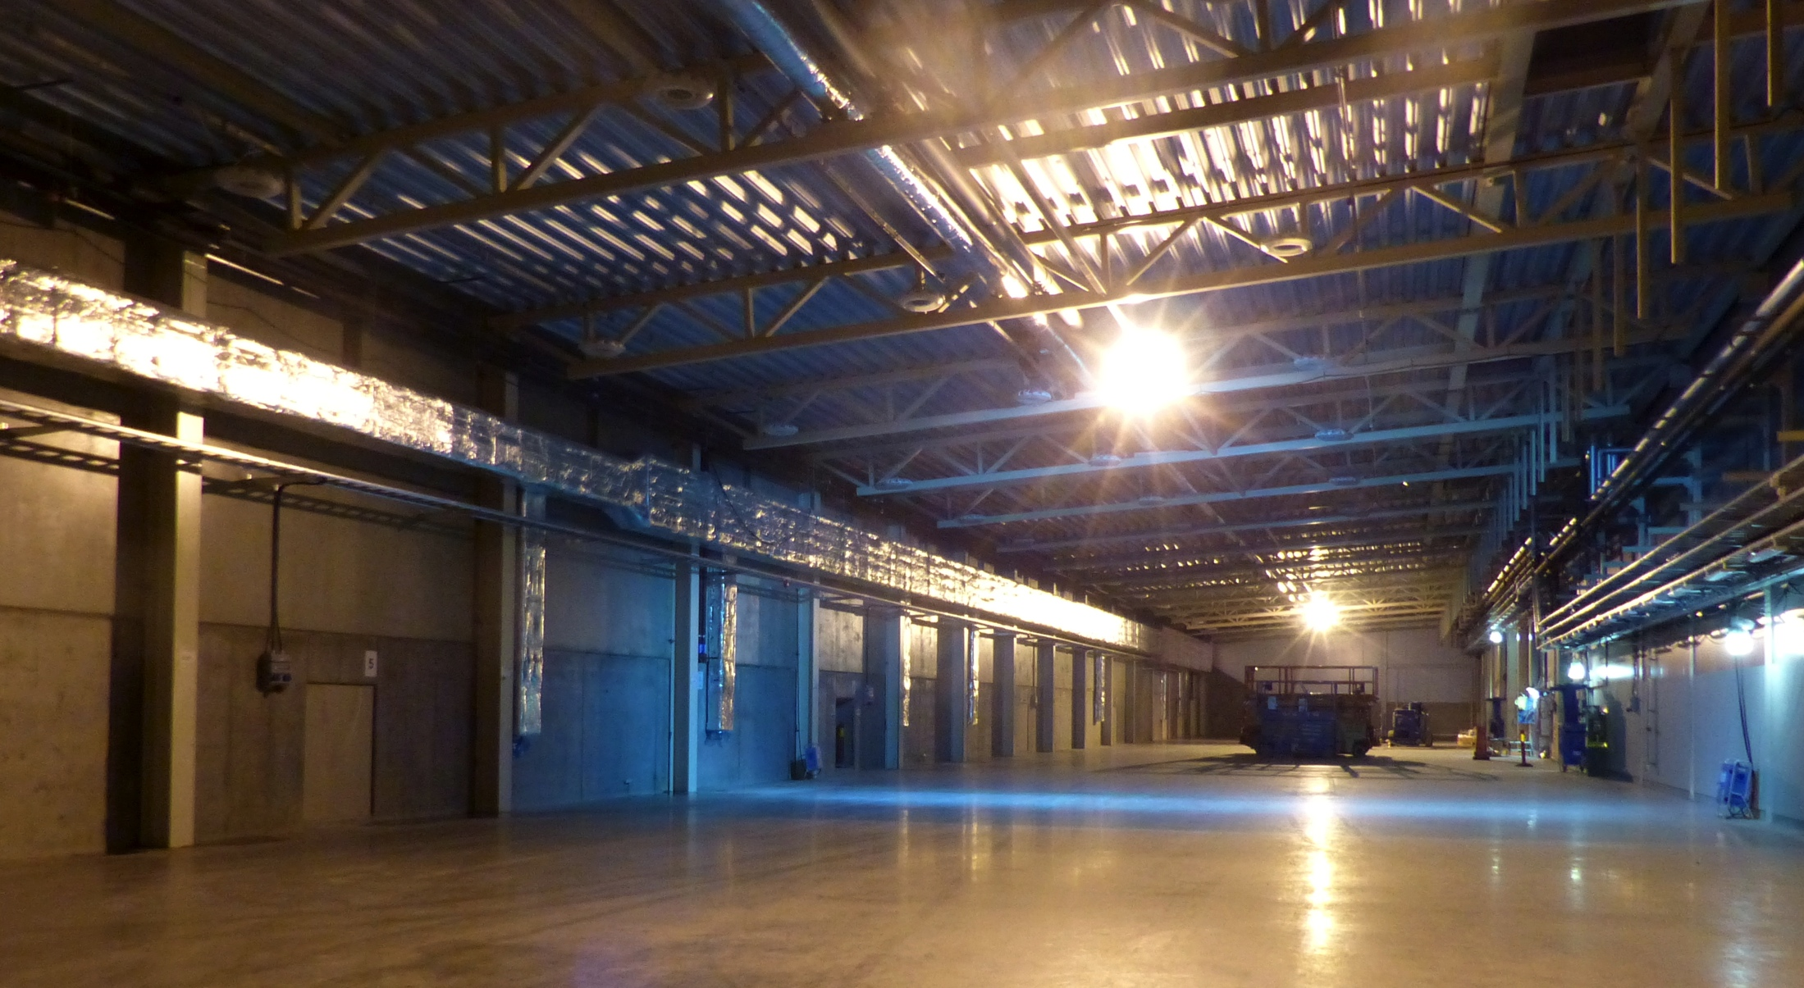
Klystron Gallery – Test Stand

Slide 15
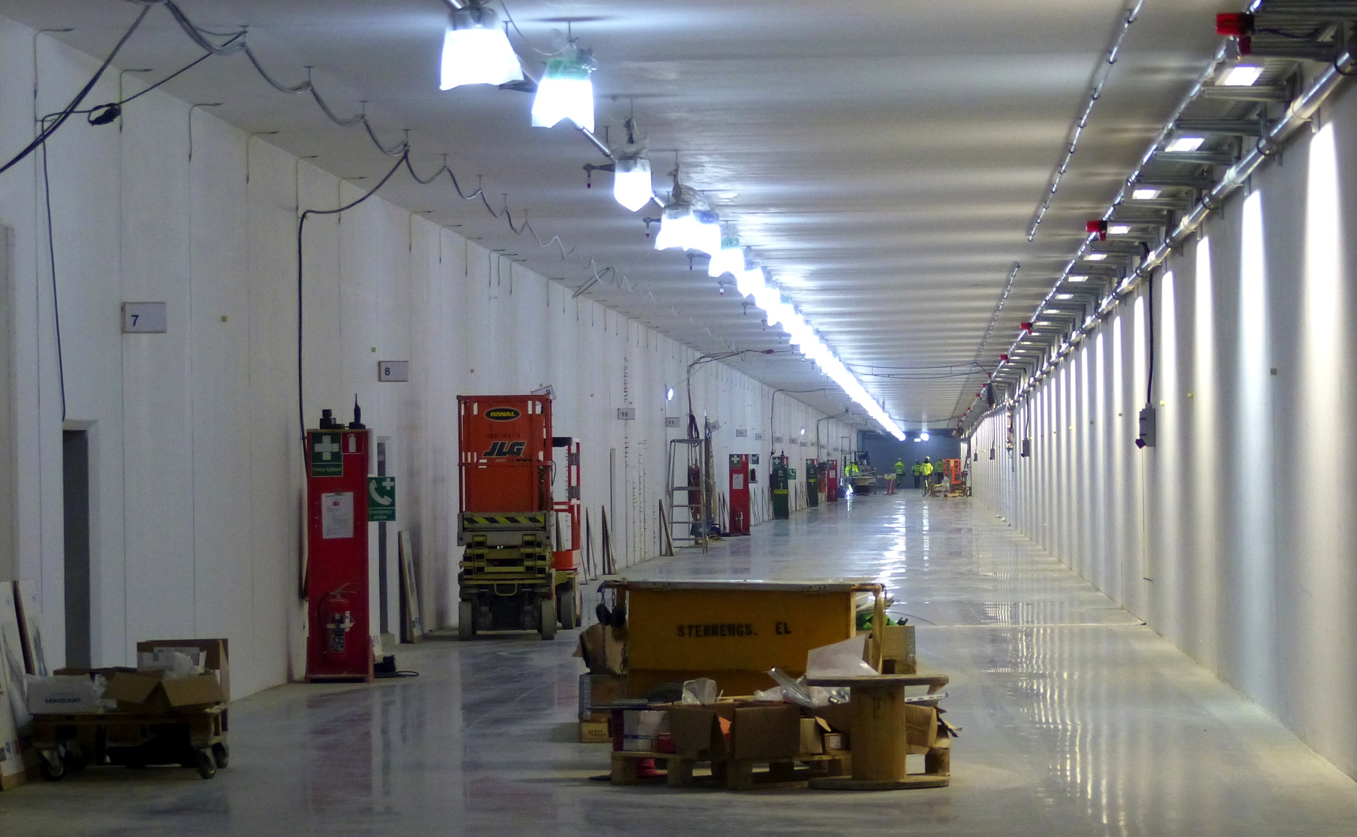
Inside G01 Linac

Slide 16
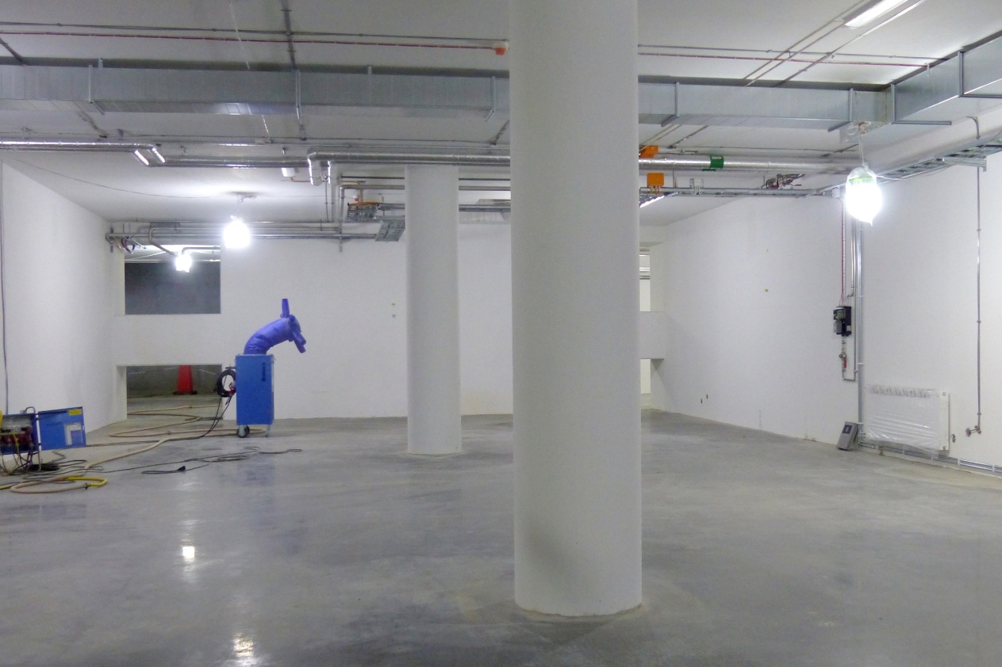
G01
Tunnel, view from HEBT
Front End Building

Slide 17
G04, Cryo Compressor Building

Slide 18
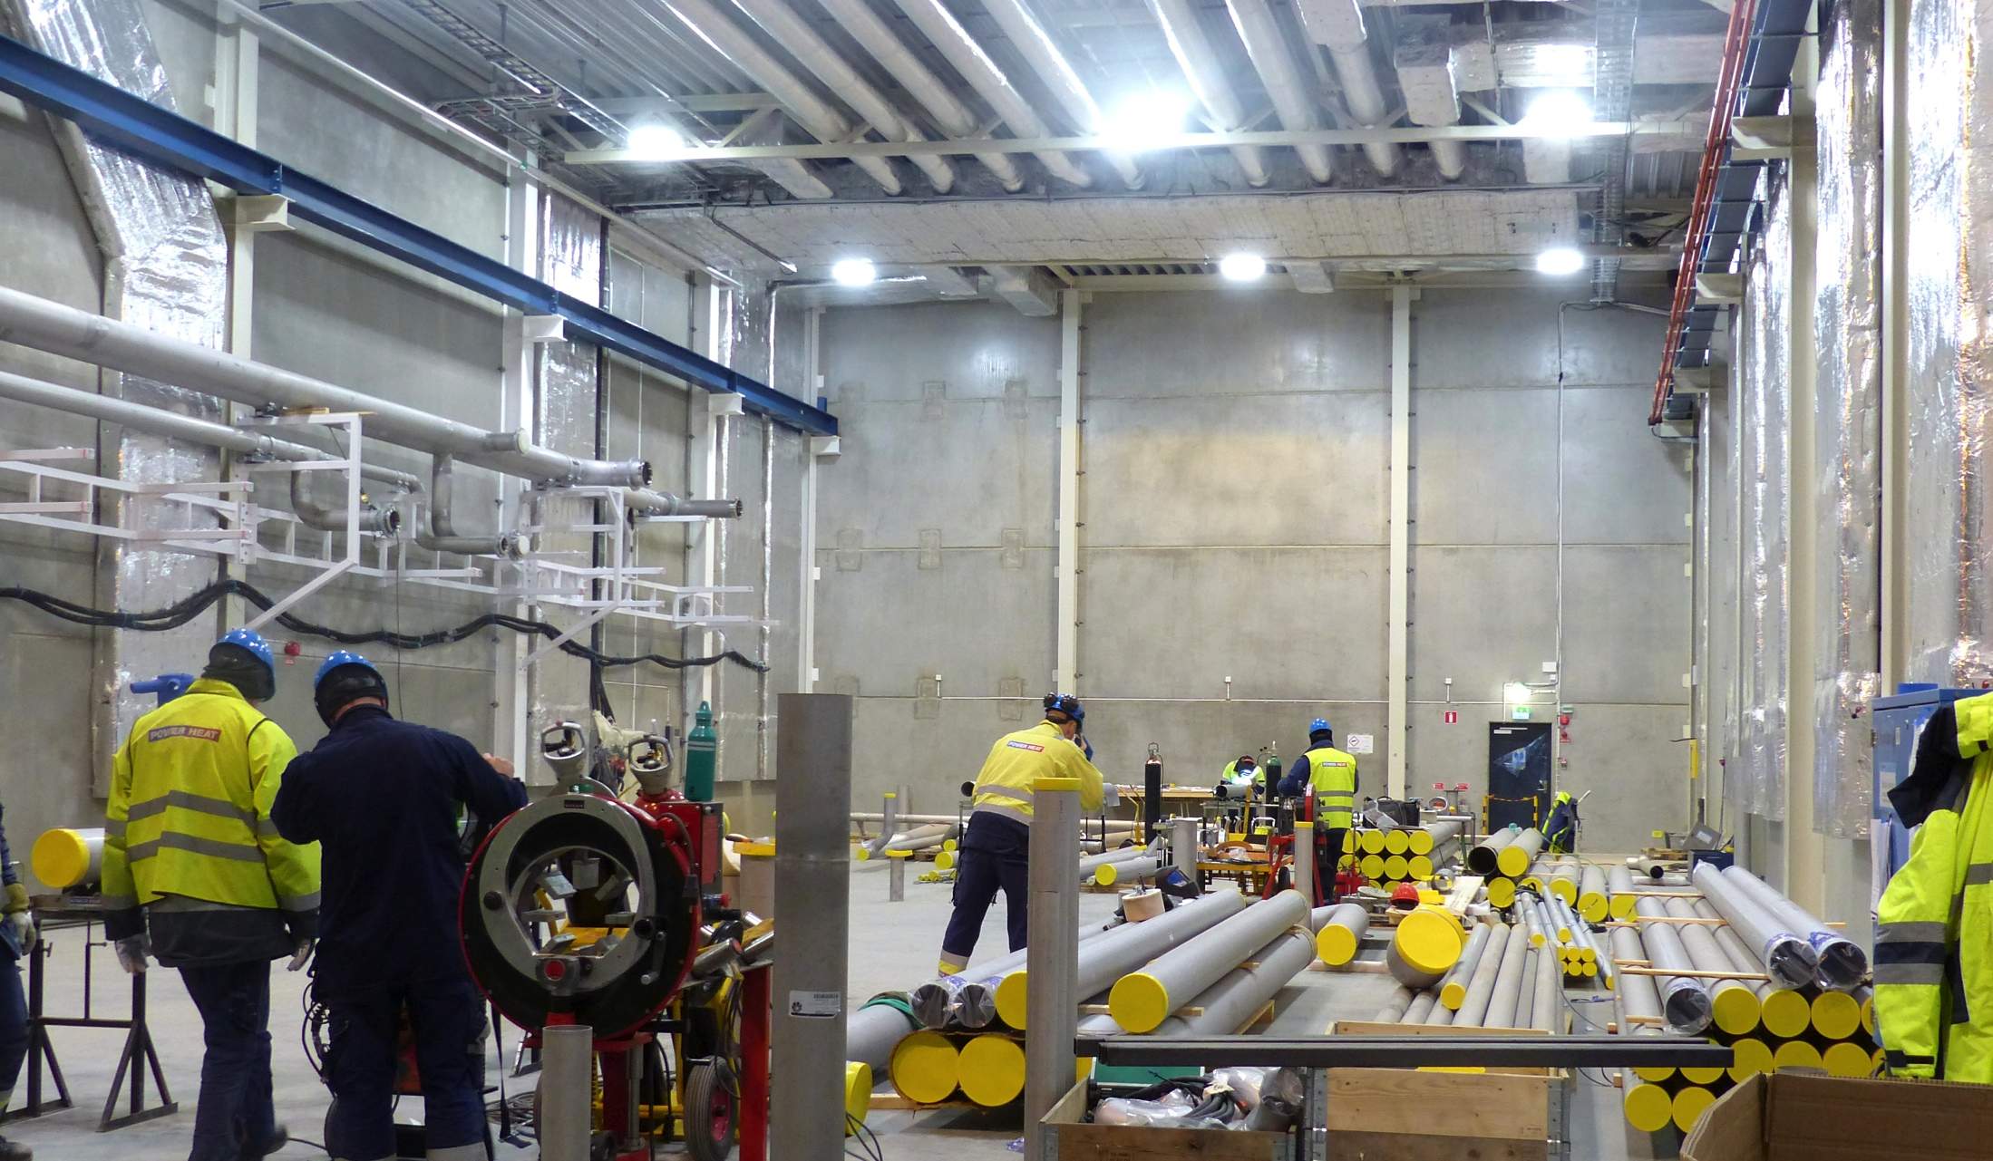
G04 Cryo Compressor Building

Slide 19
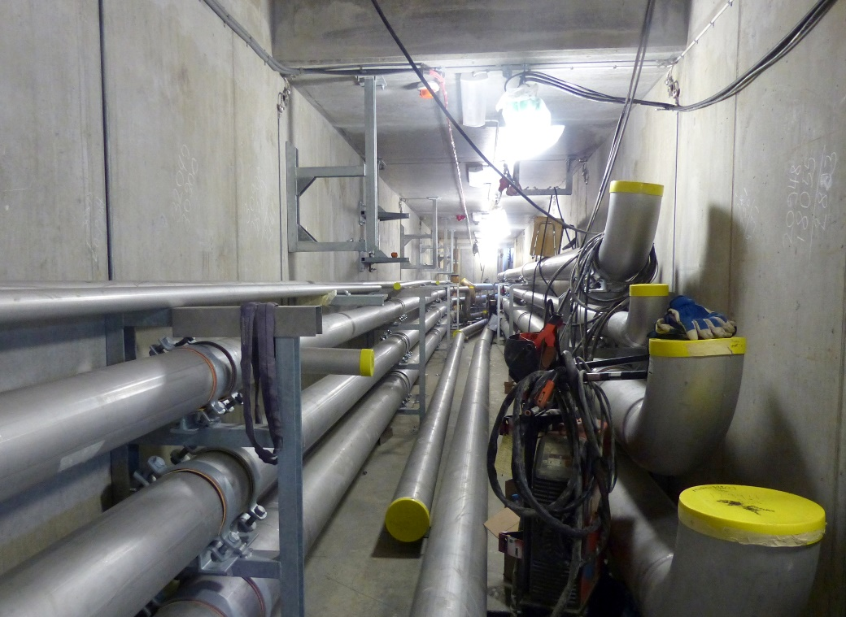
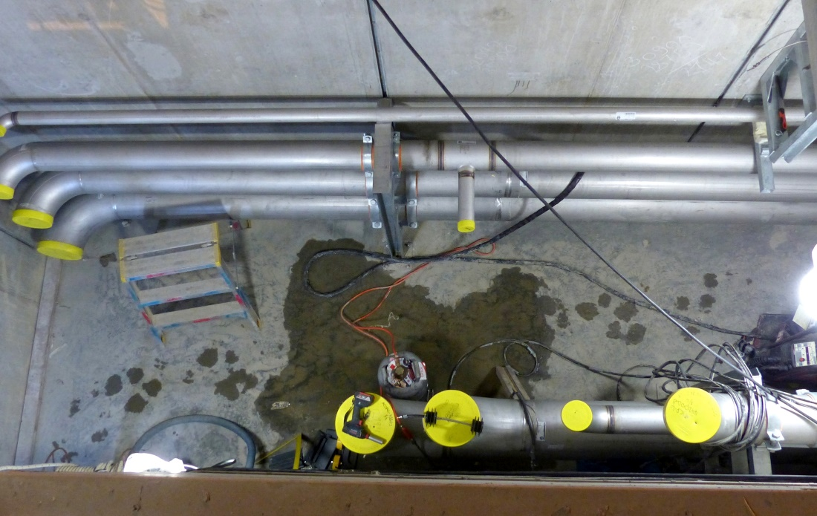
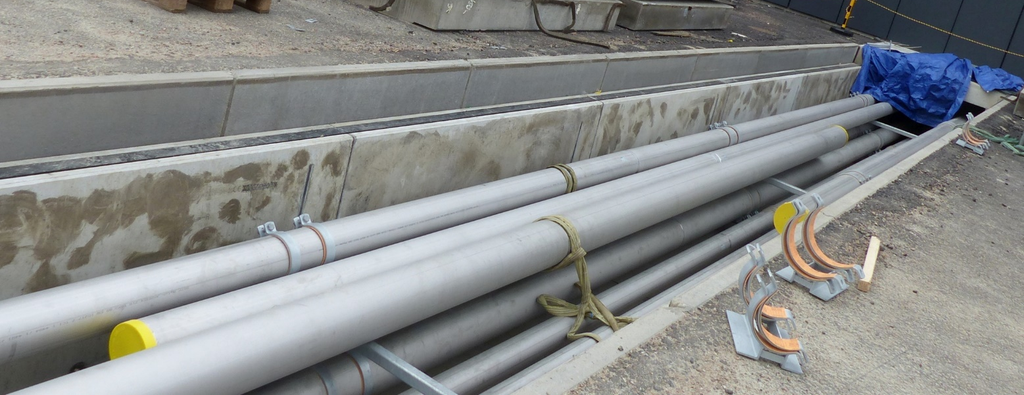
CTL Gallery, pipe installations

Slide 20
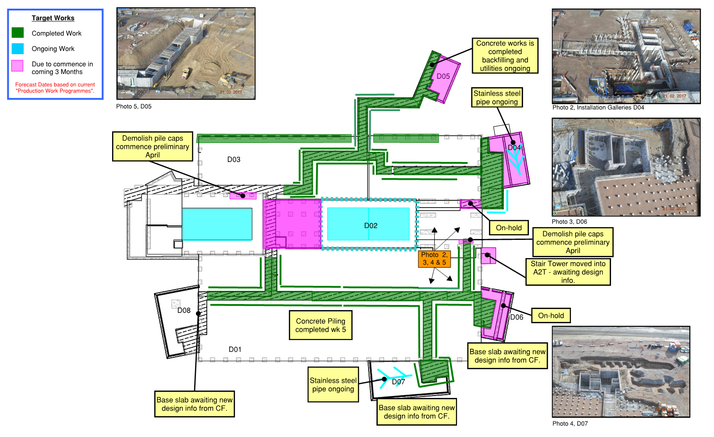
D01, D02 & D03 3-Month Lookahead

Slide 21
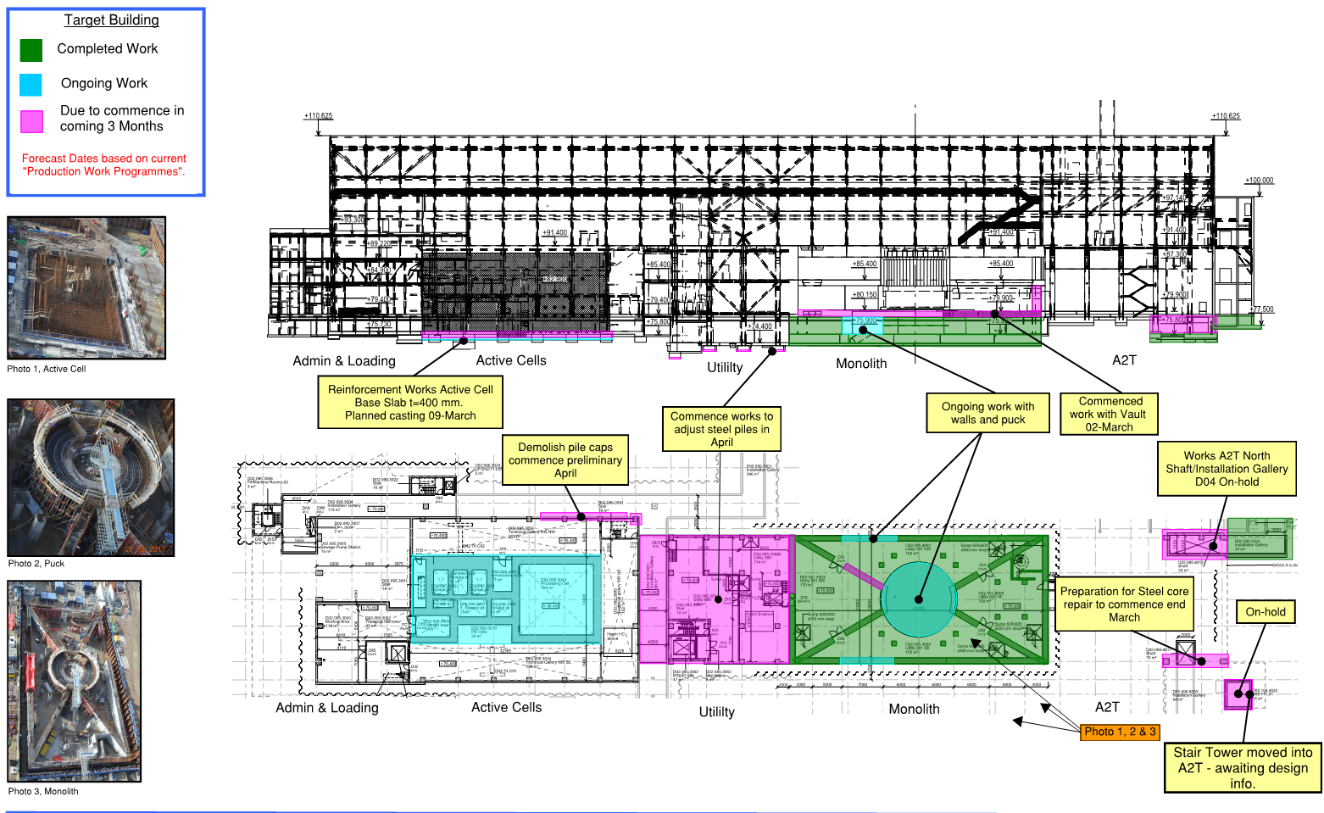
D02 3-Month Lookahead

Slide 22
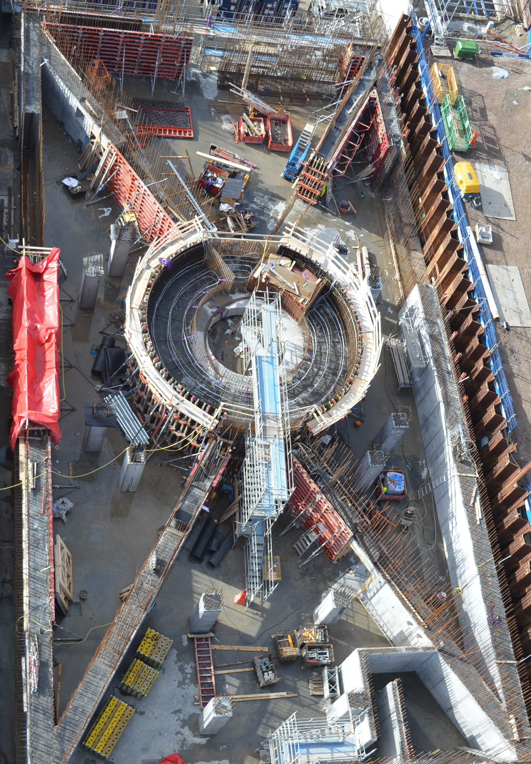
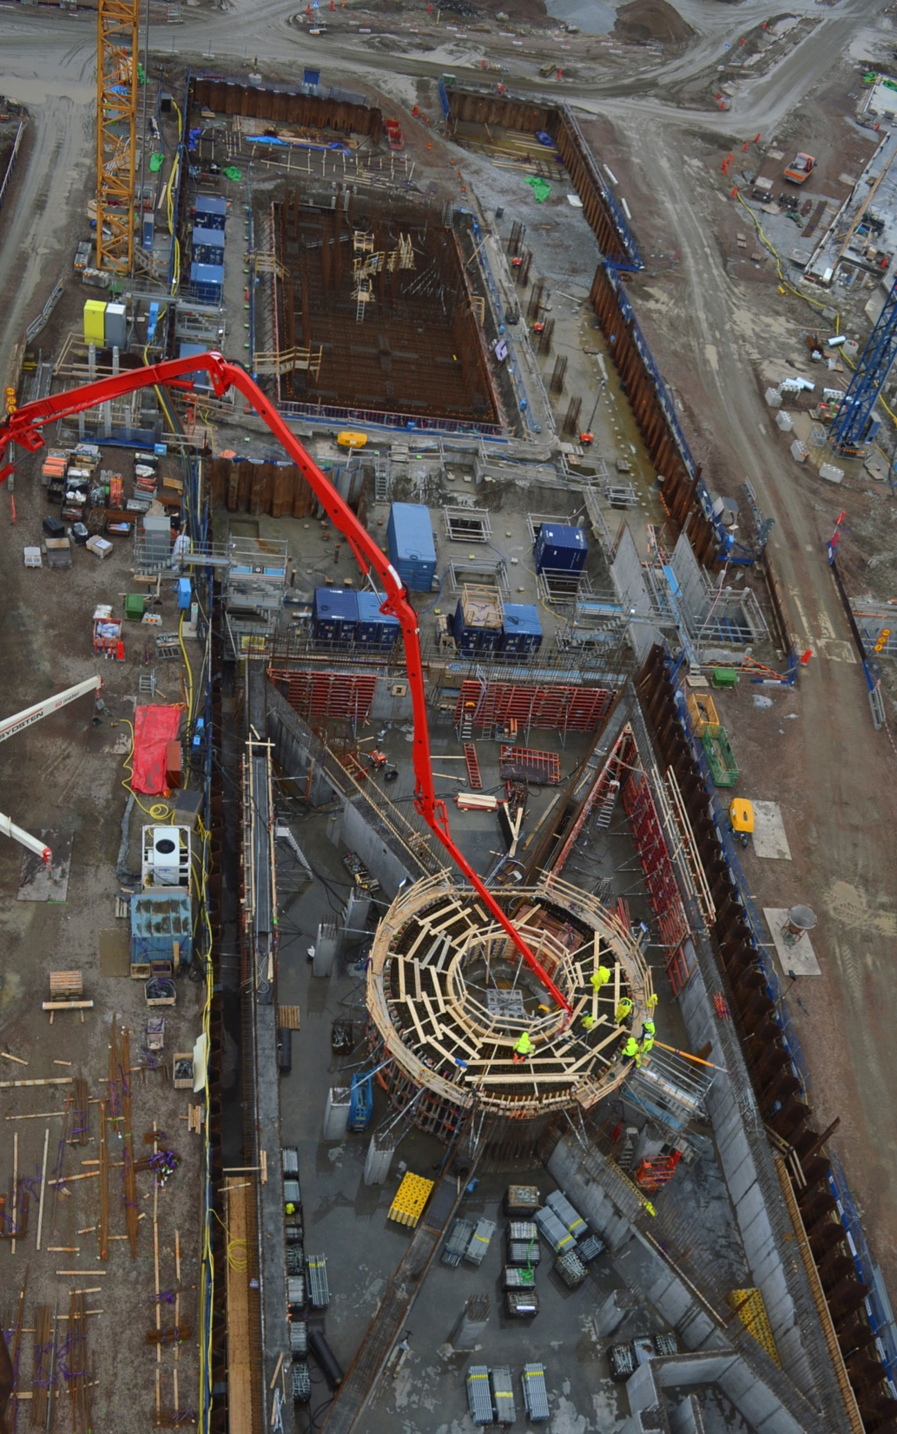
Target Monolith & Active Cells

Slide 23
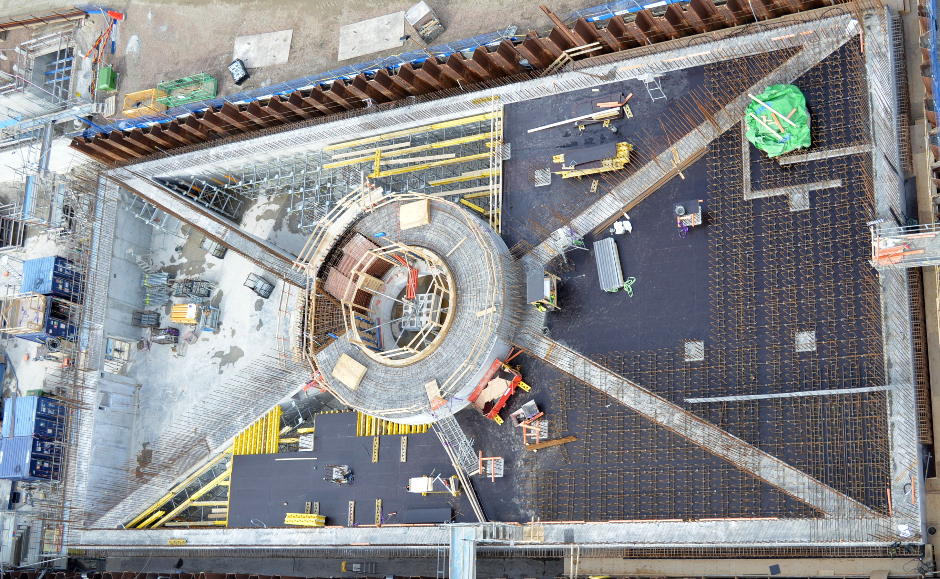
Target Monolith, puck

Slide 24
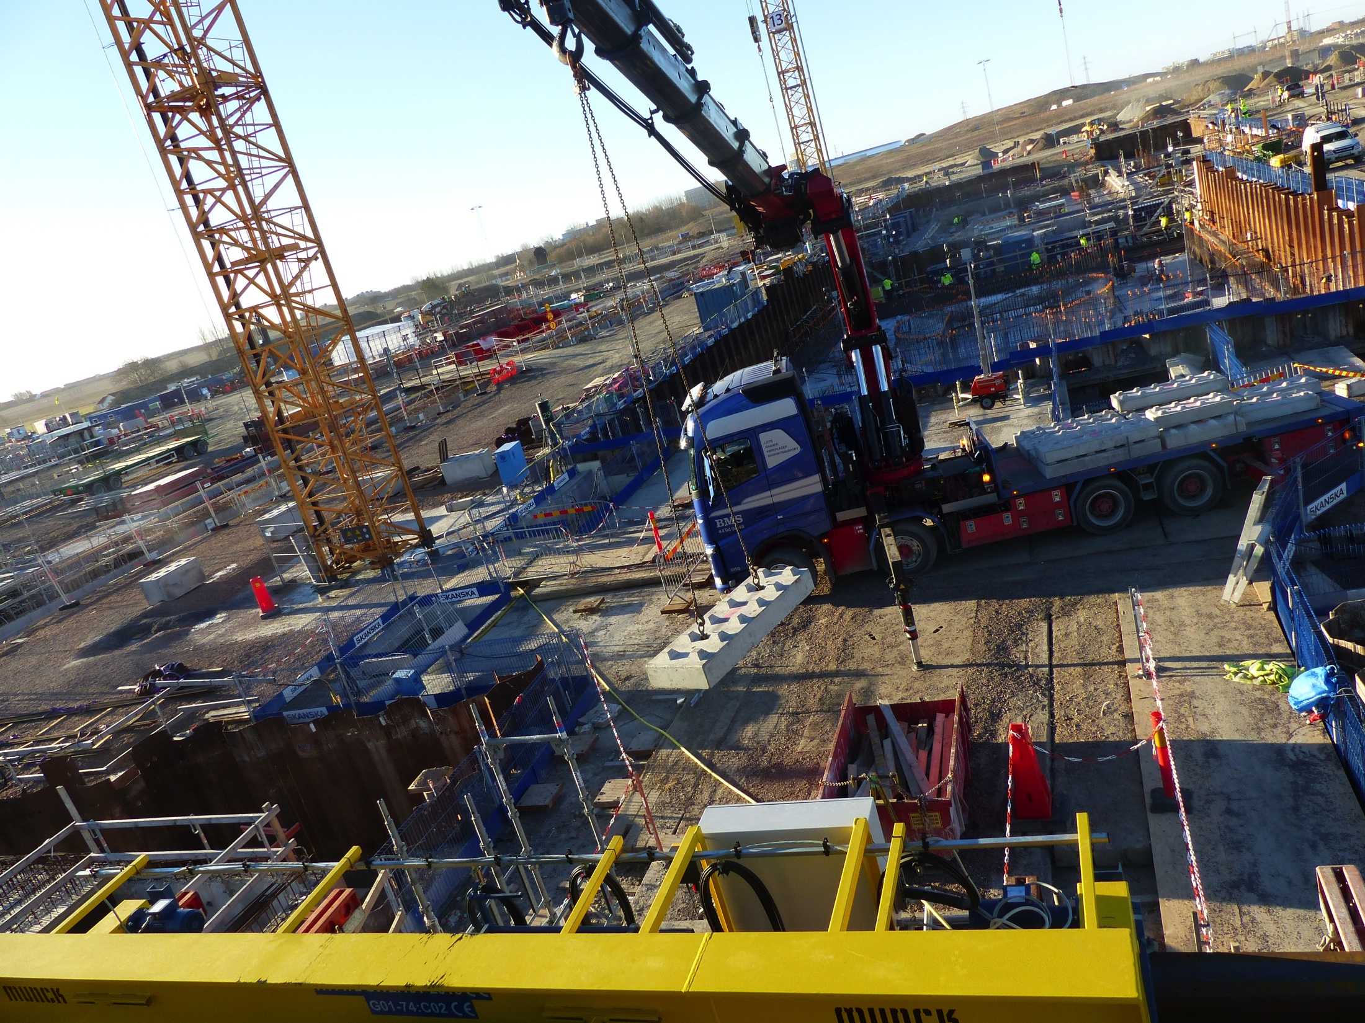
Beam dump (first in kind delivery to site) Shielding blocks installation

Slide 25
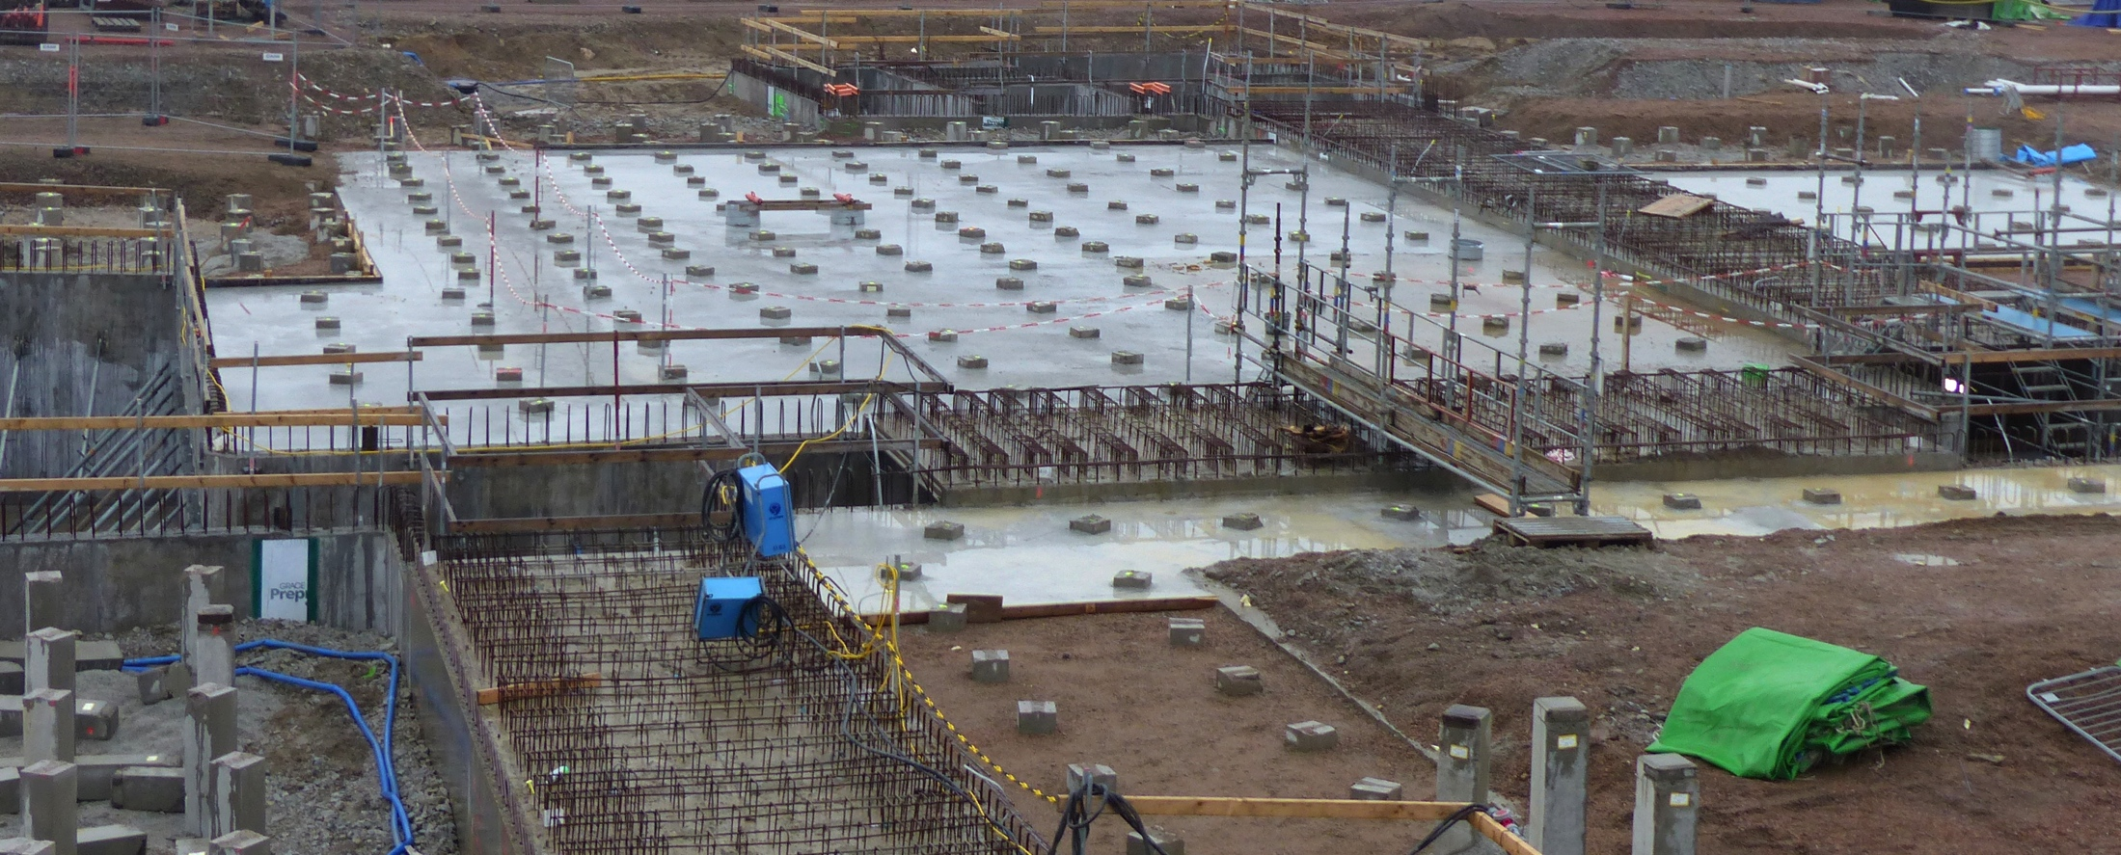
Installation Galleries (D01)

Slide 26
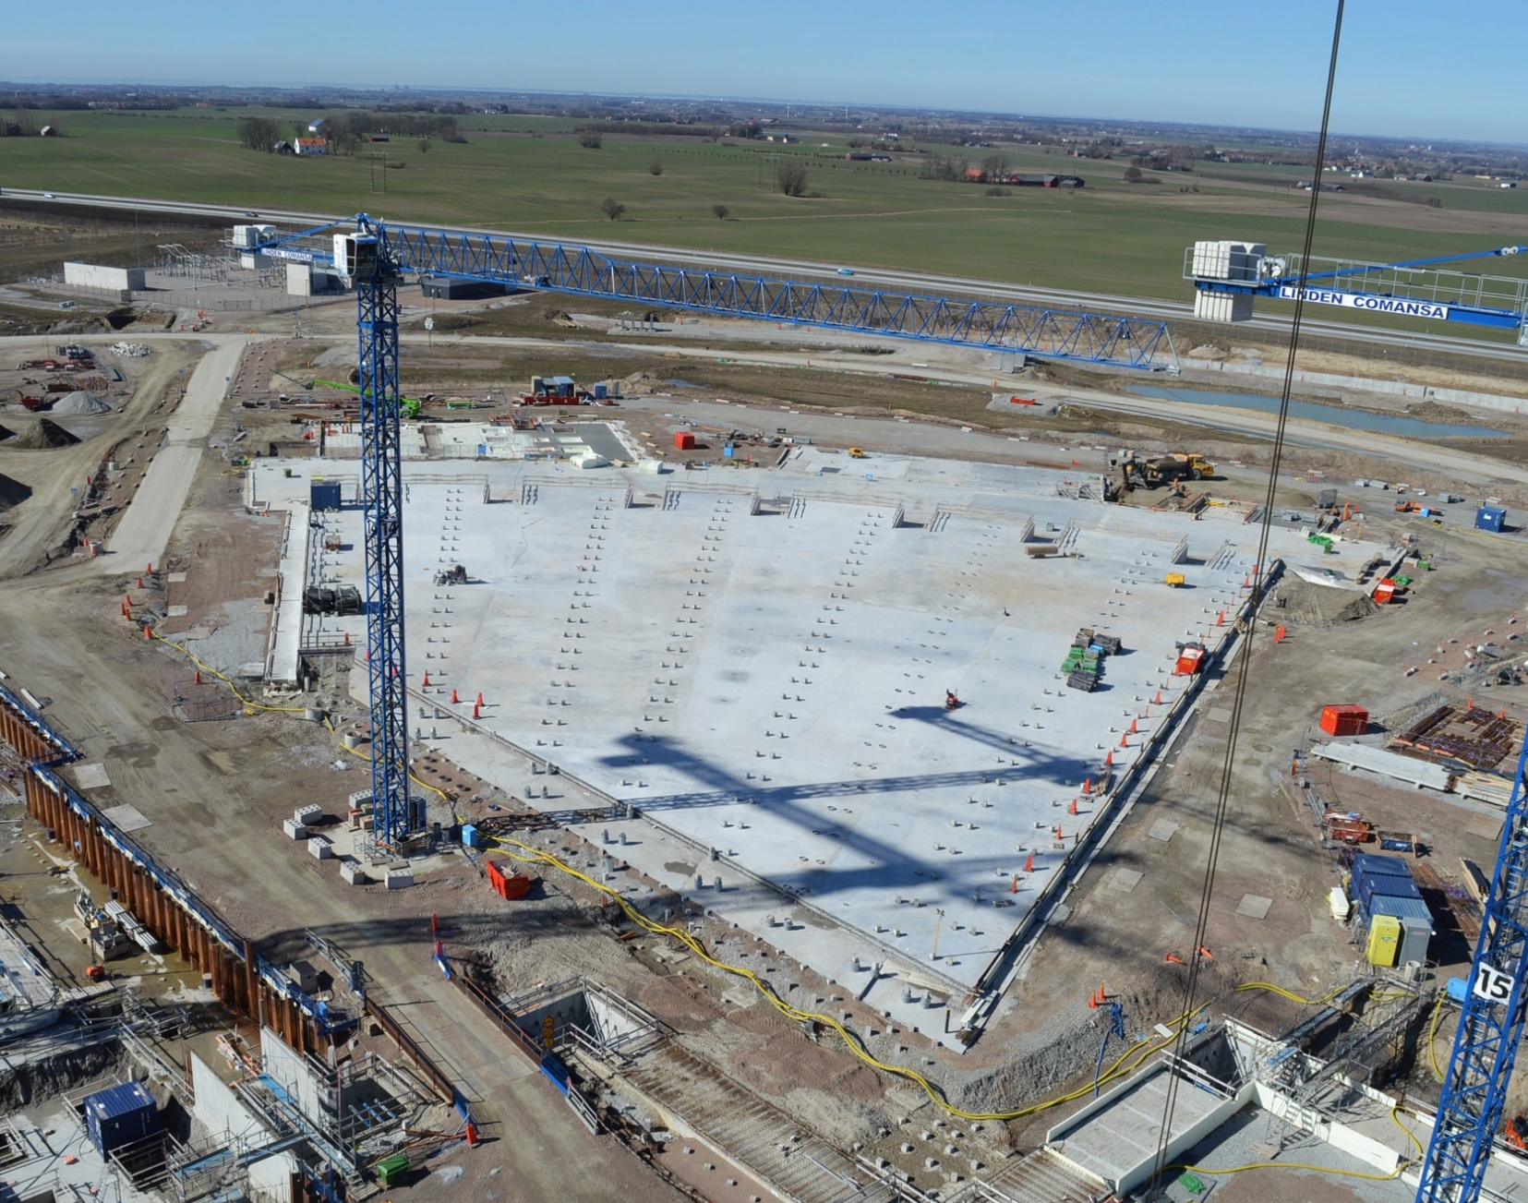
E02 Beam Line Gallery 8,000 m² base slab – last casting 14/03/2017

Slide 27
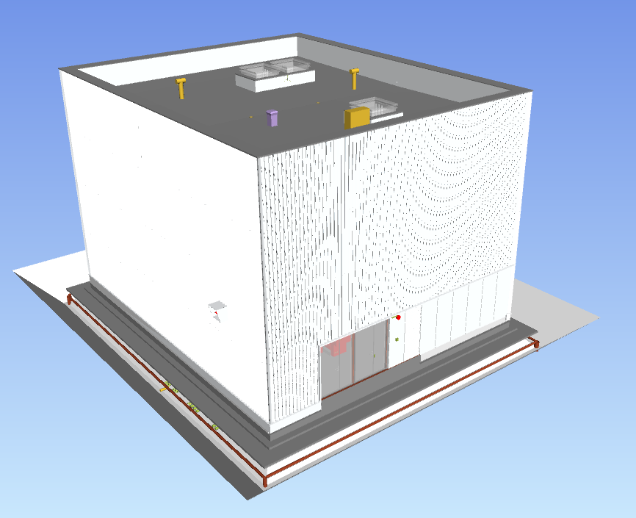
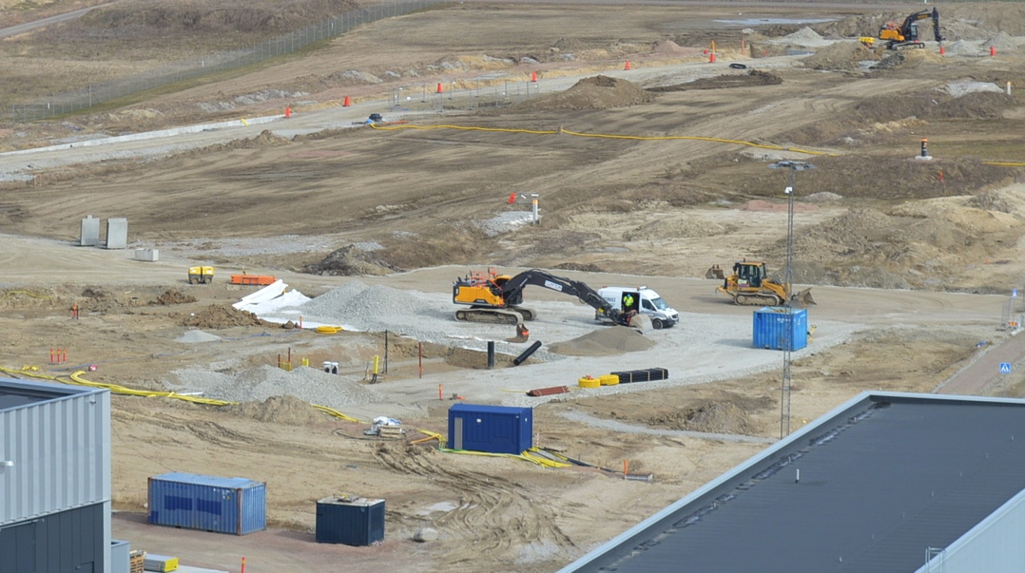
H10 Sprinkler Building Excavation, Building works starts early April

Slide 28
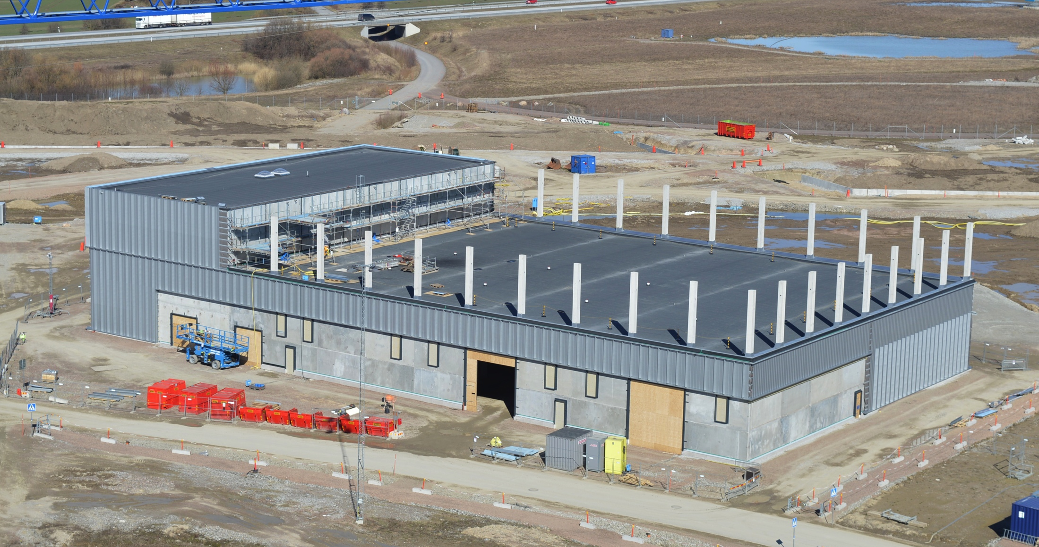
H01 facades

Slide 29
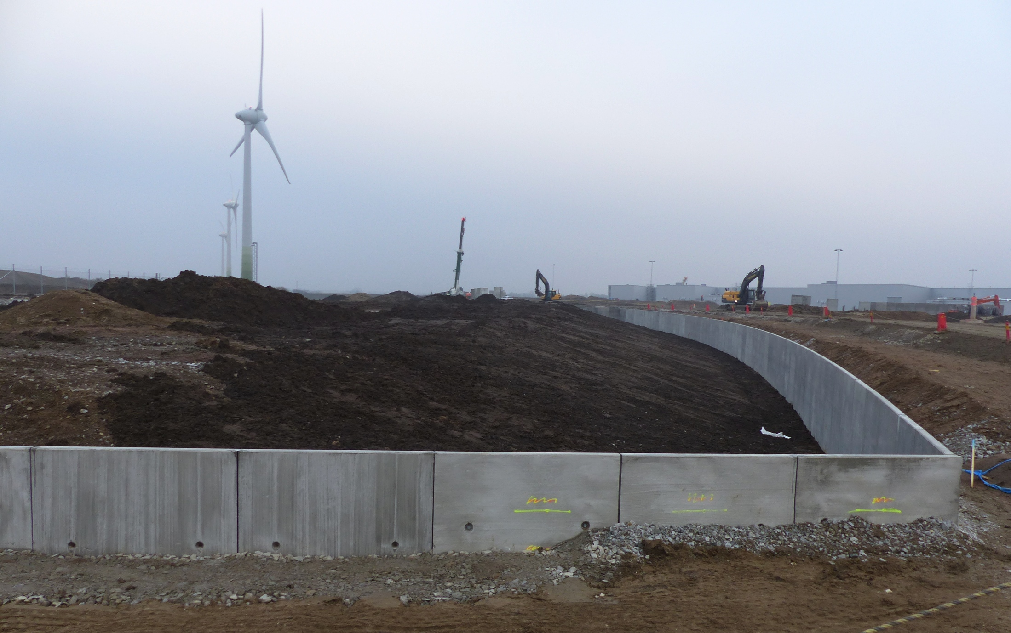
Ha-ha wall construction, north

Slide 30
Target Station and Instrument Hall sequence

Slide 31
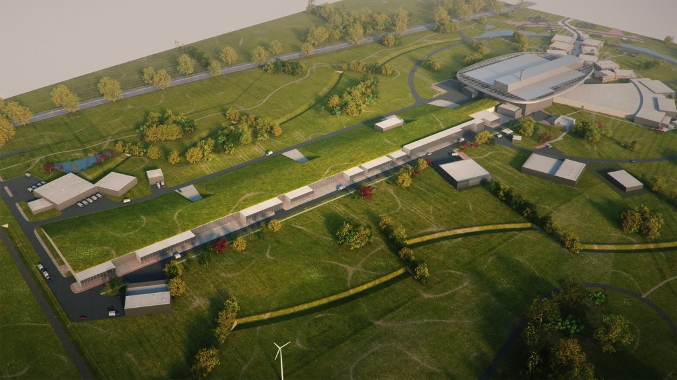
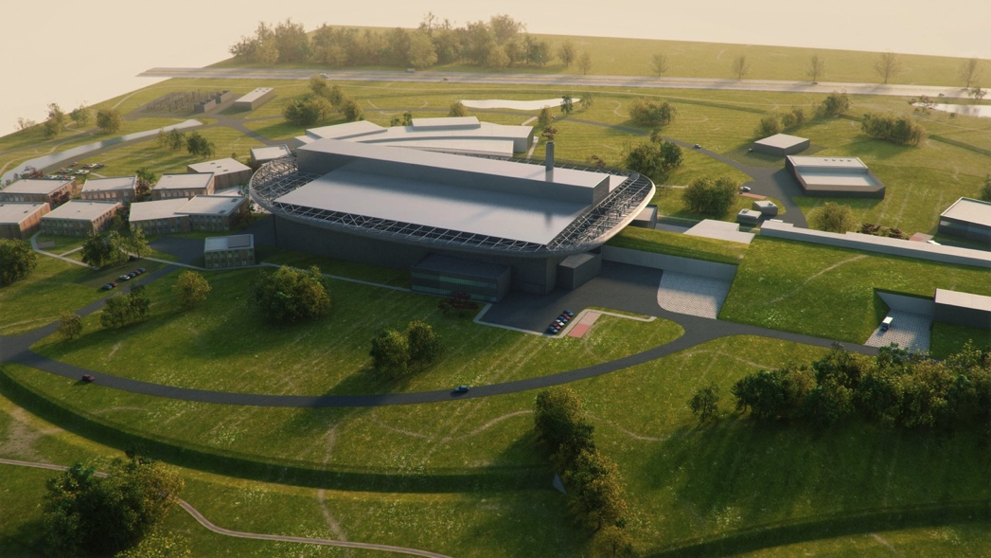
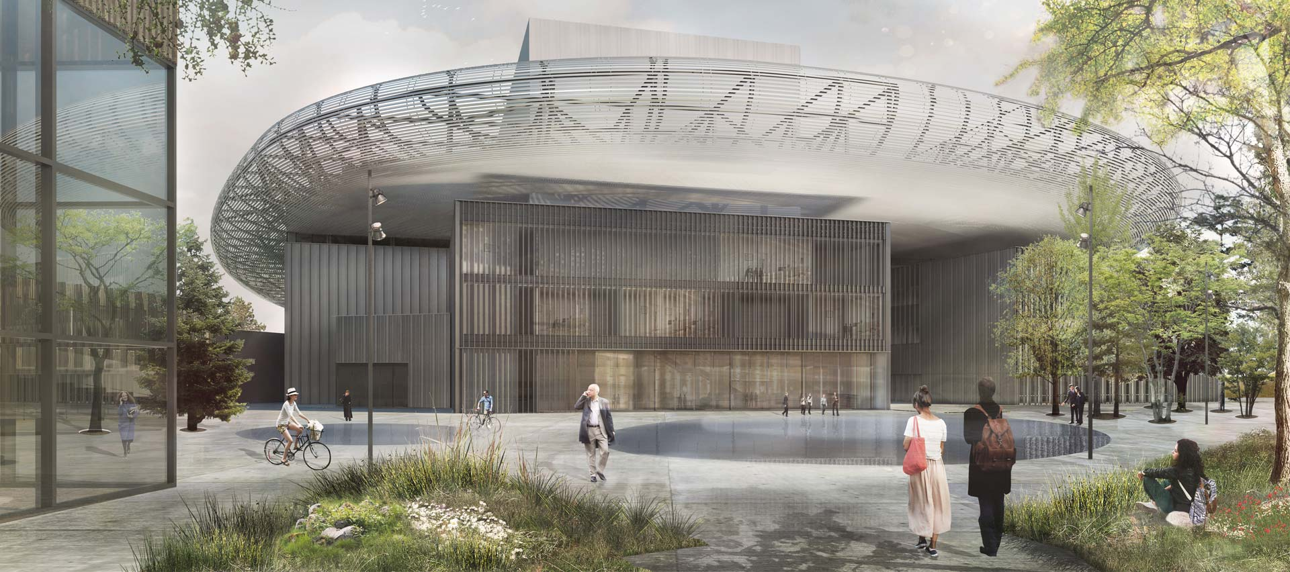
ESS vision

