Slide 1
Embedded and application software stacks
Jeong Han Lee
Integrated Control System Division
www.europeanspallationsource.se
2017-04-06

Slide 2
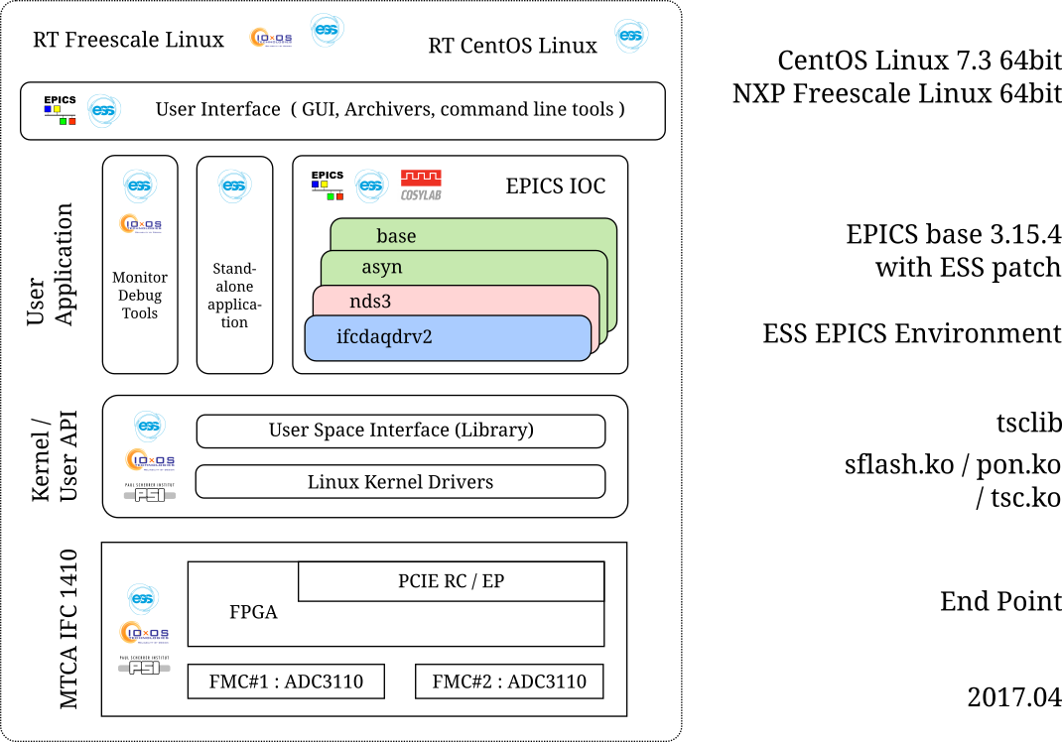
MTCA Software Stacks / 2017.04

Slide 3
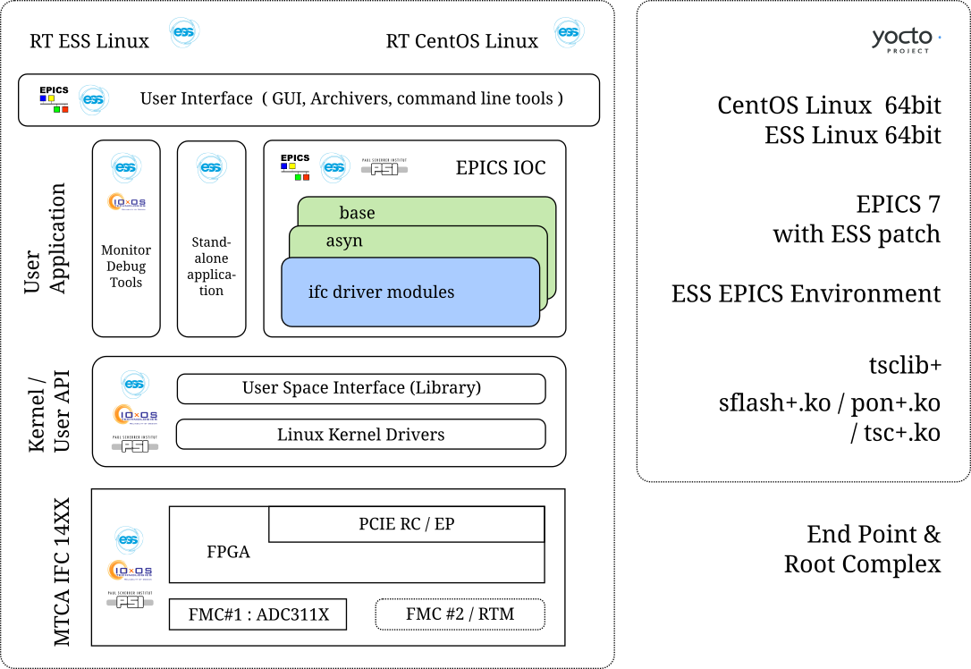
MTCA Software Stacks / Plan

Slide 4
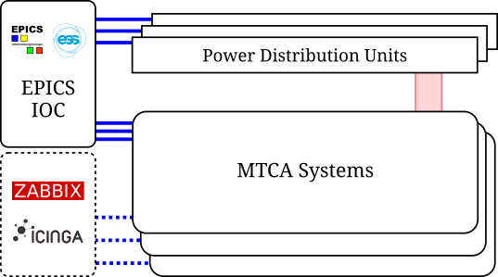
MTCA Systems Monitoring / Plan
MTCA Infrastructure Monitoring System
Slow > 1 Hz
Read Only (very limited Write)
Most PDUs support SNMP
MTCA MCH supports
RCMP (IPMI)
SNMP
EPICS modules
ipmiComm (SLAC)
devSNMP (FRIB)
snmpLib (RAON)
Existent Open Source Tools
ZABBIX
ICINGA

