Slide 1
Digital Platform Interfaces to FBIS
Annika Nordt
Integrated Control System Division
www.europeanspallationsource.se
2017-04-06

Slide 2
FBIS Interface - Sensor Side Scope (Partial View)
We talk about those links
ESS Timing System
BIS
MP-related Beam Monitoring Systems
FBIS
Ion Source Plasma + Extraction Power
MP-related RF Systems
Ion Source
System
Other MP-related Systems for «Fast» Protection Functions
LEBT Chopper System
MEBT Chopper
System
BIS: Set of all «Logic Systems» being part of Protection Functions
FBIS: Subset of the BIS dealing with «Fast» Protection Functions

Slide 3
FBIS Interface - Sensor Side Requirements Analysis
Primary Functional Requirement
Transmit boolean BEAM-PERMIT signal.
Primary Performance Requirements
Optimize for speed.
Derived from Requirement for “Fast” Protection Functions
Processing time from input of FBIS to output to actuation systems shall be < 3µs
PIL 2 capability
Minimize “spurious trip” probability
On the next slides: additional Requirements from Protection Function Failure Analysis according to IEC 61508-2:2010

Slide 4
FBIS Interface - Sensor Side Requirements Analysis – Mode Confusion
Foreseeable Failures with Impact on Interface Design
Mode Confusion: subset of sensor systems assume wrong mode, i.e. wrong reference values for off-nominal state detection → Loss of protection function

Slide 5
FBIS Interface - Sensor Side Requirements Analysis – Mode Confusion
Mode Confusion - Current Concept of Operations
MP-related Systems for which the following conditions apply
they are part of a «fast» protection function;
their MP-related function depends on a «mode» setting;
transmit the «mode» they are using to the FBIS.
The FBIS checks whether all received «mode» information is consistent and compliant with the «intended mode» distributed through the timing system.
If this is not the case, the FBIS inhibits beam.
→ Link to FBIS needs to support transfer of «mode» information.

Slide 6
FBIS Interface - Sensor Side Requirements Analysis – Sensor “death”
Foreseeable Failures with Impact on Interface Design
Sensor System “dies” with stuck-at OK → Loss of Protection Function

Slide 7
FBIS Interface - Sensor Side Requirements Analysis – Sensor “death”
Sensor System «death» - Current Concept of Operations
MP-related systems that are part of a «fast» protection function send a regular «heartbeat» signal to the FBIS
can be timestamp, incrementing counter, ..., but it must confirm the proper functioning of the MP-related functions running on that system.
The FBIS inhibits beam if the «death» of an MP-related system is detected.
→ Link to FBIS needs to support transfer of «heartbeat».

Slide 8
FBIS Interface - Sensor Side Requirements Analysis – Link Faults
Foreseeable Failures with Impact on Interface Design
Link Faults:
Stuck-At OK → Loss of Protection Function
Stuck-At NOK, Glitches → Loss of Availability (Spurious Trips)
Degraded Connection, Connection Loss → Both Consequences possible

Slide 9
FBIS Interface - Sensor Side Requirements Analysis – Link Faults
Options given in IEC 61508 for Diagnostic Measures

Slide 10
FBIS Interface - Sensor Side Requirements Analysis – Link Faults
Additonal Requirements from Facility Operations point of view:
System shall allow to detect disconnected or degraded links directly and explicitly.
Rationale: allow for efficient system test, fast problem diagnostics and troubleshooting.
→ Link to FBIS needs to support direct detection of connection loss and degraded connection.

Slide 11
FBIS Interface - Sensor Side Requirements Analysis – Speed
Speed Optimization - Consequences
Signal type must support «high-density» logic
Manage as many signals a possible on one FBIS logic board to minimize FBIS «tree»-depth
Minimize BEAM-PERMIT transmission latency
Transmission over «dynamic» signal, like a constant frequency (e.g. frequency-present = OK and frequency-absent = NOK) or a data-link, introduces additional latency
Increasing the link frequency to lower the latency increases complexity of the signal handling; e.g. proper management of spurious packet-loss or pulse-loss would again increase latency.
→ BEAM-PERMIT Transmission through «dynamic» signals would compromise optimizatzion for speed

Slide 12
FBIS Interface - Sensor Side Satisfy all Requirements – Current Proposal
Discrete, static link for BEAM-PERMIT transmission
Minimize Latency
Support «high-density» logic
Additional data-link
Transmission of «mode» information
Transmission of «heartbeat»
Redundant and diverse transmission of BEAM-PERMIT states
Bonus: full Handshake Capability (e.g. for BCM Calibration Support)
Primary Requirement: Speed
Mode Confusion Check
Sensor «Alive» Check
Allows Input comparison/voting (Table A.7 IEC 61508-2)

Slide 13
FBIS Interface - Sensor Side Discrete Link - Current Status
Discrete Link: two options under detailed investigation
3-wire current loop
Separate current loop for OK and NOK transmission. Current through both loops or no current indicate link failures.
RS-485 with additional link-fault circuit
Fast off-the-shelf components available (with data-sheet latencies < 20ns).
A few more discussions and investigations are needed.

Slide 14
FBIS Interface - Sensor Side Data Link - Current Status
Data Link: current proposal is to use standard Ethernet (100 Mb, Layer-2) for data communications
Proven in use, Easy to integrate, «Networkeable», Still allows low latency data transmission
Upgreadable from simple ethernet to realtime and/or safety profiles on same hardware
Current activities: investigate options for network topology
Identify additional requirements from IEC 61508-2:2010 for «black-channel» implementation: general rules from IEC 61784-3

Slide 15
«Black-channel» communication in the scope of IEC 61508 → IEC61784-3

Slide 16
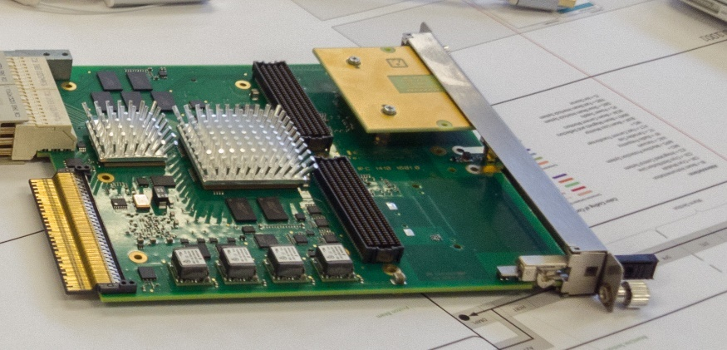
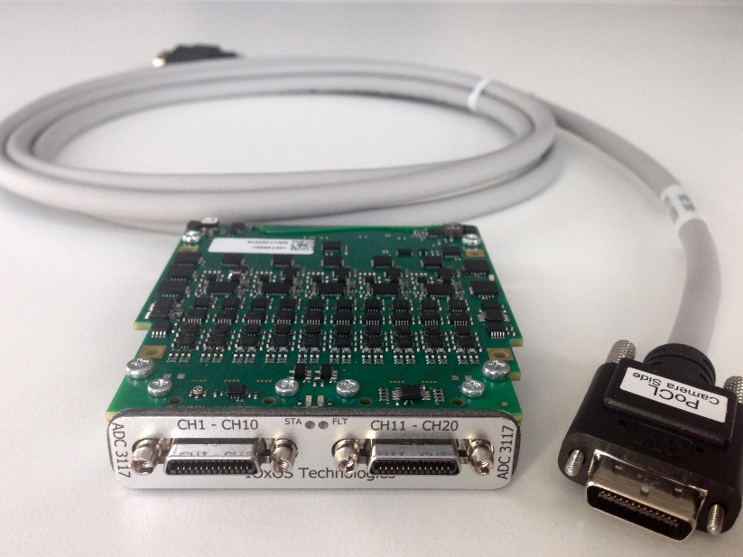
Realization Options for Ioxos IFC 14x0 based boards - Connectivity
Three connection options
Dedicated Interlock Piggy-Back (top picture shows mock-up)
Dedicated Interlock FMC Card
Interlock Connectivity on uRTM
Connector options under investigation
3M-SDR 26 pin
mixed data-link and multiple discrete signal connection (bottom picture shows connector example; courtesy of Ioxos)
Support for redundant interface
3M-SDR for discrete signals and RJ-45 for data link

Slide 17
Realization Options for Ioxos IFC 14x0 based boards - Firmware
Direct Integration of interlock interface management into TOSCA framework:
User does not need to cope with data-link protocol details or concrete discrete link implementation
Include «heartbeat» generation into MP-related protection function processing

Slide 18
Realization Constraints for other boards
Hardware-side
Foresee enough space and «FPGA-Pins» to drive both the discrete links (at least one) and data-links (at least one).
«Enough» will be fixed, once the final decision for the interface has been made.
Be ready to support redundant connectivity if part of «fast» protection function with PIL 2 requirement
Firmware-side
Implement control (and monitoring) of discrete signal outputs
Include «heartbeat» generation into MP-related protection function processing
Be ready to implement Ethernet communication to send «mode» and «heartbeat» information (if applicable)

