Slide 1
Monolith Atmosphere Update
Leif Emås
15th TAC Meeting
April 6, 2017
www.europeanspallationsource.se

Slide 2
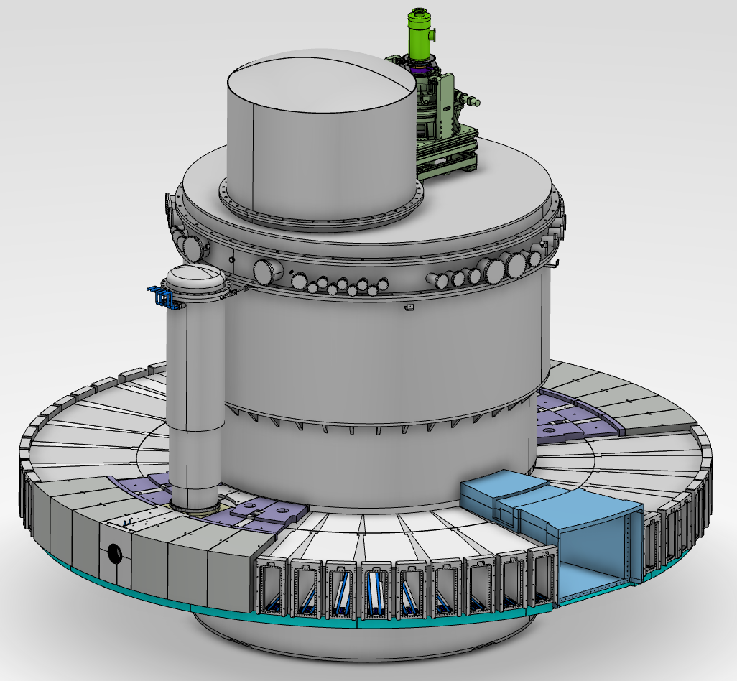
Monolith Vessel & Nutron beam ports

Slide 3
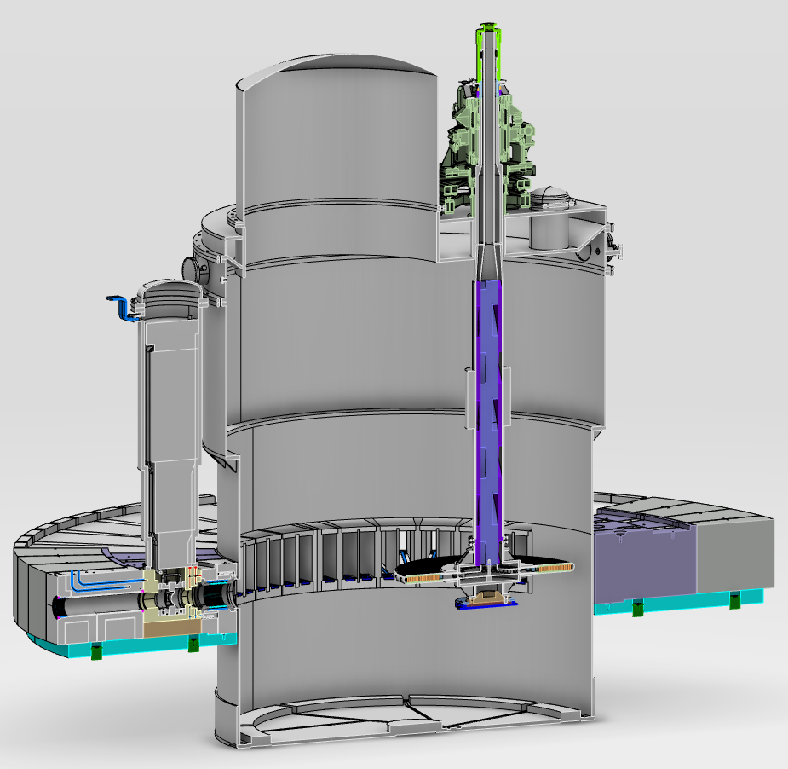
Monolith Vessel
Volume: 144 m³
Proton beam

Slide 4
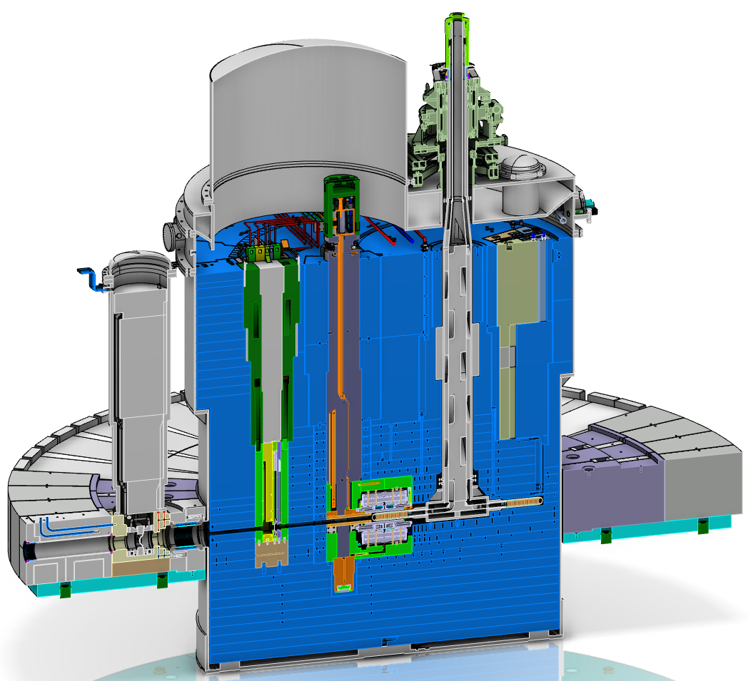
Monolith Vessel
Free volume: 41.8 m³
Inner shielding
Proton beam

Slide 5
Four alternatives
Alternative 1: Helium atmosphere at 99.7 kPa
Alternative 2: High vacuum at 0.01 Pa
Alternative 3A: Rough vacuum at 10-100 Pa – air
Alternative 3B: Rough vacuum at 10-100 Pa – helium

Slide 6
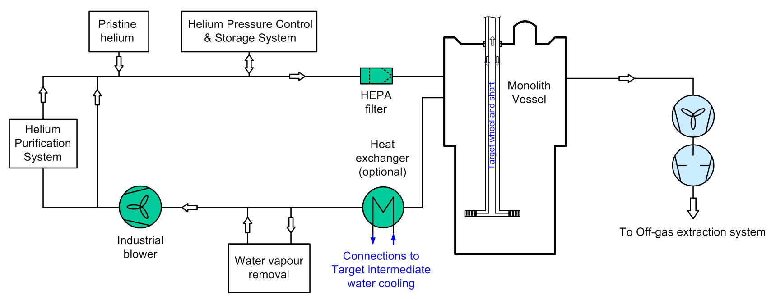
Alternativ 1: Helium atmosphere @ 99.7 kPa
Helium loop with purification and pressure control
Design loop flow 40 g/s (≈ 900 m³/h), He inventory ≈ 6.8 kg
Vacuum pumps for
rough vacuum

Slide 7
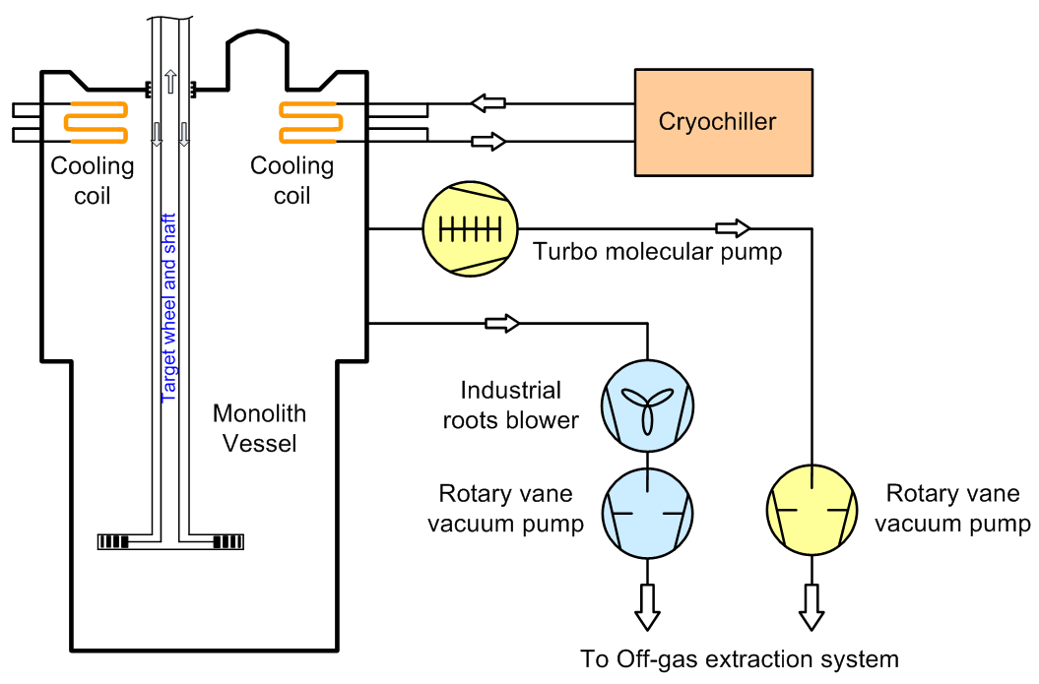
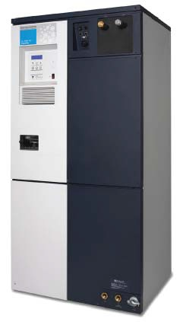
Alternativ 2: High vacuum @ 0.01 Pa
Volume:
Atmosphere:
Pressure:
Weight air in vessel:
41.8 m³
Air + H₂O
0.01 Pa
0.003 g
Cryochiller
TMP

Slide 8
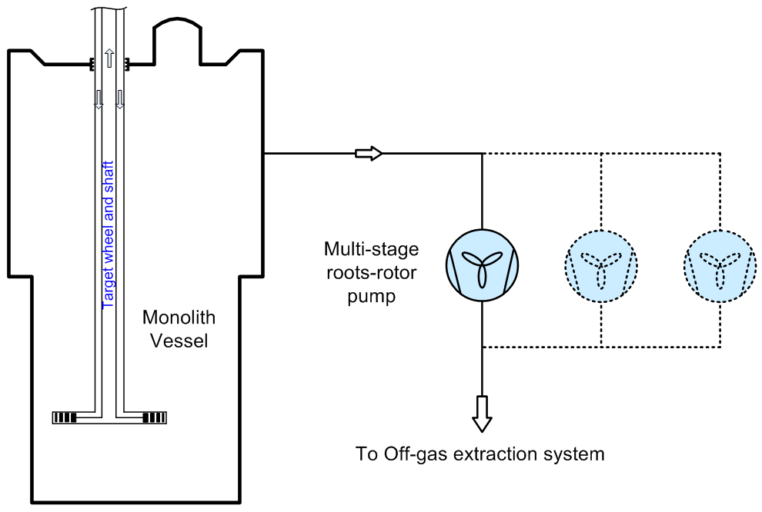
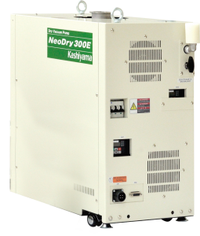
Alternativ 3A: Rough vacuum @ 10-100 Pa - air
Volume:
Atmosphere:
Pressure:
Weight air in vessel:
41.8 m³
Air
10-100 Pa
5-50 g
Multi-stage roots-rotor pump

Slide 9
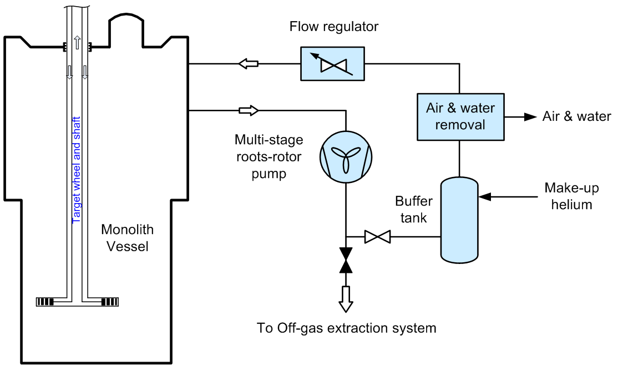
Alternativ 3B: Rough vacuum @ 10-100 Pa - He
Volume:
Atmosphere:
Pressure:
Weight He in vessel:
Weight He in loop:
41.8 m³
Helium
10-100 Pa
0.7-6.9 g
30 g
Multi-stage roots-rotor pump

Slide 10
Requirements
NSS requirements with He @ 99,7 kPa are:
< 700 ppm N₂ Partial pressure of < 70 Pa
< 30 ppm H₂O Partial pressure of < 3 Pa
< 1000 ppm impurities partial pressure of < 100 Pa
Rationale:
Water and nitrogen under irradiation forms nitric acid which affects the super-mirror coating on the guides.

Slide 11
Air removal capacity alt. 1 (He @ 99.7 kPa)
Removal efficiency: 97%
Purification flow
0.3 g/s
1 g/s
5 g/s
40 g/s
Air content at steady state = f (air leakage)
Permissable air content in helium atmosphere (870 ppmV)
Air content in He (ppmV)
Air leakage (g/h)
882 g/h

Slide 12
Water removal capacity alt. 1 (He @ 99.7 kPa)
Removal efficiency: 97%
Purification flow
0.3 g/s
1 g/s
5 g/s
40 g/s
Water content at steady state = f (water leakage)
Water content in He (ppmV)
Permissable water content in helium atmosphere (30 ppmV)
Water leakage (g/h)
18.8 g/h

Slide 13
Argon accumulation alt. 1 (He @ 99.7 kPa)
Argon partial pressure = f (operating time)
Air leakage
0.5 g/h
1 g/h
2 g/h
5 g/h
10 g/h
10 g/h
2 g/h
5 g/h
1 g/h
Renew helium (6.8 kg)
Argon partial pressure (Pa)
0.5 g/h
Annual helium consumption approx. 14 kg with an air leakage of 2 g/h
Operating time (hours)

Slide 14
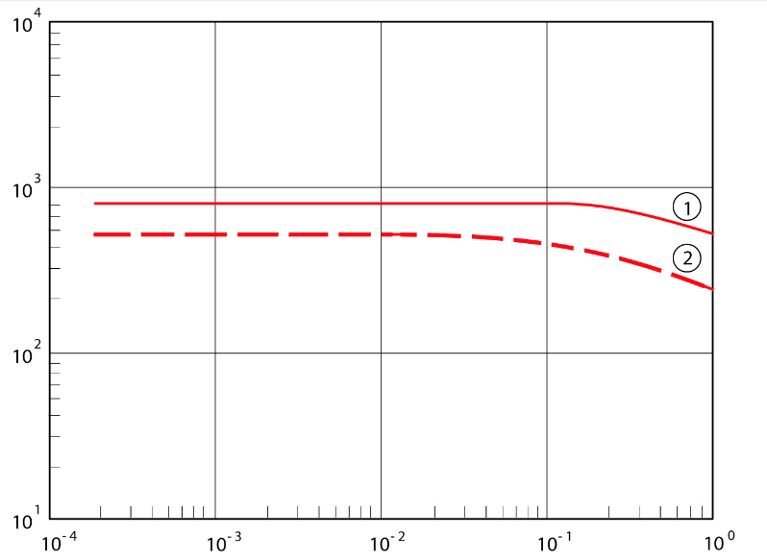
Air removal capacity alt. 2 (0.01 Pa)
Atmosphere:
Pressure:
100% air
0.01 Pa
Pumping speed:
Pumping speed:
48 m³/min
3.5 mg/min
0.01 Pa
Pumping speed (l/s)
Air partial pressure (Pa)
Turbo molecular vacuum pump

Slide 15
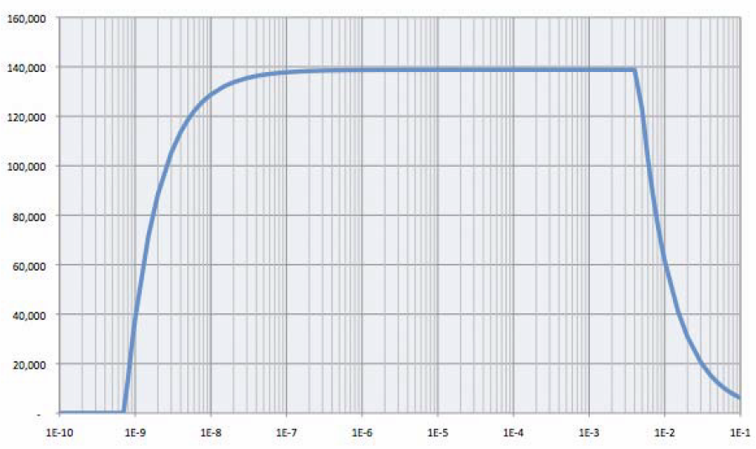
Water removal capacity alt. 2 (0.01 Pa)
Atmosphere:
Pressure:
100% water
0.01 Pa
Pumping speed:
Pumping speed:
8,400 m³/min
1.0 g/min
0.01 Pa
Pumping speed (l/s)
Water vapor partial pressure (Torr)
Polycold MaxCool 2500 L Cryochiller

Slide 16
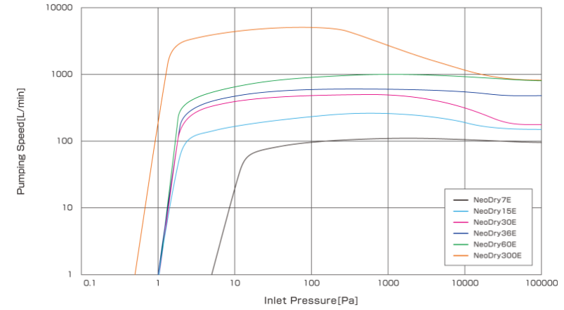
Air removal capacity alt. 3A (air @ 90 Pa)
Atmosphere:
Pressure:
100% air
90 Pa (N₂ partial pressure 70 Pa)
Pumping speed:
Pumping speed:
5 m³/min
3.3 g/min
90 Pa
Pumping speed (l/min)
Pressure (Pa)
Multi-stage roots-rotor vacuum pump

Slide 17
Water removal capacity alt 3A (water @ 3 Pa)
Atmosphere:
Pressure:
100% water
3 Pa
Pumping speed:
Pumping speed:
4 m³/min
0.14 g/min
3 Pa
Pumping speed (l/min)
Pressure (Pa)
Multi-stage roots-rotor vacuum pump

Slide 18
Air + H₂O removal capacity alt. 3B (He @ 100 Pa)
Atmosphere:
Total pressure:
Pumping speed:
He + air + H₂O
100 Pa
5 m³/min
Atmosphere:
Pumping speed:
Pumping speed:
87% air + 10 % He + 3% H₂O
3.2 g/min of air
0.18 g/min of H₂O
100 Pa
Pumping speed (l/min)
Pressure (Pa)
Multi-stage roots-rotor vacuum pump

Slide 19
Argon accumulation alt. 3B (He @ 10-100 Pa)
Argon partial pressure = f (operating time)
Air leakage
10 g/h
50 g/h
100 g/h
100 g/h
50 g/h
10 g/h
Argon partial pressure (Pa)
Renew helium (1,5 + 30 g)
Annual helium consumption approx . 2.25 kg with an air leakage of 50 g/h
Operating time (hours)

Slide 20
Maximum allowed air and water leakage
Helium atmosphere @ 99,7 kPa
Alternative 1 | g/min | g/hour | kg/24 hours | kg/5000 hours
Air | 14.7 | 882 | 21.2 | 4,410
Air due to Ar build-up | 0.03 | 2 | 0.048 | 10
Water | 0.31 | 18.8 | 0.45 | 94
High vacuum @ 0.01 Pa
Alternative 2 | g/min | g/hour | kg/24 hours | kg/5000 hours
Air | 0.0035 | 0.21 | 5.04 | 1.05
Air due to Ar build-up | Non-limiting
Water | 1.0 | 60 | 1.44 | 300

Slide 21
Maximum allowed air and water leakage
Rough vacuum @ 10-100 Pa - air
Alternative 3A | g/min | g/hour | kg/24 hours | kg/5000 hours
Air | 3.3 | 198 | 4.75 | 990
Air due to Ar build-up | Non-limiting
Water | 0.14 | 8.4 | 0.20 | 42
Rough vacuum @ 10-100 Pa - He
Alternative 3B | g/min | g/hour | kg/24 hours | kg/5000 hours
Air | 3,2 | 192 | 4.61 | 960
Air due to Ar build-up | 0.83 | 50 | 1.2 | 250
Water | 0.18 | 10.8 | 0.26 | 54

Slide 22
Result
Helium atmosphere @ 99,7 kPa
Rough vacuum @ 10-100 Pa - air
Rough vacuum @ 10-100 Pa - He
High vacuum @ 0.01 Pa
 | Alt 1 | Alt 2 | Alt 3A# | Alt 3B
Air removal capacity (g/h) | 2 | 0.21 | 198 | 50
Water removal capacity (g/h) | 18.8 | 60 | 8.4 | 10.8
# Pumping capacity can easily be increased by installing more pump(s)

Slide 23
Result
Helium atmosphere @ 99,7 kPa
Rough vacuum @ 10-100 Pa - air
Rough vacuum @ 10-100 Pa - He
High vacuum @ 0.01 Pa
 | Alt 1 | Alt 2 | Alt 3A# | Alt 3B
Air removal capacity (g/h) | 2 | 0.21 | 198 | 50
Water removal capacity (g/h) | 18.8 | 60 | 8.4 | 10.8
Remove PBW | No | Yes | No | No
High vacuum standards | No | Yes | No | No
Helium consumption | High | None | None | Low
Heat removal (from nutron beam guides) | Good | Enough? | Enough? | OK
System simplicity | - | + | ++++ | ++
# Pumping capacity can easily be increased by installing more pump(s)

Slide 24
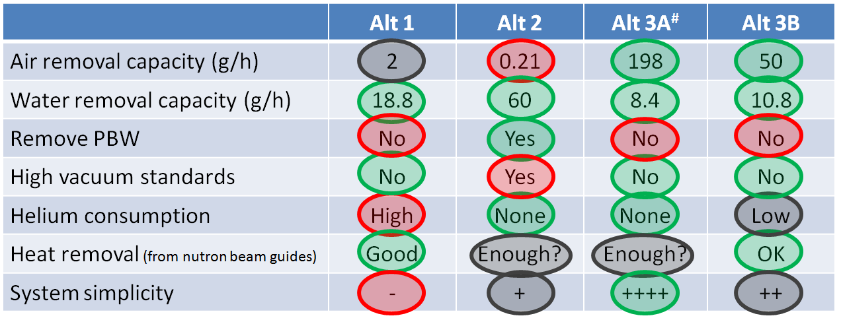
Conclusion
Decision
Alternative 3: Rough vacuum 10-100 Pa with PBW
It is not decided if the rough vacuum shall consist of air (air + water) or helium (He + air + water).

Slide 25
Pros & cons for alttenative 3A and 3B
Pros
Very/fairly simple and reliable system (air/helium)
Does not require high vacuum standards
None/low helium consumption (air/helium)
Viscous (laminar) flow region – high pumping capacity
Pumping capacity can easily be increased (air)
Quick pump down time to rough vacuum (3,25 hours)
Cons
Proton Beam Window required

Slide 26
Thank you.
www.europeanspallationsource.se
April 6, 2017

