Slide 1
TAC#15 ICS Installation Planning Overview
Hector Novella
Deputy project manager at ICS
www.europeanspallationsource.se
2017-04-06

Slide 2
Motivation
TAC#14 recommendations [ESS-0084949]:
2. ICS should ensure they provide complete input for integrated installation planning and implementation
TAC#15 charge questions [ESS-0100252]:
c5) Have all the major installation activities for commissioning and operation been identified and their needs addressed?
c6) Is the relative priority and ordering of tasks appropriate and reasonable considering the commissioning/operation plans?

Slide 3
Outline
Motivation
Scope
Time
Cost
Quality
Organization and communications
Risk management
Procurement
Status

Slide 4
Scope
The re-planning of ICS project during 2016 revealed that there was a general lack of consideration of installation activities throughout all the work packages
All ICS work packages considered that their installations would be covered by other divisions’ budgets, due to the interrelations and interdependencies of the control system
The following is the result of an internal effort at ICS to define and group the activities during the installation and commissioning stages until the end of the Construction phase.
Notes:
This effort has on one side considered the scope that was estimated based on other accelerators’ installations, and on the other side, costs for each new activity were estimated based on a labour and cost estimating book.

Slide 5
Scope break-down (1/2)
Activity | Name | Related to
14.20.00 | Management & Quality Assurance | -
14.20.01 | Other ICS installations | -
14.20.01.01 | Installation of the Control System for the Cryoplant | WP-10 Accelerator Integration
14.20.01.02 | Inst CS for Test Stand 2 and peripheral activities (GNSS) | WP-14 Test Stands
14.20.01.03 | Inst Building integration | WP-13 Building Integration
14.20.02 | CS Infrastructure | WP-07 CS Infrastructure
14.20.02.01 | Inst Local Control Room | -
14.20.02.02 | Inst Main Control Room | -
14.20.02.03 | Inst Data Centre (Server Hall, Temporary server room, IT server hall) | Also ESS IT department
14.20.02.04 | Inst CS Networks | -
14.20.03 | PSS installation, V&V | WP-09 Personnel Safety System
14.20.03.01 | Installation of the ODH system (Cryoplant, CTL, Coldbox, G01) | -
14.20.03.02 | Installation of PSS for Test Stand 2 | -
14.20.03.03 | Installation of PSS-1 (first phase of PSS to cover the Normal Conducting Linac) | -
14.20.03.04 | Installation of PSS for the Accelerator | -
14.20.03.05 | Installation of PSS for Target | -
14.20.03.06 | Installation of PSS for Bunker | -

Slide 6
Scope break-down (2/2)
Activity | Name | Related to
14.20.04 | Machine installation | -
14.20.04.01 | Installation of CS for the warm Linac | WP-10 Accelerator integration
14.20.04.02 | Installation of CS for the cold Linac | WP-10 Accelerator integration
14.20.04.03 | Installation of CS for Target, Bunker* and Test Beamline* | WP-11 Target integration WP-12 Instruments integration
14.20.05 | Pre-beam preparation | -
14.20.05.01 | Pre-commissioning of sub-systems for ISrc+LEBT | WP-10 Accelerator Integration
14.20.05.02 | Pre-commissioning of sub-systems for RFQ+MEBT | WP-10 Accelerator Integration
14.20.05.03 | Pre-commissioning of sub-systems for DTL-4 | WP-10 Accelerator Integration
14.20.05.04 | Pre-commissioning of sub-systems for DTL-1 to DTL-3 | WP-10 Accelerator Integration
14.20.05.05 | Pre-commissioning of sub-systems for DTL-5+SPK+MBL | WP-10 Accelerator Integration
14.20.05.06 | Pre-commissioning of sub-systems for HEBT+A2T | WP-10 Accelerator Integration
14.20.06 | Hardware commissioning | WP-10 Accelerator Integration
14.20.06.01 | ICS support to getting the first beam and commissioning in cascade | -
 | * Integrated testing without beam with ICS+ISrc+LEBT | ESS Readiness Review #1
 | * Integrated testing without beam with ICS+…+RFQ+MEBT | ESS Readiness Review #2
 | * Integrated testing without beam with ICS+…+DTL-4 | ESS Readiness Review #3
 | * Integrated testing without beam with ICS+…+DTL-1_3 | ESS Readiness Review #4
 | * Integrated testing without beam with ICS+NCFE+DTL-5+SPK+MB to Dump | ESS Readiness Review #5
 | * Integrated testing without beam with ICS+NCFE+DTL-5+SPK+MB to Target | ESS Readiness Review #6

Slide 7
Scope dependencies
Conventional Facilities (CF)
Building access dates
Building management system integration
Access to utilities
Parallel works management
Accelerator Systems (AccSys)
Definition of ESS Readiness Reviews milestones
Target Station (TS)
Definition of ESS Readiness Reviews milestones
Neutron Scattering Systems (NSS)
Bunker and Test Beamline

Slide 8
Outline
Motivation
Scope
Time
Cost
Quality
Organization and communications
Risk management
Procurement
Status

Slide 9
Staged approach to initial-operations
Stage 1 (indep)
2017-01-02 - 2018-12-31
Stage 2 (Acc)
2019-01-01 - 2019/06/23
Stage 3 (Target)
2019/06/24 - 2020/03/31
Stage 4 (Test Beam Line)
2020-04-01 - 2020-10-15
ICS components ready for initial operations independently
2018-12-31
ICS ready for Target ready for BoT
2020/03/31
PSS-1 // ESS RR 1 (ISrc + LEBT)
ICS ready for NSS ready for TBL
2017-11-30
Local Control Room
ESS RR 2 (RFQ + MEBT)
ICS ready for Accelerator ready for BoT
2017-05-31
2018-04-03
2019/06/23
2020/10/15
2017
2018
2019
2020
2020
Today

Slide 10
729 days
Stage 1 (indep)
1/2/2017 - 12/31/2018
174 days
Stage 2 (Acc)
1/1/2019 - 6/23/2019
282 days
Stage 3 (Target)
6/24/2019 - 3/31/2020
198 days
Stage 4 (Test Beam Line)
4/1/2020 - 10/15/2020
ICS components ready for initial operations independently
12/31/2018
ICS ready for Target ready for BoT
3/31/2020
PSS-1 // ESS RR 1 (ISrc + LEBT)
ICS ready for NSS ready for TBL
11/30/2017
Local Control Room
ESS RR 2 (RFQ + MEBT)
ICS ready for Accelerator ready for BoT
5/31/2017
4/3/2018
6/23/2019
10/15/2020
2017
2017
2018
2019
2020
2020
Today

Slide 11
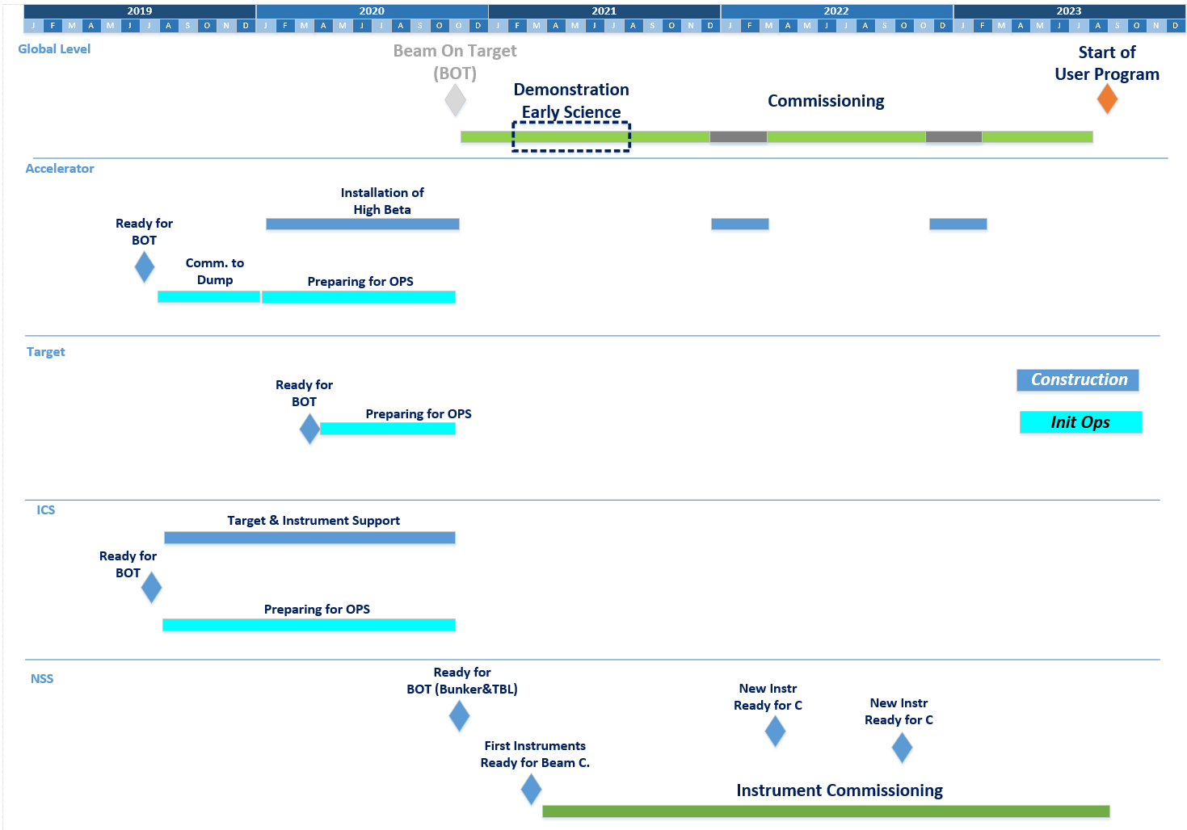
Initial-operations
ICS components ready for initial operations independently
ICS ready for NSS ready for TBL
2018-12-31
2020/10/15
ICS ready for Target ready for BoT
2020/03/31
ICS ready for Accelerator ready for BoT
2019/06/23

Slide 12
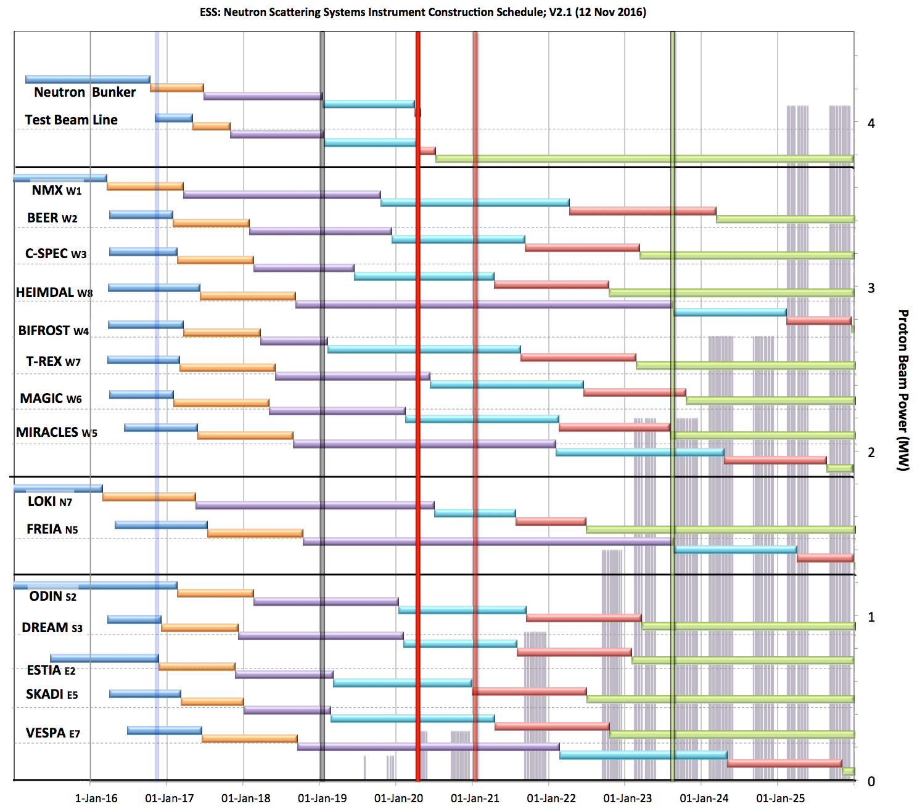
Neutron Beam Instrument Schedule V2.1, 14th November 2016 to be revised
Commissioning of test beam – to demonstrate performance and inform instrument projects
Current date
Access to NSS areas
Ready for Beam on Target
Start User Program
Hot Commission
instruments
Early access dates;
Monolith (D02) 7 Feb ’19
North (D03) 1 Nov ‘19
East (D01-E) 6 Jan ’20
South (D01-S) 2 Mar ‘20
West (4 areas)
Guides (D03-W) 1 Nov ‘19
Guides (E02-2) 15 Oct ’19
Guides (E02-1) 27 Apr ‘19
Caves (E01) “
West sector
Not yet aligned with Accelerator Schedule
North sector
Preliminary Design
Detailed Design
Manufacturing & Procurement
Installation & Integration
Hot Commissioning
Operation
East and South sectors
2016 2017 2018 2019 2020 2021 2022 2023 2024 2025

Slide 13
Time dependencies
CF
Building ownership transfer from SEC to ESS
AccSys
Commissioning (high energy) out of Construction phase
TS
Commissioning out of Construction phase
NSS
Instruments installation scope out of Construction Phase

Slide 14
Outline
Motivation
Scope
Time
Cost
Quality
Organization and communications
Risk management
Procurement
Status

Slide 15
ICS installation cost rationale
ICS re-planning completed in 2016-06 estimated a need for additional ~5 M € on installation activities
After the staged approach to initial-operations phase and the relaxation of ICS in-kind goal, some installation activities can be undertaken within the current budget
Nevertheless, extra costs exist and are justified due to:
scope clarification,
better understanding of dependencies,
more realistic knowledge of the price of installation services

Slide 16
(extra) cost details (1/2)
Activity | Name | Extra Cost (EUR)
14.20.00 | Management & Quality Assurance | 0.00
14.20.01 | Other ICS installations | 452,000.00
14.20.01.01 | Installation of the Control System for the Cryoplant | 43,000.00
14.20.01.02 | Inst CS for Test Stand 2 and peripheral activities (GNSS) | 47,000.00
14.20.01.03 | Inst Building integration | 362,000.00
14.20.02 | CS Infrastructure | 752,000.00
14.20.02.01 | Inst Local Control Room | 28,000.00
14.20.02.02 | Inst Main Control Room | 43,000.00
14.20.02.03 | Inst Data Centre (Server Hall, Temporary server room, + IT server hall) | 134,000.00 + 280,000.00
14.20.02.04 | Inst CS Networks | 267,000.00
14.20.03 | PSS installation, V&V | 1,200,000.00
14.20.03.01 | Installation of the ODH system (Cryoplant, CTL, Coldbox, G01) | 100,000.00
14.20.03.02 | Installation of PSS for Test Stand 2 | 50,000.00
14.20.03.03 | Installation of PSS-1 (first phase of PSS to cover the Normal Conducting Linac) | 400,000.00
14.20.03.04 | Installation of PSS for the Accelerator | 400,000.00
14.20.03.05 | Installation of PSS for Target | 200,000.00
14.20.03.06 | Installation of PSS for Bunker | 50,000.00
14.20.04 | Machine installation | 1,095,000.00
14.20.04.01 | Installation of CS for the warm Linac | 328,000.00
14.20.04.02 | Installation of CS for the cold Linac | 450,000.00
14.20.04.03 | Installation of CS for Target, Bunker* and Test Beamline* | 317,000.00

Slide 17
(extra) cost details (2/2)
Activity | Name | Extra Cost (EUR)
14.20.05 | Pre-beam preparation | 184,000.00
14.20.05.01 | Pre-commissioning of sub-systems for ISrc+LEBT | 21,000.00
14.20.05.02 | Pre-commissioning of sub-systems for RFQ+MEBT | 21,000.00
14.20.05.03 | Pre-commissioning of sub-systems for DTL-4 | 21,000.00
14.20.05.04 | Pre-commissioning of sub-systems for DTL-1 to DTL-3 | 21,000.00
14.20.05.05 | Pre-commissioning of sub-systems for DTL-5+SPK+MBL | 50,000.00
14.20.05.06 | Pre-commissioning of sub-systems for HEBT+A2T | 50,000.00
14.20.06 | Hardware commissioning | 182,000.00
14.20.06.01 | ICS support to getting the first beam and commissioning in cascade | 182,000.00
 | * Integrated testing without beam with ICS+ISrc+LEBT
 | * Integrated testing without beam with ICS+…+RFQ+MEBT
 | * Integrated testing without beam with ICS+…+DTL-4
 | * Integrated testing without beam with ICS+…+DTL-1_3
 | * Integrated testing without beam with ICS+NCFE+DTL-5+SPK+MB to Dump
 | * Integrated testing without beam with ICS+NCFE+DTL-5+SPK+MB to Target
(extra) cost for installation: EUR 3,865,000.00

Slide 18
ICS installation cost summary
Two Change Request should be issued to ESS Change Control Board:
CEO level: to claim contingency budget for the extra cost of installation
Council level: to claim relaxation of ICS in-kind goal down to 23 M €

Slide 19
Outline
Motivation
Scope
Time
Cost
Quality
Organization and communications
Risk management
Procurement
Status

Slide 20
Generic steps for systems installation
Ready for installation milestone triggered by:
Access and logistics management
Procurement needed for installation
Installation team management
Installation activities now at a high abstraction level
To be refined on a weekly basis when installation occurs
“System installed” is not the final activity
Quality Control
To highlight its importance, even if it is represented in a generic way
Management of non-conformities also

Slide 21
Generic steps for systems installation
Example:

Slide 22
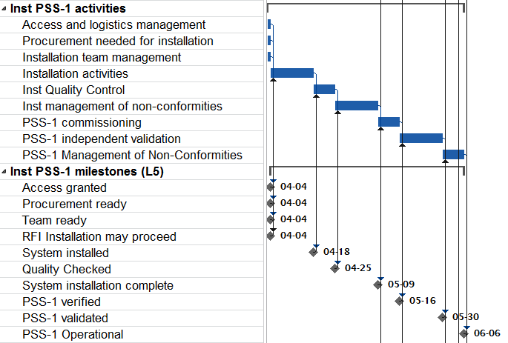
Specific steps for systems installation
PSS installation requires:
Commissioning
(Verification)
Independent
validation

Slide 23
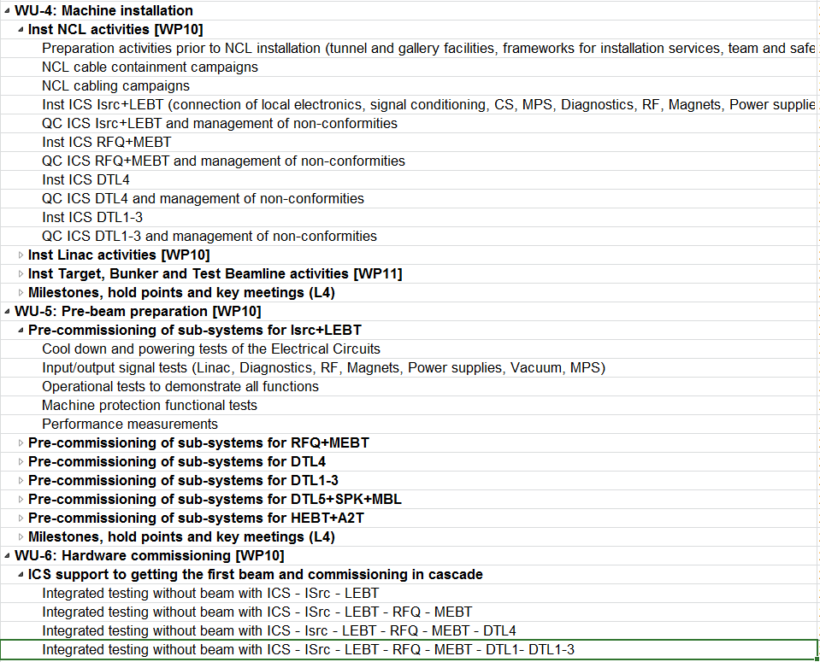
Specific steps for systems installation
AccInt in 3 work units:
To describe the process
To illustrate different installation teams

Slide 24
Outline
Motivation
Scope
Time
Cost
Quality
Organization and communications
Risk management
Procurement
Status

Slide 25
disclaimer
Installation Support Coordination (ISC) material by P. Rådahl et al.
Installation roles and titles by Nick Gazis et al.:
Roles, Responsibilities, Authorities and Accountabilities (R2A2):
https://ess-ics.atlassian.net/wiki/display/AI/Role+List+for+Accelerator+Installation
System Leaders
https://ess-ics.atlassian.net/wiki/display/AI/AD+System+Leaders+for+installation
Work and Safety Coordination Plan (WSCP) [ESS-0060903]

Slide 26
Introduction to ISC
A bridging function covering ESS central functions and subprojects with a mission to
Establish a coordinated installation support and ensure the pre-requisites for installation in terms of communication, procedures and services in order to safely and effectively install the Accelerator, Target, ICS and NSS.
Meet the communicated needs of services and support from
ESS work packages.
Installation coordinators.
Identify and follow progress of the appointed support and service-organizations and find means and solutions for a smooth transition of the C101/Skanska services and the owned/coordinated site into ESS ownership.

Slide 27
Installation Support Coordination
Mission:
Exchange of information & best practices,
Identification of common needs & suggestion of
solutions,
Definition of procedures,
Management of services and its related guidelines
Installation Support Coordination
Leader: P. Radahl
Sub-projects Installation Coordinators (AD, TD, ICS, NSS)
CF
Facility
Manager
ES & H
Quality
Administration Services
Technical Services
Represent their sub-project
Present plans and needs for services
Issues
Share experiences
Define ways of working and services
Define rules and procedures
Enable services
Share experience
Members (Installation coordinators, Main Service providers and coordinating organizations)
N. Gazis- AD Installation coordinator
T. Lexholm -TD Installation coordinator
A. Bianchi-NSS Installation coordinator
H.Novella- ICS Installation coordinator
CF Facility Manager
P. Jacobsson-ES&H
M. Skafar-Quality
M.Shirey-Procurement
J.Larsson-Logistics
T. Welander-Facility Service/Management
P. Radahl-Technical Services

Slide 28
ESS Installation roles and titles
SITE MANAGEMENT
COST
Services
Administration
Technical
SWOCOR
SAFETY
QUALITY
SCHEDULE
ESS Installation coordinator
ESS Installation coordinator
Installation Coordinator
Installation coordinator
Installation Area Supervisor
Installation area supervisor
Installation system/package leader
Installation system/package
leader
Resources arranged by individual work unit participants
IKC Resources (some already secured)
Contracted Resources (dedicated people and equipment)

Slide 29
Installation Area Supervisor
also BAS-U/P responsible person
Role appointed by the ESS building owner
Maintains the area responsibility on site (they are the Territorial Safety Officer)
Physically present on site during works
Safety responsible for the works/actions performed in their area
Safety responsible for the workers working in their area
Member of the safety team
Specific safety responsibilities e.g. fire safety responsible (hot works education etc. needed)
Generates Area Hazard Analyses (AHA) included in the Work and Safety Coordination Plan (WSCP)
Issues/revokes access to his area to all the concerned people (installation teams, IKCs, contractors, etc.)

Slide 30
Installation System/Package Leader
Role appointed by the Line
Leads and manages the installation team of the relevant WP/System
Selects and defines technicians and installation team members along with their actions
Plays the role of the technical expert on site (can be physically on site) for the components of the relevant WP/System
Responsible for performing all on-time scheduled activities
Receives and signs (commissions) the deliveries for their systems of responsibility
Generates Job Hazard Analyses (JHA)
Generates and owns the Work and Safety Coordination Plan (with help from the Area Supervisors)
Also following the BAS-U/P rules and regulations

Slide 31
Outline
Motivation
Scope
Time
Cost
Quality
Organization and communications
Risk management
Procurement
Status

Slide 32
Risk management
Application of ICS Risk Management Plan [ESS-0052287]
Highlights for installation:
Identification of risks
Perform qualitative risk analysis
Perform quantitative risk analysis
Plan risk responses (WSCP, daily standup updates, reports)
Roles:
ICS installation coordinator
BAS-U (ES&H area supervisor)
System responsible or representative

Slide 33
Outline
Motivation
Scope
Time
Cost
Quality
Organization and communications
Risk management
Procurement
Status

Slide 34
Procurement 2016-10 Short term installation needs
System | Time frame | Duration | Building | Capabilities | Team | Comments
PSS ODH | 2017-01 to 2017-05 | 1 month | - G04 Cryo compressor building - G02 TTI Compressor Hall & Coldbox - CTL Duct | - Small bore pipe fitters - Work at height (6 meters, scissor lift or eqv) - Work in confined space (in the CTL duct) - Specialized cable containment installation - Cable pulling - Electrician / technician / tester | 4 FTE | * Containment can be done independently and firstly (not included in this team)
PSS Acc PSS-1 | 2017-04 to 2017-09 | 3 months | - G01 Accelerator Tunnel (NCL) - G02 Klystron Gallery (NCG) - Front-end Building | Work at height (2 m) - Cable tray installer - Specialized cable containment - Cable pulling - Electrician | 4 FTE | * Containment can be done independently and firstly (not included in this team)
PSS Cryo Test Stand (G02) | 2017-05 to 2017-10 | 1 month | - G02 Cryo Test Stand (Coldbox Building) | - Cable pulling - Electrician - Specialized cable containment | 2 FTE | * Containment can be done independently and firstly (not included in this team)
PSS containment* | 2017-01 to 2017-12 | 12 months | - G01 Accelerator Tunnel (NCL, SPK, MBL, HBL, HEBT, DL, A2T, D2T) - G02 Klystron Gallery (NCG, SPKG, MBLG, HBLG) - Front-end Building - D02 Target Building (TAA) | - Specialized cable containment installation for all three PSS systems, done at once. Estimated 12 000 hours of work (down rounding from Spon's price book). | 8 FTE | - In PSS, cable containment needs “earth continuity” (hopefully this will help the selection of possible companies)
CF integration | 2017-01 to 2017-12 | 400 hours | - H05, H06 Electrical substations - all buildings with some type of BMS (building management system) Infrastructure | - Electrician - Data network technician | 1 FTE | - 1 technician with skills in electricity and networking would be perfect. - It is a part-time support, of around 50 NON-consecutive days in the year
CSI networks inter-building | 2017-03 to 2017-09 | 1 week | G02 Klystron Gallery (LCR) - G04 Cryo compressor building - Infrastructure | - cabling (Ethernet + Fiber optics) - optical testing | 2 FTE | Linkage of: - from LCR to Comms room in Klystron gallery G02 - from Cryo compressor building to LCR
CSI networks intra-building | 2017-09 to beyond 2018 | Upon request | - G02 Klystron Gallery (NCG, SPKG, MBLG, HBLG) - Front-end building | - Specialized cabling (Fiber optics) - optical testing | 2 FTE | - Linkage from Comms room in G02 to each rack row - Team will be activated as racks arrive on site - Team familiar with MPO connectors
CSI racks | 2017-05 to 2017-09 | Upon request | - G02 Klystron Gallery (NCG, SPKG, MBLG, HBLG) - G02 Klystron Gallery (LCR) | - rack installation - Specialized plumbing for racks - logistics / lifting / forklift driver | 1 FTE | - ICS will pay for ½ training on plumbing

Slide 35
Procurement 2017 Alignment with ESS strategy / principles
Principles
Whenever possible, always larger joint framework contracts
Then, joint procurements within the division
Last resort, specific procurements per system
Rationale: most efficient use of ESS procurement resources at a time of heavy workload
ICS requests fwk for installation services to include:
Detail design leading to…
Materials acquisition by the supplier (including minor parts)
Installation (managing their team)
Own workshop and tools

Slide 36
Procurement - Challenges
Following ESS principles might delay ICS project (timing & priorities differ)
Fulfilling ICS requests might be difficult, leading to more work for the already existing team
ESS Procurement is flooded by requisitions, and ICS teams are overloaded with engineering activities. All in all, dilating the process
Status: ~3 M €
Requisition | Description | EUR | Status
20002060 | CS Infrastructure networks | 500 K | 8 requisitions combined in 1
20002281 | Radiation Monitors for PSS-1 | 800 K | Submitted
20002279 | First requirement for cables for ODH systems, and Accelerator PSS-1 | 440 K | Joint framework with AD
20002177 | Racks for PSS-1 and ODH detector system | 40 K | Cancelled to join AD
20002014 | Procurement for detailed design, procurement of materials and installation of cable containment, ODH micro-bore pipework | 100 K | No bidders
20001435 | Framework agreement for Timing System components | 1 000 K | Scope of Work pending
20001721 | Oxygen Deficiency Monitors for Building G04, CTL, Cold Box Hall and TS2 Bunker | 190 K | Delivered to RATS

Slide 37
Outline
Motivation
Scope
Time
Cost
Quality
Organization and communications
Risk management
Procurement
Status

Slide 38
Current ICS installation status
Schedule dependent on AccSys, which is being reformulated
Small installations requested to CF division not progressing according to plan (H05 works, fiber optics link)
No ESS central installation organization / services yet
Procurements for installation services still ongoing
On-site installation activities should have started by 2017-03 to meet the original ESS Readiness Review #1
Not a single installation on-site for ICS has been completed yet

Slide 39
Questions?
Thank you!

