Slide 1
WP 15 Overview
Frithiof Jensen
Power System Engineer
www.europeanspallationsource.se
28 March 2017

Slide 2
Deliverables from WP 15
WP 15 provide the interface between CF/SI and the Accelerator systems, this involves:
  Conventional Power Installations for Racks, HPRF, CRYO, Test Stand 2 (cables, cable ladders, distribution systems),
  Grounding Systems in Klystron Gallery and Tunnel,
  Racks and Rack assemblies for Gallery, Front End Building (FEB), Gallery Support Area (GSA),
  UPS Battery Systems, UPS Power distribution,
  Power Distribution Panels for UPS, FEB, GSA, and CRYO,
  Framework Contracts for Signal- and Control Cabling, Connectors, Custom Cable Assemblies,
  Cable Pulling and Installation for cables between Gallery Systems and the LINAC
    (WU’s does termination and test).
Notes:
I will talk a bit about the overview, Evangelia will do the Racks more detailed.

Slide 3
WP 15 Procurements
Proc. ID | Procurement Name | Description of Content, WU's in P6 | Current status of techncial specification (not yet started, started, completed) | Procurement Start Date | Contract Award Date | Delivery Dates (RFI) | Value in Euro
11.15.1 | Tunnel Installations. Cable Trays and Grounding Systems (MEBB) in LINAC Front End and Accelerator Tunnel. | 11.15.2.3 MEBB Tunnel, 11.15.3.1 Cable Trays Installation, | completed | Q2 2017 (started early) | Q2 2017 | Start Inst. on 2017-05-29 (week 22), Start FEB 090 week 23, Finish NCFE (part of tunnel) week 26 Finish SPK (part of tunnel) week 28 Finish Inst. on 2017-09-18 (week 38) | 500 k€
11.15.2 | Signal and Control Cables | 11.15.6.3 Contract for Generic Type Cables (control, instrumentation, communication), 11.15.6.4 Contract Custom made cables, 11.15.6.6 Cabling and Connectors Installation | started | Q3 2016 (not ready) | Q2 2017 | Cables Available from 2017-09-01 | 2300 k€
11.15.3 | Klystron Gallery Power. Rack Power Distribution, Power Cables, Cable Trays, Support Structures and Grounding Systems (MEBB) for Klystron Gallery | 11.15.2.4 MEBB Gallery, 11.15.4 Power Cabling for Accelerator Systems, 11.15.5.2 Rack Power / Power Distribution Pannel, 11.15.4.1 Power Cabling Installation 11.15.5.3 LVCP/Rack Power distribution Installation, | started | Q2 2017 (not ready) | Q3 2017 | Start Feb lvl 090 el. power Inst. on 2017-05-15, Start Gal. lvl 100 el. power Inst. on 2017-09-11, Finish Gal. lvl 100 el. power Inst. on 2018-03-23, Finish A2T el. power Inst. on 2018-06--04 (8-10). | 1500 k€
11.15.5 | Electrical Cables and Installations for CRYO. High Voltage Cables, Low Voltage Cables, Distribution Panels, UPS Power Distribution | 11.15.5.4 Switchgear for Level 090, 11.15.7 Electrical Power for Cryo-System, | started | Q3 2016 (Q1 2017) | n/a | April 2017 | 250 k€
11.15.6 | Racks. Rack systems, Cooling systems, Pover Distribution Units and Installation Service for 19" racks in Kystron Gallary and LINAC Front End. | 11.15.5 Rack Assemblies / Enclosures | completed | Q4 2016 (started) | Q1 2017 | Start Feb lvl 090 racks Inst. on 2017-05-15, Start Gal. lvl 100 racks Inst. on 2017-09-11, Finish Gal. lvl 100 racks Inst. on 2018-03-23, Finish A2T racks Inst. on 2018-06--04 (8-10). | 2200 k€
11.15.7 | RF Cables. | 11.15.6.2 Contract for RF cables* | not started | Q4 2016 | Q3 2017 | juli 2017 | 1000 k€
11.15.4 | Connectors. | 11.15.6.5 Contract for Connectors* | not started | Q3 2016 | Q2 2017 | tbd - coordinate procurement with ICS. | 1200 k€
11.15.x | UPS Power Supplies. Installation of Central UPS power supplies (6 systems) for CRYO, LINAC Front End, Klystron Gallery. | 11.15.1.1 Forecast: UPS Battery Systems (500 k€) | started | not planned. | June 2017 | August 2017 | 500 k€
11.15.x | Installations for Test Stand 2 | not planned, part of 11.15.3. | started | not planned | March 2017 | April 2017 | 16 k€
Notes:
This cannot be read, the procurements are show to collate the many separate items planned in P6 into fewer, blockier things that Procurement can realistically deal with.

Slide 4
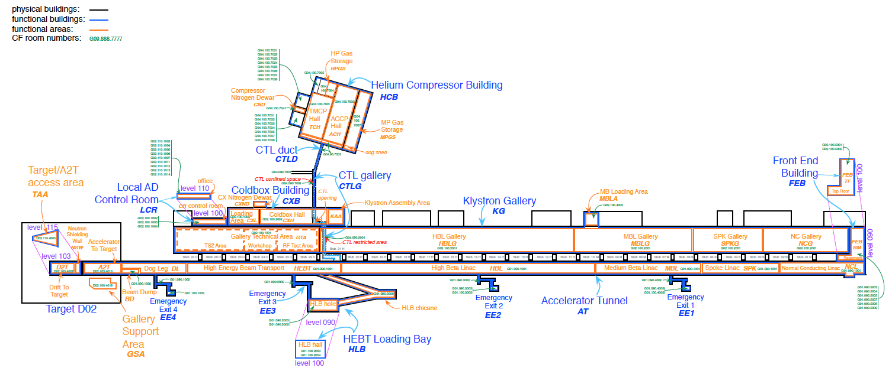
Procurements of Electrical Installations
11.15.1, Tunnel Inst.
11.15.x, Test stand 2
11.15.3, Gallery Inst.
11.15.5, CRYO Inst.
Notes:
This are the major procurements, the dates maybe should be added?

Slide 5
UPS Installations, Distribution panels
PSS: 1.5 kW
ODH: 0.6 kW
CRYO: 25 kW
UPS distribution
Central UPS
Dist. Panel
PSS: tbd
ODH: tbd
RAD: tbd
VAC: tbd
PSS: 1.5 kW
ODH: 0.5 kW
CRYO: 15 kW
PSS: 18 kW
ODH: 0.3 kW?
RAD: 0.1 kW?
VAC: 1.5 kW
PSS: 3
RAD: tbd
A2T: tbd
Notes:
I it possible that we will only have 2 power distributions, one from either side of the gallery.
There are 50 radiation monitors dotted along the gallery, probably at the stubs, tunnel wall.
Decide if UPS go on the level 090 or level 100 – not to do like Fukushima.
The accelerator will make use UPS to
Prevent permanent damage to equipment,
Reducing downtime in the event of power failure,
Enhance operational stability of the facility,
And,
Improve the performance of a few, select, EMI-sensitive systems, such as the reference oscillators (local UPS?).
We will not rely on UPS to “prevent the loss of life and property”, safety systems shall be passively fail-safe.
PSS uses UPS because PSS is a “downtime-multiplier”. The fail-safe nature of PSS will shut down the entire machine on power failure, thus amplifying the effect of short power glitches.
A “Central UPS” solution is preferred for maintenance and availability reasons. Rack mounted “Local UPS” to be avoided.

Slide 6
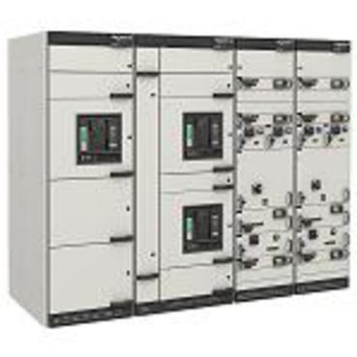
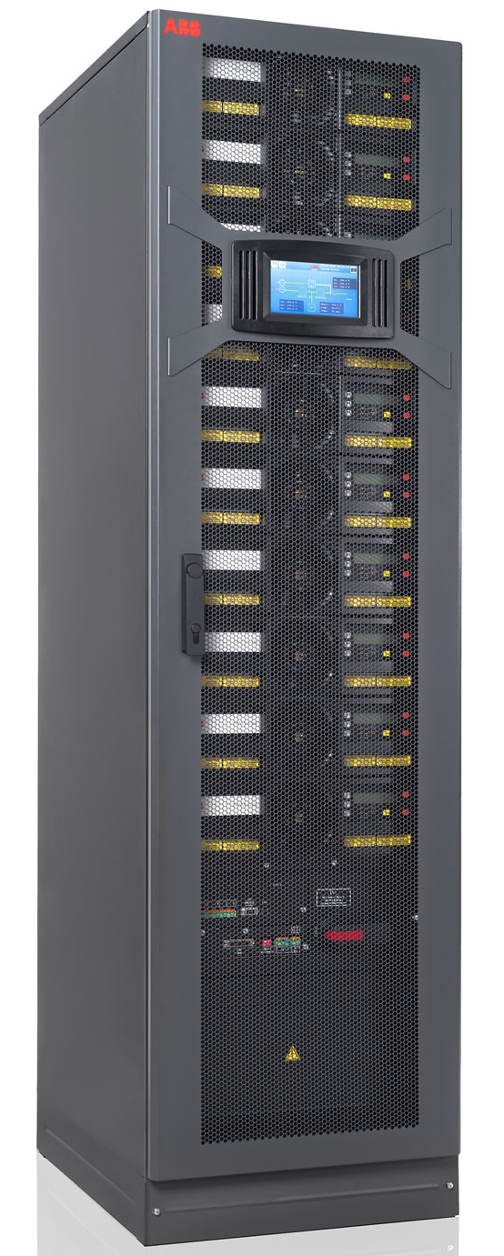
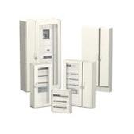
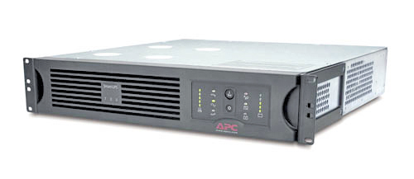
UPS Power distribution, Components
Bus-bar trunking system
Distribution Panel
Low Voltage Switch-Gear
Modular UPS
Bypass
Rack mounted PDU
Rack mounted local UPS
Racks
Notes:
Present status of UPS work
Prune requirements
PSS, VAC, ODH, RAD. primarily, will all have “Central” UPS
Some of the PSS and ODH racks have 24 V DC Batteries, with a 6 hour capacity, UPS would probably be overkill for these systems
Procurement of UPS
Complete the detailed design of distribution system, Specifications,
Need UPS for CRYO controls and ODH monitors in CRYO,
Might be better to order all UPS systems now and use “normal power” for a while, until the UPS arrive. Maybe temporary UPS, Local UPS can be used.
Design of distribution network
Decide if UPS for ODH/RAD can be on same feed as UPS for racks (simpler).
Locate physical space to install the UPS systems, G04 should have space (CF has a requirement for it, doesn’t mean there is actually space, though).

Slide 7
Electrical Distribution Panels

Slide 8
Diagram of RF-Cell Installations
Power Cables, 400 V
“LVD”
CF/SI
Cable Trays, Corridor
Cable Trays, Racks
LVSG
19”
19”
19”
19”
Power Cables, 600 V
Cable Trays, Corridor
WP 8
CF/SI delivers on the output
terminals of LV CB’s, 250 A (typ),
WP 15 “own” cables and power
distribution to the 19” rack PDU’s.
LVSG
HPRF
Notes:
11.15.4 Power Cabling for Accelerator Systems
11.15.4.1 Power Cabling Installation
11.15.5.2 Rack Power / Power Distribution Pannel
11.15.5.3 LVCP/Rack Power distribution Installation

Slide 9
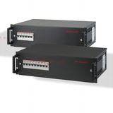
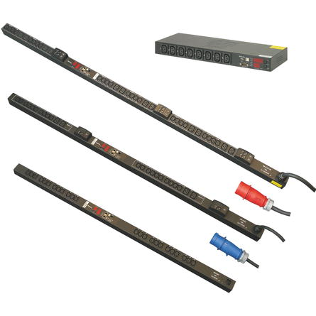
Power distribution in Racks
Normal Supply
UPS Supply
Power distribution in the accelerator racks is somewhat special because some of the equipment uses 3-phase power feeds.
The “normal” rack power distribution, socket strips.
Notes:
Present status of UPS work
Prune requirements
PSS, VAC, ODH, RAD. primarily, will all have “Central” UPS
Some of the PSS and ODH racks have 24 V DC Batteries, with a 6 hour capacity, UPS would probably be overkill for these systems
Procurement of UPS
Complete the detailed design of distribution system, Specifications,
Need UPS for CRYO controls and ODH monitors in CRYO,
Might be better to order all UPS systems now and use “normal power” for a while, until the UPS arrive. Maybe temporary UPS, Local UPS can be used.
Design of distribution network
Decide if UPS for ODH/RAD can be on same feed as UPS for racks (simpler).
Locate physical space to install the UPS systems, G04 should have space (CF has a requirement for it, doesn’t mean there is actually space, though).

Slide 10
“Procurement Lessons” learned (so far)
It is quite important to not be “too detailed” in the requirement specification, only specify details and parameters that really matter,
  Too much detail leads to many questions, which will take time to answer, possibly causing delays and confusion,
  Some suppliers may think that there is already a “secret” design based on a favourite supplier, which will cause complaints or suppliers dropping out of the tendering process,
  More documentation is more to read for everyone -> more work!
It is very important to build some flexibility for changes into the contract,
  ESS procurement proposes a 15% limit on the contract value, the idea is that the contract manager (usually WP responsible) can handle variations within the 15% budget limit, after that, we will escalate using the existing change procedures.
Consult with Procurement before getting ideas about contracts,

Slide 11
Lessons Learned (so far, Ctd)
Minimise the number of Interfaces. All interfaces require coordination and agreements which creates complexity and “border skirmishes”,
  Try to arrange for fewer contracts covering several WP’s so that the contractor is responsible for the entire area,
    Failed to do this with CRYO installations so now that work will be more expensive than necessary,
    Succeeded with the installations in the Accelerator Tunnel, where Piping (WP 16), Cable trays and Grounding (WP 15) are combined into one tender (this cuts one “step” in the installation plan, helps procurement too), Cables and Connectors may be shared with ICS, …
  ESS Procurement may schedule other procurements in between “split” procurements, thus causing a delay for the entire WU.
    The procurement officers does not know “my project”, unreasonable to expect this.

