Slide 1
ACCSYS WP16 Cooling Support
Anton Lundmark
Cooling System Engineer
www.europeanspallationsource.se
17 March 2017

Slide 2
WP16
Anton Lundmark – WP leader
Akif Coku – Lead Engineer
Fredrik Persson – Piping design Engineer
Additional designer – TBD
2 x Technicians TBD
Support from other groups:
Ola Ingemansson (Target) – Instrumentation
Emil Lundh (EIS) – Computational Fluid Dynamic
Anders Olsson (EIS) – Structural analyses
Leif Emås (Target) – Process design
Martin Hansson (CF) – Process design and interfaces with CF

Slide 3
Process groups at ESS
CF Process
Central processing plant
Site distribution + main headers in buildings
District Heating
CF HVAC
Heating
Cooling
Target Fluid Systems group
WP 16
Requirements coordination
Interface to AD & NSS
Secondary systems
Accelerator design teams
NSS design teams

Slide 4
CF Process - design parameters

Slide 5
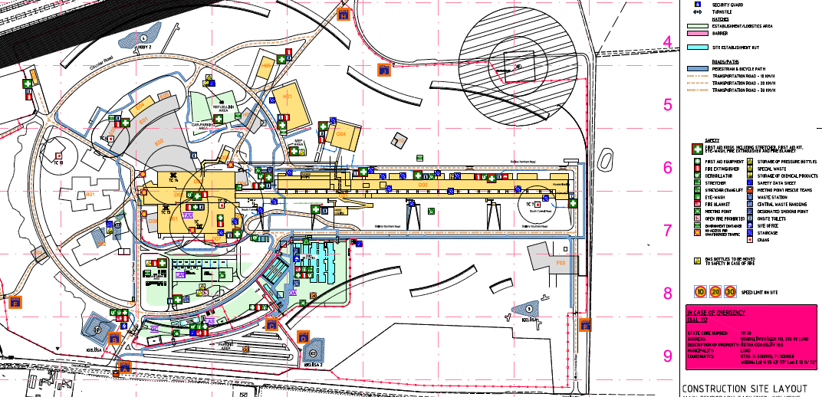
ESS site layout
Compressor building – G04
Accelerator tunnel – G01
Test stands – G02
Accelerator tunnel
Central processing plant
RF gallery – G02

Slide 6
WP16 interfaces to Accelerator/Conventional facilities
CF Process Systems
WP16
Cooling
ACC Tunnel (G01):
IS
LEBT MEBT
RF couplers (SPK, MBL, HBL)
RF Gallery (G02):
Modulators
Klystrons/Tetrodes
Circulators/Loads
Power supplies
Test Stands (G02):
Modulators
Klystrons
Circulators/Loads
RF couplers
Cryogenics (G04):
Oil coolers
Gas coolers
Turbine brakes
Electrical motors

Slide 7
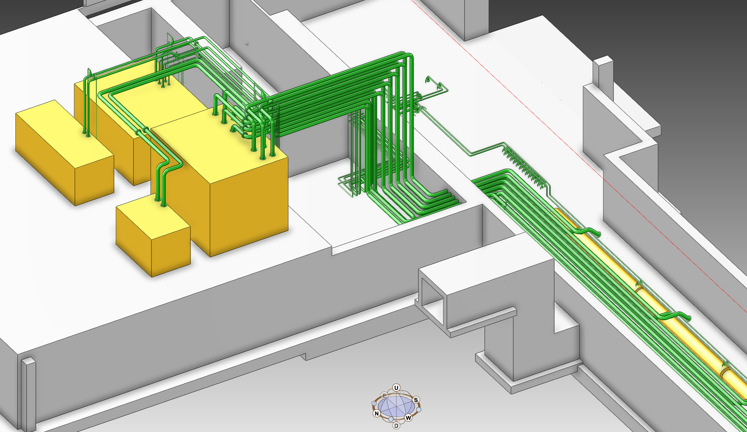
Overview – tunnel cooling
RFQ cooling skid - WP 3
DTL cooling skid - WP 3
IS/LEBT/MEBT cooling skid – WP16
85 kW, 14.5 m³/h
RF Coupler/Magnet Cooling skid – WP16
500 kW, 85 m³/h

Slide 8
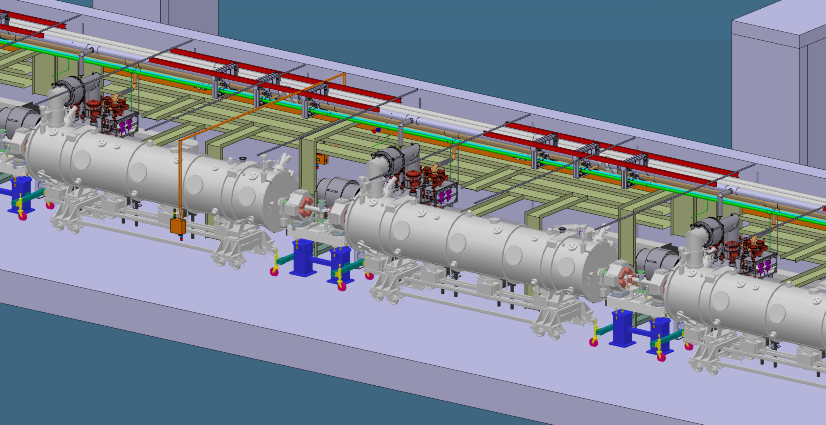
Overview - tunnel cooling

Slide 9
Status of tunnel cooling systems
Interface requirements for accelerator components defined
Statement of works written for tunnel distribution piping (combined with cable trays) and WP16 skids
Procurements to be launched any day
Slightly later than planned due to detail design issues such as RFQ valve location discussions, pipe routing issues, input from CF, as well as procurement group prioritizations
WP16 will provide detailed piping design for tunnel
Ongoing tasks are:
Coordination of rules for penetrations through fire walls and radiation shielding – CF / AD safety group
Development of piping specifications (for piping design tool) together with Integration & Engineering support group
3D model review - integration work in order to avoid clashes
Writing report on water activation
Coordination together with target design teams in order to harmonize tools and design solutions, hook-ups, supports, instruments
Coordinating procurement together with WP15 (electrical support)
Drafting WSCP (working safety coordination plan)
Fluid dynamics analysis of magnet coupler branch (see separate slide)

Slide 10
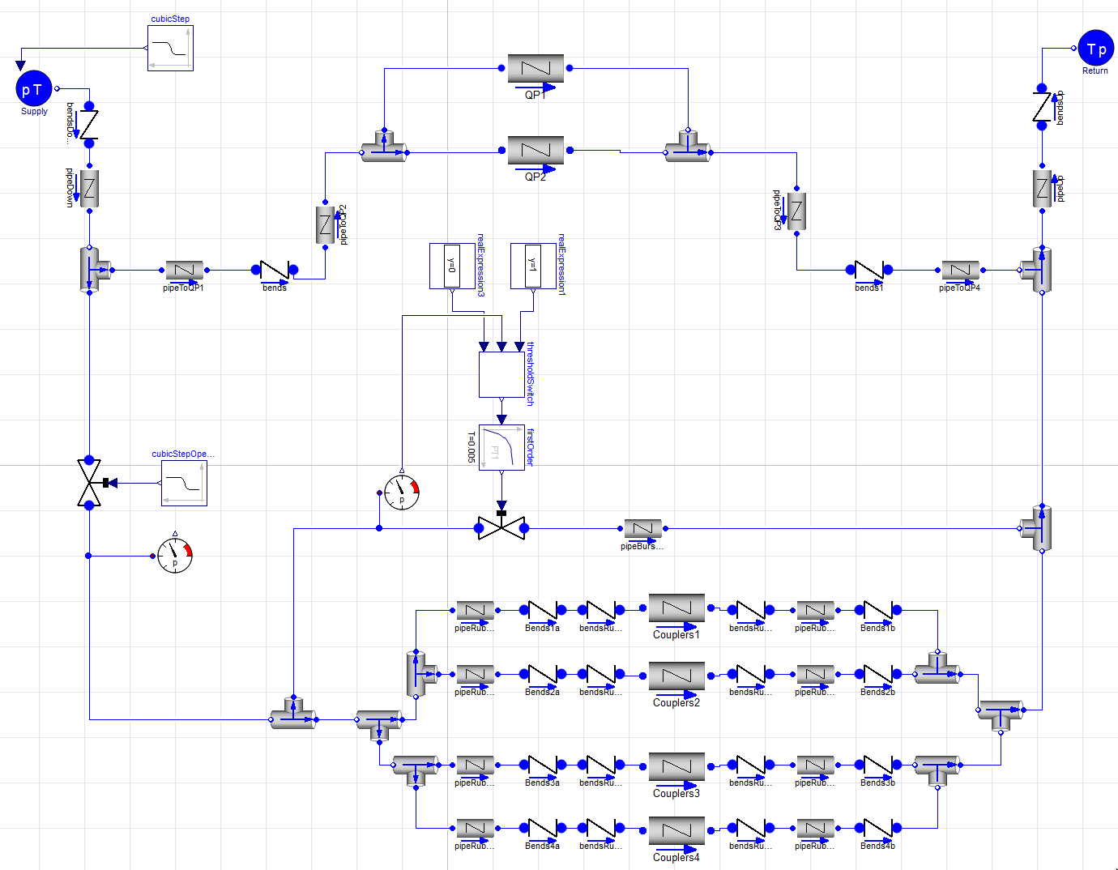
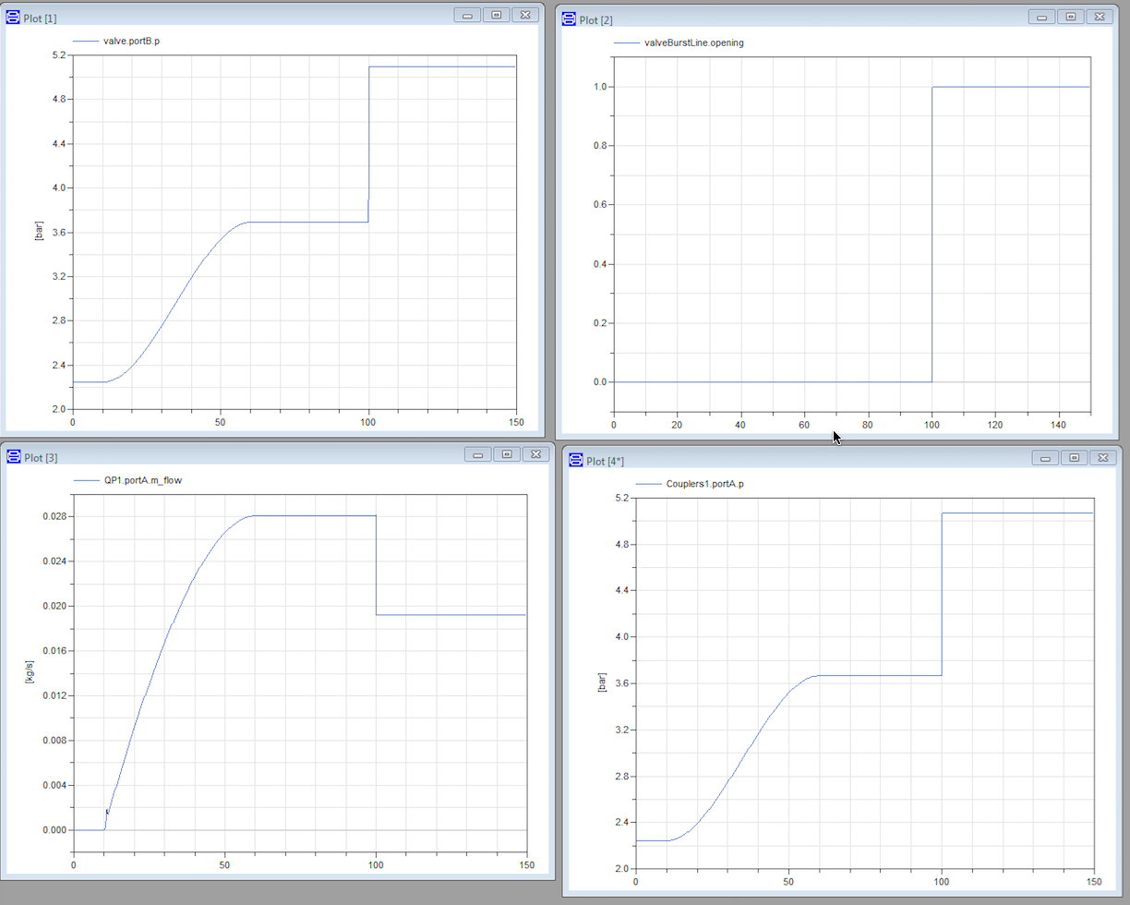
Ongoing work
Fluid analysis in Dymola of coupler/magnet circuit

Slide 11
Cooling for Test stand 2
Detail design ongoing
Piping design depends on RFDS support design
Envelopes for manifolds, skids, etc. defined together with Test Stand group
Working with RF group to define instrumentation
Will launch tender as soon as possible
Separate skid for cryomodule RF couplers
Solves low design pressure issue (max 3 bar(g) for couplers)
No risk of contaminating CF main system

Slide 12
Cooling for RF gallery
Basic design in place
P&ID:s ready
Envelopes defined
Piping loads onto RFDS support structure defined
Interfaces with CF defined (including concept for heat recovery)
Interfaces with RF group defined
Interfaces with racks defined
No information on RFDS supports structure for DTL and RFQ area
Ongoing design of RFDS supports structures for Spoke, MBL, and HBL
Notes:
Heat recovery

Slide 13
G02 RF gallery (DTL/RFQ area)

Slide 14
G02 RF gallery (MBL/HBL area)

Slide 15
G04 (compressor building for CRYO) water cooling
27°C
Middle temperature Return
37°C
30°C
Middle temperature Supply
He to fine oil removal
27°C
Compr. motor
39°C
69°C
High temperature Return
40°C
30°C
Middle temperature Return
He from cold box
83°C
39°C
Helium compressor
Helium cooler
Oil vessel
74°C
71°C
Dedicated cooling water circuit for cryoplant (quality constraints of available cooling water in the building)
Subsystem design and commissioning is CF scope.
49°C
30°C
Oil
cooler

Slide 16
Schedule
Start of piping installation
FEB level 100 access
“LOT 2” of tunnel piping – small bore piping/manifolds

Slide 17
Schedule
Installation of first skid
Installation of cooling system for RF

Slide 18
Cooling for NSS
WP16 scope:
Complete design and installation for NMX
Cooling skids and piping for bunker
Detailed piping design + manufacturing of cooling skids for LOKI and FREIA
Detailed piping design and skid specifications for other instruments
Limited “material” scope but lot of design work and coordination
Ongoing tasks:
Bunker design – coordination of piping penetrations and routing of piping inside bunker
Drafting interface requirements

Slide 19
LoKI
Type of instrument: SANS
Typical components requiring cooling: HVAC units, Choppers, Racks

Slide 20
Summary and plan forward
Initiate and oversee installation of tunnel piping
Launch and manage procurement of 2 cooling skids
Launch installation of TS2 cooling system (cryomodule cooling later stage)
Plan tunnel installation LOT 2, i.e. detail design of small bore piping for magnets, couplers, manifolds
Plan installation of DTL/RFQ RF gallery area
Define requirements with NSS

