Slide 1

Cryomodule test stand TS2
TAC15
Wolfgang Hees, WP leader Test Stands
2017-04-06

Slide 2
Contents
outline
team
progress
layout
organisation
schedule

Slide 3
TS2 outline
TS2 in Lund shall perform the SAT of the elliptical cavity cryomodules as well as a number of preparations before installation
testing shall include:
  reception & preparation
  coupler conditioning
  cooldown
  RF tests up to full power
  heat load tests
  warm up & prepping for installation
detailed testing procedures will be written by WP10, IK partners, WP5 and linac group’s specialists

Slide 4
The Test Stand Team
ESS staff:
1 WP leader (W. Hees)
1 test stand engineer (E. Asensi)
RF engineers & technicians
water & electrical engineers
IKC staff from IFJ PAN (Poland):
according to IKC: 53 FTEs spread over 7 years

Slide 5
Progress since TAC14
In-Kind contract with IFJ PAN signed
First In-Kind personnel at ESS, more to arrive after the summer
procurement for bunker concrete blocks has started
choice of modulator (Ampegon)
interfaces between work packages are documented
schedule refined (arrival dates for CMs defined)
TS2 area in klystron gallery: partial access since end of February
work safety coordination started

Slide 6
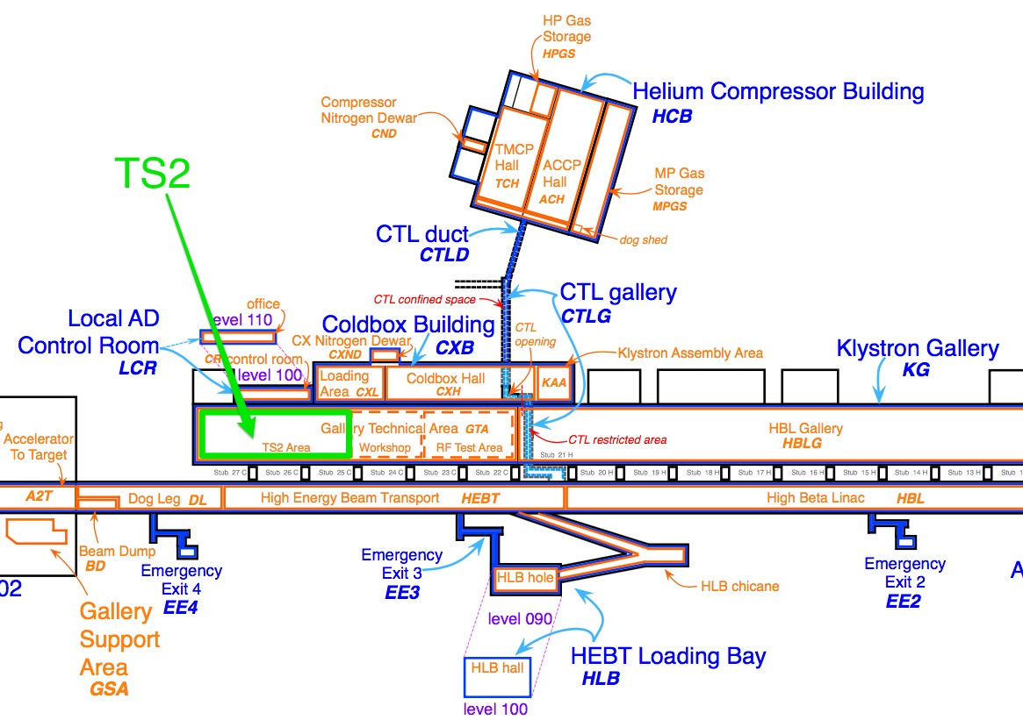
Layout 1

Slide 7
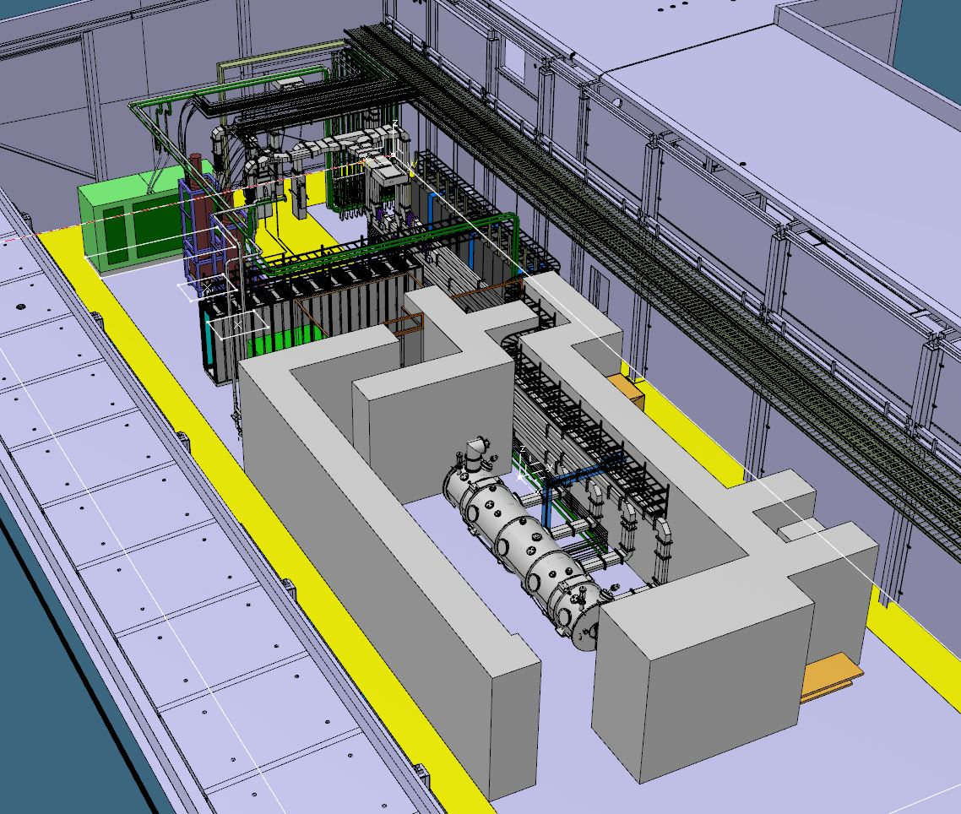
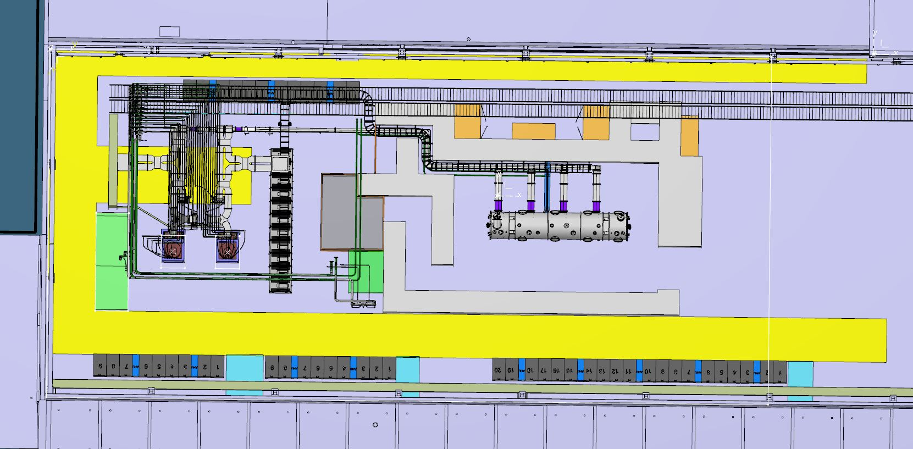
Layout 2

Slide 8
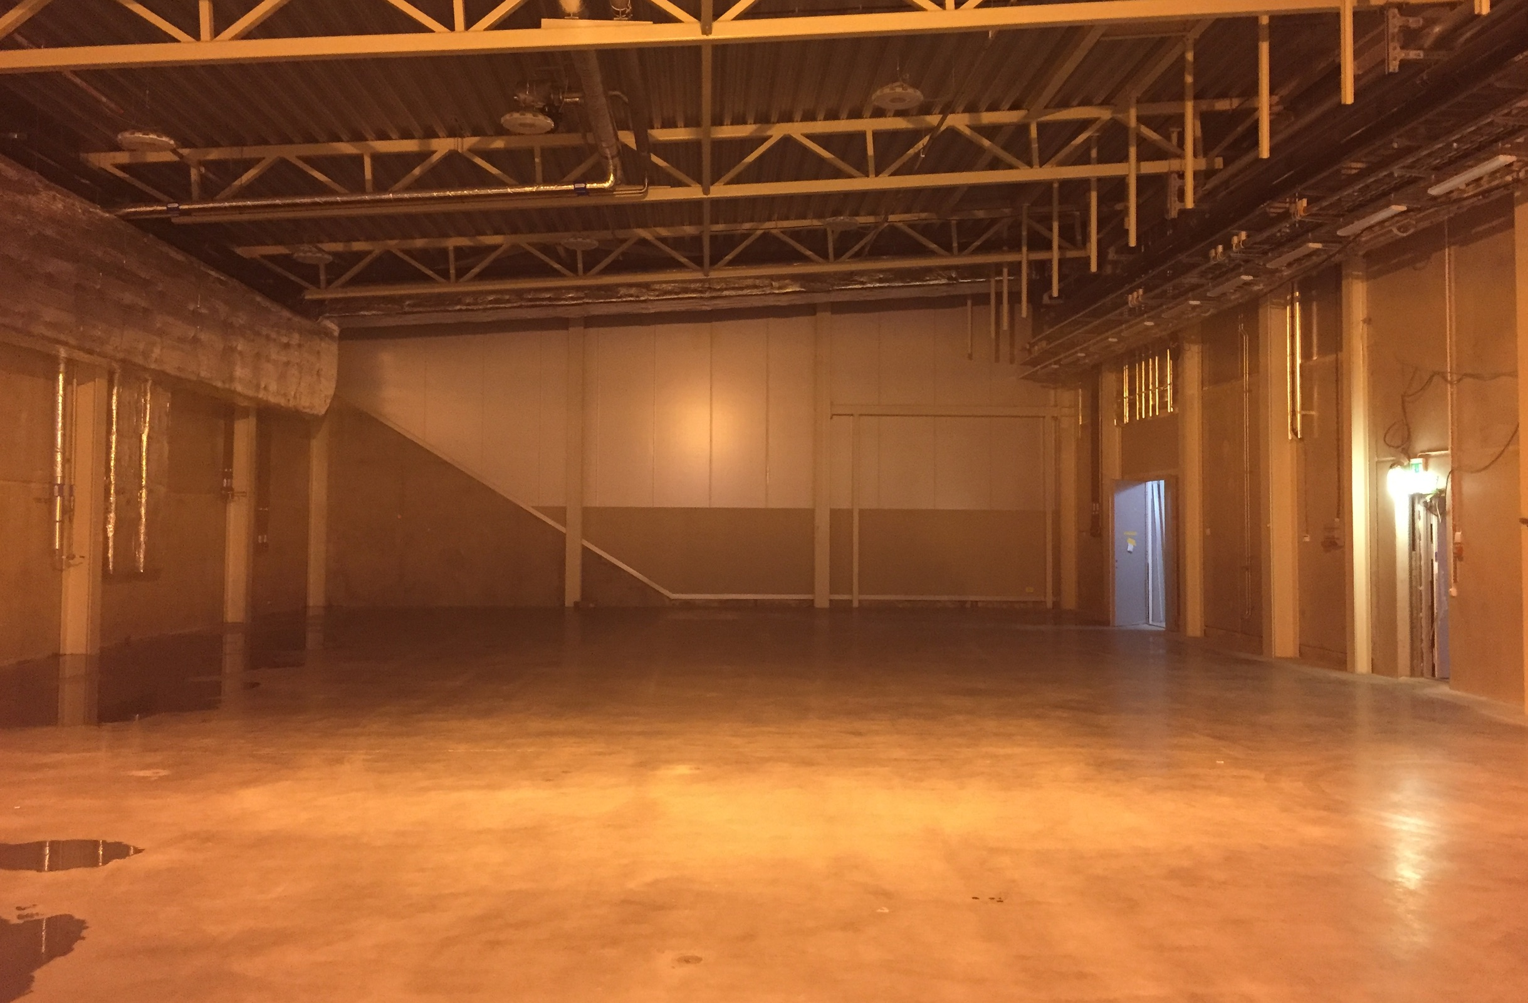
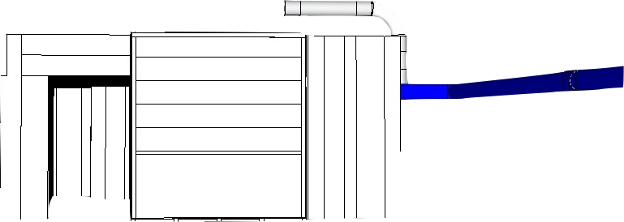
TS2 area in the Klystron Gallery

Slide 9
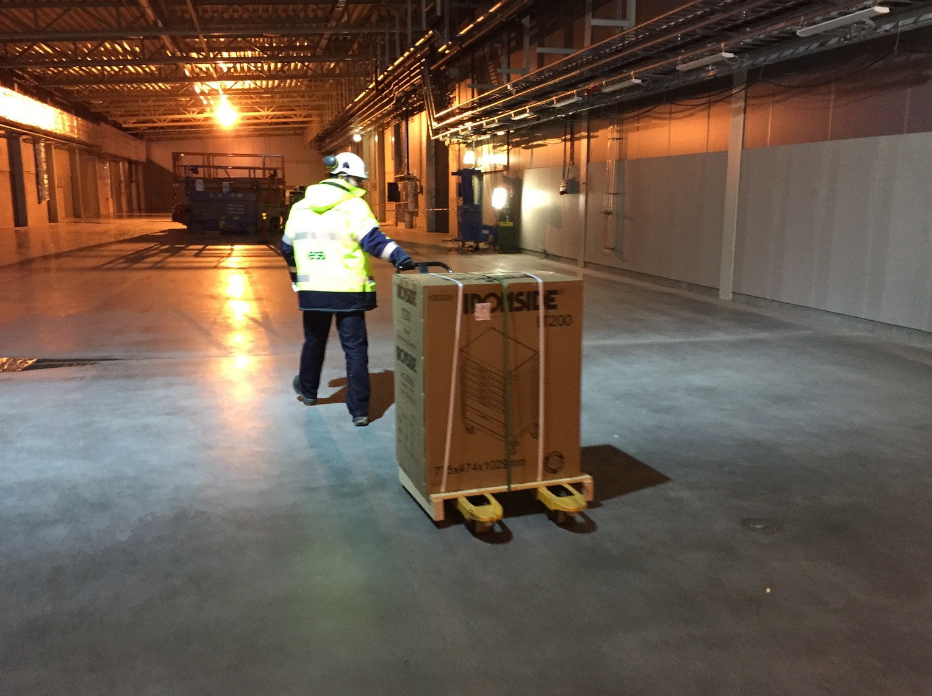
TS2 area in the Klystron Gallery

Slide 10
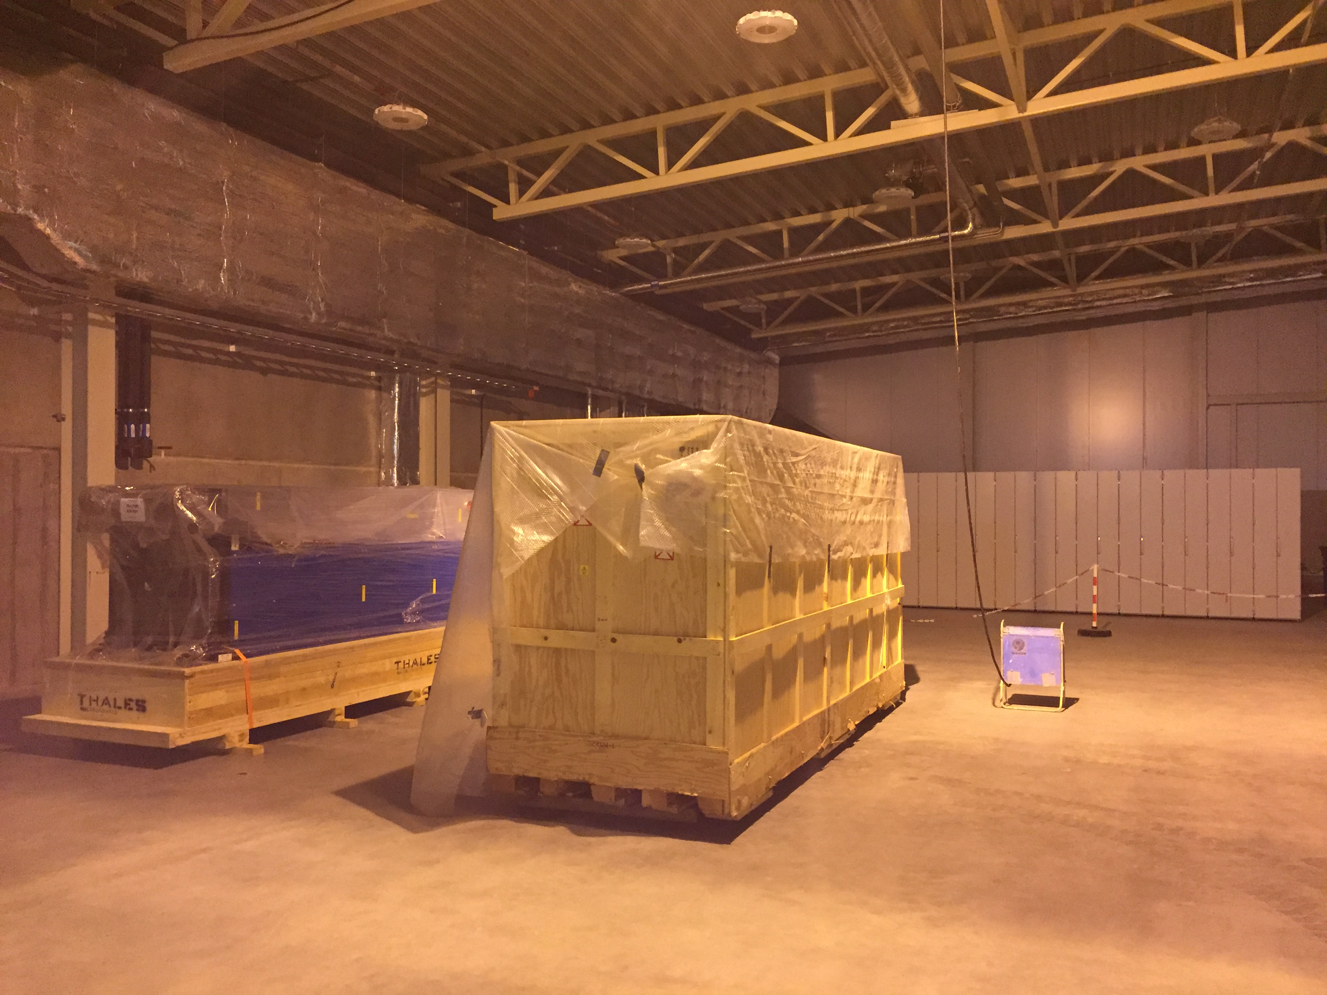
TS2 area in the Klystron Gallery

Slide 11
https://ess-ics.atlassian.net/wiki/display/ATS/Accelerator+Cryomodule+Test+Stand+2

Slide 12
Organisation: Installation
TS2 installation is coordinated by WP10. The other teams provide:
WP11: cryoplant, transfer line (incl. valve box & warm lines)
WP8 & WP17: HP RF (modulator, klystrons, waveguides, circulators, dummy loads and splitters) and LLRF equipment
WP12: portable clean room (inst. & removal of beam vacuum pump), insulation vacuum pump, cryo line purging pump
ICS: controls, timing system, motion control (CTS), PSS (access control, radiation & ODH monitoring)
WP15: cabling, racks
WP16: cooling water skid & connections, cp air connection
CF: building, utilities
ESS logistics: transport & handling
WP5 IKC partners (CEA & IPNO, France): advice and support
AD linac group: support on SRF & other issues

Slide 13
Organisation: operation
TS2 operation is organised by WP10. Other teams provide:
WP11: cryoplant operation, support during CM cooldown
WP8: RF engineers to operate RF equipment during tests
WP12: clean room operation, connection of pumps
ICS: database for test data storage
IFJ PAN (In-Kind partner): specialists for CM handling, preparation, connection, testing (experience from XFEL)
WP5 IKC partners (CEA & IPNO, France): advice and support
AD linac group: support on SRF issues and with testing
WP10 is responsible for delivering fully tested elliptical cavity cryomodules.

Slide 14
TS2 Installation Schedule
CF: TS2 partial access
CF: LCR partial access
CF: TS2 full access
& utilities
WP10: bunker accessible
WP5: TD available in Lund
WP5: 1st MB CM available in Lund
2017-02-27
2017-03-31
2017-05-02
December 2017
2018-02-01
2018-11-01
partial access
full access
utilities available
LCR partial access
LCR full access
bunker procurement
bunker manufacturing
bunker inst.
TD available
preparation
cold comm
1st MB CM
RF installation & commissioning outside bunker
RF inst. inside
RF dry commissioning
MB CM testing
cabling
rack installation
rack inst.
cabling outside
cabling inside
TD inst
MB CM inst
TICP inst & comm
TL inst. outside
TL inst. & c. inside
ICS / IPNO: CM controls design
inst. & comm.
PSS inst. & comm

Slide 15
Outlook & Summary
Detailed list of work will be consolidated during this summer, together with WP5, CEA
Workshop about test procedures and delivery conditions will be held
RF continue installing equipment and start commissioning
Water and electrical supplies will be installed
Test Stand 2 for elliptical cryomodules is on schedule to be ready for operation when the MB CMs arrive in Lund.

