Slide 1
The State of Beam Instrumentation
Tom Shea
Beam Instrumentation Forum, Trieste
26 April 2017

Slide 2
Outline
Overview of the BI partnership
  Systems
  Overview of responsibilites
  Some Changes in Lund
Toward deployment
  Capture lessons learned
    Example: BI Commissioning in Catania
  Scale up
    Accelerator model -> Mechanical Components
    Supply chain management

Slide 3
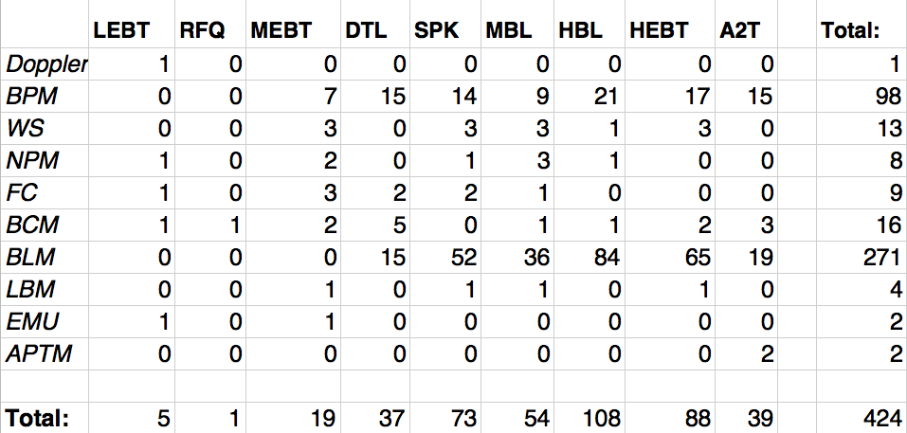
Systems
Yes, still some inaccuracies that we are working out this week

Slide 4
Working with Us: by System
Benjamin: EMU, FC, WS, IBS, BSM (interim); Partners: Saclay, Bilbao, Trieste, Århus
Irena: BLM, BSM; Partners: Saclay, INR
Cyrille: Target imaging, grid, aperture, NPM, Doppler; Partners: Oslo, J-PARC, Cockcroft, Saclay
Hooman: BCM; Partners: Saclay, Bilbao, Legnaro, Daresbury, DESY
Rafael: BPM; Partners: Bilbao, Legnaro, DESY, Daresbury
Tom: BLM (interim)
Steve: BPM (after CDR)
Slava: BSM (intirim in June)
Notes:
Not intended to be an exhaustive list; categorization is not strict - it indicates primary intent of documentation
Refinements coming as new recruits arrive.

Slide 5
Working with Us: by Technology
(In Lund)
Mechanics (Thomas G)
Electronics (Rafael)
Software (Hinko)
FPGA (Maurizio)
Installation (Johan/Slava)
Verification (Clement)
Lab management (Edvard)
Notes:
Not intended to be an exhaustive list; categorization is not strict - it indicates primary intent of documentation
Refinements coming as new recruits arrive.

Slide 6
Design Documentation
Requirements and Interface Management:
By System
  Specification Document
  with L4 Requirements
  Functionality Document
  Verification Plan
  Commissioning Plan
By Technology
  Mechanics:
  Catia/CHESS
  Electronics, Software, and FPGA: Building Blocks
  Data Management:
  Naming Tool, Cable Database, CCDB, etc

Slide 7
Rafael Baron
System Lead
  BPM (until CDR in May)
Technology Lead
  Electronics hardware
  NEWS: Now on academic leave at DTU (20% with ESS for continuity)

Slide 8
Stephen Molloy
System Lead
  BPM (as of CDR in May)
NEWS: Moved to Beam Diagnostics in April

Slide 9
Irena Dolenc Kittelmann
System Lead
  icBLM
  nBLM
  LBM/BSM
NEWS: Returning 1 September

Slide 10
Edvard Bergman
Technology Lead
  Laboratory Manager/Safety
  Racks and cabling
  CE marking
NEWS: Started April 3

Slide 11
Clement Derrez
Technology Lead
  Verification Systems
  Testing BLM electronics
NEWS: Started April 3

Slide 12
Slava Grishin
  Arriving in the transition to Installation, Deployment phase
  icBLM detectors
  BSM (interim)
  NEWS: Arriving June 1

Slide 13
Thomas Shea
Beam Diagnostics Section Leader
Also Beam Instrumentation Work Package Manager
  Supervision, planning and technical oversight

Slide 14
Lessons learned from diagnostics commissioning in Catania
Adapted from 2017-02-16 Technical Board presentation

Slide 15
Lifecycle of Each Instrumentation System
PDR (incl. L4 performance requirements)
CDR (incl. verification plan, first proton functionality)
SAR 1 – ready to ship
RFI - Installation and Integration
ARR – ready for first protons
SAR 2 - handoff from IK partner to ESS-BD section
Commissioned – handoff from ESS-BD to Operations
Updates
  Remove from service (return to ESS-BD)
  Update
  Verification (similar to SAR)
  Recommission (during studies mode of operation)
  Return to service (handoff back to operations)
Continuous improvement of Beam Diagnostics team performance:
Capture lessons learned at each step
Apply this experience to upcoming activities

Slide 16
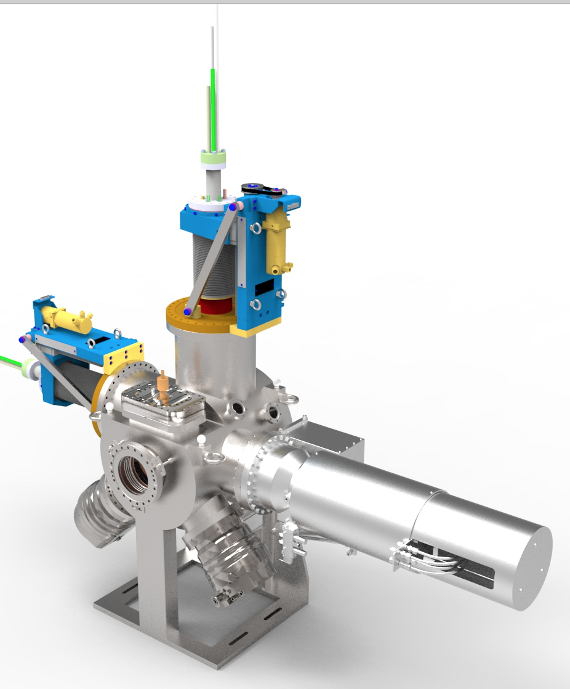
Instrumentation in LEBT
FC
  Measure the total beam current
Doppler
  Measure the ion species fraction
EMU
  Measure the transverse phase space
NPM
  Measure beam profile and position
  Will be used as an optical BPM to measure the beam trajectory
BCM (downstream of this chamber)
  Measure the transported current
BD section also provided the vacuum chambers
EMU
NPM
FC
Doppler (port hidden on bottom side)

Slide 17
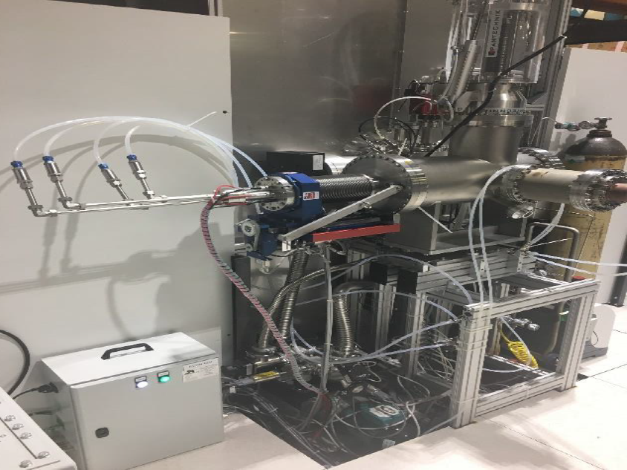
EMU Acceptance at Catania, Dec 2016
People (EMU and Doppler):
CEA Saclay Team:
  Olivier Tusk: main responsible for the EMU
  Franck Senée: Main responsible for the Beam Instrumentation projects for ESS-CEA in-kind
  Mechanical Engineers: Nicolas Misiara / Philippe Daniel-Thomas
  Controls and Automation Engineers: Victor Nadot / Tom Joannem
  Controls and Software engineer: Jean-François Denis / Victor Silva
ESS Team:
  Cyrille Thomas: responsible for the EMU on behalf of Benjamin Cheymol
  Hinko Kocevar: Software Engineer
  Nick Levchenko: ICS control engineer
NFS (Catania) Team:
  Lorenzo Neri: Proton Source Engineer
  NFS technicians (mechanical and vacuum)

Slide 18
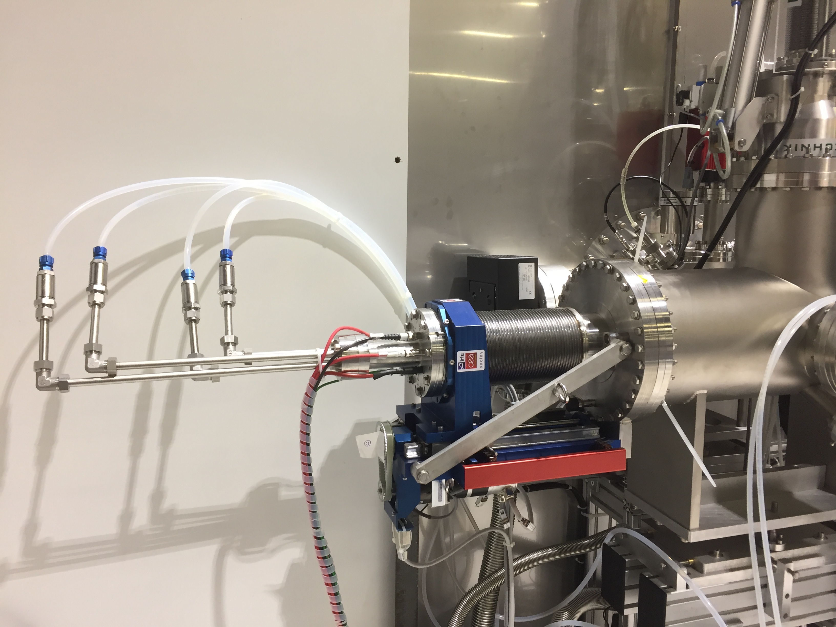
EMU Commissioning Jan 2017
Design to absorb the full beam power (90 mA, 75 keV at 8% duty cycle)
Phase space reconstruction accuracy better than 10%
Time resolved measurement (1 MHz)
Commissioned in January 2017 with a team of 3 people
  1 software
  2 physicists
Issue found in software
  Solved
Issue found in PLC
  Solved
Issue found in Motion
  Solved
Later: Issue found in deflection calibration
  Solved
Archiver not working, no time resolved measurement
  Unsolved

Slide 19
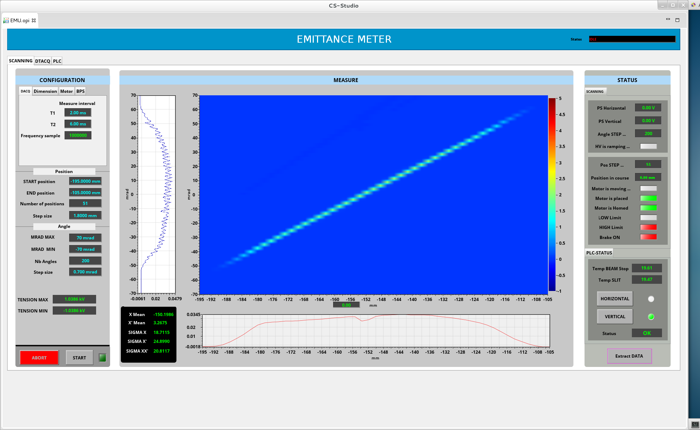
EMU Summary
EMU GUI screenshot
Reconstructed rms and 98% emittance after data treatment
Last commissioning step demonstrates the performance of the EMU
EMU fully commissioned and ready to acquire beam distributions for end to end simulations; Matlab analysis package provided to Catania.
Next steps:
  Solve Archiver issue
  Migrate from VME to uTCA; Migrate from geobrick to ethercat MC
Commissioning Report: https://chess.esss.lu.se/enovia/link/ESS-0094745/21308.51166.47104.14968/valid

Slide 20
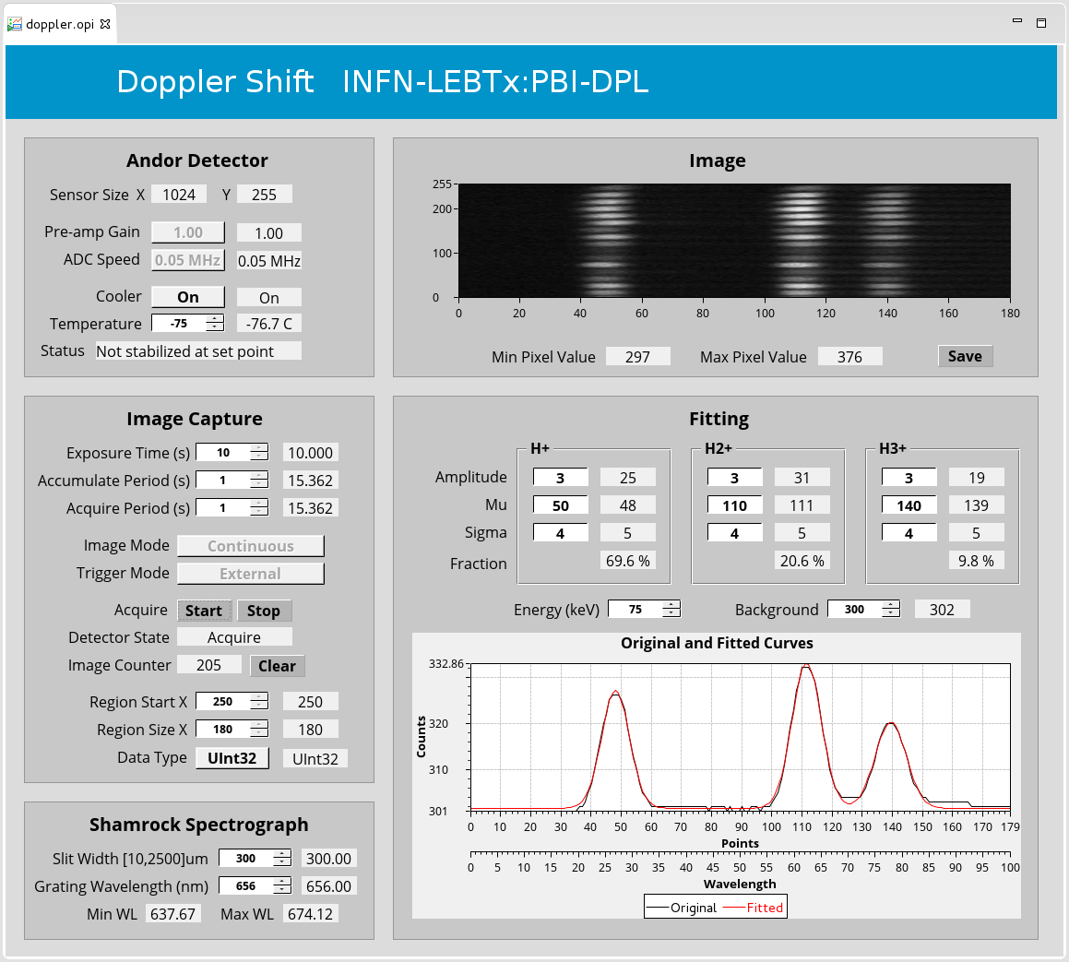
Doppler: Commissioned at Catania
Control and Software Development
  Expert screen, allow full control of the instrument
    Should not be used by operator!
      Operator Screen almost released by now
  Critical: No control = no instrument
    Control issues caused delay for technical reasons but also due to (mis-)communication
  Final software qualification in Catania
    Good collaboration between 3 institutes, but different expectation from the instrument than specified in CEA-ESS agreement
Doppler successfully commissioned and hand-over of the system from CEA to ESS: SAR (2) accepted (Dec 2016)

Slide 21
Summary: Lessons Learned (a very tiny subset)
I believe that our organizational structure can handle the challenges to come
Even better, we will evolve, based on experience and a spirit of continuous improvement
Legacy
  Schedule issues: Embed float in contract/plans; review at PDR&CDR
  LEBT vacuum component issues: Vacuum section/partners provide vacuum chambers and components.
Recent PBI deployment in Catania (observation: response)
  Excellent physics/technical designs: Continue focus on commissioning and beam measurements
  Motivated partners: Maintain engagement through commissioning in Lund
  Useful BCM demo on HV supply: Leave this loaned device in place for now (although prototyping of linac BCM is impacted). BD is prepared to apply expertise to future needs as they arise.

Slide 22
More Lessons
(observation: response)
  Mechanical integration issues (temporary chamber did not accept EMU, EMU had to be mechanically worked to fit in, and the Doppler fiber coupling optics had to be changed): Review and release all devices, even temporary, into mechanical CAD model in CHESS
  Limited time for system deployment: Document integrated commissioning plans with more detail and with goals for each step; more frequent face-to-face engagement
  Mismatch between expectations and initial functionality: Commissioners, system leads, IK leads, ICS coauthor the (first proton) functionality documents
  Resource limitations at host lab: ESS-Lund should be resourced to support commissioning activities
  Missing MPS: Coauthor building block documentation with ICS and assure that necessary blocks such as interlock systems are provided.
  Grounding/EMI/analog front end issues (missing installation documentation; FC front end details fell in gap between system lead and ICS integrator): More engagement of technology leads, obtain documentation of site installation and electromagnetic environment.
  Software tools had issues (archiver, etc): Work with ICS to prepare tools that support commissioning shift work, data acquisition for complex studies, etc

Slide 23
Toward Deployment in Lund

Slide 24
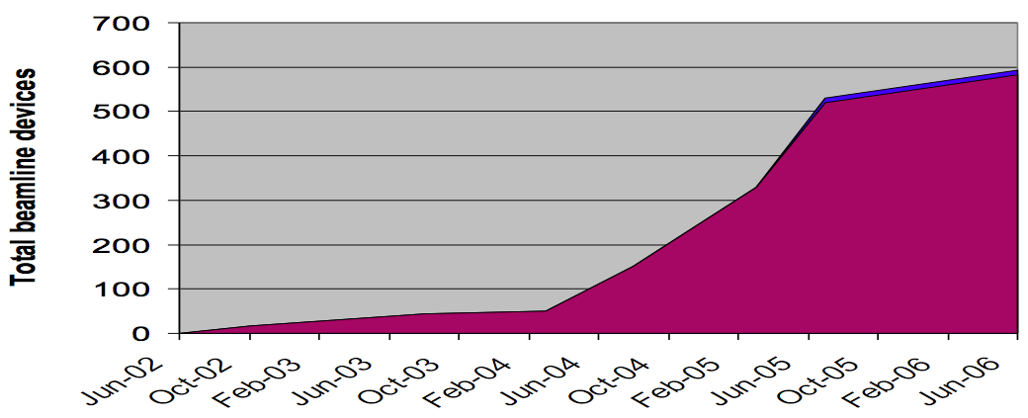
Awake at Night
April 2017
We are here
Source/
LEBT
RFQ
+
MEBT
Source/LEBT
at
Catania
DTL
Tank 1-4
DTL5
+ Spokes
+ Medium Beta
ESS
2015
2016
2017
2018
2019
SNS
2002
2003
2004
2005
2006
1
2
3
4
5
6
7
8
9
MEBT
improve
DTL 1
improve
Elliptical
Deployment of superconducting linac devices

Slide 25
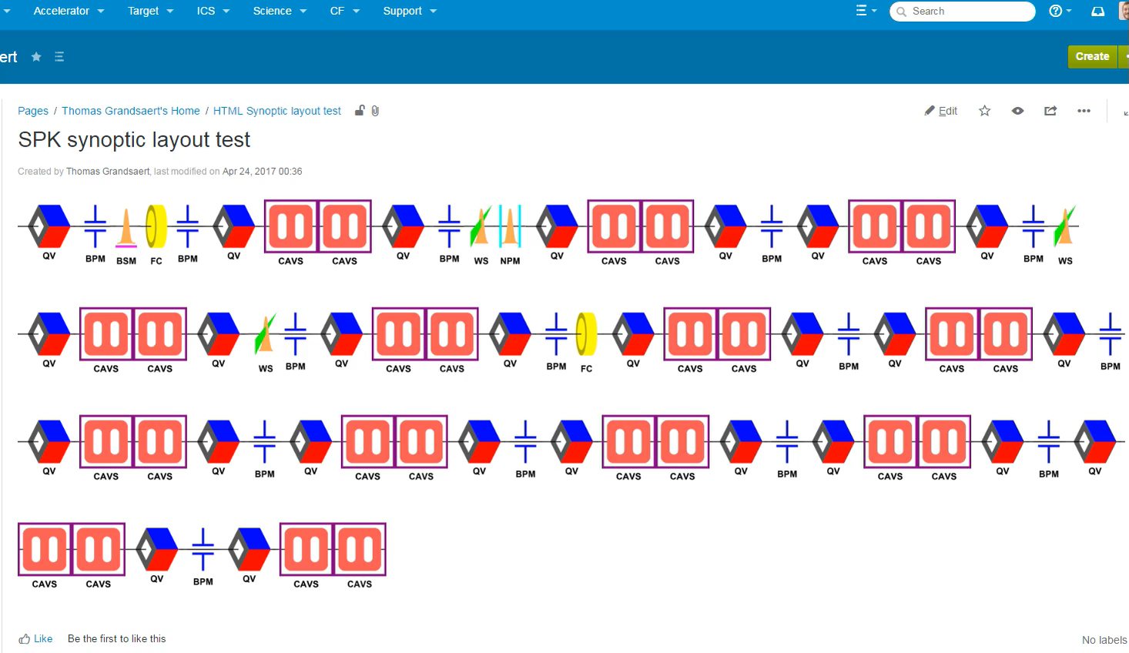
Checking the Layout
Thomas Grandsaert

Slide 26
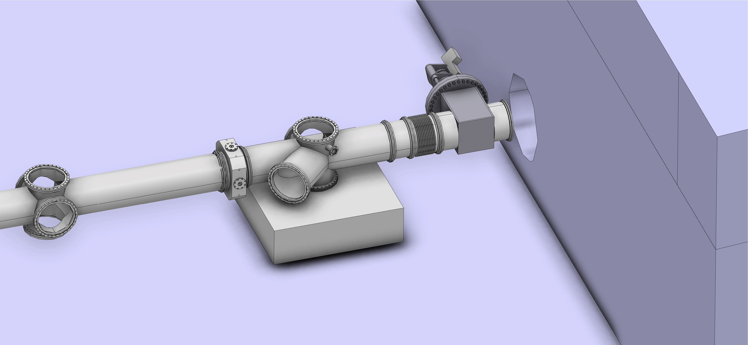
Layout work: Dump

Slide 27
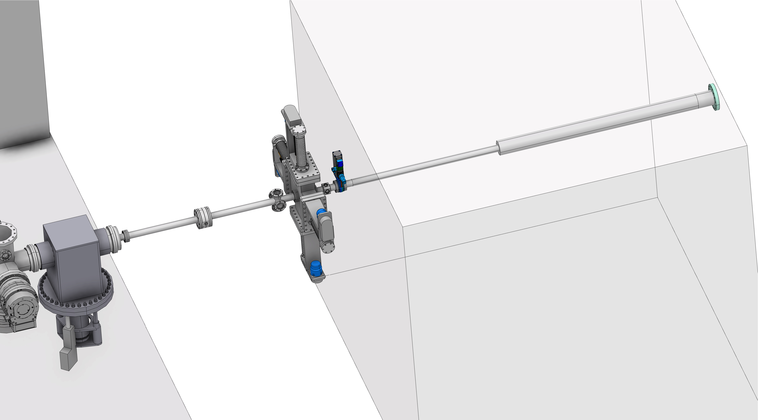
Layout work: Neutron Shield Wall

Slide 28
Racks and Cables
Cable database in operation (simple version)
With spreadsheet entry form
Rack/gallery layout currently only in Johan Norin’s spreadsheet (circa 2016)

Slide 29
PBI Shopping List
Hinko

Slide 36
We are using it now to request ICS equipment
Programmatic interface (and some reasonable data design) will allow data migration to future systems

Slide 37
Outlook
April 2017
We are here
(In parallel with Design Reviews)
Focus areas for front end:
1st protons in
Lund
Catania: Commission, Support
Decide
Prototype
Produce
Install
!
New Year
2017
midsummer
gallery ready
New Year
2018
Building blocks
First Proton Functionality
~4 additional staff members
Revisions to system and technology leads
Installation manager
Cables and Shopping List
System Teams responsible for integration and commissioning
  System Lead
  Partner
  Beam Physics
  ICS
Notes:
General areas of PBI focus; actual activities will overlap.

