Slide 1
icBLM electronics tests
Clement Derrez
Verification Engineer
www.europeanspallationsource.se
25 April, 2017

Slide 2
Outline
BLMs at ESS
icBLM
Production status
Requirements for electronics
AMC-PICO-8
Specifications
measured performances
Conclusions

Slide 3
BLMs at ESS ESS BLM: 3 detector technologies
icBLM (SCL)
Ionization chambers (ICs) developed for LCH BLM – primary BLMs in SCL
Background Levels are difficult to predict numerically – they depend on the quality of cavities, operation conditions and time.
Background sampling and subtraction in the signal processing necessary.
cBLM (Cherenkov based BLM, SCL)
Currently considering to design Cherenkov radiation sensitive detectors.
To be used as an addition to the ICs.
nBLM (neutron sensitive BLM, NCL)
Plan to place BLM detectors in the MEBT and DTL sections.
See presentation from CEA Saclay

Slide 4
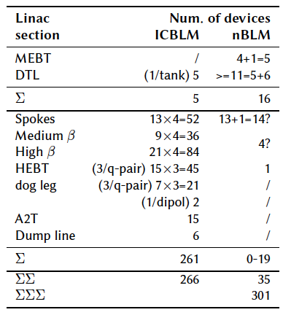
BLMs at ESS Detector count
NC linac – nBLMs
Original count when writing the technical annex:
MEBT: 1 per collimator or chopper dump
DTL: at least 1/tank, 1 between the tanks, 1 at start or end of the DTL
SC linac - icBLMs
3-4 devices per doublet lattice cell: 4 where there is a cryomodule and 3 in the transport section.

Slide 5
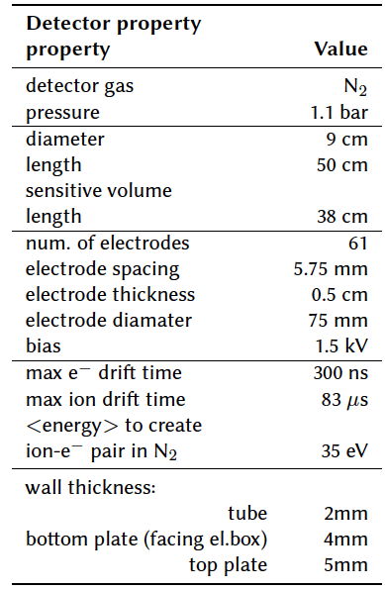
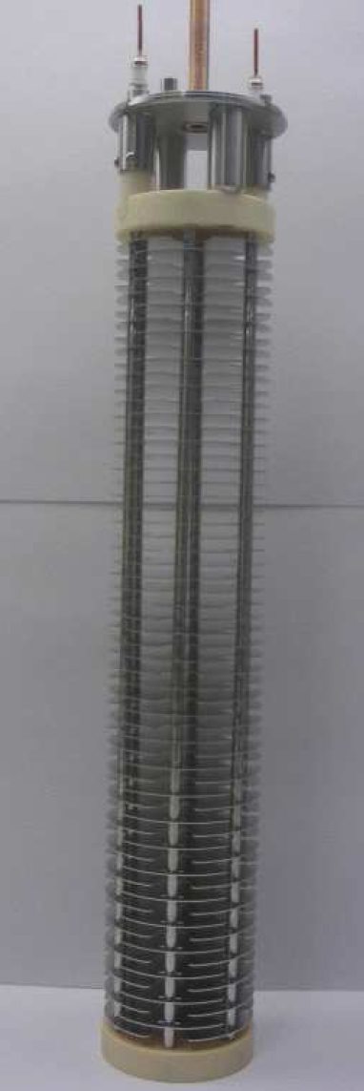
icBLM
See update from Slava
Ionization Chamber based BLM
Showers of secondary particles (charged and neutral) are expected in the SC linac.
Parallel plate gas Ionization Chambers (ICs) developed for the LHC BLM system will be used – chosen due to their fast response.
ICs production finished, acceptance tests performed at CERN
Inner structure of the LCH BLM [1]
5

Slide 6
icBLM ICs production & acceptance status
830IC:
*8 ICs – well known assembly problems
*822 ICs tested
799 ICs are accepted
+10 ICs will be checked and re-tested
icBLM Status
Done – production, test
Next – insulation, shipping to ESS

Slide 7
icBLM Electronics: Preliminary Requirements
Preliminary requirements
Current range estimated to 800 nA – few mA
“BLM is required to be able to measure at least 1% of 1W/m loss during normal operation and up to 1% of the total beam loss”
SC linac response time:
10 us (based on melting time calculation) but a shorter response time is actually required
→ Bandwidth: 300KHz

Slide 8
AMC-PICO8 CAENels PICO-8 picoammeter specs
8-channel 20 bit Bipolar Floating Picoammeter with MTCA.4 REAR I/O
“standard” AMC PICO-8 specs: http://www.caenels.com/products/amc-pico-8/
Full-scale ranges of 1mA and 1 uA
Input bandwidth: 10KHz
ESS custom AMC PICO-8: (different input op-amp)
full-scale ranges of 10 mA and 500 uA
input bandwidth: 300 kHz

Slide 9
AMC-PICO8 Measurement setup
PICO_8
CAEN DAMC-FMC25
current source Keithley 6221

Slide 10
AMC-PICO8 Preliminary results
Noise levels, as measured by manufacturer vs measured at ESS: (1 $σ$,10000 points @ 1MSPS)
Bandwidth, as measured by manufacturer:
 | CAENels | ESS testbench
10 mA range | 190 nA | 195 nA
500uA range | 10 nA | 10 nA
 | CAENels, 10mA range | CAENels, 500uA range
Ch 0 | 301 kHz | 300 kHz
Ch 1 | 294 kHz | 292 kHz
Ch 2 | 299 kHz | 299 kHz
Ch 3 | 303 kHz | 391 kHz

Slide 11
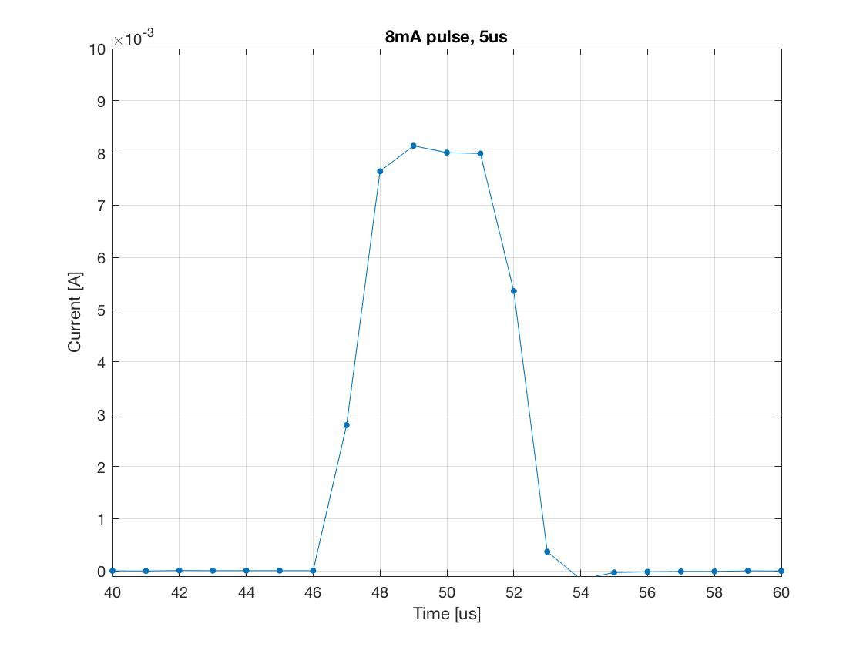
AMC-PICO8 Preliminary results
Shortest pulse:

Slide 12
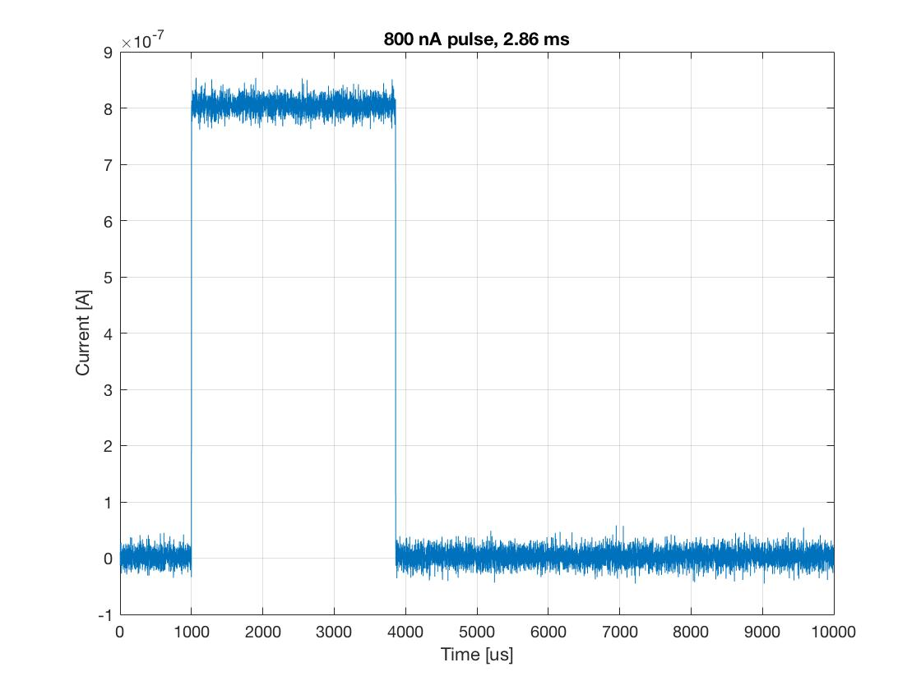
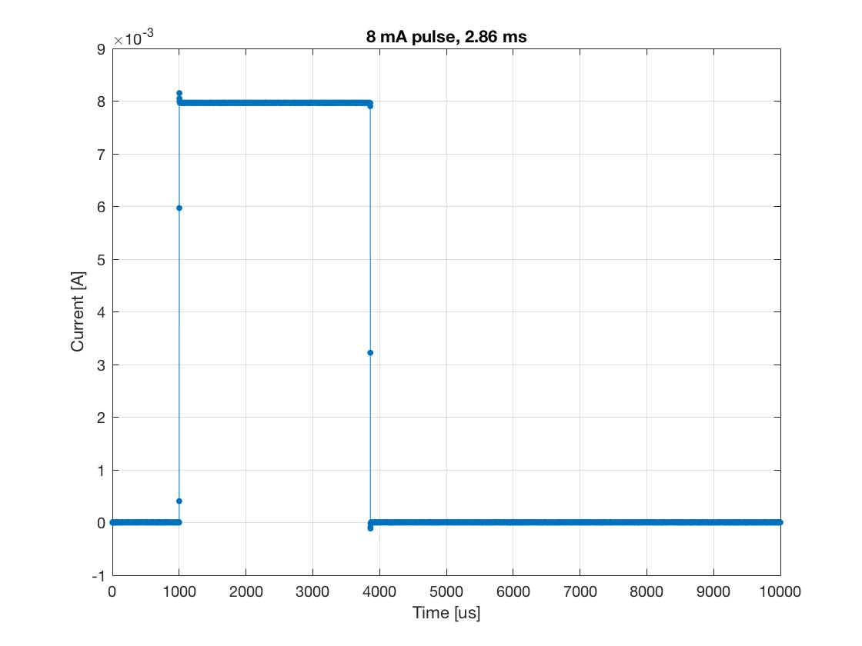
AMC-PICO8 Preliminary results
Longest pulse:

Slide 13
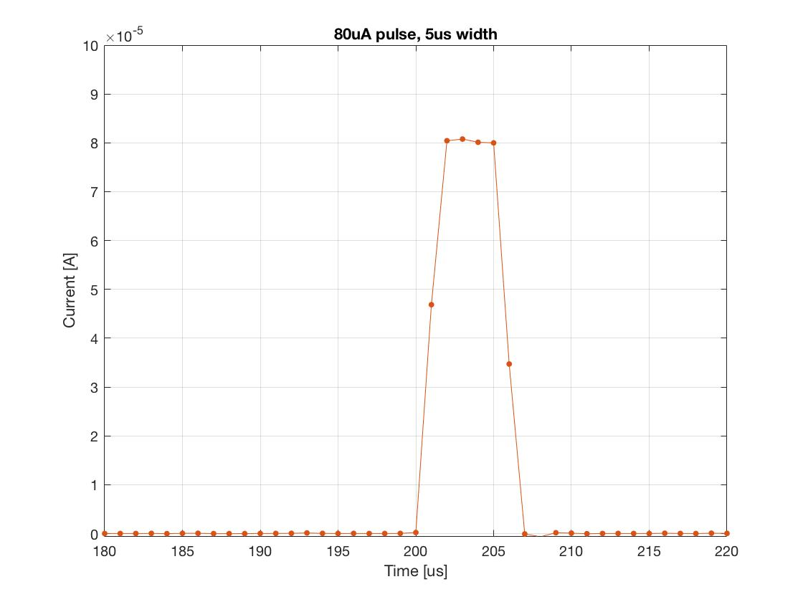
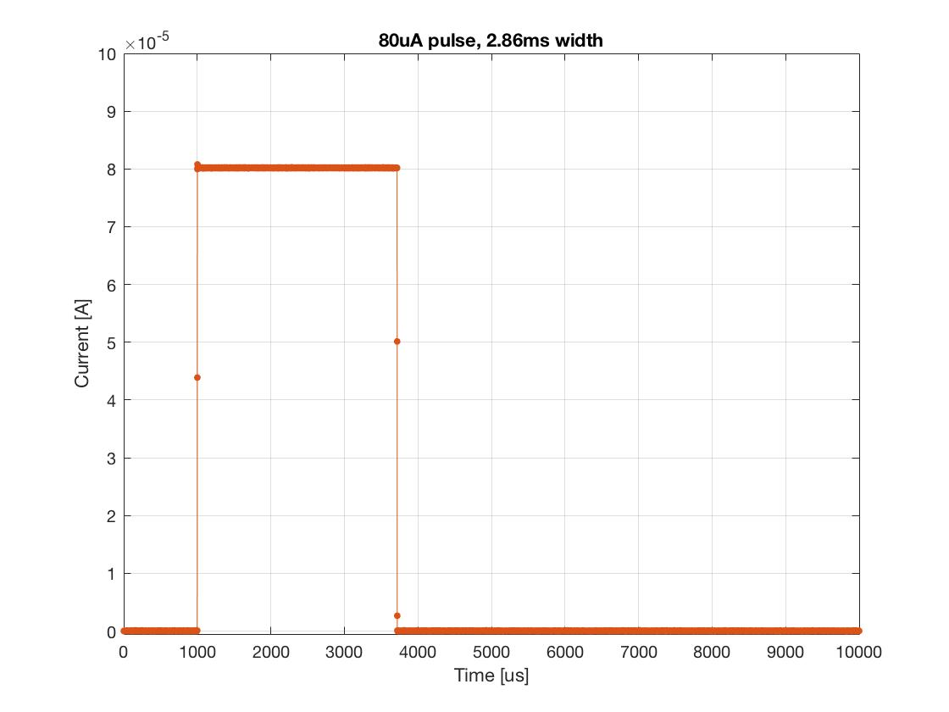
AMC-PICO8 Preliminary results
80 uA pulse amplitude: 1W/m loss during normal operation

Slide 14
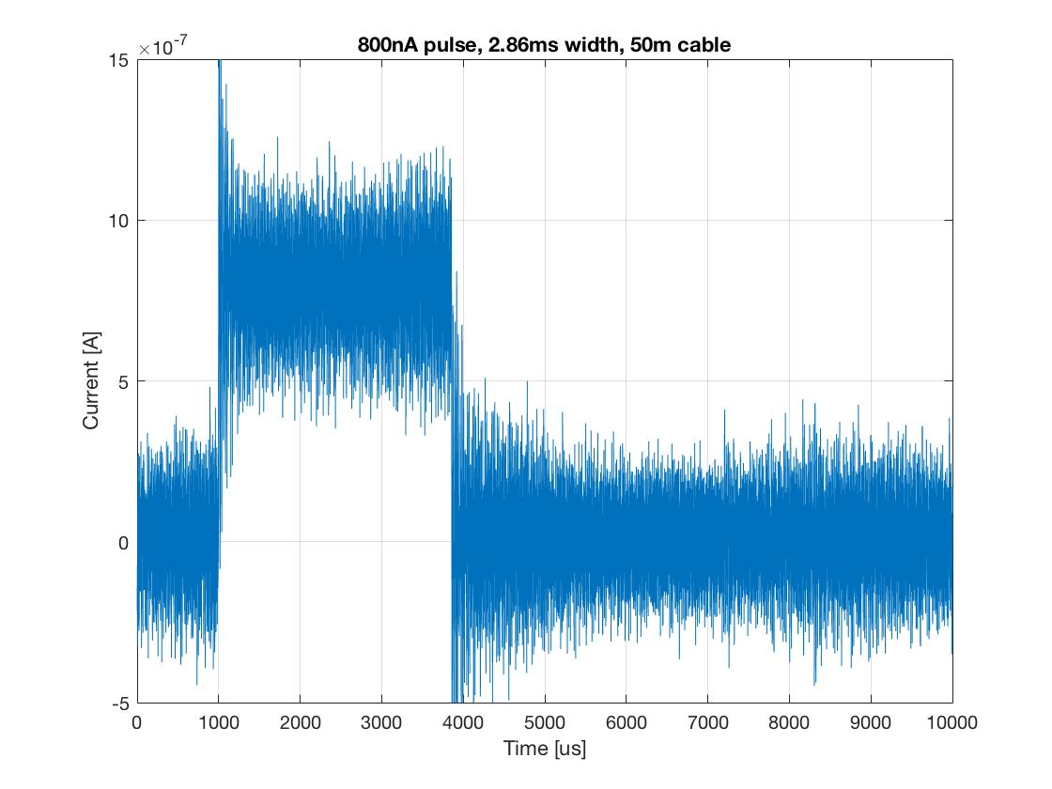
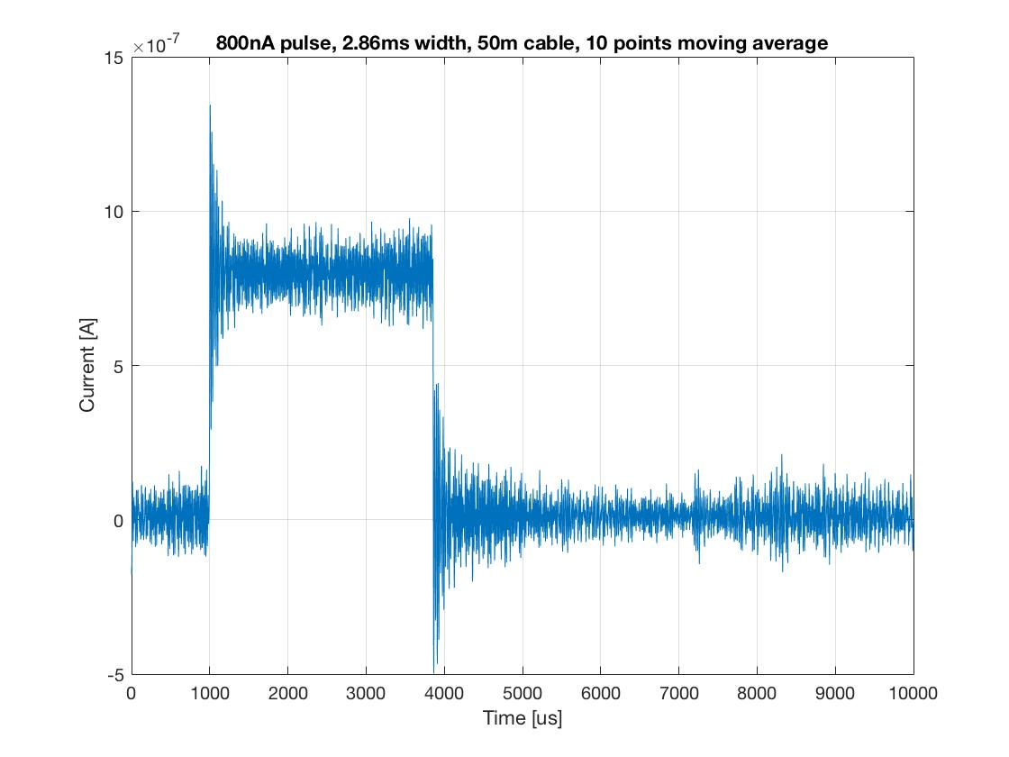
AMC-PICO8 Preliminary results
Worst case: 50m off the shelf coax cable
$σ$ = 150 nA
$σ$ = 50 nA
Notes:
Std(worst): 151nA
Std(10 points moving average): 50nA
Std(100 points moving average): 3.6nA

Slide 15
Conclusions, Next steps
ToDo: Perform a “long-term” measurement to check for possible drift
More measurement to be able to confirm that CAENels PICO8 fits ESS requirements
Big plus: off the shelf digitizer, commercially available
Performances are to be compared with the digitizer solution from CERN

Slide 16
Acceptance tests workflow at ESS:
System lead provides tests requirements
Translated to test system SDD by verification engineer
Possibly list needed lab devices, new hardware etc.
SDD is then validated by system lead
Implementation starts
Test systems SW in python, possibly including matlab packages.
Data stored in hdf5 format, traceability ensured by linking devices’ id tags to each data file.

