Slide 1
Critical design review #1
for medium beta cavity cryomodules
3-4 APRIL 2017
-
Risks management
-
Philippe Gastinel on belhaf of the Risk Owners
F. Peauger (mainly for CM components)
Th. Trublet (mainly for CM assembly)

Slide 2
Risks management Dispositions
Risk evaluation (brainstorming with experts team):
  Two categories : Cryomodule components (Schedule 5.2) / Cryomodule assembly (Schedule 5.3)
  Several types:
    Top level / WP level
    Shared (co-responsibility) / transferred risks (risk owner is ESS)
  Rating before / under/ after mitigation and criticity assessed by likehood x impact = K for “criticity”
Mitigations
  Risk owner
  Actions list and follow-up
Update when needed (at least every 6 months)
  ESS/CEA Workshop in Jan 16 (baseline set for risk monitoring)
More details in “RISK MANAGEMENT FOR ESSI PROJECT” - CEA-ESS-PJT-AQ-0006 A
Risk registers
  CM components : CEA-ESS-CMS-AQ-0001
  CM assembly : CEA-ESS-CMS-AQ-0002

Slide 3
-
CM components
Risk status
-

Slide 4
Cryomodule components (current risks)
Status via criticity matrix
(F1) Coupler pre-series will not reach the expected performance during conditioning (K128 -> K8)
(M1) Series components integrated not matching performances (assembly, tooling compatibility, alignment, thermalization, cryo performance under power …) (K64 -> K32)
(F2) RF source lack of reliability at start (K32 -> K16)
(new C5) - Cryogenics performance not matching requirements (K16)
(F1) – Coupler pre-series
(M1) – Series comp. performance

Slide 5
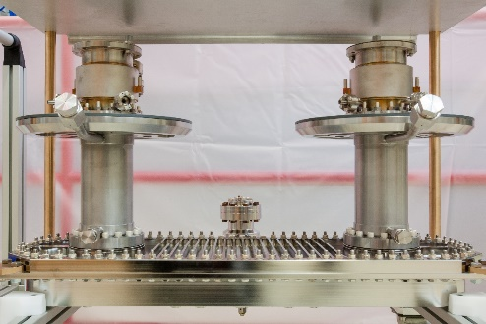
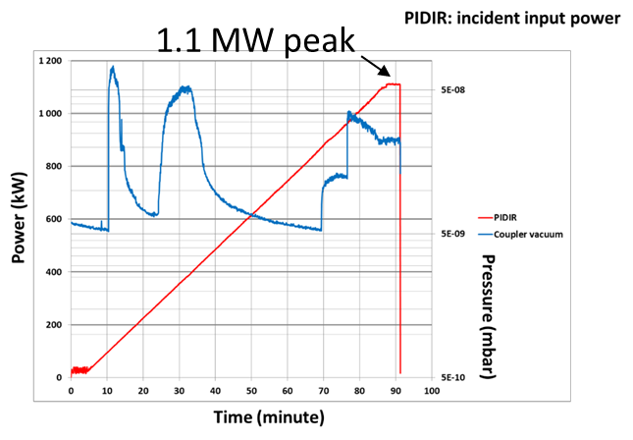
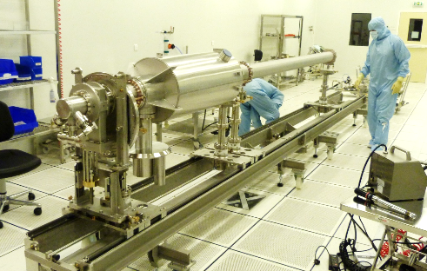
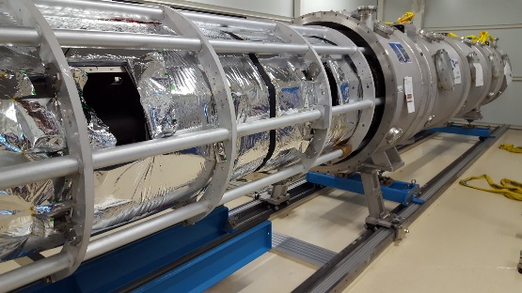
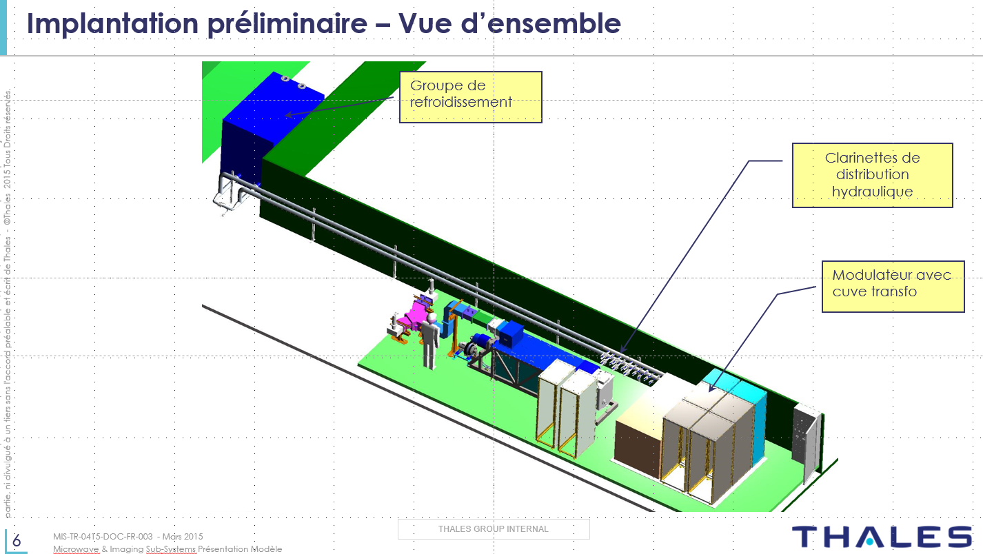
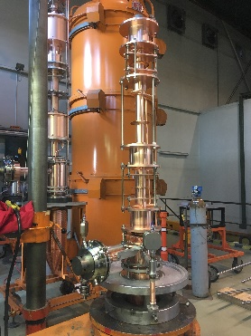
Cryomodule components (current risks)
Mitigation action status
  (F1) Analyze schedule impacts with different procurement scenarii. (100%). Keep the companies involved in prototypes in the business (100%). 2 proto couplers tested by CEA & contractor at full performance (100%)
  (M1) Dummy assembly (100%) + Drawings control before proc. (50%) + Show stopper in compo. contracts after H-ECCTD assembly (50%) + M-ECCTD assembly (50% )& tests ASAP > Split CDR_M1 /_M2 (100%)
  (F2) Prioritize the RF source procurement (100%) + Prepare the installation in advance (50%)
  (C5) Internal critical review with cryogenics experts -Nov 16 (100%)- link to RR4-M1
Coupler pair for RF processing
Mockup string
Spaceframe insertion
RF source
Klystron fabrication

Slide 6
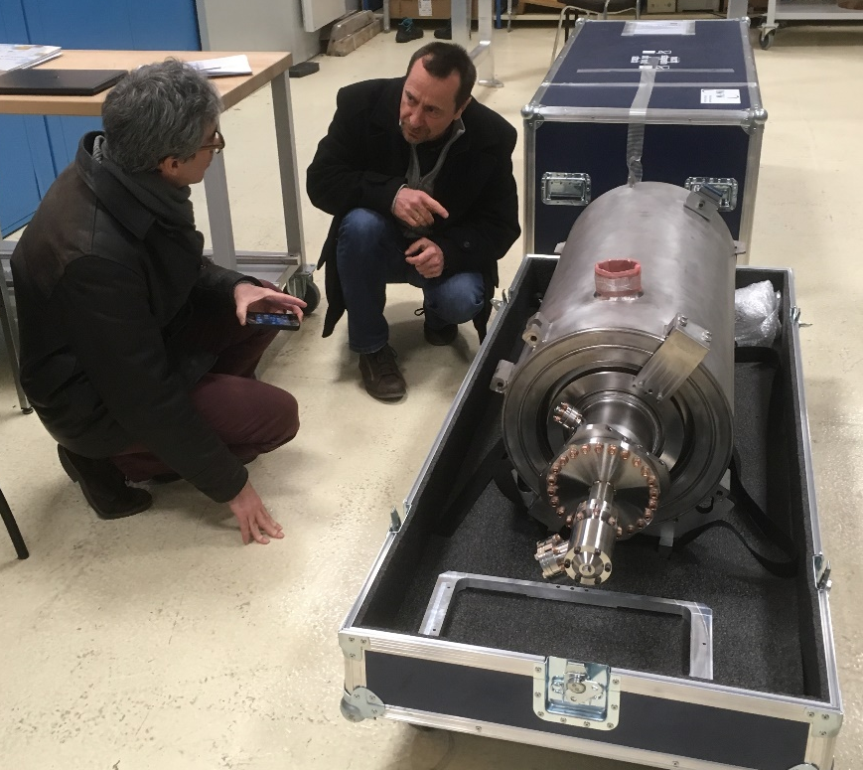
Cryomodule components (Transfered risks)
(E1) Cavity expertise : CEA responsability is directly or undirectly engaged
  Transfered : ESS schedule will explicit limit of responsabilities and change instruction provisions (studies)
(T2) TS /Cavity not adapted
  Transferred : Tests of one LASA cavity in M-ECCTD + interfaces drawings
LASA Cavity for M-ECCTD received at CEA

Slide 7
-
CM Assembly
Risk status
-

Slide 8
Cryomodule ASSY (current risks)
Status via criticity matrix
(M4) CM assembly tasks duration or contingency reserves not sufficient - aleas during assembly contract (K64 -> K8)
(M6) Assembly contractor not fully efficient -at the starting time mainly (K64 -> K32)
(A6) Too few optimization possible of the components after proto phase (K64 -> K32)

Slide 9
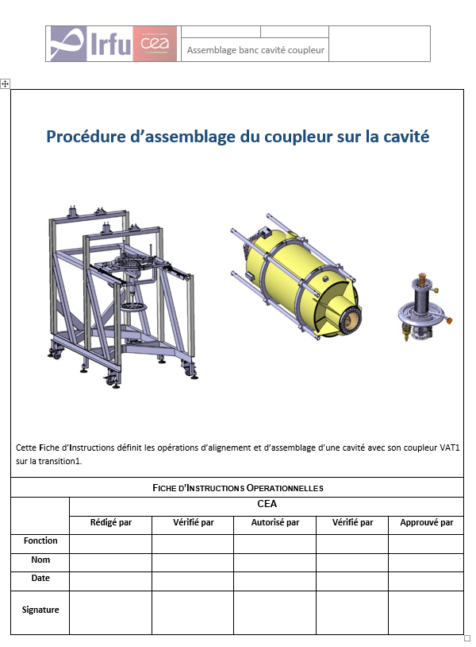
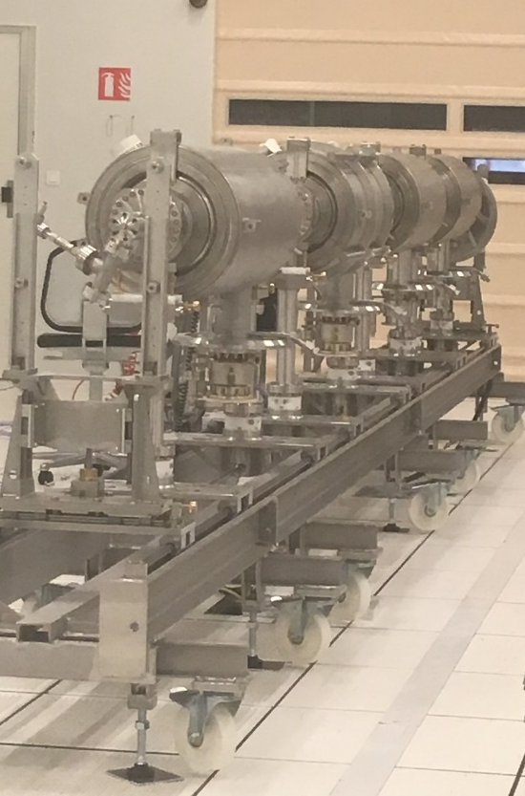
Cryomodule ASSY (current risks)
Mitigation action status
  (M4)General schedule before In-kind signature(100%). Internal expertise to secure the assembly plan and detailed schedule before industrial contract call for tender to identify optimum cost, lessons learnt of XFEL CM assembly costs (75%). External assistance contract (75%). CM assembly hall reservation (100%). Clean room co-activities evaluation (75%)
  (M6) Expertise (75%) + Assembly procedure clarification (50%) + more involvement in procedure elaboration + good selection of contractors + Task force with contractor + schedule acceleration (operation shift)
  (A6) CM CDR as soon as possible to qualify assembly tooling and procedure (75%) & split CDR in (light and enhanced(100%). Hold points in procurement contract after pre-series components manufacturing (100%). Delay the start of CM series assembly (not possible at this moment)
M-ECCTD cavity string

Slide 10
Cryomodule ASSY (current risks)
Additional risks in major zone (K32 line - description and mitigation status)
(M2) Uncontrolled interfaces design definition or uncontrolled changes from ESS or partners(K32 -> K32)
  CEA included in the loop of approval on system design report (interface document) (50%). Efficient Change control (25%)
(M7) Unsuccessfull call for tender for assembly contract (K32 -> K32)
  Identify the possible descoping items (options) to match allocated budget (25%)
(E2) Major non conformity on components (interfaces & performances) not detected before shipping (K32 -> K32)
  Extended QA control at Saclay (50%).
(E5) String contamination during CM assembly (for CM not tested at Saclay) not detected before shipment (K32 -> K32)
  Connection procedures (75%) + training on mock-up (100%) + specific assembly and control tools (50%)
  CEA participation decision to first CM installation, check out (100%)

Slide 11
Cryomodule ASSY (Transfered risks)
(M1) CM piping welding not approved (K32)
  Transfered : Mitigation actions in progress (Rupture disk, certification report from TUV nord, meeting with cryogenic group after cryogenic design - margin)
(M3) CM Warranty period expirated before the CM acceptance
  Transferred : IKCA contract (warranty reserve )
(T2) frame realization and transportation out of spec
  Transferred : IKCA contract - Additional studies on clamping system
(T4) Degradation of performance during transportation and handling for unloading
  Transferred : IKCA contract- Transportation studies + full size tests + (under vacuum with active pumping?)
(E1) RF test stand ( ESS) not ready in due time
  Transferred : IKCA contract - In-kind paragraph on CEA responsibilities due to ESS test stand delay. Establish a permanent financial statement = evolution, costs evaluation and follow-up
(E3) Accidental damage on CM at ESS
  Transferred : IKCA contract - Implement protection tools and using of handling procedures and connection procedure validated by CEA
(E4) CM string contamination during beam pipe connexion with tests stand
  Transferred : IKCA contract - Connection procedures + training on mock-up + specific assembly and control tools

Slide 12
Thank you for your attention
Commissariat à l’énergie atomique et aux énergies alternatives
Centre de Saclay | 91191 Gif-sur-Yvette Cedex
T. +33 (0)1 69 08 76 11 | F. +33 (0)1 69 08 30 24
Etablissement public à caractère industriel et commercial | RCS Paris B 775 685 019

Slide 13
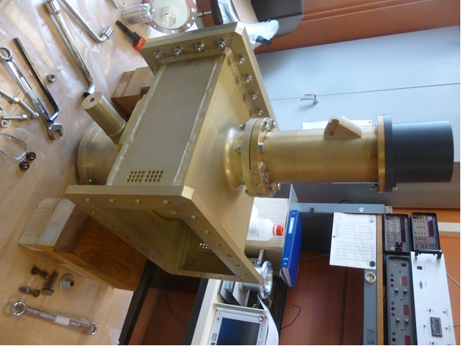
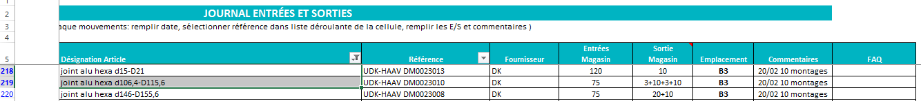
Cryomodule components (Closed risks)
(E1) Cavity expertise : CEA responsibility is directly or indirectly engaged
  Mitigation (even transferred) : involvement in Configuration Control Board
(F3) Couplers doorknob do not respect specifications or very difficult to manufacture
  Design qualified by successful test in Sept 16
(F4) Unsuccessful coupler call for tender or offers out of budget
  Call for tender successful
(C4 )Un-availability of Aluminium gaskets for assembly
  Alumimium materials provided
doorknob

Slide 14
Cryomodule ASSY (Closed risks)
(B2) Integrity of cmp before assy : Components failure during transportation from other site to SACLAY
  Quality control (visual check) before and after transportation
(A1) Assy : Lack of component
  Anticipation of components procurement
(C1) Perf demonstration : Lack of performance of cryogenic and RF utilities (Operating Temp not achieved and/or Test runs limited to few hours, RF source + Power eqt failure during tests, Vacuum eqt failure during tests)
  Assumed to be OK but transferred to CEA internal RR for monitoring

