Slide 1
OVERVIEW OF THE HELIUM COLLECTOR
Elliptical Cryomodules Critical Design Review – April 3,4

Slide 2
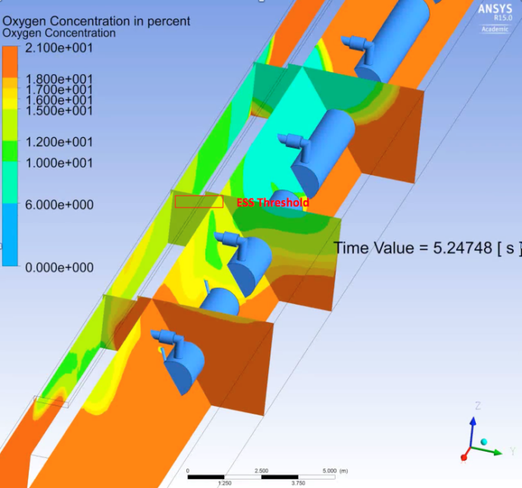
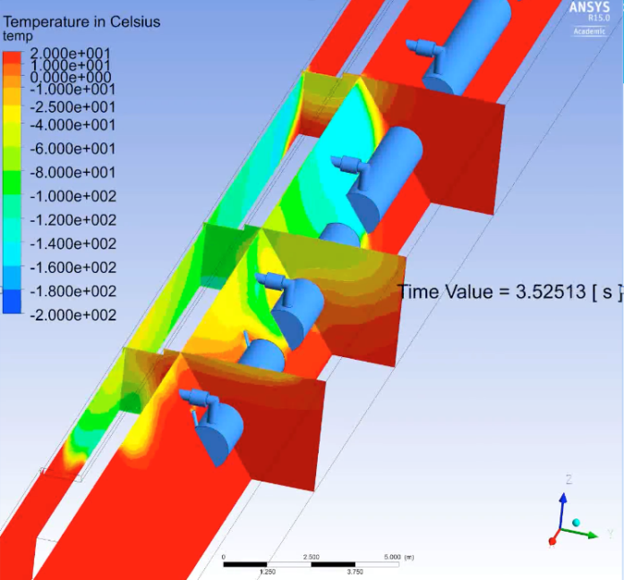
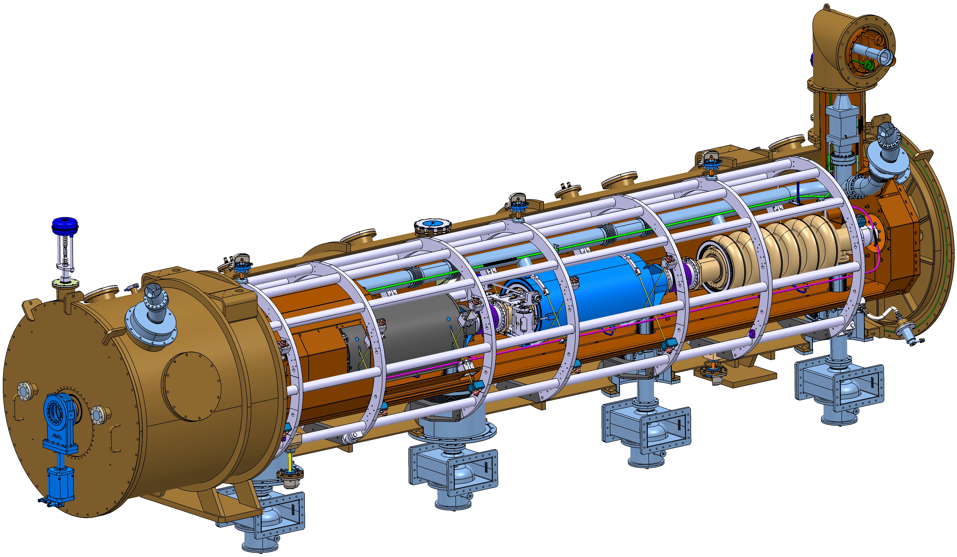
Main motivation
In Q4 2015, the ESS AD Safety Group with the help of the EIS Division investigated possible cold helium propagations in the tunnel for several credible failure scenarios.
Loss of beam vacuum
Lowest attainable O2 concentration = 6%
Lowest attainable temperature = -135°C
A collection header for evacuation of cold helium vapour
may reduce or eliminate Oxygen Deficiency Hazard (ODH) and personnel exposure to cold burns
Source: D.Phan and E.Lundh:ESS ODH concept and on-going safety study
presented during “Cryogenic Safety Workshop at ESS” on 2016.02.10

Slide 3









History
ESS Cryogenic Safety Workshop – Feb. 2016
“Technical solutions to vent the helium coming out from the burst disks of the 2K helium vessel to a safe place should be investigated. Facilities like XFEL, Fermilab and ORNL only vent the vacuum vessel of cryogenic systems in the tunnel.”
ESS Cryomodules Safety Review – June 2016
“Integrating in the tunnel a helium collector in order to discharge helium outside the tunnel is a very interesting solution in order to cope with the risk of ODH and cold burns to personnel in the vicinity of the cryomodules. The committee supports the continuation of this work with high priority, as well as the evaluation of the impact of this system on the cryomodule design and integration aspects in the tunnel. “

Slide 4
Main function and design constraints
Function
The helium collector is designed to be able to collect the helium released by the burst disks of the 2 K helium vessel of the cryomodules and vent it outside of the tunnel in order to prevent exposure of the personnel to helium releases during access to the tunnel (Beam OFF).
Design constraints
The helium collector shall be designed in such a way that the impact on the cryomodules design and operation (both elliptical and spoke) is very limited:
  Maximum allowable pressure of 1.9 bara at the outlet of the cryomodules’ burst disks.
  The helium collector shall “behave” as if there was no collector during operation (Beam ON) to limit back-pressure effects.
  Limit as much as possible the pressure drops in the connection line between the burst disks and the collector.

Slide 5
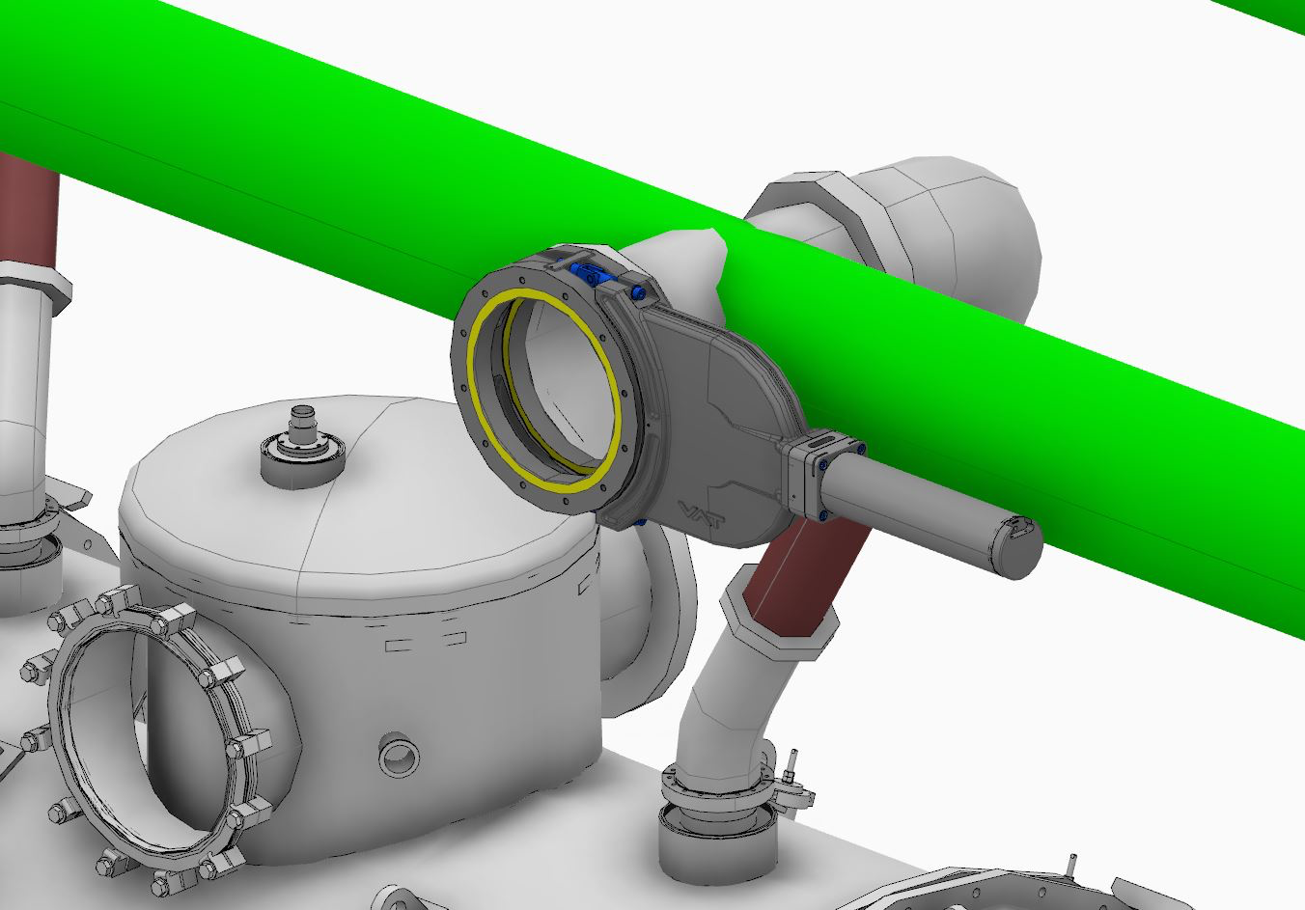
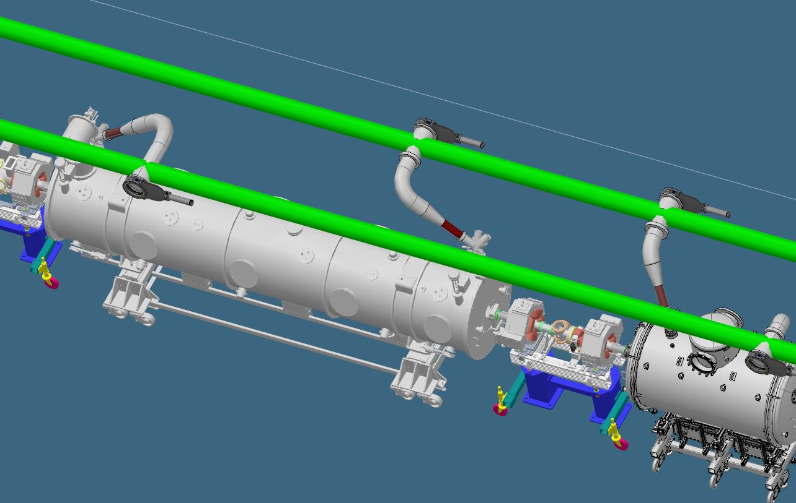
Main function and design constraints
BEAM ON
Access | No personnel allowed in the tunnel
CM gate valves position | Open
Collector gate valves position | Open
Helium collector ”mode” | Inactive
Worst case scenario | Release of helium from 6 elliptical CM* caused by accidental beam loss
This is a very low probable event considering the Machine Protection System (MPS) in place
Acknowledgement: J.Moberg & C-J.Hårdh
*The loss of 6 High-β (or 8 Spoke) was estimated based on an average air propagation speed of 3 m.s⁻¹ in case of an air inleak in the beam vacuum assuming that the gate valves would close in 4 seconds. As a result, air would propagate along the beam pipe (12 m on each direction) and thus affecting a total of 4 High-β (or 6 Spoke). A safety margin of an extra cryomodule on each side has been added to this number.
Source: A.Dalesandro & R.Dhuley, Results from sudden loss of vacuum on scaled superconducting radio frequency cryomodule experiment

Slide 6
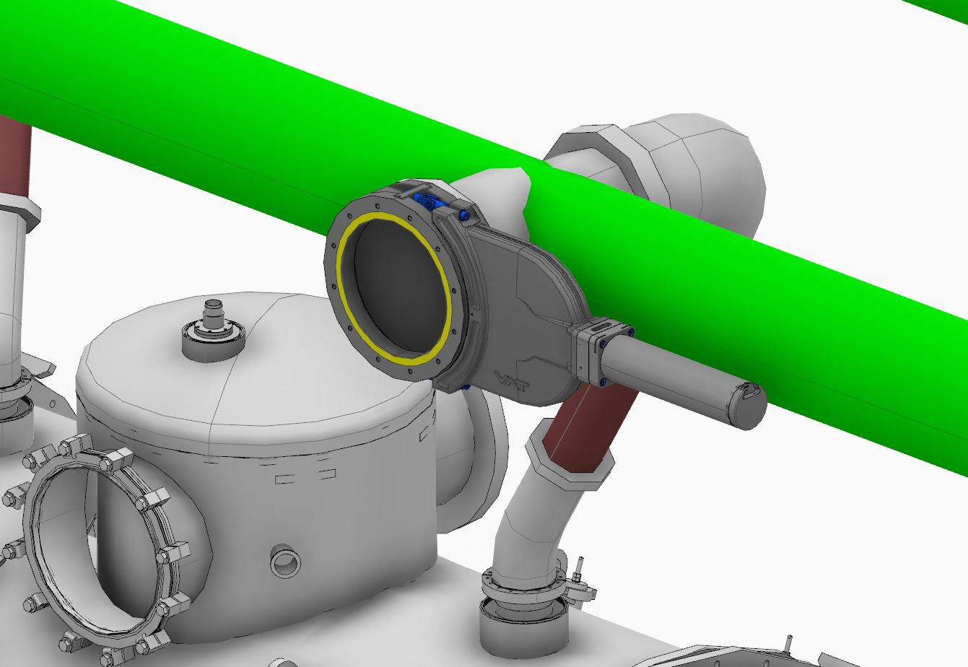
Main function and design constraints
BEAM OFF
Access | Personnel allowed in the tunnel
CM gate valves position | Closed
Collector gate valves position | Closed
Helium collector ”mode” | Active
Worst case scenario | Release of helium from 1 CM*
Acknowledgement: J.Moberg & C-J.Hårdh
*This assumption was made based on the fact that the gate valves of the cryomodules are closed, thus preventing the helium release from several cryomodules at the same time

Slide 7
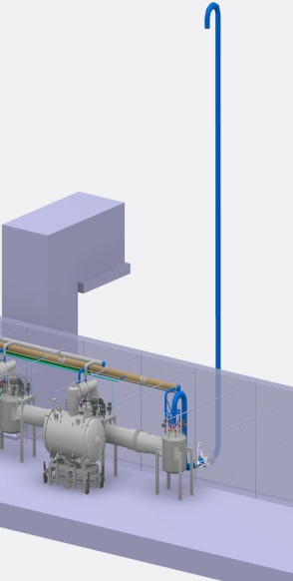
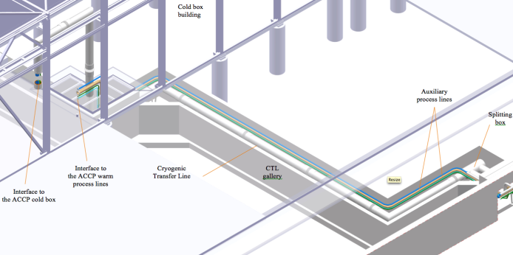
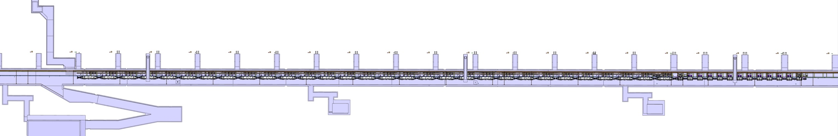
Routing of the collector
Cold box room
vent line
CDS vent line
L = 12 m, DN400
CTL gallery
L = 55 m
Total length of the collector < 400 m
Elliptical and Spoke Linac tunnel
310 m
Acknowledgement: J.Fydrych

Slide 8
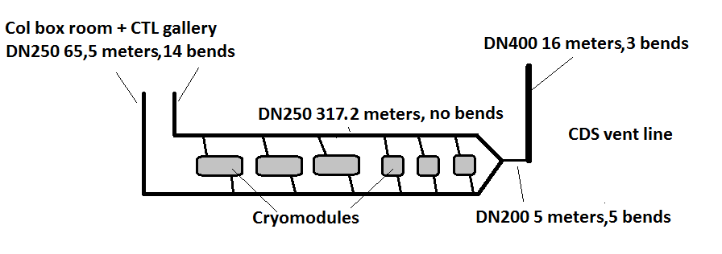
Collector concept – double pipes
Main motivations:
Reduce back-pressure effects from one release point to adjacent burst disks
Cope with the mechanical integration constraints of the accelerator tunnel
Acknowledgement: J.Moberg

Slide 9
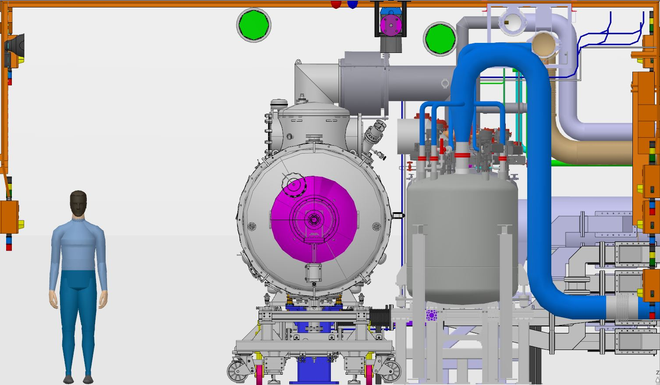
Cross-section of the accelerator tunnel
Acknowledgement: J.Moberg & C-J.Hårdh

Slide 10
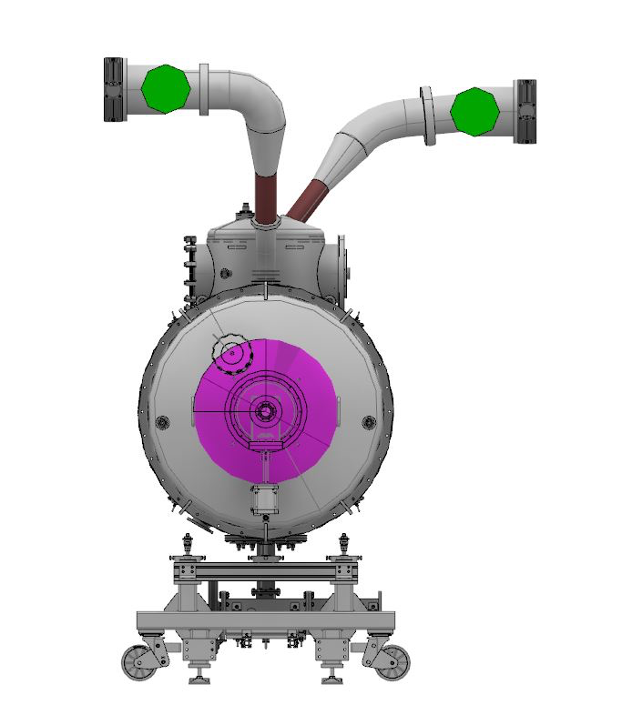
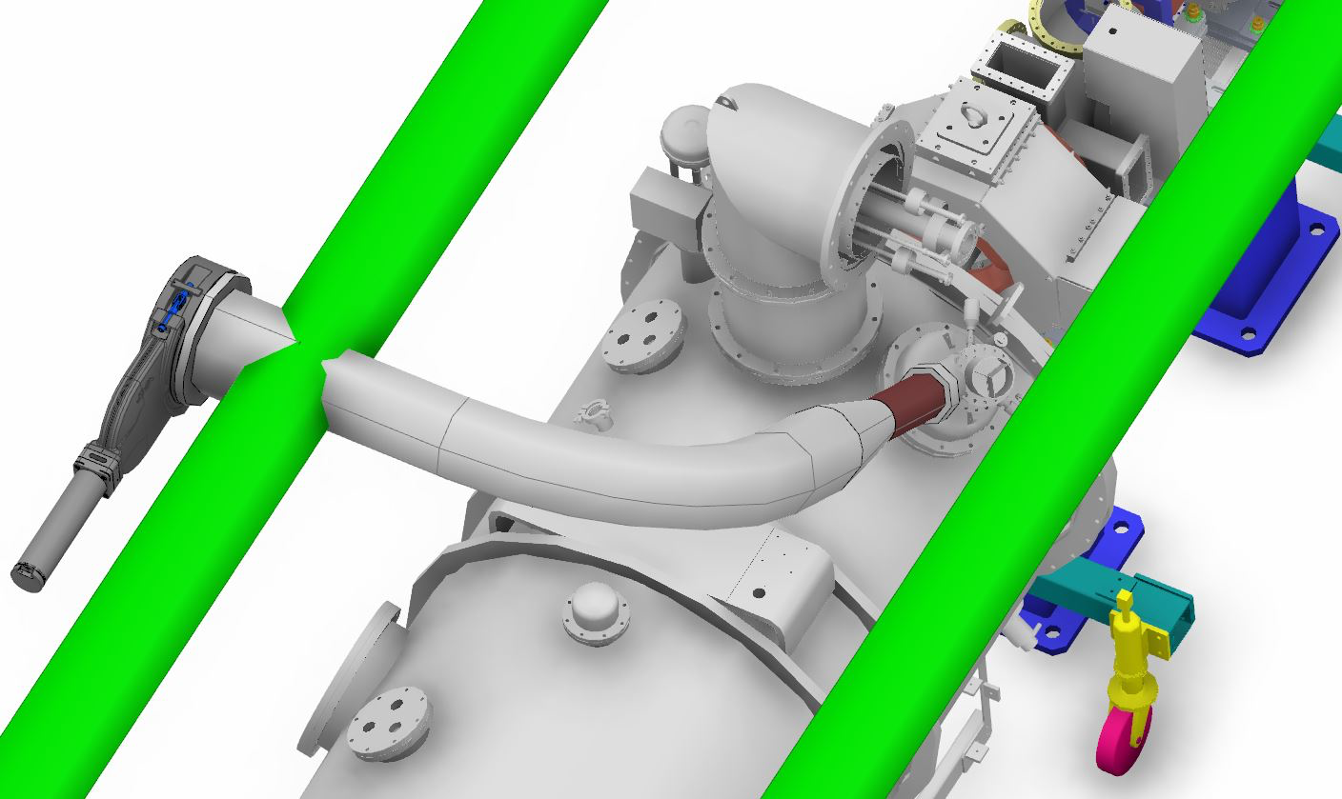
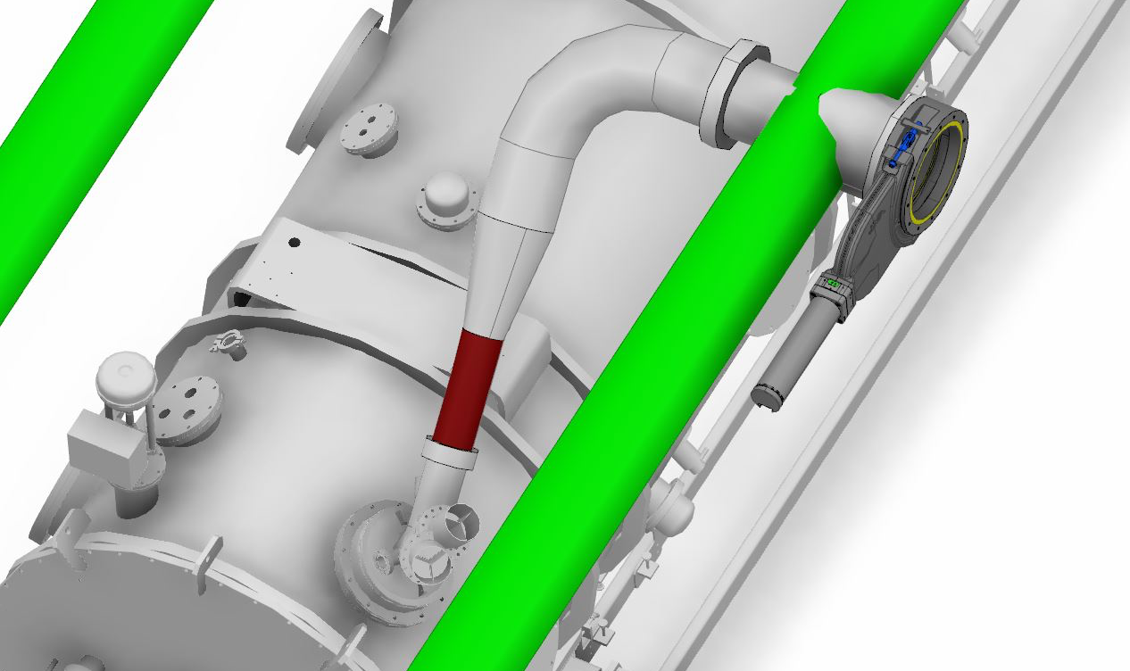
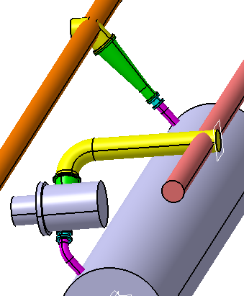
Collector concept – connection lines
Spoke cryomodule
Elliptical cryomodules
Design proposal for the Elliptical CM submitted by G.Olivier (IPNO) on March 30th to be evaluated by ESS in the coming days
Acknowledgement: J.Moberg

Slide 11
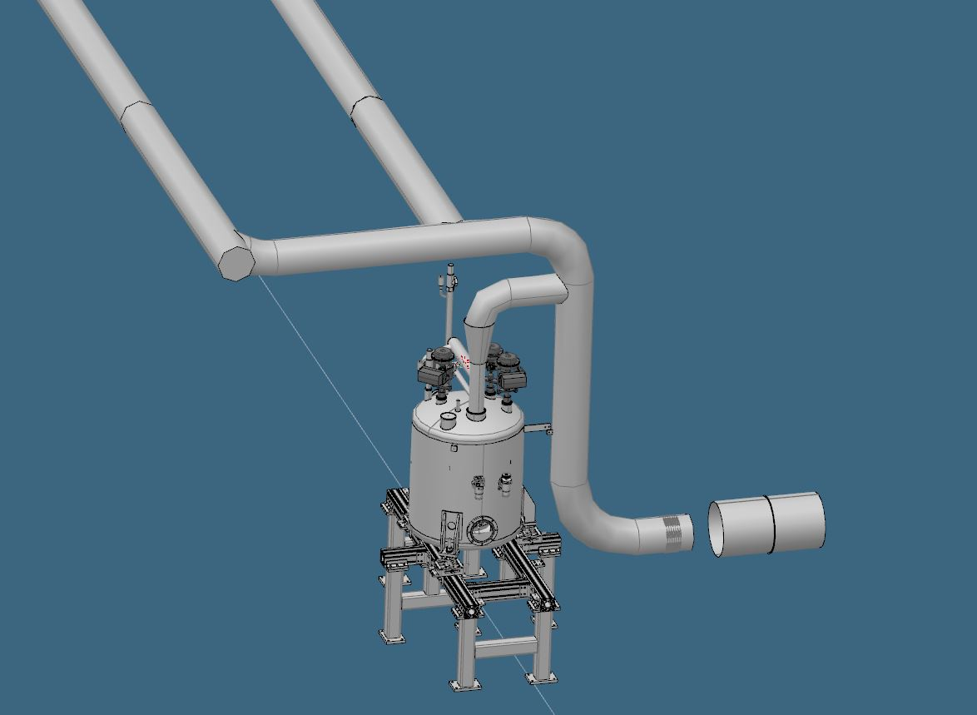
Collector concept – connection to the CDS vent line
Collectors DN250
DN250
Re-routing
(DN200)
Acknowledgement: J.Moberg

Slide 12
Pressure calculations
Assumptions
Type of helium collector: two-pipes type —> one pipe connected to every 2nd burst disk
Diameter of the helium collector: 2 x DN 250
Type of cryomodules: Elliptical
Distance considered between two burst disks of the Elliptical section: 8.4 m
Temperature at the outlet of the burst disk: 5.06 K (corresponding to the saturation pressure of the fluid)
Mass flow rate of one Elliptical cryomodule: 7.2 kg/s per burst disk
Duration of the release: 1.9 seconds
Maximum allowable pressure in the collector: 1.9 bar(a)
Acknowledgement: J.Moberg

Slide 13
Pressure at the discharging burst disk*
*Calculations were made assuming a 2m long DN150 straight pipe between the helium collector and the burst disks of the cryomodules
Acknowledgement: J.Moberg

Slide 14
Pressure within the helium collector
Entry point to the helium collector
Acknowledgement: J.Moberg

Slide 15
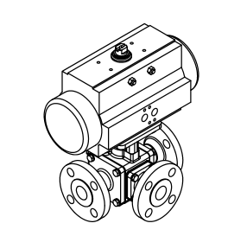
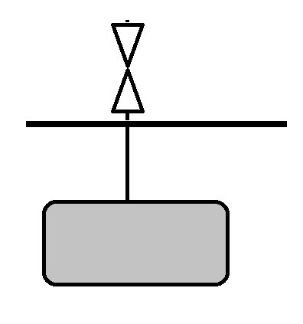
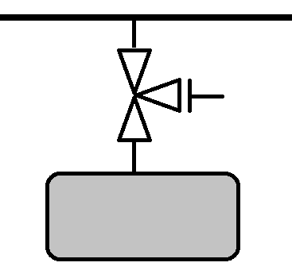
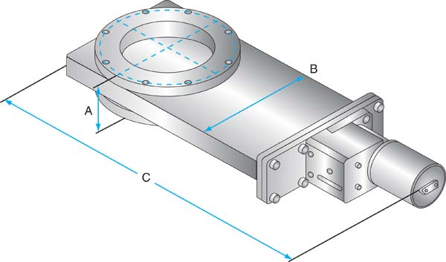
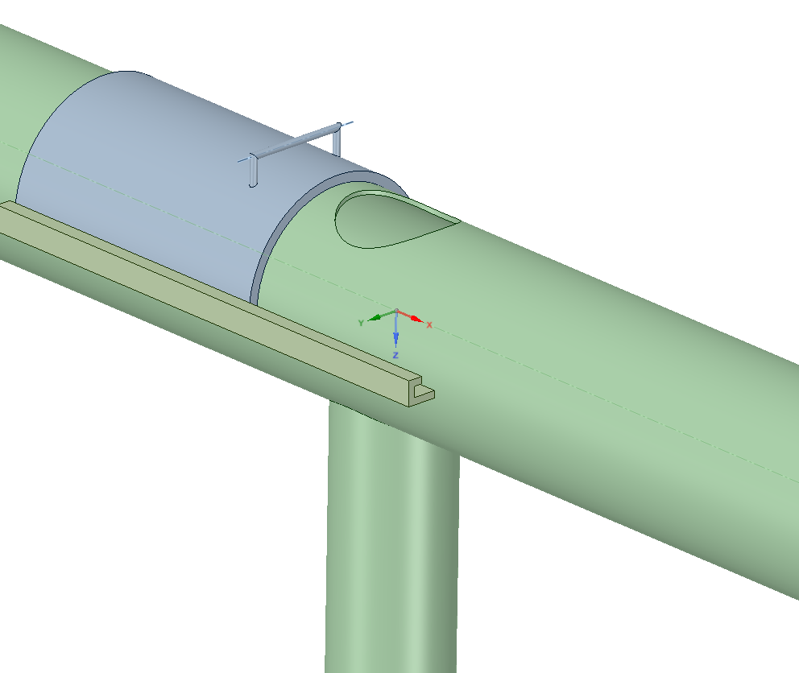
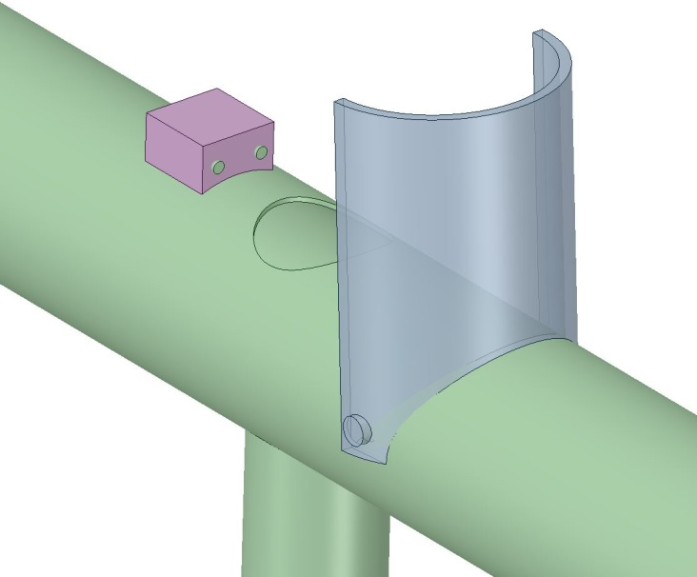
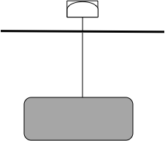
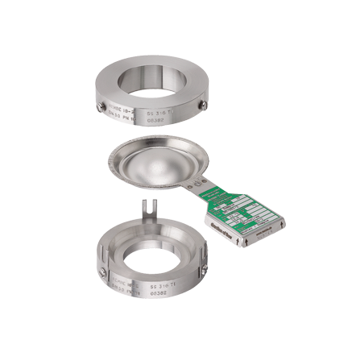
Collector openings– Engineering solutions
5 different options investigated but only 2 were retained
Option n°1: 3-way T port valve
Option n°2: Gate valve
Option n°3: Slider valve
Option n°4: Flap valve
Option n°5: Burst disk
Acknowledgement: J.Moberg

Slide 16
Collector openings – Gate valves
Acknowledgement: J.Fydrych
Component | Unit price | Quantity | Total price
Vacuum valves (DN250) | 4100 EUR | 90 pcs | 369,000.- EUR
Valve Controls | 400 EUR | 90 pcs | 36,000.- EUR
DN250 pipe | 80 EUR | 800 m | 64,000.- EUR
Supports | 300 EUR | 200 pcs | 60,000.- EUR
Hoses DN100 | 300 EUR | 86 pcs | 26,800.- EUR
Bellows DN250 | 600 EUR | 50 pcs | 30,000.- EUR
Installation | 200 EUR | 800 m | 160,000.- EUR
 |  |  | 744,800.- EUR
+
-
Remotely controlled
Off-the-shelf product
Efficient perforation of the collector during operation (Beam ON)
Poor accessibility of the gate valves
Cost
Complex maintainability (90 valves + 180 switches)
Failure probability?*
*DN250 vacuum gate valves are designed for 5000 cycles

Slide 17

Collector openings – Burst disks
Yield strength of Niobium
versus temperature
Max pressure in the CM
versus helium mas flow rate
6 CMs
YS_{Nb@70K}
5 CMs
4 CMs
Proposed set pressure for the collector burst disks
3 CMs
2 CMs
1 CM
Estimated temperature of the cavity wall during an accident: 70 K
YS_{Nb@300K} = 80 MPa
YS_{Nb@70K} = 580 MPa ( 7.2 times higher)
Assumption: Stress proportional to pressure load
PS = 1.04 barg
P_{max} = 7.5 barg
The constraint of the maximum allowable pressure limit from the PED is not considered in the results presented in this slide
Acknowledgement: J.Fydrych

Slide 18
Collector openings – Burst disks
Acknowledgement: J.Fydrych
Component | Unit price | Quantity | Total price
Rupture disks (DN150) | 700 EUR | 86 pcs | 60,200.- EUR
RD holders | 1000 EUR | 86 pcs | 86,000.- EUR
DN250 pipe | 80 EUR | 800 m | 64,000.- EUR
Supports | 300 EUR | 200 pcs | 60,000.- EUR
Hoses DN100 | 300 EUR | 86 pcs | 25,800.- EUR
Bellows DN250 | 600 EUR | 60 pcs | 36,000.- EUR
Installation | 150 EUR | 800 m | 160,000.- EUR
 |  |  | 492,000.- EUR
+
-
No (or very limited) maintenance
Passive device (no controls to manage)
Cost efficient
Potential impact on the compliance with the applicable PED (maximum allowable pressure)
Burst disks (cryomodule side) that can withstand high pressure available on the market?
Potential impact on the design of the cryomodules (i.e. burst disks and diphasic line)?

Slide 19
Helium collector – Time schedule
Acknowledgement: J.Fydrych
Collector – spoke section
Collector – Elliptical section
Collector – Elliptical section

Slide 20
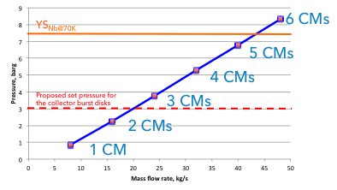
Next steps
ESS to evaluate the design proposal for the Elliptical CM submitted by G.Olivier (IPNO) on March 30th.
ESS to perform new pressure drop calculations in the connection line between the cryomodules’ burst disks and the helium collector.
IPNO to investigate if burst disks designed to withstand a maximum pressure of 4 bara downstream are available on the market as well as the cost impact. Also, the potential impact on the cryomodules design shall be assessed
ESS to make make a final decision regarding the engineering solution for the perforation of the helium collector in the coming weeks.

Slide 21
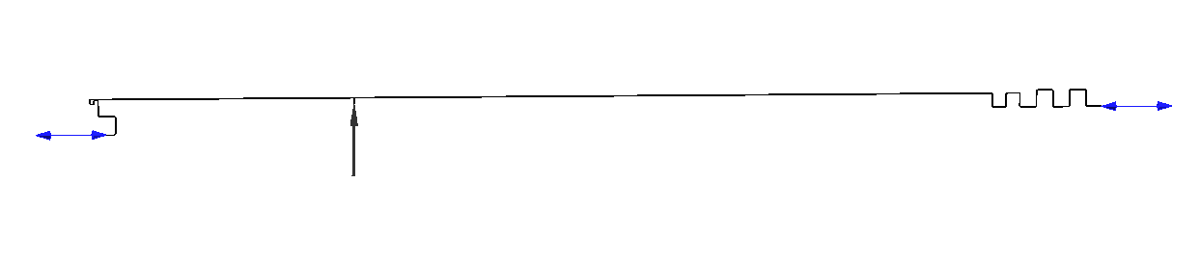
Simplified Geometry

Slide 22
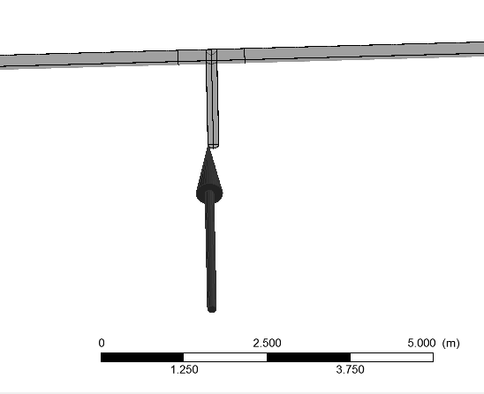
Boundary conditions, Elliptical cryomodule
Inlet
3.6 kg/s
5.06 K

Slide 23
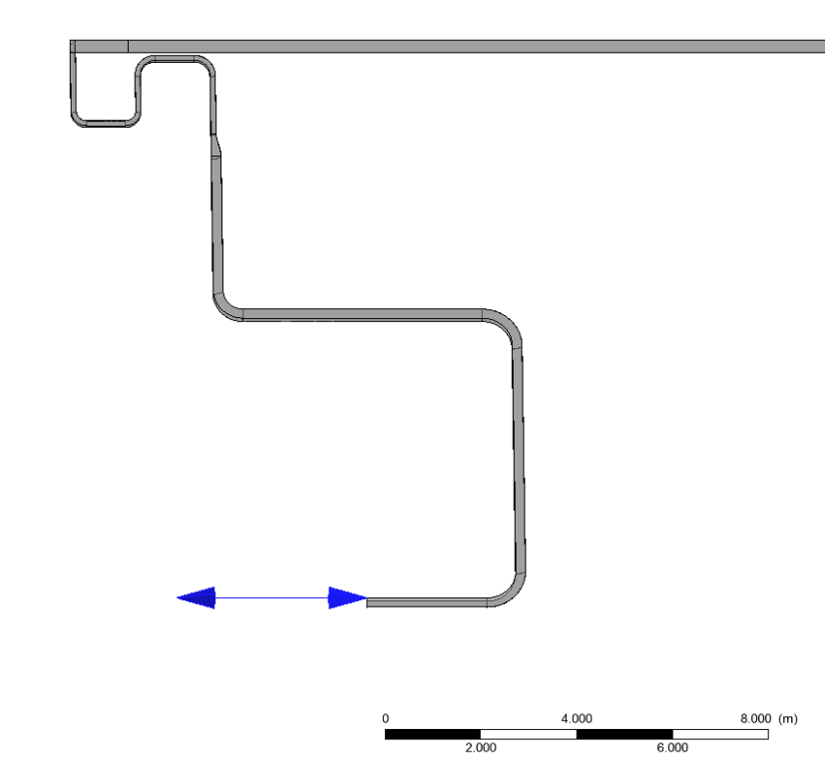
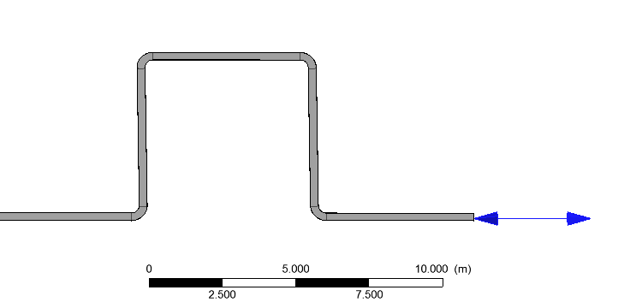
Boundary conditions, Elliptical cryomodule
Outlets
1 atm
30°C
1 atm
30°C

Slide 24
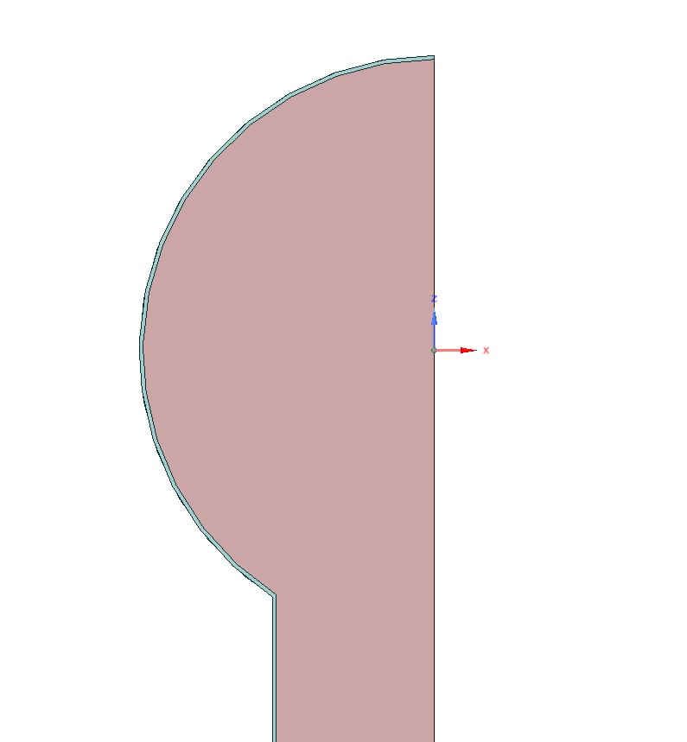
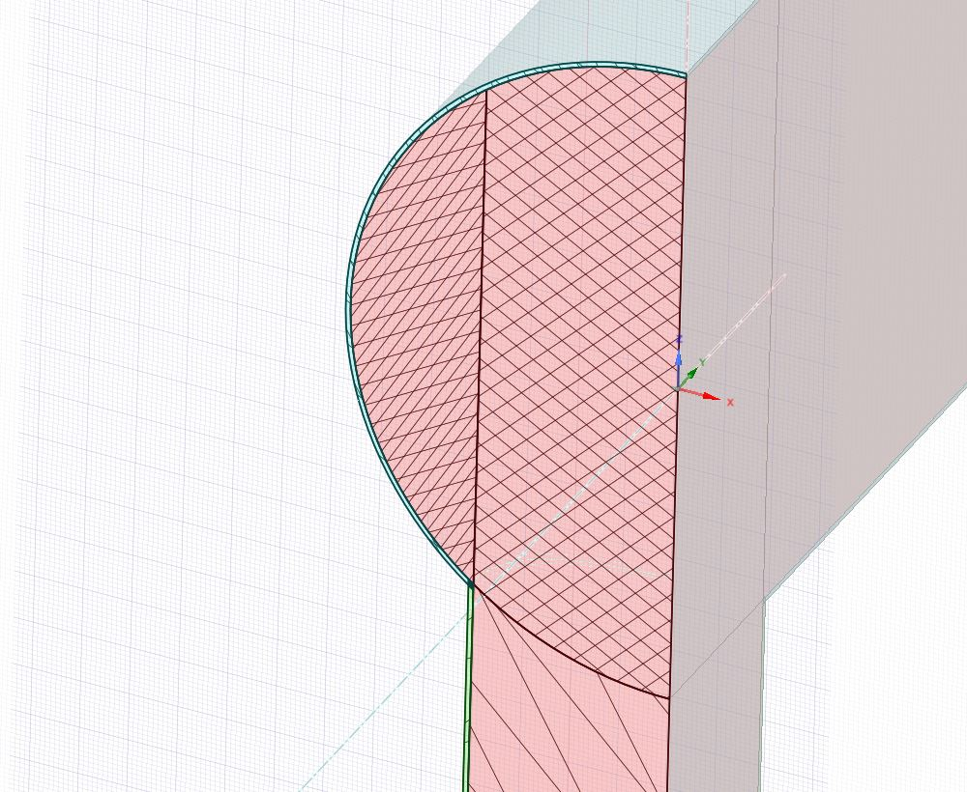
Tunnel-Pipe-Helium boundary
30°C
30°C

