Slide 1
Critical design review #1 for medium beta cavity cryomodules
3-4 APRIL 2017
-
Cryomodule overview, organization and development plan
-
Franck Peauger

Slide 2
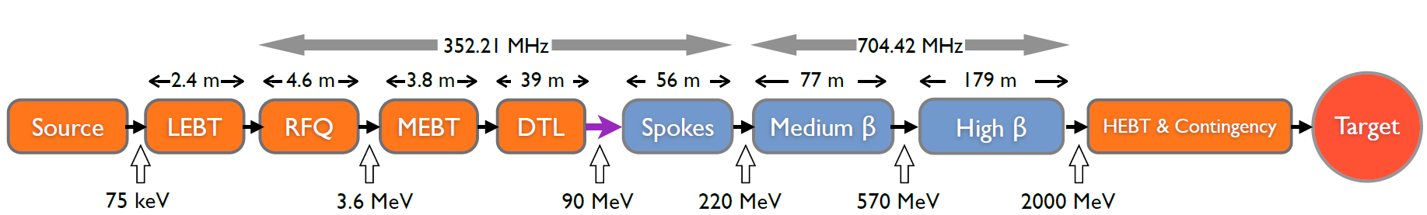
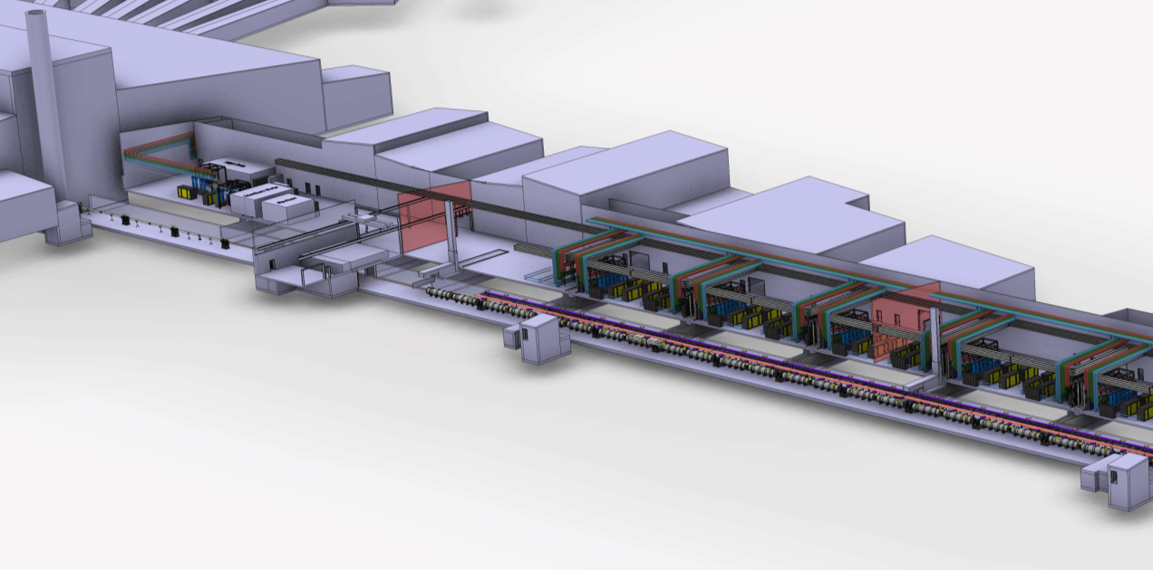


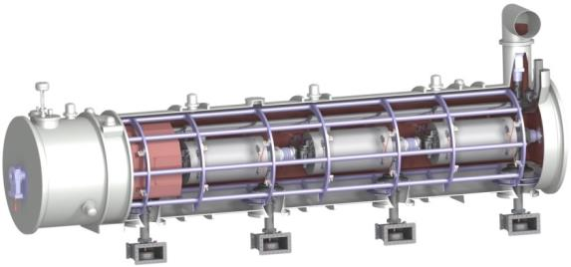
Medium beta cryomodules in ESS linac
 | MEDIUM-β | HIGH-β
β | 0.67 | 0.86
# CM | 9 | 21
Cav. /CM | 4 | 4
# Cav. | 36 | 84
CM L [m] | 6.584 | 6.584
Sector L [m] | 77 | 179
Medium-β and high-β elliptical cavity cryomodules
Proton Beam

Slide 3
CEA – ESS Agreements for the Elliptical Cryomodules
Fr-Sw Agreement:
  Cooperation Agreement in the field of Neutron Accelerator Science to the ESS Design Phase, Amendment #2, 18 December 2013
    Medium-Beta Elliptical Cavity Cryomodule Technology Demonstrator (M-ECCTD)
Schedules of the In Kind Contribution Agreement
  AIK#1.1: Technical Management Scope of Work to the In-Kind Contribution Agreement signed between ESS-ERIC and CEA
  AIK#5.1 High-Beta Elliptical Cavity Cryomodule Technology Demonstrator (H-ECCTD)
  AIK#5.2 Elliptical Medium and High Beta Cryomodule Component Supply
  AIK#5.3 Elliptical Cryomodules Engineering, Assembly and Test and Technical Assistance in Cavity Design, Manufacturing and Tests
  AIK#5.5 Elliptical Cryomodules Installation and Commissioning

Slide 4



Scope of the medium beta cryomodules activities
CEA is charge of all the prototyping activities and series production of the 9 medium beta cryomodules except:
  The design and prototyping of the cryostat (IPN Orsay)
  the production of the series medium beta cavities (INFN/LASA)
  The RF power acceptance tests of the cryomodules at ESS in Lund
The INFN/LASA proposed a new medium beta cavity design slightly different from the one developed in the prototyping phase by CEA
Activities done in two steps:
  Development of a cryomodule demonstrator M-ECCTD
  Delivery of the nine series medium beta cryomodules
 | M-ECCTD | M-SERIE
β | 0.67 | 0.67
# CM | 1 | 9
Cav. /CM | 4 | 4
# Cav. | 3 + 1 LASA + 3 spares | 36

Slide 5
Detailed scope
For the prototype phase M-ECCTD :
  design and procurement of the cavities, couplers, tuners, magnetic shieldings (CEA)
  Design and procurement of the vacuum vessel, spaceframe, thermal shielding, cryogenic circuits (IPNO)
  Preparation and tests of the cavities and couplers (CEA)
  design and fabrication of the cryomodule assembly toolings (CEA)
  Development of the high power test stations (for couplers and cryomodules) (CEA)
  assembly and high power RF tests of the cryomodule (CEA)
For the series phase:
  CEA is responsible for:
    the procurement of the cryomodule components (except cavities)
    the clean room preparation and RF conditioning of the power couplers
    the assembly of the nine cryomodules
    the high power RF tests of the three first cryomodules at CEA
    The prepare the cryomodule for shipment to Lund
  INFN is responsible for the procurement, preparation and tests of the cavities
  IPNO is responsible for the update of the cryostat components design and drawings

Slide 6
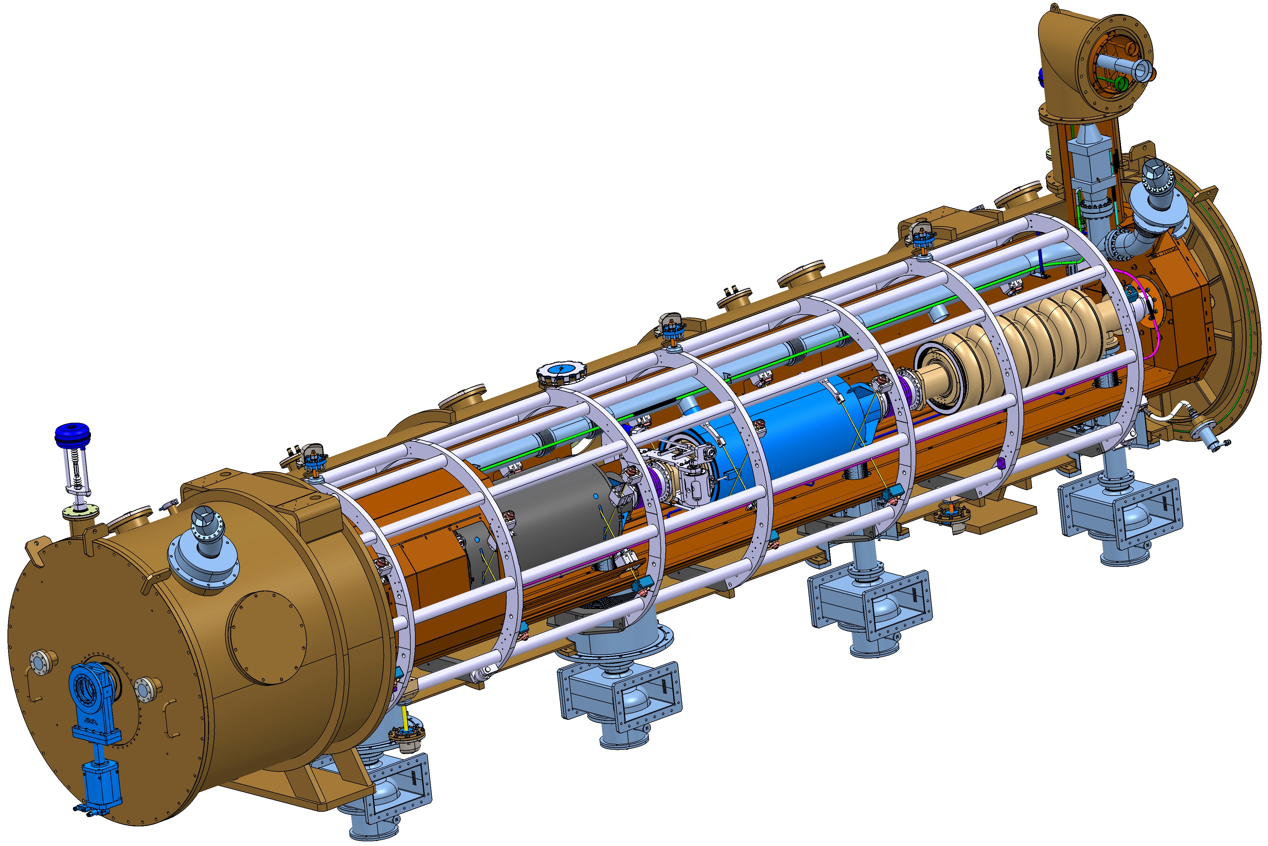
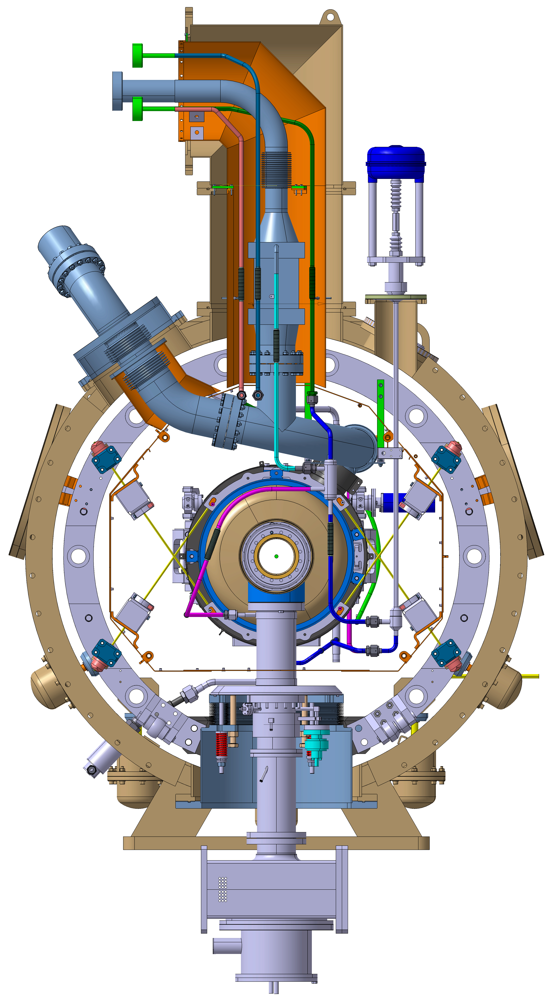
ESS MB Cryomodule 3D view and cross section
6.6 m long

Slide 7
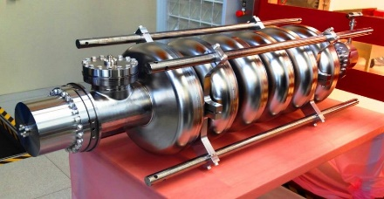
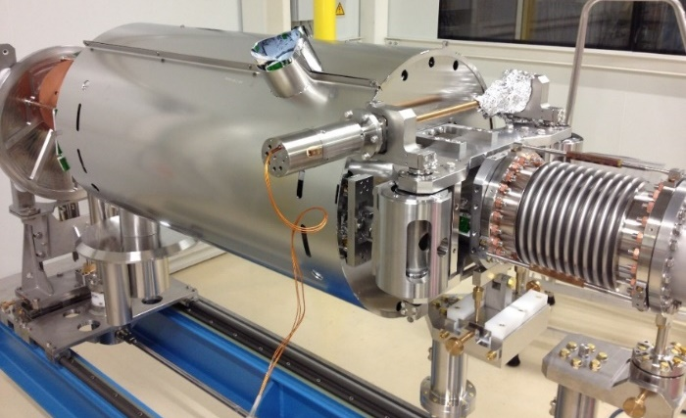
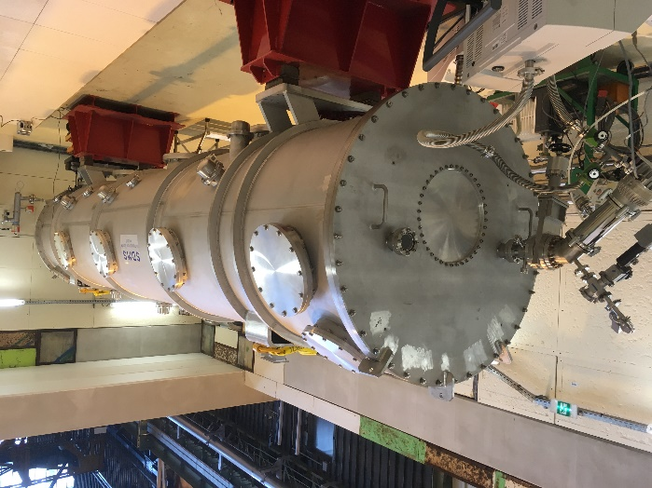
Medium beta cryomodule Main specifications
Four superconducting cavities in pure bulk niobium (RRR>250)
  Frequency: 704.42 MHz
  6 cells at β=0.67
  Beam pulse: 2.86 ms at 14 Hz
  No HOM couplers (decided at the PDR)
Accelerating gradient
  E_{acc} max = 16.7 MV/m, Q₀ > 5.10⁹
  Power coupler: 1.1 MW max
  External coupling: Q_{ext} = 7.5.10⁵
Slow tuning system: ± 300 kHz
Fast tuning system (LFD) : 1+1 piezo
Cavity cooling: LHe at 2 K
Coupler cooling: SHe at 4.5 K, 3 bars
Thermal shielding cooling: LHe 50 K
Overall length: 6584 mm from flange to flange
Thermal losses (for MB):
  Static losses at 50 K: 46.2 W
  Static losses at 2 K: 13.2 W
  Dynamic losses at 2 K: 23.2 W
Pressure vessel: good engineering practice (article 4.3 of PED)

Slide 8
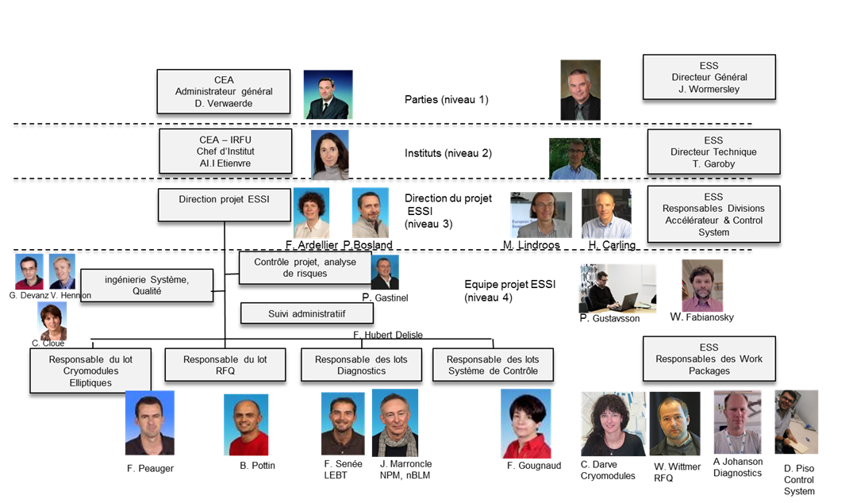
Organisation chart
(ESSI project level)

Slide 9



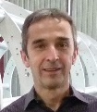
















Organisation chart (CRYOMODULE LEVEL)
Functions
Products
G. Devanz
+ CEA/DRF purchase department (« Service Commercial »)
+ CEA/DRF/IRFU/SACM Infrastructures and Safety managers

Slide 10




Project organisation and collaborationS
ESS Medium beta cryomodule activity
ESS
CEA
IPNO
STFC
INFN
Contractual links
“short links” for technical exchanges
(with ESS and CEA always in copy)
“Observers”

Slide 11
Product Breakdown Structure (PBS)
CRYOMODULES
Cavités
Coupleurs
Cryostat équipé
Outillage
Infrastructures et zones de test
x.1.
Nobium
x.2.
Coupleurs M-beta
x.3.
Train de cavités (SB)
x.3.1.
x.4.
x.5.
x.1.1.
x.2.1.
Outillage cavités
x.4.1.
Cavité M-beta
Coupleurs H-beta
Soufflets inter-cavité M-beta
x.1.2.
x.2.2.
Soufflets inter-cavité H-beta
Outillage assemblage coupleurs
x.4.2.
Cavité H-beta
x.1.3.
Doorknob
x.2.3.
Ex. niv. 3
Transitions M-beta
Transitions H-beta
Outillage conditionnement coupleurs
x.4.3.
RF pick up
Vannes vide
x.1.4.
Instrumentation coupleurs
Outillage assemblage coupleur/cavité
x.4.4.
Train de cavités (hors SB)
x.3.2.
SAF
Outillage assemblage cryomodule
x.4.5.
Blindage M-beta
Ex. niv. 3
Blindage H-beta
Instrumentation cavités
1. M-ECCTD
2. H-ECCTD
3. MBL
4. HBL
x.3.3.
x
Circuits cryogéniques
Écran thermique
x.3.4.
Structure spaceframe – Ensemble
x.3.5.
  6 levels in total
Enceinte à vide – Ensemble
x.3.6.
Deliverables to ESS
Instrumentation externe
x.3.7.

Slide 12
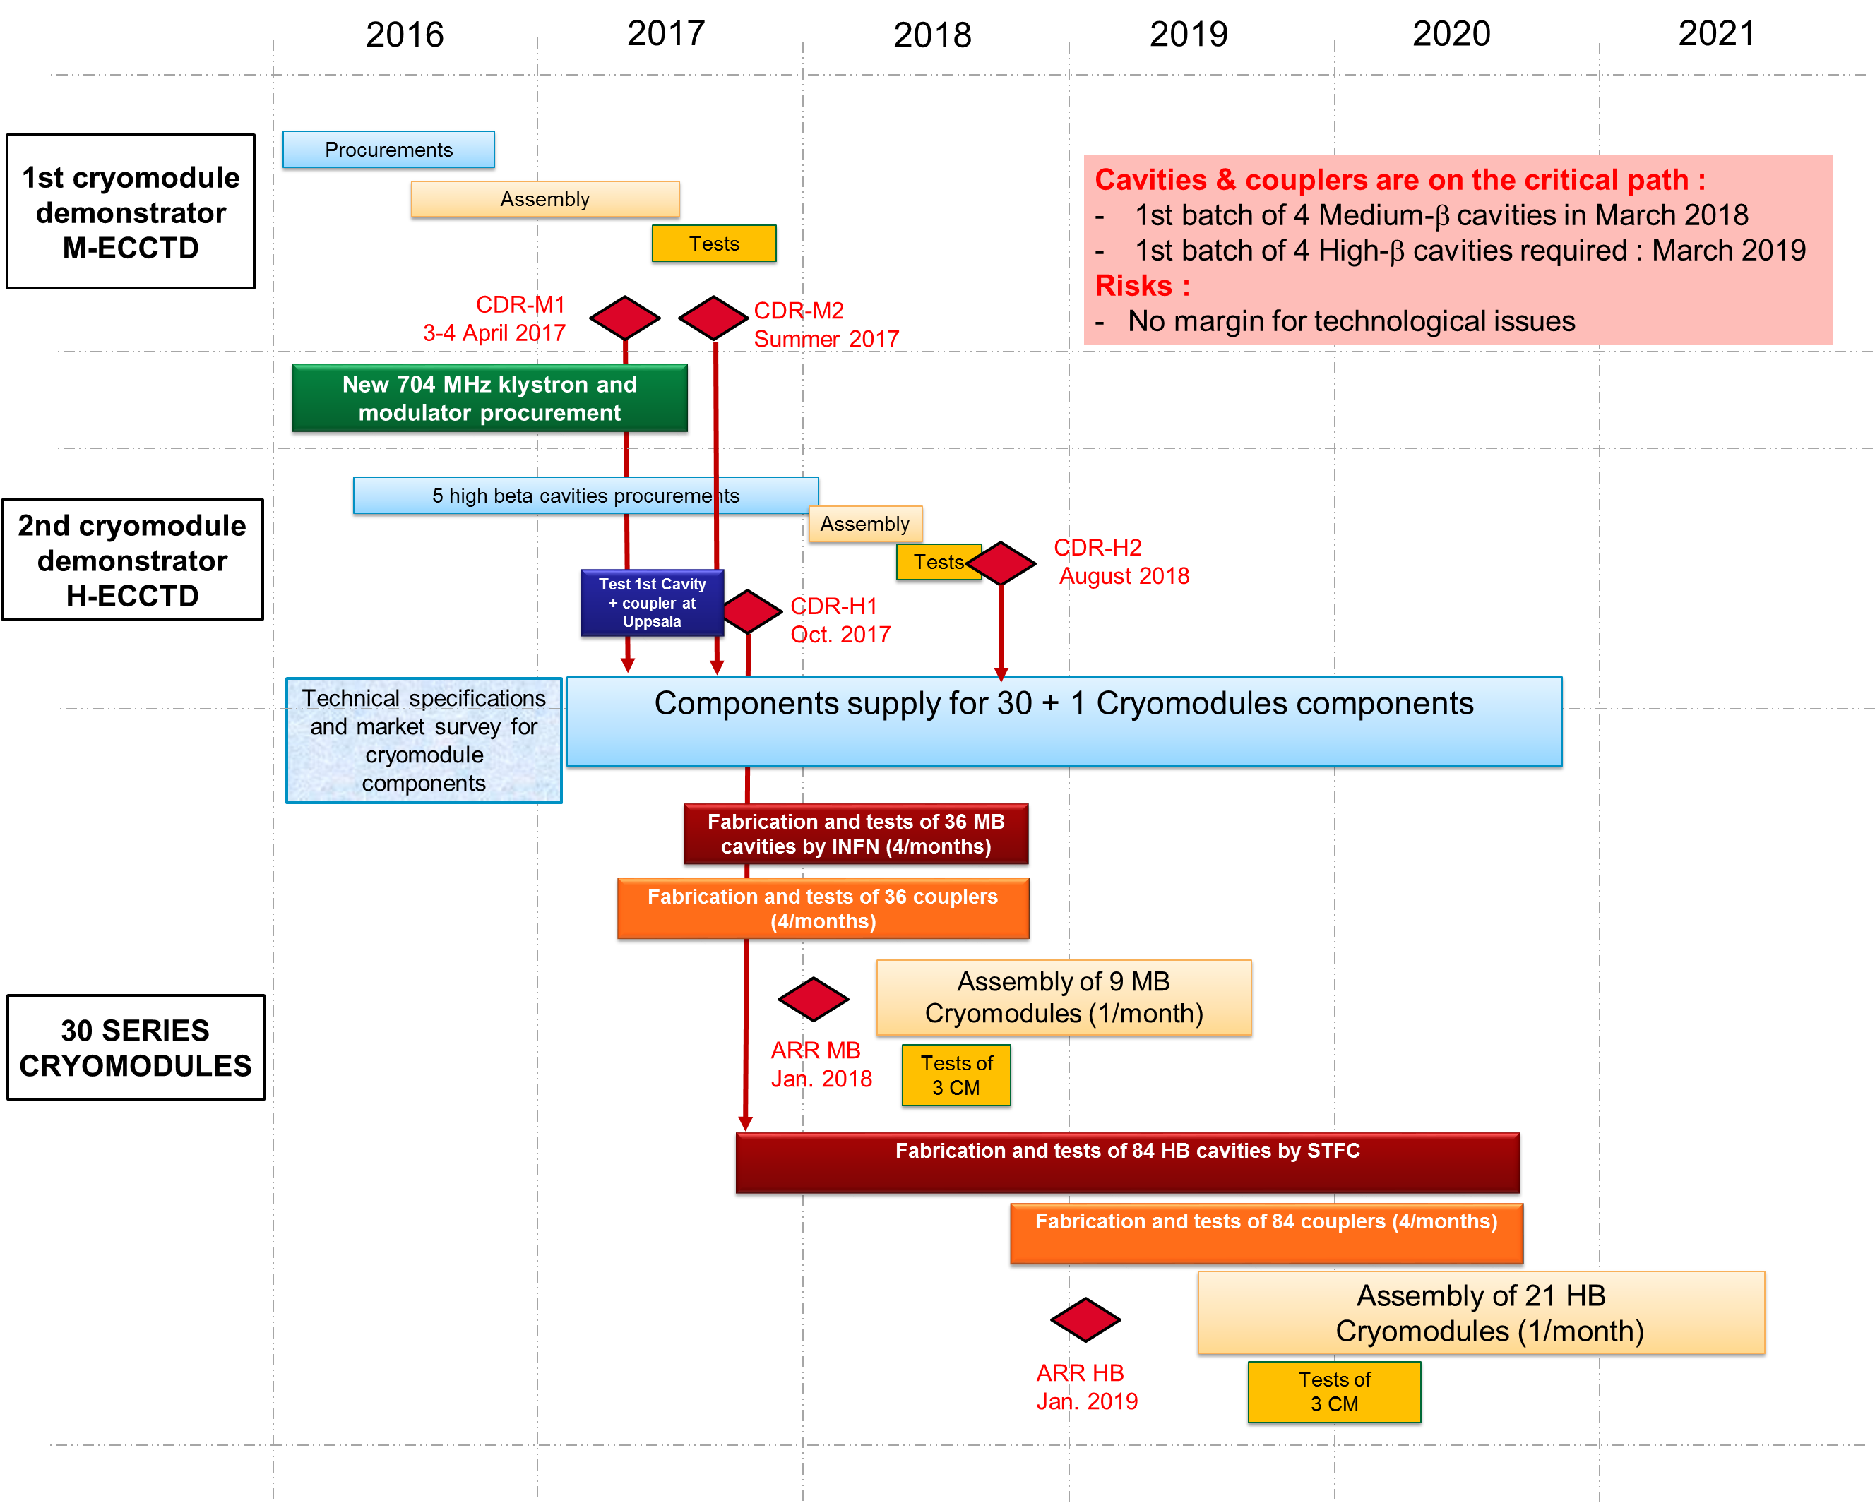
Overall ESS cryomodule Development plan

Slide 13

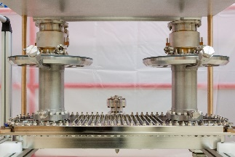
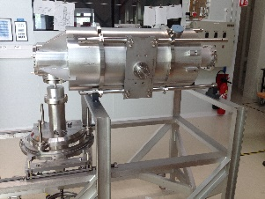
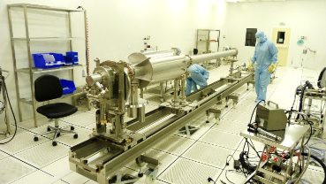
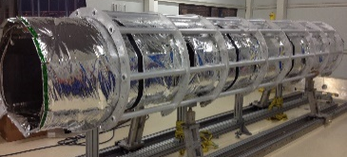
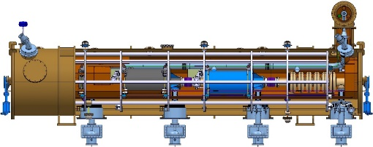
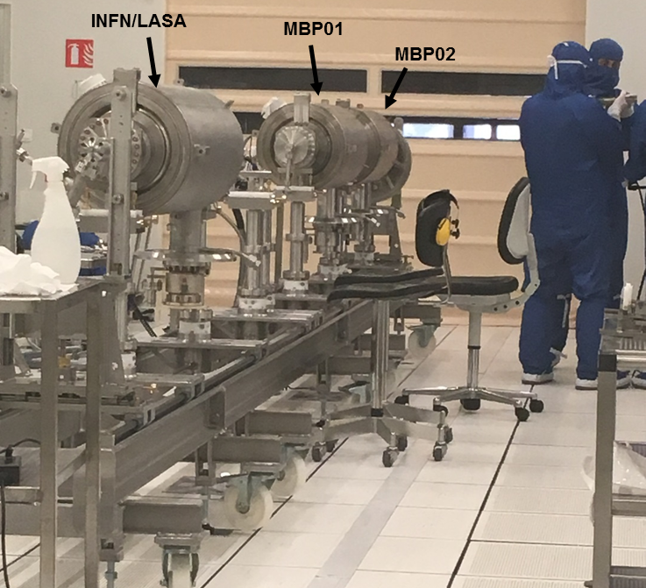
Medium beta cryomodules Development plan and reviews
Fabrication, surface preparation and test of medium beta cavities
Fabrication and test of power couplers
Development and fabrication of assembly toolings
Assembly of a cryomodule mock-up
Procurement of cryostat components
Final assembly and high power test of the M-ECCTD
Cavity performances in a cryomodule configuration
Validation of the cryogenic circuits operation
Clean room assembly of the M-ECCTD cavity string
CDR-M1
03&04/04/2017
CDR-M2
Jan 2018
Assembly Readiness review
First 4 MB cavities arrives 2 months later
→ March 2018 (from LASA)
Summer 2017
ARR
Acceptance for shipment to Lund
Procurement of the series cryomodule components
Oct. 2018
Jan 2019
Apr. 2019
End March 2018
Mars 2019
SAR1
SAR1
SAR1
System Acceptance Review for Medium-beta pre-series components
SAR
System Acceptance Review for Medium-beta series components
CM1,2,3
SAR
CM4,5,6
CM7,8,9
Acceptance after RF test at Lund
Dec 2018
March 2019
July 2019
SAR2
SAR2
SAR2
CM1,2,3
CM4,5,6
CM7,8,9

Slide 14
Key points
Cryomodule components procurement:
  Divided in several procurement contracts adapted to the skills of the companies
Cryomodule assembly :
  Assembly rate of one cryomodule per month
  Will be performed in the former “XFEL Village” which becomes officially now the “ESS Village”
    Fully dedicated to the ESS cryomodule (no interference with other projects at Irfu)
  Will be done by an industrial partner on CEA Saclay site, under the supervision of CEA team
    Include clean room cavity string assembly, rool –out activities, alignment and cryostating (XFEL like)
    Include also power coupler clean room preparation (same clean room) (new!)
Cryomodule tests at CEA:
  Will be done on the three first series MB cryomodules only
  These tests are mandatory to have a fast feedback on the quality of the cryomodule assembly

Slide 15
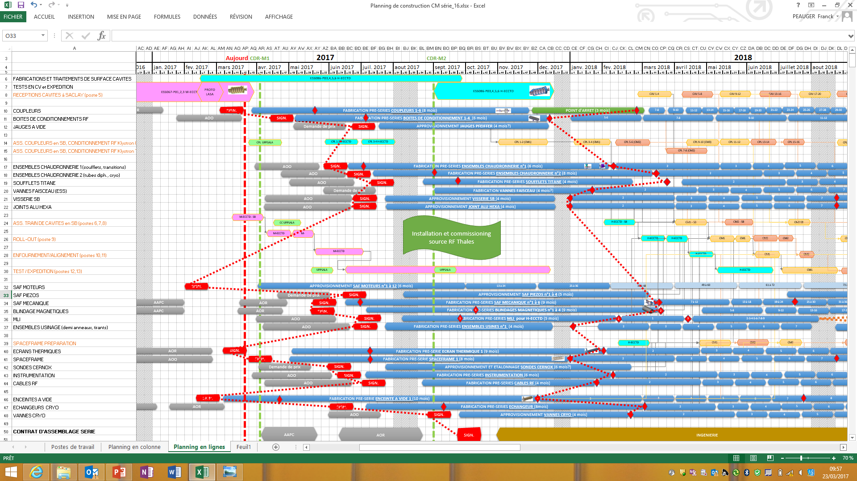
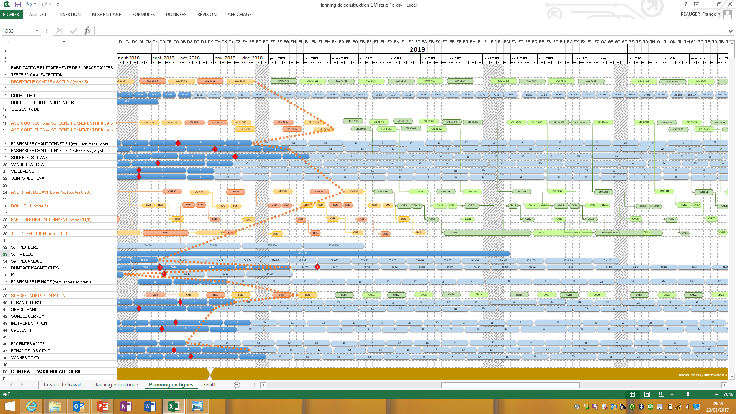
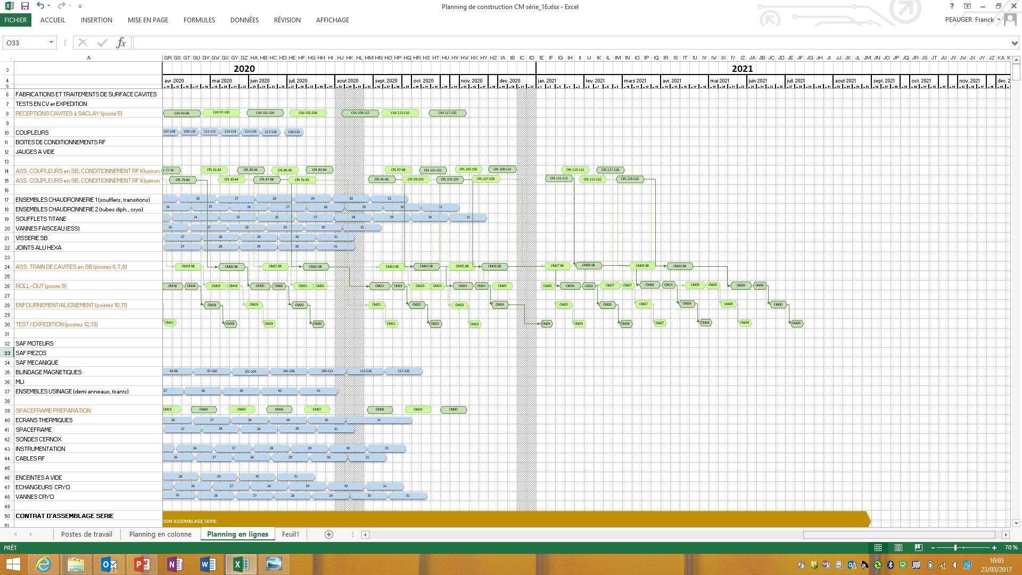
PROCUREMENT and ASSEMBLY ROADMAP
CDR-M1 = TODAY
CDR-M2
HOLD POINTS n°2 AFTER PRE-SERIES PROCUREMENT
2017
2018
2019
2020
2021
CAVITIES
COUPLERS
KLYSTRON #1
KLYSTRON #2
RF conditionning of the last couplers pair = CRITICAL PATH
- CDR-M1 will give the authorization to award the main cryomodule components procurement contracts
- CDR-M2 will be mandatory to release the hold point n°2 after the pre-series fabrication and start the series components fabrication
INTERCAVITY BELLOWS, CRYOGENIC LINES
CLEAN ROOM
ROLL-OUT
Start of the clean room assembly of the last MB CM
CRYOSTATING
TESTS/SHIP.
M-ECCTD RF TESTS
TUNERS, MAGNETIC SHIELDS, MLI
LAST MEDIUM BETA CRYOMDULE CM#9
SPACEF. PREP.
THERMAL SHIELD, SPACEFRAME, INSTRUM.
VAC. VESSEL, EXCHANGER, VALVE
ASSEMBLY INGENIERIE
PRODUCTION ASSEMBLY
CALL FOR TENDER
CONTRACT AWARDED

Slide 16
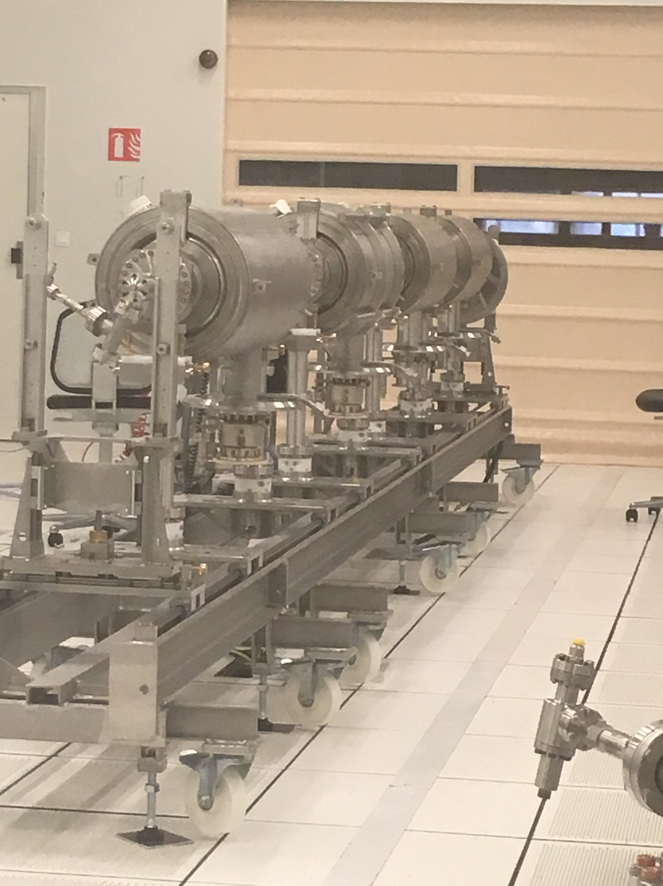
Conclusion
Cryomodule scope and development plan well defined
Organization in place and structured within the ESSI project and within an international collaboration
Procurement process anticipated and fully optimized to limit technical risks and to “fine-tune” the cryomodule delivery schedule

Slide 17
Thank you
Commissariat à l’énergie atomique et aux énergies alternatives
Centre de Saclay | 91191 Gif-sur-Yvette Cedex
T. +33 (0)1 69 08 76 11 | F. +33 (0)1 69 08 30 24
Etablissement public à caractère industriel et commercial | RCS Paris B 775 685 019

Slide 18
Organisation: meetings
Internal CEA meetings
Organized by ESS
ESSI Project meeting
  with all the workpackage + CEA purchase department
  Every month (Thursday morning)
ESS cryomodules meeting:
  with all the workpackage + CEA purchase department
  Every month (Thursday morning)
Non-conformity/modification meeting:
  Internal meeting at CEA with workpackage leaders, Quality team and system engineer
  Tuesday afternoon every 2 weeks
Infrastructures meeting:
  Internal meeting at CEA with infrastructures leaders and other project leaders
  Agree on short term schedule for chemical treatment, clean rooms, testing activities
  Every Friday afternoon
SRF meeting :
  Visio
  ESS / CEA / INFN / STFC
  every Friday morning
Interface meeting:
  Visio
  ESS / CEA / IPNO
  Every Tuesday afternoon
SRF collaboration meeting
  ESS / CEA / INFN / STFC
  every 3 months

