Slide 1
Critical design review #1 for medium beta cavity cryomodules
3-4 APRIL 2017
-
Cryomodule assembly scenario
-
Stephane BERRY
Notes:
Bonjour,
Franck Peauger,
Je suis Ingénieur RF accélérateurs au SACM
Je suis au CEA depuis janvier 2006

Slide 2
outline
Assembly scenario in our infrastructures
Mock-up activities
MECCTD status
Outputs :
  MECCTD
  Set of approved tools
  Documentation (Set of assembly procedures, Tests report files, Traveller, NC reports)
Experienced team for ESS cryomodules
Inputs for the series (list of changes & inspection reports)

Slide 3
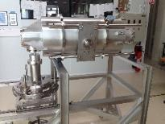
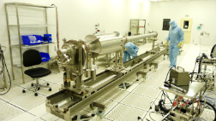
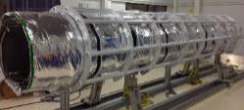
Scope for the integration team
Development and fabrication of assembly toolings
First check for the tooling design with the mock-up assembly
  MECCTD tools design ~ 98% finished
  About 95% of tools approved (two phase tube positioning not tested)
  Some tools are still missing (GV & WC transition handler, washing racks)
The team is in charge of the MECCTD assembly ; our goal is :
  To check the component interfaces and eventual collisions
  To optimize the arrangement of the assembly tasks
  To define the tests to insure the quality of the product
CEA is in charge of some MECCTD components
  Cavity, coupler, tuner, mag. shielding, warm cold transition, beam bellows,
  Define cleaning procedure or delivery conditions
  Establish the check list for the incoming inspection report
The INFN/LASA medium beta cavity new design has been successfully integrated in the MECCTD
Assembly of a cryomodule mock-up
Procurement of cryostat components

Slide 4
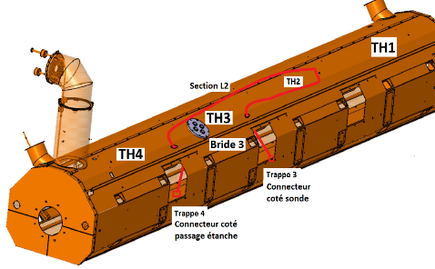
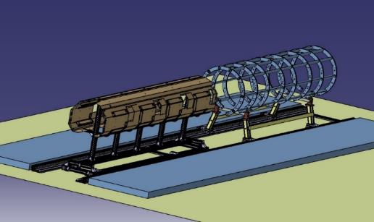
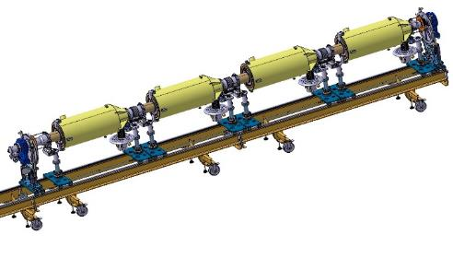
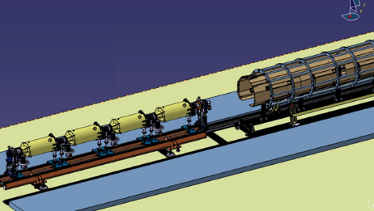
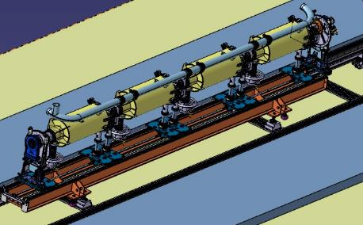
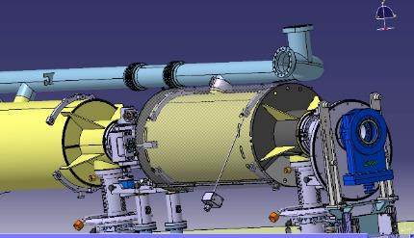
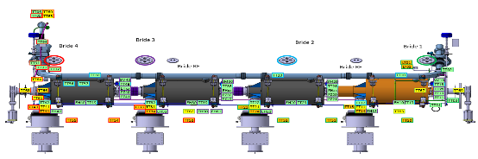
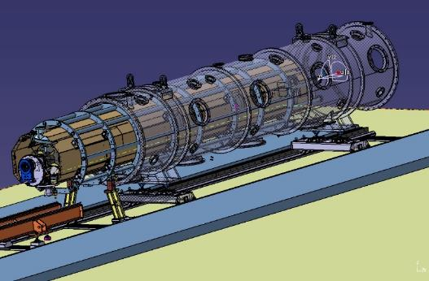
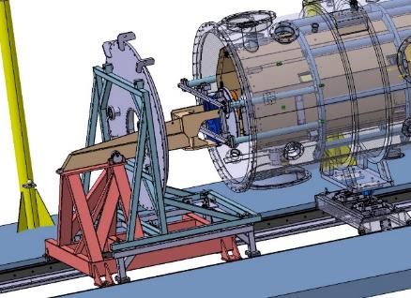
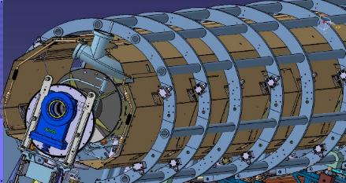
Flowchart: main assembly steps not shown cryogenic piping and alignement phases
Cavity string in clean room
Thermal shield
Spaceframe
Cold mass assembly welded
Cold mass assembly equipped (MLI,CTS, Mag Shield)
Vacuum
vessel

Slide 5
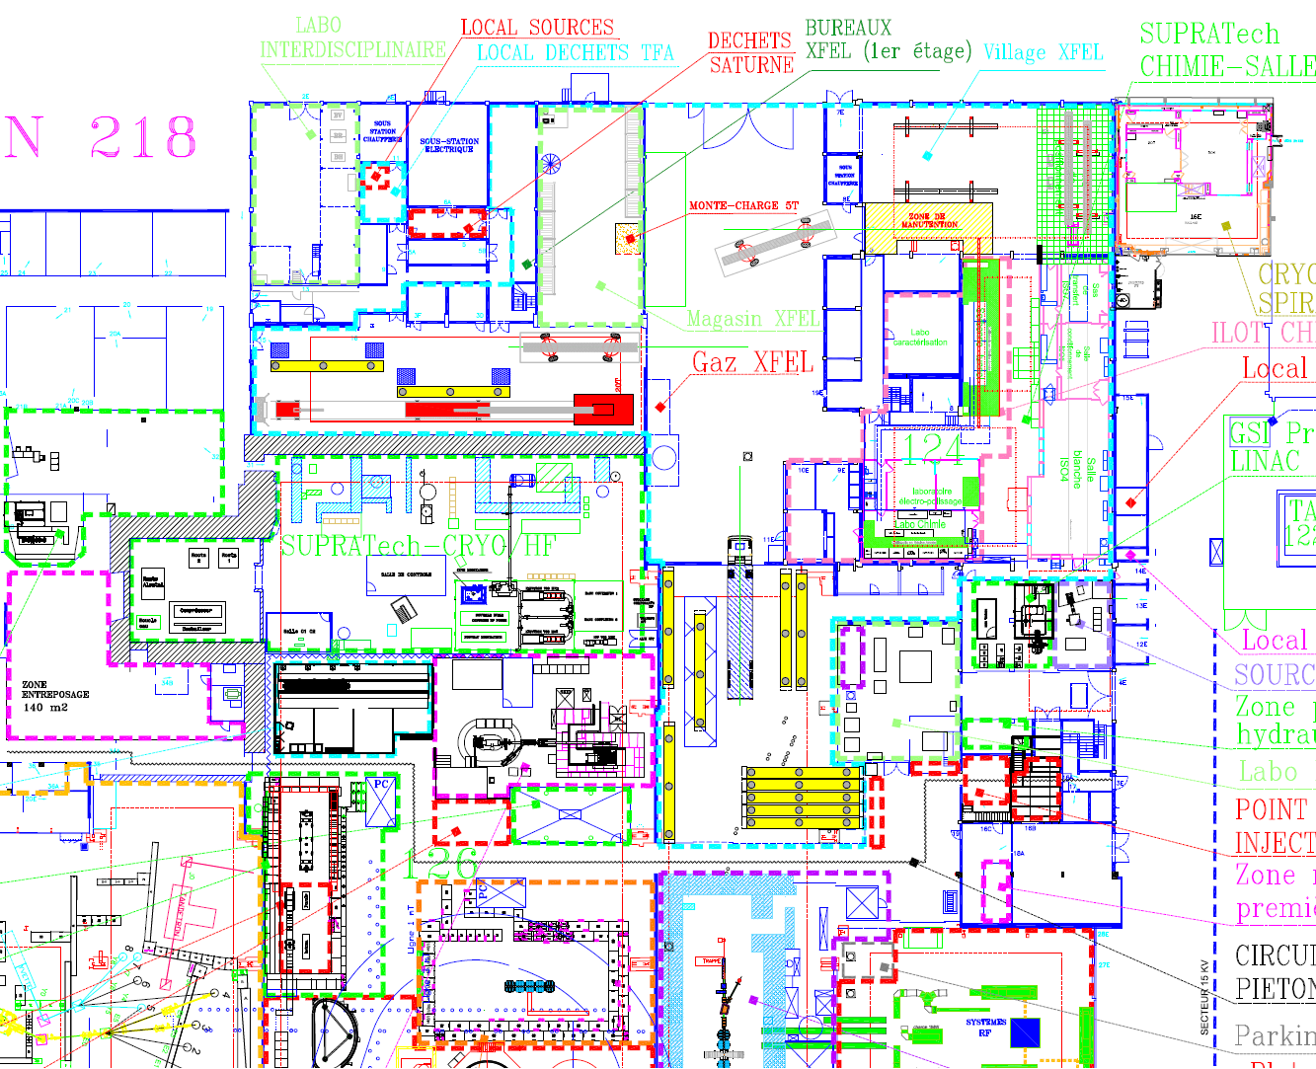
Infrastructure OVERVIEW
ESS Series
Cryostating (RO, Enfournement, Align. etc..)
Coupleurs & Cavities Qualification ECCTD
Clean room
Cryostating MECCTD
Böth
Cavity string Mock-Up
MECCTD
ESS Series
bunker

Slide 6
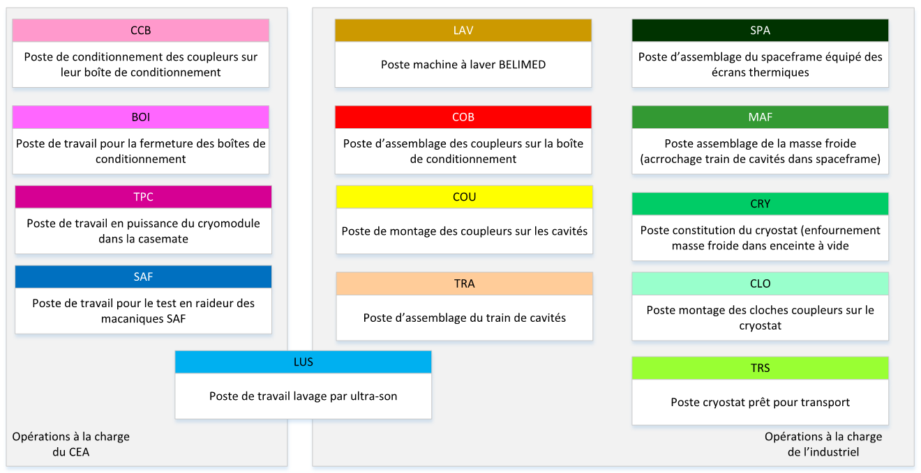
Series cryomodules Workstations
Flowchart vue d’ens Bazin et Thierry

Slide 7
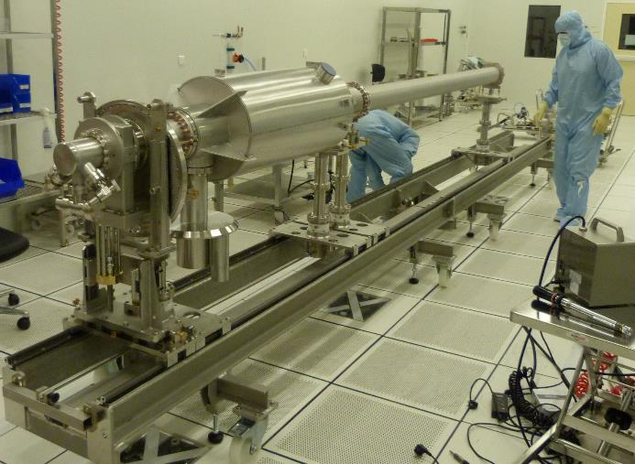
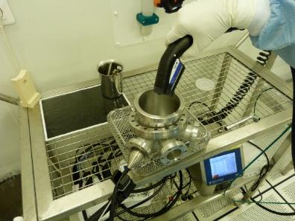
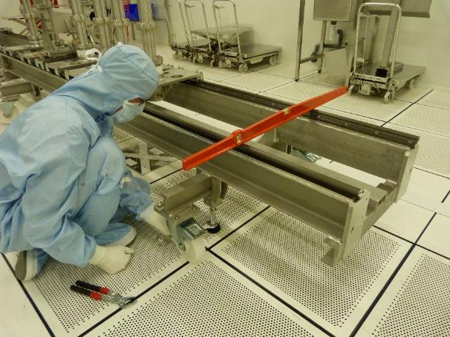
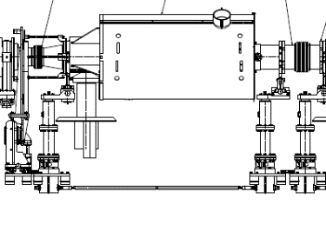
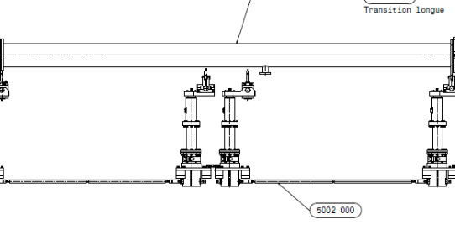

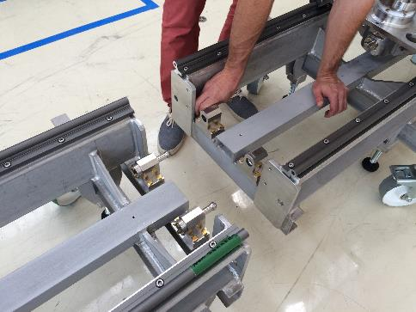
Mock-up activities (string in CleanRoom)
1 (Cavity+coupler) M-U + 1 tube
Establish the cleaning procedure
Discover the real tool and modify
Clean and level the tools
Leak test OK

Slide 8
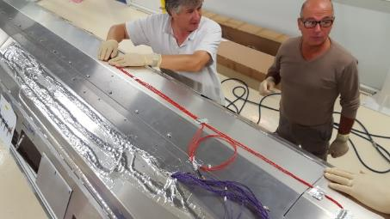
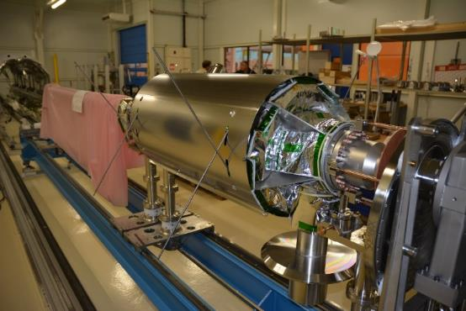
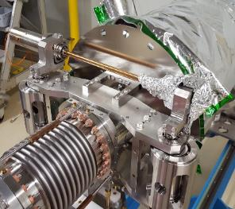
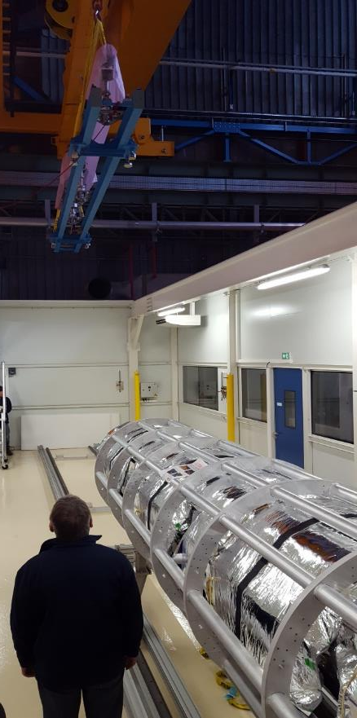
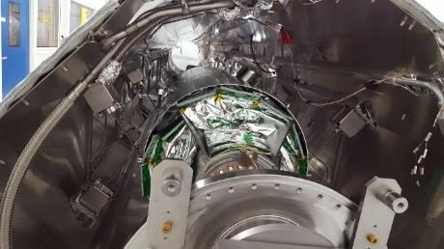
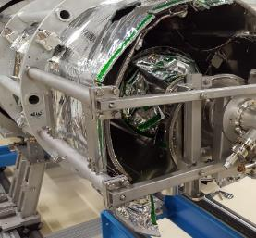
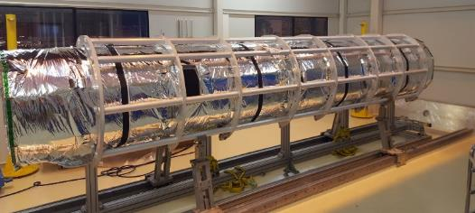
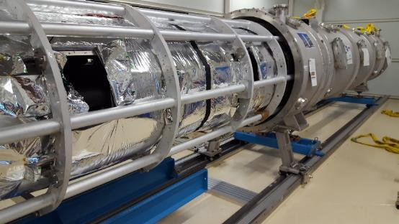
Mock-up activities (cryostating in Böth)
Cavity string handling
Cavity MLI/Magn.Shield/Ancoring
Thermal shield ass.
Cables thermalization
MLI assembly
SF rolling over
Thermal shield ass. to SF
Definitive Assy for MECCTD
Cold Tuning System
Tie rods
WC transition tool
SF in Vacuum vessel

Slide 9
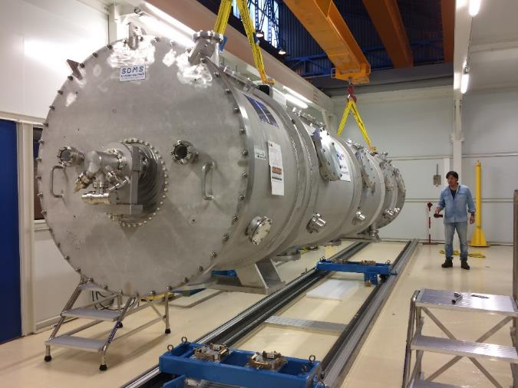
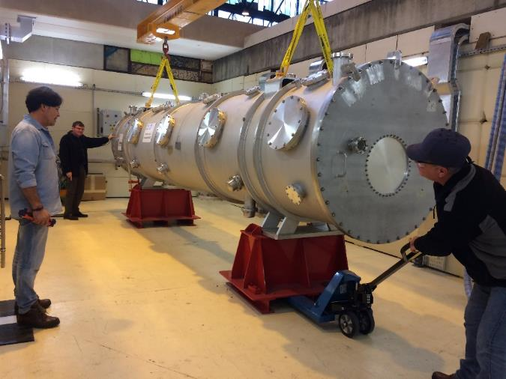
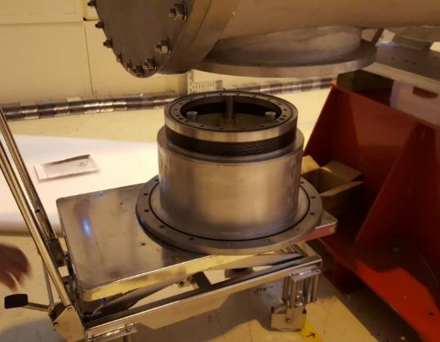
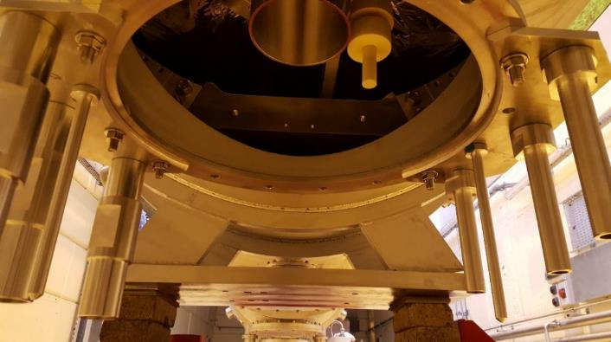
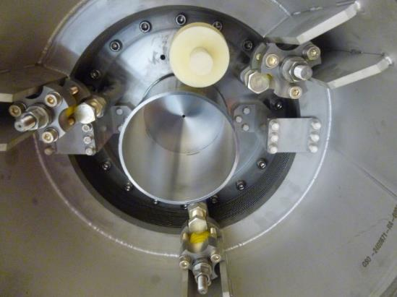
Mock-up activities (in Bunker)
Handling from Böth to Bunker
Coupler bell assembly (new tool & bars set)
Barometric compensation system assembly
Mock-up module leak test

Slide 10
MECCTD status: past activities
Coupler on Cavity P02 02/02/2017
Coupler on cavity P01 26/01/2017
Coupler on cavity P03 23/03/2017
not yet reported to the file : 3 10-10mbarl/s
Coupler on LASA cavity 22/03/2017
  Configuration file
Pumping cross/gate valve/WC transition mid March
string finish on 31/03
Leak signal with Helium spray
is less than 1 10-10 mbarl/s difference with the background level➔ CONFORM

Slide 11
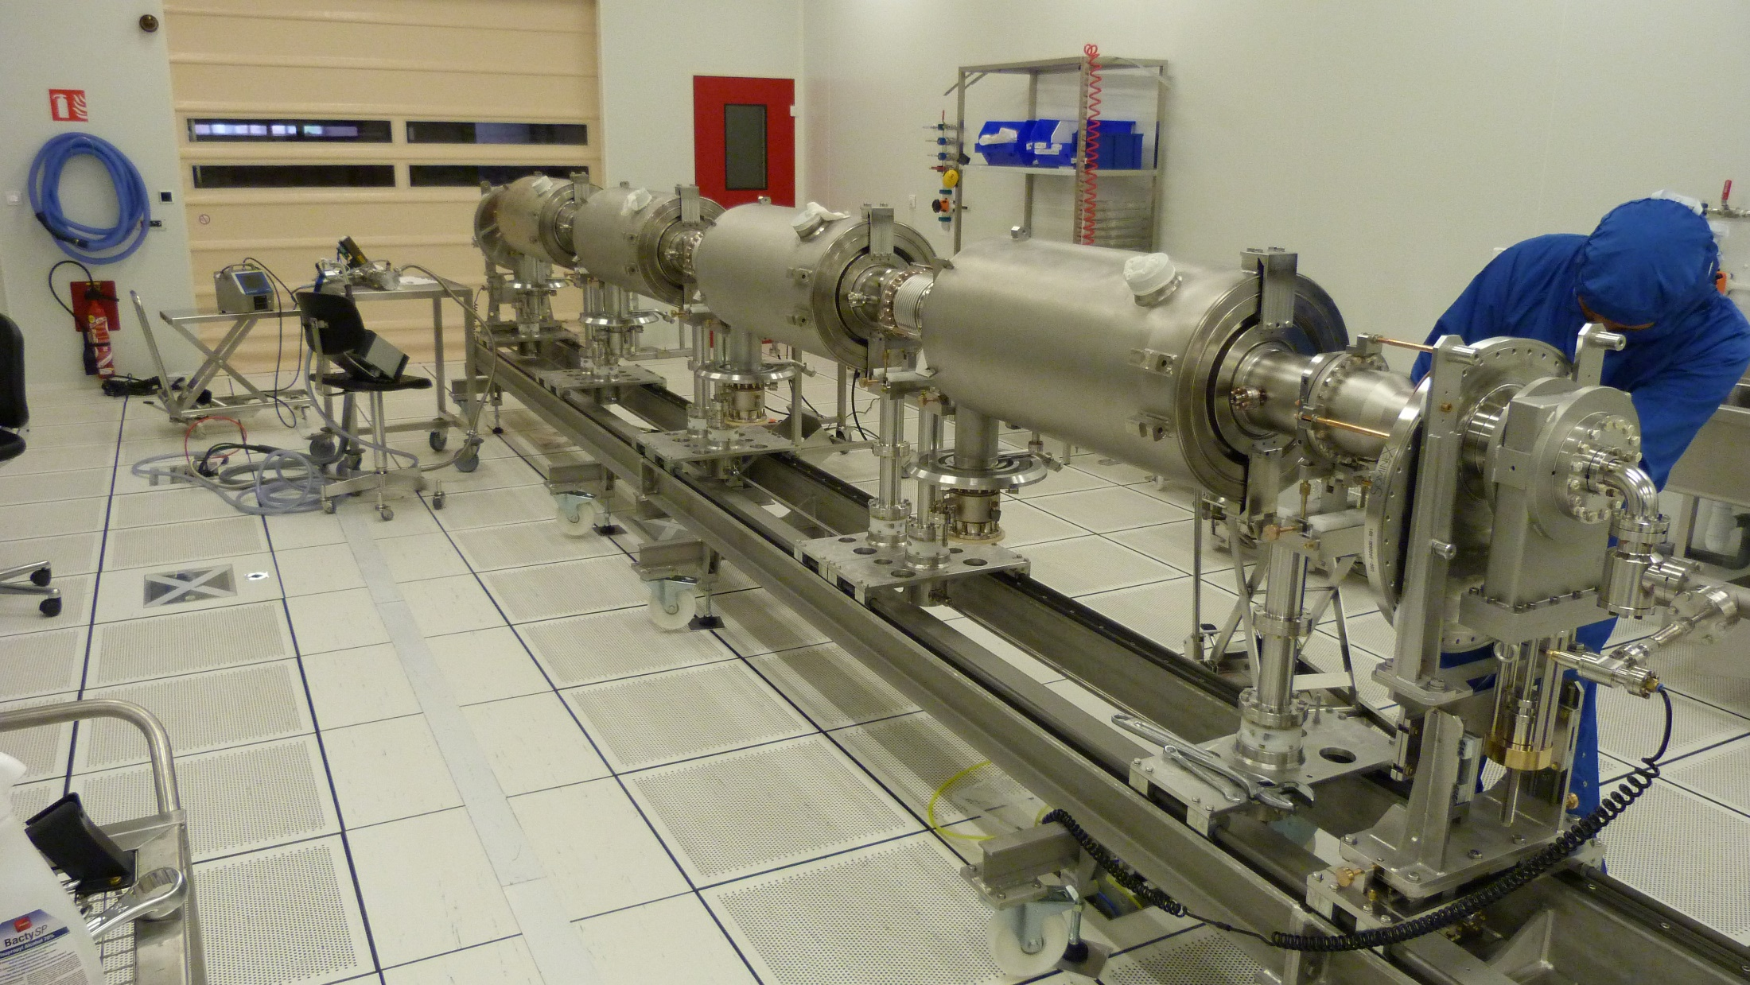
MECCTD status: future activities
Leack test of the string, RGA
Chek cavity string aligment
Transfert to the Böth
Chek cavity string aligment
2 phase pipe welding (subcontracted to SEIV)
Chek cavity string aligment
Complete cavity string with sensors, CTS, MLI, Mag. Sh.

Slide 12
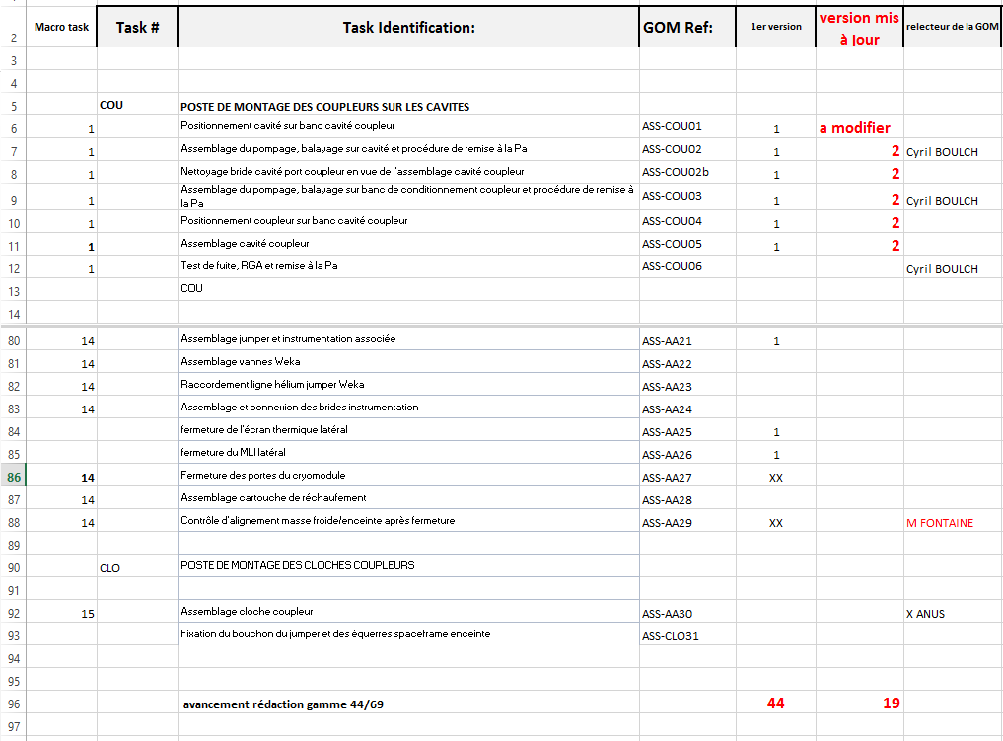
Procedures
69 identified tasks and classified by 7 workstations:
COU: POSTE DE MONTAGE DES COUPLEURS SUR LES CAVITES
TRA: POSTE D'ASSEMBLAGE DU TRAIN DE CAVITES EN ISO 4
SPA: PREPARATION DU SPACEFRAME ET ECRAN THERMIQUE
MAF 1: POSTE D'ASSEMBLAGE DE LA MASSE FROIDE
MAF 2: INSERTION MASSE FROIDE EQUIPEE DANS SPACEFRAME
CRY: ASSEMBLAGE DU CRYOSTAT
CLO: POSTE DE MONTAGE DES CLOCHES COUPLEURS
Written tasks: 44
from 3D model!
Within corrected tasks: 19
with real pictures

Slide 13
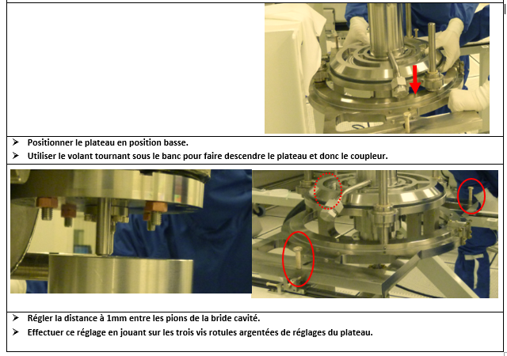
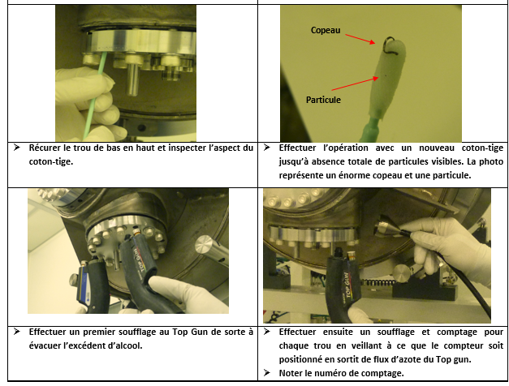
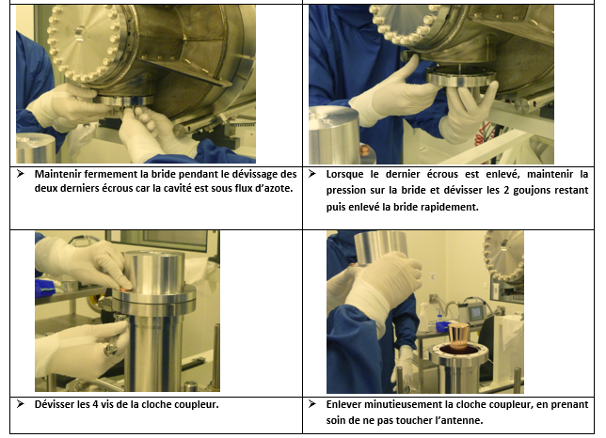
Procedure Ex. : coupler to cavity assembly
Detail of the adjustment screws
Cleaning procedure
Critical steps

Slide 14
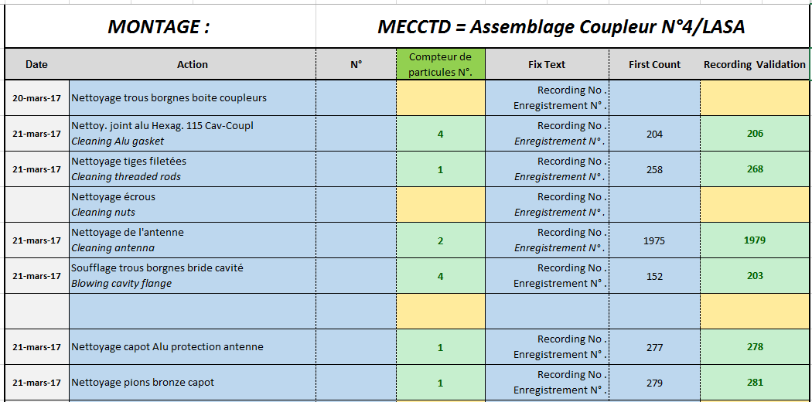
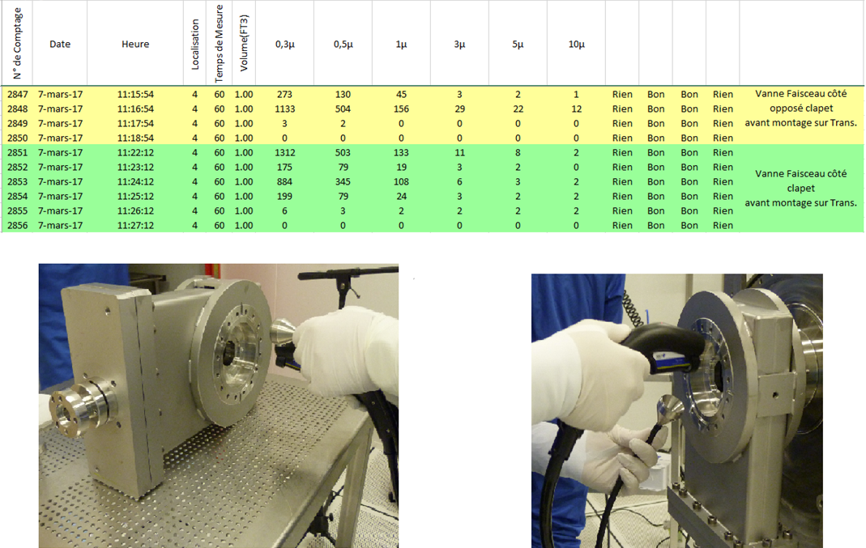
Assembly and test report ex. : coupler to cavity
Which part is controlled
Counter and record numbers
Particles counts decrease,
criteria < 10 part/min. bigger than 0.3µm: OK
Leak signal with Helium spray
is less than 1 10-10 mbarl/s difference with the background level➔ CONFORM

Slide 15
Change request ex.: design ajustement to reality
Cavity hanging ring (block welds, non cylindrical helium tank):
done
drawing
parts

Slide 16
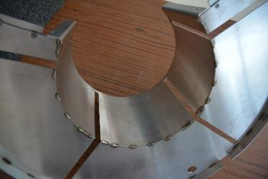
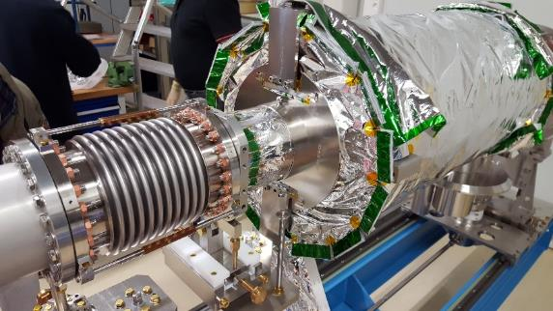
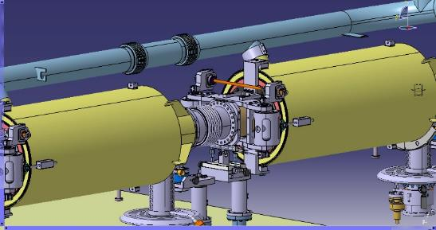
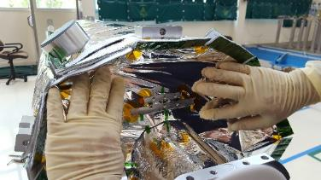
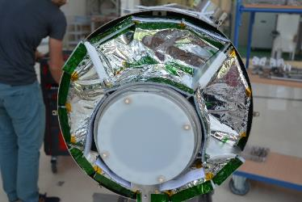
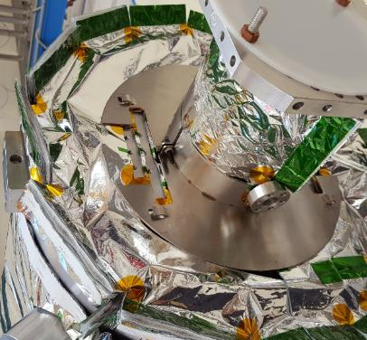
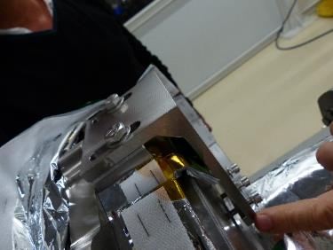
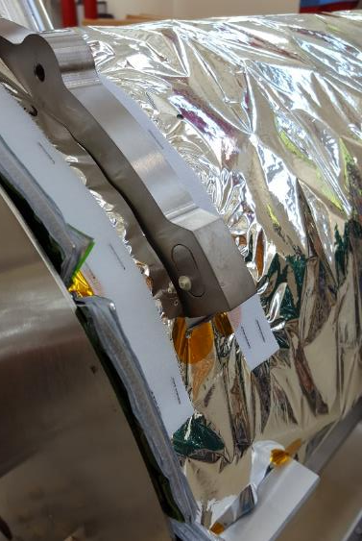
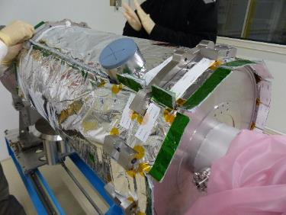
Change request ex.: tasks intrication
Additional MLI cuts
New design of Mag Shields
Change request for L shape being compatible with hanging ring

Slide 17

Non Conformity ex.: Cavity P03 performance
Rapport de NC ex cav 03
Introduire le processus de decision via ESS
Detect and record the deviation
Deviation classification
L1
Not L1
but L2 or L3
CEA PMO & WP
Analyse the root causes
and the consequences
Propose corrective and preventive actions
Impact at higher level
L2
L3
ESS - CEA
Analyse the root causes and the consequences / Validate the corrective and preventive actions
L3 : NCR or CR that will affect interfaces, safety, lifetime, performances, functional requirements with an impact at ESS level.
Actions implemented after the ESS approval.

Slide 18




Instrumentation : choices & drawing
/PT100 and CX1050
Scenario leads to sectors : from compound//thermalisation//to feedthrough
L3
Internal connectors: FGG.0S.304.ZLAT ou FGG.1S302.ZLAT de chez LEMO
Feedthroughs: HGP.5S.316.CLLPVE, HGP.5S.324.CLLPVE et HGP.5S.336.CLLPVE de chez LEMO

Slide 19




Instrumentation : choices & drawing
/ heaters
Calculation of the ideal length by B. RENARD
<- Coupler warming up: ok
slow warming up
of the thermal shields ->

Slide 20




Instrumentation : from PID to procedure
schetch
PID
Thermalisation procedure ready, work acheived for MECCTD
Cold mass sensors location drawings:71HAAVDM6300000

Slide 21
Check point list
Actual list of check points (en cours de définition)
  Cleanliness
  Torque (most critical ones)
  Leak tighness (beam, insulation, Helium’s) and RGA for beam line
  Cabling conformity and test (thermal sensors,CTS,piezzo,heater,gauge…)
  Alignment
Pressure tests to be define (2 tests, conditions of the tests, when in the sequence, which part to close circuits, specific tools)

Slide 22
Procurement plan and development plan
Development plan

Slide 23
meetings
Cryomodule Assembly meetings
  Internal meeting at CEA with all the involved person
  Every week (Monday morning)
LCAP – LIDC2 meetings
  Integration team leaders and Tools designers
  Every week during design phases (Wednesday morning)
NC and modifications review
  Quality, head of the integration team and WP Leader
  Twice a month
Feedback meetings
  To the designer or to the person in charge of different market
  Depending on issues
Meeting for integration of different 3D-models in one (subcontracted)
  System engineer and subcontracted company
  Frequence : to be define
Day to day meeting
  Integration team
  Every day since real MECCTD assembly

Slide 24

















Quality
Management
Tools
Vacuum
Alignment
Mechanics
Cold Tuning System
Electrotech
Magnetic shielding
ML Insulation
Cryogenics
Welding
BOULCH |  |  | CHARRIER
 | BOUYGUES
 |  | BRUNIQUEL
 |  |  | CLOUE
FONTAINE
 | GASSER
 |  | JACQUES
 |  |  | MONNEREAU
PEROLAT
 | PERRIN
 |  | PLOUIN
 |  |  | POUPEAU
RAGON
 | REGNAUD
 |  | RENARD
 |  |  | TRUBLET
Thanks for your attention
Questions?
Commissariat à l’énergie atomique et aux énergies alternatives
Centre de Saclay | 91191 Gif-sur-Yvette Cedex
T. +33 (0)1 69 08 76 11 | F. +33 (0)1 69 08 30 24
Etablissement public à caractère industriel et commercial | RCS Paris B 775 685 019

Slide 25


Cryomodule 3D view
6.6 m long

Slide 26
M-ECCTD planning
CDR-M1
13/ Alignement spaceframe
7/ Blindages magnétiques
2/SA
3/ Transfert Böth
14/
Connexions cryo, fermeture portes
2/
SA
8/ Alignement cavités
3/ pre-alignement cavités
15/
Montage cloches coupleurs
9/ Insertion spaceframe
10/ Reprise de charge sur tirants
4/Soudures tubes diphasiques
1/ CC LASA
16/
Tests (RF, fuites)
1/ CC P03
11/ Contrôle Alignement cavités
17/ Transfert Casemate
4/ radio
5/ 6/
MLI cavités + SAF
18/ 19/ Montage DK, connexion cryo instru
12/ Cryostating

Slide 27




Instrumentation : Choices
/helium level
Helium level : intern electrical connector & feedthrough :
PLUG-MINI-1B-10-V, PLUG-MINI-1B-10-A and CF16-VB-1B-10
from VACOM.

