Slide 1
Critical design review #1 for medium beta cavity cryomodules
3-4 APRIL 2017
-
Technical interfaces
-
Franck Peauger / Vincent Hennion
Notes:
Bonjour,
Franck Peauger,
Je suis Ingénieur RF accélérateurs au SACM
Je suis au CEA depuis janvier 2006

Slide 2
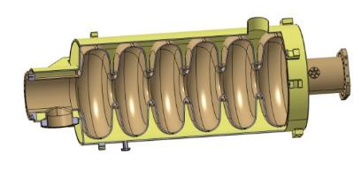
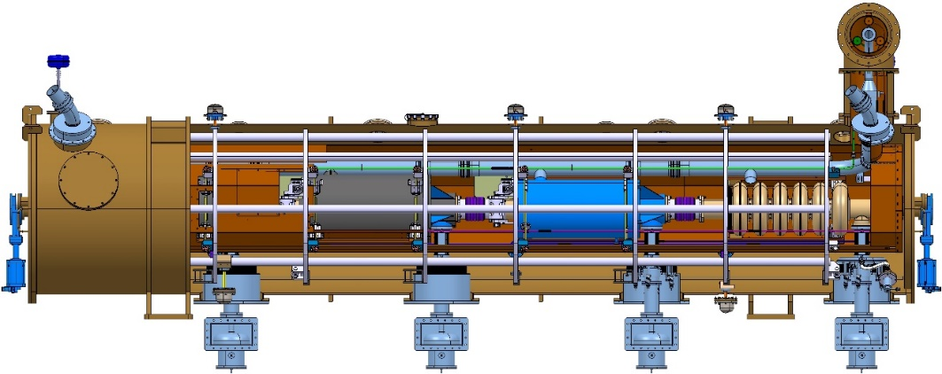
Two types of interfaces
Internal interfaces:
  Cavity with helium tank welded, equipped with flanges, brackets (on tuner), pick-up antennas and vacuum valve
  Interfere closely with cold tuner, MLI, magnetic shielding, cavity support, intercavity belows / cold warm transitions and cryogenic lines
External interfaces:
  Vacuum vessel fully equipped
  Limit of the delivery: at the connectors of instrumentation fixed on the cryomodule (for its vacuum integrity)
  Interfere with warm-units, waveguides,
  cryomodule supports, valve box, auxiliary lines,
  exhaust lines, isolation vacuum pumping systems,
  cables for instrumentation

Slide 3
Cavity interfaces document
Document written by CEA for INFN/LASA after many iterations
First signed version sent to LASA (by ESS) the 16th of Dec. 2016

Slide 4
Cavity Interface drawings
7 sheets defining the footprints, dimensions, tolerances, interfaces, and shipment configuration
71 HAAV DM-9000 000 RD sheets 1 to 7
Draft version sent to LASA by ESS the 12/04/2016
Signed version (revision RC) sent to LASA by ESS the 16/12/2016

Slide 5
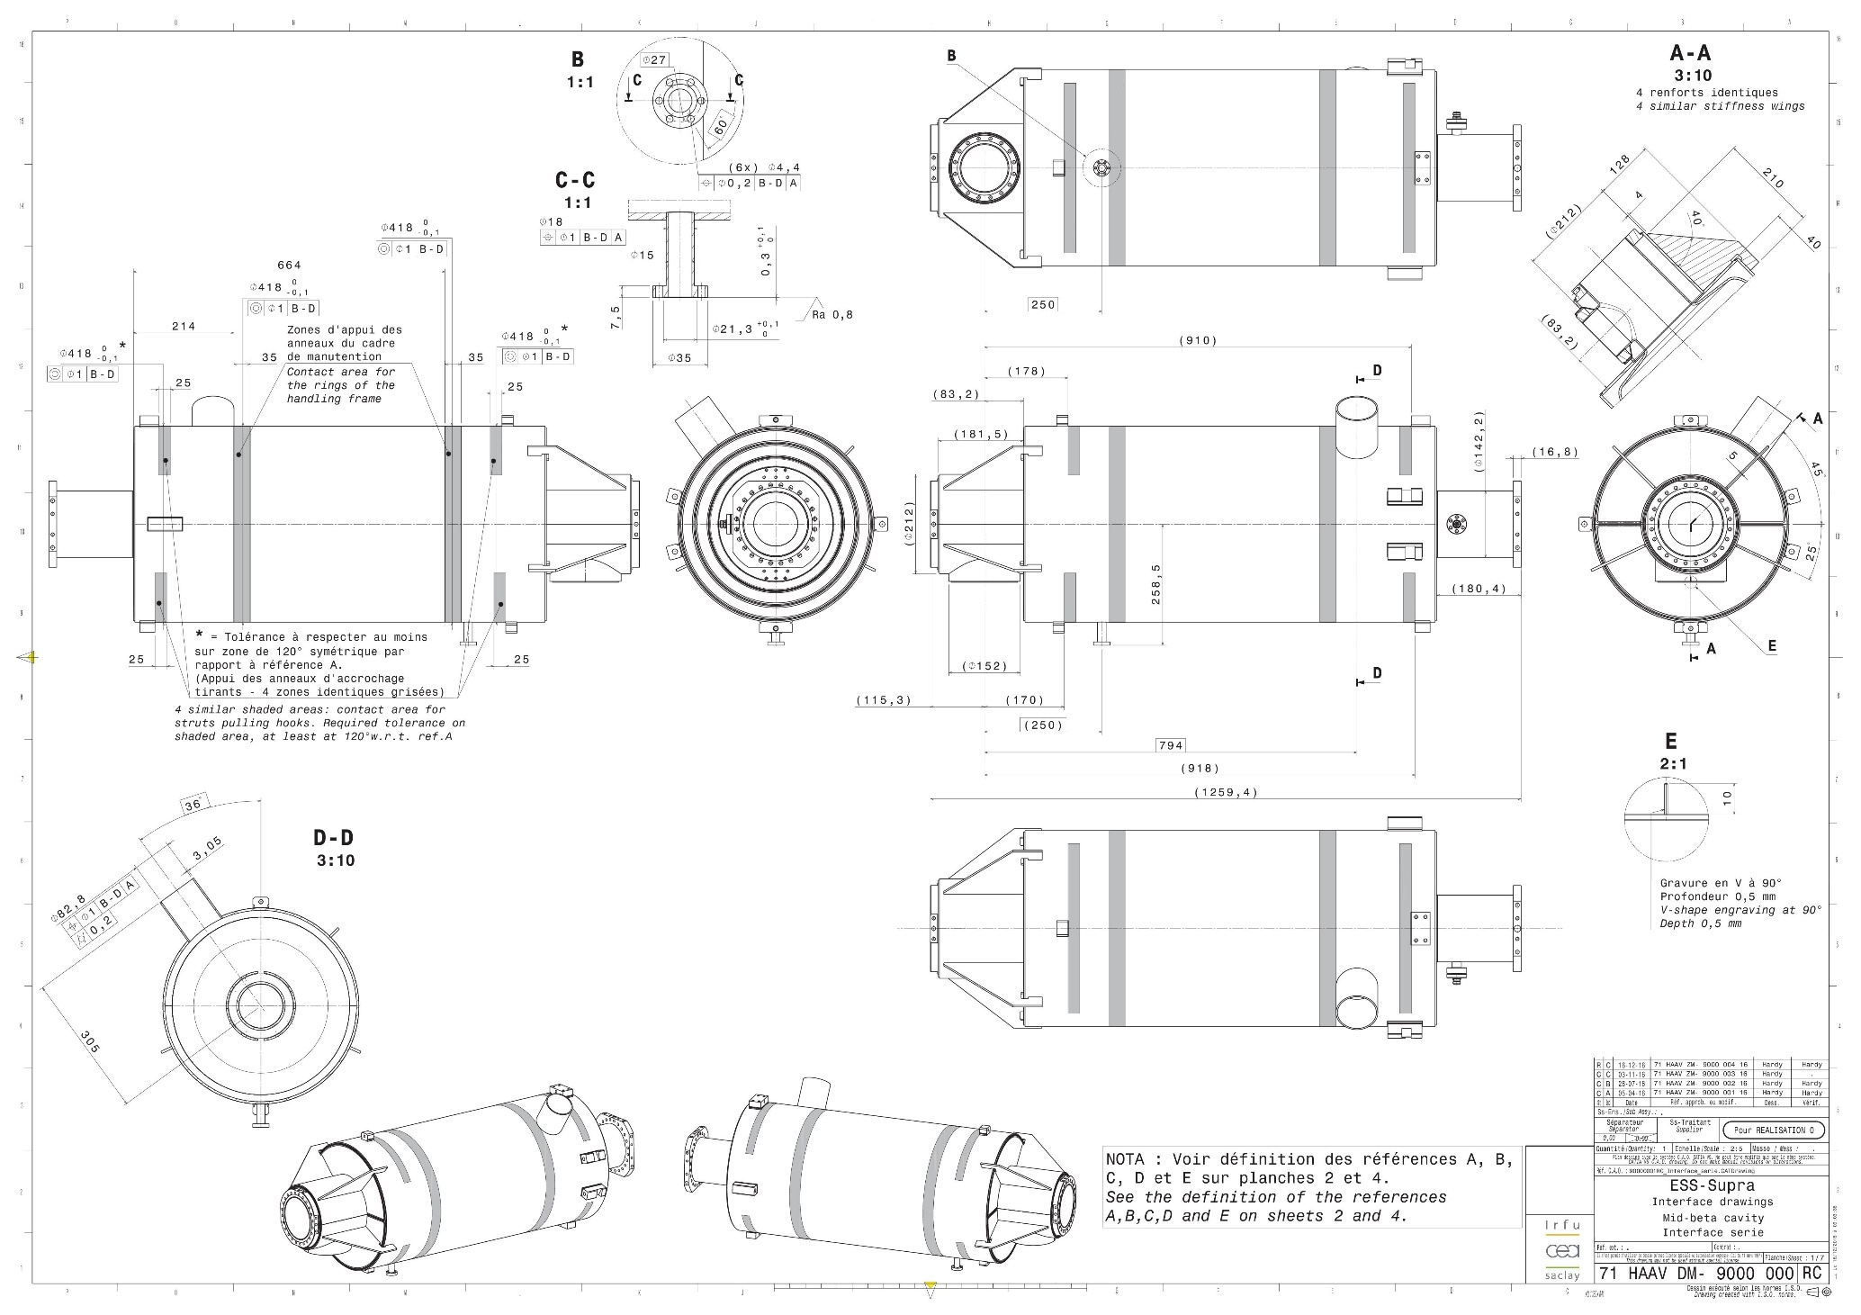
Cavity Interface drawings – sheet 1/7
Tank geometry
Footprints for cavity handling
Cryo Inlet/outlet

Slide 6
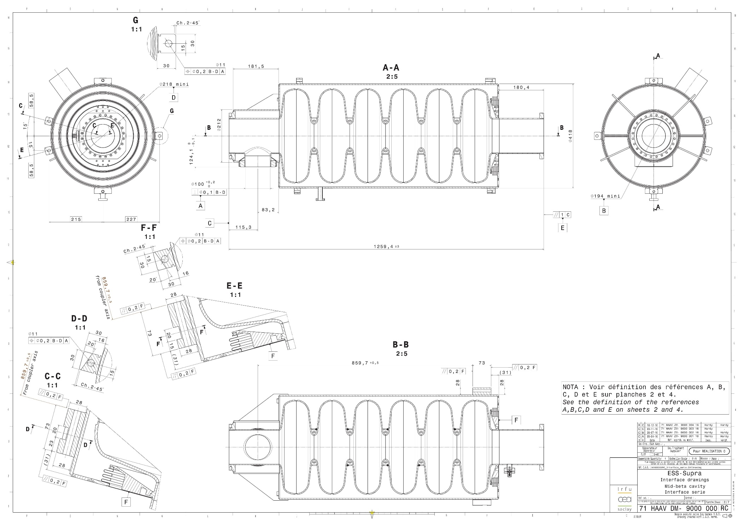
Cavity Interface drawings – sheet 2/7
Blocks for tuner and brackets

Slide 7
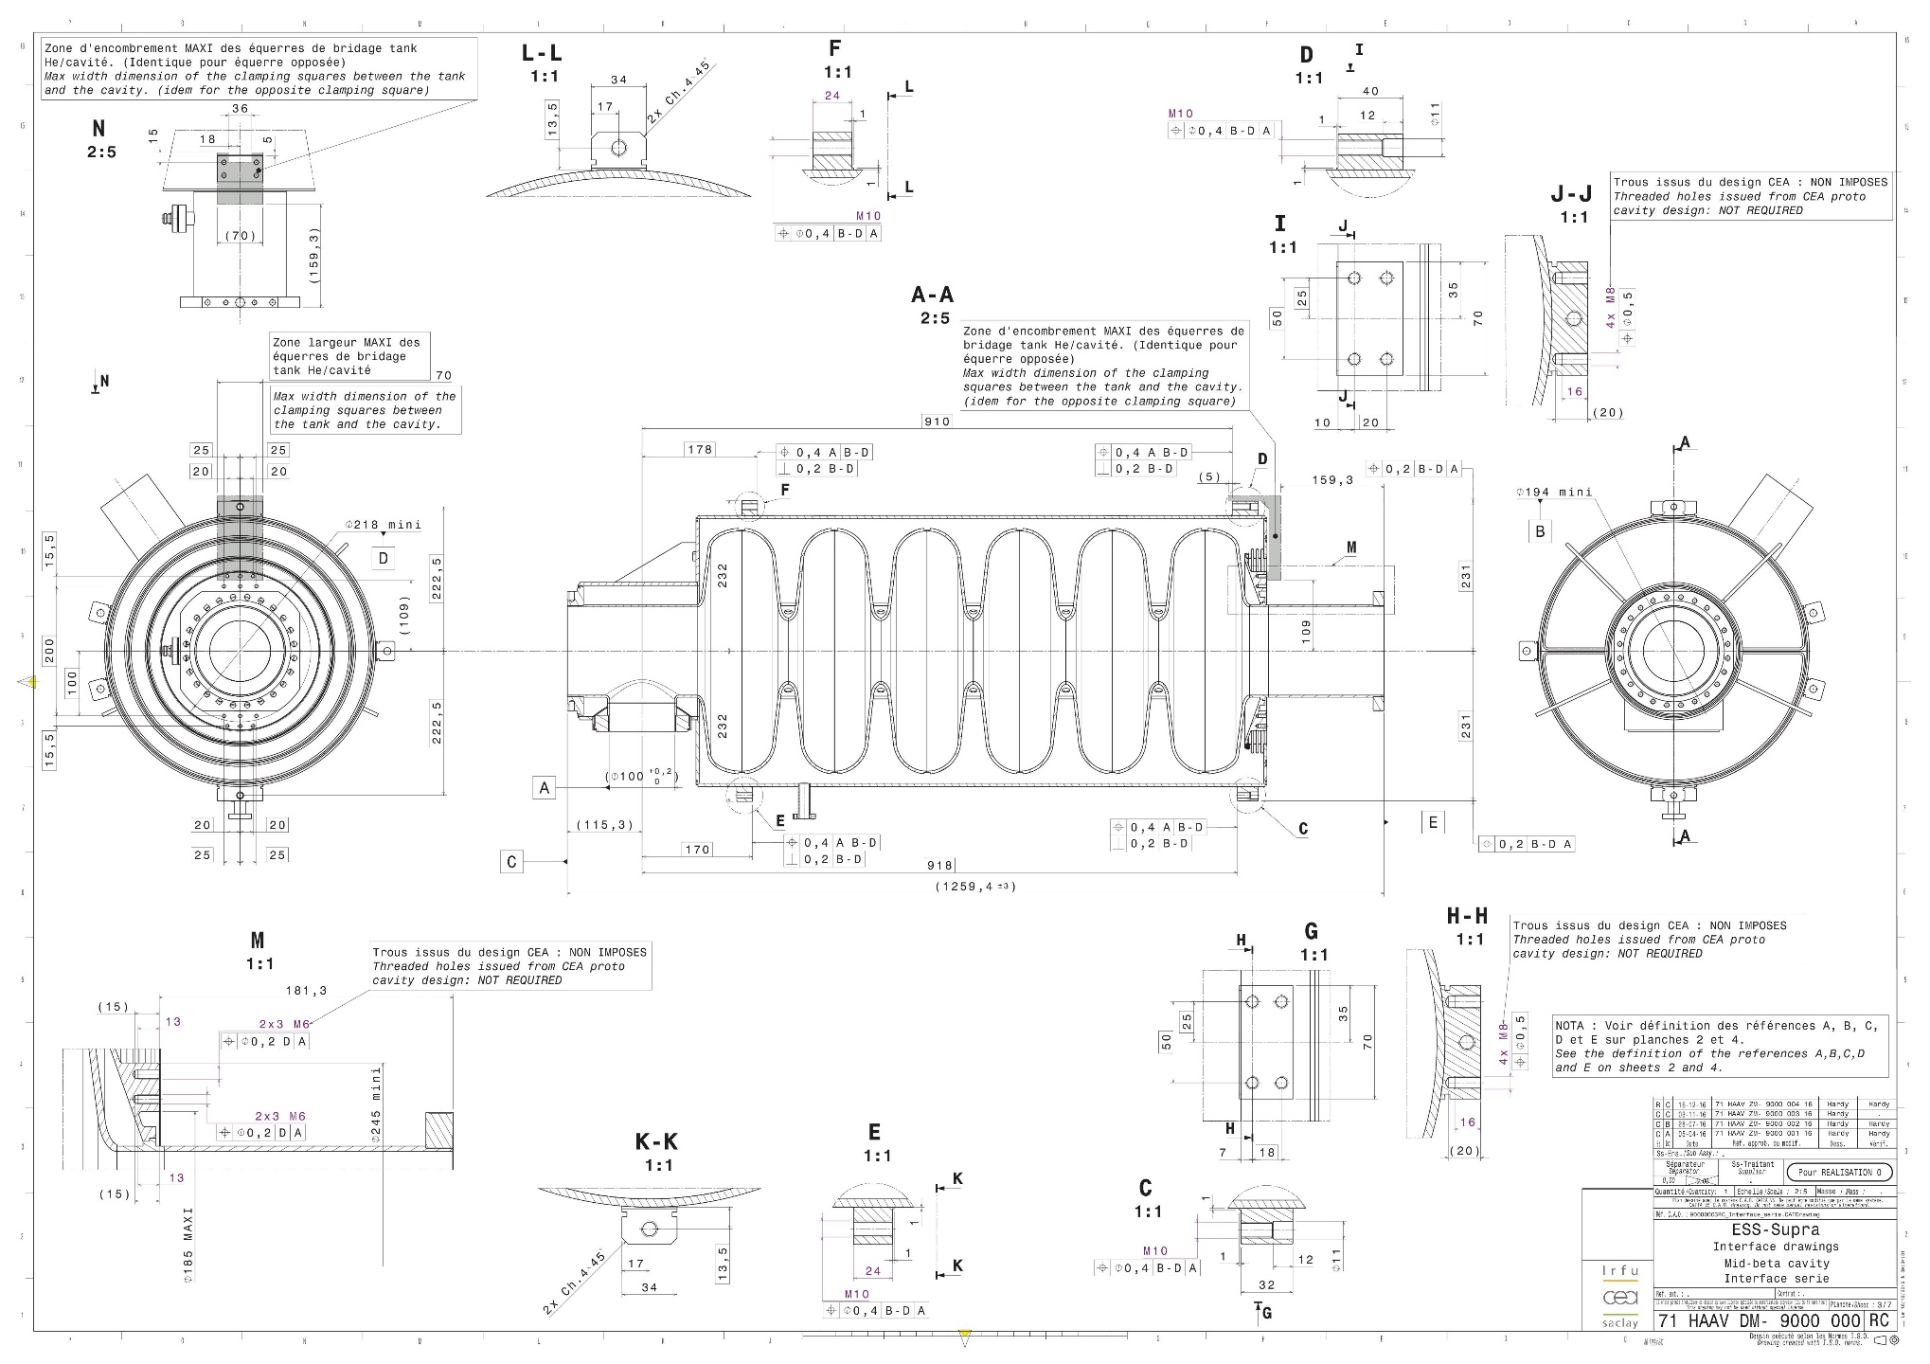
Cavity Interface drawings – sheet 3/7
Blocks for tuner and brackets

Slide 8
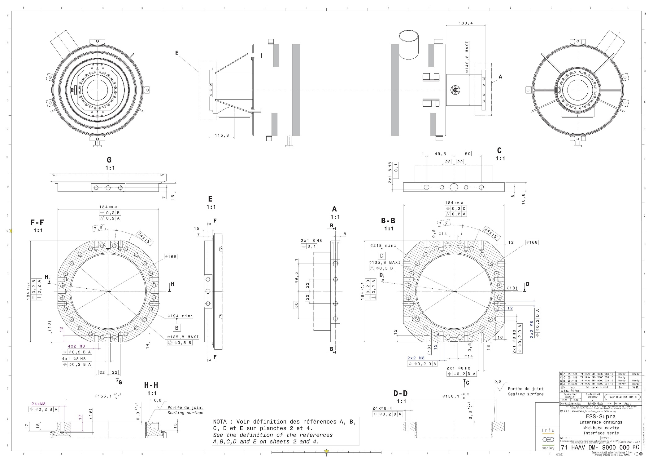
Cavity Interface drawings – sheet 4/7
Beam ports flanges

Slide 9
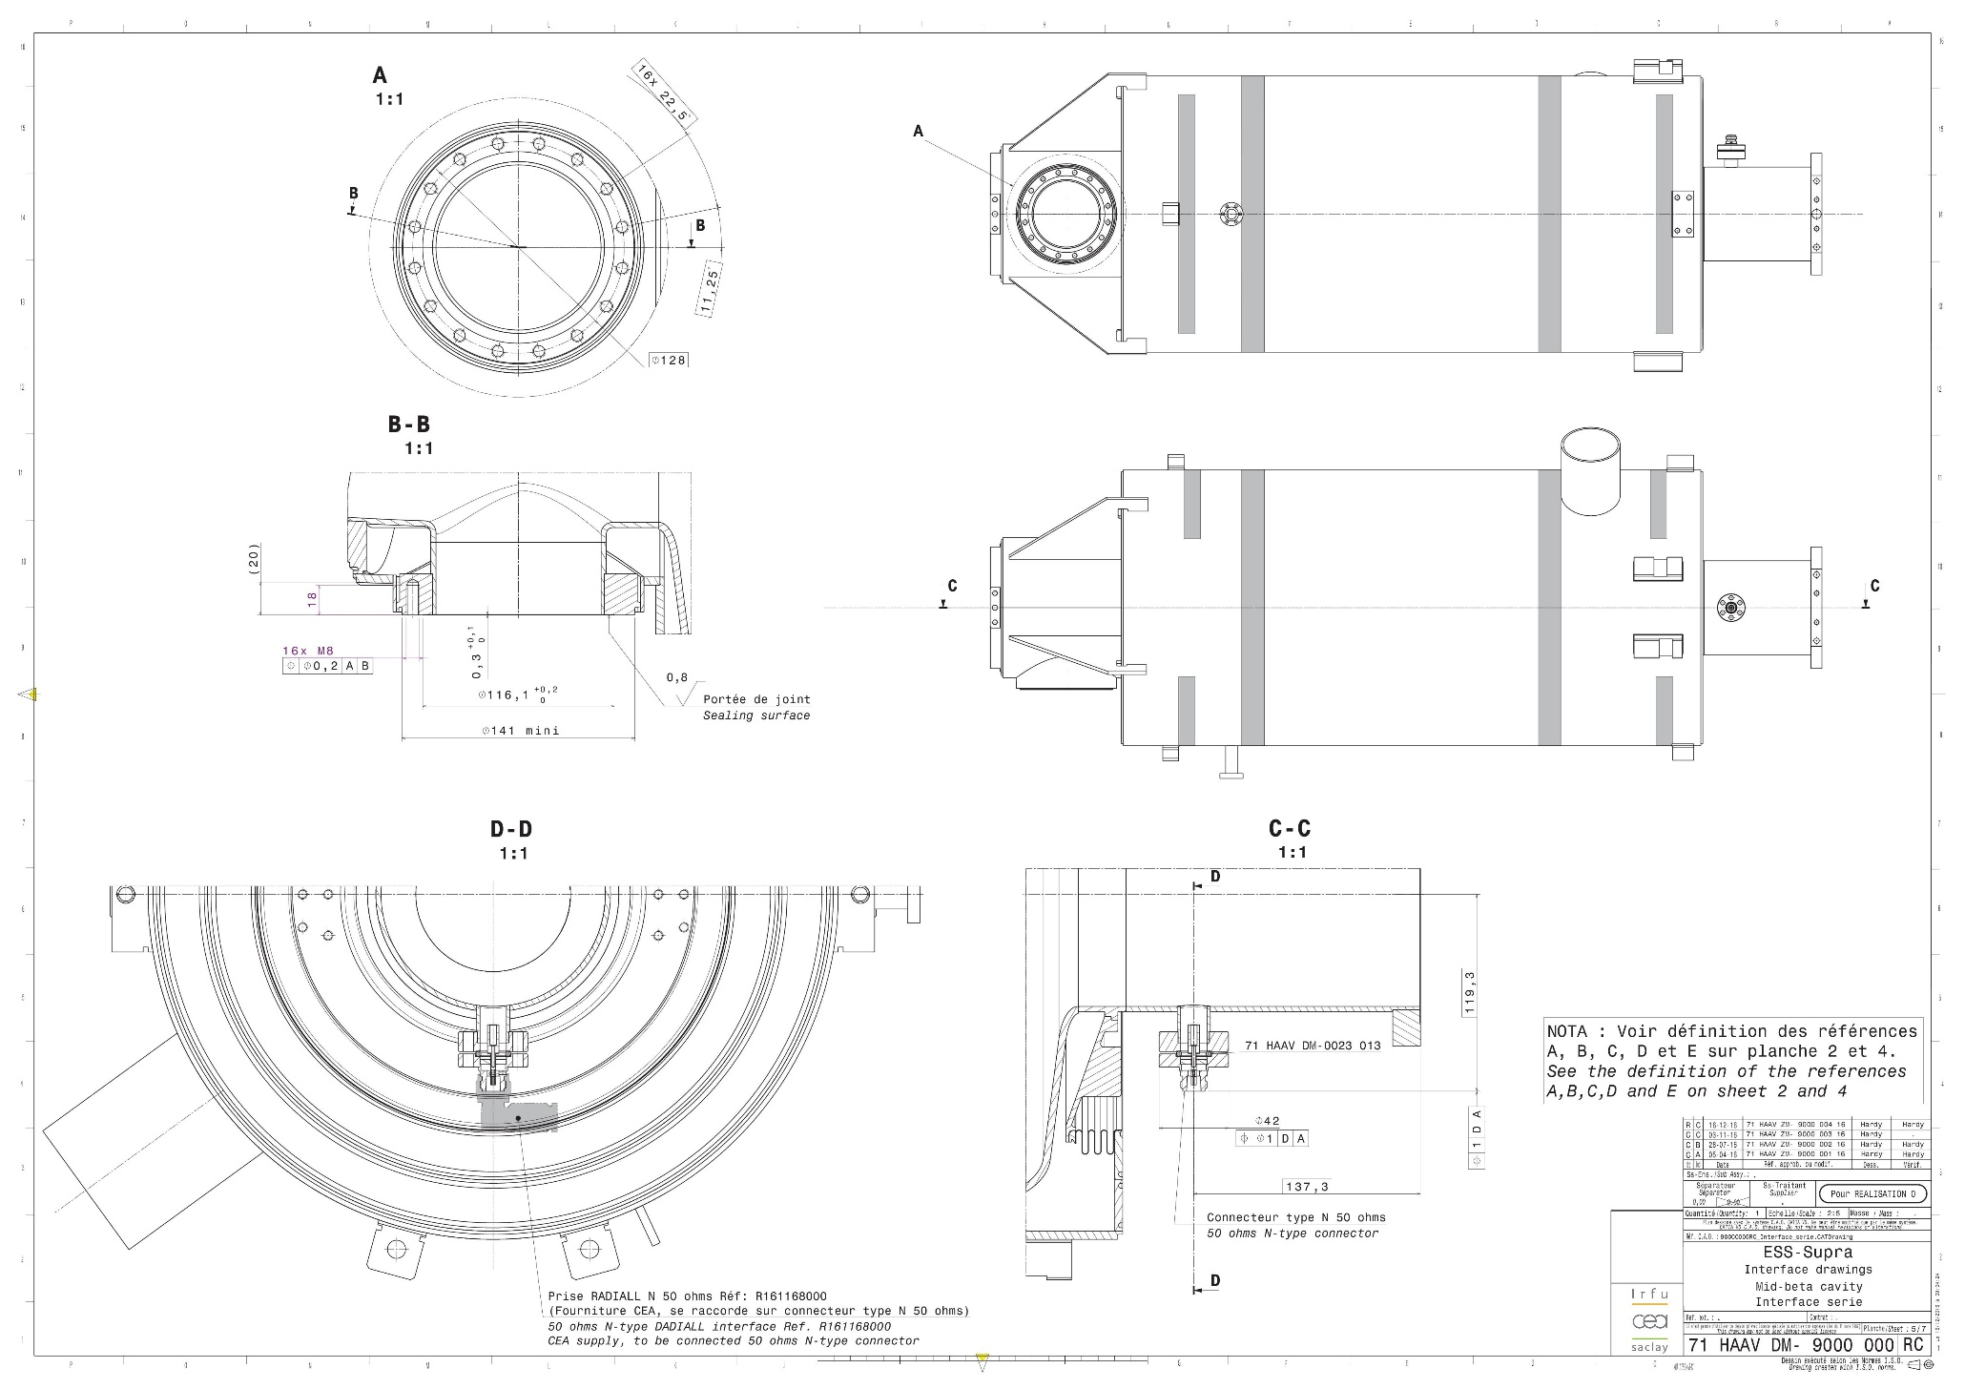
Cavity Interface drawings – sheet 5/7
Coupler flange and pick-up

Slide 10
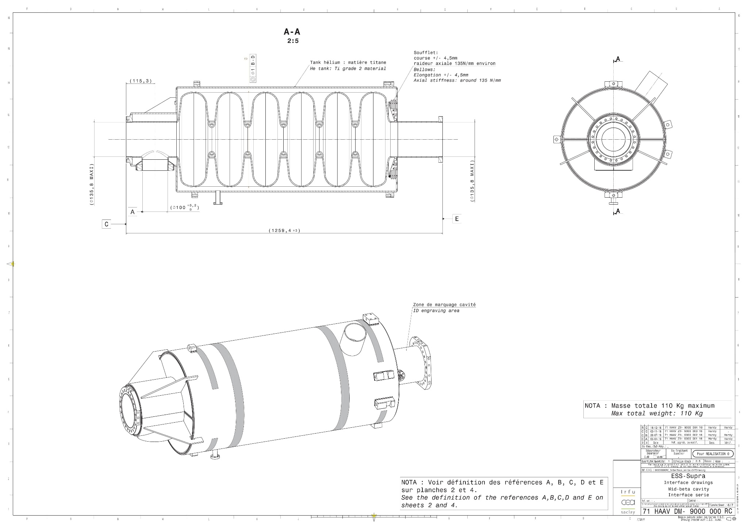
Cavity Interface drawings – sheet 6/7
Bellow characteric and engraving area

Slide 11
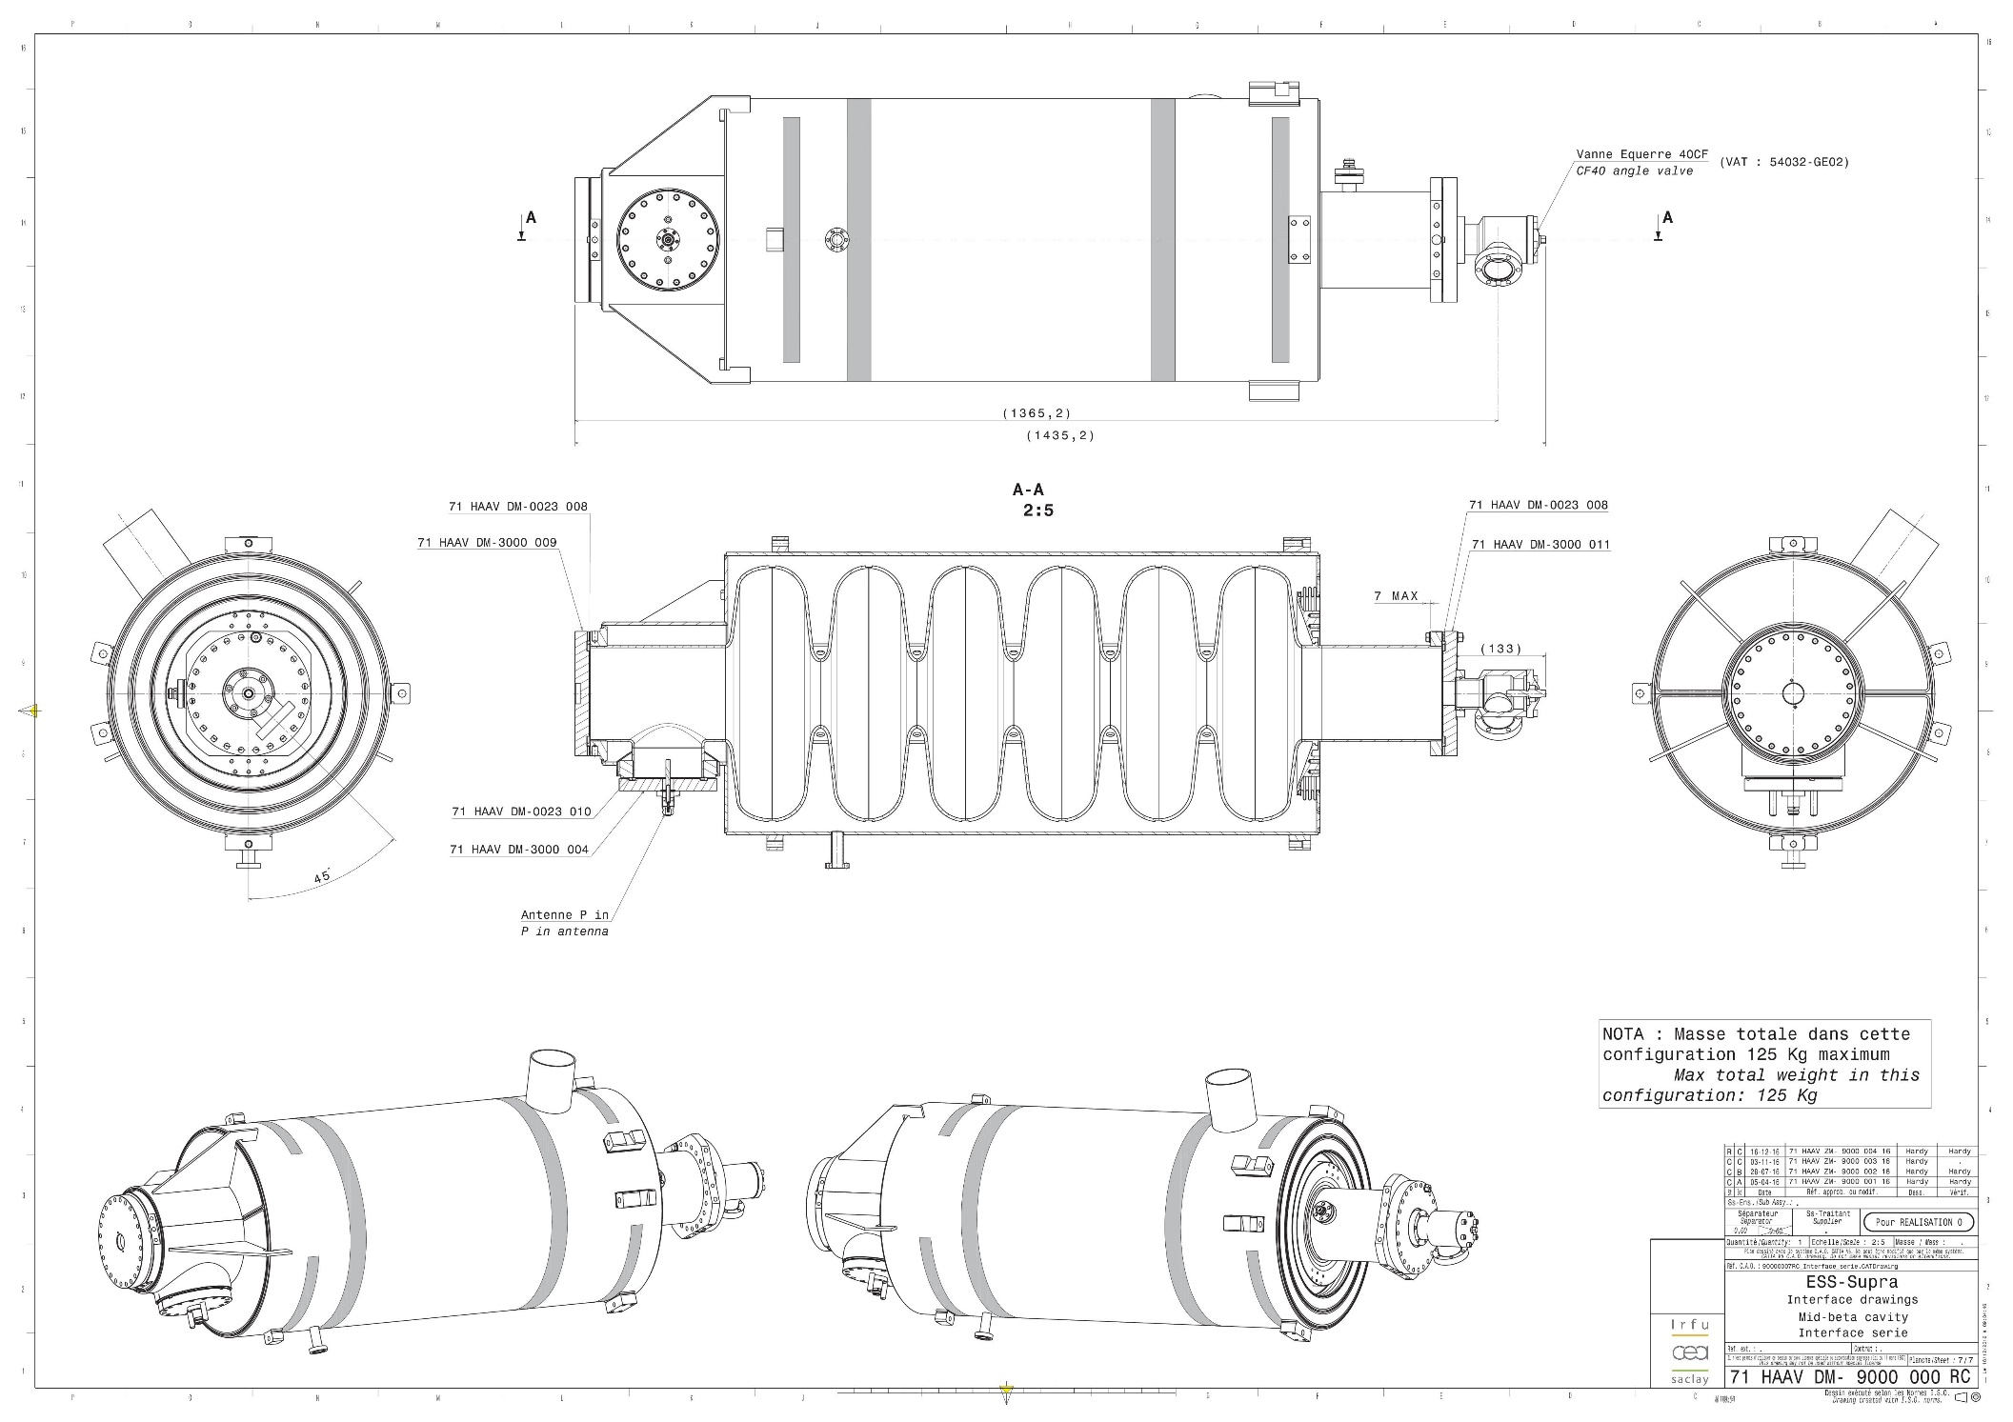
Cavity Interface drawings – sheet 7/7
Vertical test / reception configuration

Slide 12
New version of cavity interface drawings
A new version of drawings is under study to include the bimetallic junctions in the helium supply circuit
This new cryogenic input is based on the XFEL and LCLS2 design and will reduce drastically the risk of leakage at 2K (in inaccessible region inside the cryomodule)
Diameters: 5 mm inner, 8 mm outer

Slide 13
Cavity accessories drawings
6 drawings defining the closing flanges and gaskets
71 HAAV DM-3000 004 RD
71 HAAV DM-3000 009 RC
71 HAAV DM-3000 011 RC
71 HAAV DM-0023 008 RC
71 HAAV DM-0023 010 RC
71 HAAV DM-0023 013 RB

Slide 14
Cryomodule Interface document and drawings
Document written by CEA for ESS:
  first draft version in progress
3 types of drawings:
  Transport version
    Without doorknob transitions, with protection end cap on jumper
  Test stand version
    With CF (and VCR) interconnexions on jumper
  Tunnel version

Slide 15
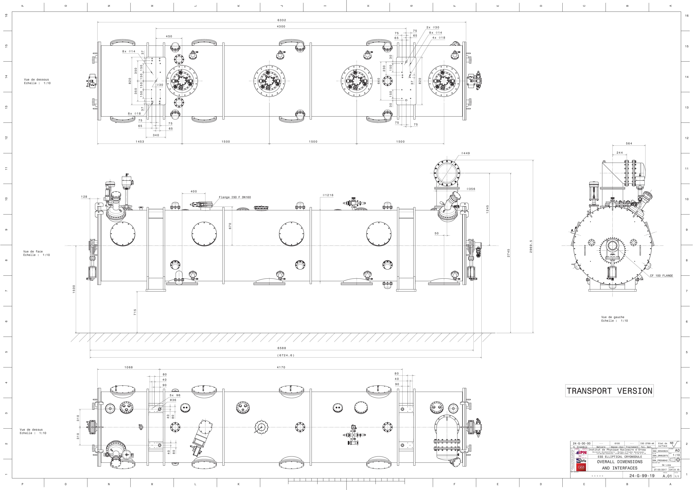
Cryomodule Interface drawing
1st DRAFT (new, not discussed with ESS yet)

Slide 16
Cryomodule Interface drawing

Slide 17
InterfaceS table in the tunnel (1/3)
 | Designation | Location | Type | Connection | Interface on cryomodule side | Interface on tunnel side | Comments
1 | He 4,5K inlet | Jumper | Helium circuit | Weld | Rimmed welding end Ø_{int} 61mm (see 24G9914) | Rimmed welding end Ø_{ext} 60mm (see ESS-0011309) | Change request ESS-0100756, new interface sheet ESS-0011219R2
2 | He 40K Thermal shield cooling inlet | Jumper | Helium circuit | Weld | Rimmed welding end Øint 61mm (see 24G9914) | Rimmed welding end Øext 60mm (see ESS-0011309) | Change request ESS-0100756, new interface sheet ESS-0011219R2
3 | He 50K Thermal shield cooling outlet | Jumper | Helium circuit | Weld | Rimmed welding end Øint 61mm (see 24G9914) | Rimmed welding end Øext 60mm (see ESS-0011309) | Change request ESS-0100756, new interface sheet ESS-0011219R2
4 | He 2K Pumping outlet | Jumper | Helium circuit | Weld | Rimmed welding end Øint 101mm (see 24G9914) | Rimmed welding end Øext 100mm (see ESS-0011309)
5 | Bursting disk exhaust line 1 | Bursting disk (jumper side) | Helium circuit | Flange | Flange ISO-F DN100 ?? 8xØ9, on Ø145 | Flange ISO-F DN100 ?? 8xØ9, on Ø145 | Interface to be validated (ESS)
6 | Helium purge HV90 | Bursting disk (jumper side) | Vacuum valve | Weld | Rimmed welding end Øint ??mm (Flange CF16, 6xØ4,30, on Ø27 for sdt) | Rimmed welding end Øext ??mm | SP Line
7 |  |  |  | Electrical | Plug male 7 pins (VAT model) | Plug female 7 pins (provided by manufacturer VAT) | Position switches
8 | Bursting disk exhaust line 2 | Bursting disk (jumper opposite side) | Helium circuit | Weld | Flange ISO-F DN100 ?? 8xØ9, on Ø145 | Flange ISO-F DN100 ?? 8xØ9, on Ø145 | Interface to be validated (ESS)
9 | Safety valve SV90 | Bursting disk (jumper opposite side) | Helium valve | Weld | To be defined (ESS) | To be defined (ESS) | Rimmed weldind end? To be grouped with CV91 BS3 line
10 | Controled valve CV91 | Bursting disk (jumper opposite side) | Helium valve | Weld | To be defined (ESS) | To be defined (ESS) | Rimmed weldind end? To be grouped with SV90 BS3 line
11 |  |  |  | Pneumatic | To be defined | To be defined
12 |  |  |  | Electrical | To be defined | To be defined | Position switches
13 | Coupler cooling He outlet (x4) | Coupler | Helium circuit | Connection | Connector VCR male 1/2" 6-LV-8-VCR-3S-12MTB7 + SS-8-VCR-4 | Connector VCR female 1/2"
14 | Coupler Antenna cooling inlet (x4) | Coupler | Water cooling | Connection | Unions double Traversée de cloison Legris ref. 3816_08_00 | Tube PA (blue) Legris ref. 1025P08_04 | Possibility to change to a VCR Swagelock connector
15 | Coupler Antenna cooling outlet (x4) | Coupler | Water cooling | Connection | Unions double Traversée de cloison Legris ref. 3816_08_00 | Tube PA (red) Legris ref. 1025P08_04 | Possibility to change to a VCR Swagelock connector
16 | Beam vacuum gate valve (x2) CV80/81 | Beam line | vacuum valve | Flange | Vaccum valve Flange CF100 16xM8, depth 14, on Ø130,3mm | CF100 flange 16xØ9 on Ø130,3mm
17 |  |  |  | Electrical | Plug male 7 pins (x2) (VAT model) | Plug female 7 pins (x2) (provided by manufacturer VAT) | 2 x position switches
18 |  |  |  | Pneumatic | NPT 1/8" female (x2) | NPT 1/8" male (x2) | To be checked on prototype
19 | Penning gauge for beam vacuum on pumping cross | Beam line | Instrum. | Electrical | Jauge PFEIFFER IKR-070 Triaxial connector | Equiped cable PFEIFFER L=xxm Ref. BP 229 748-T
20 | Hand valve DN40 on pumping cross | Beam line | vacuum valve | Screw nut and flange | Vacuum valve series 541 – DN40 VAT ref. 54132-GE02 | N/A
21 | Hand valve DN16 on pumping cross | Beam line | vacuum valve | Screw nut and flange | Vacuum valve series 541 – DN16 VAT ref. 54124-GE02 | N/A
22 | Port for insulation vacuum pumping | Vacuum vessel top | vacuum circuit | Flange | flange ISO-F DN160 8xM10, depth 13, on Ø200mm | ISO-F DN160 flange 8xØ11 on Ø200mm
23 | Hand valve (position switches) HV71 | Vacuum vessel top (KF40 cross) (jumper side) | vacuum valve | Electrical | Plug male 7 pins (VAT model) | Plug female 7 pins (provided by manufacturer VAT) | Are position switches needed ?
24 | Jumper flange | Jumper | Vessel | Flange | 12xØ??, on Ø410mm (see 24G9914) | 12xM20, on Ø410mm (see ESS-0011309R2) | Change request ESS-0100756, new interface sheet ESS-0011219R2

Slide 18
InterfaceS table in the tunnel (2/3)
25 | Cryomodule resting support 1 | Vacuum vessel bottom (jumper side) | Vessel | Mechanical | see 24G9914 | see 24G9914 | To be validated by ESS according to transportation and alignment equipments
26 | Cryomodule resting support 2 | Vacuum vessel bottom (jumper opposite side) | Vessel | Mechanical | see 24G9914 | see 24G9914 | To be validated by ESS according to transportation and alignment equipments
27 | Fiducials supports (x4) | Vaccum vessel top | Vessel | Mechanical | 5xM6 (x4), depth > 15 mm (see 24G9914) | Fiducials
28 | Handling points (x4) | Vaccum vessel top | Vessel | Mechanical | 1xM36 (x4) (see 24G9914) | Handling hooks
29 | Feedtrough for temperatures gauges TT05/06/30/91/92/93/94 | Feedtroughs cover DN160 n°1 (jumper side) | Feedthrough | Electrical | 1 socket LEMO 36 pins AWG20 HGP.5S.336.C.L.L.PV.E | 1 plug LEMO 36 pins AWG20 FFA.5S.336.C.L.A.C?? | Cable grip to be defined according to cable diameter
30 | Feedtrough for temperatures gauges TT60/64/65/68 | Feedtroughs cover DN160 n°1 (jumper side) | Feedthrough | Electrical | 1 socket LEMO 36 pins AWG20 HGP.5S.336.C.L.L.PV.E | 1 plug LEMO 36 pins AWG20 FFA.5S.336.C.L.A.C?? | Cable grip to be defined according to cable diameter
31 | Feedtrough for temperatures gauges TT33/34/43/44 | Feedtroughs cover DN160 n°1 (jumper side) | Feedthrough | Electrical | 1 socket LEMO 36 pins AWG20 HGP.5S.336.C.L.L.PV.E | 1 plug LEMO 36 pins AWG20 FFA.5S.336.C.L.A.C?? | Cable grip to be defined according to cable diameter
32 | Heaters EH10/12/13/20/22/23/30/32/33/40/42/43 | Feedtroughs cover DN160 n°2 (central) | Feedthrough | Electrical | 1 socket LEMO 36 pins AWG20 HGP.5S.336.C.L.L.PV.E | 1 plug LEMO 36 pins AWG20 FFA.5S.336.C.L.A.C?? | Cable grip to be defined according to cable diameter
33 | Cold Tuning System Motorization SM10/20/30/40 | Feedtroughs cover DN160 n°2 (central) | Feedthrough | Electrical | 1 connector LEMO 24 pins AWG18 HGP.5S.324.C.L.L.PV.E | 1 plug LEMO 24 pins AWG18 FFA.5S.324.C.L.A.C?? | Cable grip to be defined according to cable diameter
34 | Cold Tuning System Piezos PZ10/11/20/21/30/31/40/41 | Feedtroughs cover DN160 n°2 (central) | Feedthrough | Electrical | 1 connector LEMO 16 pins AWG22 HGP.4S.316.C.L.L.PV.E | 1 plug LEMO 16 pins AWG22 FFA.4S.316.C.L.A.C?? | Cable grip to be defined according to cable diameter
35 | Feedtrough for level &temperatures gauges LT01/02, TT01/02/03/12/19 | Feedtroughs cover DN160 n°3 (jumper opposite side) | Feedthrough | Electrical | 1 socket LEMO 36 pins AWG20 HGP.5S.336.C.L.L.PV.E | 1 plug LEMO 36 pins AWG20 FFA.5S.336.C.L.A.C?? | Cable grip to be defined according to cable diameter
36 | Feedtrough for temperatures gauges TT10/18/20/29/39/49 | Feedtroughs cover DN160 n°3 (jumper opposite side) | Feedthrough | Electrical | 1 socket LEMO 36 pins AWG20 HGP.5S.336.C.L.L.PV.E | 1 plug LEMO 36 pins AWG20 FFA.5S.336.C.L.A.C?? | Cable grip to be defined according to cable diameter
37 | Feedtrough for temperatures gauges TT13/14/23/24/50/69 | Feedtroughs cover DN160 n°3 (jumper opposite side) | Feedthrough | Electrical | 1 socket LEMO 36 pins AWG20 HGP.5S.336.C.L.L.PV.E | 1 plug LEMO 36 pins AWG20 FFA.5S.336.C.L.A.C?? | Cable grip to be defined according to cable diameter
38 | RF Pick-up for cavities 1 & 2 RF10/20 | Feedtroughs cover DN100 n°1 (jumper opposite side) | Feedthrough | Electrical | Coaxial N socket female | Coaxial N plug male
39 | RF Pick-up for cavities 3 & 4 RF30/40 | Feedtroughs cover DN100 n°2 (jumper side) | Feedthrough | Electrical | Coaxial N socket female | Coaxial N plug male

Slide 19
InterfaceS table in the tunnel (3/3)
40 | Temperature sensors for coupler helium outlet TT15/25/35/45 | Coupler helium outlet (x4) | Instrum. | Electrical | To be defined | To be defined | PT100 sensors
41 | Heaters for coupler helium outlet EH11/21/31/41 | Coupler helium outlet (x4) | Instrum. | Electrical | To be defined | To be defined | Vulcanic Vulstar basse charge type 1004 laiton 95W 36V
42 | Helium pressure transmitter (x2) PT03/04 | Bursting disk (jumper side) | Instrum. | Electrical | 1 socket SubD 9 pins female (x2) | 1 plug SubD 9 pins male (x2)
43 | Helium valve JT CV01 | Vacuum vessel top (jumper opposite side) | Helium valve | Electrical | Actuator SIEMENS Sipart PS2 6DR5011 Terminal block | To be defined | Interface to be checked on prototype
44 |  |  |  | Pneumatic | Actuator SIEMENS Sipart PS2 6DR5011 xxx | To be defined | Interface to be checked on prototype
45 | Helium valve cooling down CV02 | Vacuum vessel top (jumper side) | Helium valve | Electrical | Actuator SIEMENS Sipart PS2 6DR5011 Terminal block | To be defined | Interface to be checked on prototype
46 |  |  |  | Pneumatic | Actuator SIEMENS Sipart PS2 6DR5011 xxx | To be defined | Interface to be checked on prototype
47 | Coupler bias (x4) PS10/20/30/40 | Coupler (x4) | Instrum. | Electrical | Radial high voltage R317405000 | To be defined
48 | Electron detector (x4) ED10/20/30/40 | Coupler (x4) | Instrum. | Electrical | Coaxial SMA male ¼ 36 UNS 2B | To be defined
49 | Transparent window for Arc detector on window vacuum side (x4) AD11/21/31/41 | Coupler (x4) | Instrum. | Electrical | Transparent window on ISO CF DN16, drawing 1000-100 | To be defined
50 | Port for Arc detector on window air side (x4) AD10/20/30/40 | Coupler (x4) | Instrum. | Electrical | 26 mm flange, 4xØ2.5mm on 14mm square | To be defined
51 | Penning gauge for beam vacuum (x4) PT10/20/30/40 | Coupler (x4) | Instrum. | Electrical | Jauge PFEIFFER IKR-070 Triaxial connector | Equiped cable PFEIFFER L=50m Ref. BP 229 748-T
52 | Penning gauge for insulation vacuum PT70 | Vacuum vessel top (KF40 cross) (jumper side) | Instrum. | Electrical | Jauge PFEIFFER IKR-070 Triaxial connector | Equiped cable PFEIFFER L=50m Ref. BP 229 748-T
53 | Pirani gauge for insulation vacuum PT71 | Vacuum vessel top (KF40 cross) (jumper side) | Instrum. | Electrical | PFEIFFER TPR010 or TPR018 socket according to the model | Equiped cable PFEIFFER according to the gauge model
54 | Coupler waveguides (x4) | Coupler (x4) | RF system | RF flange | WR1150 EIA dimensions | WR1150 EIA dimensions | Flexible waveguide required on the ESS side

Slide 20
Urgent Topics to be confirmed for the cryomodule interfaces
20/53 (37%) interfaces need to be defined or confirmed on the cryomodule side
35/53 (66%) interfaces need to be defined or confirmed on the tunnel side
Change request of the jumper connexions → OK
  but needs to analyse the cost impact at CEA
Cryomodule support for transportation → 14th of April 2017
  Procurement contract lunched, drawings in on-going in our manufacturer
Exhaust line configuration → 21th April 2017
  orientation of the tubes handling the rupture disks needs to be decided
  We would like to start ASAP the call for tender for the procurement of these elements
Pine-out of instrumentation ports → 28th April 2017
Safety valves SV90 and safety controlled valve CV91 → 26th May 2017
Need of a DN160 valve of cryostat for cryomodule isolation vacuum → 26th May 2017
All the other interfaces → 16th June 2017
Proposed dates
(TBC)

Slide 21
Thank you
Commissariat à l’énergie atomique et aux énergies alternatives
Centre de Saclay | 91191 Gif-sur-Yvette Cedex
T. +33 (0)1 69 08 76 11 | F. +33 (0)1 69 08 30 24
Etablissement public à caractère industriel et commercial | RCS Paris B 775 685 019

