Slide 1
Beam Position Monitors (BPM) for MYRRHA
SLHiPP-7 – ORSAY – 9th June 2017

Slide 2
BPM for MYRRHA
Outline
MYRRHA Context
Specifications for BPM
BPM system
Prototype timeline

Slide 3
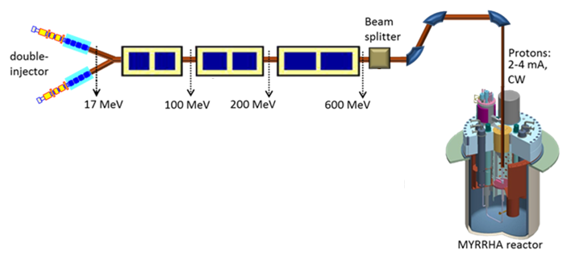
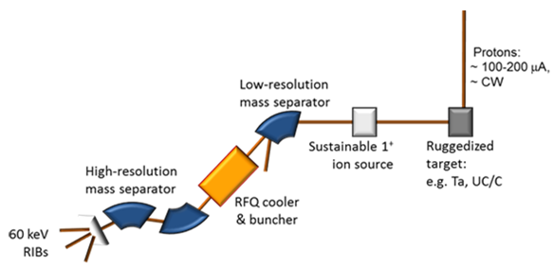

MYRRHA context
Multi-purpose hYbrid Research Reactor for High-tech Applications
SPOKE
352MHz
Double SPOKE
352MHz
Elliptic
704MHz
k eff ~ 0.95
Fuel : MOX
Target : Eutectic Pb-Bi
Reactor :
-Subcritical (65-100MWth)
-Critical (100MWth)
Goals:
- To build a hybrid reactor demonstrator for transmuting radiotoxic waste, (ADS).
- To product Radio Isotopes to medicine
- For fundamental research

Slide 4
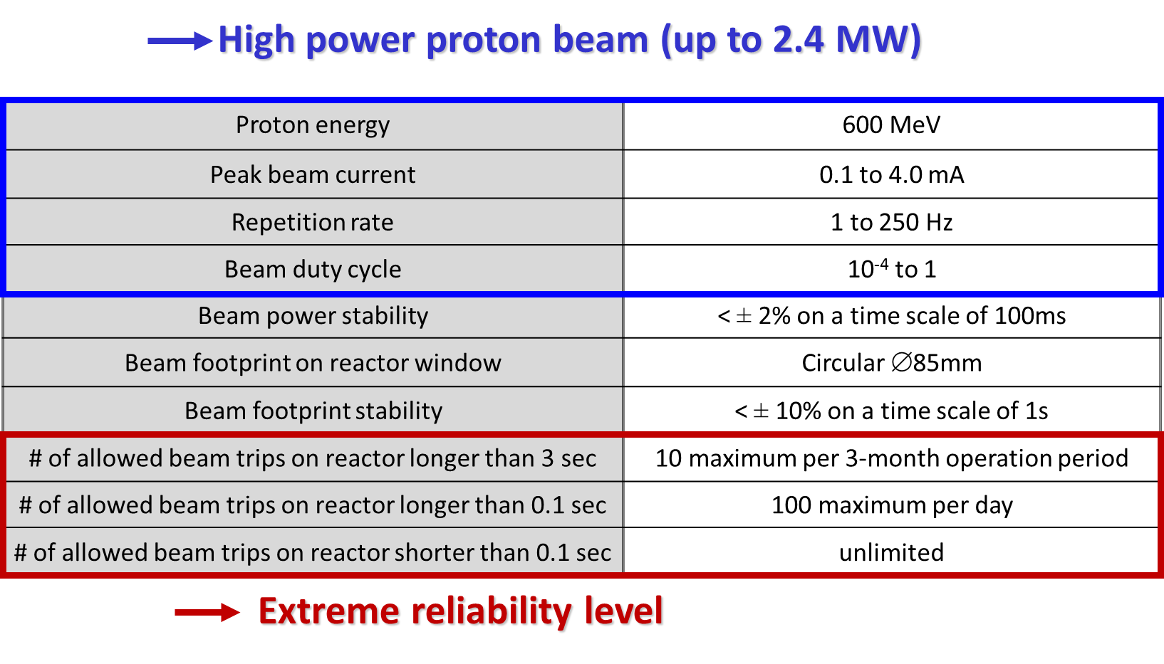
MYRRHA context
CW RF with pulsed beam

Slide 5
MYRRHA context
Extreme reliability Level
Highly reliable diagnostics
No false alarms on beam position and phase
Performant BPM systems

Slide 6
BPM Specifications
Beam
Energy : 17MeV-100MeV
Current : 100µA-4mA
Frequency : 176,105MHz
Repetition rate : 1Hz to 250Hz
Commissioning : Pulsed with duty cycle =1% min to CW
BPM constraints :
BPM diameter : fixed
BPM housing : fixed
BPM outputs :
Position precision : +/-100µm over 10mm radius range
Phase precision : +/-0.5deg over 10mm radius range
BPM interfaces : Machine Protection System MPS, LLRF, …

Slide 7
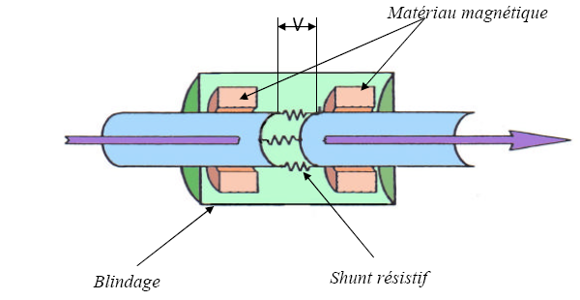
Main BPM types
I
R
« Resistive"
V=R.I
" Capacitive "
SP2, IPHI
I1
1/n.I1
PRAE
I2
" Magnetic "
1/n.I2
Most of proton accelerators use " Capacitive " BPMs. Easy to realize

Slide 8
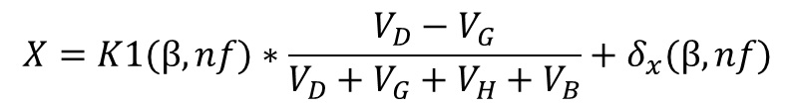

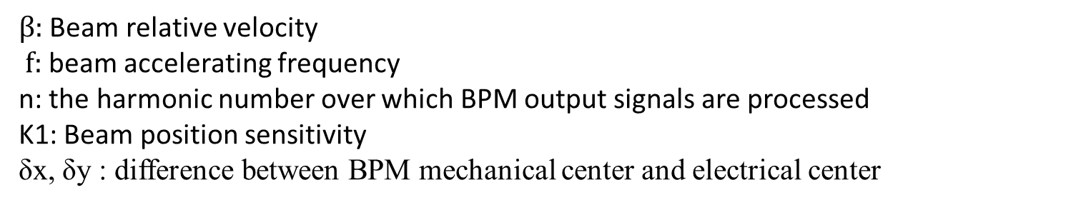
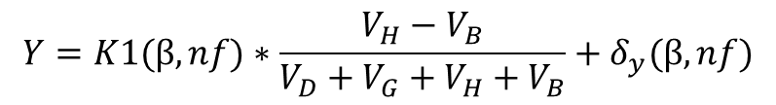
Position/phase Measurement
Electrode H
$$X=K1(β,nf)∗\frac{V_{D}−V_{G}}{V_{D}+V_{G}+V_{H}+V_{B}}+δ_{x}(β,nf)$$
Electrode G
Electrode D
$$Y=K1(β,nf)∗\frac{V_{H}−V_{B}}{V_{D}+V_{G}+V_{H}+V_{B}}+δ_{y}(β,nf)$$
Y axis
X axis
φ$=phase(V_{D}+V_{G}+V_{H}+V_{B}$)
Electrode B
$β:$ Beam relative velocity
$f:$ beam accelerating frequency
n: the harmonic number over which BPM output signals are processed
K1: Beam position sensitivity
δx, δy : difference between BPM mechanical center and electrical center

Slide 9
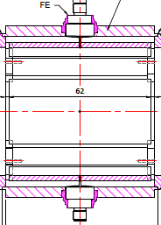
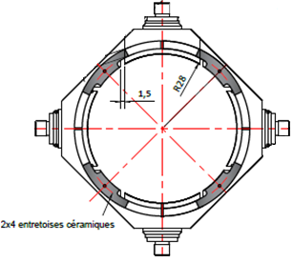
Mechanical Design
Goals: Robust design, maximize output signal
Robustness and precision are achieved using ceramic spacers: each electrode has 5 supports
Electrode
Output signal over the beam energy range [17MeV, 100MeV] is maximized by optimizing electrodes length.
Expected output dynamic range [-52dBm;-12dBm]

Slide 10
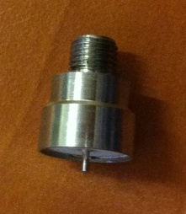
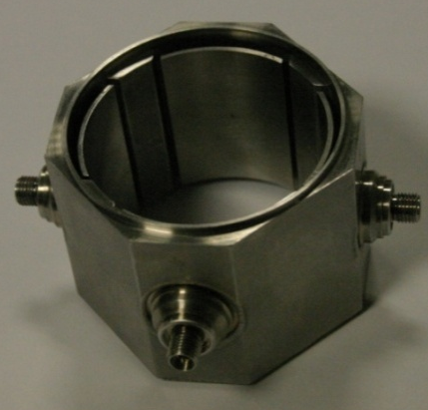
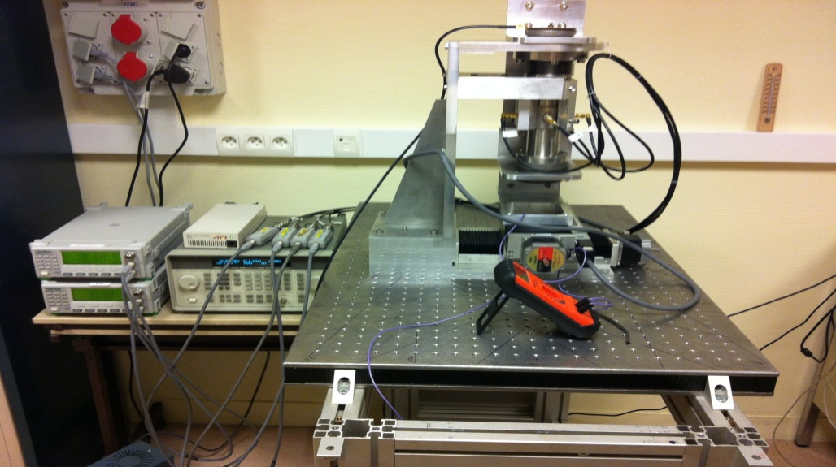
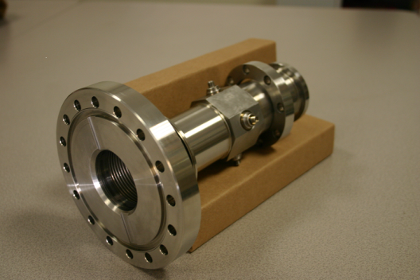
Mechanical
Realization
Steps
Characterization of feed throughs : electrical isolation, capacitance, impulse response
Choice of the feed through to match inside a BPM : minimum difference between feed throughs responses
Verification of the BPM BLOC
Verification of the whole BPM
Characterization of the BPM in order to measure:
  BPM sensitivity
  BPM electrical center
  δx, δy (slide 8)
Feed through
BPM BLOC
BPM
BPM test bench

Slide 11
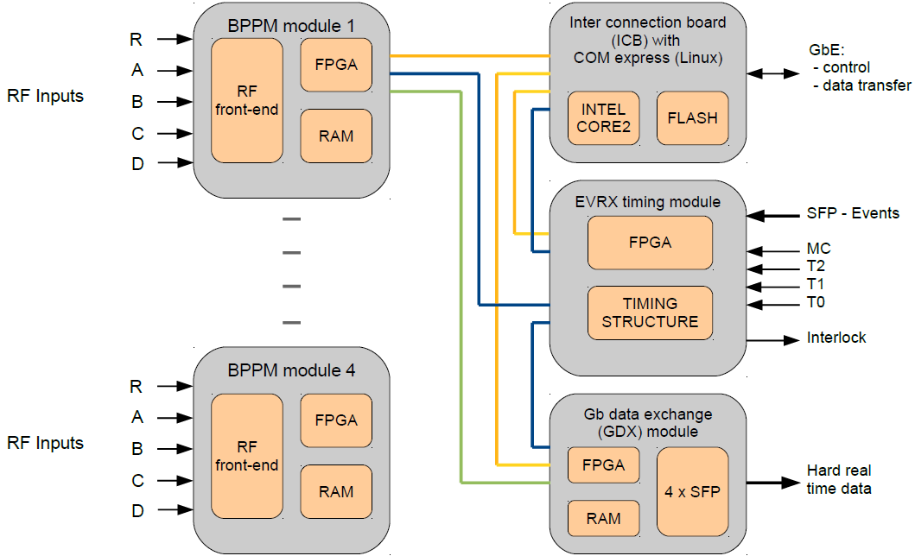
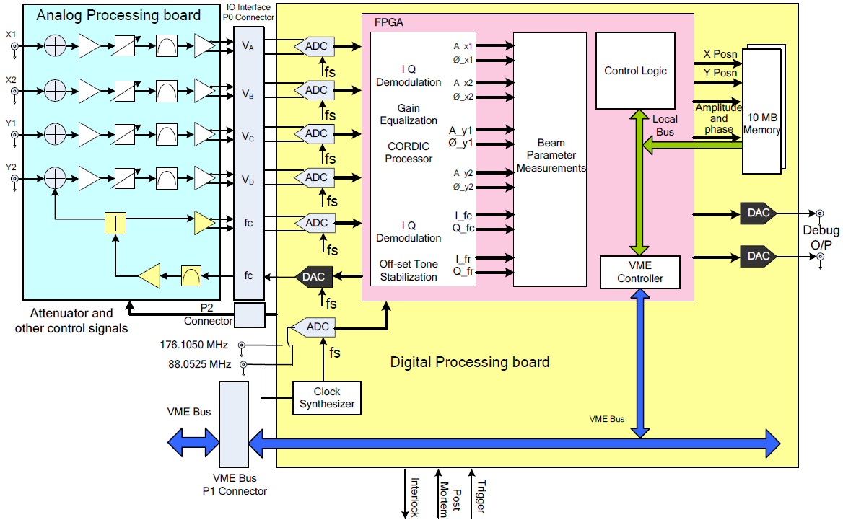
Acquisition System
Solution 1: industrial
Libera single pass H
Direct Digital conversion of the outputs and reference signals
Solution 2: Custom
Example: SP2 BARC module
Conversion of output signals into baseband, before processing

Slide 12
Prototype Timeline
MYRRHA Research and Transmutation Endeavour (MYRTE) :
The goal of MYRTE, a H2020 european project is to perform research to support the development of the MYRRHA facility during 4 years (may2015- may2019) with a main topic : the Injector demonstration.
WP2 : Accelerator R&D for ADS/MYRRHA
WP2.4 : Beam diagnostics development
Procurement of 2 BPMs under WP2,4
Prototype Design : Done
Electronics Specifications : Done
Mechanical realization : expected fall 2017
Electronics realization : expected fall 2017
Qualification : expected 1st quarter 2018
Commissioning on MYRTE : expected 3rd quarter 2018

Slide 13
THANKS FOR YOUR ATTENTION
SLHiPP-7 – ORSAY – 9th June 2017

