Slide 1
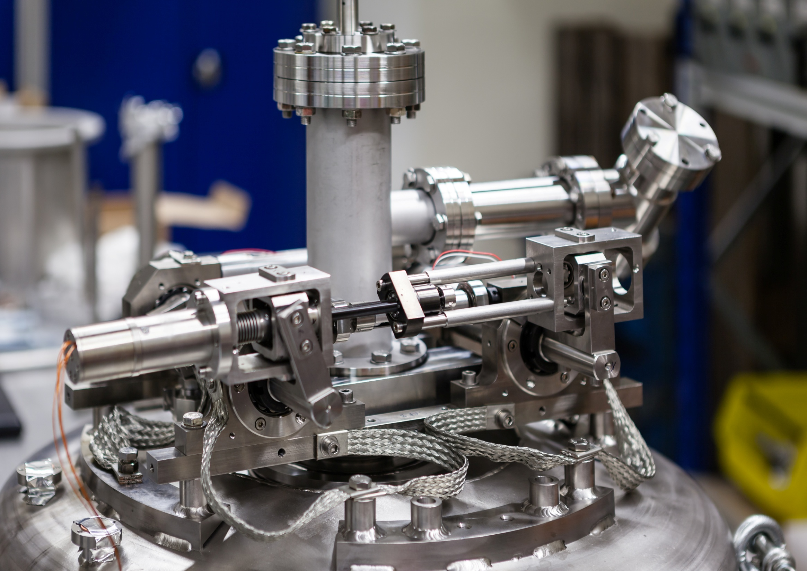



Piezo actuators and tuning systems test results for ESS and MYRRHA
N. Gandolfo
7th SLHiPP meeting at IPN Orsay – 9 june 2017

Slide 2
Outline
ESS double spoke tuner : Intro / results / issues / upgrades
Piezo actuators testing
Disengage system testing
MYRRHA tuner design & plans

Slide 3
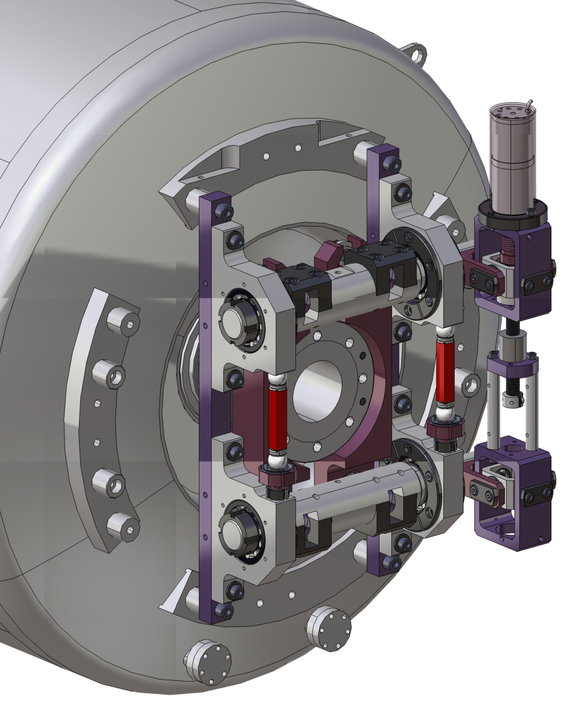
Tuner overview
Slow tuner action
Main purpose : Compensation of large frequency shifts with a low speed
Actuator used : Stepper motor with planetary gearbox (1:256)
Fast tuner action
Main purpose : Compensation of small frequency shifts with a high speed
Actuator used : Piezoelectric
actuators

Slide 4
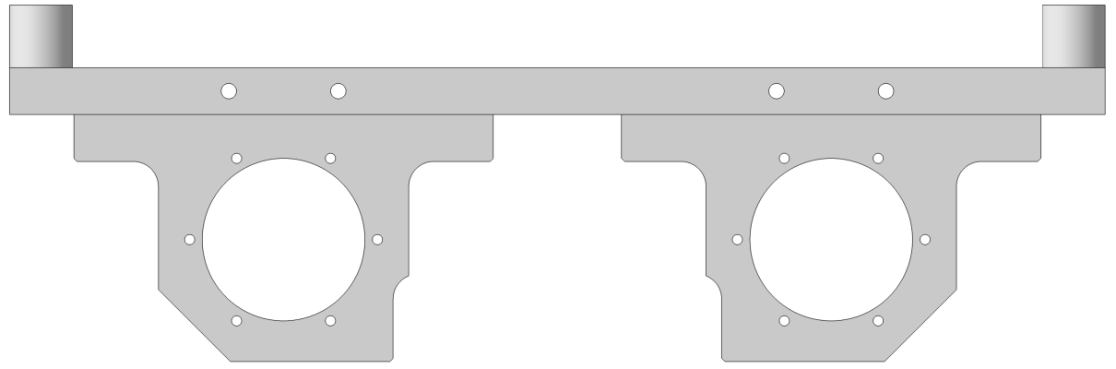
Working principle
Slow tuner principle
A ball screw system driven by a stepper motor acts on a double lever arm mechanism to provide a significantly reduced displacement of the cavity flange along the beam axis.
Cavity body
Flange frame
Bellow
Cavity flange
LHe vessel
Vacuum
Cavity vacuum
LHe bath
Insulation
vacuum
Rods
d
Motor
D
Lever arm
(D/d = 10)
Ball screw (p = 2 mm)

Slide 5
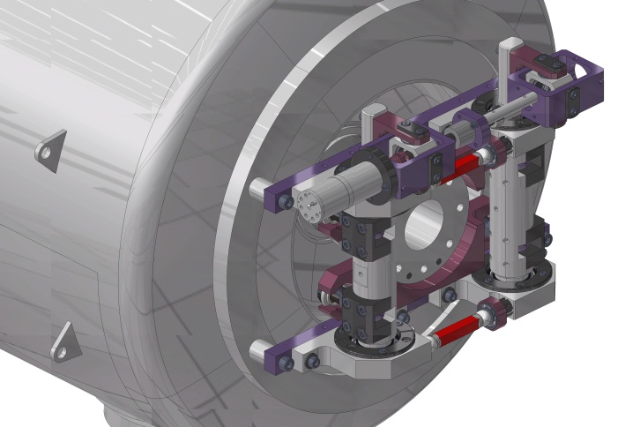
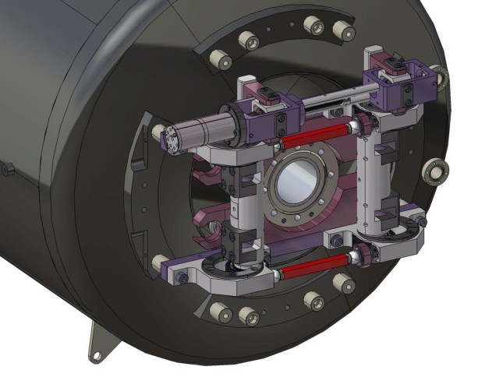
All tuner low temperature tests in a table
First tuner version
Second tuner version
« only » modification : allow to put longer piezo 50 mm ➔ 90 mm
In order to get larger fast tuning range

Slide 6
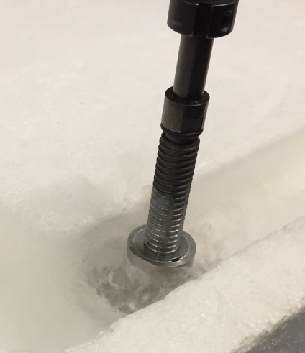
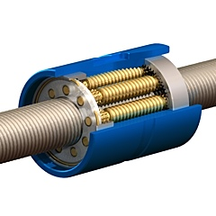
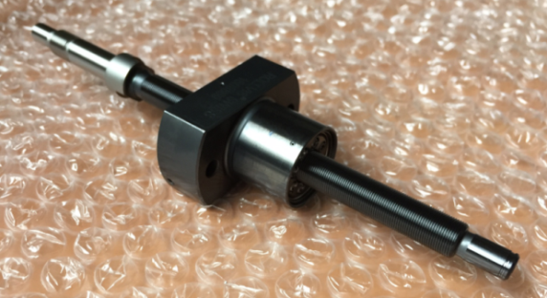
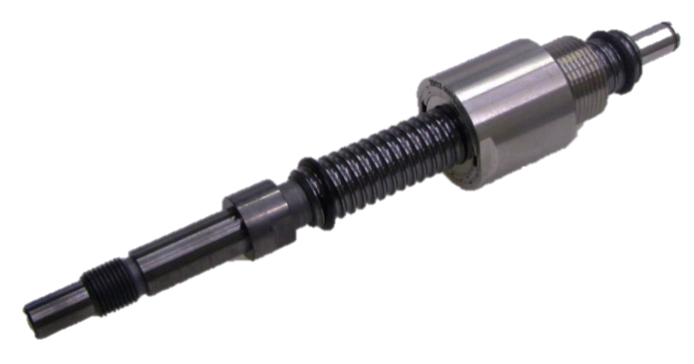
Ball screw issues
On one test at low temperature (January 2016) the tuner get stuck from the start without giving us a chance to move it. Ball screw was suspected to be stuck.
A LN2 bath test of this element has been made :
Strong frictional torque appeared
Industrial high precision grade ball screw with following specifications :
Screw made in stainless steel (AISI 440C)
Balls in zircone (ZrO)
MoS2 lubricant coating
This elements went back to provider, he did not notice any damage.
We decided to replace this ball screw by a satellite roller screw.
In the same dimensions, static capacity is like 10 time higher.
Also, good experience of such elements at low temperature have been proven at Soleil Facility
LN2 bath method
Ball screw
Roller principle
Satellite roller screw

Slide 7
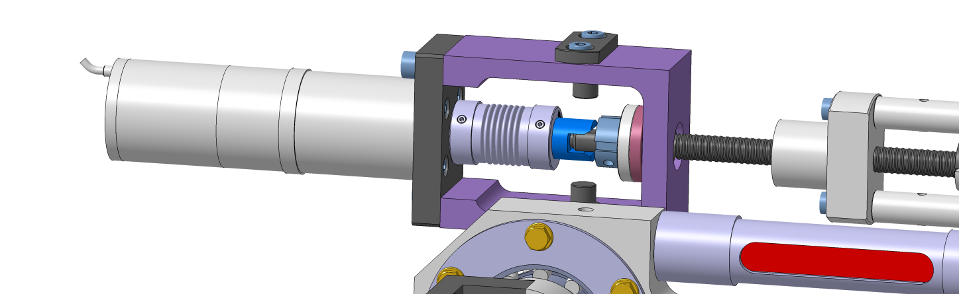
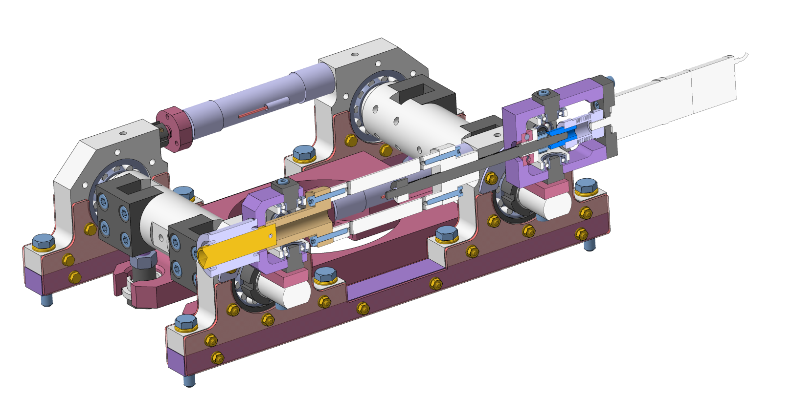
Tuner upgrades
Only two screws to remove the motor
Screwless coupling
Easy access to motor
Improved thermalization
Four large copper frame will accelerate bot warming up and cooling down and reduce the needs of thermal braids

Slide 8
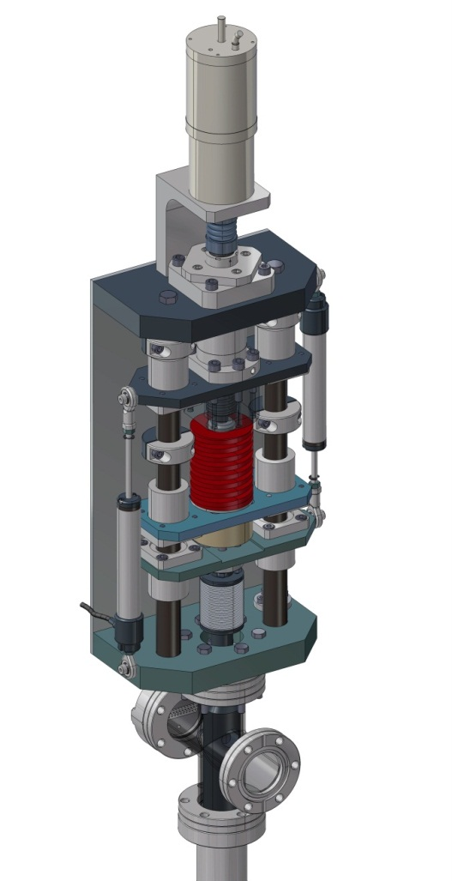
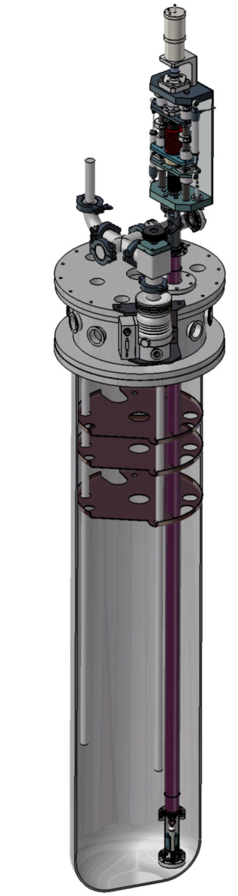
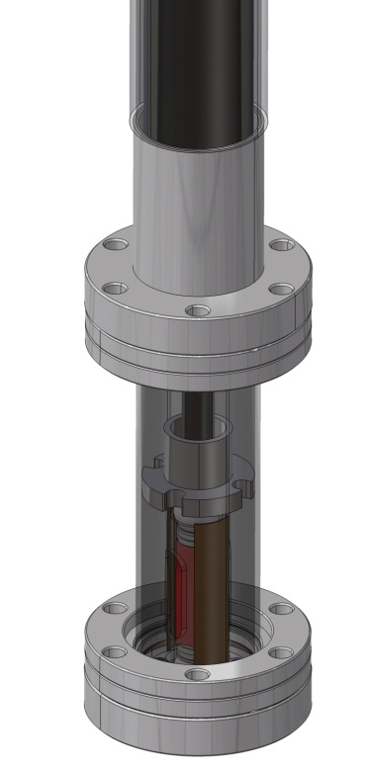
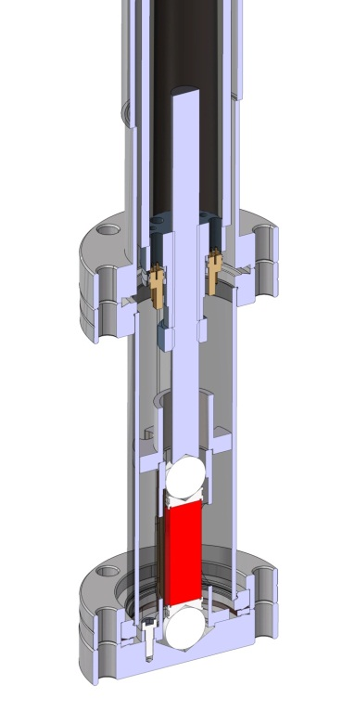
Piezo actuators tests
R&D program : Dedicated tool built for testing piezo at low temperatures.
Features :
Compressive force (0 to 4kN) applied with electric motor + springs (with various stiffness)
Online force measurement thanks to a RT load cell and a stiff coaxial transmission tube
Axial displacements in the cold box up to 20 mm, also measured on RT side
Possibility to cool with LHe (for characterization) or LN2 (for accelerate life test)

Slide 9
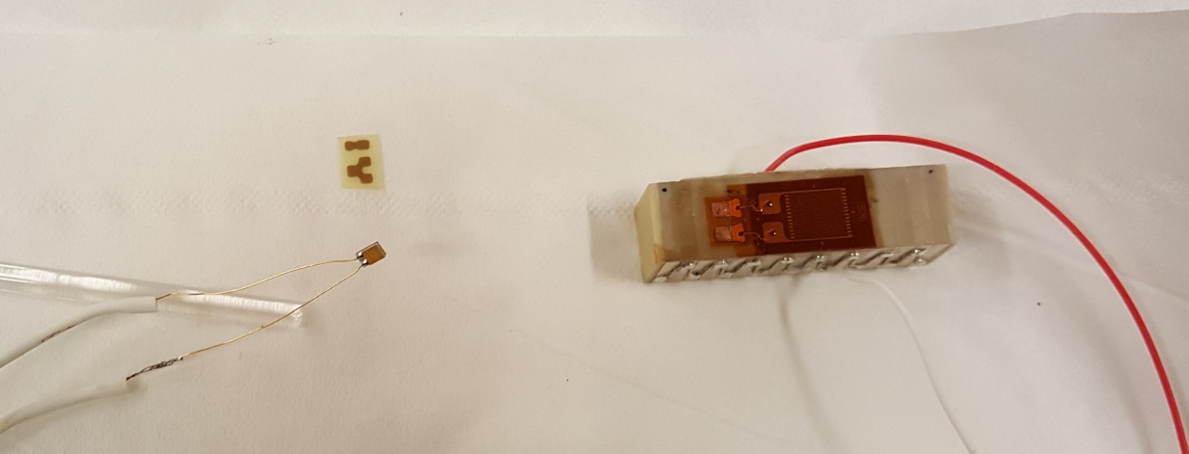
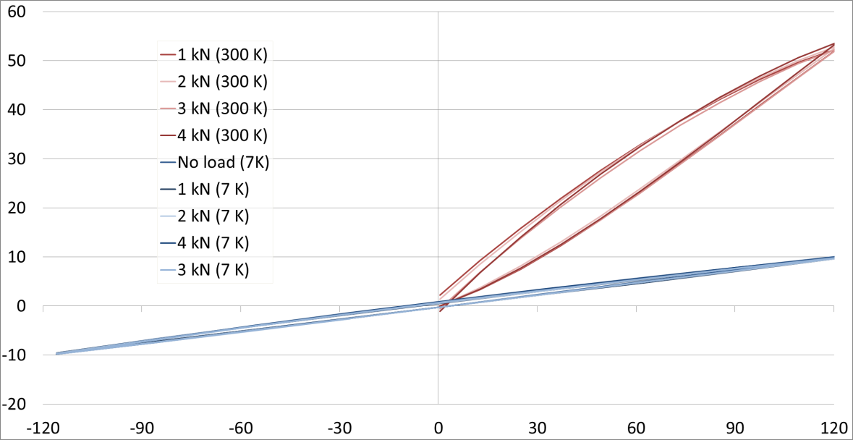
Piezo actuators tests
Instrumentation
The piezo actuator is equipped with a strain gage to measure its elongation and a Cernox temperature sensor.
Both are glued directly on it.
Two piezo were tested :
Noliac 36x10x10 mm^3
Physik instrument (PI) : PICMA
All tests have not been done on both.
Noliac piezo (at right) with its strain gage during gluing and cabling
Effect of the preload on the strain (PI piezo)
It is well know to use preload when using piezo in with AC signal, typically 2 kN for 10x10 mm² section stack.
Here we can see there is no significant change on the strain when loading the piezo from 1kN to 4kN, both at 300K or 4K.
300K
Displacement (µm)
7K
Excitation voltage (V)

Slide 10
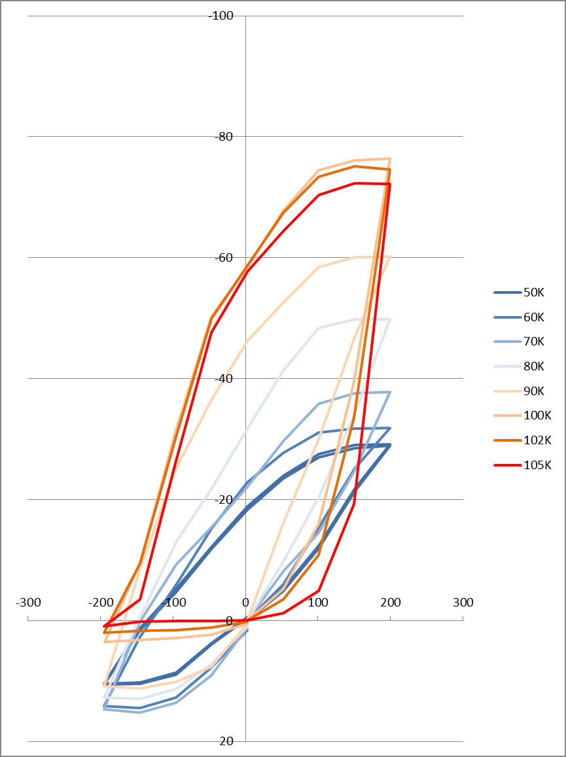
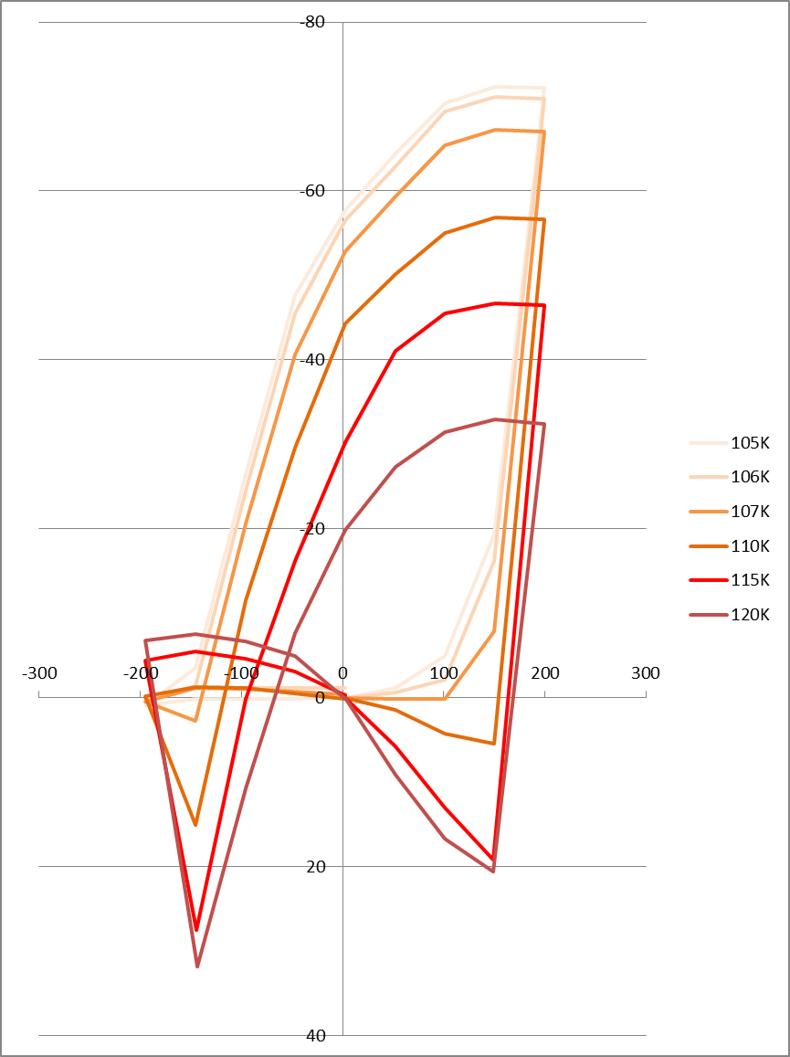
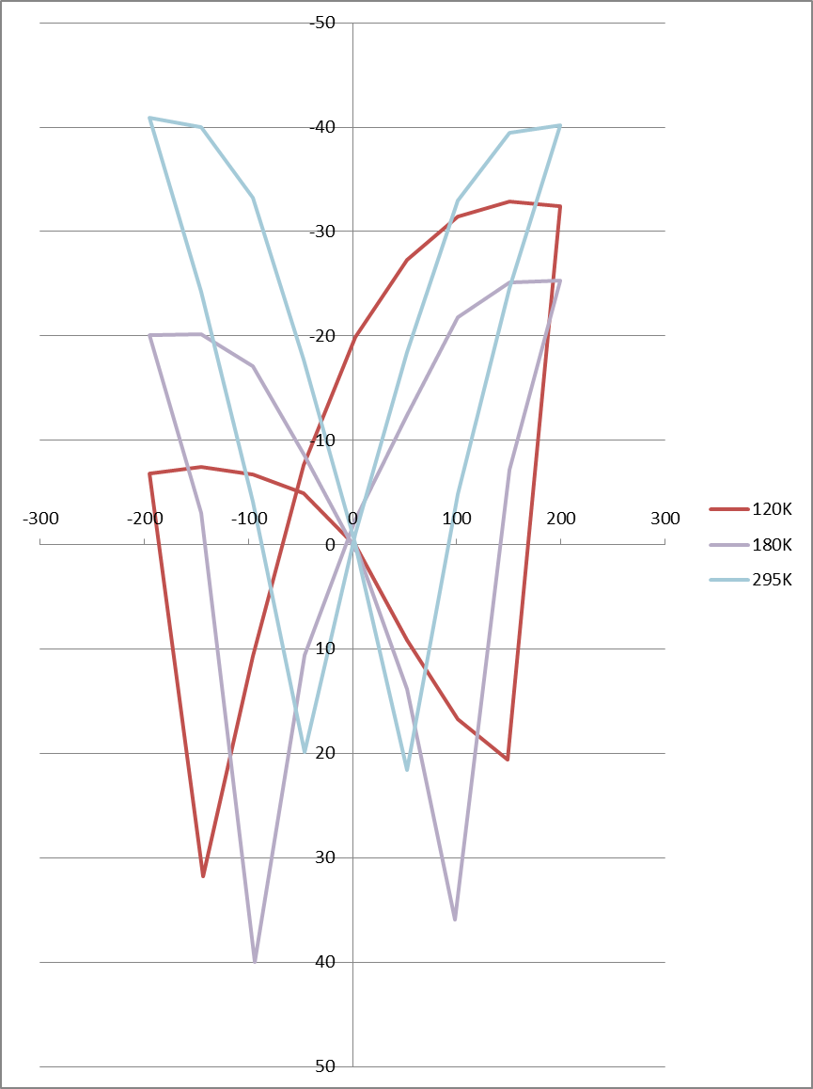



Piezo actuators tests
Bipolar mode test : Strain (µm) Vs voltage (V) over large range of Temperature (Noliac piezo)
Piezo providers agree on the use of both positive and negative excitation voltages when piezo is at 77K or lower.
We made a continuous DC scan during all the warming up of the cryostat while gathering strain data.
The results show a the start of the non linearity around 100K. Problems may appear if you intend to use piezo in bipolar mode above this temperature.
+/- 200 V excitation
T < 105 K
Bipolar mode OK
105 K < T < 120 K
Non linearity appears
120 K < T < 295 K
« Butterfly » diagram

Slide 11
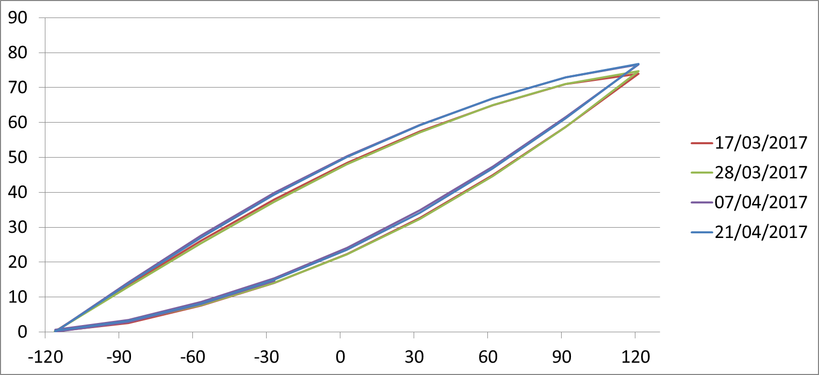
Piezo actuators tests
Accelerated lifetime test at 77K (PI piezo)
34 days excitation with a 117Hz sine (but unipolar 35 V → 85 V to prevent overheating)
3.39 * 10^8 cycles ( equivalent to more than one year operation of ESS)
Checked the strain every 10 days ➔ no significant variation on piezo strain
Displacement (µm)
Excitation voltage (V)

Slide 12
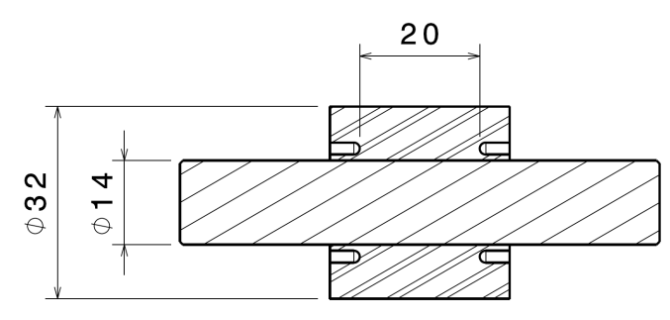
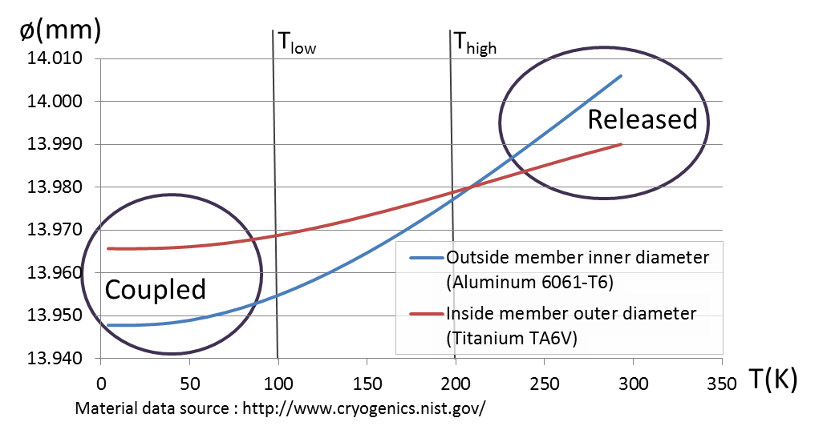
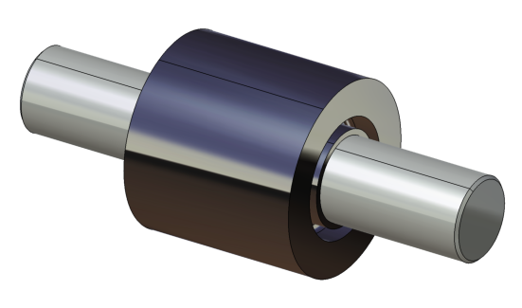
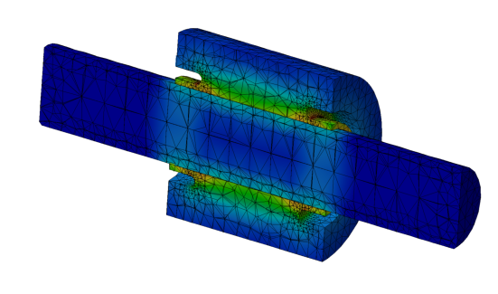
Disengage system
Introduction : During operation, part of the cavity body is potentially highly stressed (up to 311 MPa) by the tuner action, much far away from the RT elastic domain (around 40 MPa). This can lead to cavity damage risk in a case where the tuner is getting stuck.
Goal : Get the possibility to release the cavity from the tuner prior any warming-up, even in case of failure of motor/gearbox/ballscrew.
Idea : Put inside the tuner a disengage system that act likely as a mechanical
switch and rely on the association of two different materials to :
Release the system above a temperature (> T_{high})
Couple the system at low temperature (< T_{low})
(old design values)
A heater located on the outside member provides heating to the whole assembly.
(old design values)

Slide 13
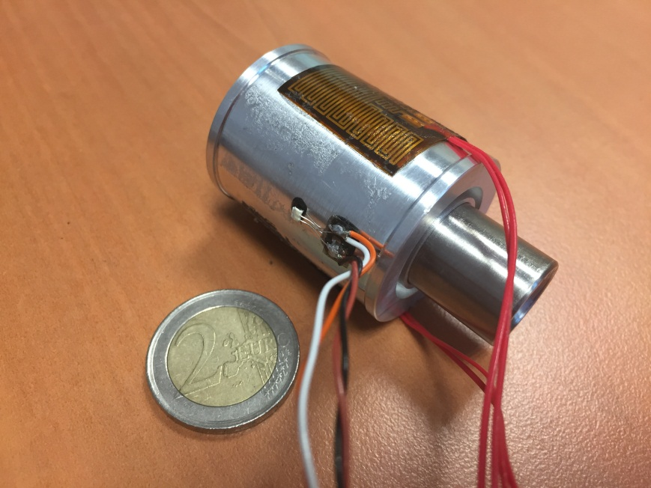
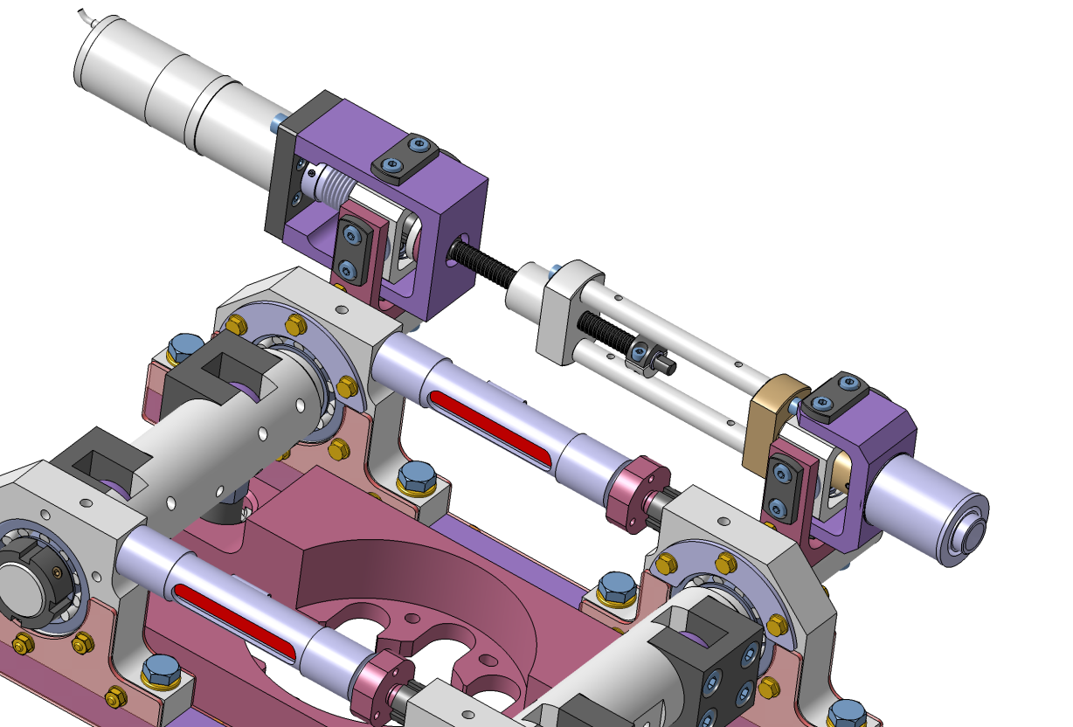
Disengage system
Where would it goes ?
Preliminary computations showed some difficulties to find a model that fit well to the already existing design and transmit up to 20 kN force which is the tuner specification.
An idea is to put it on the screw/nut system, thus before the lever action there is only 1kN max force to transmit.
Heaters (x2)
Thermal sensor
Ballscrew
What does it look like ?
Disengage system

Slide 14
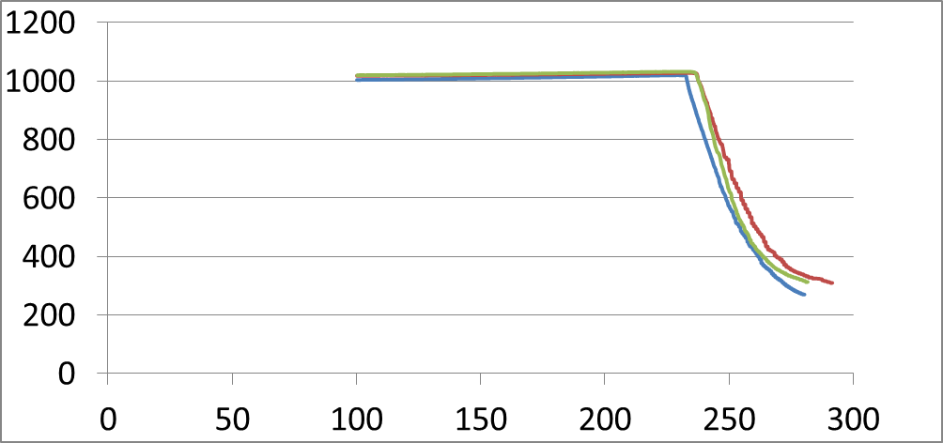
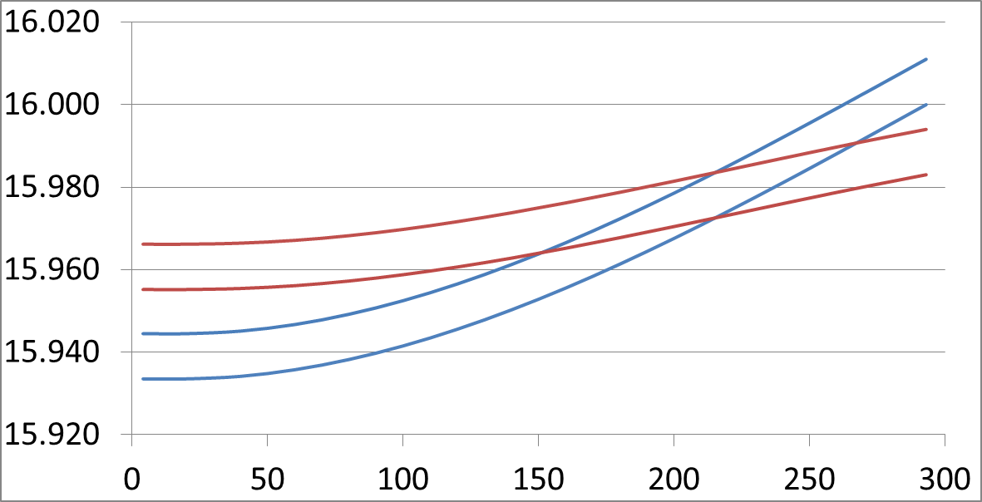
Disengage system
Test protocol :
1- Cooling down to 4K : no force applied
2- Applying a force
3- Heating up to 300 K : dissipating 30 W on two resistive film heaters → 30 minutes
Result with ø16 mm device (1 sample) :
The system disengage smoothly with good reproducibility from 230 K to 300 K.
F(N)
Heating up from 4K to 300K
Inside member ø
Ø(mm)
Start to disengage around 230K
Outside member ø
T(K)
T(K)
3 runs of heating on same setup and same day
Diameter over T(K)

Slide 15
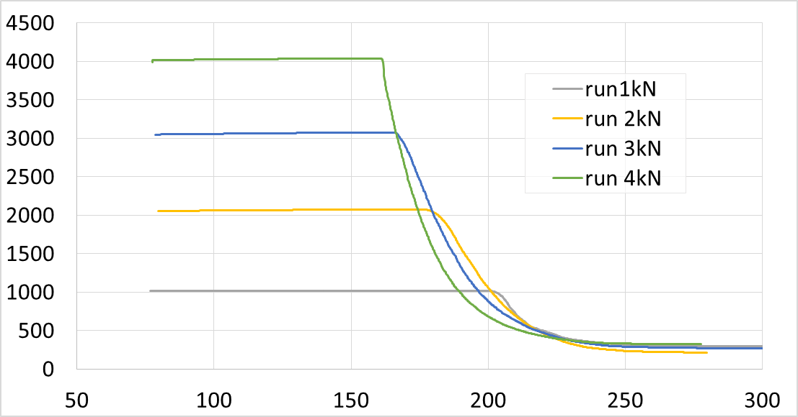
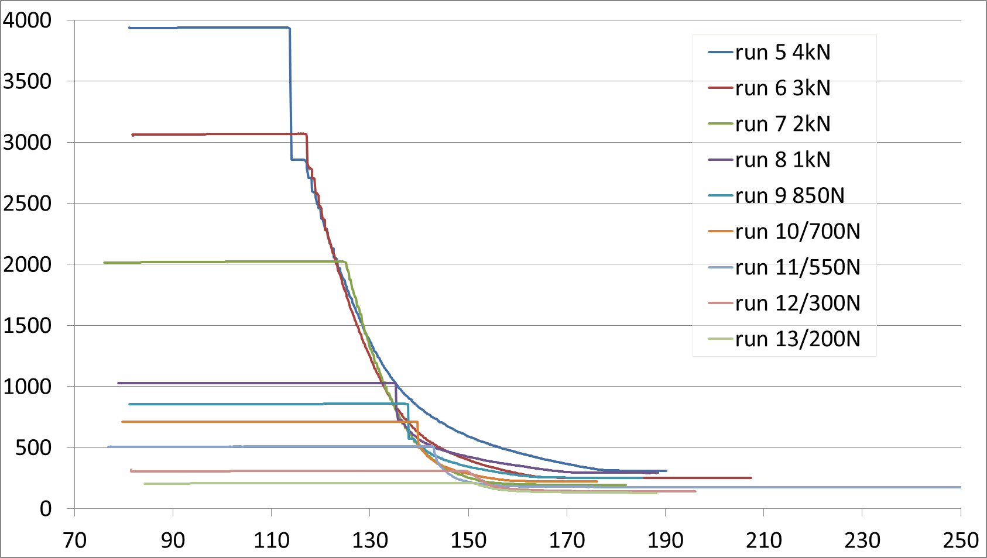
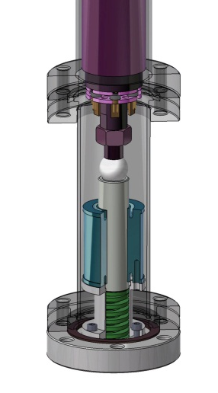
Disengage system
Results with ø14 mm devices (2 samples)
With different preloading scenarios, the system start to disengage at different temperatures which is normal.
Everytime, we can consider it is fully disengage at less than 250K.
Force applied (N)
#2
Temperature (K)
Force applied (N)
Residual forces due to reset spring
#1
Temperature (K)

Slide 16
Preparing the production for ESS spoke tuners
Procurement stage : Motor / Ball screw / Piezos / Pre assembled mechanics
➔ For piezo, we will ask the suppliers to supply customized solution according to our specifications
Assembly stage
Burn-in test RT + LT
Cavity + tuner vertical test
Cryomodule integration
Check the performances of each tuners without cavity
Ensure a cavity+tuner pair fulfill the final resonant frequency requirement prior a cryomodule assembly

Slide 17
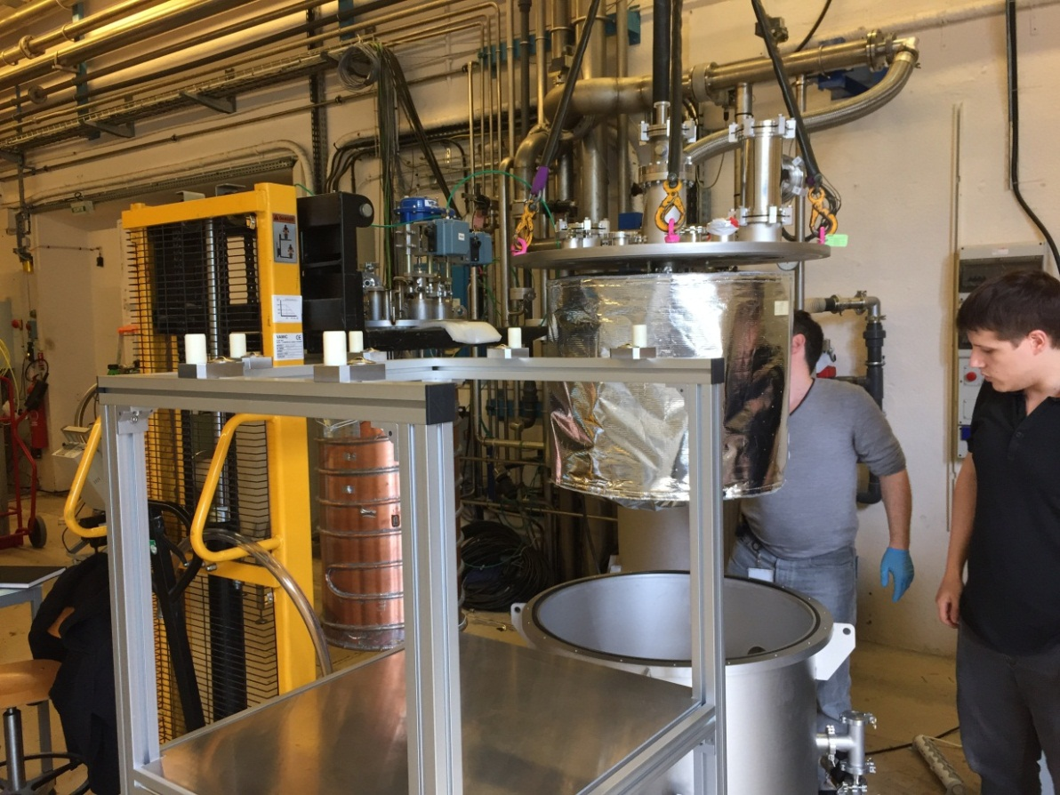
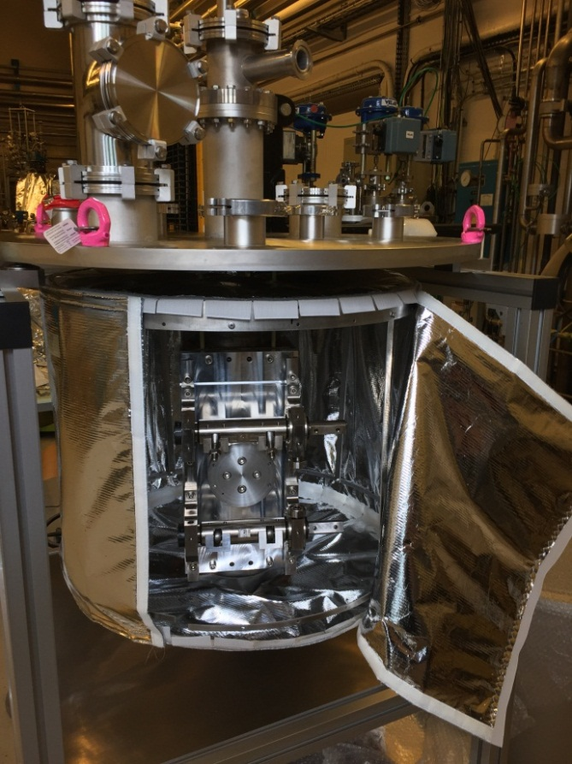
Burn-in test dedicated cryostat
First tests scheduled for this summer
Long term operation with up to 4 tuners without cavity (more safe) at 300 K and 77 K
Goals are :
  Validation of the tuner trough a burn in test (300K and 77K) prior utilization on a cavity
  Accelerated life test of whole tuners at 77K planned for 2018/2019.
  Easy R&D on actuators and mechanical joints at low temperature

Slide 18
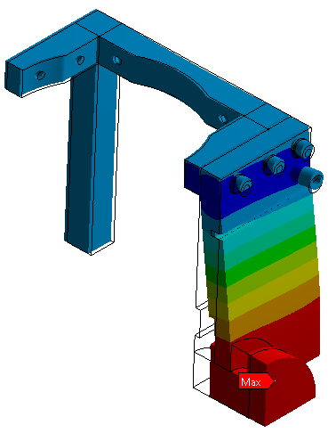
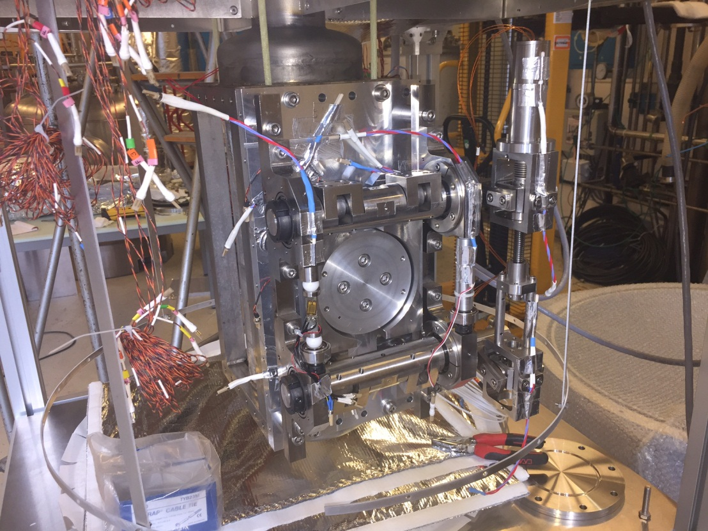
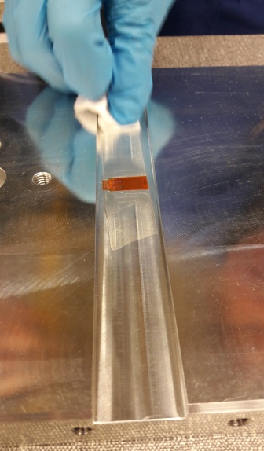
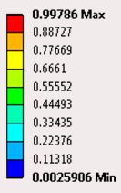
Burn-in test dedicated cryostat
Stiff frame simulates the cavity stiffness to achieve both all tuning range with the nominal expected forces
Made of Aluminum 6082 T6 plate with 21 mm thickness
Equipped with strain gage so we can check if the tuner is responding properly
Unit : mm
Strain gage gluing
Displacement ~1 mm
Stiffness ~20 kN/m
Tuner fully equipped on the cold mass

Slide 19
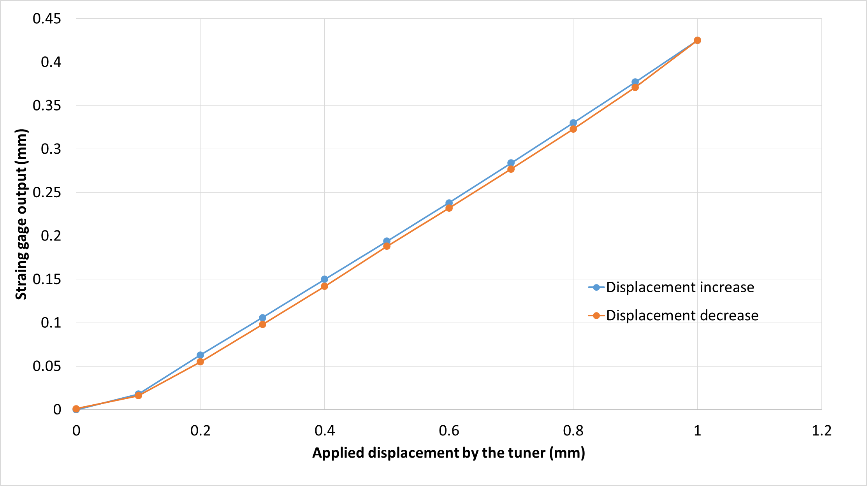
Burn-in test dedicated cryostat
First test to validate the setup at room temperature
➔ around 46% of displacement absorbed in the tuner, same behavior than on a cavity
7kN force

Slide 20
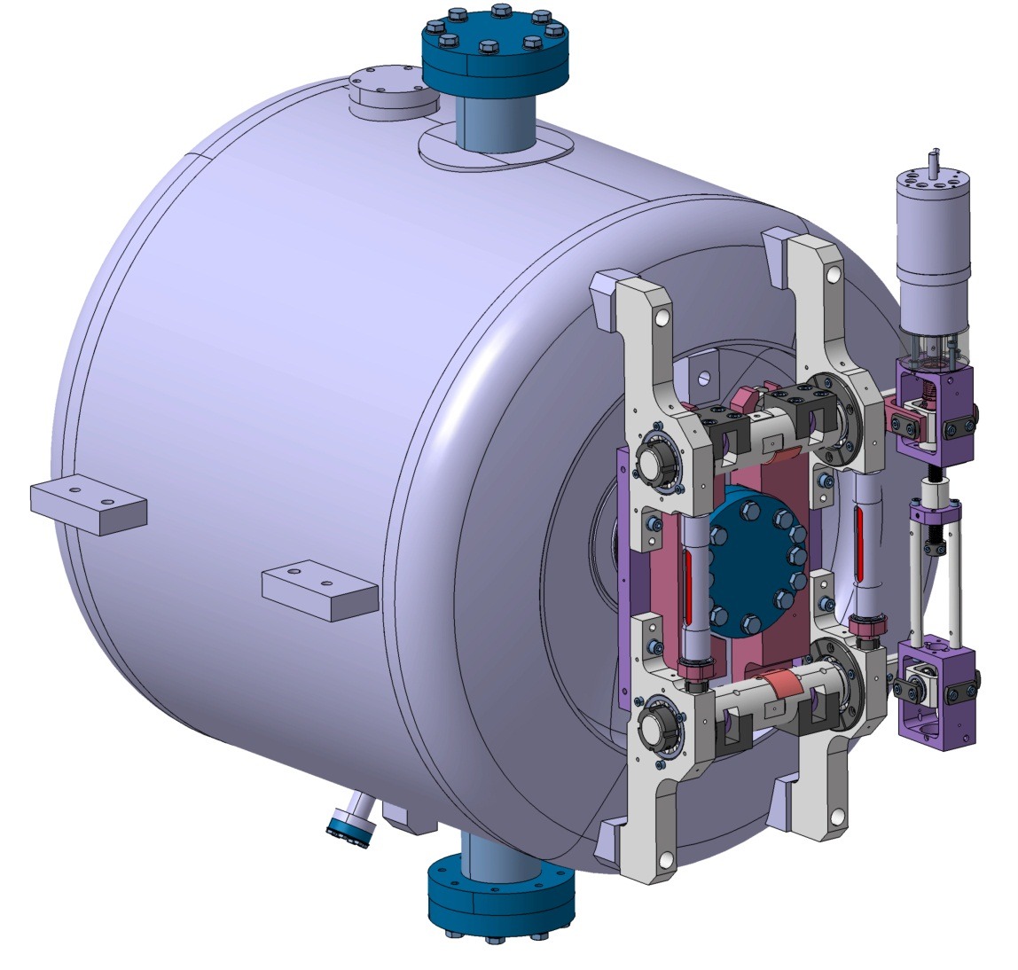
MYRRHA single spoke cavity tuner
Cavity parameters are very close to the ESS double spoke
Bigger motor in order to achieve 100x cavity bandpass (16 kHz) in 1s
Possibility to quickly detune / retune the cavity in order to satisfy the fault recovery procedure
Will be tested in the tuner cryostat first
Cavity parameters
Cavity Stiffness | 14.5 kN/mm
Cavity strain | 367 MPa/mm
Cavity stiffness | 170 kHz/mm
LHe vessel stiffness | 196 kHz/mm

Slide 21
Conclusions
Many ESS spoke prototype tuner tests have been done, most have worked well but some revealed some irregularities on piezo and joints.
Most of those have been corrected/enhanced to handle ensure better reliability and ease the maintainability.
A dedicated tool bench have been developed in order to validate each tuner prior cryomodule integration with 300K and 77K burn-in tests.
MYRRHA spoke tuner design will be very similar and will take benefits from experience learned on ESS spoke tuner.
Fault recovery procedure to be tested and validated
R&D will continue with accelerated lifetime tests on piezo and tuners.

Slide 22
Acknowledgment
Thanks to many people who helped on this work :
S. Bousson, S. Blivet, S. Brault, F. Chatelet , S. De Lima, F. Dubois, P. Duchesne, S. Durand, P. Duthil, F. Galet , D. Grolet, A. Guilbot, D. Longuevergne, R. Martret, G. Olry, T. Pépin-Donat, M. Pierens, V. Quipourt, D. Reynet, S. Roset, O. Spiga, Y. Zeraia

