Slide 1

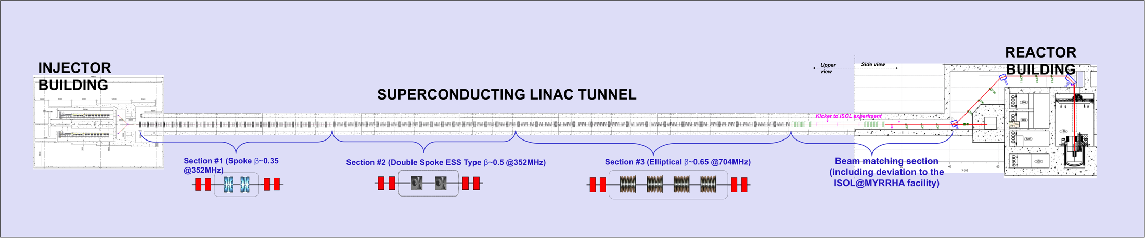
Status of MYRRHA
Dirk Vandeplassche, Jorik Belmans, Wouter De Cock SCK•CEN
SLHiPP-7, Orsay
June 8, 2017

Slide 2
MYRRHA: recall
MYRRHA: ADS project 100 MW_{th}, 600 MeV CW linac
phased approach
  100 MeV
  600 MeV
  Pb-Bi cooled reactor
100 MeV subdivision = teams
  accelerator: prototyping → construction
  target: design
  buildings: functional descriptions, initial integration

Slide 3
600 MeV

Slide 4
100 MeV layout

Slide 5
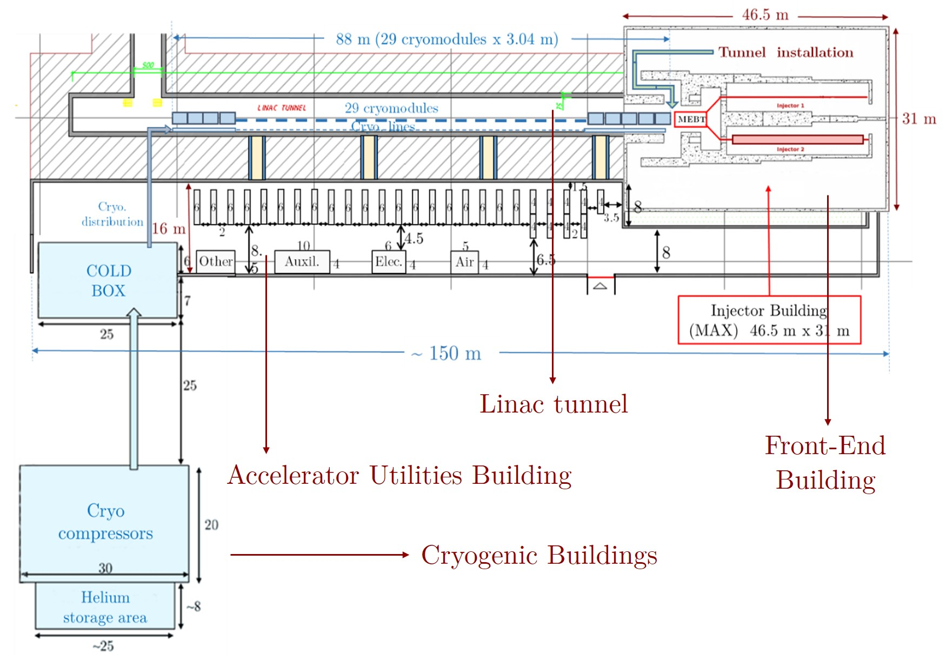
accelerator building
figure by ACS

Slide 6
100 MeV accelerator program
goal and schedule
  decisional hold point 2024 after 2y commissioning
  construction ready 2022
  financial milestone end of 2017
  prototyping & construction in parallel 5y
frameworks
  H2020: MYRTE: historical partners
  collaboration agreements with defined financial scenario: IN2P3, U. Frankfurt/IAP, UCL/CRC
  industrial contracts: Bevatech, ACS, (Cosylab)

Slide 7
100 MeV accelerator program
WPs
  ECR ion source + LEBT + chopper
    existing
    LPSC Grenoble
    cfr. Frédéric Bouly's talk

Slide 8
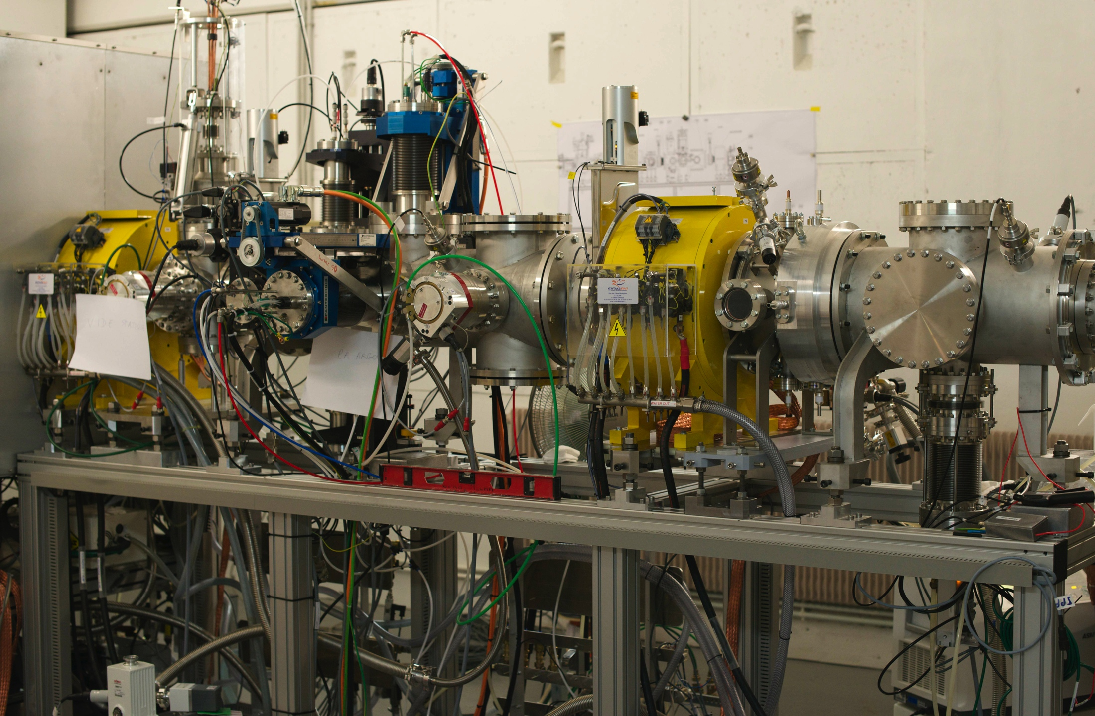
LEBT

Slide 9
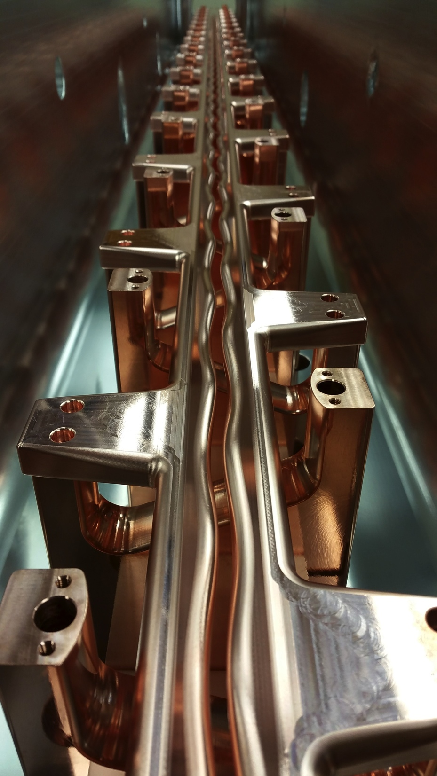
100 MeV accelerator program
WPs
  ECR ion source + LEBT + chopper
    existing
    LPSC Grenoble
    cfr. Frédéric Bouly's talk
  MYRTE: RFQ 4-rod, CW, 1.5 MeV, 176 MHz, 5 mA
    cavity 4 m (NTG + IAP)
    SS amplifier 160 kW (IBA)
    LLRF µTCA-based (IPNO)
    EPICS (Cosylab)

Slide 10
100 MeV accelerator program
WPs
  MEBT1 + diagnostic bench
    inspired by Spiral2 bench
    goal: beam characterisation + diagnostic test platform
    bench being designed (LPSC, IRFU, IPNO, IPHC, IAP, ...)
    to be installed after MEBT1 (Bevatech)

Slide 11
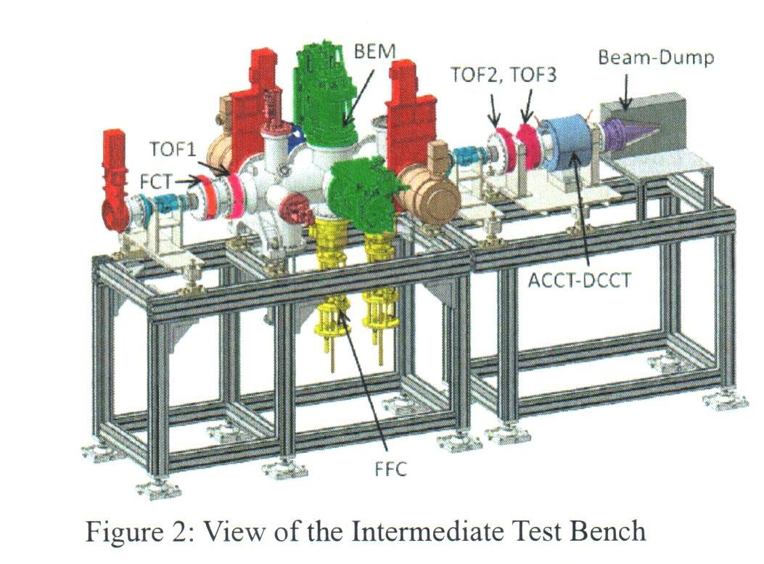
Spiral2 test bench

Slide 12
MEBT1
figure by Bevatech

Slide 13
100 MeV accelerator program
WPs
  MEBT1 + diagnostic bench
    inspired by Spiral2 bench
    goal: beam characterisation + diagnostic test platform
    bench being designed (LPSC, IRFU, IPNO, IPHC, IAP, ...)
    to be installed after MEBT1 (Bevatech)
  CH section
    7 cav. (5.9 MeV) + MEBT2 + 8 cav. (16.6 MeV): detailed concept design by IAP, engineering design by Bevatech
    magnets: quadrupoles, steerers
    176 MHz RF

Slide 14
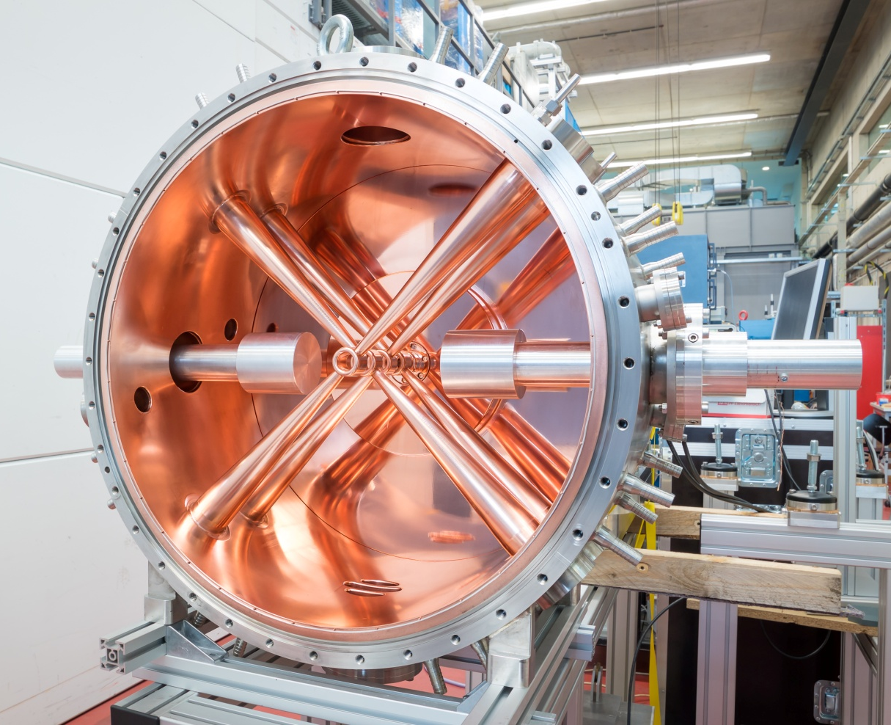
IAP: CH cavity 175 MHz

Slide 15
5.9 MeV by Bevatech
figure by Bevatech

Slide 16
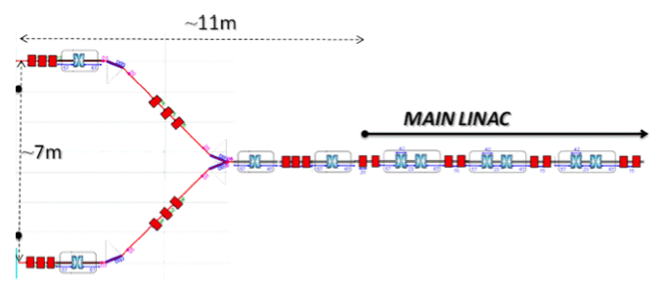
100 MeV accelerator program
WPs
  MEBT3 @ 17 MeV: strategic for fault recovery
    fast switching dipoles, quadrupoles, SC rebunchers
    selection dipole
    diagnostics, scrapers
    beam dump(s)
    to be designed (IPHC)

Slide 17
100 MeV accelerator program
WPs
  spoke section: IPNO, LPSC, LAL
    cryomodule: designed
    valve box
    power couplers
    warm section
    352 MHz RF
    industrialisation for series of 25–29 crymodules
  cryogenics: ACS → industry
prototyping (2 cavities will be ordered soon)

Slide 18
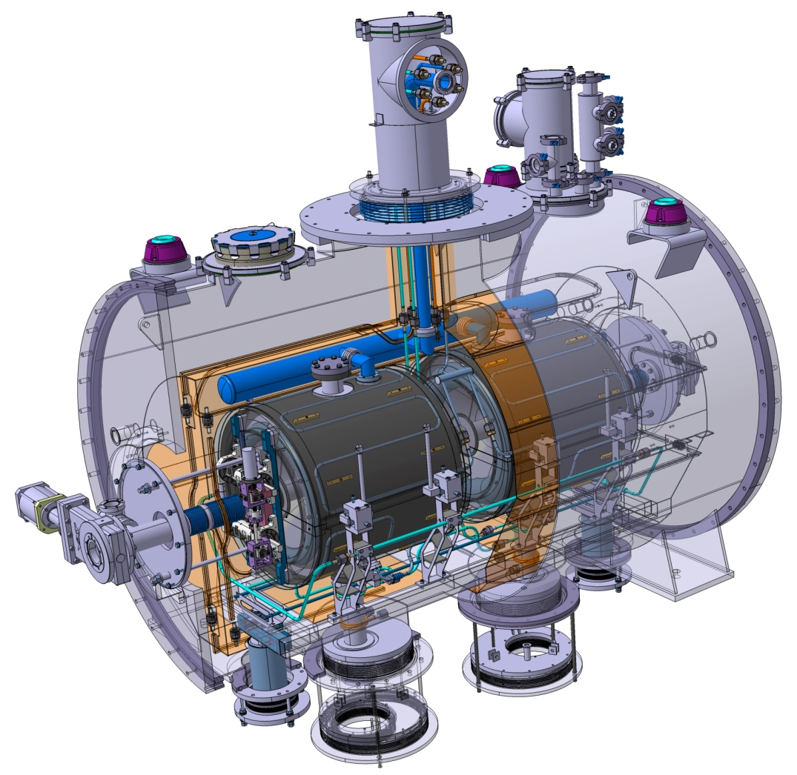
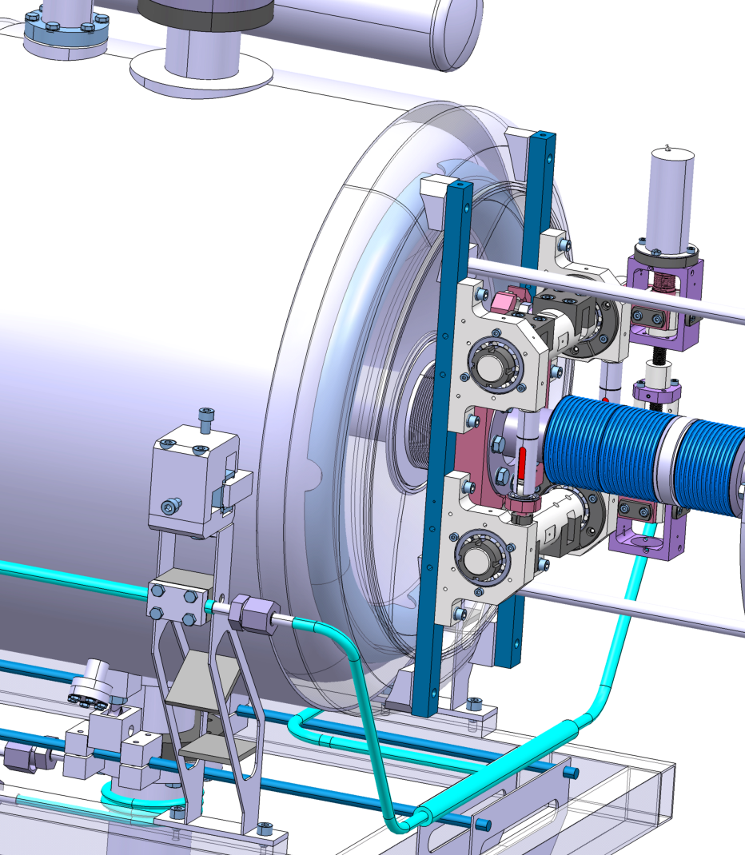
single spoke cryomodule
figure by IPNO

Slide 19
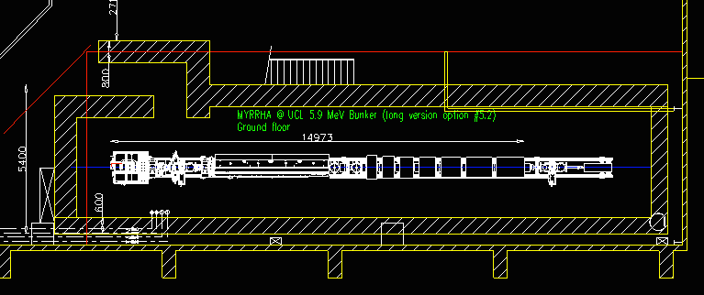
near future activities @ LLN
purpose: installation of 5.9 MeV injector with diagnostic bench and beam dump
  new bunker 24m

Slide 20
near future activities @ LLN
  near milestones
    August '17: start construction of bunker
    September '17: arrival of ECR-IS + LEBT
    December '17: arrival of RFQ + RF amplifier
    Q2 '18: first characterisation of RFQ beam with dipole
  manpower increase
    mechanical engineer
    beam dynamics physicist
    RF engineer
    technician
control system engineer
program manager
integration engineer
documentation manager

Slide 21
Conclusion
dark sides ?
highlights
  hardware at LLN: show, learn, test, attract ...
  significant prototyping program
  ambitious construction program
  internal organisation
  collaborations
  MYRRHA Accelerator TDR being finalized

