Slide 1
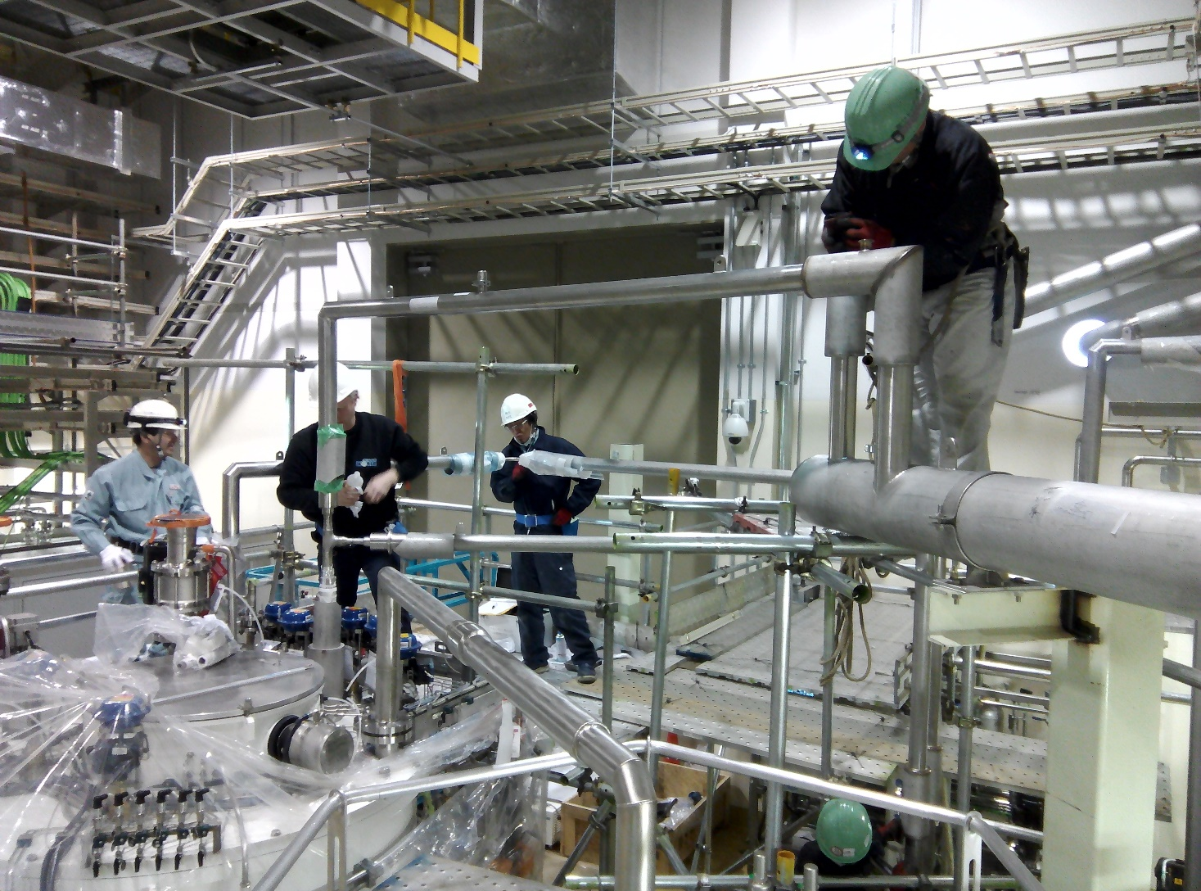
Ifmif Cryoplant : installation and commissioning
Bertrand RENARD (CEA)

Slide 2
Ifmif-eveda
The International Fusion Materials Irradiation Facility
(Engineering Validation and Engineering Design Activities phase), is an accelerator-based neutron source that will use Li(d,xn) reactions to generate a flux of neutrons with a broad peak at 14 MeV equivalent to the conditions of the Deuterium-Tritium reactions in a fusion power plant.
Under a procurement agreement between F4E (EU) and QST (JA), the cryoplant is meant to cool one SRF Linac with 8 Half-wave resonators and 8 solenoids packages.
The Ifmif cryoplant is medium-size standard and was delivered by
Air Liquide Advanced Technologies
2

Slide 3
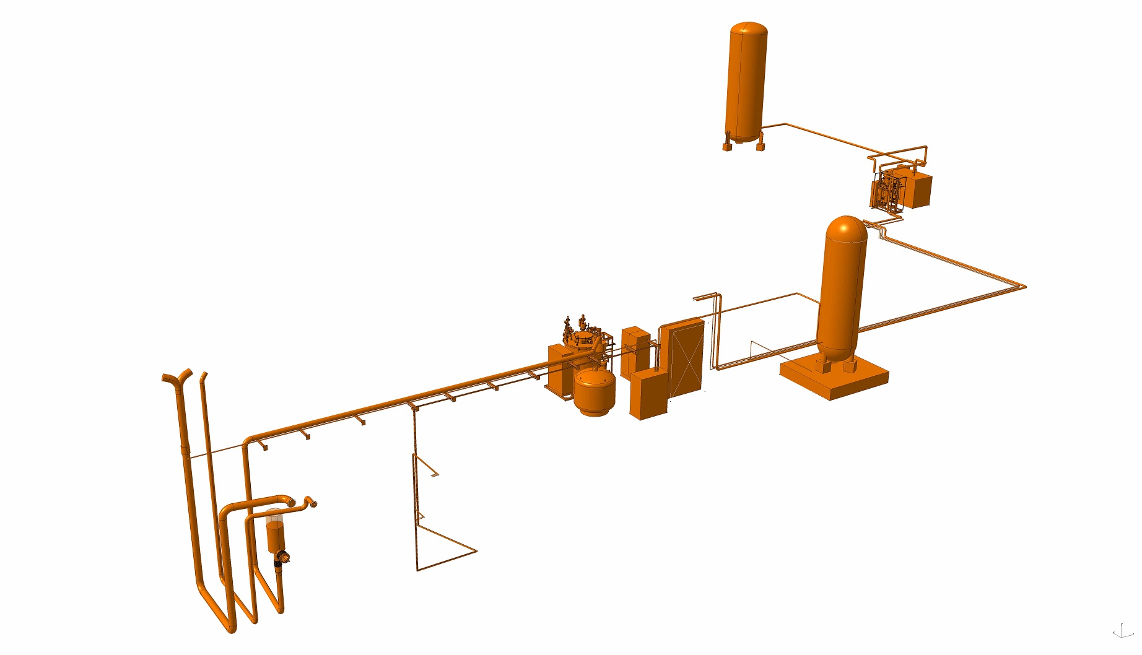
Ifmif Cryoplant description
Cryogenic production
Cold Box, Compressor unit, Oil Removal System,
Local Control System
Cryogenic distribution
Dewar, storage Buffer, atmospheric Heat Exchanger and Room Temperature Valve Panel
Cryogenic lines, room temperature piping
cabling
3

Slide 4
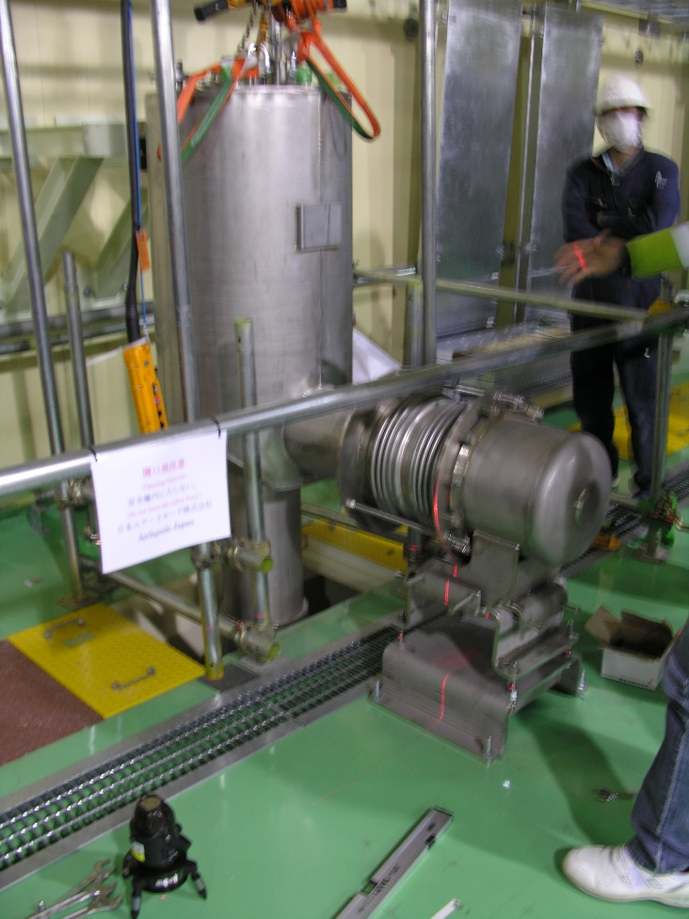
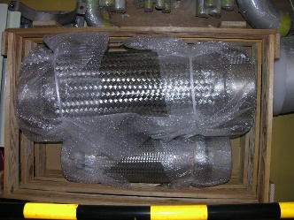
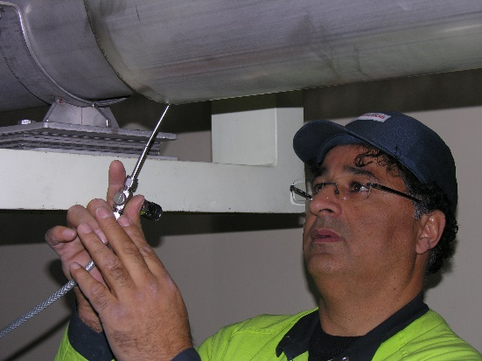
Ifmif Cryoplant preparation
Cryoplant and cryomodule interfaces installation in advance
All connections with +/-10 mm flexibility in 3D
cryogenic connection (with additional
cooling flexibility for internal lines)
Current Leads outlets
Power Couplers outlets
Safety relief chimneys
Cryogenic power margin
50% margin for static loads
20% margin for dynamic loads
Licensing preparation
(ASME + additional requirements)
Equipment and tests
Certificates
4

Slide 5
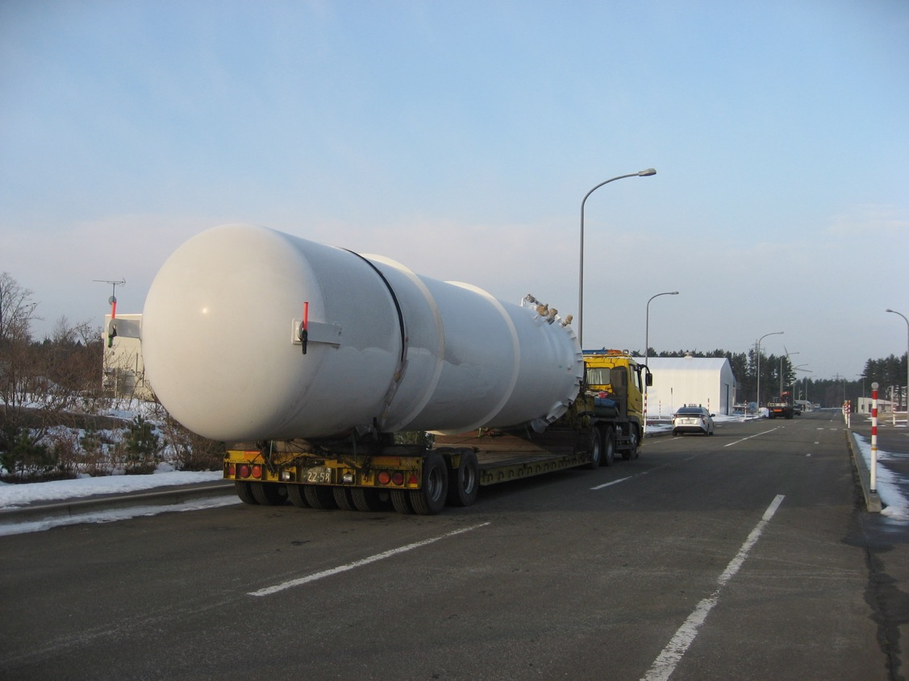
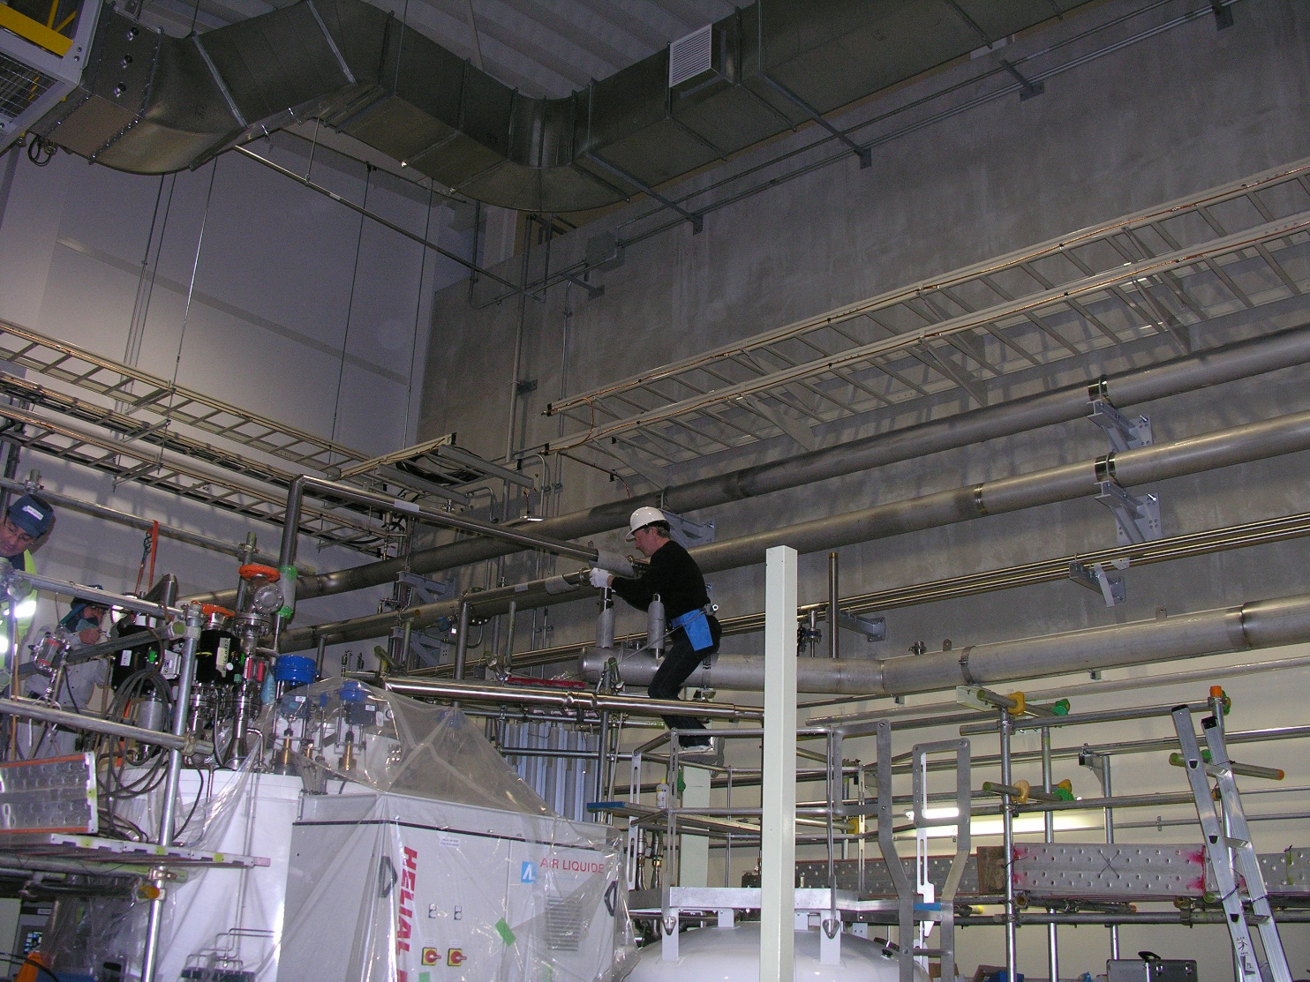
Ifmif Cryoplant: installation

Slide 6
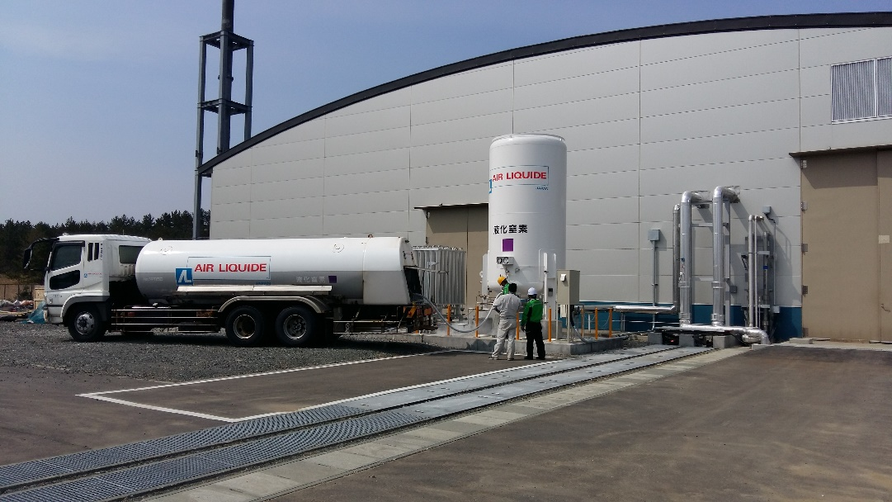
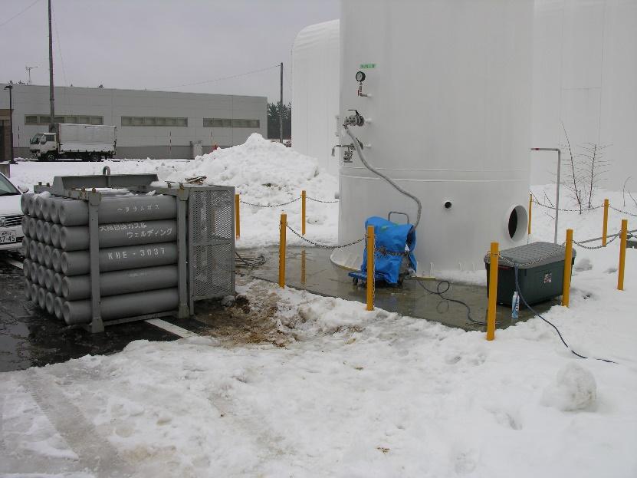
Installation risk analysis
Utilities unavailable (Power, cooling water, instrument air, LN2, GN2, GHe, vacuum pumps, He leak detector, nitrogen trace detector)
Risk: limited commissioning and testing
Mitigation: anticipation
Major GHe leaks or pollution of the buffer
Risk: large helium loss
Mitigation: separate circuits with separate safety valves, systematic testing with precise protocols
6

Slide 7
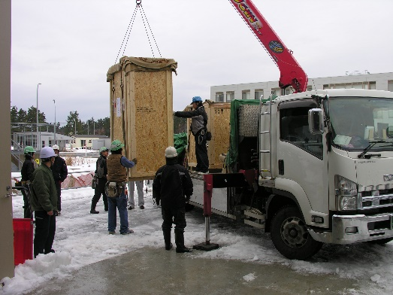
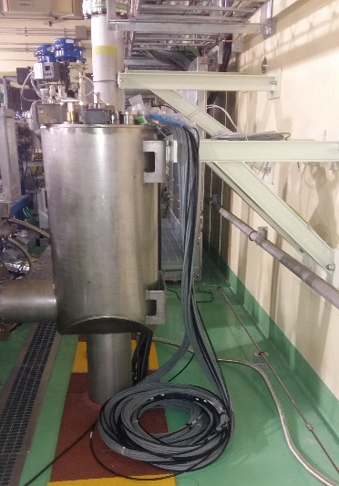
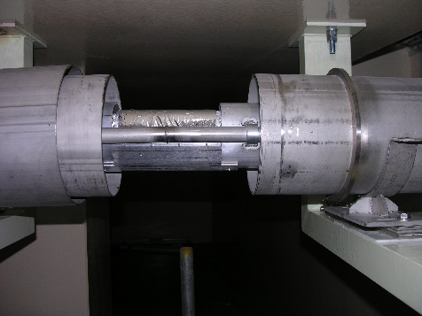
Installation work and adjustments
WORK CONTENT
Deliveries
EU equipment
Local piping and cabling material
Positioning and anchoring
Cryogenic lines installation
Interface connections
Room temperature piping work
Cabling work
ADJUSTMENTS
Heavy paperwork
Creation of a matrix of responsibilities to precise ownership, work sharing, toolings, anchor calculation responsibility, supervision…
X-ray replaced by
Dye-penetration tests
Modifications reporting on 3DMU
Power safety rules and documentation

Slide 8
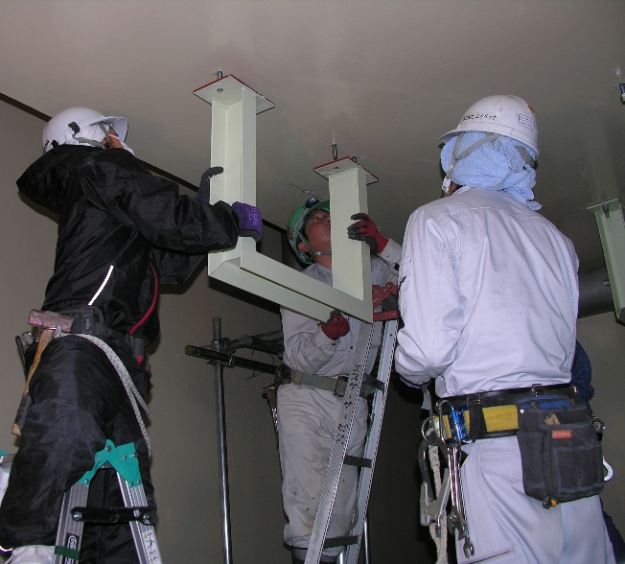
Installation adjustments
3D Mock-up
Expectations had to be clarified:
Precise tool for accelerator and interfaces, but rough volume reservation for some piping and cabling
Corrections:
Inevitable mistakes and surprises (wall position, lamp, missing cable tray…) that required fast decisions
Schedule and on-site rules
Work steps conducted in parallel, so only the duration of operations were useful
Weather constraints and work priorities
Safety and coactivity
Weekly meetings, daily meetings to follow operations
Schedule for each work area
Safety rules of each activity (welding, confined work…)

Slide 9
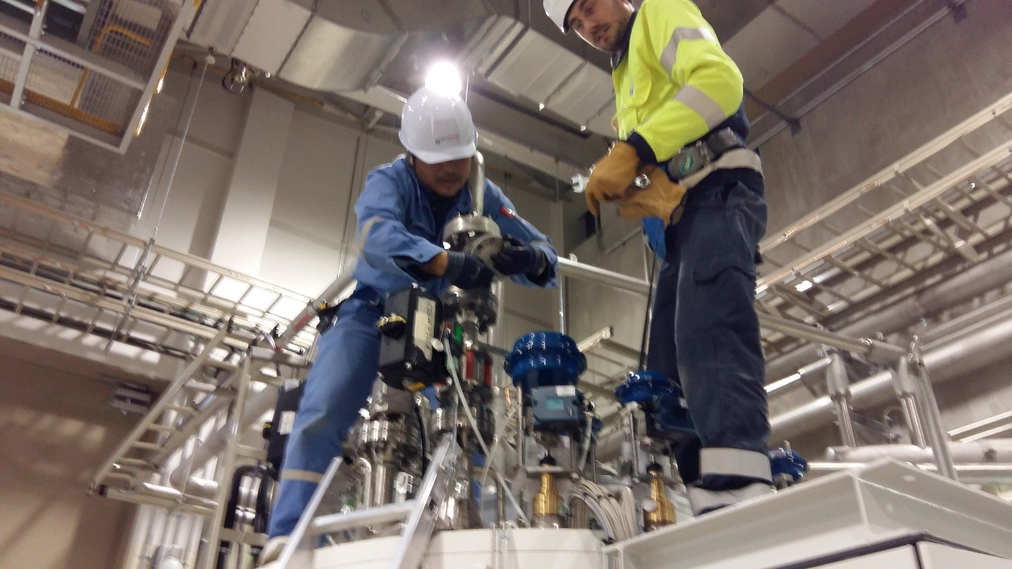
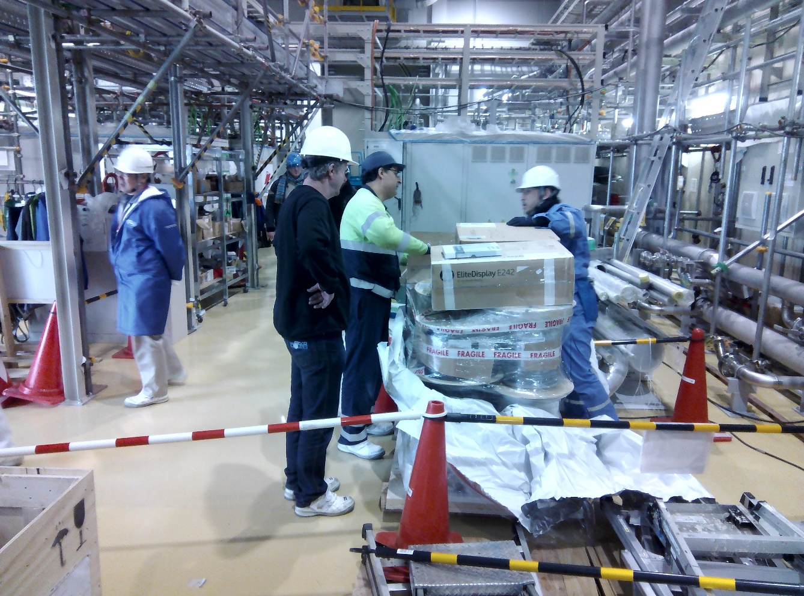
Ifmif Cryoplant: commissioning and tests

Slide 10
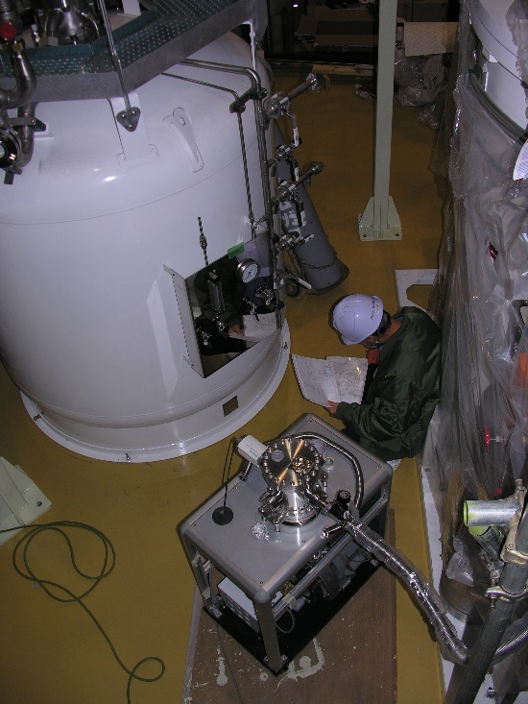
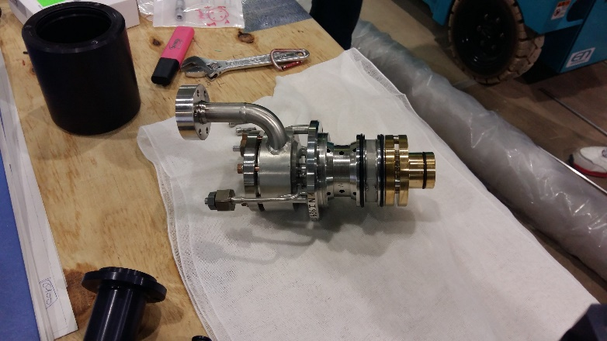
Commissioning and tests risk analysis
Startup helium contamination
Risk: damage the Cold Box turbines
Mitigation: careful monitoring of pollution during conditioning and cooling
Cryogenic power needed is heavily increased (beyond margin)
Risk: duration of dynamic tests heavily reduced
Mitigation: increase storage Dewar size
Correction: optimization of cryogenic power use, and eventually increase storage buffer size
10

Slide 11
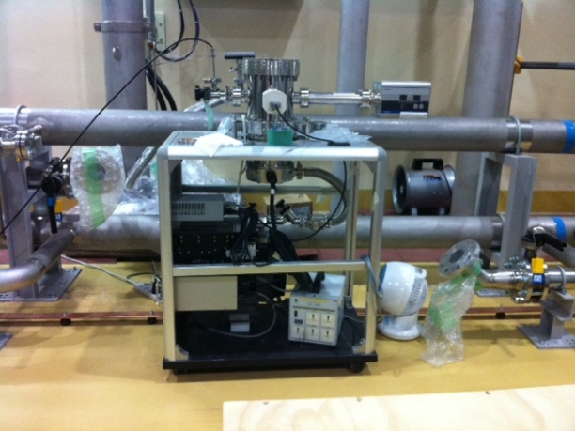
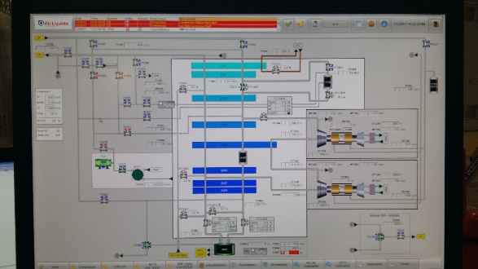
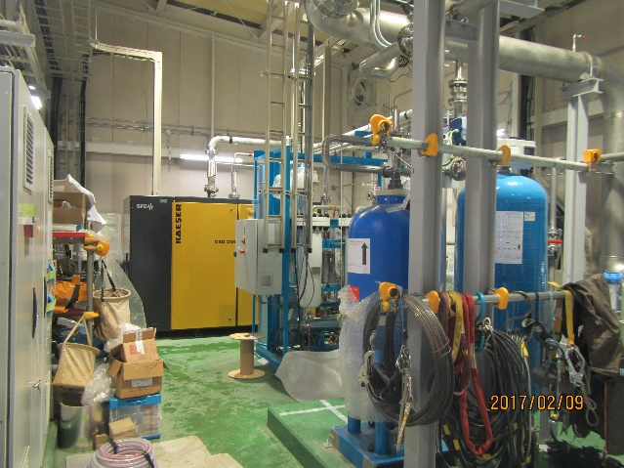
Commissioning problem solving
COMMISSIONING CONTENT
Utilities checks
Electrical checks
Connection checks
Conditioning
(compressor oil, ORS charcoal drying,
CB adsorbers drying, GHe conditioning)
Programs checks
Safety checks
Compressor commissioning
Turbines installation
PROBLEM SOLVING
Incorrect connections…
Missing parts, leaks,
labelling, protections…
By compressor
Manufacturer
24h operation needed

Slide 12
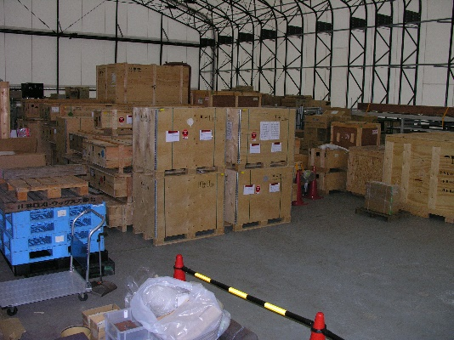
Cryoplant tests
CRYOPLANT TESTS
Cooling
Performance tests
Cryogenic elements tightness
Dewar losses
Refrigeration 101 W and liquefaction 52 l/h @5K
Acceptance tests
Complete documentation:
Manufacturer book
Operation manual
Maintenance manual
Operators training
Storage of material
ADJUSTMENTS
Work overtime necessary
Parameter settings time constant ~6h
Leak sensitivity x1000
Performances confirmed after
post-processing
Passed in terms of cryogenic power!
Meetings and exchanges to clarify
content and additions
Postponed

Slide 13
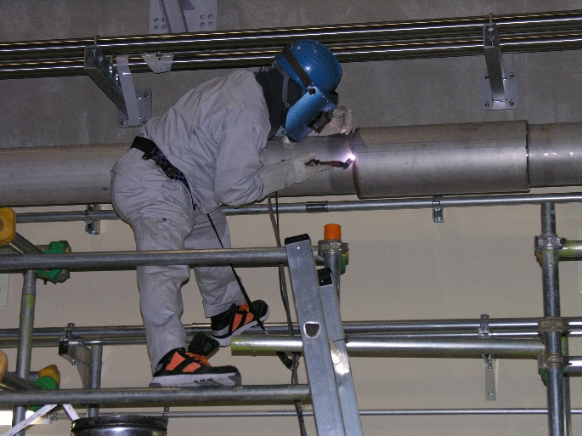
Conclusions
Special Ifmif challenges:
Cultural/communication challenges in Japan
(paperwork, safety rules, working hours…)
Licensing regulation challenges in Japan
Limited local support: best if maintenance
and operation teams are already operational
General lessons
As much tests as possible in factory
Commissioning consists mainly in problem solving!
Industry is highly experienced
Although deeply modified, the schedule proves to be efficient
Commissioning engineers have the support of industry experts
The Ifmif cryoplant is waiting for parameters adjustments (cooling parameters fine tuning, cryogenic line phase separator setting…) and for the SRF Linac cryomodule connection.

