Slide 1
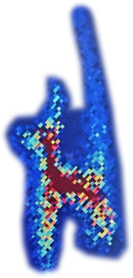
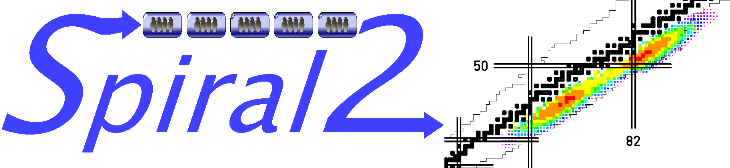

SPIRAL2: installation and commissioning of the accelerator
Project status
Commissioning strategy
Injector results
LINAC partial cool down
Next phases
Robin FERDINAND for the GANIL teams

Slide 2
SPIRAL2 facility
4 levels 7,200 m²
More than 100 rooms

Slide 3
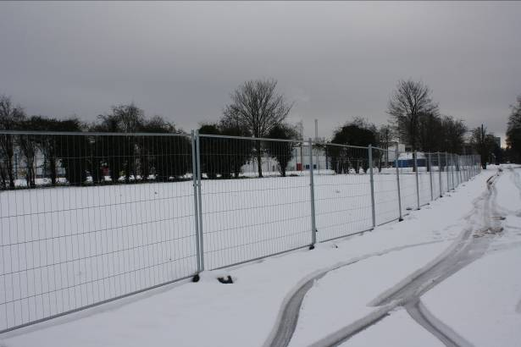
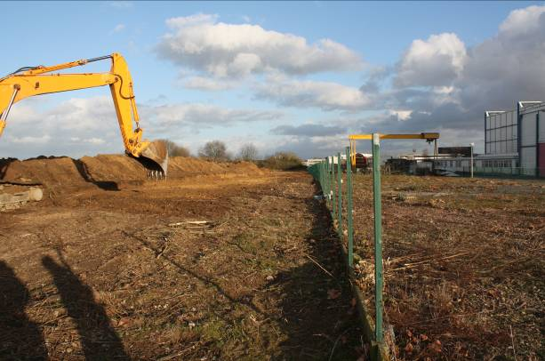
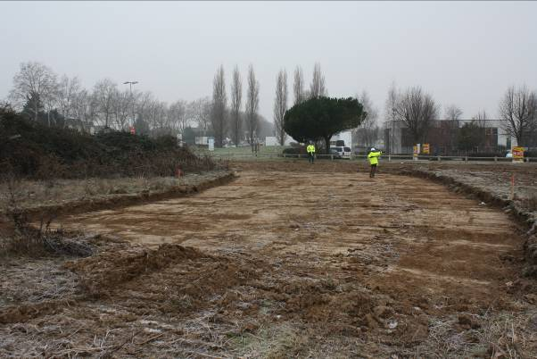
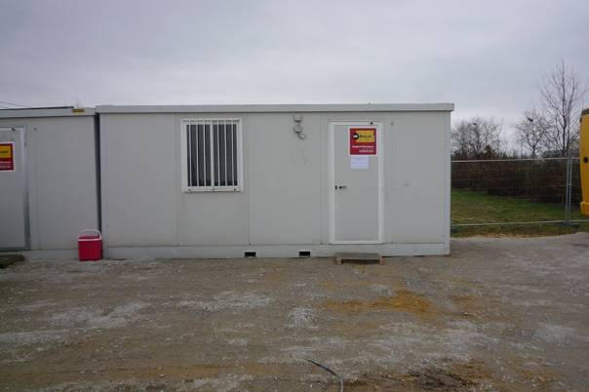
SPIRAL 2 Construction
SPIRAL 2 building site preparation January 2011

Slide 4
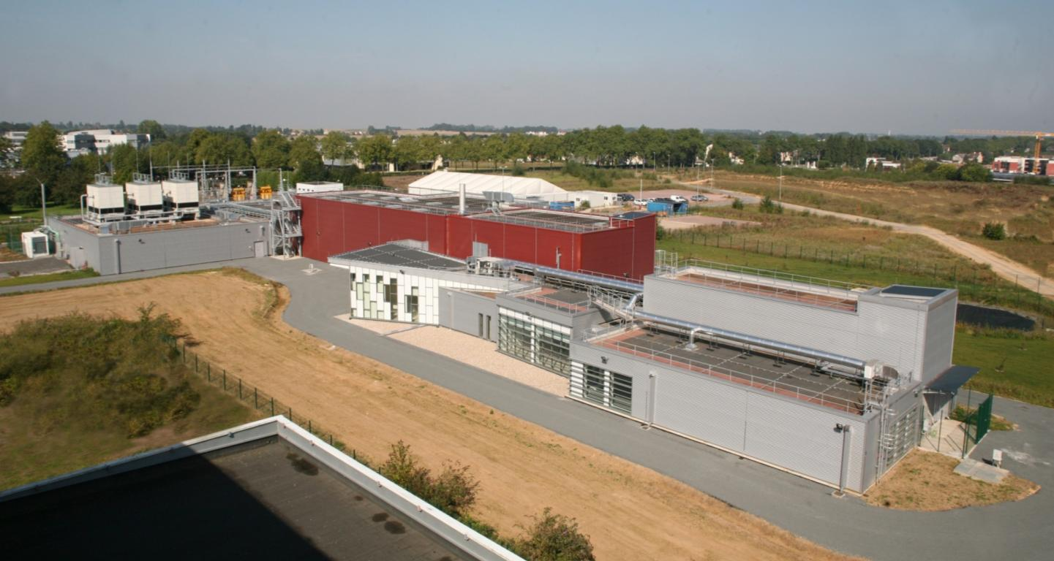
SPIRAL 2 Construction
2011 +3.5 years : September, 2014

Slide 5
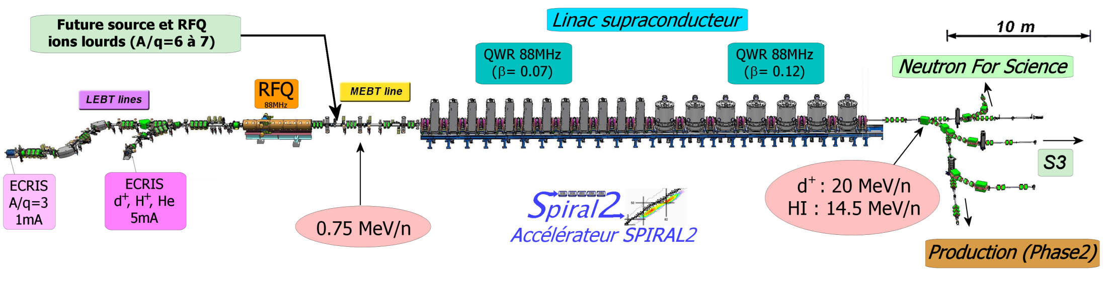
SPIRAL2 accelerator
Started
Cool down started. RF when safety authorization
Wide range of particles, intensities, energies, duty-cycles (CW up to single bunch)
Particles | H⁺ | D⁺ | ions | option
A/Q | 1 | 2 | 3 | 6
Max I (mA) | 5 | 5 | 1 | 1
Max energy (MeV/A) | 33 | 20 | 15 | 8.5
Max beam power (kW) | 165 | 200 | 45 | 51

Slide 6
SPIRAL2 linac installation : Numbers…
Short vs. long cryomodule design: SPIRAL2 vs. SNS
Equipments:
  19 cryomodules
  20 RT sections
  19 cryogenic valves boxes
 | SPIRAL2 | SNS
Length | 35 m | 230 m
Energy gain (H⁺/H⁻) | 32 MeV | 814 MeV
Cryomodules | 19 | 23
Installation burden similar for a 35 m and a 230 m machine!!
Connections:
  187 cryogenic flanges (CF, Helicoflex™) on main cryo lines
  44 isolation vacuum flanges
  More than 200 other metal seals flanges for cryogenics
  40 beam lines (clean) connections
> 400 online leak checks (+ rechecks)
> 150 pressure tests (+ retests)

Slide 7
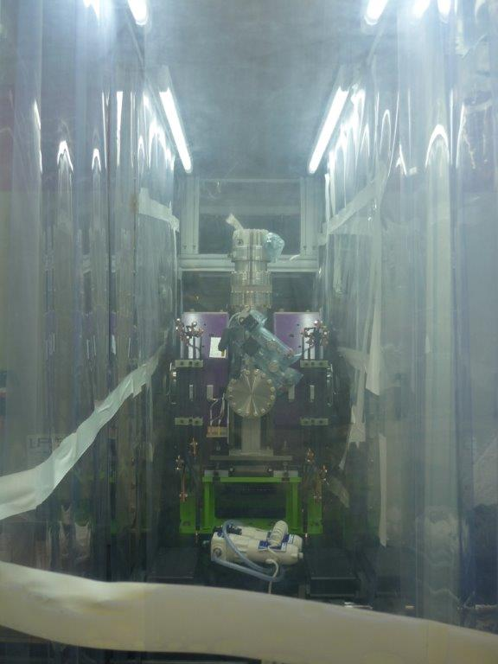
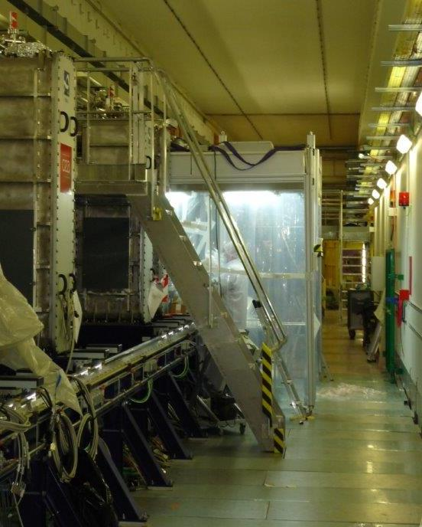
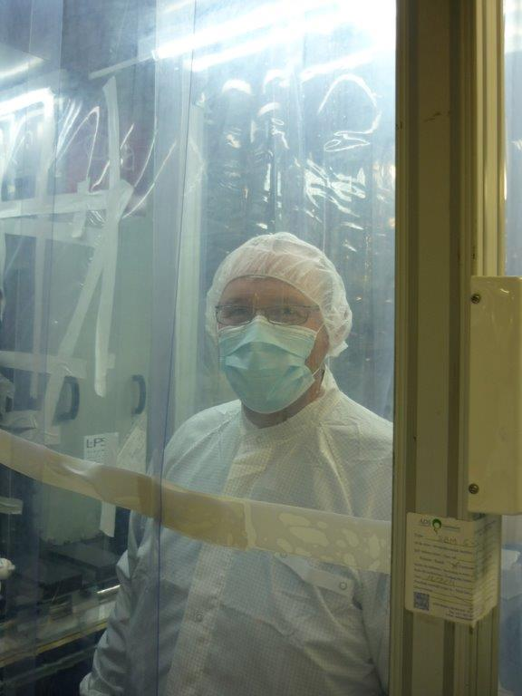
SPIRAL 2 LINAC “warm section” installation
Assembly under ISO 5 moveable laminar flows
Trained personnel only
Extensive cleaning
Particle counters to determine when connection area is clean enough

Slide 8
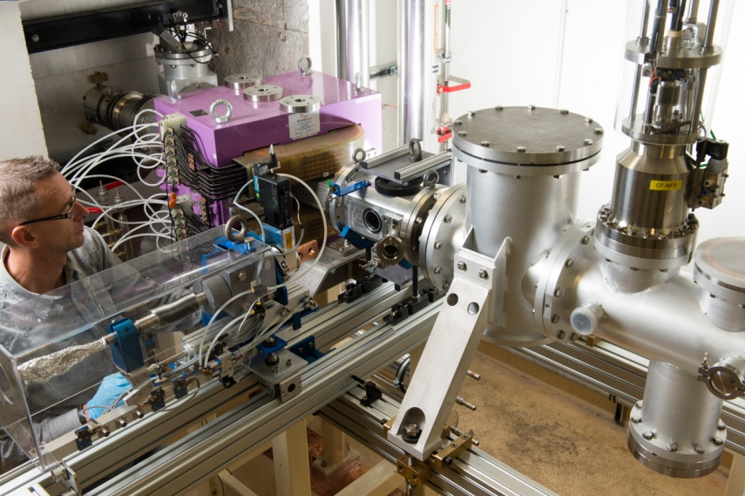
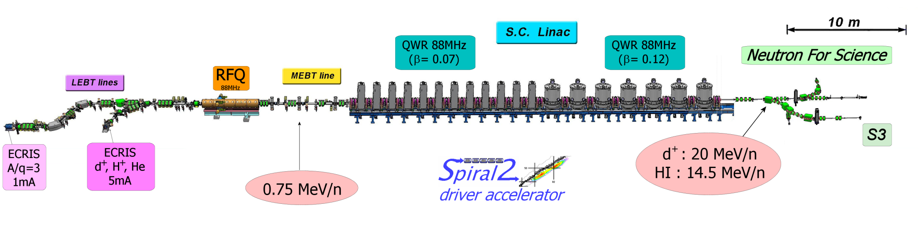
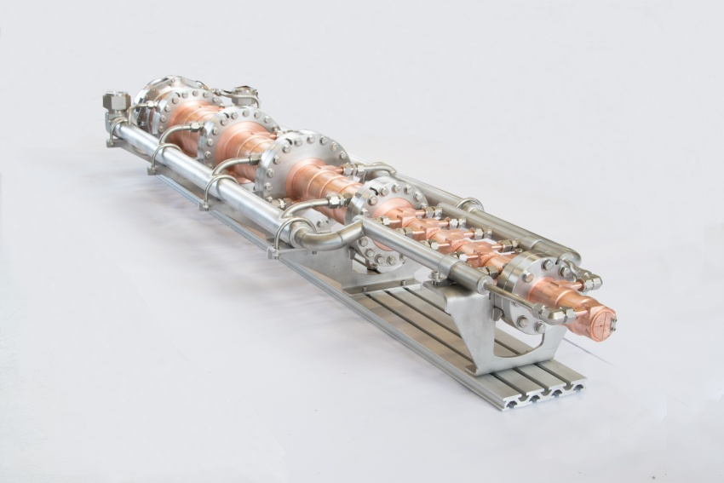
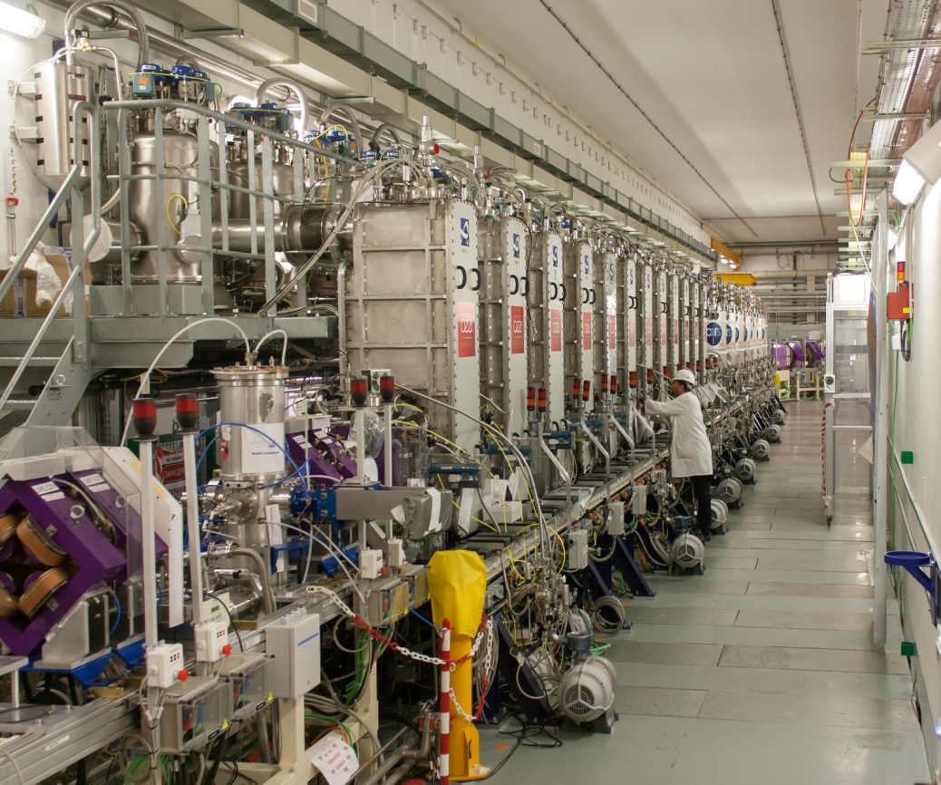
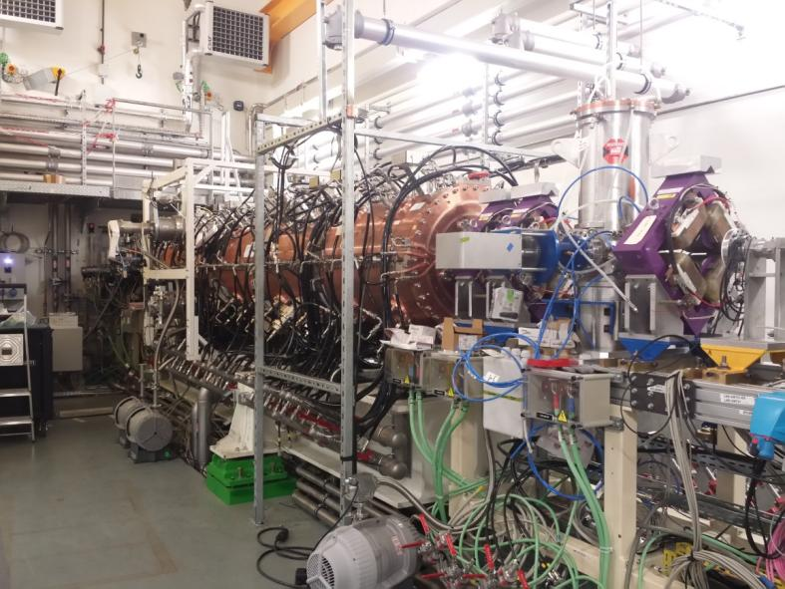
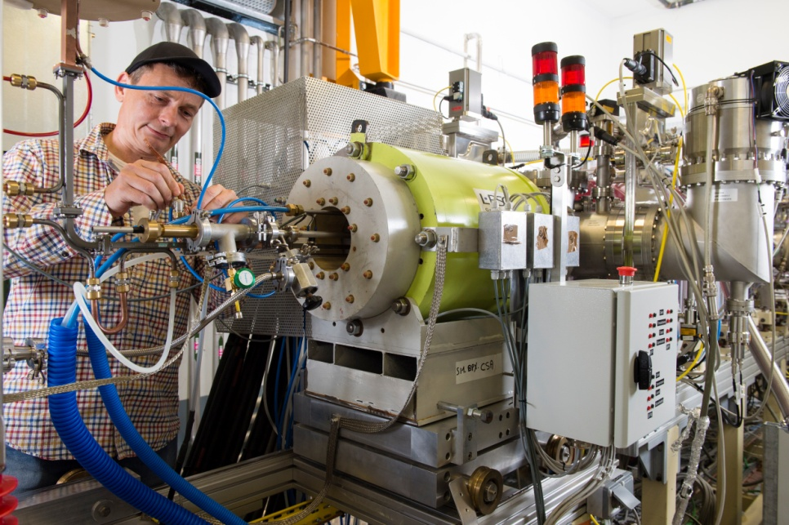
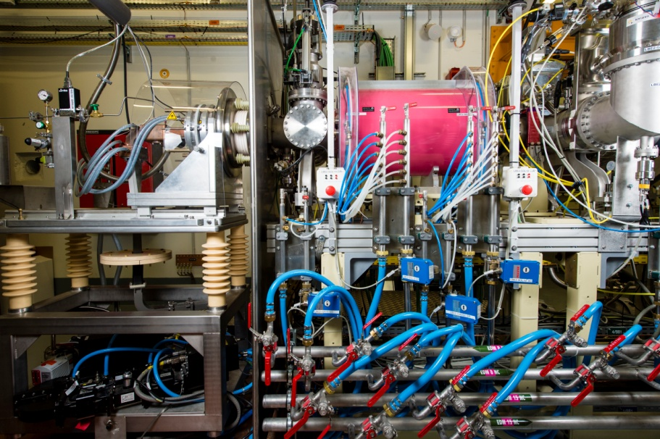
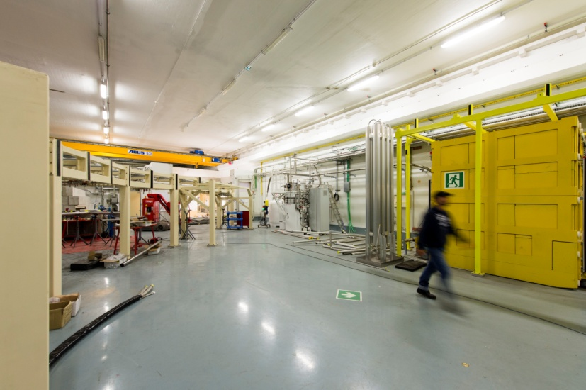
Installation status
LINAC ready for RF
Partial cooled down
First beam (2mA H⁺) Dec. 19th, 2014
First beam (H⁺) Dec 3rd, 2015
First beam (230 μA Ar⁹⁺) July 10, 2015
First RFQ acceleration (230 μA ⁴He²⁺) February 12, 2016

Slide 9
Commissioning Strategy

Slide 10
SPIRAL2 : beam commissioning in 4 phases
Qualification of the ion sources and LEBT in the laboratories in charge of the development (LPSC-Grenoble and CEA-Saclay)
  2009-2012
Qualification of the injector on a test bench (GANIL)
  Reproduce the results from the pre-commissioning
  Validate the RFQ performances
  Provide a development platform for various diagnostics
  Measure the beam characteristics at the RFQ exit.
SC linac beam commissioning up to the main beam dump
  Progressive cool down
  RF validation of all cavities
  Beam commissioning
“day-1” experiments to NFS and S3 experimental halls, including commissioning.
Notes:
Reproduce the results from the pre-commissioning of the ion sources, i.e. validate the source performances on SPIRAL2 site,
Validate the RFQ performances for the various main reference particles (see below): transmission, beam energy, output emittances in the three planes, and bunch extension,
Provide a development platform for various beam diagnostics required either to validate the RFQ beams or later to tune and validate the linac beams,
Measure the beam characteristics at the RFQ exit, to serve as input parameter for the next stage.
RF to validate the cold tuning system, the automations, the dynamics RF consumption and so on

Slide 11
Strategy for a multi beam commissioning
Increasing stress for the RFQ cavity and later for the linac
  ❶ : H⁺ beam, Light ion source and LEBT, 50kV on RFQ vanes, up to 5mA
  ❷ : ⁴He²⁺ beam, heavy ion source and LEBT, 80kV, up to 2mA, mimic the D⁺
  ❸ : ultimate injector performances, A/Q=3, 114kV, up to 1mA ➔ ¹⁸O⁶⁺
  ❹ : 20 µA Ni ion beam to facilitate the future tuning of the accelerator
  ❺ : D⁺ beam, up to 5mA
    requires the final licence from the Safety Authority Offices
    Activation
    May become ❸ to respect the Application Decree

Slide 12
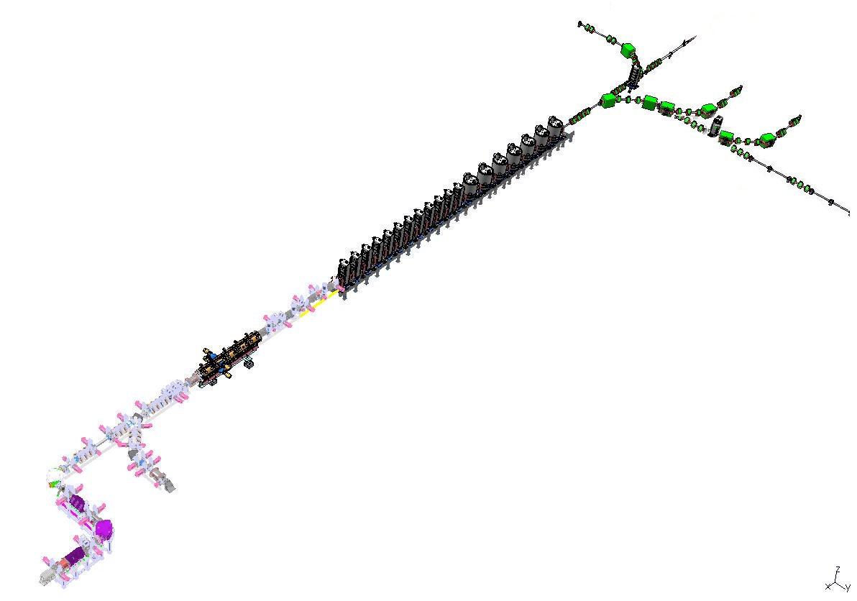
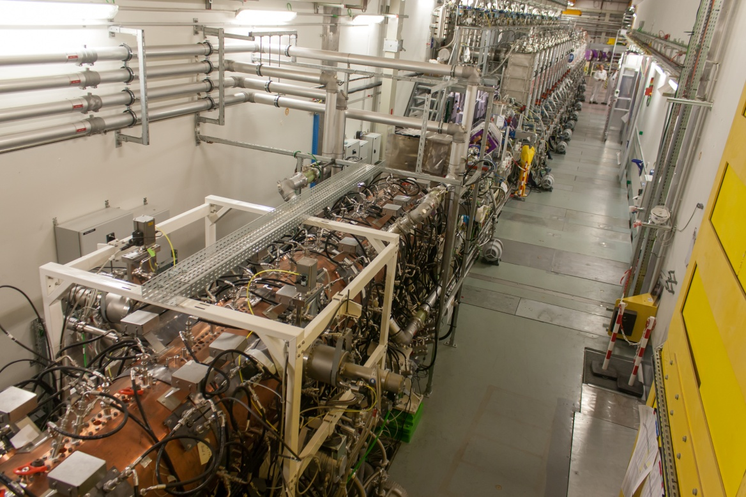
Injector results

Slide 13
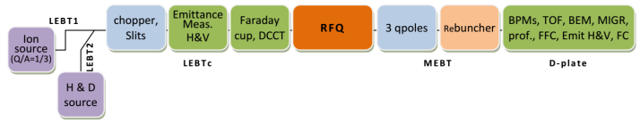
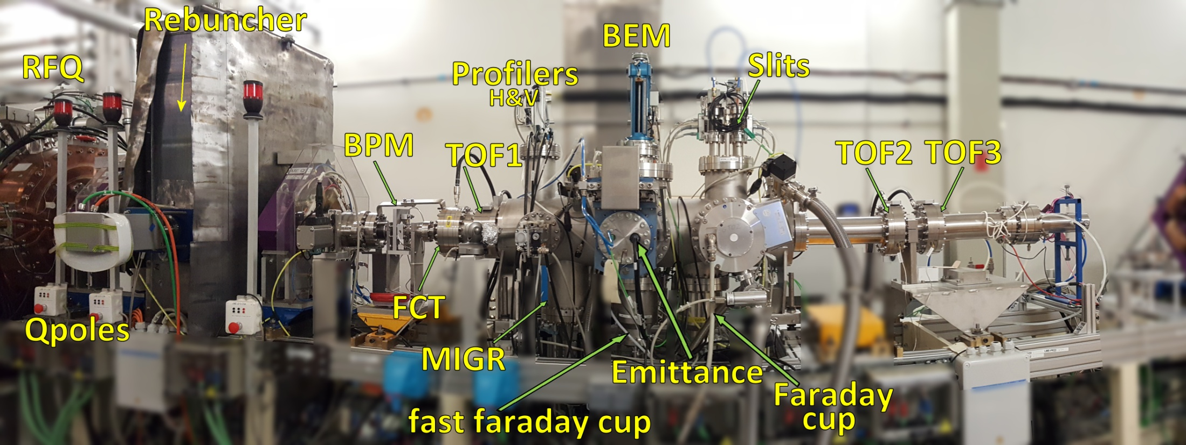
Test bench configuration

Slide 14
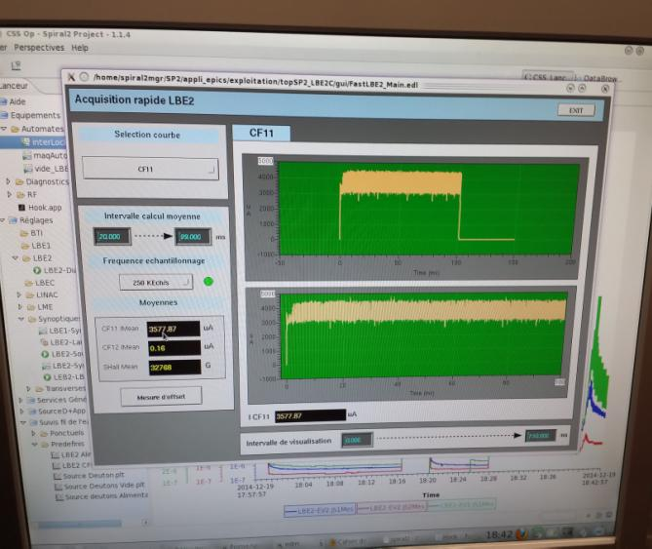
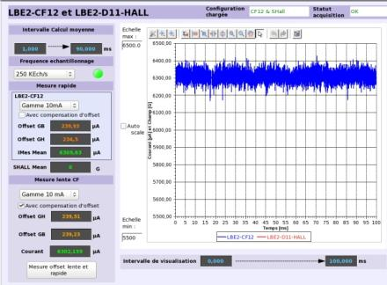
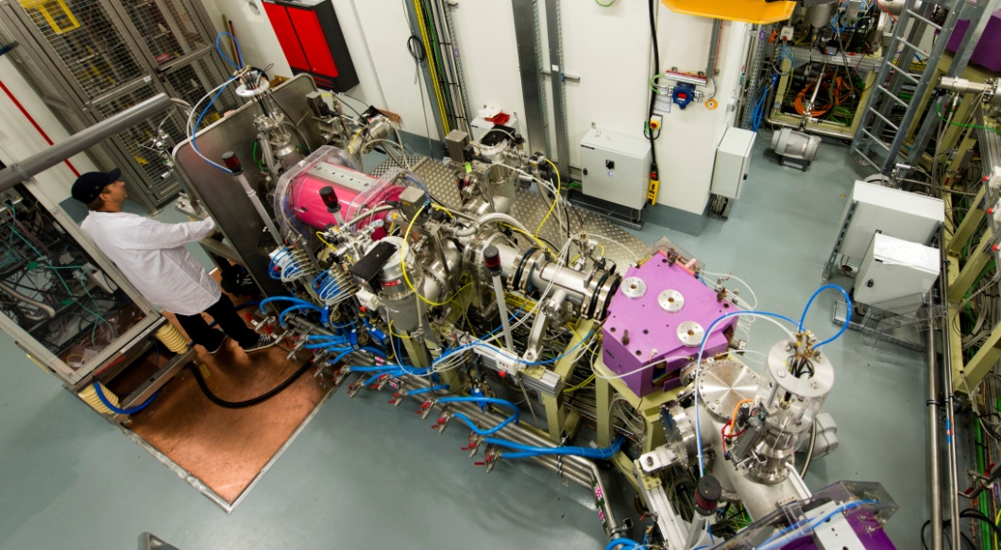
source commissioning
Source deuton (SD)
First beam (proton) at GANIL
December 19, 2014
Ability to extract 11 mA CW from source => up to 6 mA proton beam at the RFQ entrance
Beam intensity and emittance control using 6 H and 6 V slit systems

Slide 15
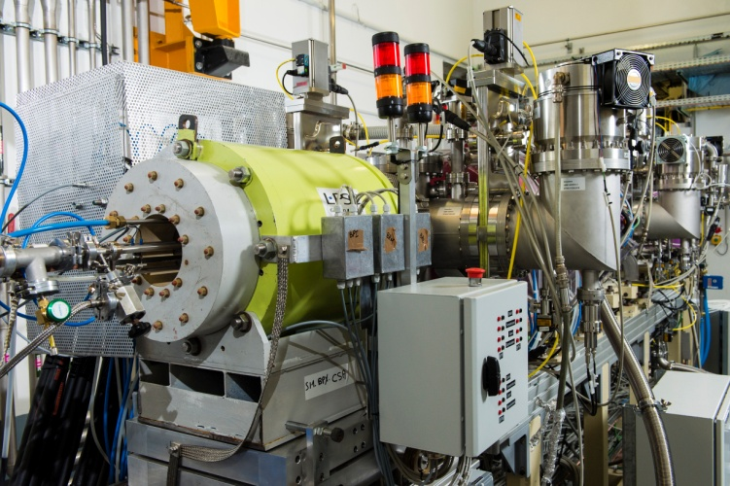
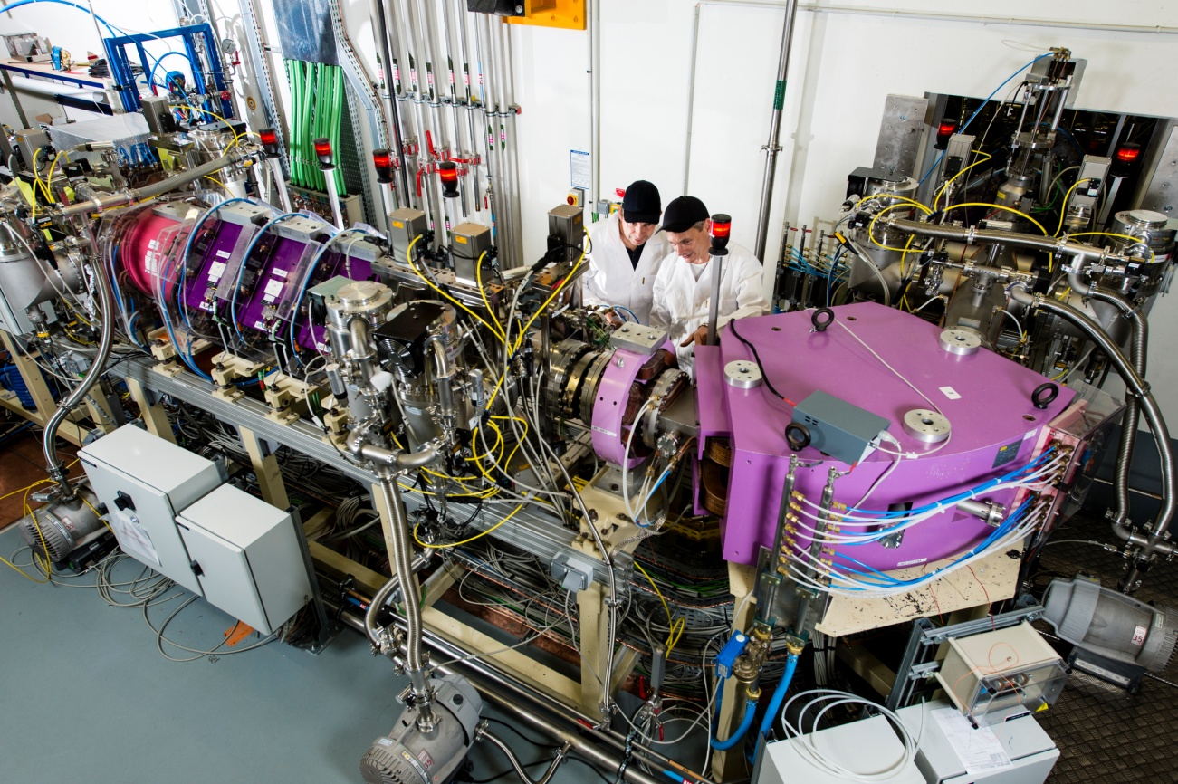
source commissioning
HI source (Q/A=1/3)
First beam (230 μA Argon 9+) July 10, 2015
Already tested :
⁴He²⁺ A/Q = 2, 3mA, 1.5 mA after RFQ
⁴⁰Ar¹⁴⁺ : 45µA
¹⁸O⁶⁺ : 1.2 mA
Metallic not showing up… :-(

Slide 16
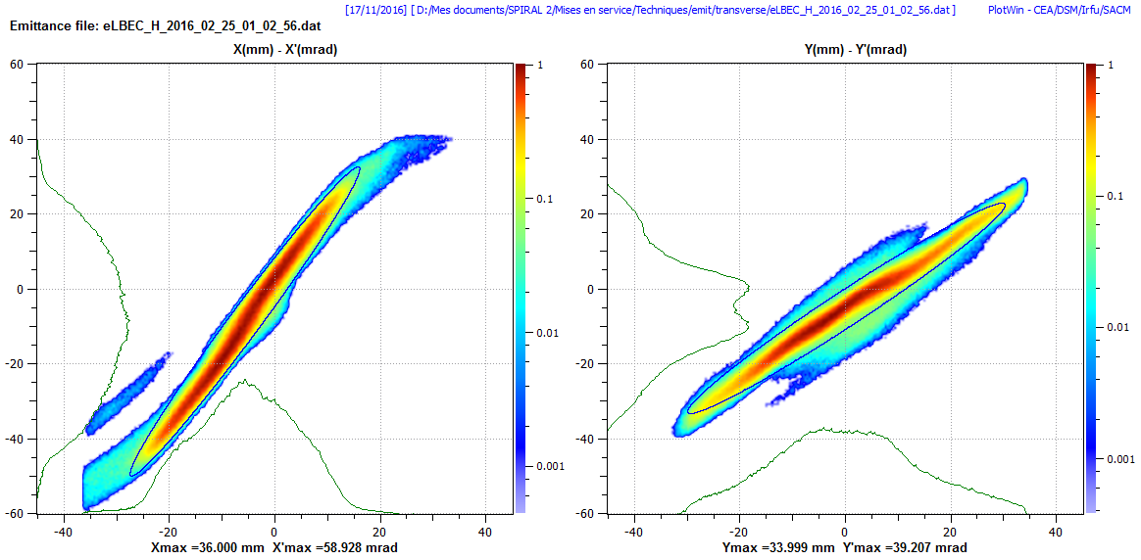
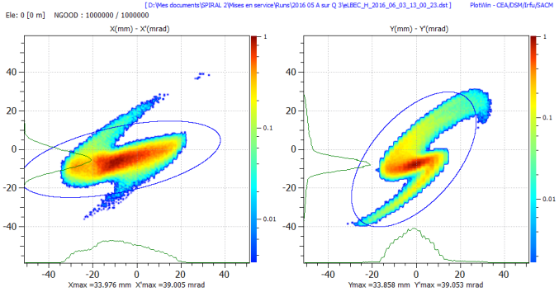
Emittance at the end of the LEBT
Particle | Beam current (mA) | Emit X (π.mm.mrad) | Emit Y (π.mm.mrad)
H⁺ | 5.2 | 0.18 | 0.2
⁴He²⁺ | 1.35 | 0.54 | 0.43
¹⁸O⁶⁺ | 0.75 | 0.36 | 0.42
Expected:
P or D : 5mA, 0.2 π.mm.mrad
HI : 1mA, 0.4 π.mm.mrad
5.2mA H⁺, 0.2 π mm mrd rms norm.
750µA ¹⁸O⁶⁺, ε=0.36/0.42 π.mm.mrad

Slide 17
RFQ high Power commissioning
4 x 60 kW rf amplifiers (tubes / 3 kW solid state preamplifier)
Voltage law measured by means of 16 pick-ups, in RF operation
Relative errors are less than ±0.8% as the vane voltage is varied from 10 kV to 95 kV, rise to 3.4% at 113.6kV (might be related to a bad cable)
Conditionned up to 121kV above the nominal voltage (113.6kV)
  No sparks at 80kV (D⁺ value)
  @nominal : Spark every 45min (mean), record 1.5h
  121kV (one spark every 2min, record 8min)
RF shows instabilities at high voltage
  Investigation of cooling circuits/LLRF/RF amplifiers
38kW more than expected (200kW instead of 170kW)

Slide 18
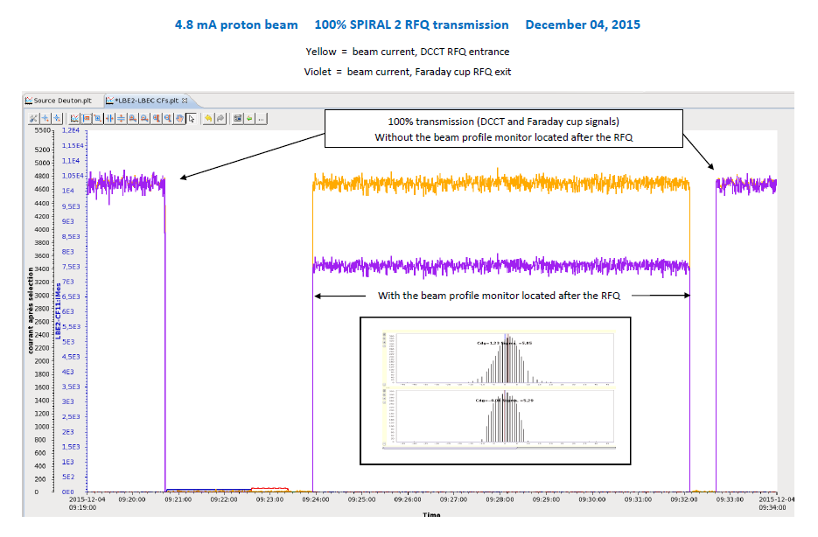
RFQ beam commissioning
2015, December 03, 9h26 : First RFQ beams (Protons)
4.8 mA with 100% transmission at the end of the same working day (SPIRAL 2 nominal beam current)
First CW proton beam :
2.3 mA on December 18
Now routine operation
Notes:
RFQ in CW rf operation (up to 50 kV) Pulsed beam 200 μA, 200 μs, 2 Hz
magenta

Slide 19
Transmission comparison with calculation
Proton : December 23, 2015
Helium : June 04, 2016
Oxygen : December 9, 2016
trans. OK, but not fully tested
RFQ specifications reached
(transm., energy, emittances…
In CW operation) for H⁺, ⁴He²⁺
RFQ always operated CW from the rf point of view, rf operation stable and reliable for Proton/Hélium

Slide 20
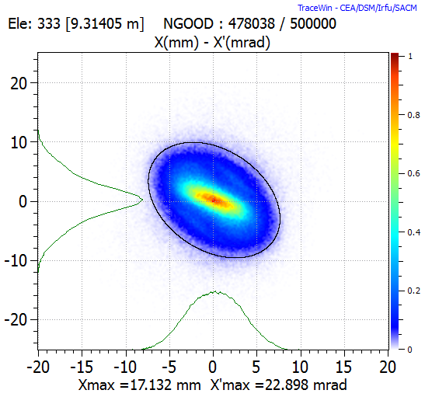
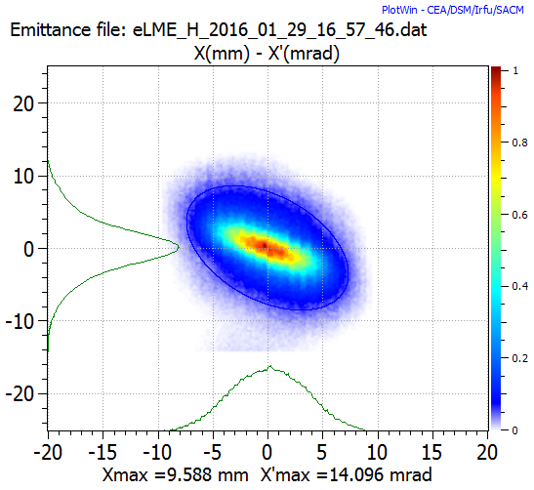
RFQ beam commissioning
Emittance measurement and comparison with the code
TraceWin
Measurement

Slide 21
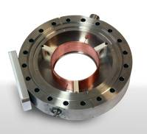
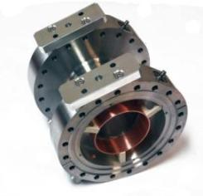
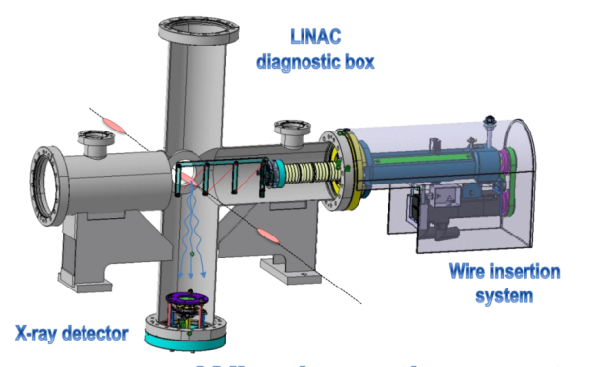
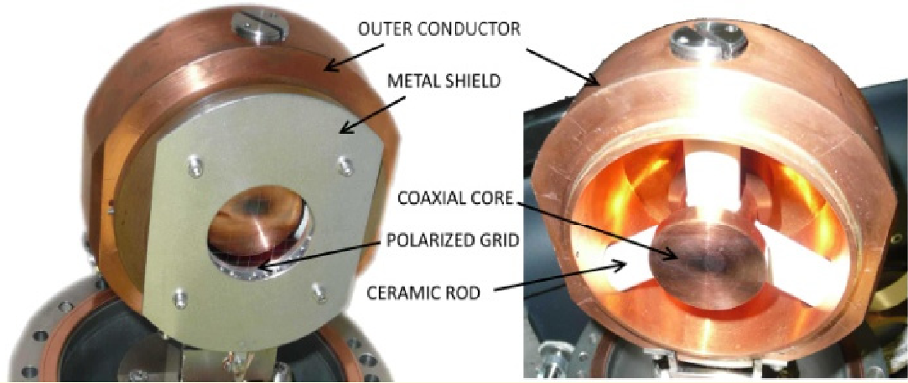
Longitudinal measurements
TOF measurements (IBIC – W. LeCoz – WEPF32)
Fast Faraday Cup (IBIC – C. Jamet - WEPG42) and Beam Extension Measurement (IBIC – R. Revenko - TUPG59)
Energy (keV/nucleus) | Toutatis simulations | TOF measurement
Proton | 730 | 729.3
Helium | 727.2 | 728.1
σ_{rms}= 47 ps
400W max, and σ_{rms}= 320–330 ps

Slide 22
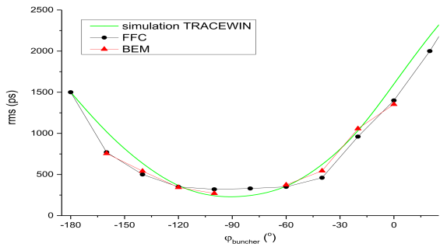
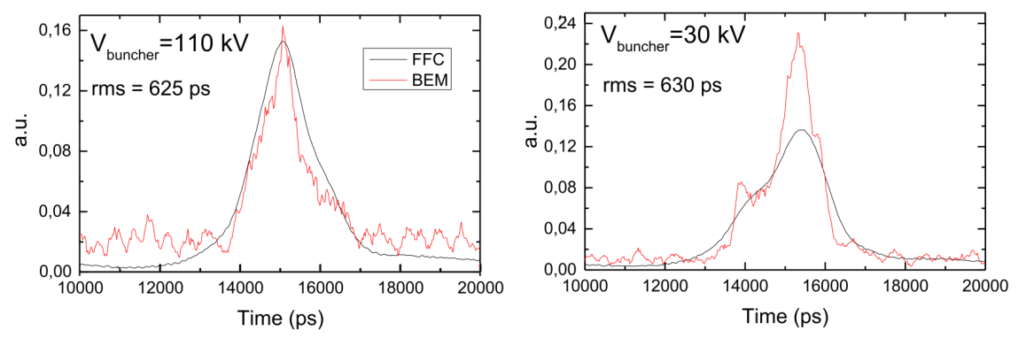
Bunch length measurement comparison
Good agreement between the two measurements and the TraceWin simulations
Buncher variation in phase or voltage
0.27 π.deg.MeV (Helium, 0.19 expected)
Comparison FFC with BEM, 0.6mA, 1%dC

Slide 23
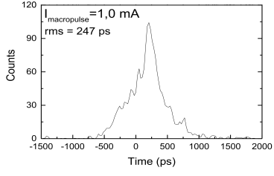
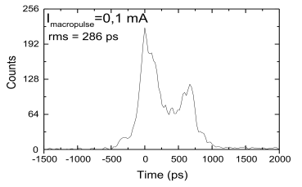
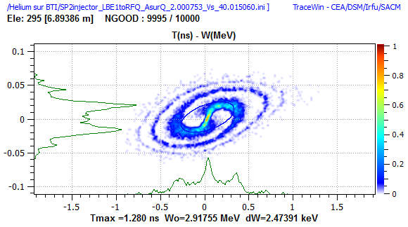
Longitudinal results
Very different shapes for 1 mA and < 150µA beams
1 mA
0.1 mA
Notes:
⁴He²⁺ longitudinal bunch shape for 1 and 0.1 mA

Slide 24
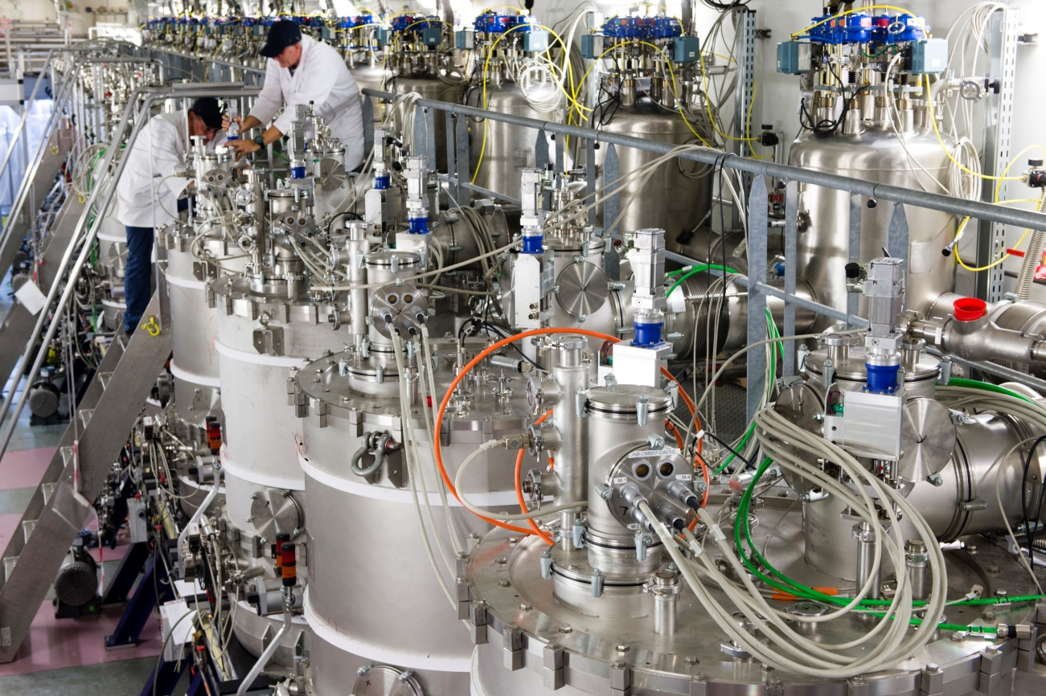
Linac results
1

Slide 25
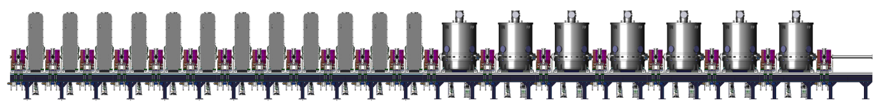
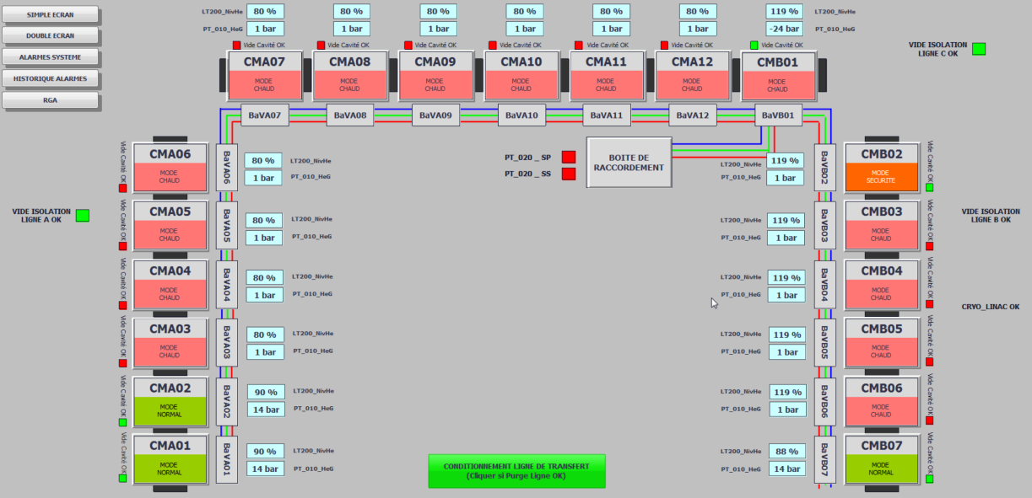
Linac partial cool downs
Helium distribution
First partial cool down on July, 2016
  test a major part of the cryogenic installation
    thermal acoustic oscillations (TAO)
  PLCs and C/C
Second in march 2017
  validate the helium pressure stability requirements of ± 3mbar

Slide 26
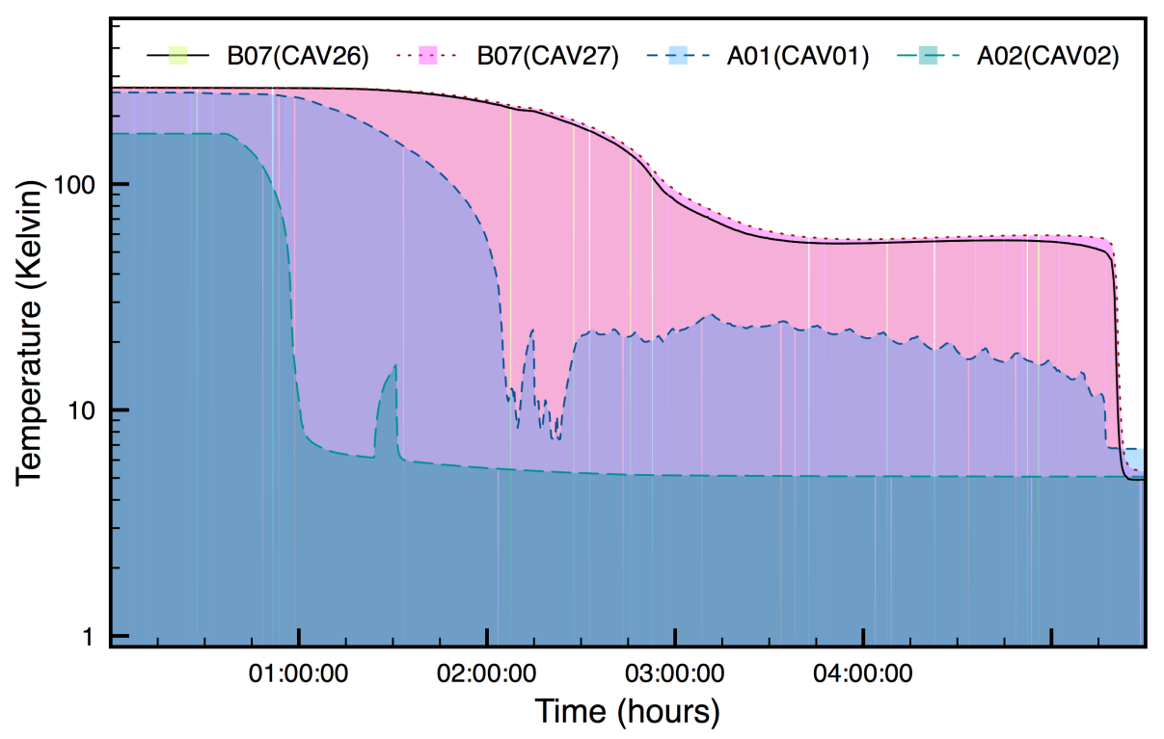
Cryogenic results
Fast cool-down
of the 3 cryomodules
better cryogenic consumption
Static @4K | CMA01 | CMA02 | CMB07
Saclay/Orsay meas. | 5.73 W | 3.98 W | 19 W
GANIL meas. | 4.95 W | 2.99 W | 12.33 W
Notes:
Rupture disc

Slide 27
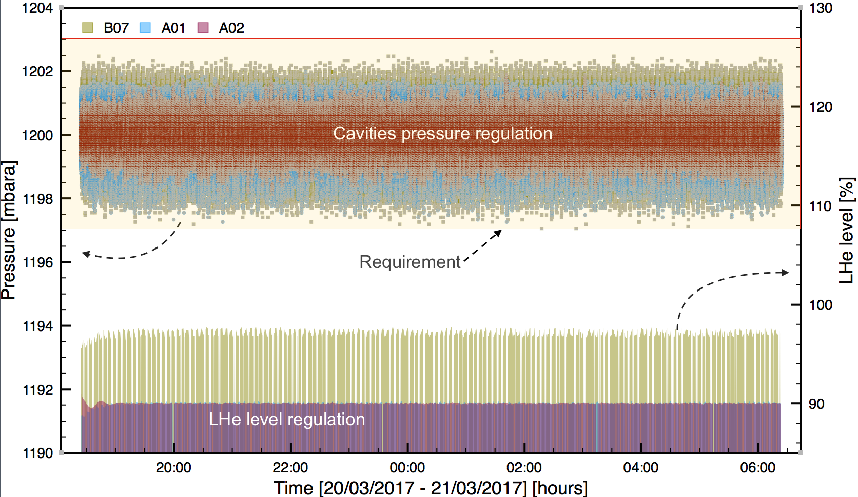
Pressure stability (11h)
Notes:
Steps of 4W had no impact on pressure stability

Slide 28
What’s next ?
RFQ RF commissioning to be finished
Deuteron RFQ beam measurement
  Waiting for the safety authorization
RFQ validation with beam (¹⁸O⁶⁺)
  depend on D-plate removing and the Linac commissioning
RF in linac cavities
  Waiting for the safety authorization
Linac first beam (H⁺)
  Next year

Slide 29
Partner labs for GANIL/SPIRAL2 phase 1
CEA-Irfu (SACM, SIS, LENAC) : P/D source, RFQ, LEBT, A-type cryomodule, C/C, LLRF, Activation simulation, commissioning
CEA/DAM/ DP2I : safety
CNRS-IN2P3 (IPNO, IPNL, IPHC, LPSC, LAL, LPC) : HI source, B-type cryomodules, power couplers, diagnostics, final main beam bump, timing, commissioning
BARC : BPM electronic
INFN : Slow Choper, bunch selector (fast chopper), test stand
IFJPAN: Valves boxes installation
SOREQ : diagnostic beam test stand
IFIN-HH : Beam loss monitor
INRNE-BAS : linac supports
Argonne : design of A/Q=1/6 injector
CIEMAT : beam dump

Slide 30
Summary
Good advances of the SPIRAL2 project !!!
  Both light and heavy ion sources working very well
  RFQ working well
    RFQ with about 100% transmission
    Very good comparisons with TraceWin simulations
RFQ partly conditioned up to maximum voltage (114 kV, CW)
RFQ improvements
  rf amplifiers (reliability) LLRF (variable freq. loop) Tuning system (faster and stable)
Superconducting linac :
  Stable cryogenic operation with 3 cryomodules

Slide 31
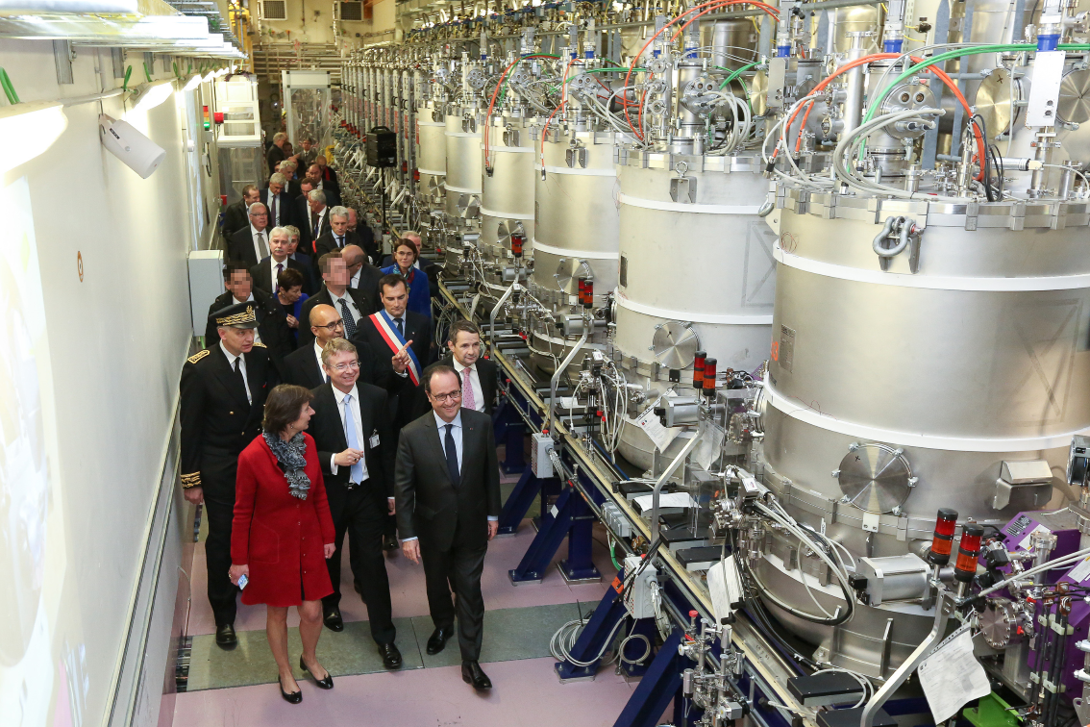
Thank you for your attention
Thank all the GANIL and partner labs staff
Thanks to P-E.Bernaudin, P. Bertrand, M. Di Giacomo, A. Ghribi, H. Franberg, O. Kamalou, JM.Lagniel, G. Normand, A. Savalle, F. Varenne, D. Uriot

Slide 32
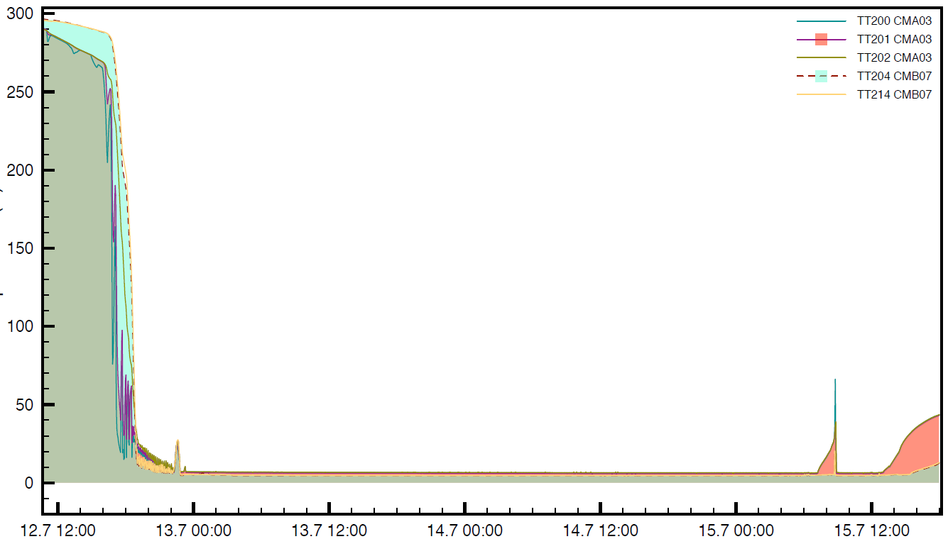
Cryogenic system – first cooldown (1)
End of cooldown
Warmup start
~12 h for 2 CMs
~60 h @ 4K
CMA3, CMB7, all cryo valves boxes
Temperature (K)
Cold box failure & restart
Time
P.-E. Bernaudin GANIL/SDA/GVC
SPIRAL2Week - November 24th, 2016

Slide 33
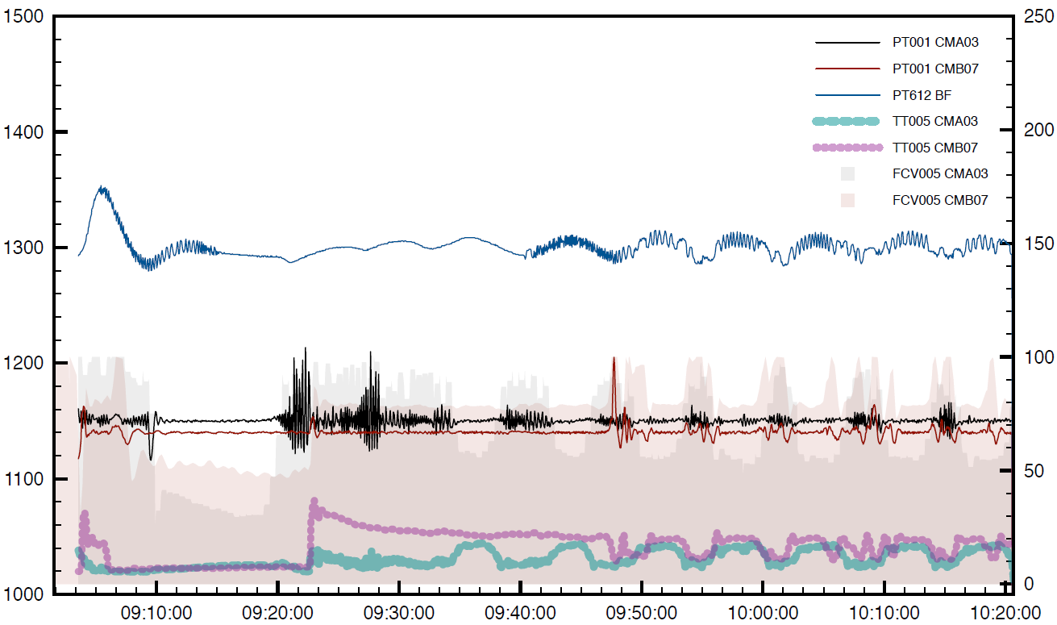
Cryogenic system – first cooldown (2)
Pressure instabilities:
Pressure in dewar
Taconis
Pressure in cavities
Pressure (mbar)
Temperature (K) / Valve opening (%)
Time
P.-E. Bernaudin GANIL/SDA/GVC
SPIRAL2Week - November 24th, 2016

Slide 34

Cryogenic system – first cooldown (3)
Coupling to refrigerator (LP case):
Pressure (mbar)
Temperature (K) / Valve opening (%)
Time
P.-E. Bernaudin GANIL/SDA/GVC
SPIRAL2Week - November 24th, 2016

Slide 35
Cryogenic system – first cooldown summary
Coupling between refrigerator and linac stronger than anticipated
  More communications between PLCs
  Protect cavities from refrigerator LP trips
  More data from refrigerator to store
Pressure stabilization tricky
  Specs not achieved for now
  Replace bursts discs with pressure valves on LHe circuits
  Investigate coupling between cryomodules ASAP
TAO (Taconis) shall be solved first
Cold helium leaks to keep under surveillance
  leak to LINA: 1.9e⁻⁶ Pa.m³/s
  leak to Cold Box vacuum: 1.1e⁻⁴ Pa.m³/s)
Work done since that first cooldown
P.-E. Bernaudin GANIL/SDA/GVC
SPIRAL2Week - November 24th, 2016

Slide 36




Cryomodules general design
Common features:
  QWR cavities, 88 MHz
  Bulk niobium
  4.5K operation
  Same power coupler
  Separate vacuum
  BCP treatment
Plunger tuning system
LHe buffer
Mechanical tuning system
Differences
RT magnetic shield
No HPR after vertical cryostat test
Cavity removable bottom
Cold magnetic shield
Cavity baking
P.-E. Bernaudin GANIL/SDA/GVC
SPIRAL2Week - November 24th, 2016

Slide 37


SPIRAL2 4-vanes RFQ
Crédit : P. Galdemard IRFU
Assembly from Sept 2014 to March 2015
First beam (H⁺) Dec 3rd, 2015

Slide 38




SPIRAL 2 LINAC cryogenic system
Cryogenic system (1,300 W equivalent 4.5 K) installed, first liquid helium in July 2015

Slide 39

SPIRAL 2 LINAC RF system
One solid state amplifier / cavity
Up to 20 kW
Amplifiers,
feeders, circulators, LLRF and interlock PLC have been tested independently, installed in the building and interconnected

Slide 40



SPIRAL 2 HEBT line installation

