Slide 1

MB-IOT at CERN
(& HG 3.0 FPC)
SLHiPP-7 Collaboration meting, 08-09 June 2017, IPN Orsay
Eric.Montesinos@cern.ch on behalf of all colleagues involved
Special thanks to Gino cipolla, maria Sanchez barrueta, Cedrick Grandbois, antoine boucherie

Slide 2
Outlook
MB-IOT CPI/Thales Conclusion
History
Test bench components
Delivery and assembly of the tube
Tests
High Gradient (HG) Fundamental Power Coupler status

Slide 3
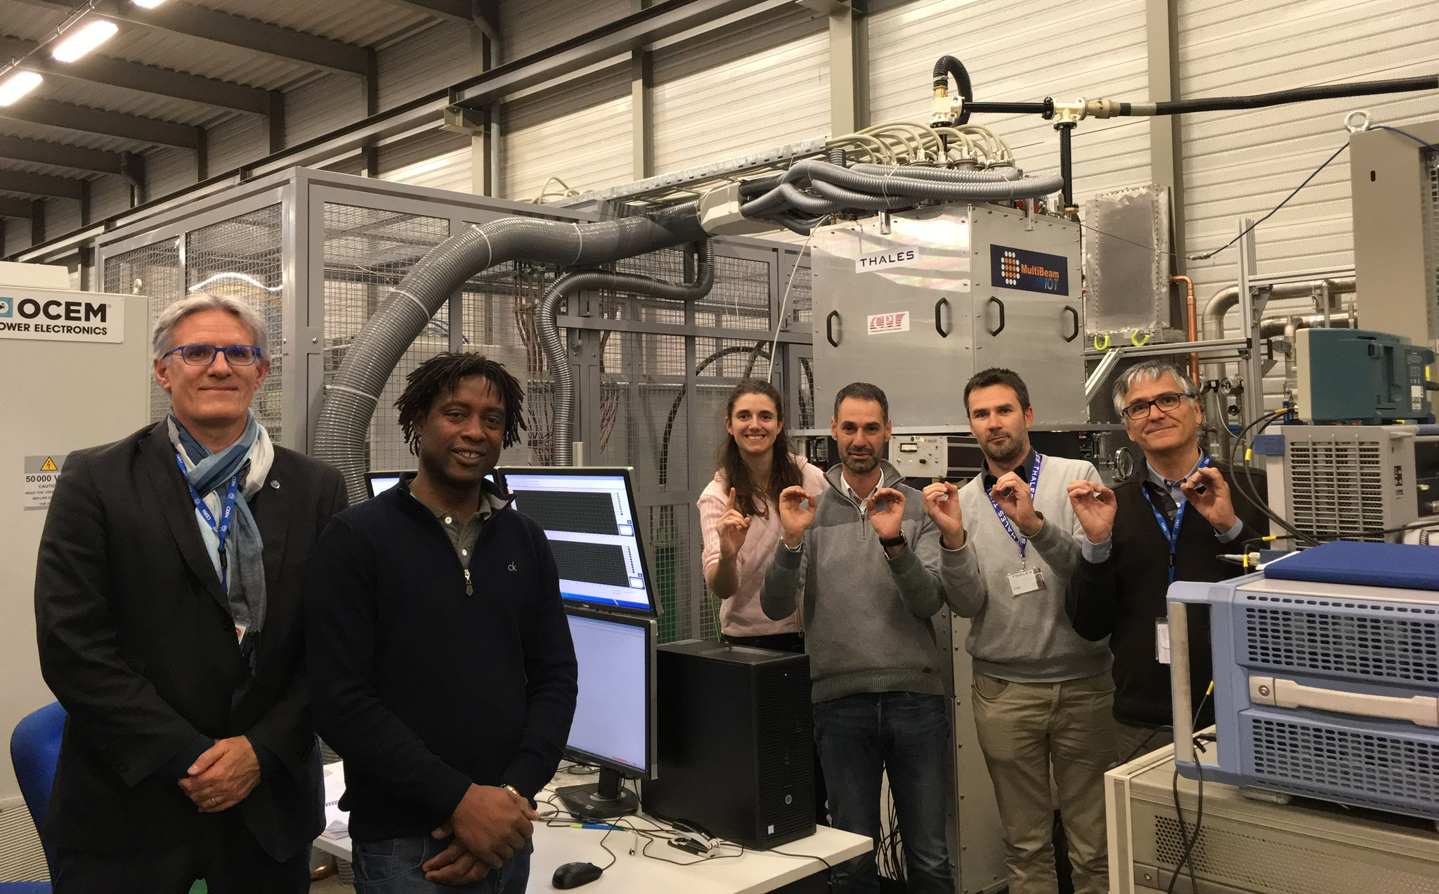
Mb-iot Cpi/thales Conclusion
The CPI/Thales MB-IOT feasibility proof of principle has been made
We successfully achieved
  1.20 MW – 1.0 ms – 14 Hz
  1.05 MW – 4.0 ms – 14 Hz
We were limited in performance because of an output window RF contact trouble
1
0
0
0
0
0
0
Cern’s team and Thales colleagues when
we obtained 1.0 MW the first time

Slide 4
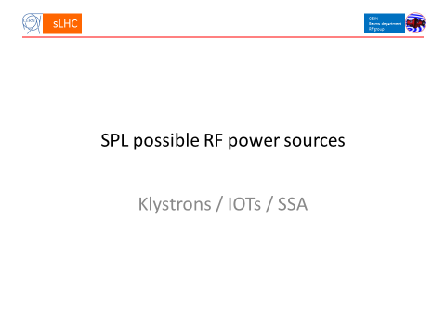
History
For the Fifth SPL Collaboration meeting (former SLHiPP meeting) in November 2010, the SPL project Leader (Roland) asked for ‘a SPL possible RF sources’ study
The Study was done for the CERN SPL project, comparing sources for 62 Low power and 184 High power cavities
In the conclusion slide, I stated that a
600 kW MB-IOT is a very interesting option to study
  Series tube price, life time and effective efficiency ???
  Even if very risky, building a new IOT prototype could help to improve IOT technology and reduce (?) final total cost, and be useful for other projects
Fifth SPL Collaboration Meeting,
Eric Montesinos, BE-RF, CERN November 25-26 2010

Slide 5
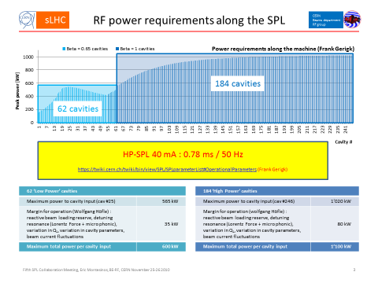
History
For the Fifth SPL Collaboration meeting (former SLHiPP meeting) in November 2010, the SPL project Leader (Roland) asked for ‘a SPL possible RF sources’ study
The Study was done for the CERN SPL project, comparing sources for 62 Low power and 184 High power cavities
In the conclusion slide, I stated that a
600 kW MB-IOT is a very interesting option to study
  Series tube price, life time and effective efficiency ???
  Even if very risky, building a new IOT prototype could help to improve IOT technology and reduce (?) final total cost, and be useful for other projects
Fifth SPL Collaboration Meeting,
Eric Montesinos, BE-RF, CERN November 25-26 2010

Slide 6
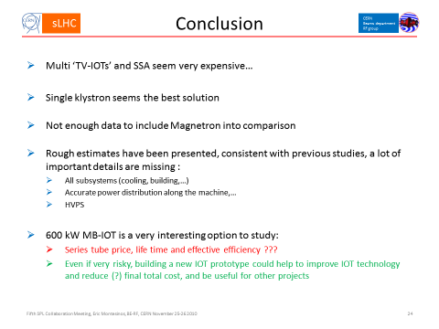
History
For the Fifth SPL Collaboration meeting (former SLHiPP meeting) in November 2010, the SPL project Leader (Roland) asked for ‘a SPL possible RF sources’ study
The Study was done for the CERN SPL project, comparing sources for 62 Low power and 184 High power cavities
In the conclusion slide, I stated that a
600 kW MB-IOT is a very interesting option to study
  Series tube price, life time and effective efficiency ???
  Even if very risky, building a new IOT prototype could help to improve IOT technology and reduce (?) final total cost, and be useful for other projects
Fifth SPL Collaboration Meeting,
Eric Montesinos, BE-RF, CERN November 25-26 2010

Slide 7
History
In January 2013, CERN and ESS started to work on a collaboration agreement that was fully signed in July 2013
The agreement was to develop a high power IOT technology at 704 MHz
  ESS will procure a tube
  CERN will build a test bench (on a best effort basis) to test it

Slide 8
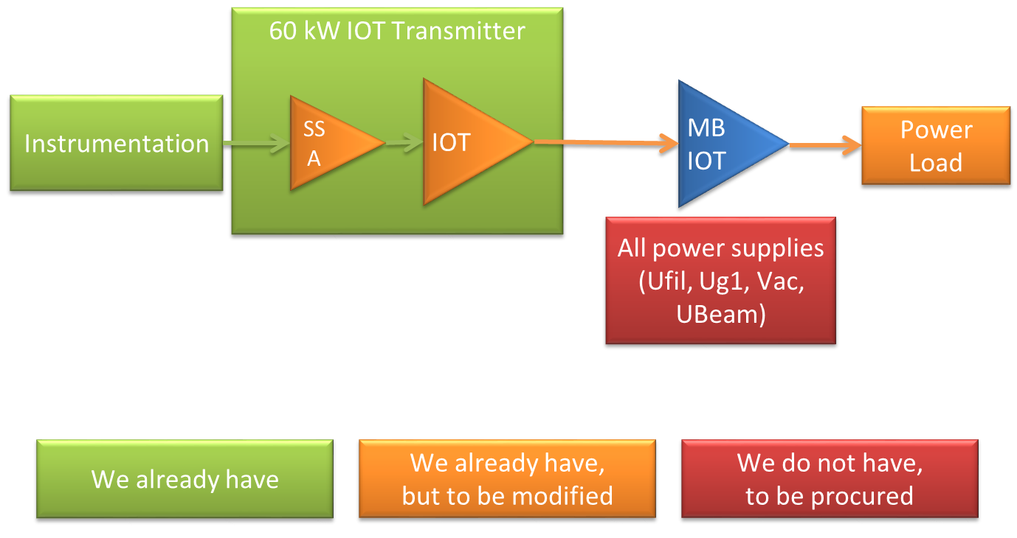
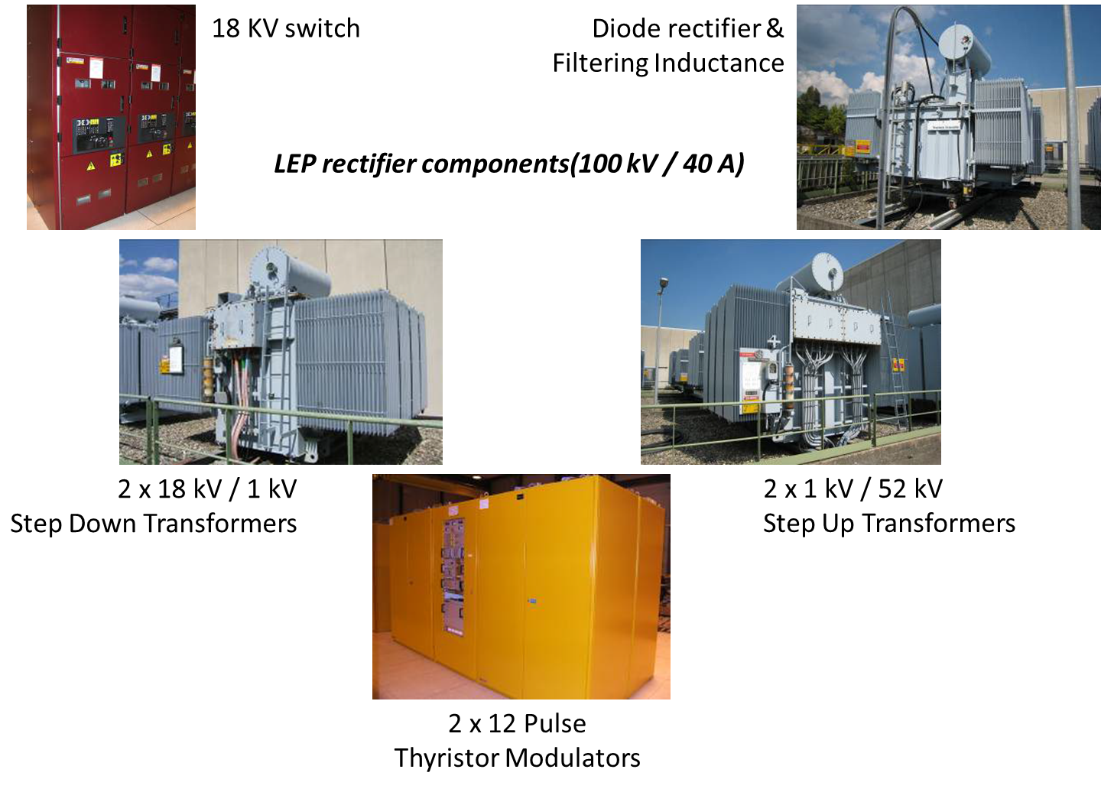
Test bench 2013-2014
The first option was based on LEP equipment already present in LHC point 2, it requested a lot of consolidation work to be done
It turned out that the CW LEP systems were not correctly suited for operation at 3.5 ms – 14 Hz
It was analysed that LHC operation and IOT tests at the same time were not compatible
All the LEP equipment to be consolidated in order to operate a MB-IOT in pulse mode at 14 Hz

Slide 9
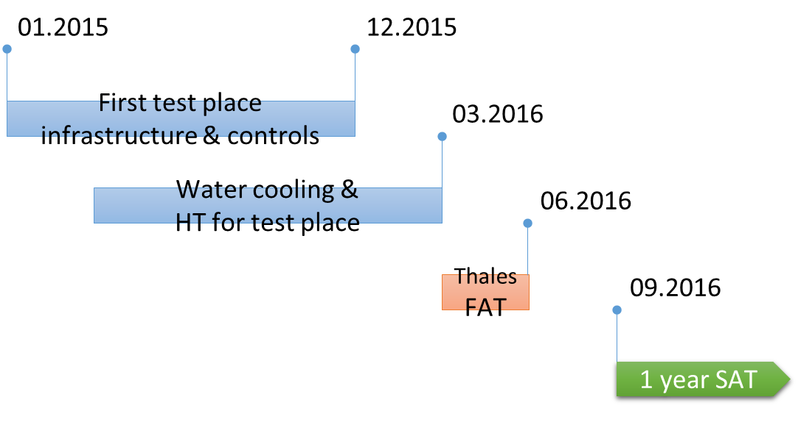
Test bench 2015
We found a new location, BAF3 (new building for CERN-LIU project)
Request from Thales that CERN would also be their FAT test place
ESS requested CERN to consider to build the test bench at Lund, after a deeper analysis, ESS confirmed to build it at CERN
From August to December 2015, HIE-Isolde FPC crisis, test bench on hold (best effort basis)
End 2014, the schedule has been made in order to have the tests starting mid-2016, in line with tube production

Slide 10
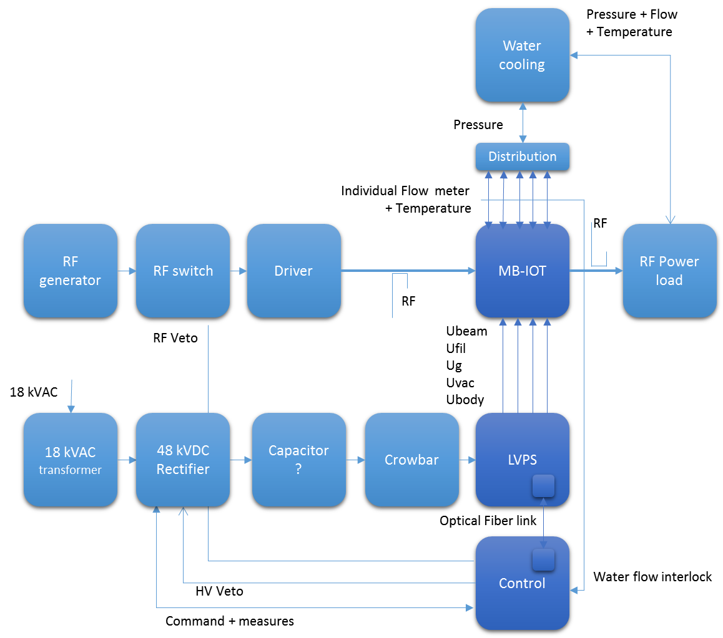
Test bench 2016-2017
Completed the identification and started the purchasing of all the needed devices
Initial cost of 150 kCHF (Single Beam IOT) increased to 300 kCHF (Multi-Beams IOT with LEP systems) and to 600 kCHF (MB-IOT with new capacity charger)
We also designed it to be compatible with two tubes, the CPI/Thales tube and the L3 tube
However, for cost reasons, we decided a staged design
  Stage 1 = 1.2 MW, 4 ms – 14 Hz (ESS SOW)
  Stage 2 = 1.5 MW, 4 ms – 28 Hz
  or 1.5 MW, 2 ms – 50 Hz (CERN SPL)
From the test bench point of view, a MB-IOT with 10 beams is much more complex than a single beam high power tube

Slide 11
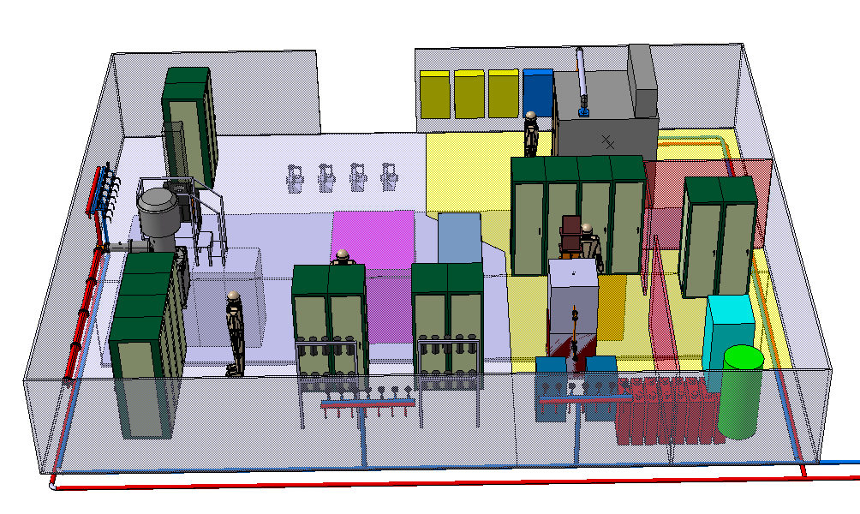
Test bench Main devices
  Capacity charger
  Capacitors
  HV cage
  LEP Crowbar
  Grid supplies *
  Filament supplies *
  HV PLC Controls *
  Water cooling
  Air cooling system
  PLC Controls
  Fast interlocks
  RF measurements
  SSPA Driver
  RF power load
  Ion pump supply
  Focus supplies
  * Floating at – 50 kV
Test place in BA3, usual SPS grid tube test place at CERN, with in yellow the MB-IOT area including its HV cage

Slide 12
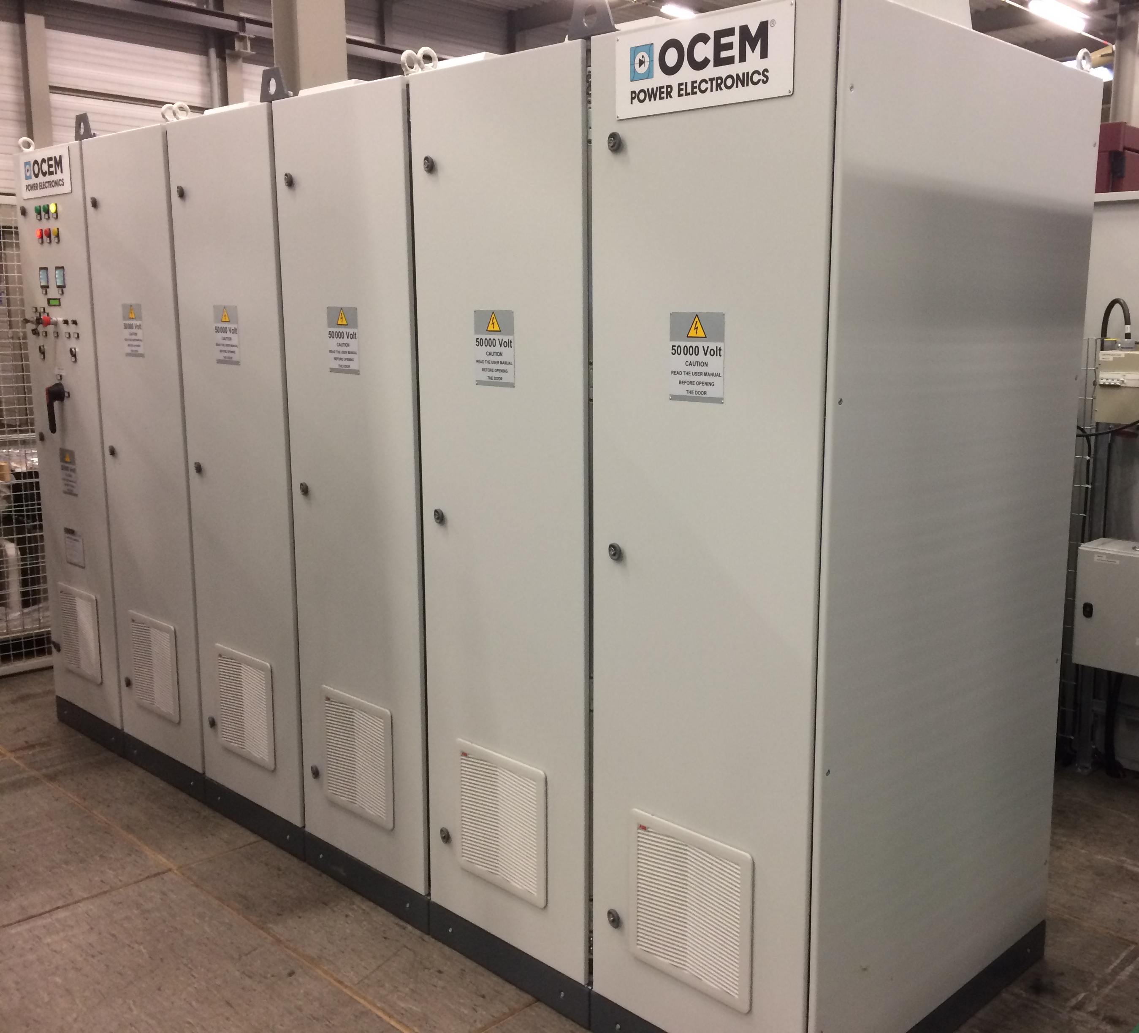
Capacity Charger
We did the Market Survey in 2015 and placed the order to OCEM first days of January 2016 for an expected delivery in June 2016
This was a very short delivery delay
The charger was delivered in December 2016
We had a lot of grounding difficulties, that induced broken devices and additional delays
Once the RF tests have started, there was also a di/dt protection that prevented us to increase the RF power level
OCEM reacted within few hours and sent us the modified software that helped to increase the RF power
The 160 kW capacity charge delivered by OCEM
It could be more compact by one rack if needed

Slide 13
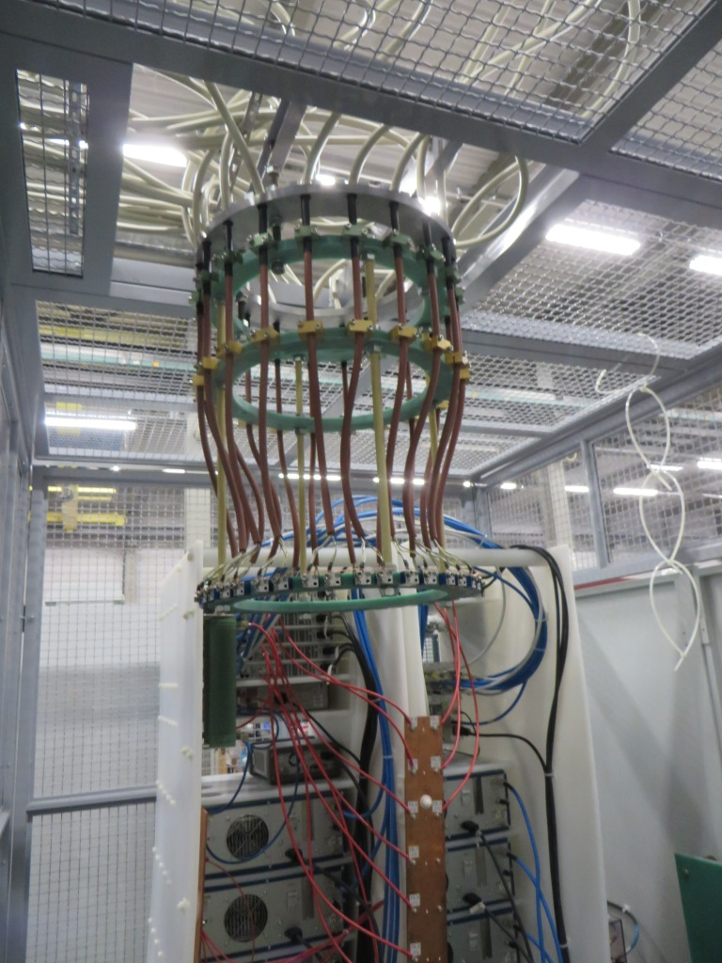
Low Voltage Power Supplies
The initial design was with one grid and one filament supplies
The tube suppliers informed us that they both decided to go with 10 grid and 10 filament supplies,
This made the test bench much more complex as the supplies have to be floating at – 50 kV
We designed a special ‘plastic’ rack standing inside the HV cage hosting the LVPS and the HV PLC
We also designed a LVPS distributor that allowed us to have the same cable lengths for all guns in order to minimize the unbalance effects
The LVPS distributor, the ‘plastic’ rack, the gird and filament supplies and the HV PLC

Slide 14
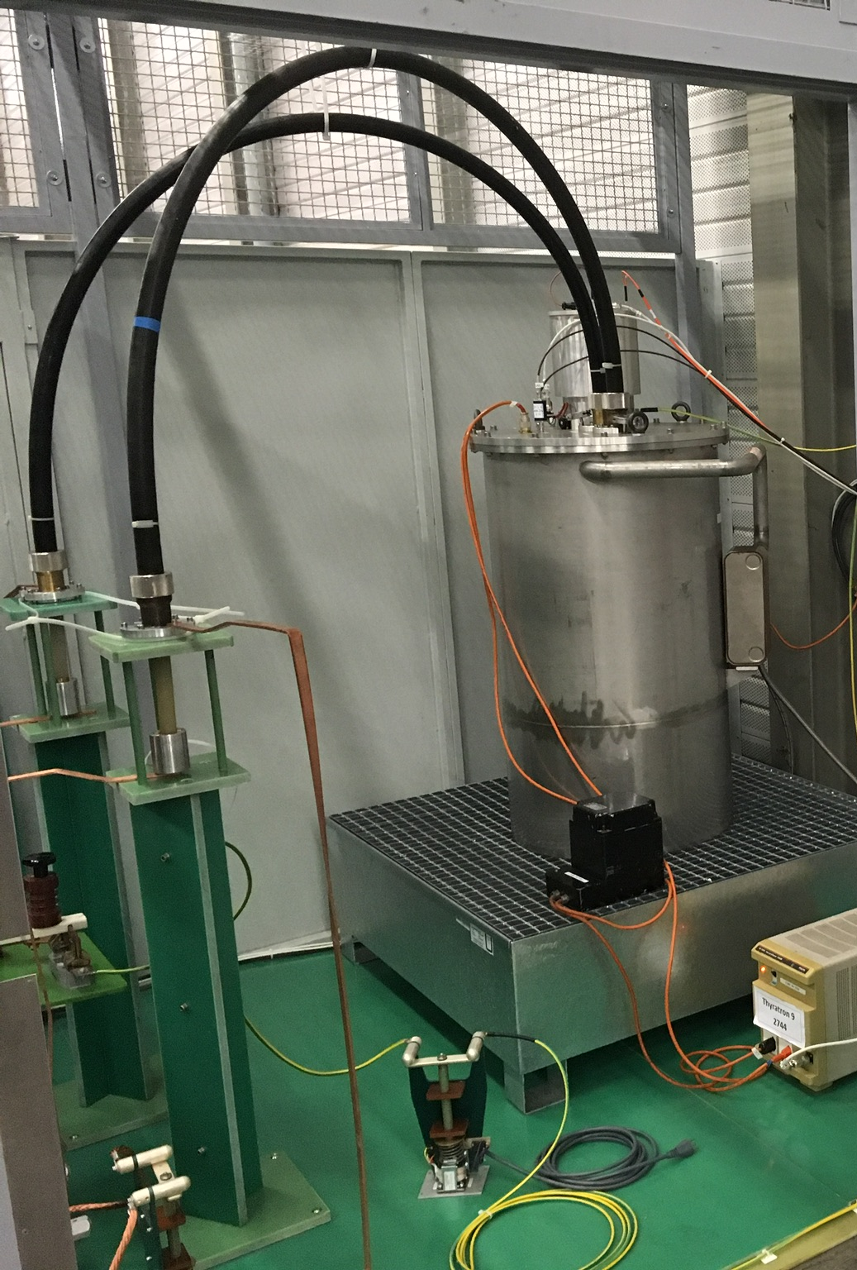
capacitors and crowbar
Stage 1 test requests a 80 µF capacitor
We bought eight * 10 µF capacitors that are standing in a special enclosure under the false floor
In order to protect the tube, we have installed an old but very efficient LEP crowbar system
We performed several tests with a thin 0.2 mm diameter copper wire in short circuit, the wire did not fail
The LEP crowbar system

Slide 15
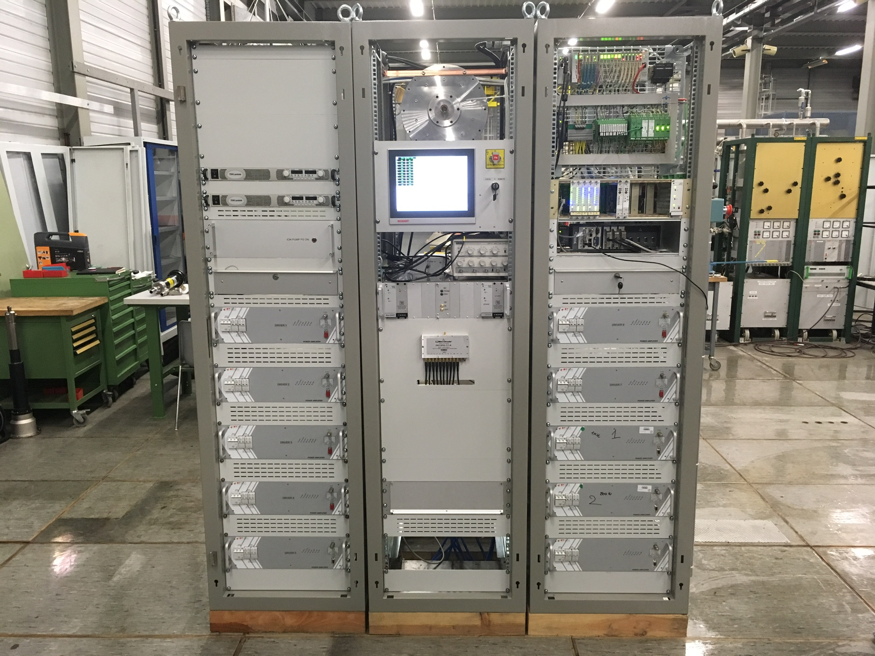
RF drivers
We bought 10 * 1 kW units to Btesa in Spain
CPI/Thales requested 1 * 10 kW input
L3 requested 10 * 1 kW inputs
To be compatible with the two tubes, we developed a radial cavity combiner
  For CPI/Thales we have 10:1
  For L3 we have 10:1 + 1:10, doing so, all 10 phases and power levels are equilibrated
The ten SSPA and the cavity combiner

Slide 16
controls & interlocks
In order to control the LVPS, we have a PLC inside the HV cage, it communicates with the main PLC via an optical fibre link
The main PLC monitors all the slow interlocks such as flow and temperature signals
A Compact Rio system manages all the RF and current signals
A LHC fast interlock system takes care of the sensible signals, vacuum and CRio
The way the protection is made has been designed in close collaboration with Thales
We are now preparing the modifications for the L3 tube
The Controls & interlocks systems

Slide 17
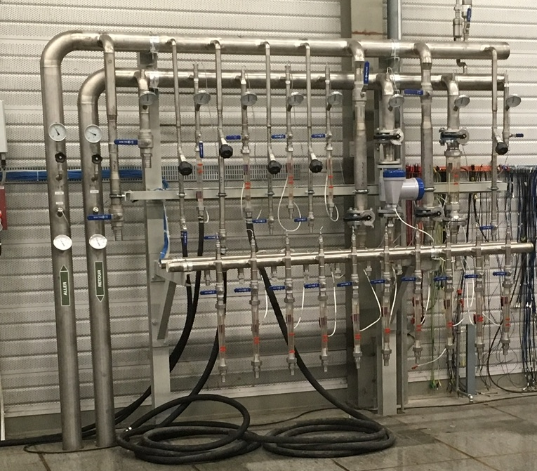
cooling systems
Two cooling systems have been built
CPI/Thales requested to have individual water cooling flow meter for each collector, they also requested an individual air inlet per input circuit
We designed a 3D printed air distributor that guaranty a balanced air cooling per input circuit
L3 has a common water cooling line and a single air system, still to be built
The water cooling systems,
in red for the CPI/Thales tube, in yellow for the L3 tube

Slide 18
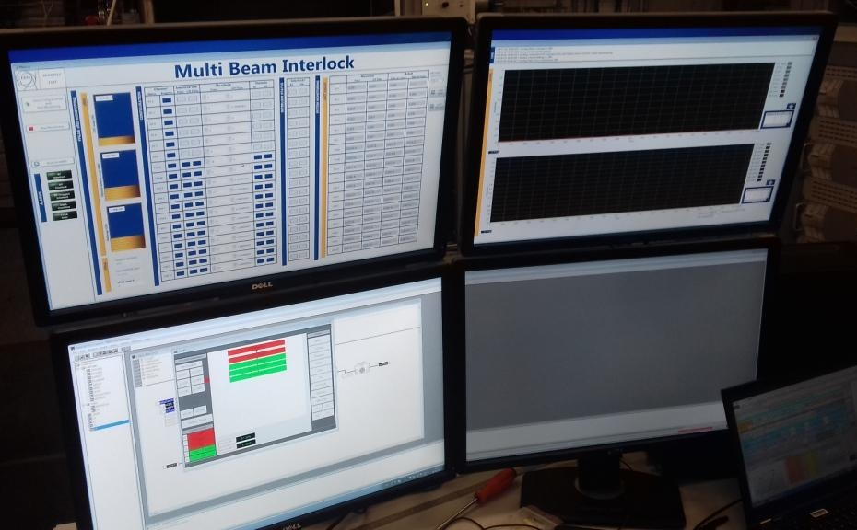
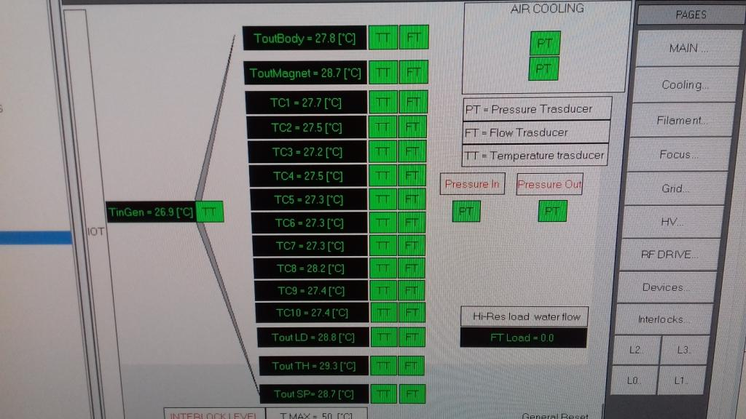
Test bench ready by beginning 2017
Lot of CERN’s teams were involved
  Controls, Cooling & Ventilation, Electrical Network, Electrical Power Converters, Mechanical Workshop, Finance, …
Thanks to all involved colleagues!
Best effort basis is not the best to stick to a schedule, even if the schedule had to be revisited several times, beginning of 2017, we were ready to install a tube
Several specific applications have been tailor made by several specialists in order to operate the tube

Slide 19
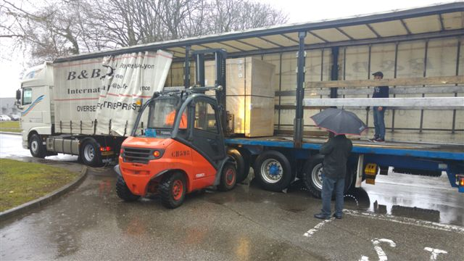
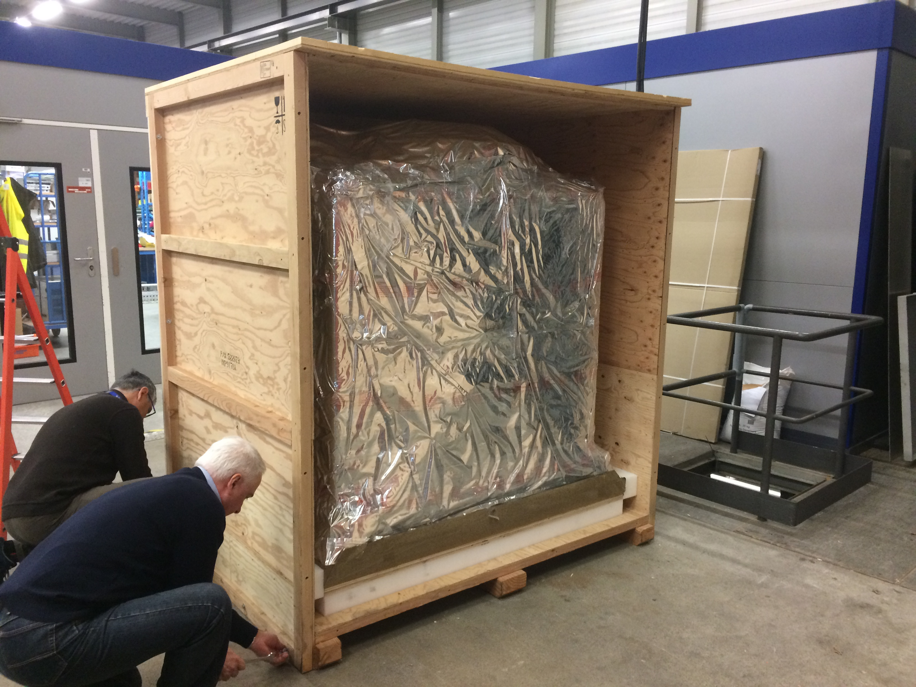
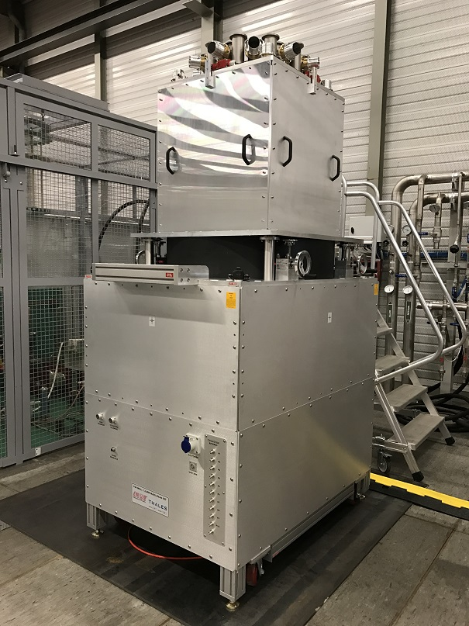
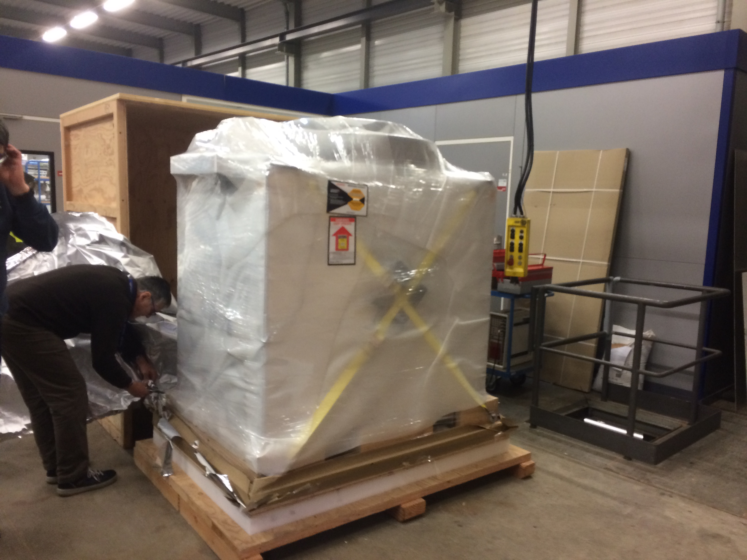
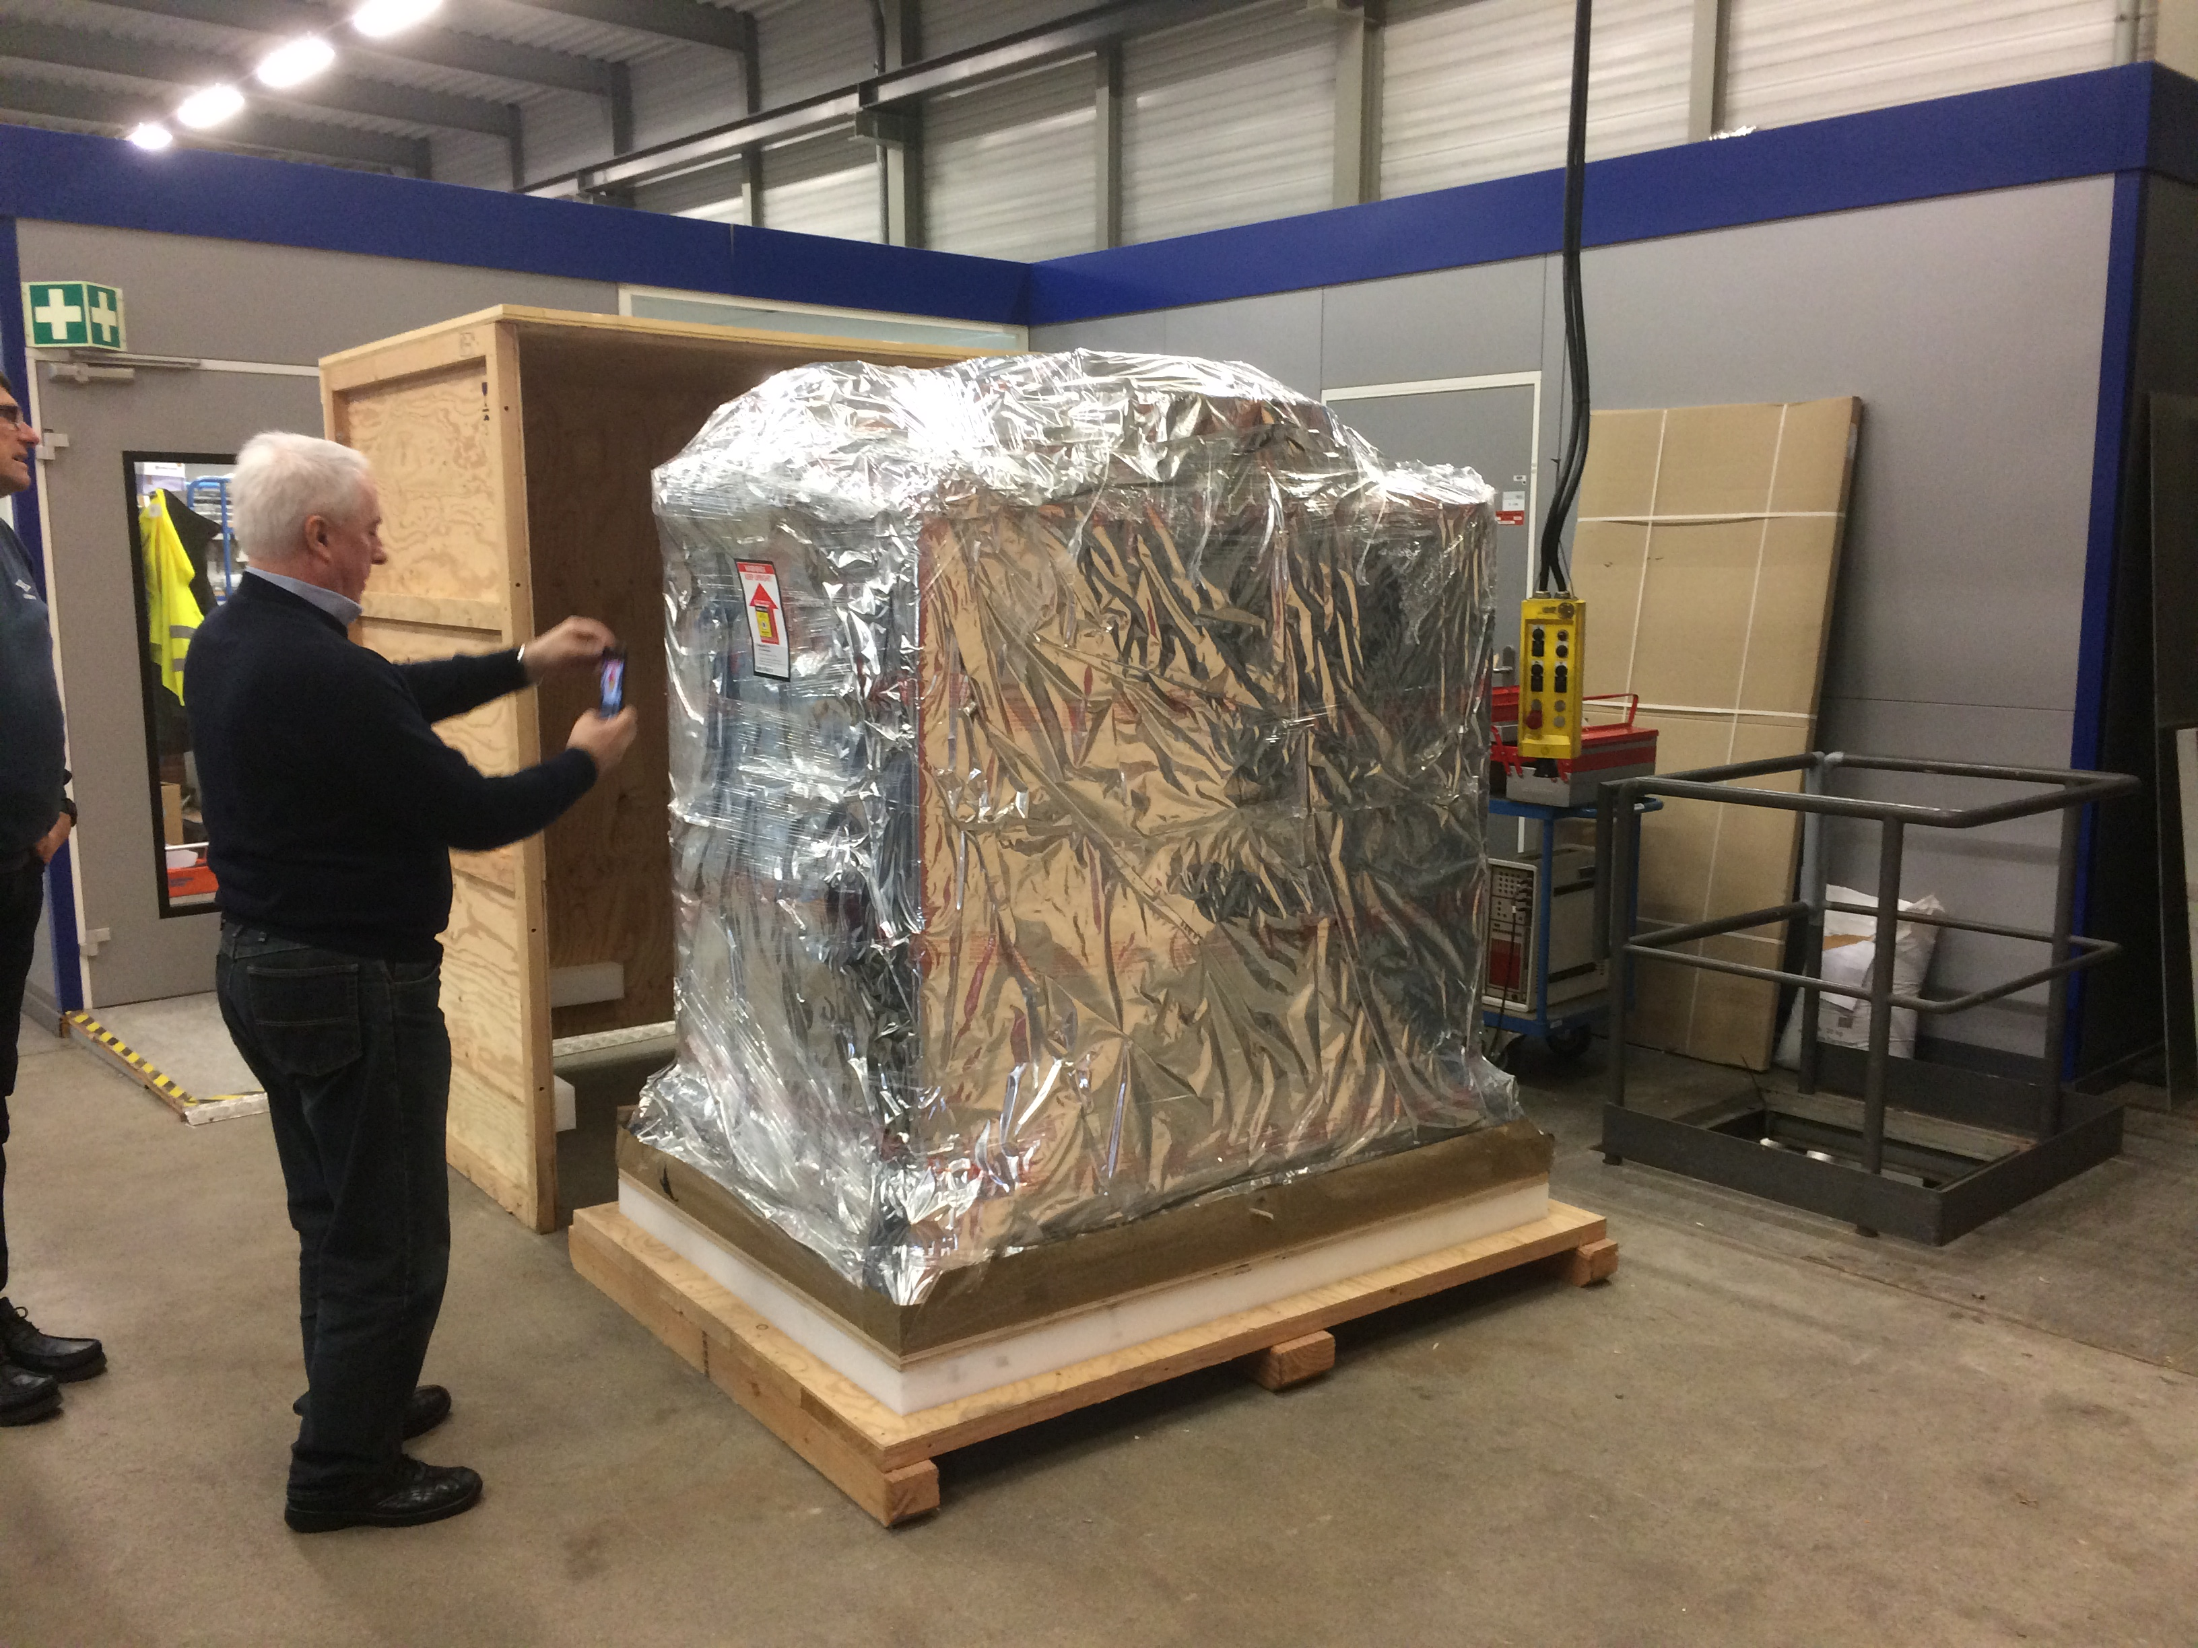
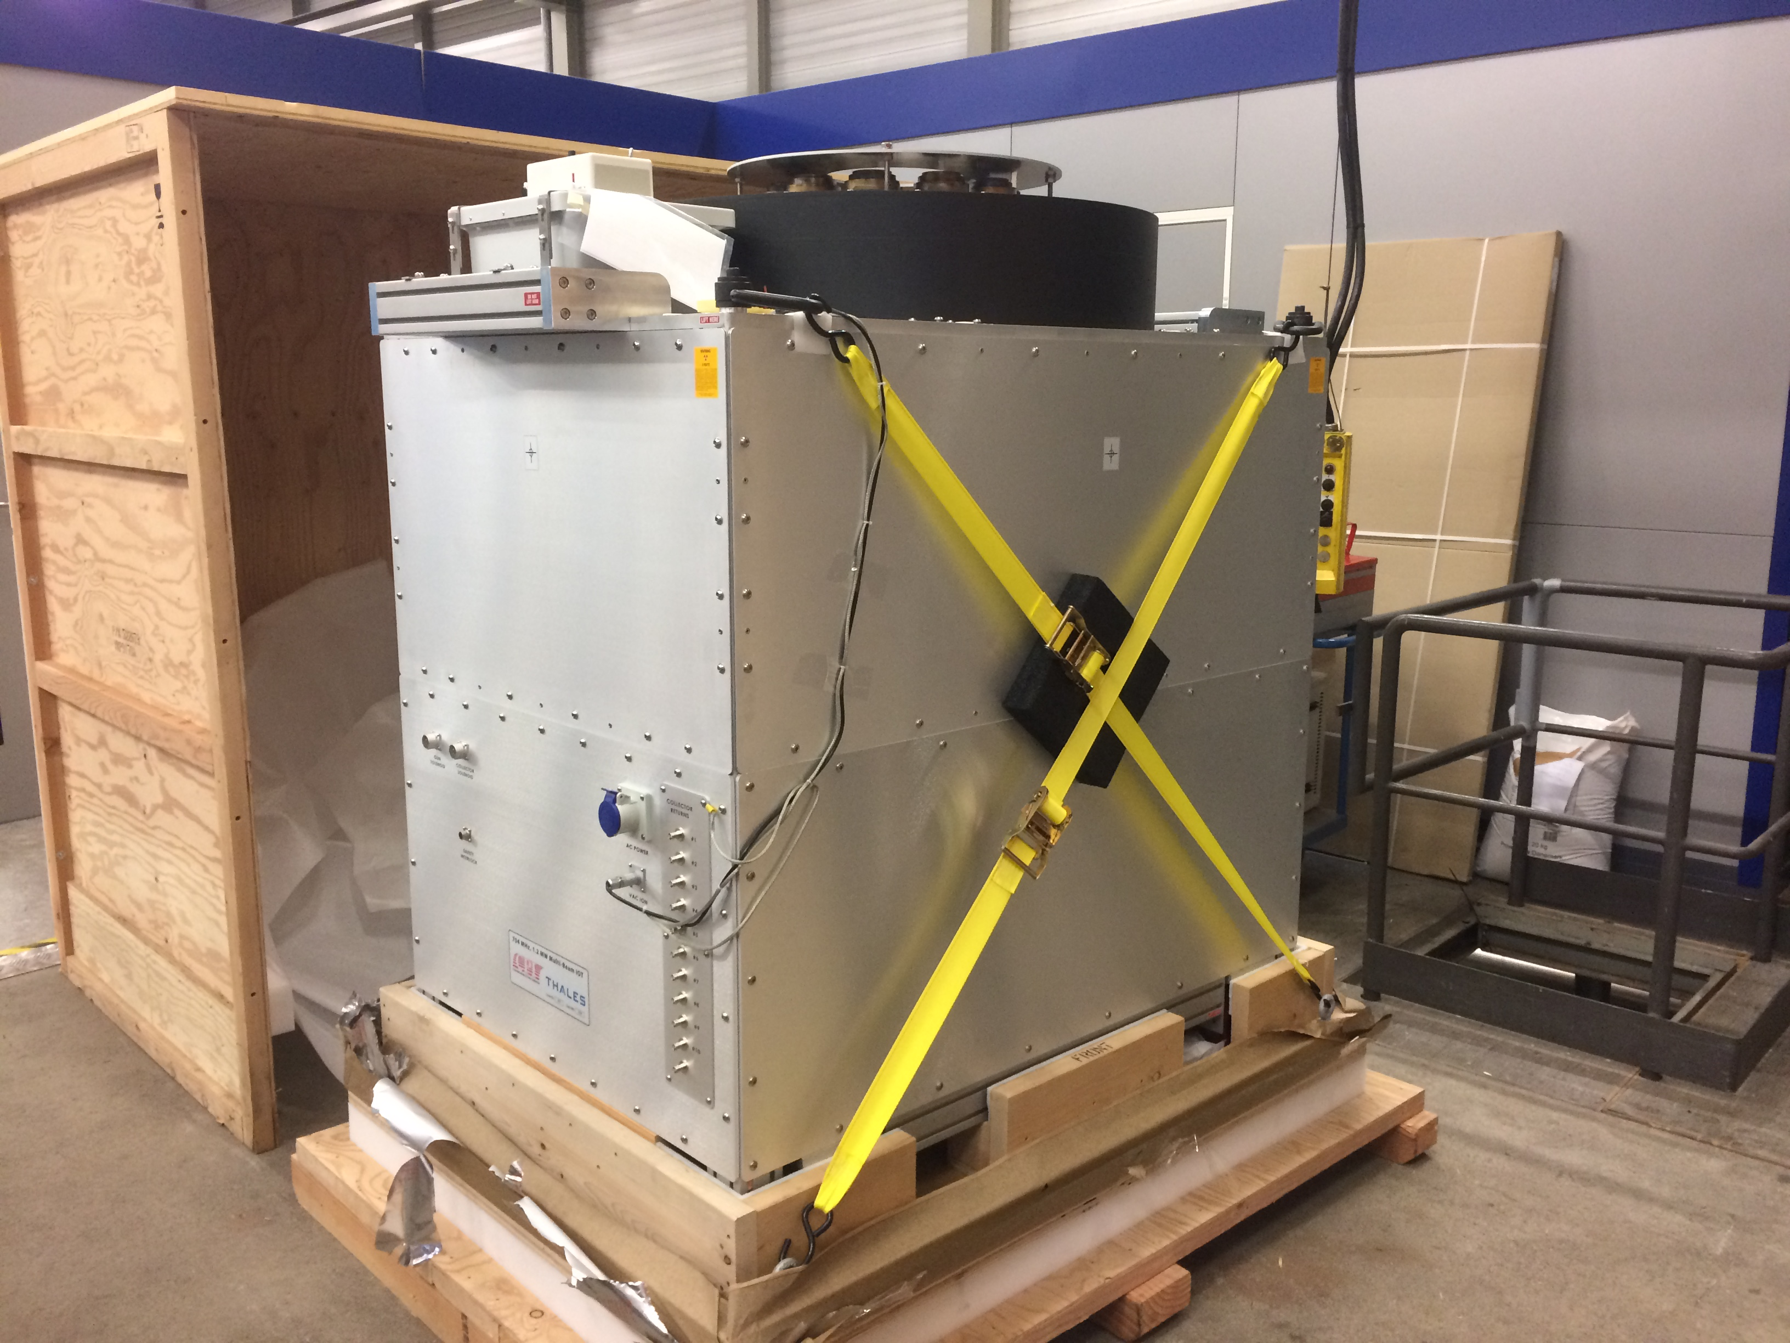
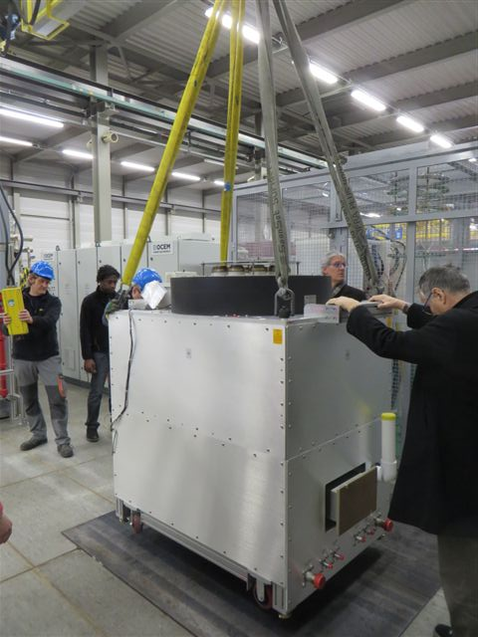
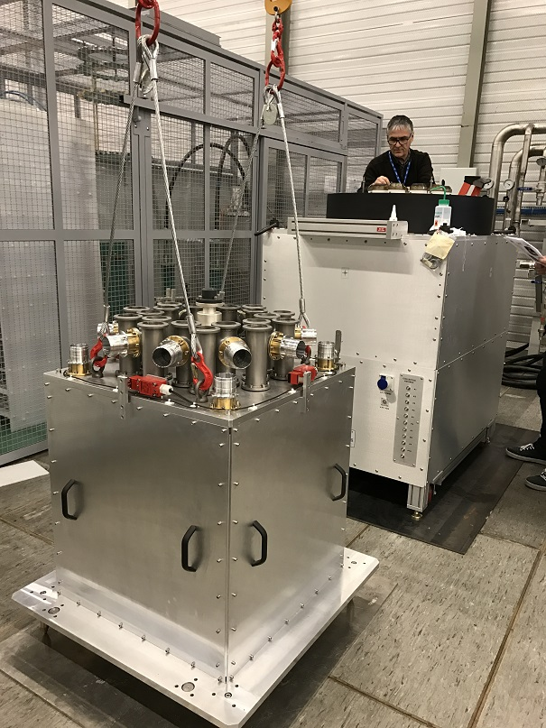
Delivery of the CPI/Thales tube March 2017
It has been long (15 months) and difficult to setup the collaboration agreement with Thales
Thales wanted to give his green light before any CERN communication on the tests
CERN of course did not accept
We finally agreed that CERN will inform Thales prior to any communication
The CPI/Thales tube arrived at CERN beginning of March 2017
We unpacked it, and start the installation in the test bench and the assembly has been very easy even if the MB-IOT is very big (we had to reinforce the false floor)
The CPI/Thales tube assembled,
input circuit on top of the output tube

Slide 20
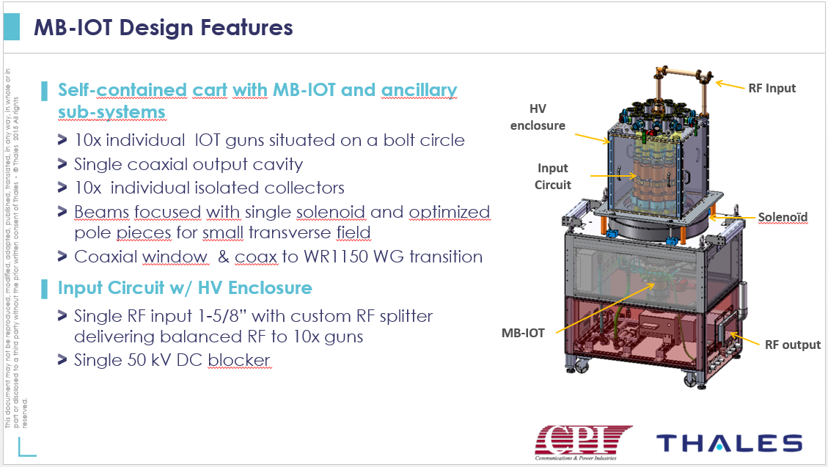
CPI/Thales MB-IOT at a glance

Slide 21
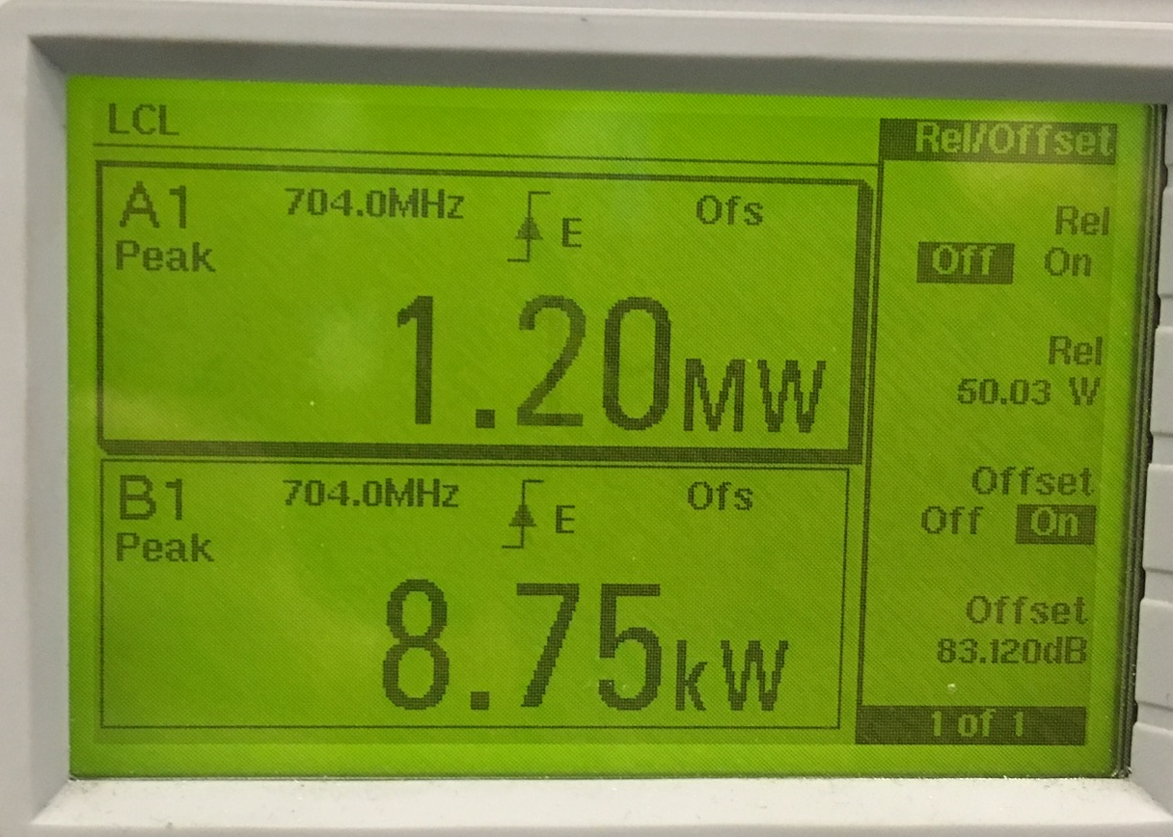
Tests Results
We were very caution whilst starting the RF tests and we were very surprised how easy the tube powered up
Due to a di/dt protection in the Capacity Charger, we had to implement long rise and fall ramps
When we talk of 1 ms pulse it has to be understood
  Rise ramp of 1 ms
  Flat top of 1 ms
  Fall ramp of 1 ms
We impressively quickly reached
1.2 MW – 1 ms – 14 Hz in less than a few days
power
1 ms
1 ms
1 ms
time
Repetition 14 Hz (71.43 ms)

Slide 22
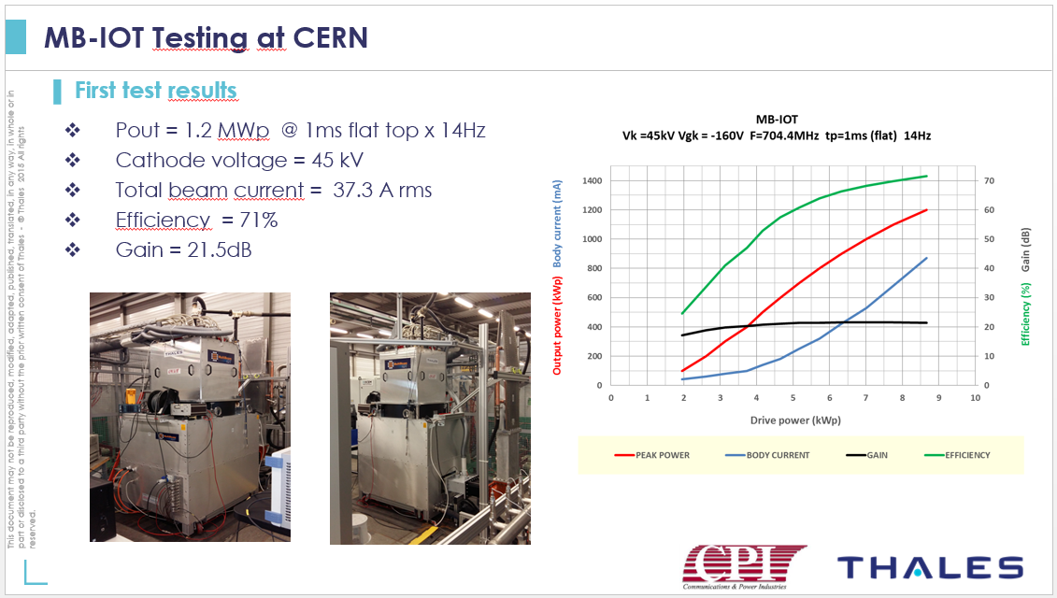
Tests Results

Slide 23
Tests results
We modified the protection of the Capacity Charger, and we modified the pulse shape
We obtained 1.05 MW again very easily and had a strong outgassing
We implemented the CERN FPC conditioning system (that I described last year at the SLHiPP#6), it helped, but the default remained
CPI/Thales localised the default to the output window, they are still working on it
power
0.3 ms
time
4.0 ms
0.3 ms
Repetition 14 Hz (71.43 ms)

Slide 24
Conclusion
The MB-IOT feasibility proof of principle has been made
We successfully achieved
  1.20 MW – 1.0 ms – 14 Hz
  1.05 MW – 4.0 ms – 14 Hz
We were limited in performance
  The tube had an output window RF contact trouble
  Not linked to a MB-IOT technological trouble, occurs on klystron windows from time to time
  To be repaired before we resume the high power tests
We started to work on the test bench beginning 2014
Best effort basis induced delays in its construction
Cost was more expensive than expected, pulsed mode, ten beams, 20 LVPS, compatible for two different tubes
Long definition phase, long commissioning phase, a long software tailor made phase
A lot CERN’ specialists involved, thanks to all of them again!

Slide 25
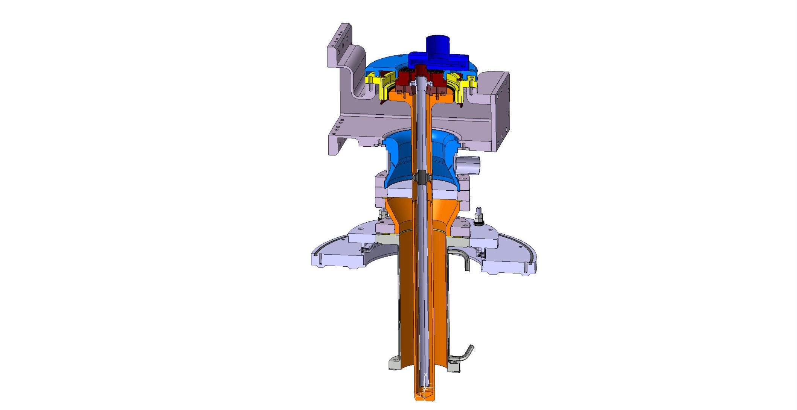
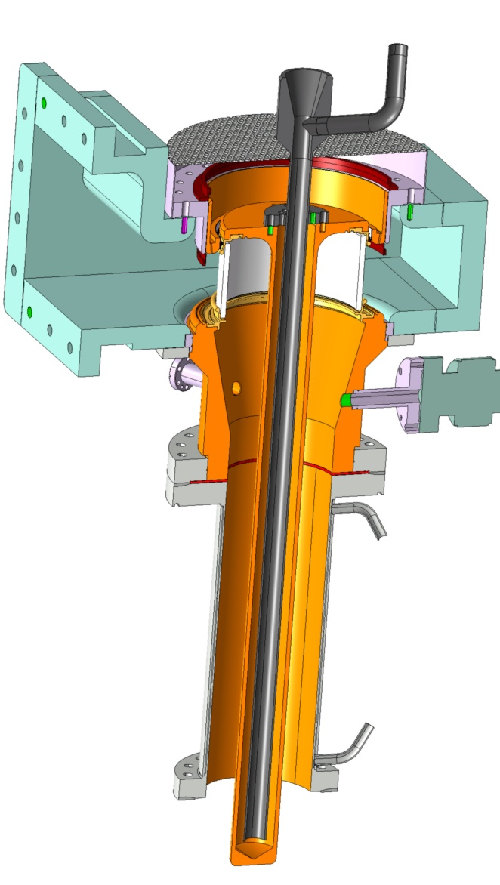
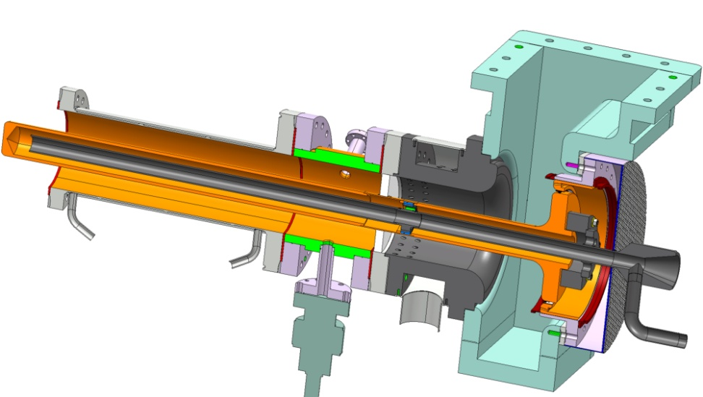
SPL fundamental Power couplers
SPL 1.0
SPL 2.0
SPL 3.0 (HG)

Slide 26
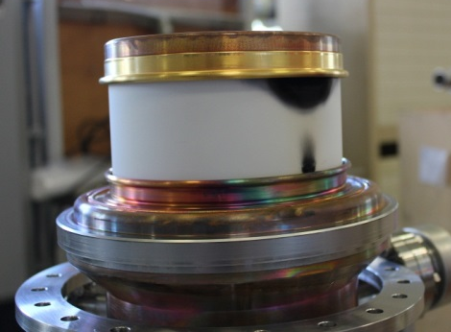
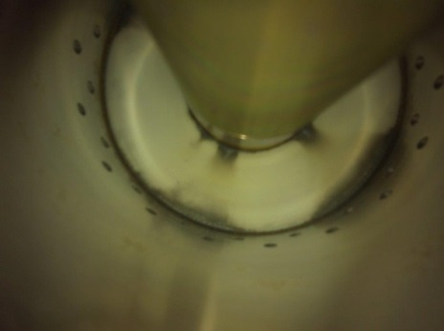
SPL 1.0 & SPL 2.0 fPc tests results
Test Repetition rate 50 Hz | Power level kW | SPL 1.0 Cylind. window coupler | SPL 2.0 Coaxial window coupler
TW | 1000 | √ | √
SW 100 µs | 1000 | √ | √
SW 200 µs | 500 | √ | √
SW 500 µs | 250 | X | √
SW 1 ms | 250 | X | √
SW 2 ms | 250 | X | √
Both designs
have the same
  Double walled tube
  Matching waveguide without doorknob
  Contacts ring including DC capacitor
  Interface to
  cryomodule flange &
  RF + vacuum gasket
SPL 1.0
Cylindrical window Coupler
SPL 2.0
Disk window Coupler

Slide 27
HG FPC (SPL 3.0)
Designed to sustain 2 MW peak @ 704 MHz in SW and 10 % duty cycle
  SPL 2 ms – 50 Hz
  ESS 4 ms – 28 Hz
As much as possible SPL components reused
  Double Walled Tube & its cryostat flange
  Capacitor
  Air cooling distribution
  Test box
Design improvements
  Quasi matched ceramic
  Higher E-field capability ceramic line design
  Cyclonic air
  WG monobloc to avoid any risk of bad contact

Slide 28
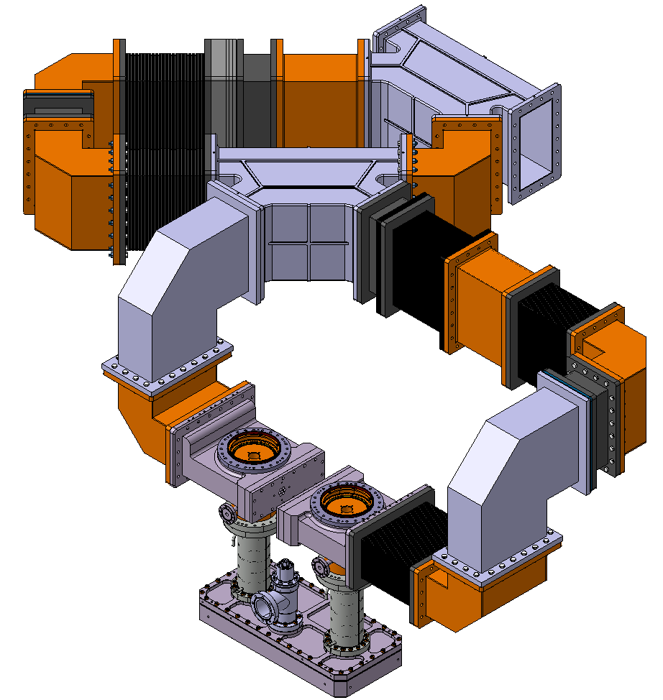
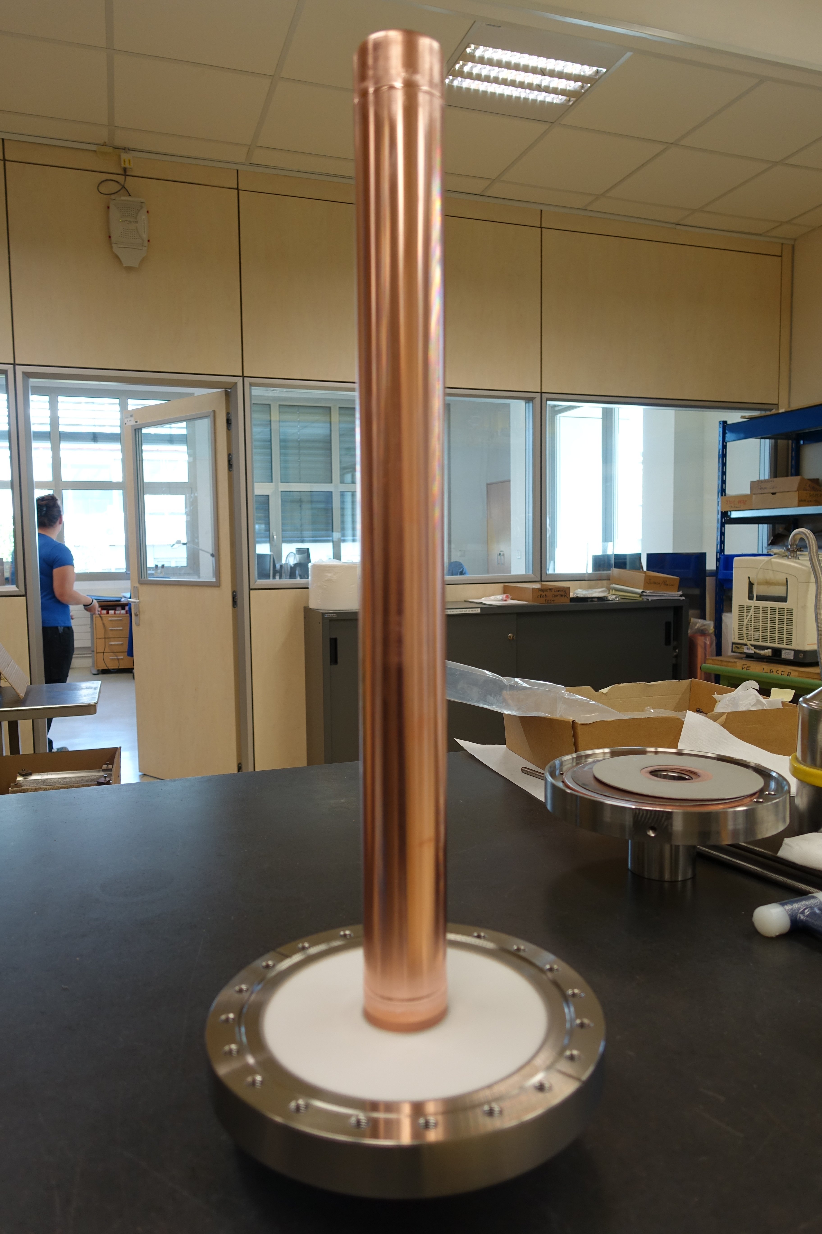
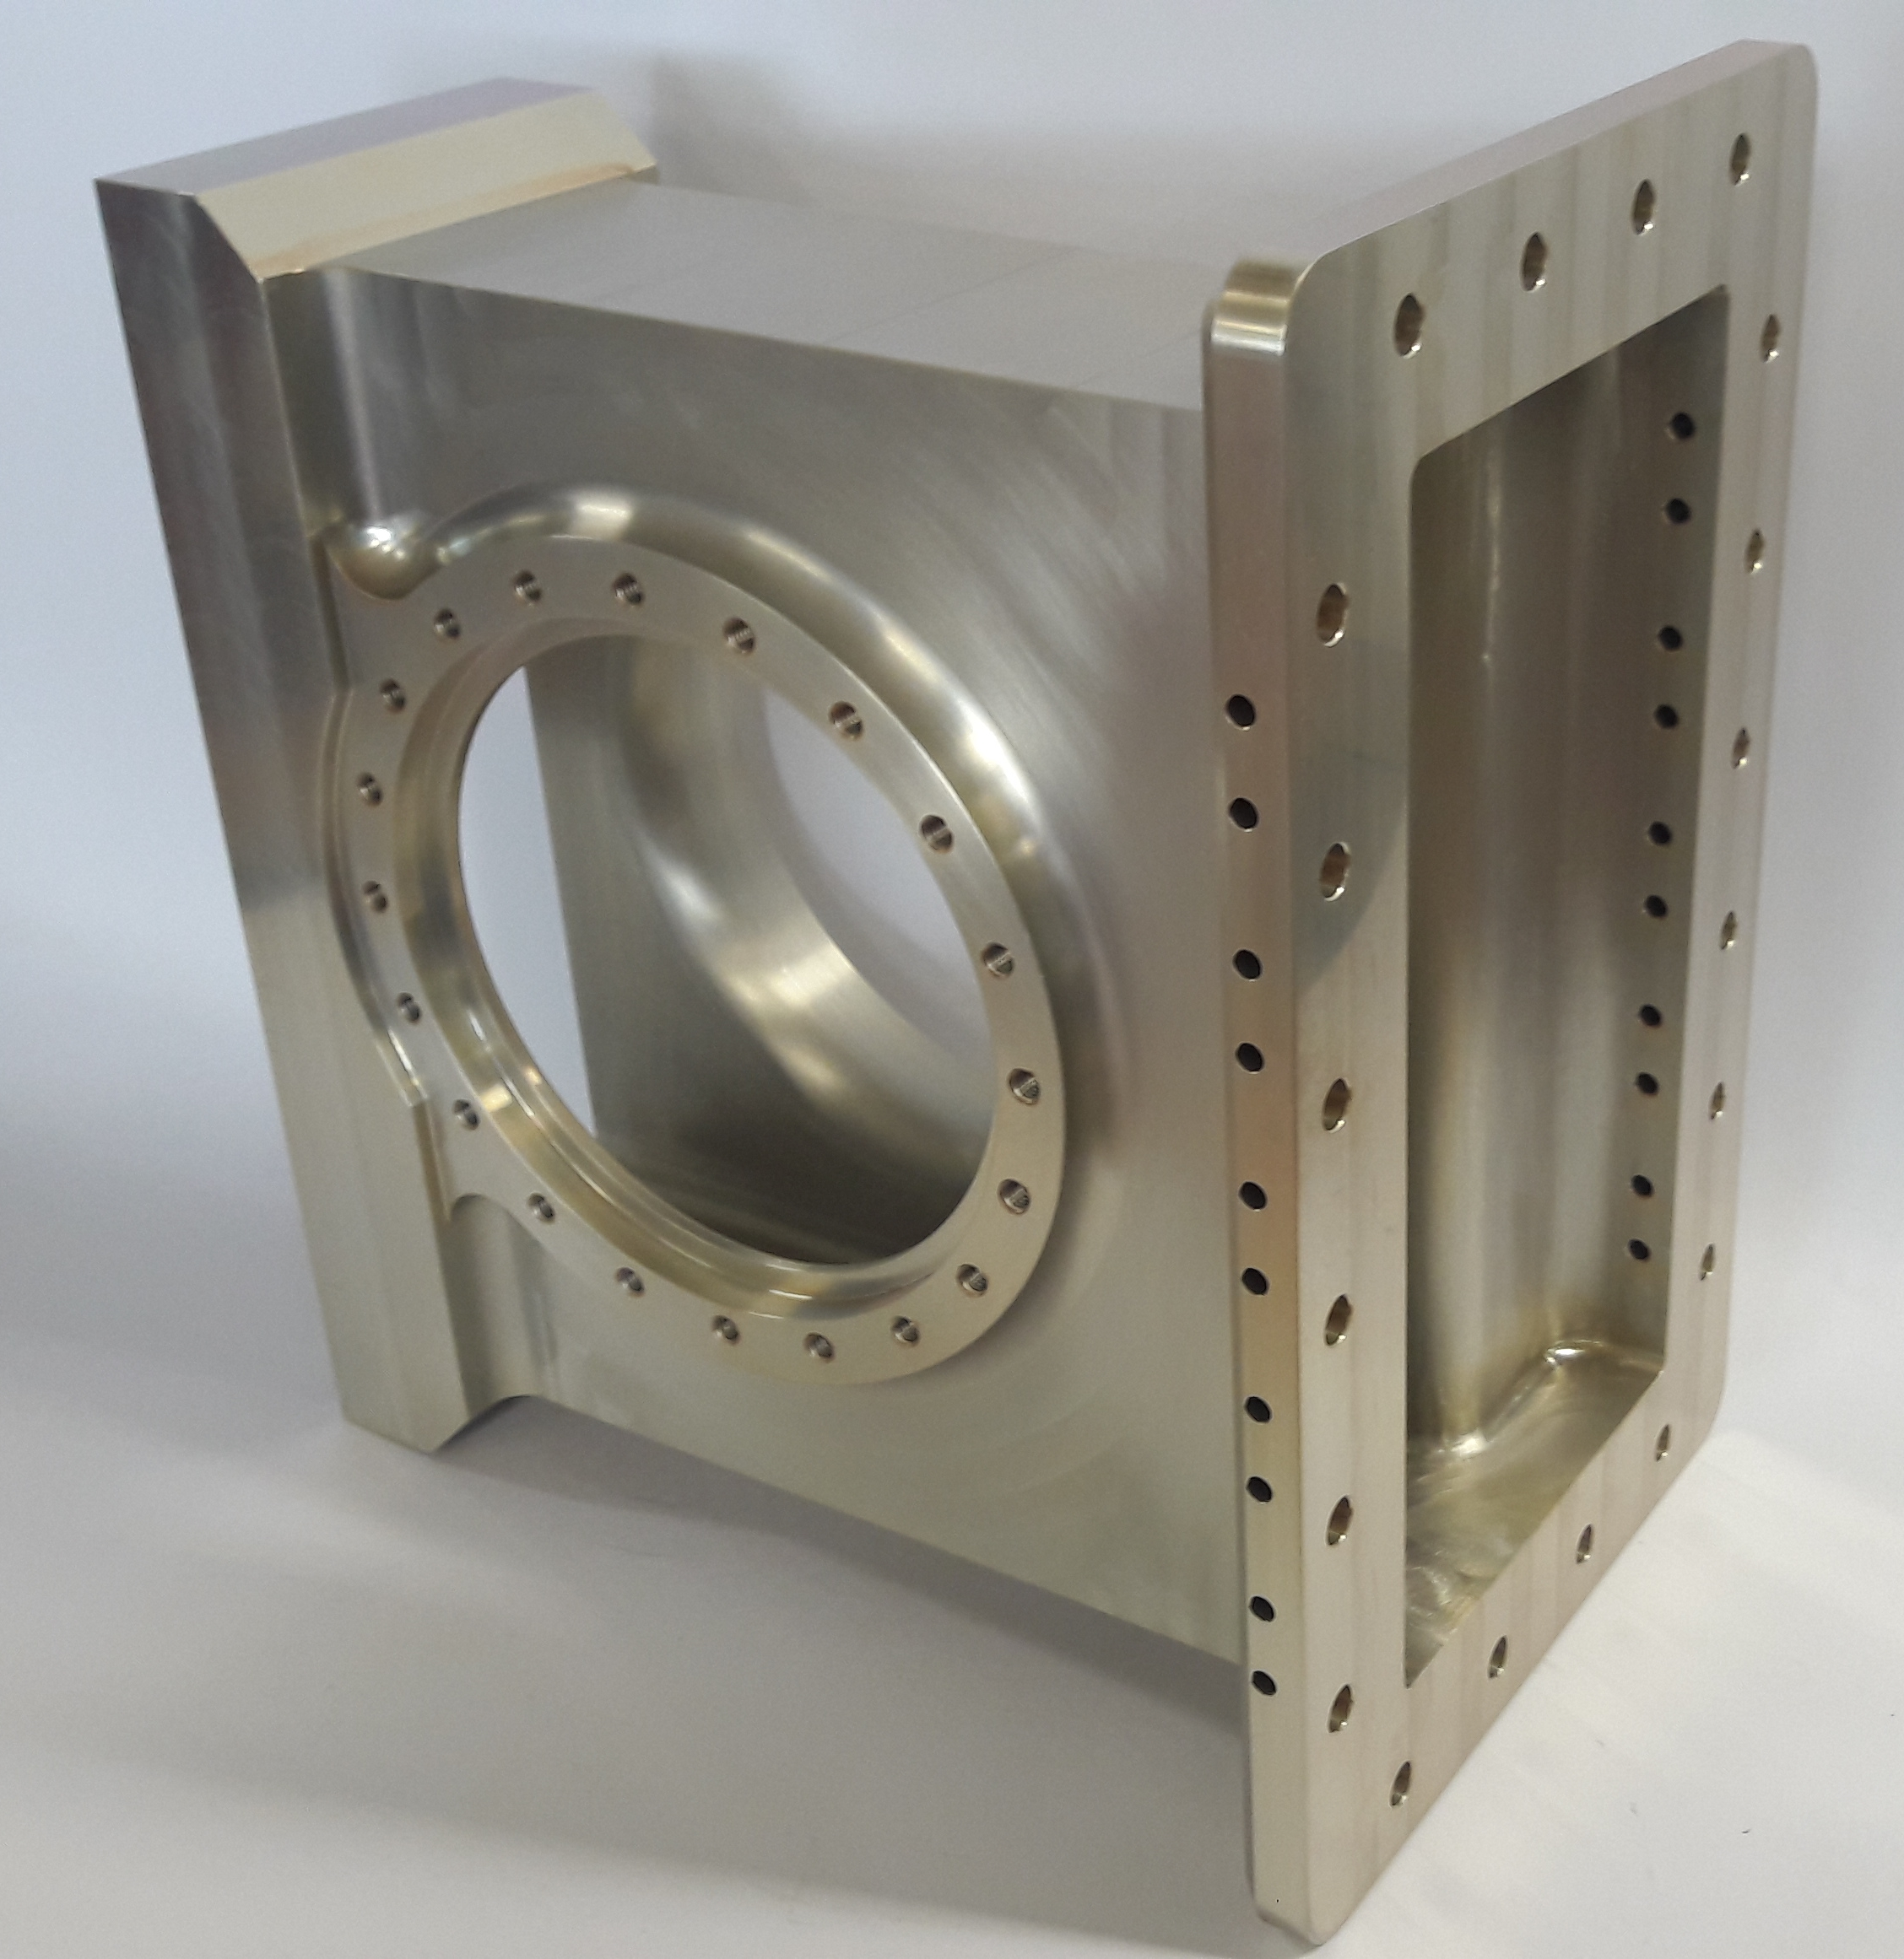
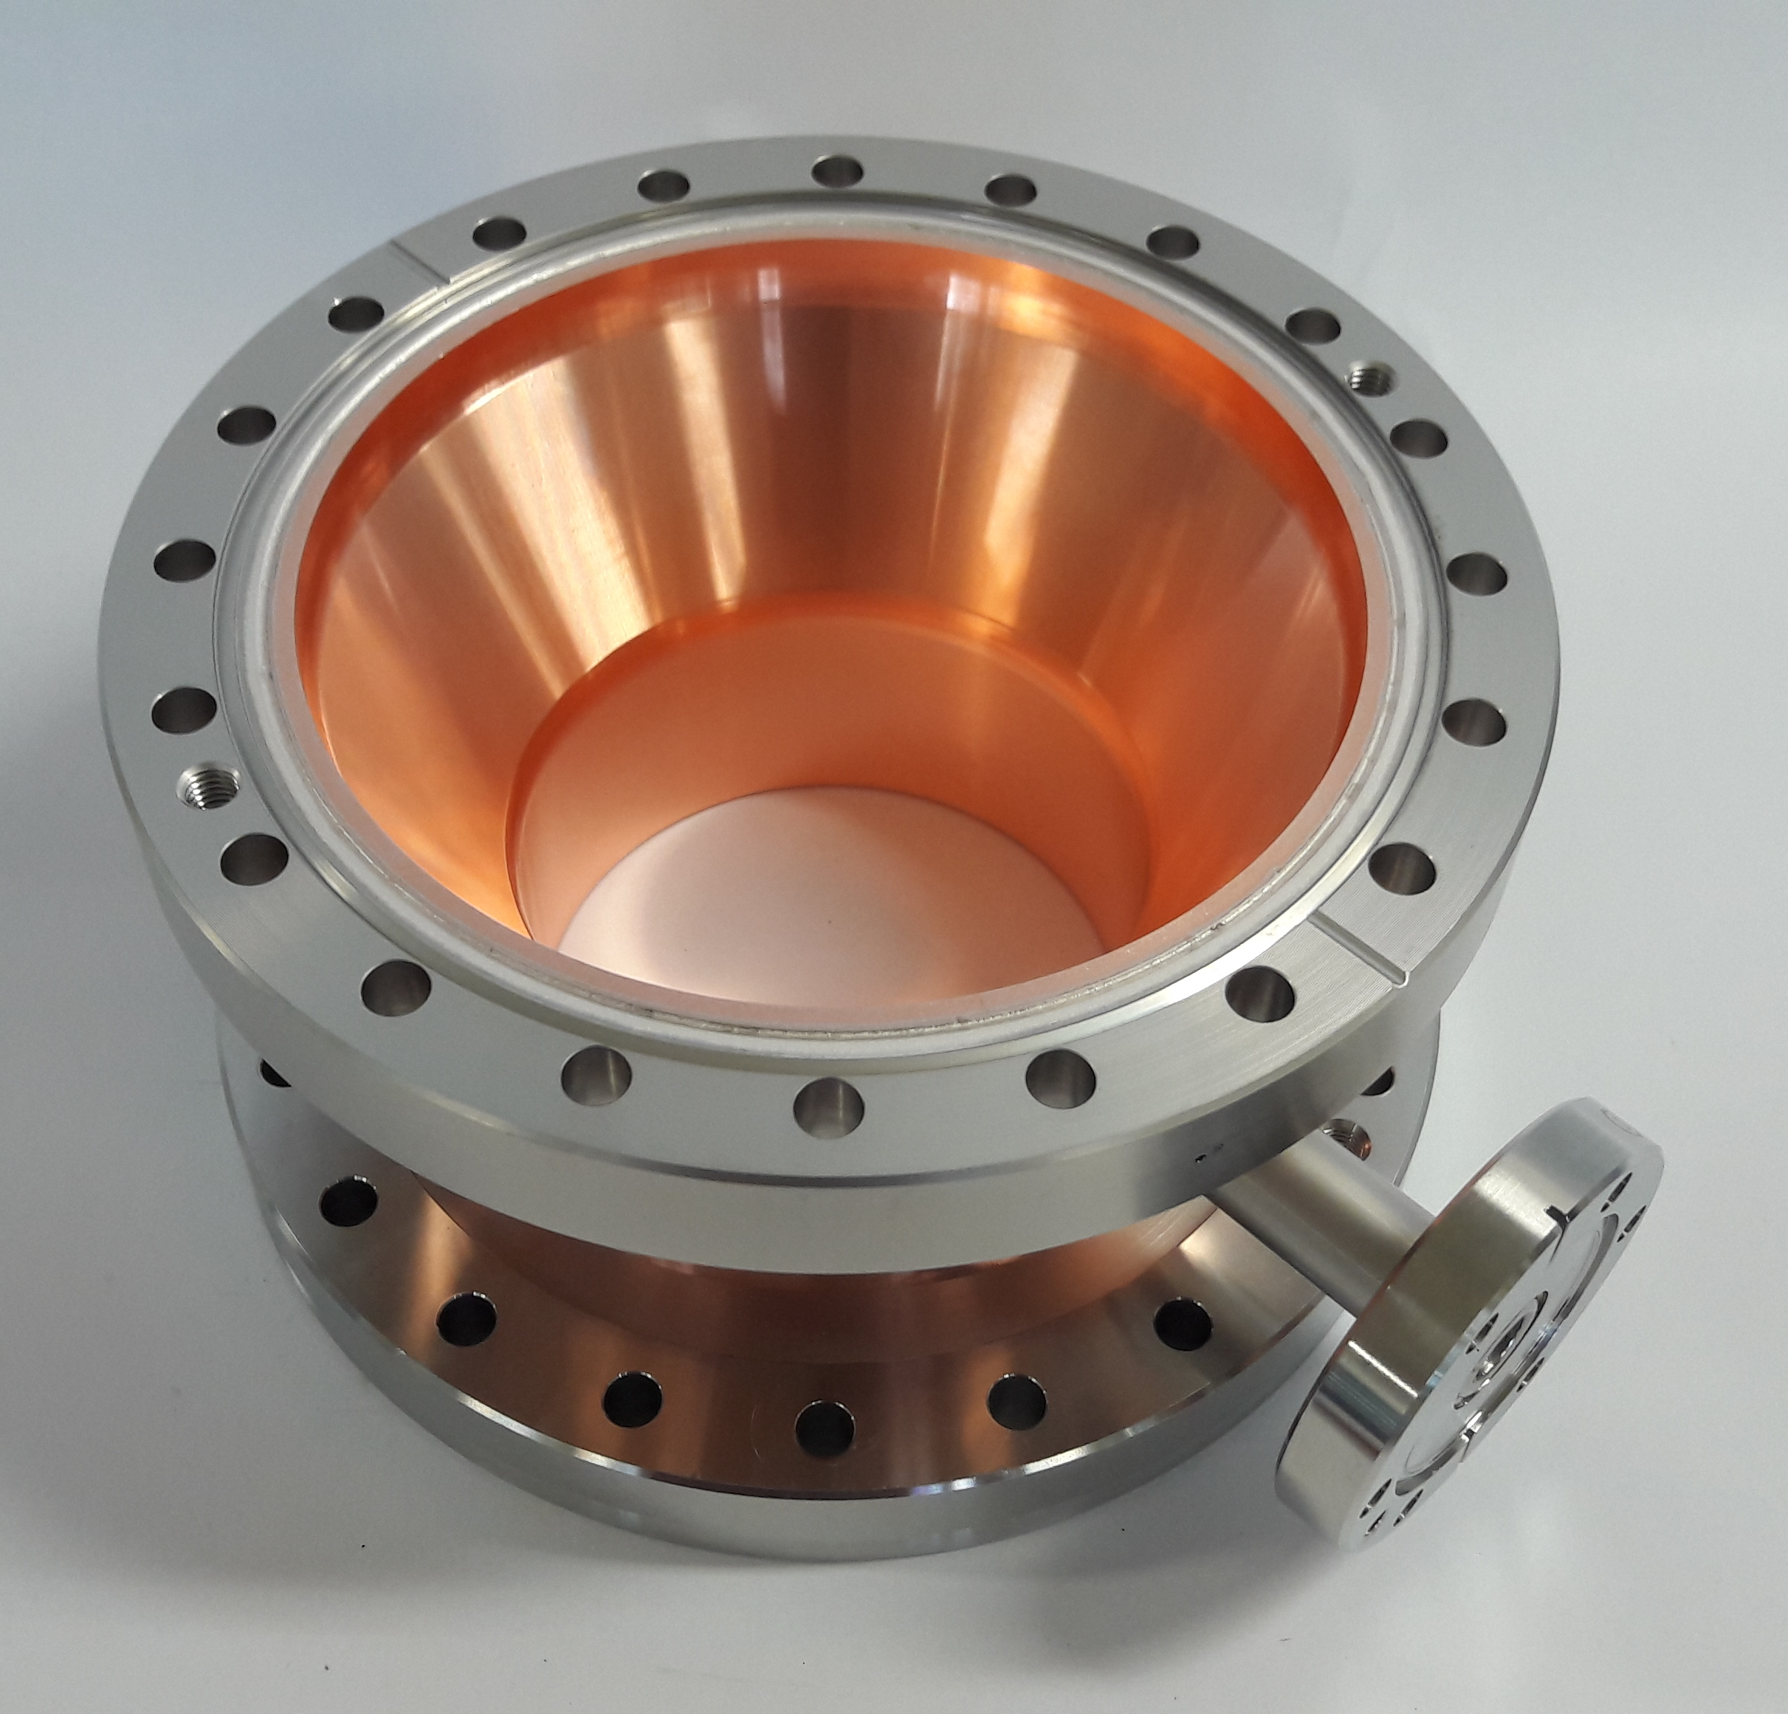
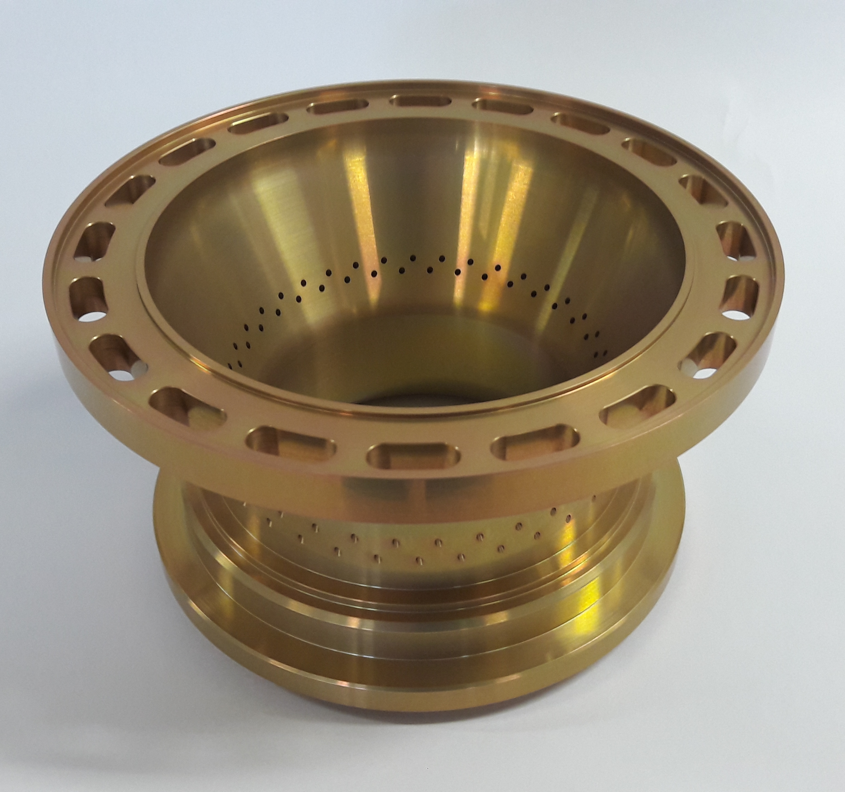
HG FPC (SPL 3.0)
All components for three prototypes have been delivered beginning 2017 and vacuum leak tight tested
Assembly onto test box in ISO4 CERN clean room will be done during the Summer 2017
RF Tests with a resonant ring will be performed at CERN Fall 2017
HG is not our top priority project, nevertheless we intend to have the FPC tests results as soon as we can
Double resonant ring in order to test the couplers
with a 20 dB gain system

