Slide 1



Recent developments on SARAF-Phase2 Linac
Nicolas Pichoff
June 8th, 201

Slide 2



SARAF-LINAC goal
CEA shall provide to SNRC a LINAC able to fulfil the SARAF TLR :
Beam properties:
  Deuterons/protons,
  pulsed/cw,
  0.04 - 5 mA,
  2.6-40 MeV (protons 35 MeV).
Transport:
  Emittance growth < 25%,
  Losses <150 nA/m @ <5 MeV,
  Losses < 40 nA/m @ <10 MeV,
  Losses < 5 nA/m @ <20 MeV,
  Losses < 1 nA/m @ <40 MeV.
Operation:
  6000 h/yr,
  90% availability.
< 20 mW/m !
| PAGE 3

Slide 3


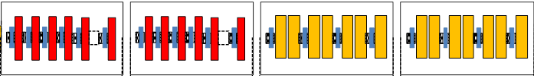
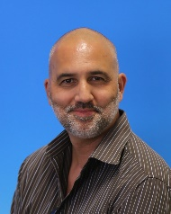

MAJOR subsystems
SARAF Phase 2 (SNRC)
RF power
Electricity
Main Control System
SARAF-LINAC (CEA)
SARAF-LINAC
Alim.
Alim.
LCS
Source
+ LEBT
HEBT
+ targets
RFQ
cryogeny
Building
Water cooling
Liquid Helium
SARAF-LINAC is a SARAF Phase 2 subsystem, made of 4 subsystems:
- The Medium Energy Transport Line (MBT)
- The Super-Conducting Linac (SCL)
- The Beam Diagnostics (DIA)
R. Duperrier
M. Di Giacomo
- The associated Control System (CCD)

Slide 4
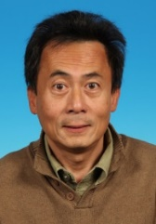

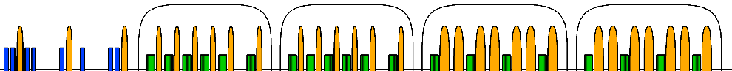
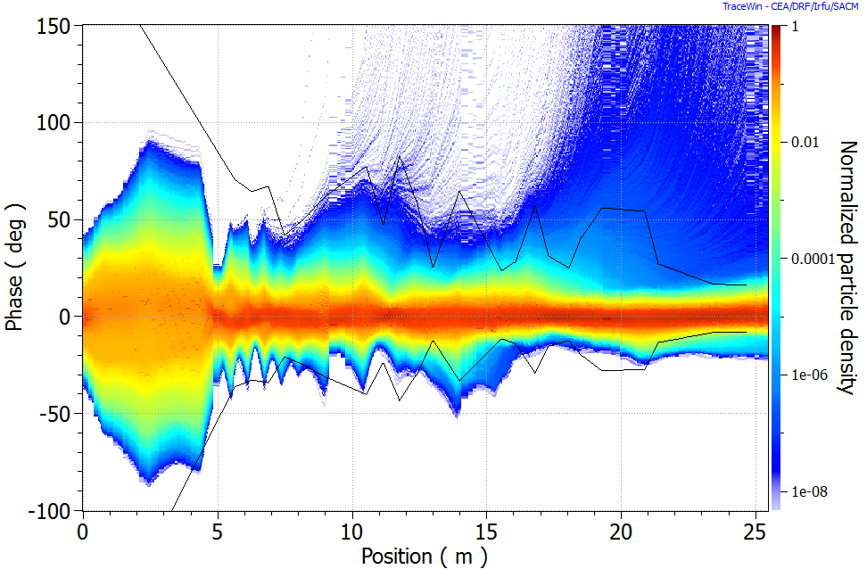
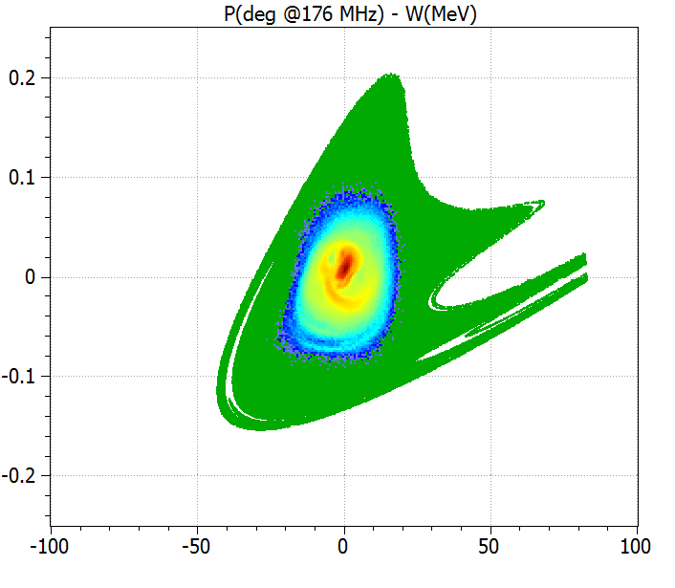
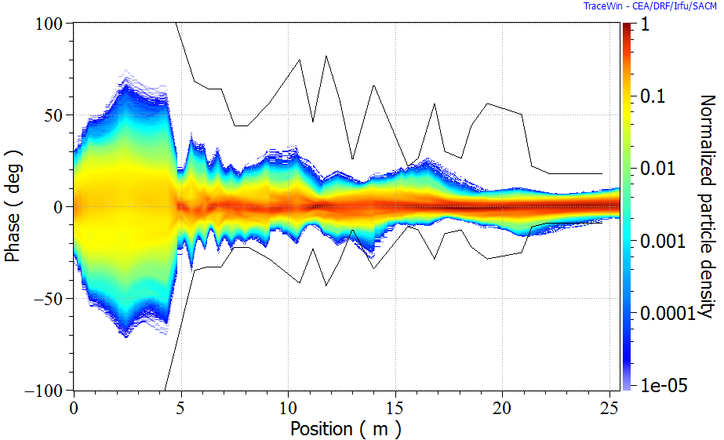
Beam Dynamics
Beam Dynamics studies concern:
- Linac Design (transport element positions, fields…),
- Linac Tuning procedure (Beam diagnostics, correctors…)
- Linac Performances (Nominal, Error studies,…) → BEAM LOSSES
P. Nghiem
J. Dumas
- Linac Robustness (failure studies, MPS,…)
Nominal case : 1M particles (TraceWIN)
→ Special care to long.
acceptance improvement
With errors: most losses are longitudinal
(1k linacs with 1M particles each)

Slide 5
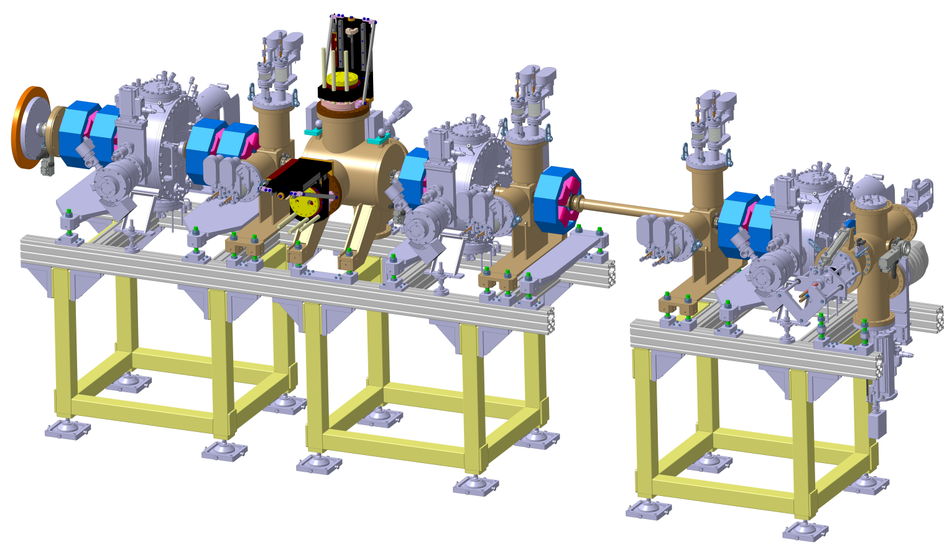
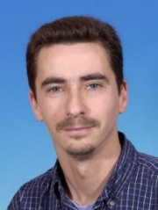
MS1 - MEBT
D. Uriot
Main roles:
Match the beam from RFQ exit to SCL entrance,
Steer the beam to the SCL axis,
Host beam diagnostics,
Clean the beam if necessary,
Stop the beam (low power) during tuning process (low power),
Minimize flow of gazes/impurities from NCL to SCL.
8 Qpoles + 3 rebunchers
8 Steerers (in qpoles)
2 boxes + 4 BPM + 2 ACCT
3 slit boxes
1 Faraday Cup
5 pumping ports + valves

Slide 6
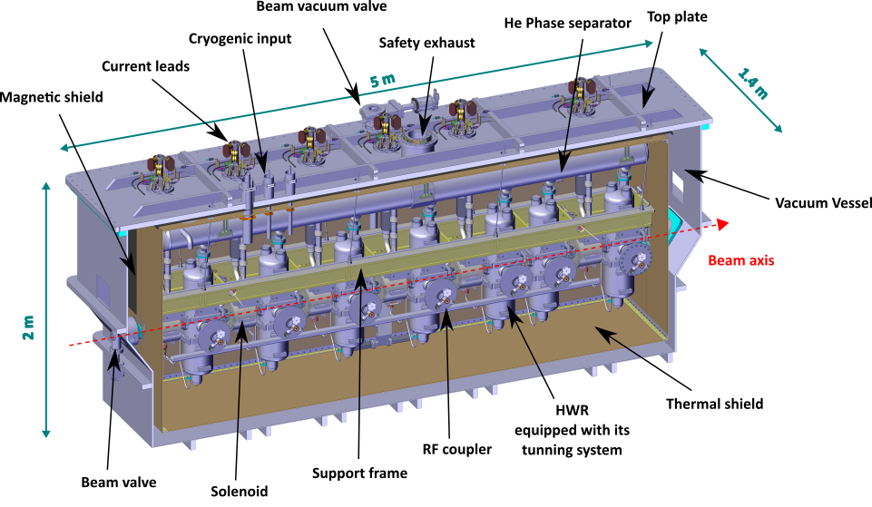
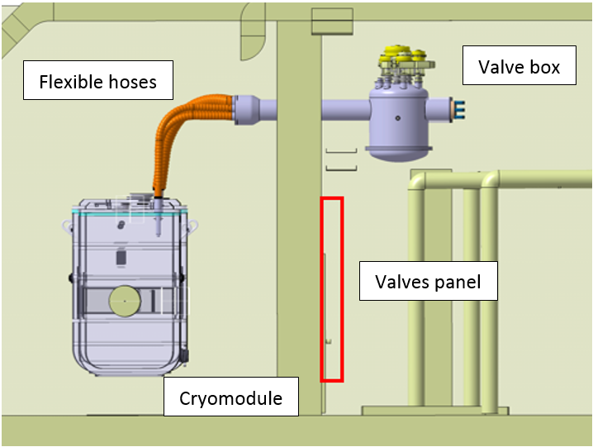
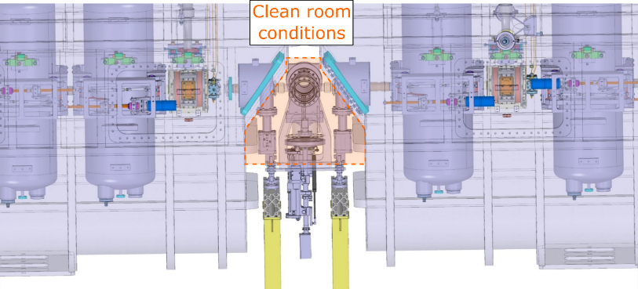

MS2 – SCL
Main roles:
Cavities: give energy to the beam
Solenoid Packages: keep the beam on nominal trajectory
Cryomodules: keep hosted cavities and solenoids
around nominal trajectory, in vacuum and at 4K
Valve boxes: distribute cooling helium,
Warm sections: host diagnostics, pumping and
connecting CM in clean conditions.
26 (12+14) SC cavities
20 solenoid packages
4 (2+2) cryomodules
4 valve boxes
4 warm sections
C. Madec

Slide 7
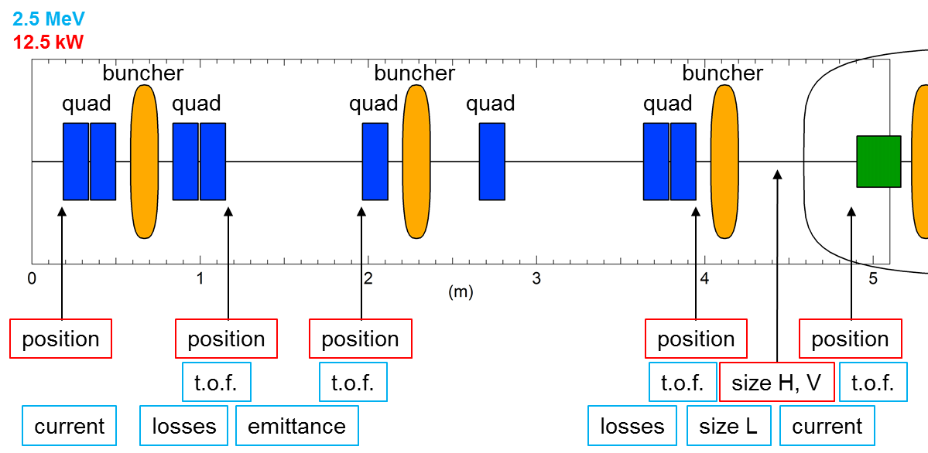
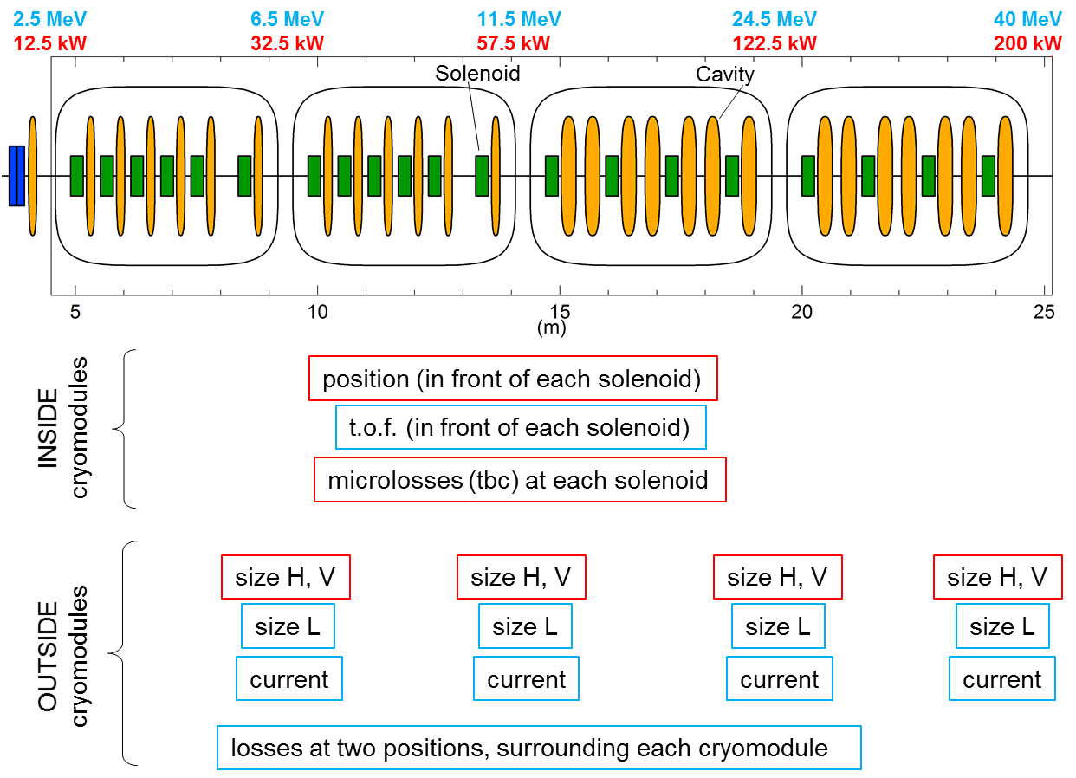
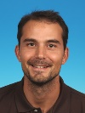
MS3 – Beam Diagnostics
In MEBT
In SCL
Main roles:
Measure beam characteristics for direct or undirect tuning
→ Solutions (based on existing) are under investigation.
F. Senée

Slide 8
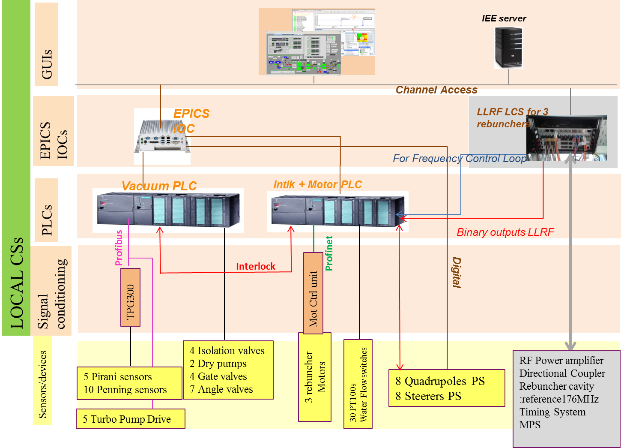

MS4 – Control Systems
Example of MEBT Local CS
Main roles:
Exchange linac component data from/to main CS or operator,
Assure linac component local protection system
Contribute to machine protection system
F. Gougnaud

Slide 9
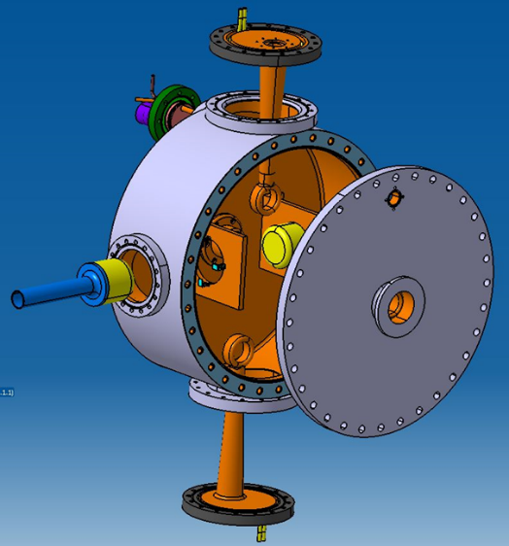
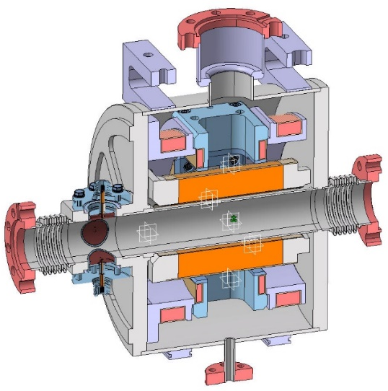
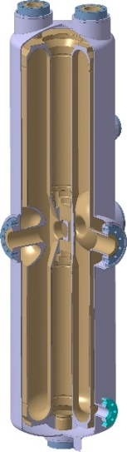
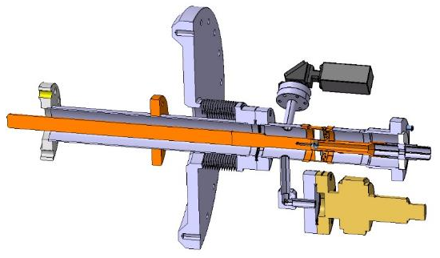
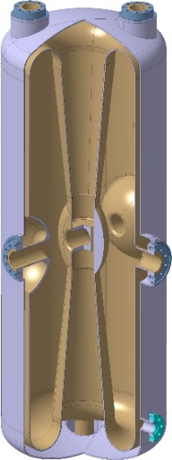
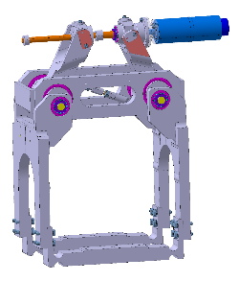
MAJOR components
They are components with major technical risks needing prototypes :
- MEBT rebunchers: × 3.
- SC HWR cavities: ×12(+1) low-β and × 14 high-β.
- Cold RF couplers and Tuners: for × 12(+1) low-β and × 14 high-β.
- Solenoid Packages: × 20.
Couplers/Tuners (×26+1)
Rebunchers (×3)
SC Magnets (×20)
Low-β cavity (×12+1)
High-β cavity (×14)

Slide 10
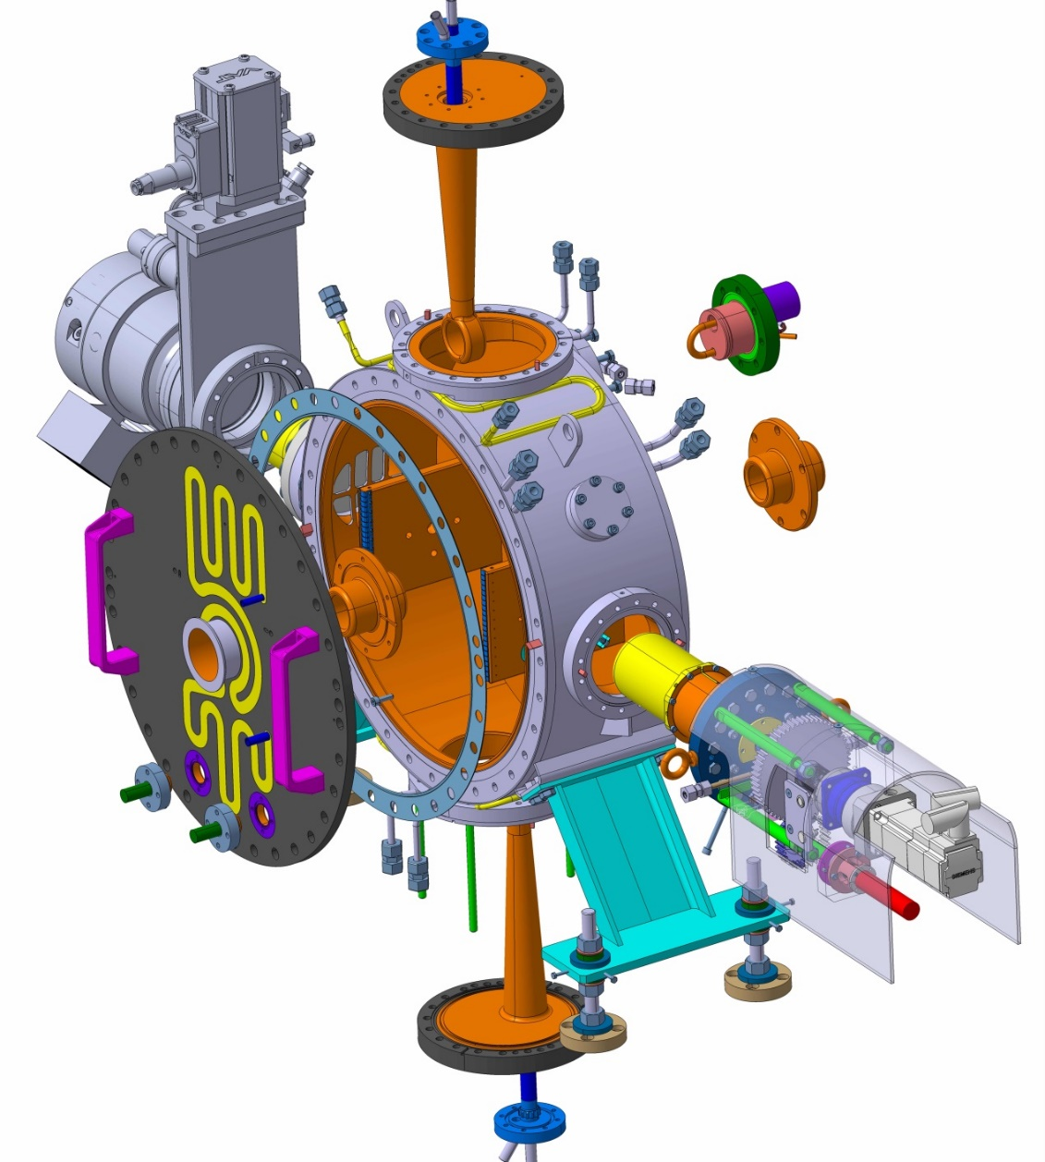
MC1 - Rebunchers
Property | Unit | Spec.
Optimal beta | % | 5.3
Cavity aperture diameter | mm | 40
Flange to flange length | mm | 260
Maximum effective voltage (cw) | kV | 120
Maximum effective voltage (pulsed, <40%) | kV | 165
Minimum effective voltage | kV | 15
Surface peak magnetic field at RF contact | A/m | 3700
Surface peak electric field (pulsed) | Kp | 1.0
RF peak power budget (cw) | kW | 4.4
RF peak power budget (pulsed) | kW | 8.3
Design coupler power (pulsed) | kW | 10
Coarse tuning range | kHz | ±400
Fine tuning range | kHz | 200
Pick-up probe power (@120 kV) | dBm | 25
Maximal local temperature (@ 105 kV, cw) | °C | 98
Alignment | mm | ±1
Upper stem
Turbo molecular
Pumping system
Fixed tuner
Power coupler
Beam port
Tank
Motorized tuner
Roadmap:
Pick-up probe
Front flange
Now – Call for tender
Metal gasket
Mid-18 – RB1/proto tests @ Saclay
Mid-19 – RB2&3 tests @ Saclay
Lower stem
Mid-20 – Beam commissionning @ SNRC

Slide 11
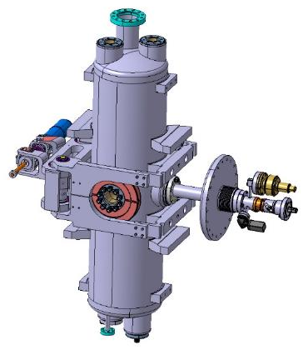

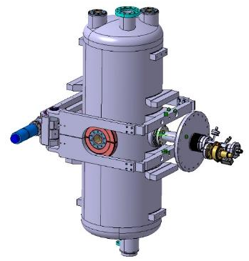
MC2 – SC fully equipped cavities
Low-beta equipped cavity
Property | Unit | Low-β | High-β
Optimal beta | % | 9.1 | 18.1
Design Eacc | MV/m | 7 | 8.1
RF power max. | kW | 10 | 20
Flange-to-flange length | mm | 275 | 410
Beam aperture diameter | mm | 36 | 40
Epk @ design Eacc | MV/m | 3700 | 3700
Bpk @ design Eacc | mT | 1.0 | 1.0
Dynamic power cryo budget @ design Eacc | W | 8.6 | 16.8
G. Ferrand
Roadmap:
Tuners
RF-couplers
Now – Order
Mid-18 – proto tests @ Saclay
Mid-19/End-20 – series individual tests @ Saclay
Mid-20/End-21 – Assembly and test in CM@ Saclay
End-21 – Beam commissioning start @ SNRC
Mid-22 – Beam commissioning end@ SNRC
High-beta equipped cavity

Slide 12

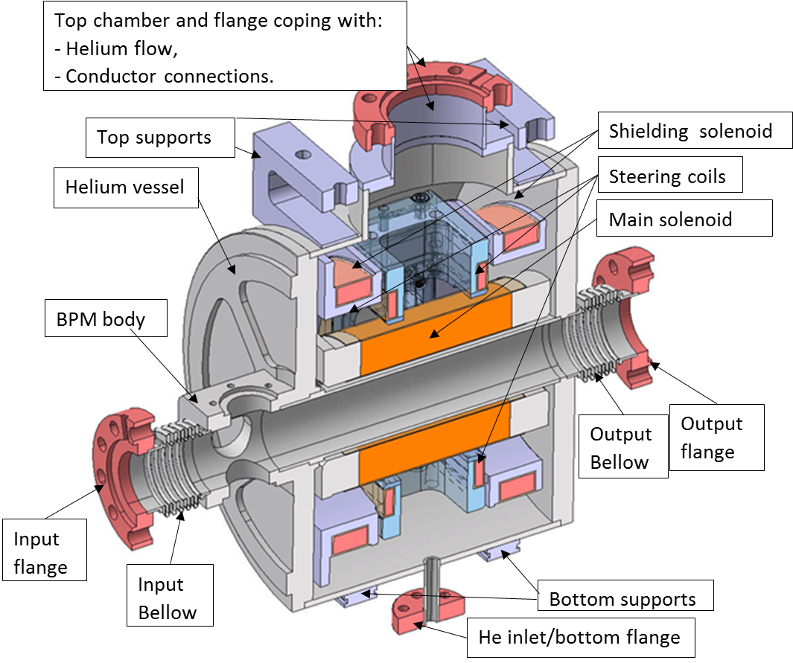
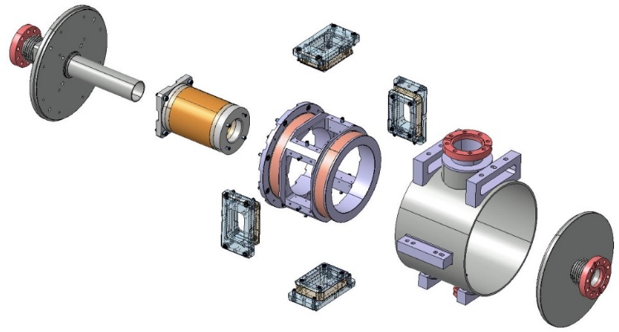
MC3 – SC solenoid package
Property | Unit | Value
Flange-to-flange length | mm | 344
BPM length | mm | 60
Assembly precision | mm | 0.25
Quench hot spot | K | 100
Focusing strength | T².m | 3.5
Maximal fringe field on cavity | mT | 33
Streering strength | mT.m | 8
B Gastineau
Roadmap:
Now – Order
Mid-18 – proto tests @ Saclay
Mid-19/End-20 – series individual tests @ Saclay
Mid-20/End-21 – Assembly and test in CM@ Saclay
End-21 – Beam commissioning start @ SNRC
Mid-22 – Beam commissioning end@ SNRC

Slide 13
Conclusion
Following period (→ mid 2018) is concentrated on MC prototypes and CM design completion.
Then, should follow 3.5 years of series production, assembly and tests.
Superimposed with 2.5 years of commissioning in 3 steps.
< 8 years
Detailed studies
Prototypes
Series (construction&tests)
Today
Commissionings
| PAGE 3

Slide 14
Thank-you for your attention

