Slide 1
Cold tests of bulk Nb cavities at CERN
Katarzyna Turaj
on behalf of
S. Barriere, A. Castilla, B. Frere-Bouniol, P. Fernandez Lopez,
K. Hernandez Chahin, A. Macpherson, K. M. Schirm,
N. Shipman, N. Stapley, A. Zwozniak, M. Wartak

Slide 2
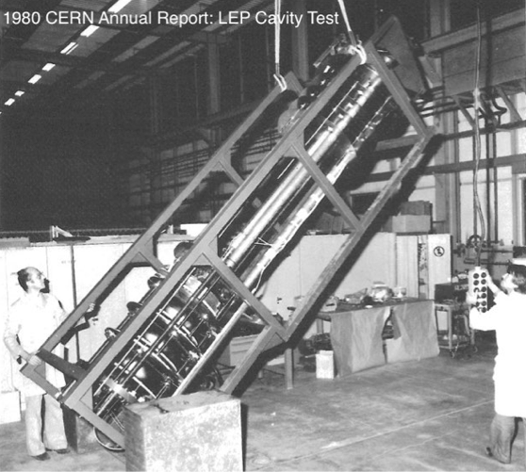
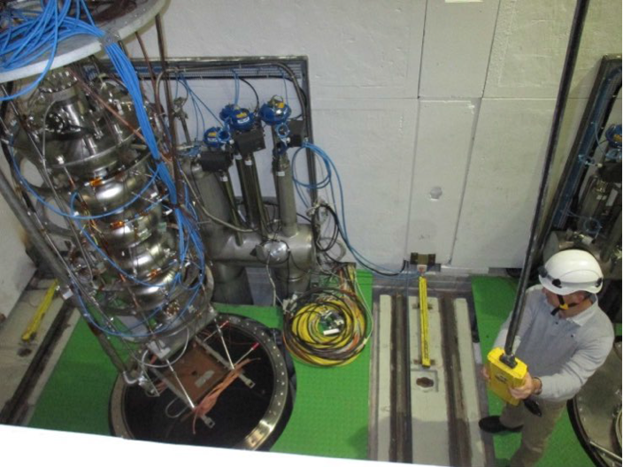
Bulk Nb Cavity Testing at CERN
RF cavity testing at CERN’s SM18 Facility:
400 MHz Crab Cavities (Bare & Dressed) & Cavity Tuners
704 MHz High Gradient Program,
1.3 GHz cavity R&D
1980
2017

Slide 3
CERN’s Bulk Niobium Program: Overview
• HL-LHC Crab Cavity
RF validation of bare and dressed 400MHz cavities for SPS
Cryomodule assembly and validation
Installation into CERN SPS for validation with proton beams (2018)
• High Gradient Cavity Program
Prepare and validate 5-cell ß=1 704 MHz cavities
Bring 4 cavities to specification for assembly
Assembly into a cryomodule for RF validation in CERN’s SM18 facility
• Process and Diagnostics development
Cleanroom techniques and cavity assembly procedures
RF surface preparation improvement
Diagnostics for Quench localization,
Bulk and surface RRR measurements
Cooldown techniques, control of flux trapping

Slide 4
Recent Activities: Key Points
Over the last 12 months
Upgrade of infrastructure interleaved with cavity testing
Ongoing upgrade of our 4m & 2m cryostats
~ 9 months for RF Testing
Dominated by RF tests on Crab Cavities
HG Cavity Performance: Specification achieved
Validated upgraded electro-polishing cathode design
Chemistry now proceeding on remaining cavities
Cleanroom assembly process
Process and infrastructure reviewed for Crab project
Cavity handling and assembly more controlled & cleaner

Slide 5
Schedule from first half of 2017
Last 12 months dominated by HL-LHC Crab activity
High Gradient RF tests “squeezed in”
Q1 2017
Q2 2017
High Gradient
CRAB
Vertical Cryostat
Chemistry/ Assembly

Slide 6
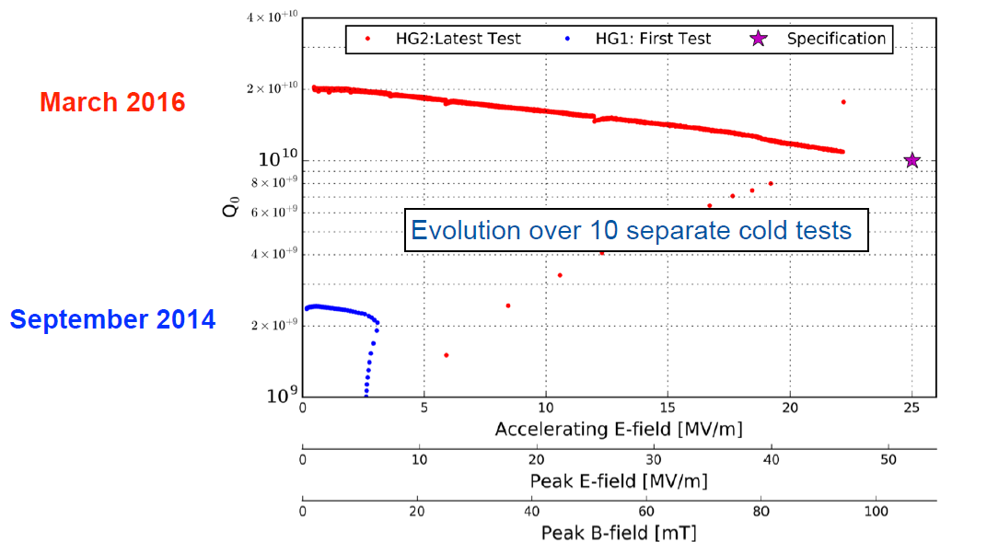
2016 Results: High Gradient
SLHiPP-6
Improvements from cavity preparation significantly reduced field emission resulting in improved RF cavity performance

Slide 7
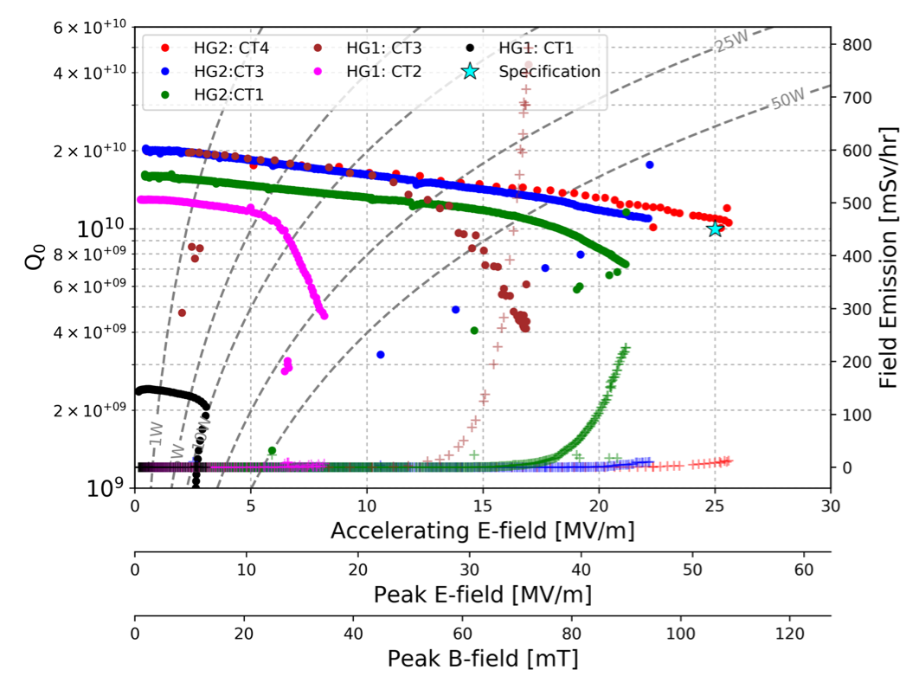
2017 Results: High Gradient
Continued improvement in preparation & test procedure => reduced field emission & reach specification
Q0>10¹⁰ at Eacc=25 MV/m

Slide 8
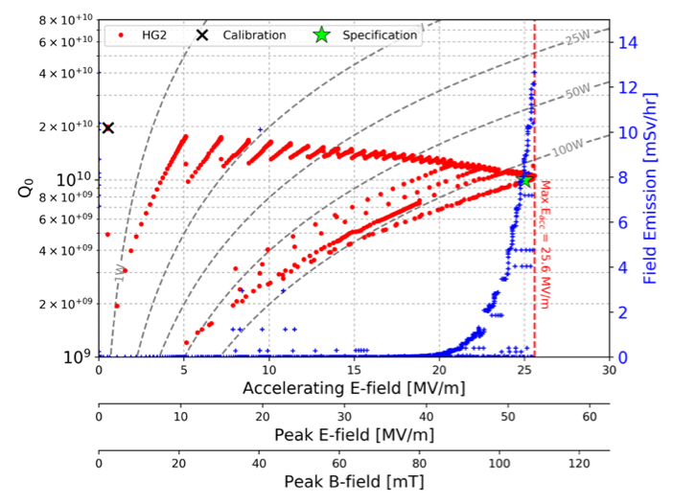
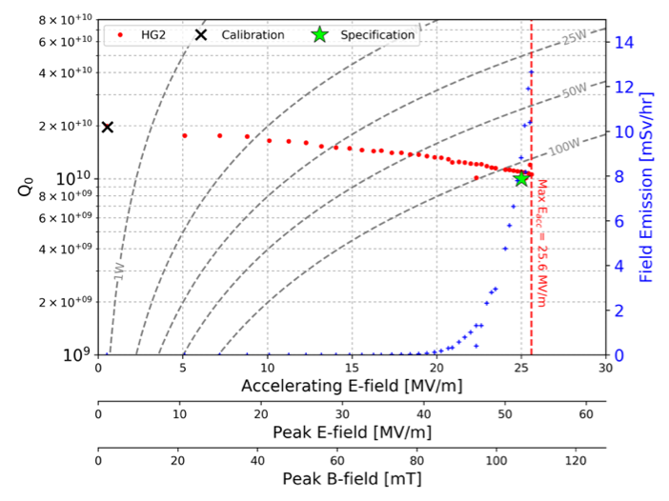
Performance Measurements
All scans performed in CW operation @ 2K
Scan increments in watts => detailed scan at high power
Field emission above 20MV/m
=> Cavity assembly still to be improved
Moving to Self Excited Loop system
Improvement of measurement uncertainties
Raw scan
Processed scan

Slide 9
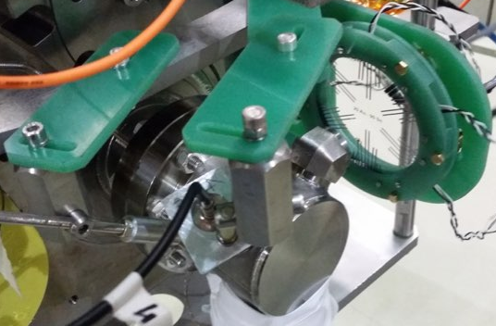
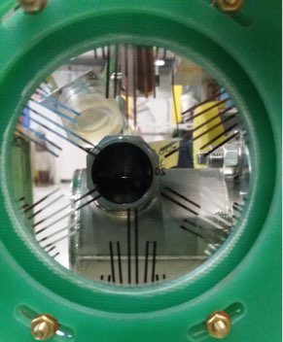
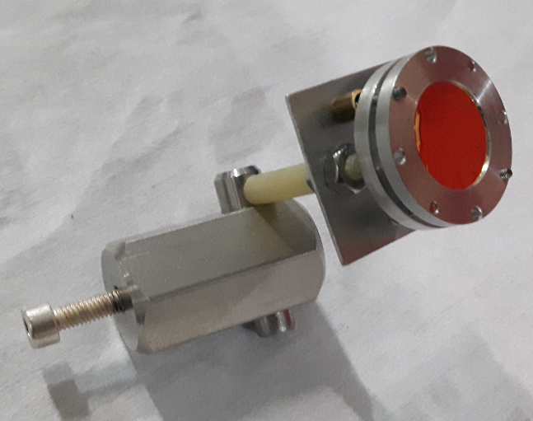
Quench studies
32 sensor array of OSTs
Readout based on CEA-Saclay design
Resolved issues with signal loss
Signal lines in cryostat replaced (coax→ twisted pair)
Cleaned up signal to noise ratio by isolating OSTs from cavity and cryostat infrastructure
Test new Transition Edge Sensors for quenches
Offers improved positioning resolution
Hernán Furci’s talk

Slide 10
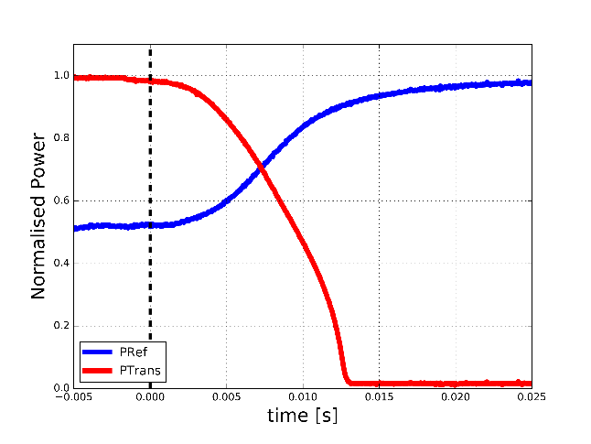
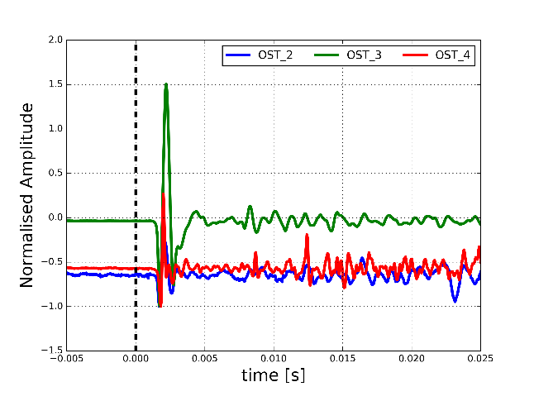
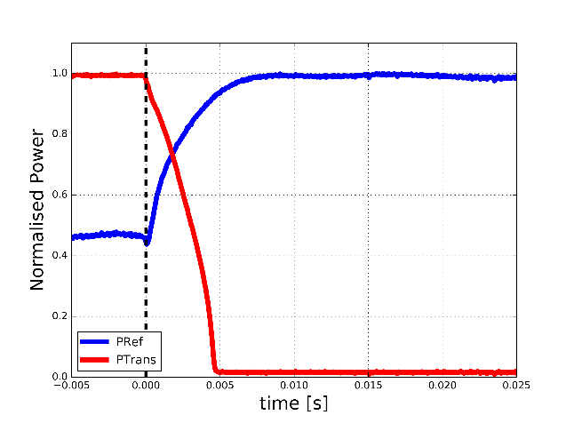
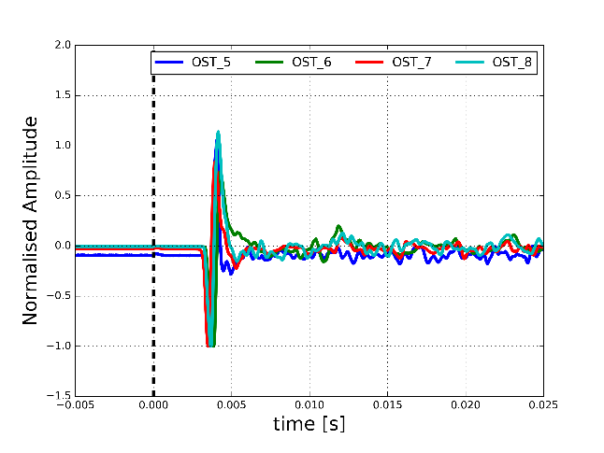
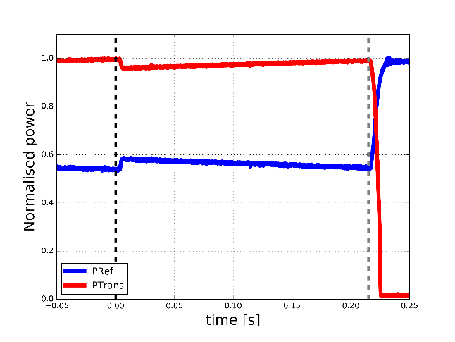
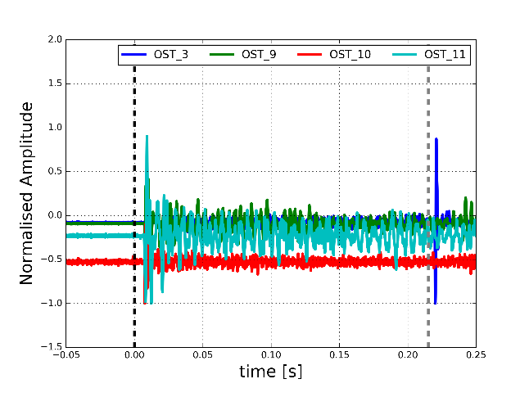
Quenches - 3 Varieties Observed
Local Quench
Slow quench
Cell 1 equator
2nd sound velocity
V = 12.4 m/s
Global Quench
Fast quench
cell 3 equator
No localisation
2nd sound velocity
V = 18 m/s
Double quench
Small quench without cavity trip

Slide 11
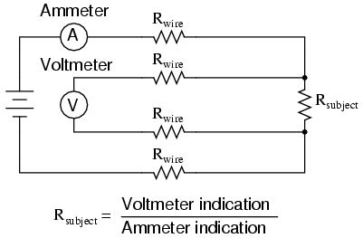
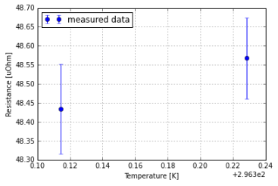
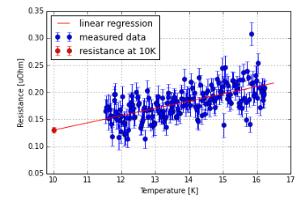
In-situ bulk RRR measurement
Standard 4-wire resistance measurement
Measurement at 300K and at 10K
Resistance at 10 K: R~0.2 µΩ
Fixation of wires to cavity is critical
Procedure validated on Crab Cavities
Cavity | Resistance at 300K µΩ | Resistance @ 10K µΩ | RRR
DQW SPS 1 | 64.247 +- 0.282 | 0.189 +- 0.025 | 340 ± 45
DQW SPS 2 | 49.022 ±0.112 | 0.130 ± 0.005 | 377 ± 15
RRR on treated Nb samples = 290 ± 30

Slide 12
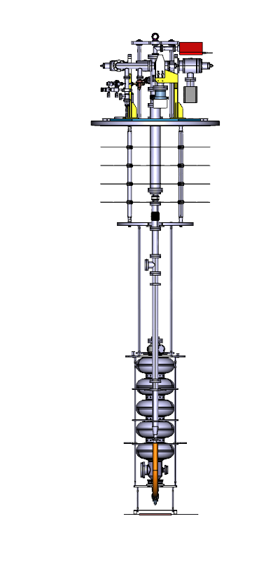
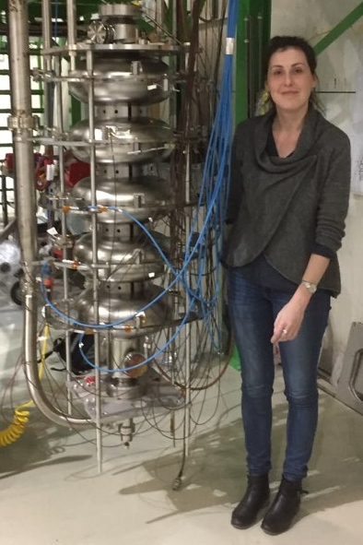
Upgraded Cryo Insert - Validated in 2016
Improved insolation & cryostat now leak free
Infux heat flow reduced & electrical grounding scheme
Cavity positioned lower in cryostat
Larger head of liquid Helium above cavity
OLD INSERT
NEW INSERT

Slide 13
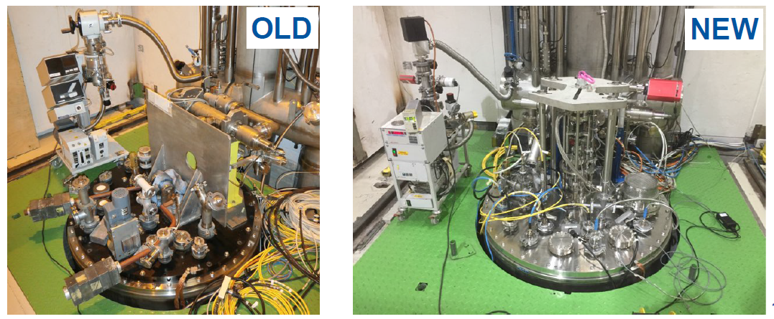
Infrastructure: Cryostat insert upgrade
New ‘top’ of vertical cryostat commissioned
Insert assembly, installation & load balancing
Vacuum pumping system replaced
Increased diagnostics (including RGAs added)
Pneumatic valves on pumping line:
Avoids ambient B-field issues when opening shielding

Slide 14
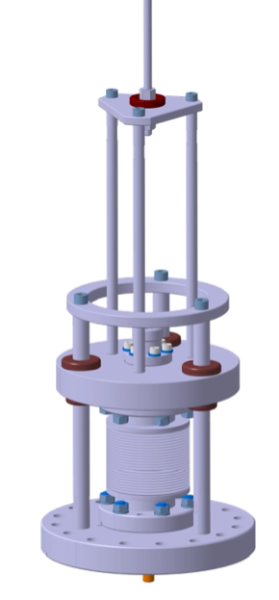
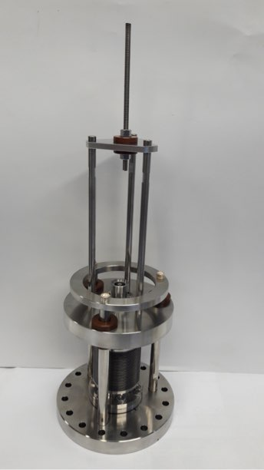
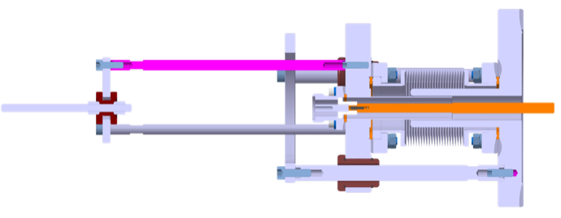
Improvements - Mobile Coupler
Switch to mobile coupler in Q3 2017
Test power antenna re-designed for beam port
Coupler designed to work in 2K liquid helium
50 mm range of movement
=> can have critical coupling from 10K to 1.8K
Will allow improved conditioning and cavity processing
Mass 7 Kg
335 mm
152 mm
Courtesy of E. Montesinos and team

Slide 15
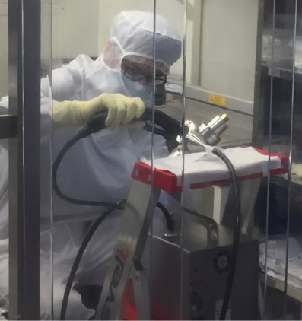
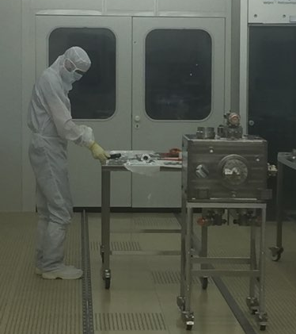
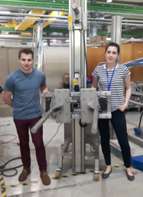
Cleanroom Practices
Post 2016 HL-LHC Crab Cavity cleanroom tooling review
Re-tooling and improvement of ISO4 cleanroom infrastructure and practices
Reinforcement of cleanroom floor and purchase of cleanroom lifter matched to project needs
Removal of silver coated nuts/bolts from cavity assembly
Using silicon bronze nuts for flange assembly
Improved pre-assembly cleaning of pieces

Slide 16
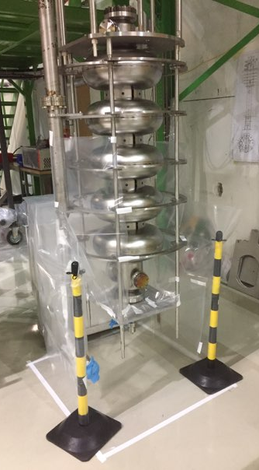
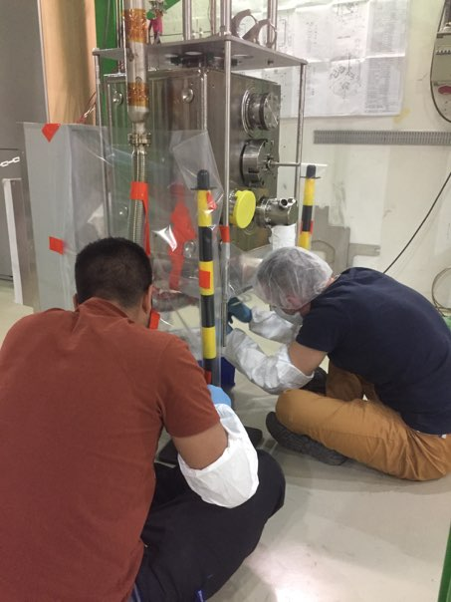
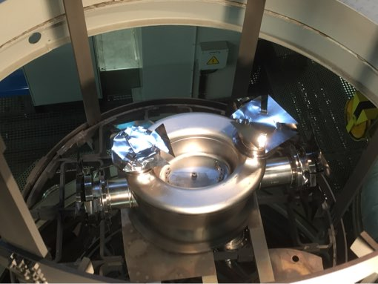
Other Improvements
Cleaner connection of cavity to insert pumping line
Reduction of contamination during 650ºC vacuum bake
Use niobium caps on all ports during bakeout
Improved prep of cavity immediately prior to HPR
Ultrasonic bath after final chemistry essential

Slide 17
Outlook
HL-LHC Crab Cavity Program
Vertical Cryostat RF tests continue through 2017
High Gradient Program: 4 Cavities
HG1: Chemistry re done → Preparing for RF Test
HG2: Achieved Specification: Now our reference cavity
HG3: Bulk EP done. Sent to vacuum oven for 650ºC bake
HG4: Waiting for EP
High Gradient Program: Cavity Testing
RF tests to be interleaved with Crab program in 2017
Combine with commissioning of mobile coupler
Bulk Niobium program
Target: 1 RF cold test per month per cryostat
2nd cryostat coming on line in Q3 2017

Slide 18
Summary
CERN’s Bulk Niobium program
dominated by Crab cavity activities at present
… but still progressing with the High Gradient Program
Soon to have 2 vertical cryostats dedicated to RF testing of bulk Niobium cavities
High Gradient: One cavity has reached specification
Other three cavities to under go same treatment/testing
Expect to finish initial test on all 4 cavities by Q1 of 2018
Ongoing developments
Cataloging of quench behaviors and quench spot localisations prior to optical inspection
Validated deployment of Self Excited Loop LLRF system and semi automation of test procedures
Integration of mobile coupler into conditioning process

Slide 19
Thank you

