Slide 1
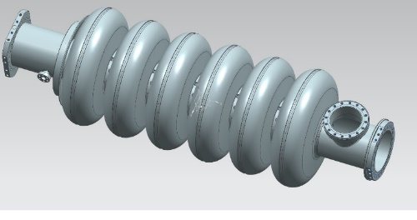
Ongoing activities at LASA for ESS
From the design to the Vertical Test of the cavity prototype integrated in the tank
Andrea Bignami on behalf of the LASA group

Slide 2
Cavity RF Parameters INFN Design
Parameters | INFN design | ESS spec.
R_{iris} (mm) | 50 | ≥47
Geometrical beta | 0.67 | 0.67
Frequency (MHz) | 704.42 | 704.42
Acc. length (m) | 0.855 | 0.855
Cell to cell coupling k | 1.55%↗(+26%)
π-5π/6 mode sep.(MHz) | 0.70↗(+30%) | >0.45
G (Ω) | 198.8
Optimum beta, β_{opt} | 0.705 | 0.705
Max R/Q at β_{opt} (Ω) | 374 ↘ (-6%)
E_{acc} at β_{opt} (MV/m) | 16.7 | 16.7
E_{peak}/E_{acc} | 2.55 ↗ (+7%)
E_{peak} (MV/m) | 42.6 | < 45
B_{peak}/E_{acc}(mT/MV/m) | 4.95 ↗ (+3%)
Q₀ at nominal gradient | >5×10⁹ | >5×10⁹
Q_{ext} | 7.8×10⁵ | 5.9~8×10⁵
Design philosophy:
Boundaries fully compatible to ESS requirement.
Our goal:
To have large cell-to-cell coupling factor, k>1.5%
Allowing for a slight modest sacrifice on peak fields and R/Q

Slide 3
Cavity Prototype Mechanical Parameters INFN Design
Mechanical parameter | INFN Design
Cavity wall thickness (mm) | 4.5
Stiffening ring radius (mm) | 70
Internal volume (l) | 69
Cavity internal surface (m²) | 1.8
Stiffness (kN/mm) | 1.7
Tuning sensitivity K_{T} (kHz/mm) | 210
Vacuum sensitivity K_{V} for K_{ext} ~ 21 kN/mm (Hz/mbar) | 31
LFD coefficient K_{L} for K_{ext} ~ 21 kN/mm (Hz/(MV/m)²) | -1.7
Pressure test scenario:
Cavity fully constrained
Pressure in the tank
The maximum pressure difference allowable is
2.60 bar for 50 MPa VM (worst scenario)
3.64 bar for 70 MPa VM (best scenario)
Scenario:
Cavity with one free end
Increasing displacement on free end
The maximum displacement allowable is
2.59 mm for 50 MPa VM (worst scenario)
3.60 mm for 70 MPa VM (best scenario)

Slide 4
Estimated Frequency evolution
A key point in the cavity fabrication is the estimation of the cavity frequency just after production and before any treatment, because at this frequency we need to produce the DB.
Effect | Δf [MHz] | Cavity Frequency [MHz]
Cavity @ 2K in vacuum | - | 704.42
Tuner pre-load | -0.2 | 704.22
Cavity @ 300K in vacuum | -1.03 | 703.19
Cavity @ 300K in air | -0.23 | 702.96
Cavity @ 300K in air before BCP (180 μm) | +0.58 | 703.53

Slide 5
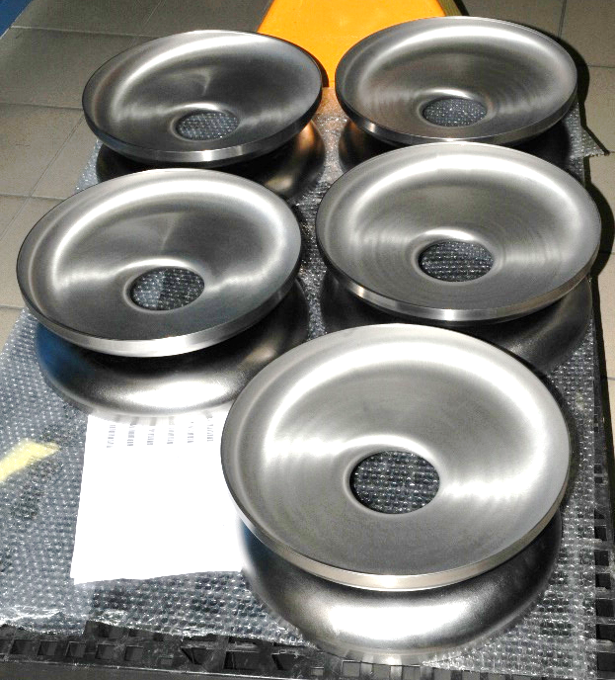
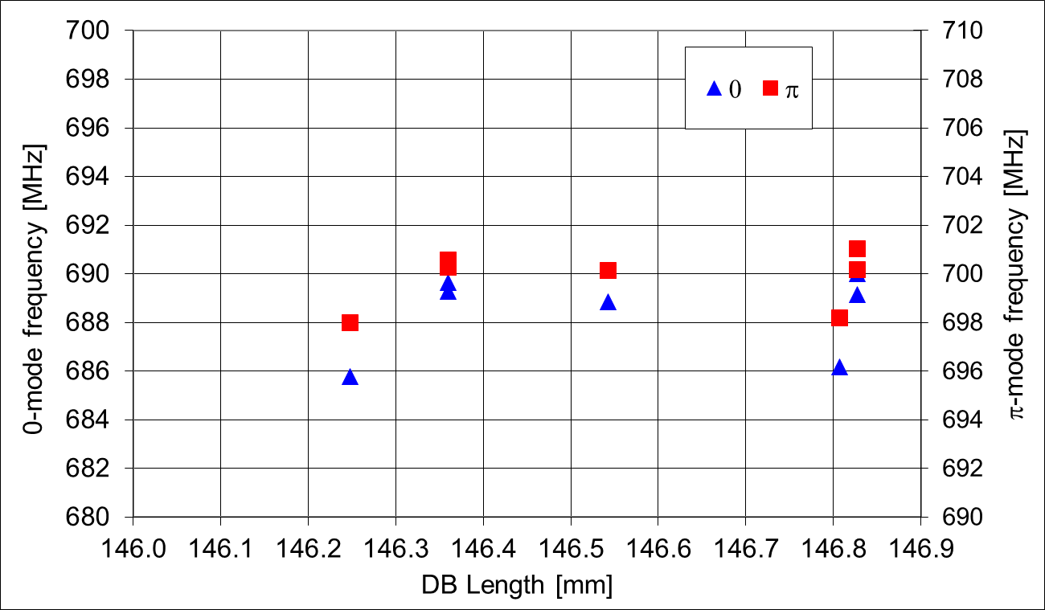
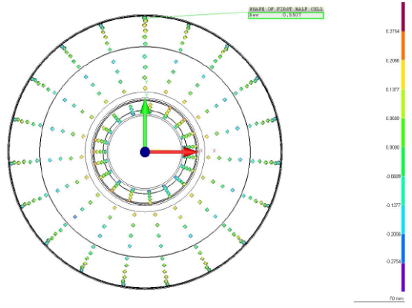
DB fabrication
The DBs have been trimmed to proper length (i.e. frequency) taking into account the shrinkage and the step-and-recess needed for cavity assembly.

Slide 6
Cavity after welding
Mechanical
The foreseen cavity length is 1259.4 ± 3 mm.
The MB001 measured length is 1256.9 mm
Frequency
The expected frequency, as reported before, was 703.53 MHz.
The MB001 measured frequency is 703.52 MHz
Field Flatness
After welding, FF ≈ 70 %

Slide 7
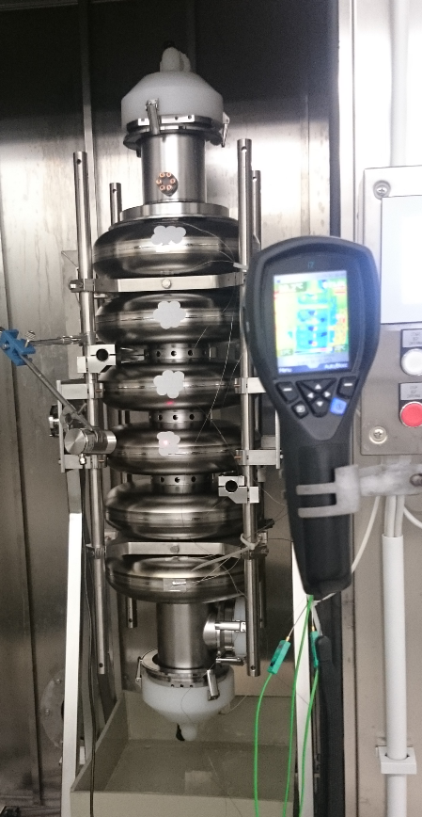
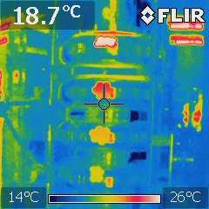
Surface treatments fully done at the industry (EZ)
Bulk & final BCP: 1:1:2
BCP1: 60 min, subdivided in 2 steps (20 min + 40 min).
BCP2: 90 min, cavity is turned upside down.
Heat treatment at 600 °C, 12 h
Final BCP (15 min)
Cavity weight monitoring for each treatment
For each BCP treatment, barrel and output acid temperature are acquired, together with acid throughput
6 thermocouple sensors are placed on cavity surface, continuously acquiring temperature during chemical etching
IR camera with standard emissivity dots monitoring T during BCP
A Nb sample is placed inside cavity (through MC) for monitor etching rate and RRR
Cavity thickness measurement with ultrasound gauge before and after etching

Slide 8
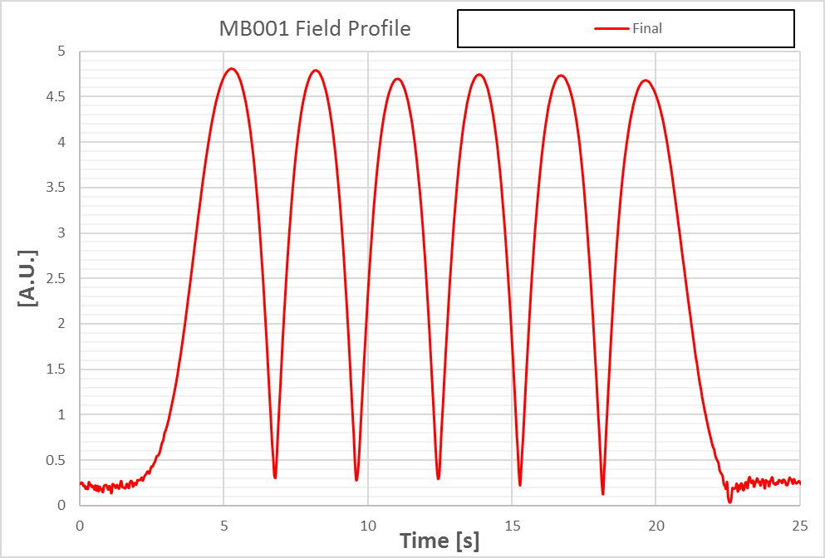
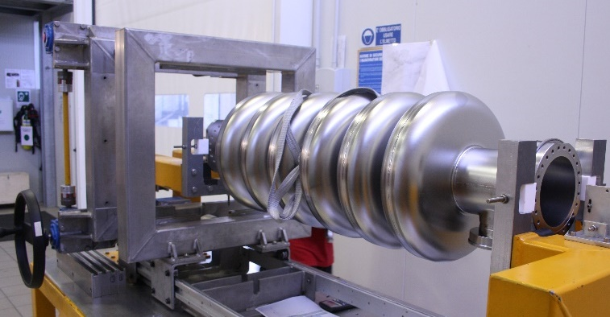
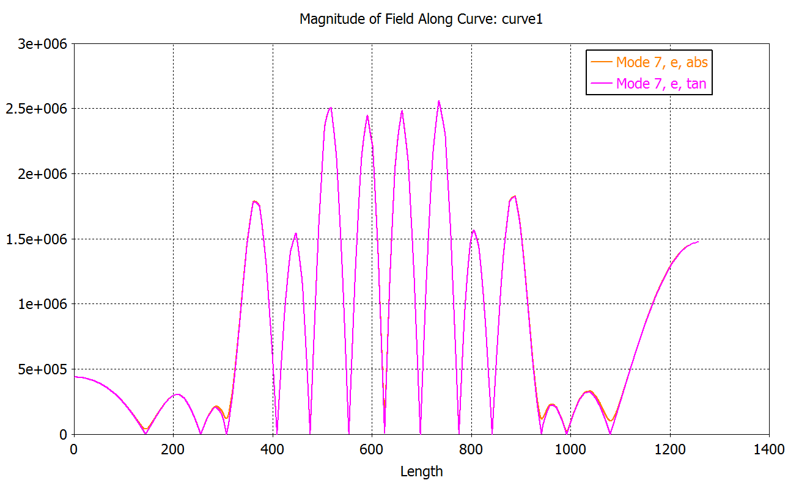
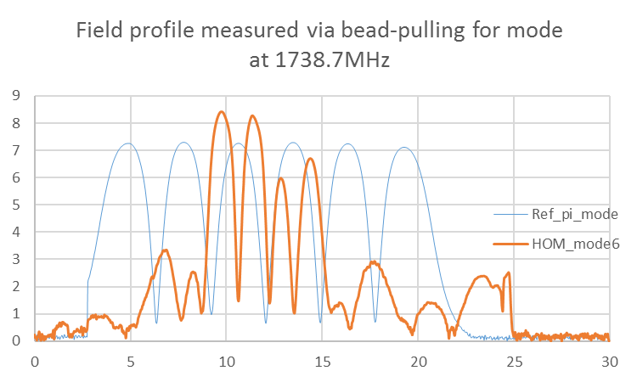
RF Parameters after final tuning
Frequency at 300 K: 702.9 MHz
Field Flatness: > 97 %
HOM measurement (nearest monopole mode to ML5)
Fsim = 1740 MHz
Simulation
Measurement
About 2.5 MHz lower than the one at 2K.

Slide 9
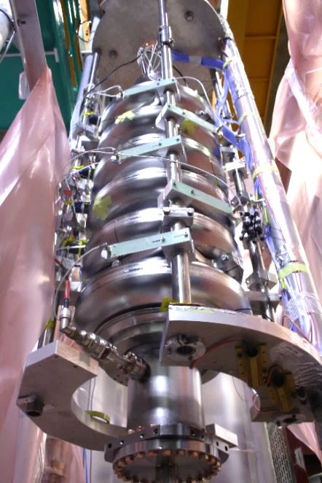
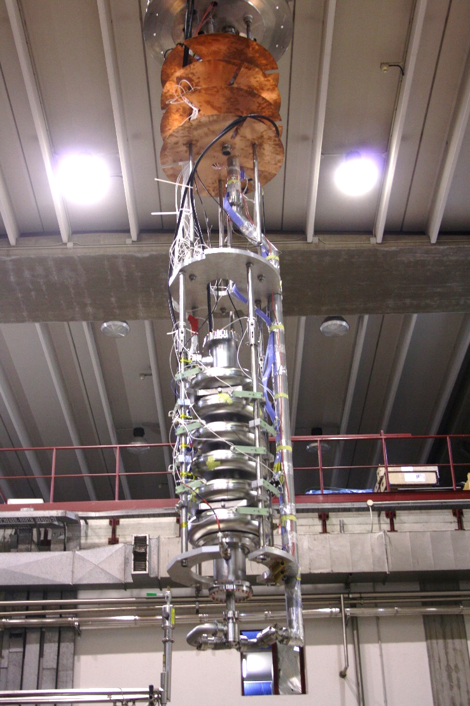
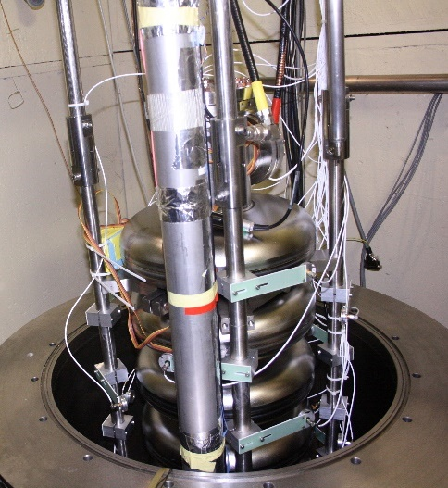
LASA Installation of the naked cavity for cold test

Slide 10
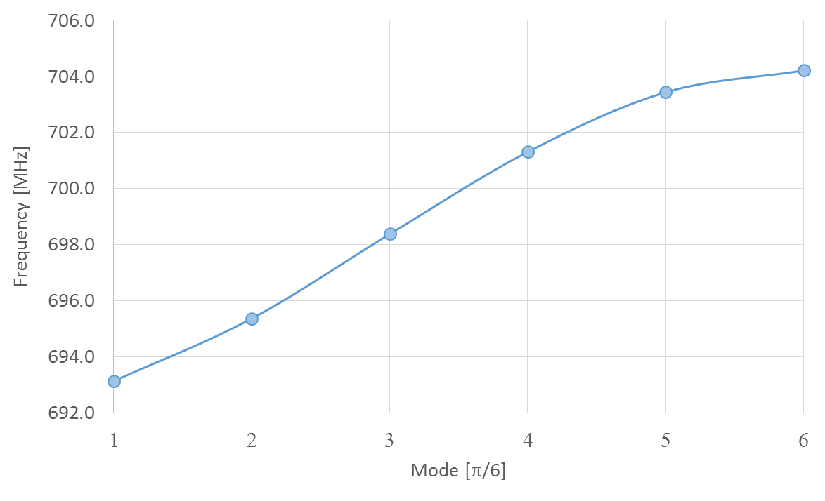
Cavity properties
Frequency at 2K
Final length at room temperature
1257.6 mm
704.213 MHz (as expected)

Slide 11
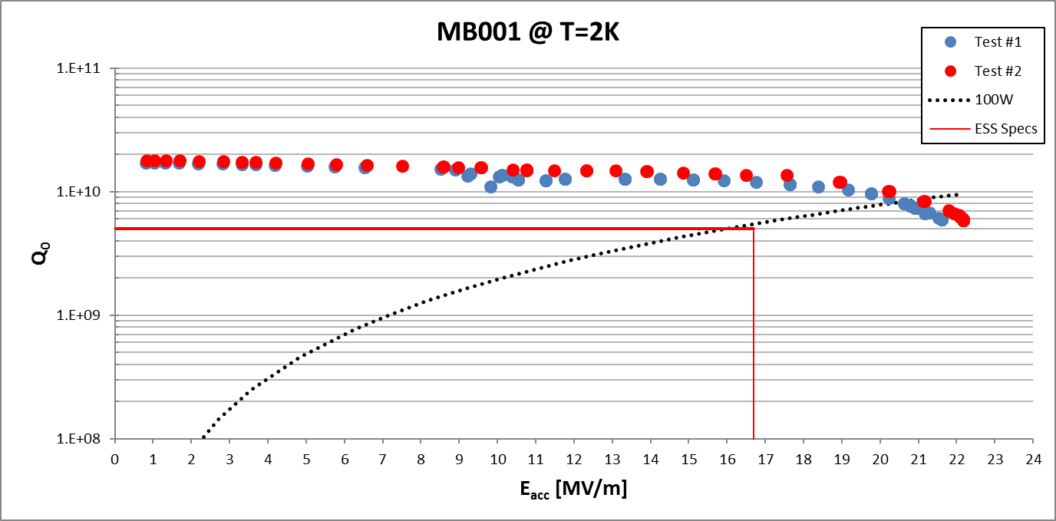
Power Rise at 2K (1 of 2)
100 W CW cryo power, i.e. 16,7 MV/m @ Q₀ 5e9
Test of cavity without He Tank

Slide 12
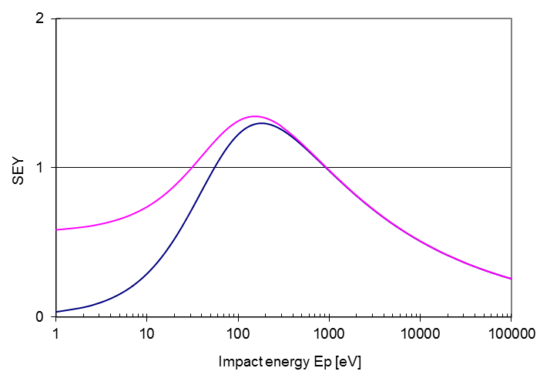
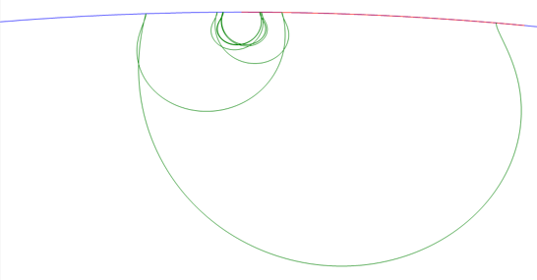
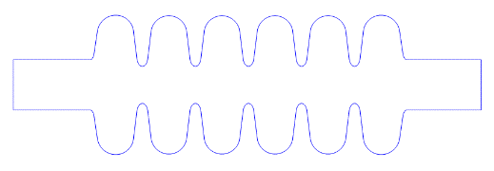
MP and SEY
MP simulations with “FishPact” and “MultiPac” codes consistently show that stable trajectories of 1st order two-point MP appear in a very small region near equator center, with E_{acc} in range from 7 to 14 MV/m and a maximum impact energy (Ef) around 30 eV at E_{acc} = 11 MV/m.
We do expect soft barriers if the initial SEY is higher.
SEY for Nb
Inner Cell
End Cell

Slide 13
Radiation
Radiation due to multipacting is seen in the first cold test, but it was easily conditioned. The data are consistent with the simulation.

Slide 14
Radiation
20-22 MV/m (quench field)
Conditioning
attempt

Slide 15
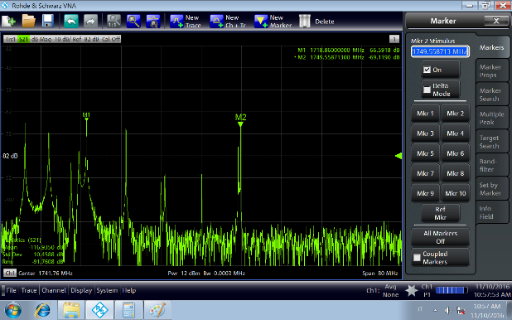
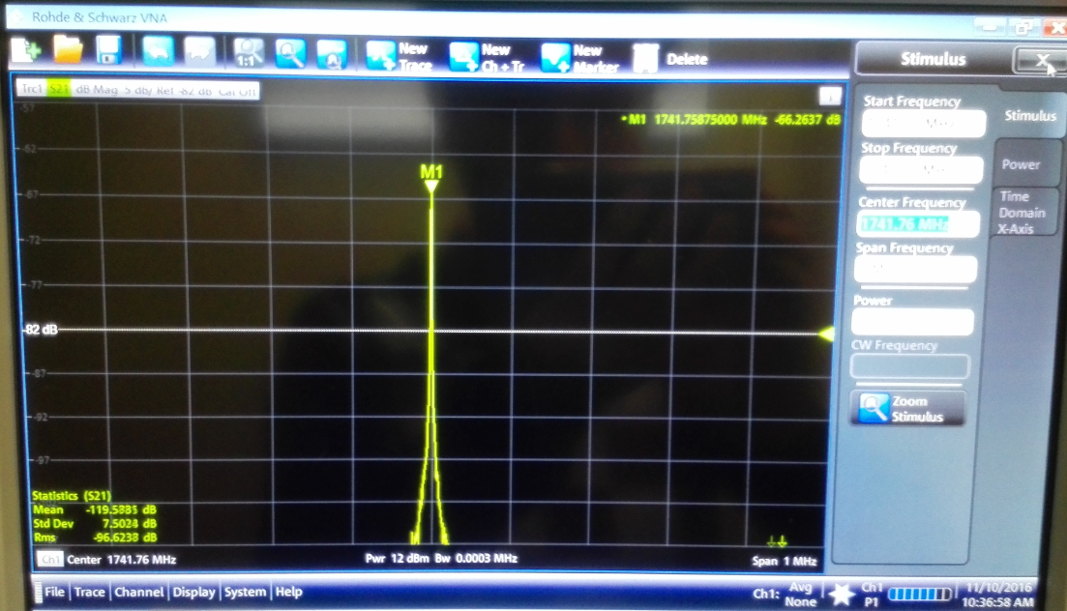
The monopole mode close to 5th machine line
All higher order modes (HOMs) must be at least 5 MHz away from integer multiples of the beam bunching frequency (352.21 MHz). The monopole mode closer to 5th harmonic of the bunch frequency (1761.05 MHz), has frequency = 1741.02 MHz and so, lower more than 20 MHz from the 5th harmonic.
Close to expected value, <1 MHz to simulation at 1742.4 MHz.

Slide 16
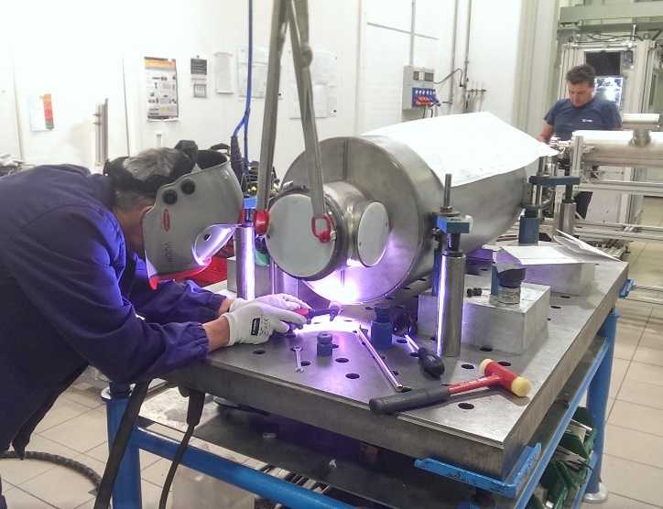
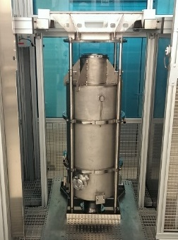
Cavity integration
After successful cold test the cavity was integrated in the He tank
Frequency change: 35 kHz
Pressure test: done
New Final BCP: 15 min, 20 μm
Successful cold test after integration done
Installation in the medium beta cryomodule demonstrator at CEA ongoing

Slide 17
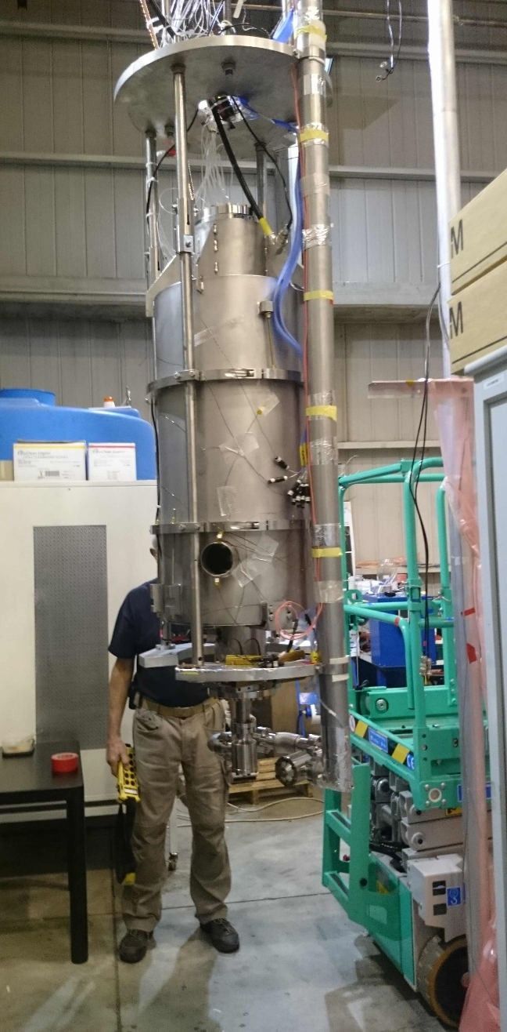
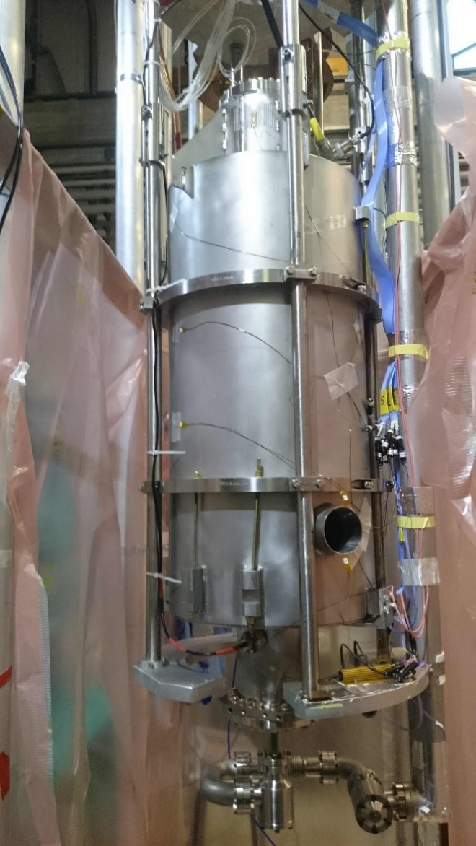
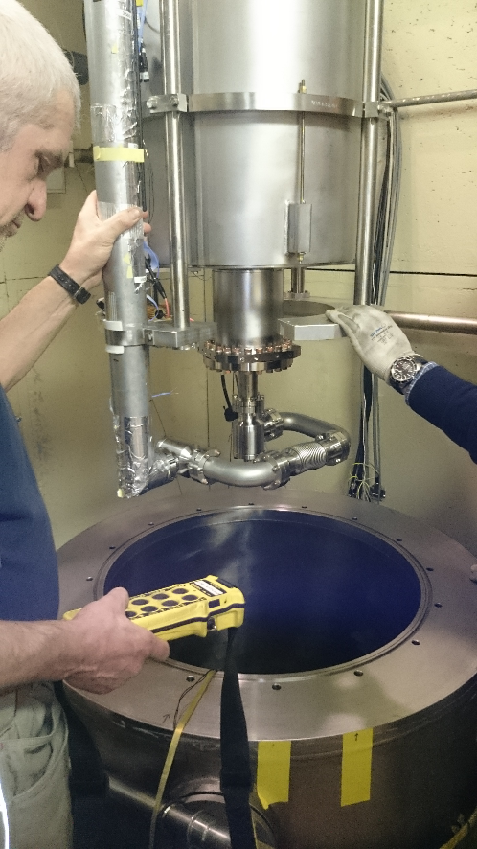
Cavity with tank cold test preparation at LASA

Slide 18
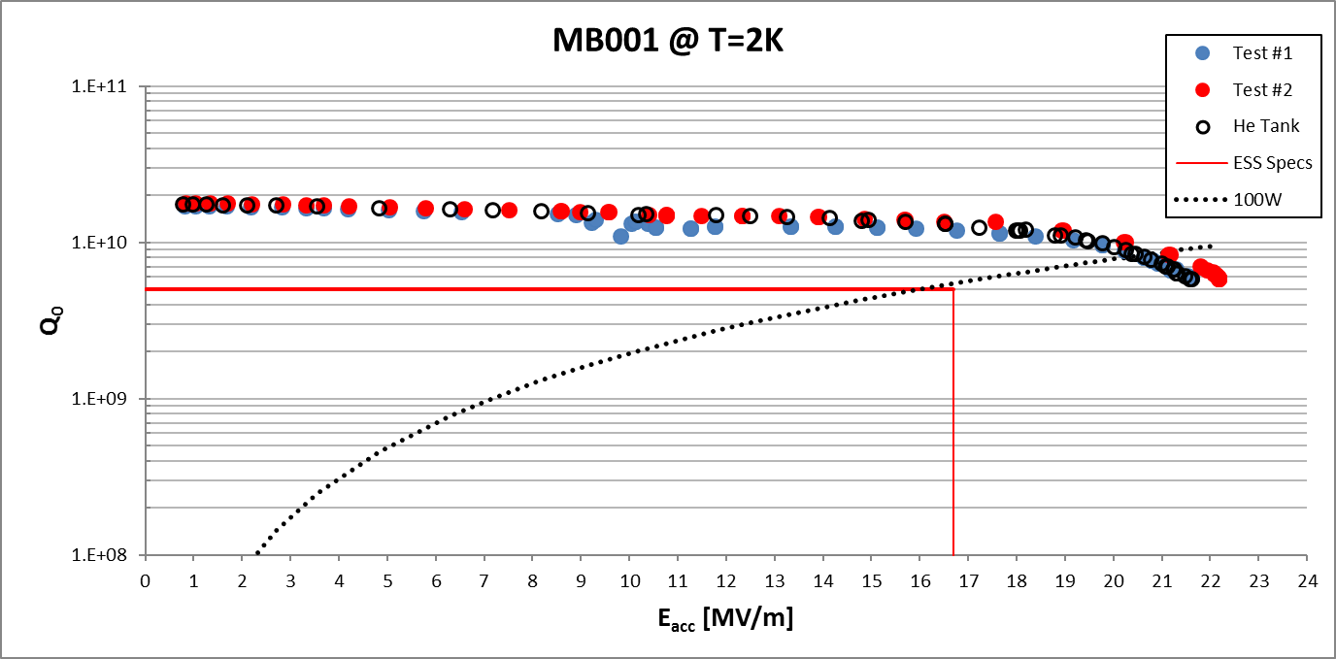
Power Rise at 2K (2 of 2)
Test of cavity integrated in He Tank

Slide 19
Summary of RF performances for MB001 in He Tank
Maximum achieved gradient E_{acc} = 21.6 MV/m with limitation due to quench.
For gradient E_{acc} = 21.6 MV/m: quality factor Q₀ = 6x10⁹
For gradient E_{acc} = 16.7 MV/m: quality factor Q₀ = 1.3x10¹⁰
 | f [MHz] | Δf [MHz]
π | 704.232
5π/6 | 703.449 | 0.78
4π/6 | 701.303 | 2.93
3π/6 | 698.391 | 5.84
2π/6 | 695.392 | 8.84
π/6 | 693.142 | 11.09
Frequencies of the TM₀₁₀ mode and Δf. The 5π/6 frequency is 0.78 MHz lower than the π mode frequency. ESS specs require > 0.45 MHz.

Slide 20
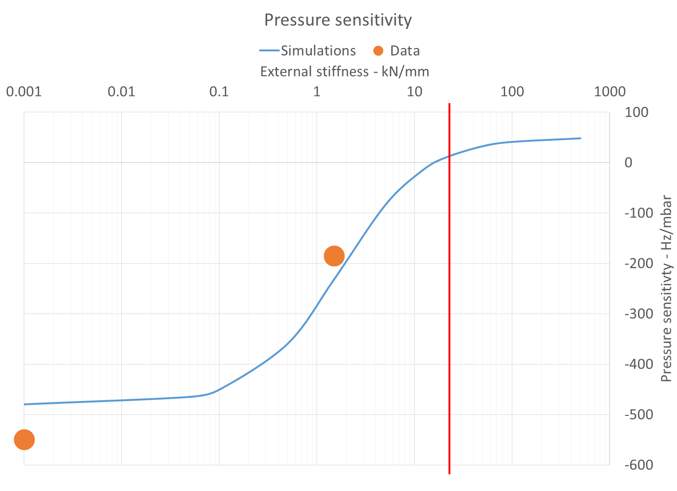
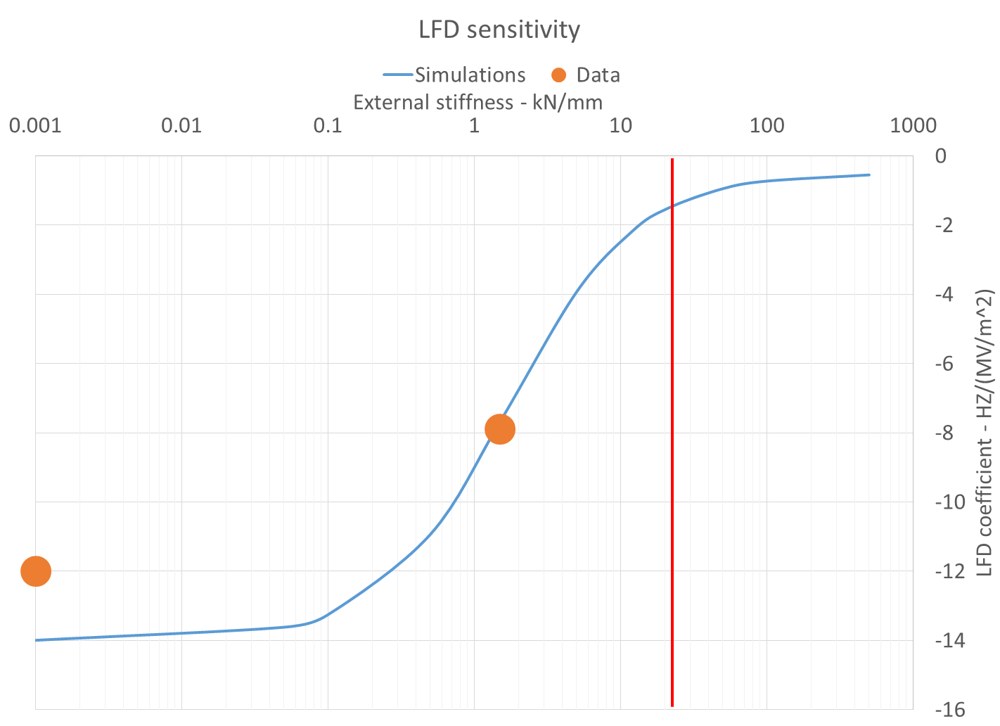
Structural Analysis
 | Insert, VT, Tank kext ˜2 kN/mm | Simulations | Insert, VT | Insert, RT Diff., gauges | Simulations | Projections in CM
k_{L} [Hz/MV/m²] | -7,9 Q vs. Eacc | -7,7 Q vs. Eacc | -12 Q vs. Eacc |  | -14 | -1,61 (-4%)
Df/Dl [KHz/mm] |  |  |  | 223 | 170/210 Slater/SF
Df/Dp [Hz/mbar] | -185 Sub-cooling | -230 Sub-cooling | -550 Sub-cooling | -590 | -480 | 27,7 (-8%)

Slide 21
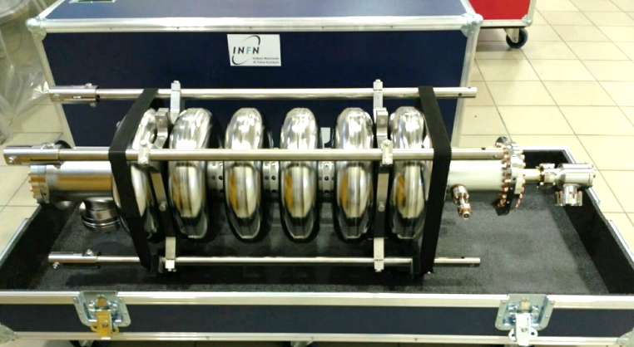
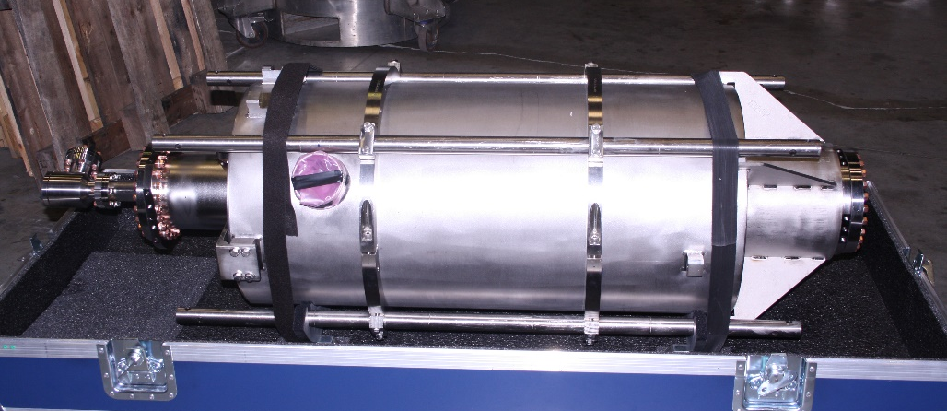
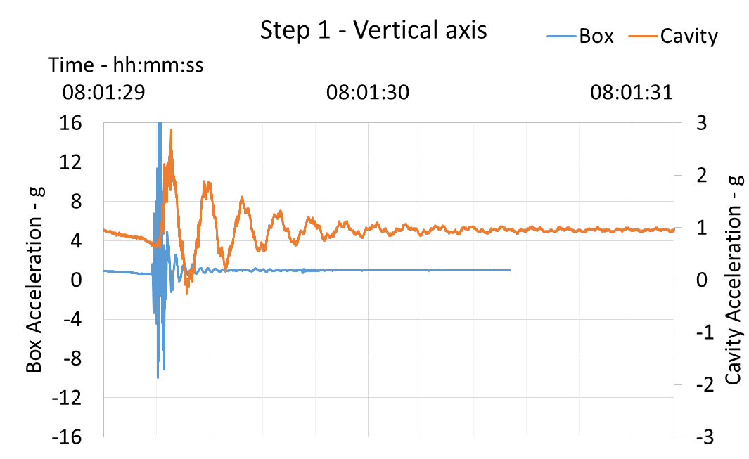
ESS cavity box and transportation
Two prototype boxes built
Four soft rubber dampers in place of foam supports
5 shipments made so far and OK
4 EZ to LASA
1 LASA to CEA
Data analyses on prototypes:
g-shock reducing factor > 8
Residual oscillations < 7 Hz
Damping τ₀ about 0.25 s
Series box design under finalization

Slide 22
The ESS series cavity
RF design: unchanged
Reduced Nb thickness
4.3 mm sheets before deep-drawing and BCP
Expected mechanical performances OK
Cavity treatments unchanged
Mechanical parameter | INFN Prototype | INFN Series
Cavity wall thickness (mm) | 4.5 | 4.1
Stiffness (kN/mm) | 1.7 | 1.5
Vacuum sensitivity K_{V} for K_{ext} ~ 21 kN/mm (Hz/mbar) | 31 | 39
LFD coefficient K_{L} for K_{ext} ~ 21 kN/mm (Hz/(MV/m)²) | -1.7 | -2.0

Slide 23
The ESS series cavity
Niobium call for tender
Middle of June the call for tender will be closed and the winner will be announced
One month to sign the contract
Cavity call for tender
29th June last day for receiving offers.
Possibly (challenging!) finalized at the end of July, otherwise middle of September
QA/QC
Protocol almost defined (cavity producer, DESY, CEA, ESS)
Nb scanning: DESY (through ESS)
One INFN sheet sent to DESY for testing
Vertical Test: DESY
Contract under finalization

Slide 24
Thanks for your attention

