Slide 1


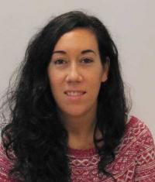
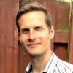
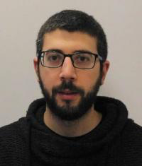
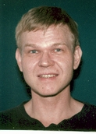
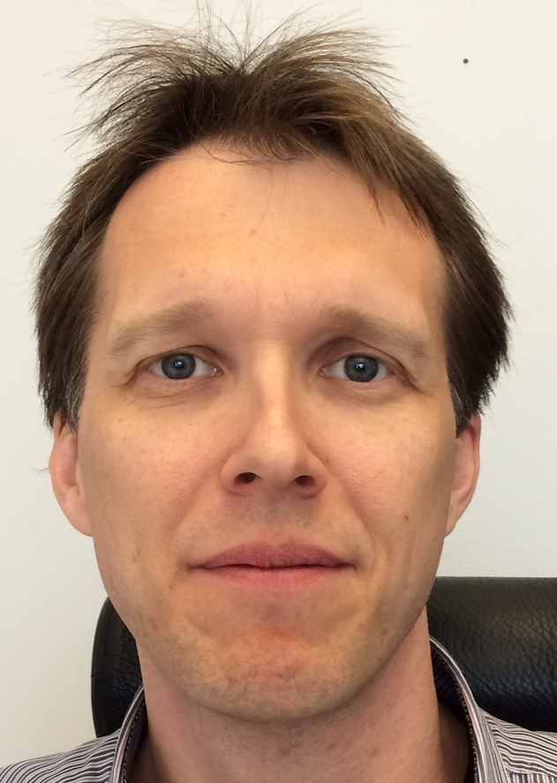

Sample environment utility supply demands
FLUCO
FLUids incl. gases, vapors and COmplex fluids
- H. Schneider -
Science Support Systems
Scientific Coord.
User Office
Temperature
Field
High Pressure
Mech. Proc.
Fluids incl. gases,
vapor, compl. fl.
Deuteration
Crystallization
Sample handling
general labs
Sample Environ.
Syst. Integration
Scientific Activities Division
delivers
Science Support Systems:
  sample environment (SE)
  scientific labs and
  (future) user office.
SAMPLE ENVIRONMENT
SEE : Sample Environment Equipment
Notes:
Present experience: fragemtnation, only partly supporting all topics …
New approach …mainaining balance; bringing it colse to the user

Slide 2
FLUCO
FLUids incl. gases, vapors and COmplex fluids
- H. Schneider -
SEE at the instruments
Needs
SEE
Utility Supplies , ESS 0038163
SEE
ESS
Mech. Dim./Mount , ESS 0038078
SEE
Instr.
Control System/Integration , ESS 0038165
Ext.
SEE : Sample Environment Equipment
Notes:
Disolve this slide or use as summary; link to SAC comments
Needs to specifc what it want from the pool and what they build for their instrument.
Instrumet team takes team during construction (and potentially in operation)

Slide 3
Sample environment utility supply demands
FLUCO
FLUids incl. gases, vapors and COmplex fluids
- H. Schneider -
What are the objectives of the utility supplies ?
-Serving pool-SEE with :
- Electrical Power, single/3-phase/UPS
- Digital/analog signals/IT/Interfaces
- Cooling water
- Gases : He, Ar, N2,…
- He-recovery-line
- Pump exhaust-line
- Compressed air
SEE : Sample Environment Equipment
Notes:
Present experience: fragemtnation, only partly supporting all topics …
New approach …mainaining balance; bringing it colse to the user

Slide 4
Sample environment utility supply demands
FLUCO
FLUids incl. gases, vapors and COmplex fluids
- H. Schneider -
What are the objectives of the utility supplies ?
- For time optimization two sets of supplies
are needed :
- One at the sample area, active (primary) SEE
- One beside the instrument to prepare
the next experiment, passive (secondary) SEE
SEE : Sample Environment Equipment
Notes:
Present experience: fragemtnation, only partly supporting all topics …
New approach …mainaining balance; bringing it colse to the user

Slide 5
Sample environment utility supply demands
FLUCO
FLUids incl. gases, vapors and COmplex fluids
- H. Schneider -
What are the objectives of the utility supplies ?
- Forming a supply standard at the instruments.
- Simplifying exchange of parts.
- Optimizing storage of parts, reducing costs.
Finally the purpose is :
Minimizing neutron waste by reducing SEE changing time.
SEE : Sample Environment Equipment
Notes:
Present experience: fragemtnation, only partly supporting all topics …
New approach …mainaining balance; bringing it colse to the user

Slide 6
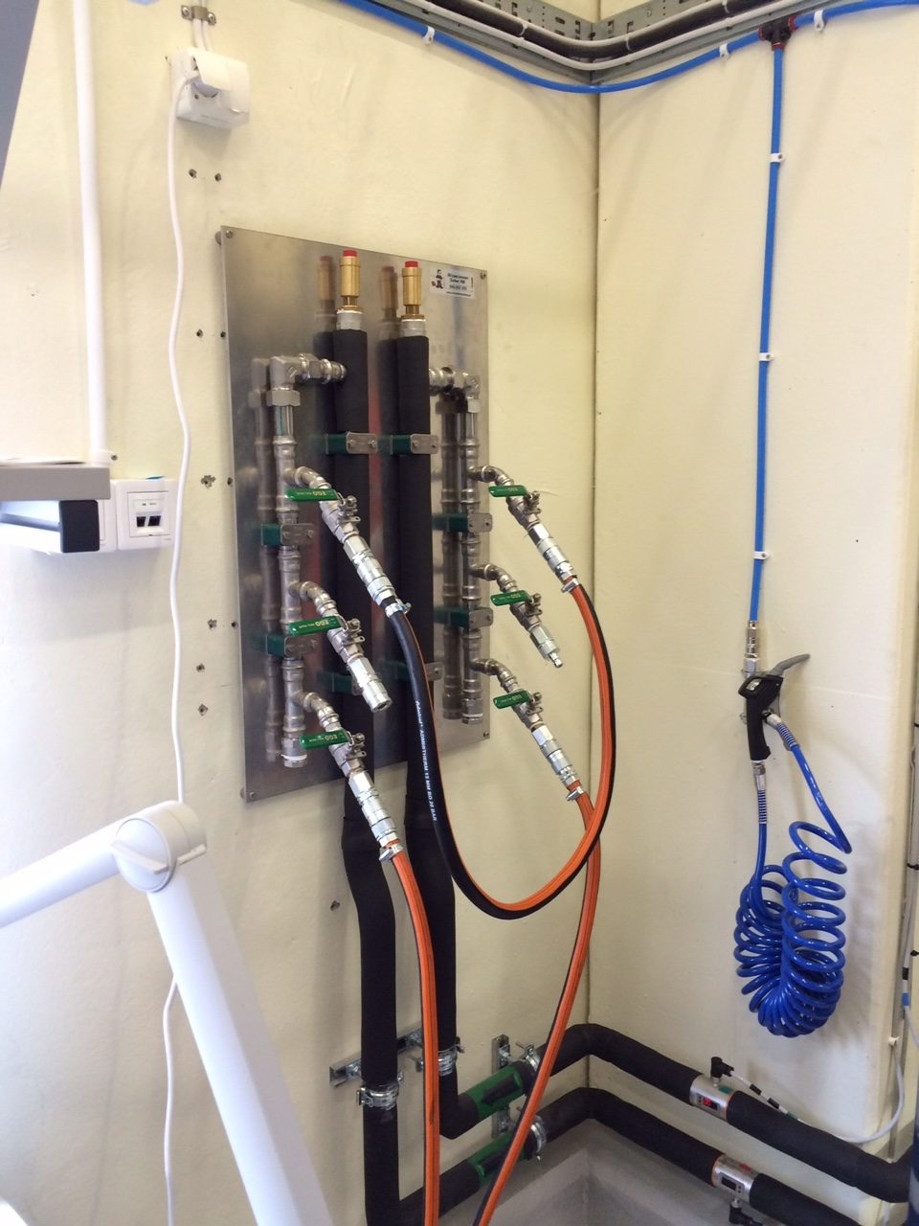
Sample environment utility supply demands
FLUCO
FLUids incl. gases, vapors and COmplex fluids
- H. Schneider -
Cooling water coupling system defined
Stainless Steel
PIN = Inlet (cold supply) , IN
Socket = Outlet ( warm return) , OUT
-> Unique defined , also for scientists
Compressed air with quick connectors
Notes:
Present experience: fragemtnation, only partly supporting all topics …
New approach …mainaining balance; bringing it colse to the user

Slide 7
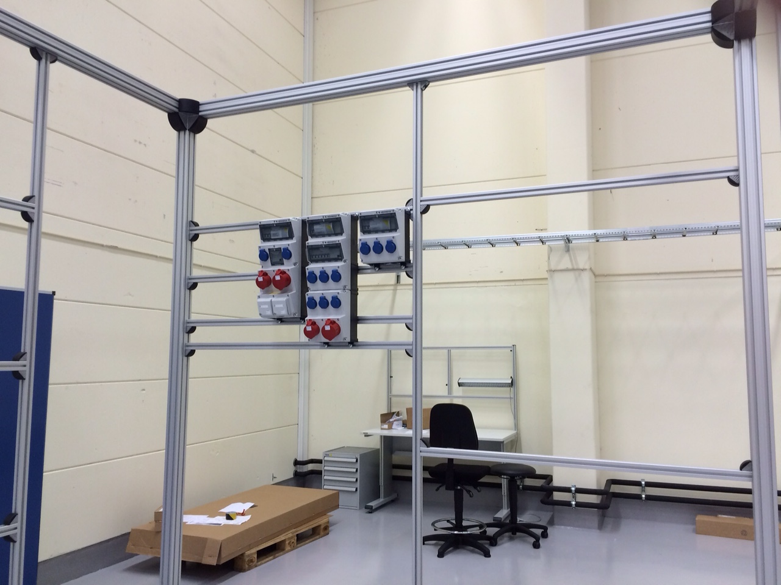
Sample environment utility supply demands
FLUCO
FLUids incl. gases, vapors and COmplex fluids
- H. Schneider -
3 Electrical Boxes
Incl. 4 Ethernet lines
Small Box
Connected to UPS
Notes:
Present experience: fragemtnation, only partly supporting all topics …
New approach …mainaining balance; bringing it colse to the user

Slide 8
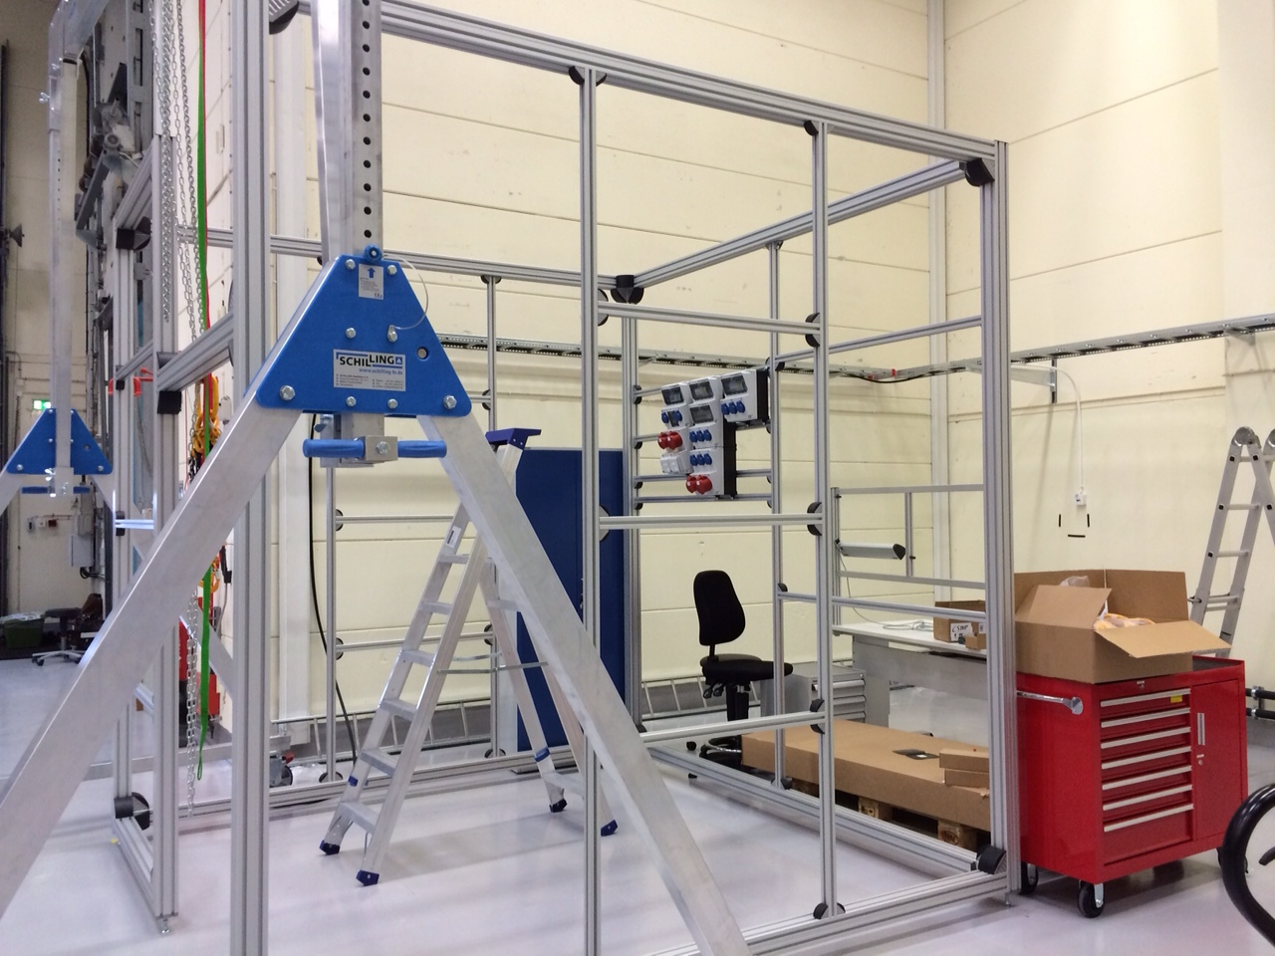
Sample environment utility supply demands
FLUCO
FLUids incl. gases, vapors and COmplex fluids
- H. Schneider -
Notes:
Present experience: fragemtnation, only partly supporting all topics …
New approach …mainaining balance; bringing it colse to the user

Slide 9
Sample environment utility supply demands
FLUCO
FLUids incl. gases, vapors and COmplex fluids
- H. Schneider -
Still in discussion :
Patch panel for signals, supply voltages, digital I/O, - interfaces, ethernet , ….
To be finalized soon
He – Recovering line
Pump exhaust line
Gas supply
  Compressed air supply
  H₂ - Gas supply
  O₂ - Gas supply
  Inert Gas supply, e.g. He, CO₂, N₂, Ar, ..
Notes:
Present experience: fragemtnation, only partly supporting all topics …
New approach …mainaining balance; bringing it colse to the user

Slide 10

Temperature and Field
Sample Environment (TEFI)
Scope:
  high/low temperatures,~10⁻² – 10³ K,
  Magnetic and electric fields
Planned Equipment
  Liquid helium and dry cryostats (Helium recovery/liquefier available)
  Superconducing cryomagnets, electromagnets
  He3/4 dilution cryostats, He3 sorption fridge
  Furnaces

Slide 11
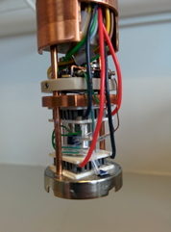
Temperature and Fields – envisaged suite for 8 by 2023
 | # | Needed for … out of first 8 Instruments
Horizontal cryomagnet 11T | 1 | Dream, C-Spec, [Odin, Skadi]
Vertical cryomagnet 10T, 15T (HZB) | 2 | Bifrost, Magic, C-Spec, [Estia, Odin]
Warm bore electro- / cryomagnet | 2 | Estia, C-Spec, Loki, Beer, [Odin] , Miracles
3D Helmholtz magnet | 1 | Loki, [Estia] (consider cryomagnet)
Cryostat incl PTR, wet, flow, cryostream | 4 | Estia, Magic, Dream, C-Spec, Loki, Beer, [Odin]
CryoFurnace (4K – 500K) incl. changer | 3 | Dream, C-Spec, Bifrost, Loki, Beer, [Odin]
Dilution | 2 | Magic, C-Spec, Bifrost
High Temperature Vacuum Furnace | 2 | Magic, Dream, C-Spec, Bifrost, [Odin]
Infrared Furnace | 1 | C-Spec, Magic, Beer, Bifrost, Dream, [Odin]
Sorption stick | 1 | Magic, Dream, C-Spec, Bifrost
6kV HV supply | 2 | Magic, C-Spec, Estia, [Odin]
Peltier subcryostat, in-situ AC susceptibility | 1 | additional in-situ possibility
Uses refurbished equipment

Slide 12
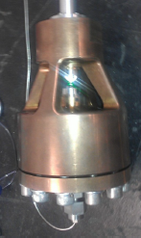
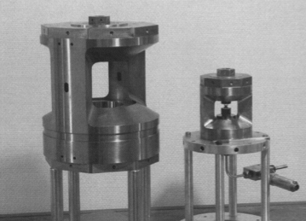
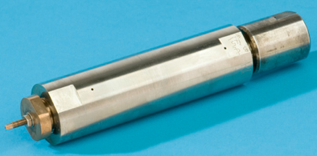
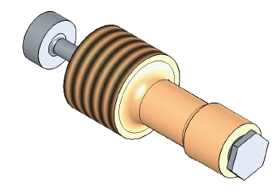
PREMP
PREssure devices and Mechanical Processing
Requires hardware spectrum
“Sputnik” cell
Paris-Edinburgh
ISIS TiZr gas cell
0.1
1.0
10
100
Pressure (GPa)
Developing diamond anvil cells
WC
ILL BeCu clamp
Notes:
New cells NOT ONLY MEGABAR!

Slide 13
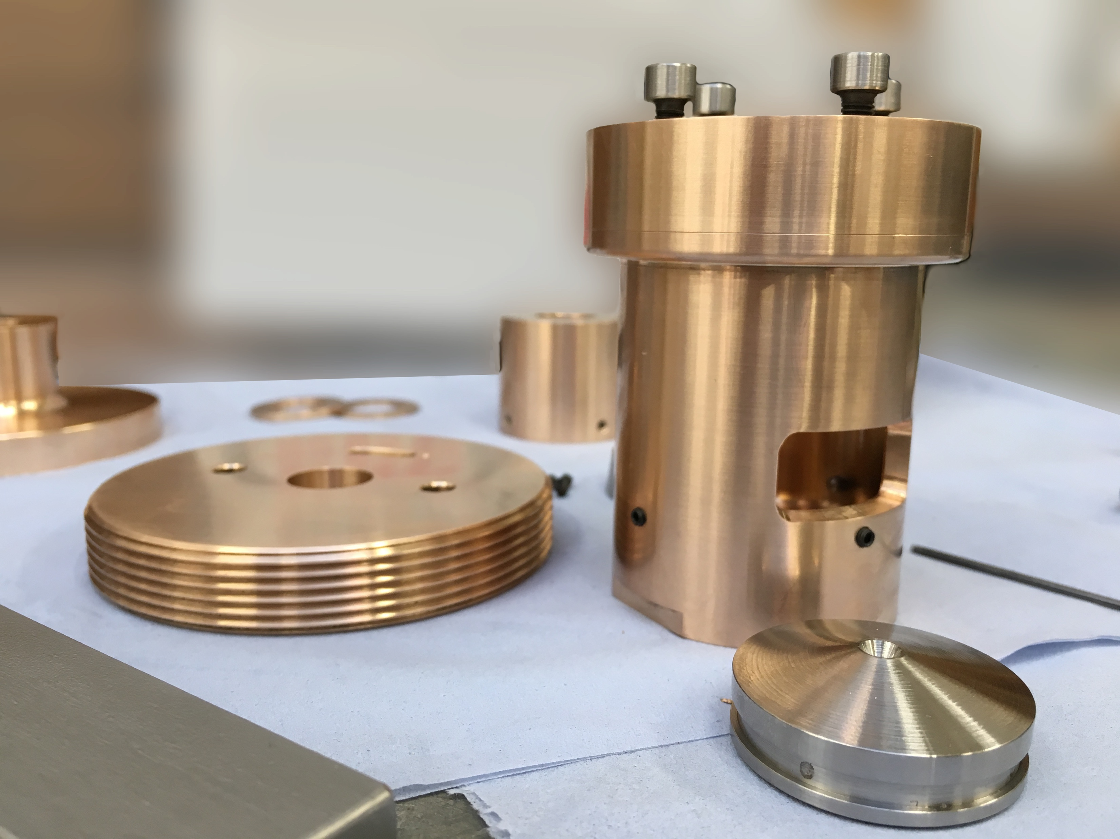
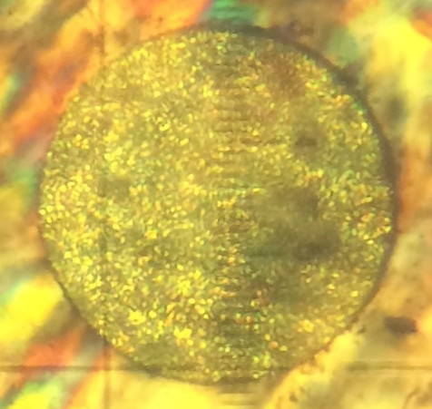
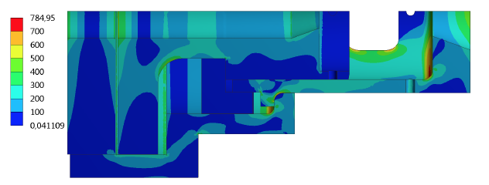
Collaborative cell development
5 GPa, RT
1.0mm
Design optimised by FE by Lund University intern
Cell fabricated in Edinburgh
Solid methane
(loading reached 35 GPa)

Slide 14
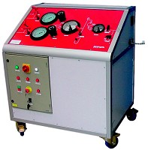
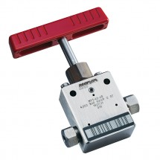
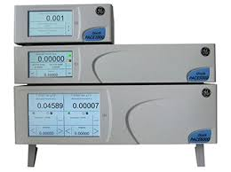
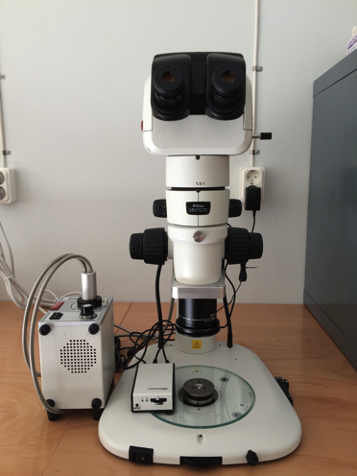
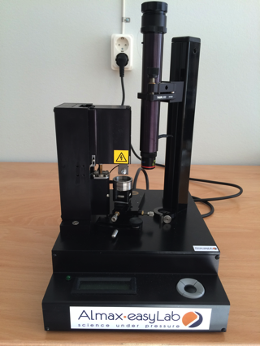
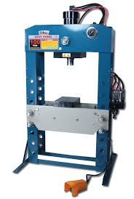
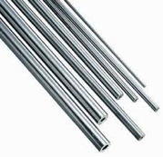
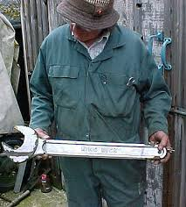
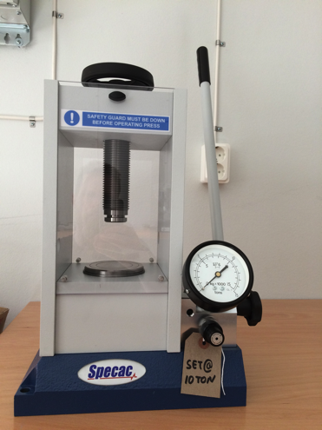
Infrastructure
Hydraulic/gas lab
Small samples lab

Slide 15
FLUCO
FLUids incl. gases, vapors and COmplex fluids
- H. Schneider -
Planned suite of sample environment equipment
Provided by the ESS within NSS (construction budget)
for the first 8 instruments:
Humidity Chamber(s)
Rheometer (RheoSANS), Shear cells, Cuette cells
Stopped Flow devices
Syringe Pumps , Peristaltic Pumps
Gas Process Handling, Manifolds
Water (Oil) bath circulating devices, aka Chiller
Magazines (multiple samples) , Rotating cells, peltier driven devices
Thermalizing gas blower
Liquid-Solid-Cells
Notes:
Disolve this slide or use as summary; link to SAC comments
Needs to specifc what it want from the pool and what they build for their instrument.
Instrumet team takes team during construction (and potentially in operation)

Slide 16
FLUCO
FLUids incl. gases, vapors and COmplex fluids
- H. Schneider -
Planned suite of sample environment equipment
Provided as part of instrument budgets :
Sample changer , multiple samples, 8 pos. CSPEC/MIRACLES TUM, Ger
Troughs, Langmuir troughs FREIA STFC, GB
50 pos. thermalized magazines, amb. Temp. LOKI/SKADI STFC/FZJ , GB/Ger
Sample changer VESPA STFC , GB
HPLC Pump LOKI/FREIA/ESTIA STFC/PSI , GB/SH
Liquid-Solid-Cells FREIA/ESTIA STFC/PSI , GB/SH
Cryostream NMX ESS , DK, FR
Humidifiyer NMX ESS , DK, FR
Notes:
Disolve this slide or use as summary; link to SAC comments
Needs to specifc what it want from the pool and what they build for their instrument.
Instrumet team takes team during construction (and potentially in operation)

Slide 17
FLUCO
FLUids incl. gases, vapors and COmplex fluids
- H. Schneider -
Actual the pool “core” equipment looks like now , to STAP 2017 :
  Rheometer, Rheo-SANS, Pending FZJ, VAT issues
  Laser Pump Probe , successfully finished !
  Laser Pump Probe 2 , Started - Updated resp. to STAP 2016
  Humidity chamber, Pending FZJ, VAT issues, new partner possible Tartu, EE
  Rotating cell magazine 6 pos, internal just started - Updated resp. to STAP 2016
  Gas process handling systems , Started - Updated resp. to STAP 2016
  Stopped flow unit, Pending FZJ, VAT issues, new partner possible Tartu, EE
  In Situ Light scattering, new external collaboration by BMBF – FlexiProb
  ,Updated resp. to STAP 2016
  Thermalizing blower , enabled by add. funding , - Updated resp. to STAP 2016
  5 Pos. (Peltier) In-Kind with RUC as feasibility project, quick temperature steps
  completion expected in Q3/2017 - Updated resp. to STAP 2016
  Chemical process chamber, R & D , cash
  Ultrasonic levitator OPS
  In Situ thermal analysis >2025
  In Situ gas adsorption funding
Blue – Funded as In-Kind
Green – Own devel. Build., Cash
Red – Not yet funded
Notes:
Disolve this slide or use as summary; link to SAC comments
Needs to specifc what it want from the pool and what they build for their instrument.
Instrumet team takes team during construction (and potentially in operation)

Slide 18
FLUCO
FLUids incl. gases, vapors and COmplex fluids
- H. Schneider -
WP | Partner | 16 | 17 | 18 | 19 | 20 | 21 | 22 | 23 | 24 | 25
Gas-processing-system | U.Tartu(Est)
Laser Pump Probe | U.Tartu(Est)
Laser Pump Probe 2 | U.Tartu(Est)
Stopped-flow-Cell | FZJ (G), EST
Humidity Chamber | FZJ (G), EST
Rheometer | FZJ (G), EST
Light scattering | ?
5x SANS-Peltier | RUC
Rotating cells | ESS
Thermalizing Bl. | ESS
Chem. Cell | ESS
Cells/solid-liquid | ESS
Lab Equipment | ESS
Equipment available
-> Testet and integrated
Ready to run
at instruments
Successfully finished
Pool
Equipment
FlexiProb
Lab building available
Planned
Hot commissioning
first instruments
Started
Users
> =2023
In discussion
Notes:
Disolve this slide or use as summary; link to SAC comments
Needs to specifc what it want from the pool and what they build for their instrument.
Instrumet team takes team during construction (and potentially in operation)

Slide 19
FLUCO
FLUids incl. gases, vapors and COmplex fluids
- H. Schneider -
Principle sketch of the device
Magazine 5 positions, up to 10 pos. possible
Different sizes of quartz /sapphire cuvettes
Dedicated for SANS applications
Each position with individual controlled T performed by Peltier elements
Temperature range 5˚C – 120˚C Base plate thermalized by circulator
In “dry” atmosphere: temperatures down to – 20˚C
Cuvette holder w. Peltier elements
Thermalised base plate
Cuvette holder
IK Partner: B Jakobson, C Niss, RUC
Notes:
Disolve this slide or use as summary; link to SAC comments
Needs to specifc what it want from the pool and what they build for their instrument.
Instrumet team takes team during construction (and potentially in operation)

Slide 20
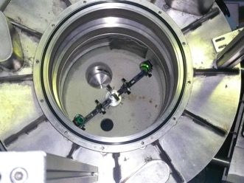
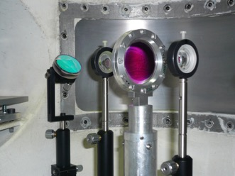
FLUCO
FLUids incl. gases, vapors and COmplex fluids
- H. Schneider -
Laser pump probe
Optical trigger
for photosynthesys
Expandable to thermal trigger
InKindPartner, Prof. J. PieperUniv Tartu, Est
Phys. Inst. Univ. Tartu/ ILL IN5
Laser pump probe II
Thermal stimuli of sample
InKindPartner, Univ. Tartu, Est.
Notes:
Disolve this slide or use as summary; link to SAC comments
Needs to specifc what it want from the pool and what they build for their instrument.
Instrumet team takes team during construction (and potentially in operation)

Slide 21
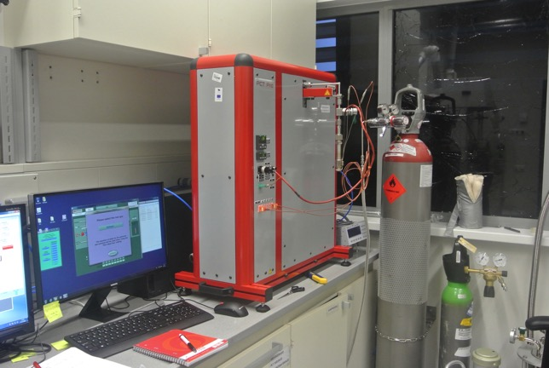
FLUCO
FLUids incl. gases, vapors and COmplex fluids
- H. Schneider -
Gas process handling system
P < 200 bar
Flushing, pressurising, filling
Simple adsorption measurement
T <= 773 K
N₂, O₂, H₂, D₂ He, Ne, Ar, CO, CO₂
expandable
Chem. Inst. Univ. Tartu
InKindPartner, Univ Tartu, Est
Notes:
Disolve this slide or use as summary; link to SAC comments
Needs to specifc what it want from the pool and what they build for their instrument.
Instrumet team takes team during construction (and potentially in operation)

Slide 22
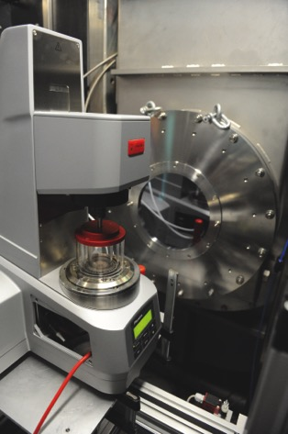
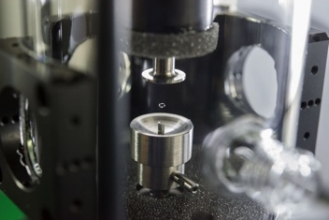
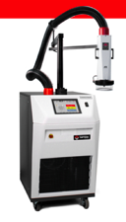
FLUCO
FLUids incl. gases, vapors and COmplex fluids
- H. Schneider -
Rheometer
Various setups
e,.g shear cell
Taylor-Cuette cell
Quench technique
Ultrasonic Levitator
JCNS , Outstation at FRM2 , MLZ
Potential InKindPartner, FZJ ,Ge
JCNS , Outstation at FRM2 , MLZ
Gas stream thermalizer
Stopped flow cell
6 channels.
278 K – 368 K
In Test thermal solutions
JCNS , Outstation at FRM2 , MLZ
Potential InKindPartner, FZJ ,Ge
Notes:
Disolve this slide or use as summary; link to SAC comments
Needs to specifc what it want from the pool and what they build for their instrument.
Instrumet team takes team during construction (and potentially in operation)

Slide 23
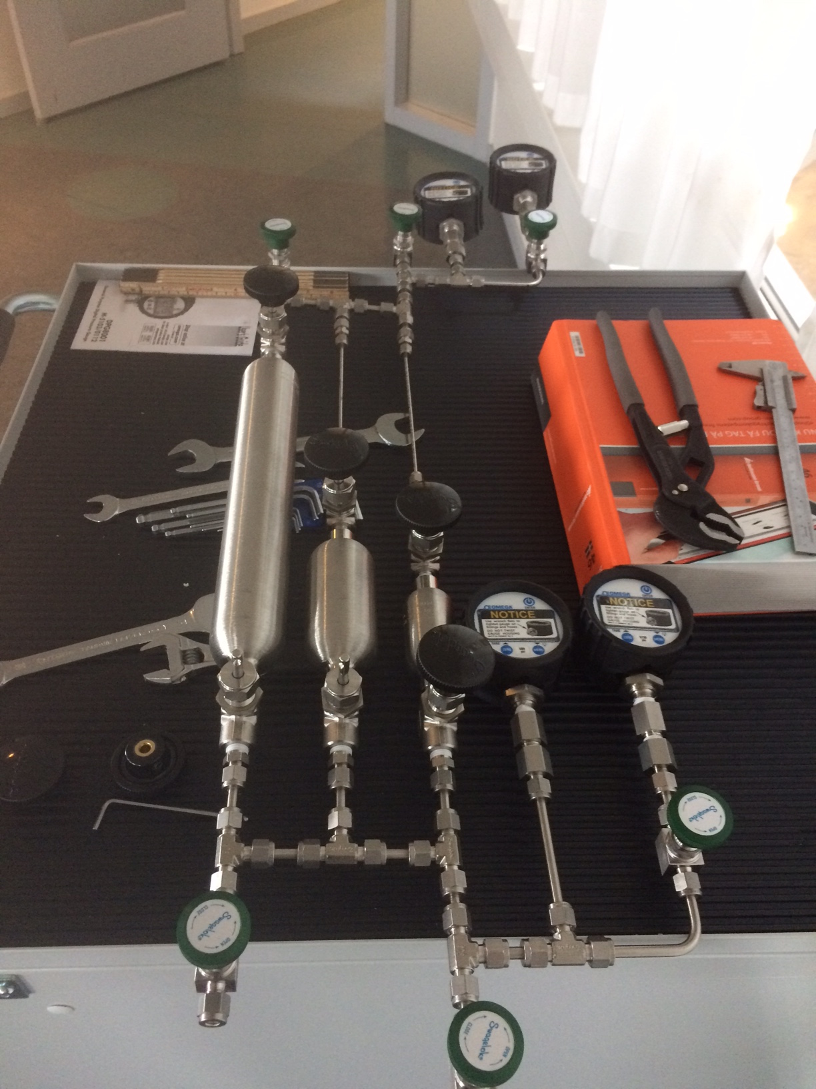
FLUCO
FLUids incl. gases, vapors and COmplex fluids
- H. Schneider -
First H2 gas manifold
Notes:
Disolve this slide or use as summary; link to SAC comments
Needs to specifc what it want from the pool and what they build for their instrument.
Instrumet team takes team during construction (and potentially in operation)

Slide 24
FLUCO
FLUids incl. gases, vapors and COmplex fluids
- H. Schneider -
FlexiProb , A german BMBF funded project
Moved , now TU-Darmstadt
MicroGels,
In Situ
Light Scattering
Foams@SANS
Kinetics and
Structures
GISANS, with
Pressure
Temperature
Humidity
Prof Th. Hellweg
Prof R. von Klitzing
Prof P.Mueller-
Buschbaum
Notes:
Disolve this slide or use as summary; link to SAC comments
Needs to specifc what it want from the pool and what they build for their instrument.
Instrumet team takes team during construction (and potentially in operation)

Slide 25
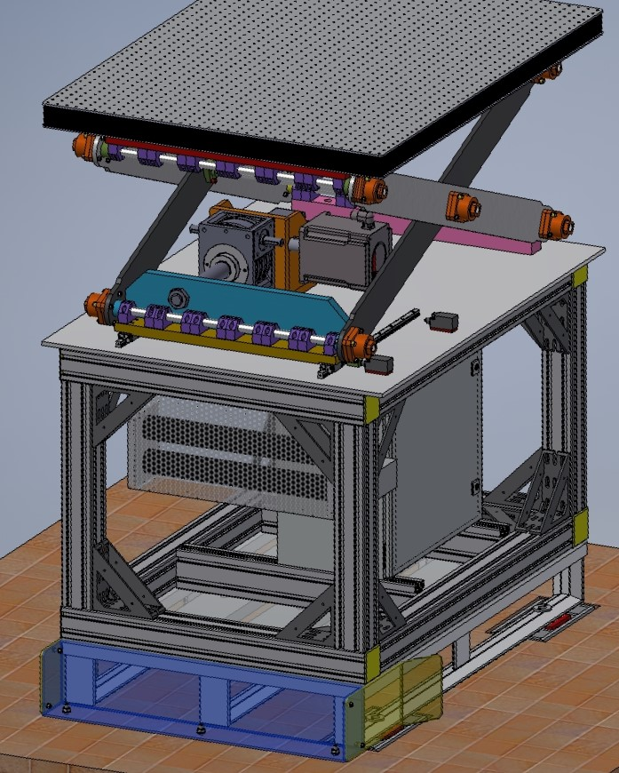
LIFTING-TABLE
Description:
max. load (central) = 10 000N
movement Z = 350mm
speed Vx = 300mm/min.
table size = 1200 *800mm
accuracy = ~ 0.1mm
( depending by the encoder )
servomotor driven
low permeability
„plug and play“ – system
( fast and easy to handle! )
Price:
starting with 16 000,- Euro
( depending the performens )

