Slide 1
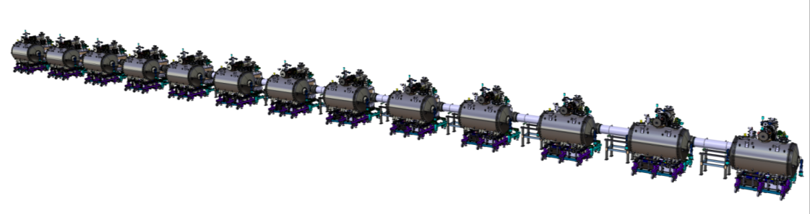
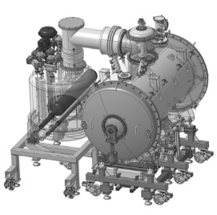
WP11: CDS-SL CDR
Overview
April 19th 2017

Slide 2
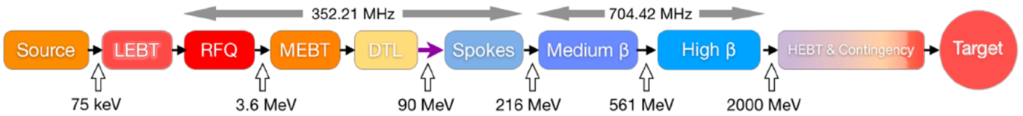
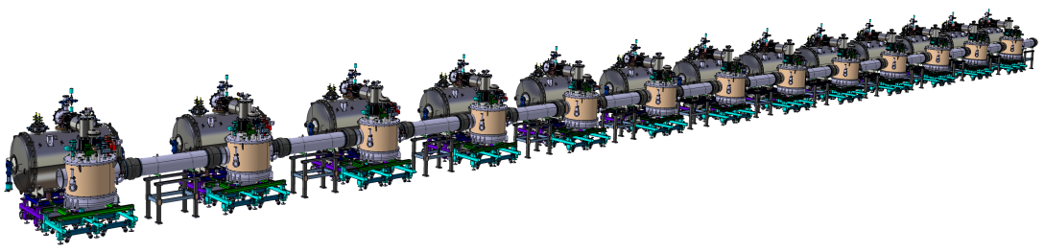
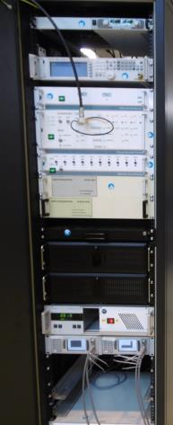

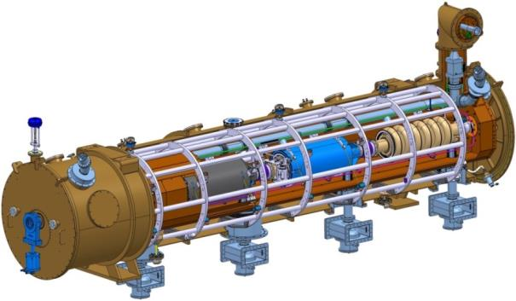
ESS MACHINE
The European Spallation Source (ESS) LINAC
CNRS CONTRIBUTION (CNRS/IN2P3/IPNO)
P
SRF LINAC: ~312 m
Moderated neutrons To experiments lines
LENGTH:
    SRF cavity cooling: 2 K in saturated He II bath (⇒ simple techno.+ few energy stored + pressure control)
    Elliptical section (~256 m):
    design of the 30 cryomodules
    (collaboration with )
    Design, construction and installation of the Spoke section (~56 m)
    Design, construction and installation of the cryogenic C&C system of theLINAC

Slide 3
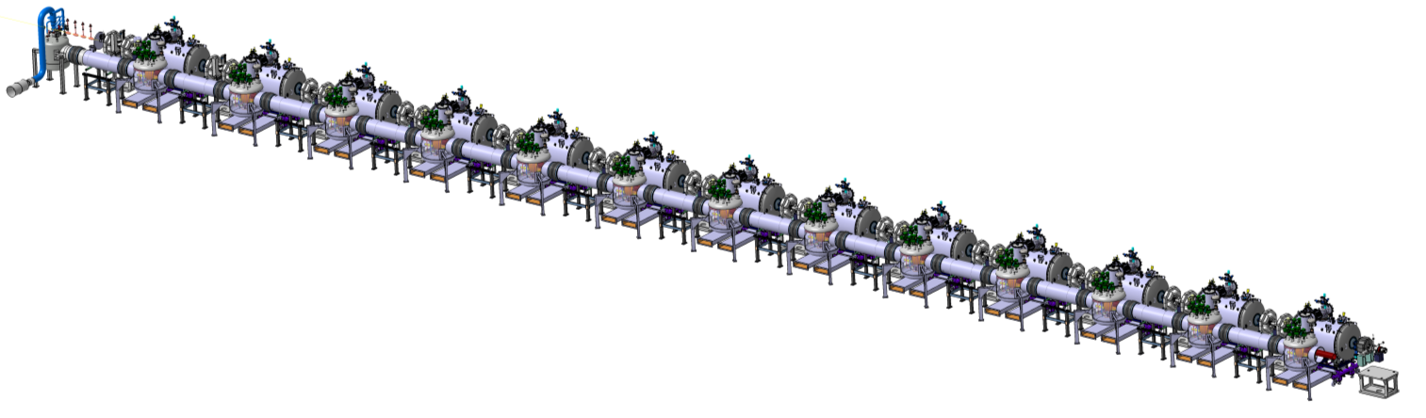
ESS Spoke section
Spoke section overview
  13 Spoke cryomodules (CM)
  Cryogenic Distribution System for Spoke linac (CDS-SL)
    main four-channels cryoline (headers)
    13 valve boxes (VB): one for each Spoke cryomodule
    1 end box: to return flow to the cryogenic plant (ACCP)
    13 branch cryolines (cryogenic jumper): connection from headers to each CM
    auxiliary process lines
    1 part of the vent line
Spoke cryomodule
End box →
Beam direction
Valve box
To the CDS-EL and ACCP→

Slide 4
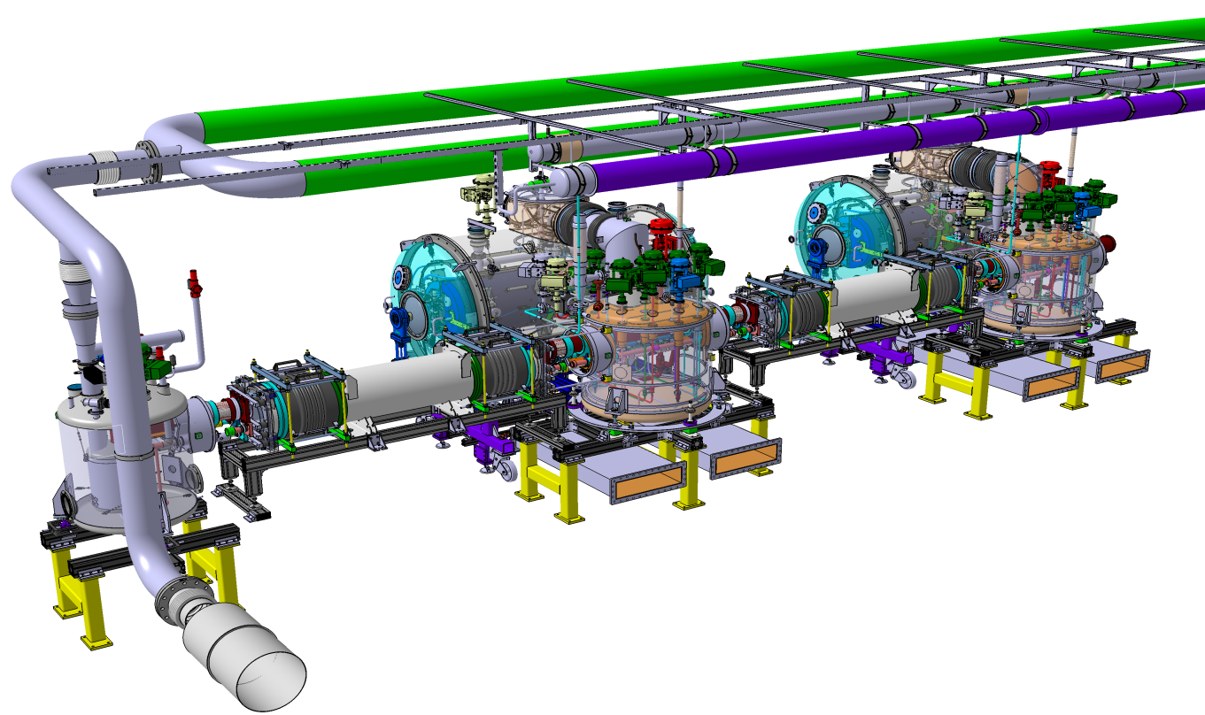
ESS Spoke section
Spoke section overview
  Cryogenic Distribution System for Spoke linac (CDS-SL)
    main four-channels cryoline (headers)
    1 End Box: to return flow to the cryogenic plant (ACCP)
    auxiliary process lines
    1 part of the vent line
End Box
Auxiliary lines
Valve box
Headers
Vent line

Slide 5
ESS Spoke section
Spoke section overview: the Cryogenic Distribution Line
  Components
TCS axis
y
x
Spoke cryomodules
Beam direction
HU01
HU02
HU03
HU13
HU-EL
End box
VB01
VB02
VB03
VB13
Interface with the CDS-EL
13x valve box (VB)
13x (standard) Headers Unit (HU)
1x Elliptic interfaced Headers Unit (HU-EL
1x End box

Slide 6
ESS Spoke section
Spoke section overview
  Flexible components
TCS axis
y
x
Beam direction
HU01
HU02
HU03
HU13
HU-EL
End box
VB01
VB02
VB03
VB13
Interface with the CDS-EL
Flexibility wrt the cryomodules cryo. distribution
valve box (VB)
Flexibility of the CDS-SL
(standard) Headers Units (HU)
Elliptic interfaced Headers Unit (HU-EL)
1x End box
Flexibility wrt the vent line

Slide 7
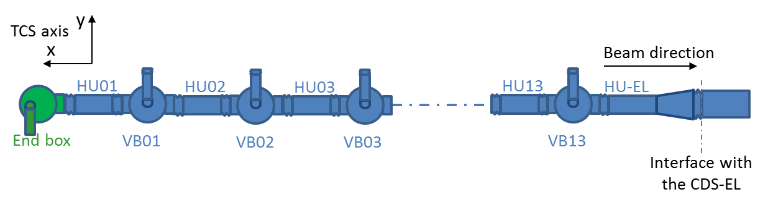
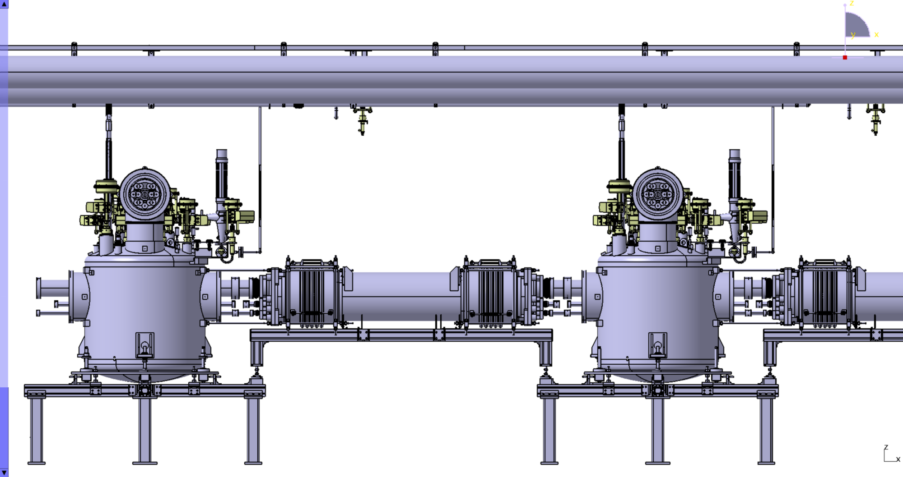
Spoke section overview
  Flexible components (vacuum vessel and cryolines)
Auxiliary lines
Valve box
Beam direction
Valve box
Flexibility
Header Unit
Flexibility
Flexibility

Slide 8



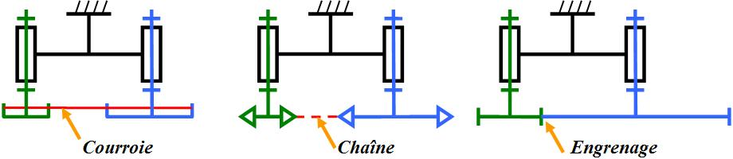
ESS Spoke section
Spoke section overview
  Supports of the cryolines (with respect to the vacuum vessel)
y
TCS axis
x
Beam direction
HU01
HU02
HU03
HU13
HU-EL
VB01
VB02
VB03
VB13
End box
Interface with the CDS-EL
Centring (sliding) support wrt the vacuum jacket
Free Rx, Ry, Rz
Tx free; Ty∼0; Tz∼0
Centring support wrt the vacuum jacket
Fixed displacement along the beam axis
Free Rx, Ry, Rz
Tx∼0; Ty∼0; Tz∼0
Centring support wrt the vacuum jacket
Fixed displacement along the beam axis
Rx=0, Ry=0, Rz=0
Tx=0; Ty=0; Tz=0

Slide 9
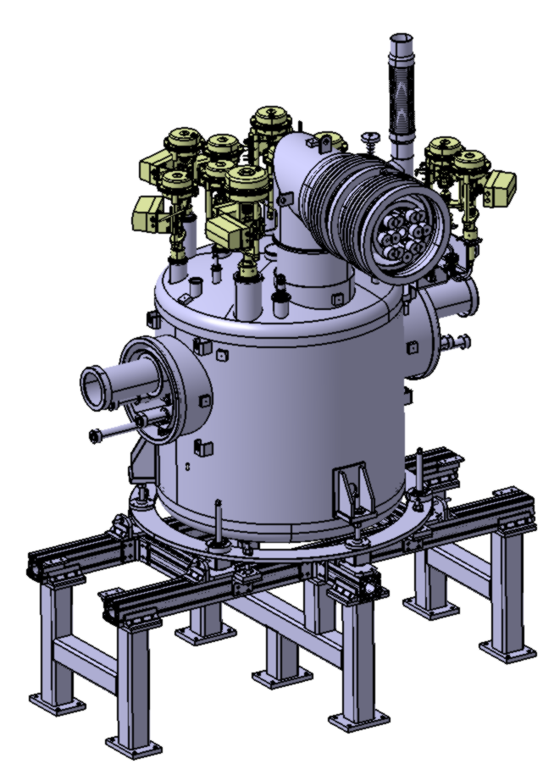
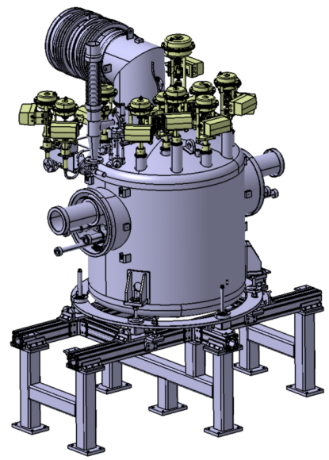
Main components of the CDL
Valve box
Cryogenic valves
He relief branch line
Interface with the cryomodule
Interface with the Header unit
Fiducials supports
Positioning frame
Valve box support

Slide 10
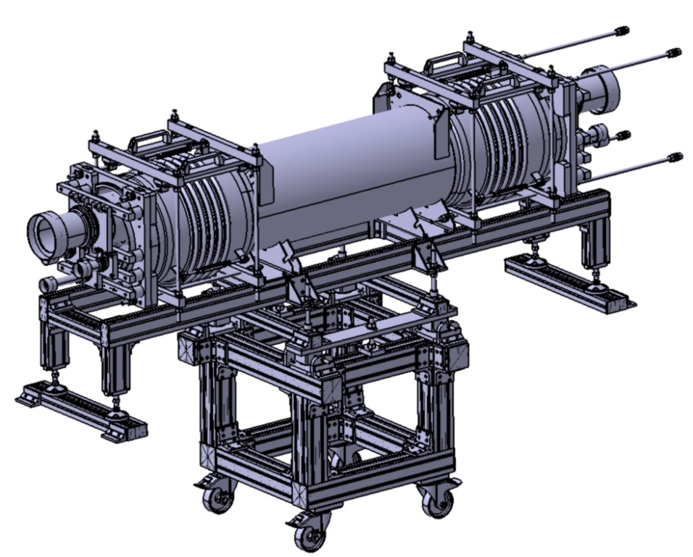
Main components of the CDL
Headers units
Installation tooling (compression and positioning of the bellows)
Support frame
Handling and positioning frame (to be removed after installation)

Slide 11
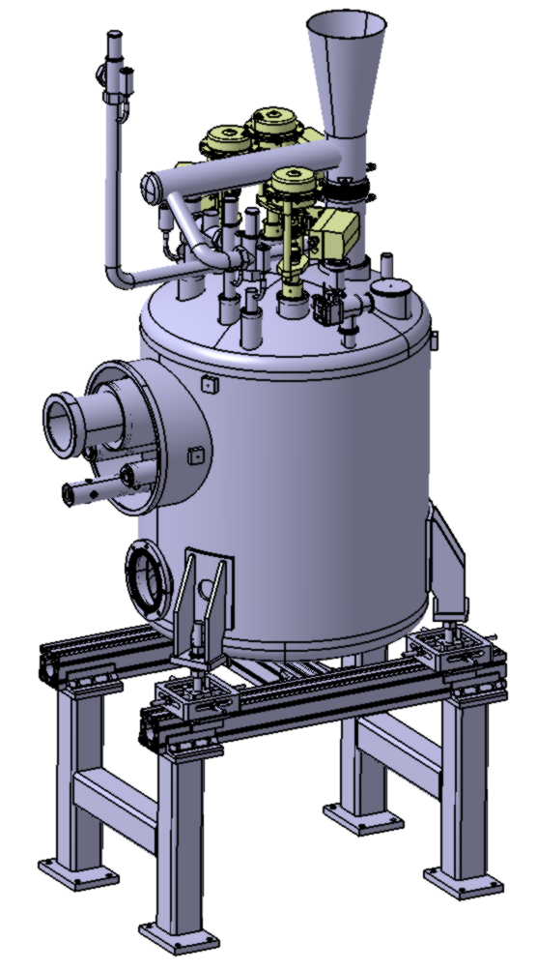
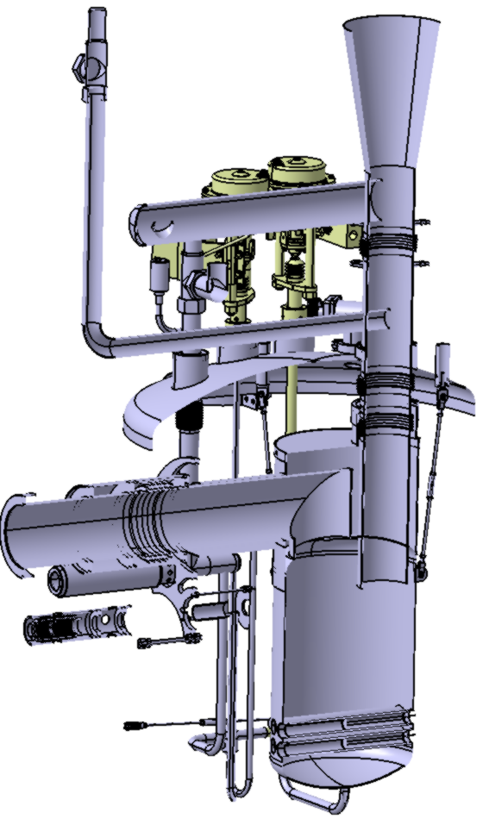
Main components of the CDL
End Box

Slide 12
Design framework
European Pressure Equipment Directive (PED 2014/68/UE)
    EN 13445: Unfired pressure vessels
    EN13480: Metallic industrial piping
    EN 13458: Cryogenic vessels – Static vacuum insulated vessels ⇒ End Box
    gives rules for:
    Design
    Materials
    Manufacturing
    Installation
    Tests
    Maintenance
AFS 2005:2

Slide 13
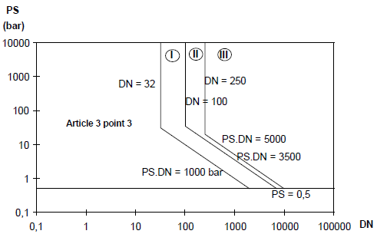
Design framework
Pressure Equipment Directive (PED 2014/68/UE)
  Process lines:
  ← Category I for CDS-EL
  ← Category I for CDS-EL
  ← Category I for CDS-EL

Slide 14
Design framework
Pressure Equipment Directive (PED 2014/68/UE)
  End Box: cryogenic pressure vessel
VLP MAWP = 5 barg
⇒ cat I for CDS-EL
⇒ §3.3 for CDS-SL)
50
Aim: to remain in category I
Max. volume of the End Box helium tank (50 L)

Slide 15
STATUS
Valve box
  Design nearly finished
  Procurement phase
Headers Units
  Design nearly finished
End Box
  Design under progress (tank supports)
Auxiliary lines
  Design nearly finished
Support frames
  Design nearly finished

Slide 16
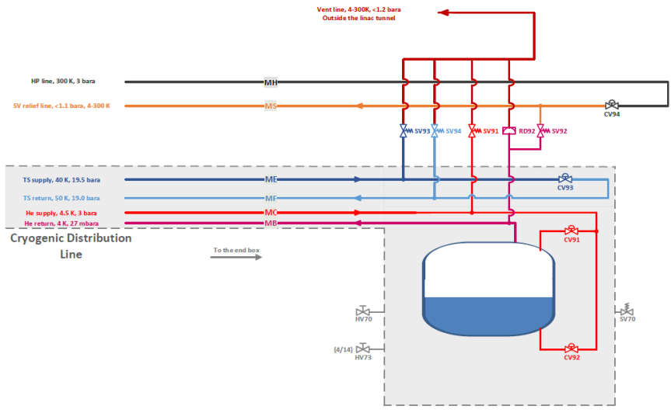
End Box status
Function of the End Box:
  To return the flow to the ACCP
  To smooth the heat loads changes
Design concepts
  From He supply to VLP
  12.3 g/s (up to 27.1 g/s)
  Helium liquefaction (JT)
    Benefit from phase change
    ⇒ T° fixed by pressure
    the vapours flowing back to the ACCP starts from saturated vapours at a fix T°
    Needs to produce vapours from liquid
    JT does not need to be very efficient (no subcooling heat exchanger)
    Need of heaters (170 to 382 W)
    Heat loading of the LHe is allowed
  Vapours flowing from the End Box (VLP)
    Limit heat loads on the vapours

Slide 17
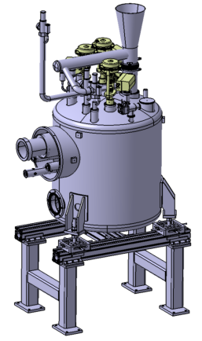
End Box status
Goal:
Design
  Support of the LHe is to finalize
  (comply with pressure loading due to “end effect”)
  Pipe routing is finished
  (burst disk connection to vent line is to be confirmed: depends on the helium collector design)
  Thermal shield is integrated
  Vacuum vessel is designed
Analyses
  Mechanical: to finalize LHe support
  Thermal analysis: under progress (support)
  Thermoacoustic: done

Slide 18
REQUIREMENTS
List of requirements
  A list of 117 requirements was established
  All requirements concerning the CDS-SL are validated
  Most of the interface requirements are agreed and validated
  But:
    We have to procure or complete some interfaces sheets describing the interfaces

Slide 19
WP is interfaced with
  WP04: Spoke cryomodules
    Cryogenic branch lines (including the cryogenic jumper)
  WP11 : Cryogenic Distribution System for the Elliptical Linac
    Main process lines (headers)
    Auxiliary lines
    Safety devices
  WP12 : Vacuum
    Pumping ports
    Diagnostic
    Control ports (diagnostic and pumping if required)
  WP13 : Safety
    (Safety devices)
    Burst disks
    Vent line
  WP15 : Cabling & Conventional Power
    Instrumentation and actuators
  ICS : Control/Command
    Instrumentation and actuators

Slide 20
REQUIREMENTS
List of requirements
  WP04: Spoke cryomodules
    List not validated by WP4
    ⇒ to be validated with the cryogenic jumpers designs (WP4 and WP11)
  WP11 : Cryogenic Distribution System for the Elliptical Linac (CDS-EL)
    List completed and several iterations. In Chess?
  WP12 : Vacuum
    List completed and validated. In chess?
  WP13 : Safety
    Requirements concerning MAWP and safety devices were written as interface requirements with CDS-EL ⇒ validated. In Chess?
    Helium collector:
    ESS does not want to establish requirement ⇒ ESS and IPNO agreed to postpone the design of the vent line. When?

Slide 21
REQUIREMENTS
List of requirements
  WP15 : Cabling & Conventional Power
    No requirement needed
    List of cables established
  WP99 :AccelInfrastructure & Installation
    Requirements list validated
  ICS : Control/Command
    No requirement yet written
    List of instrumentation written and discussed with ESS

Slide 22
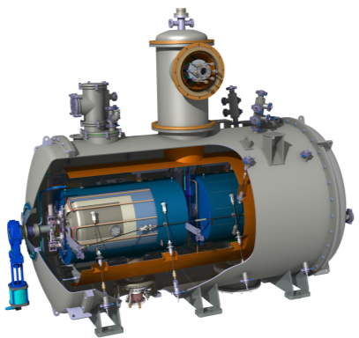
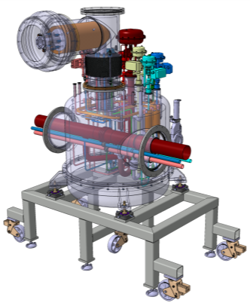

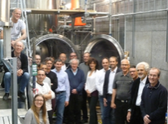
PROTOTYPING
CNRS’ contribution to ESS
Prototype Cryomodule
and test
ESS Series cryomodules
Prototype Valve box
IPNO
Uppsala univ.
Uppsala univ.
  A prototype and test valve box:
    Prototype valve box ⇒ to validate the valve box concepts
    ⇒ to validate the prototype Spoke cryomodule
    Test valve box ⇒ to validate 13 series Spoke cryomodules
    ⇒ Compromise between an optimized test stand and a demonstrator (cryoprocess, assembly)
  A versatile (flexible) valve box
    Tests at IPNOrsay (FRANCE)
    Tests at Uppsala University (SWEDEN)
    ⇒ To manage different cryogenic infrastructures

Slide 23
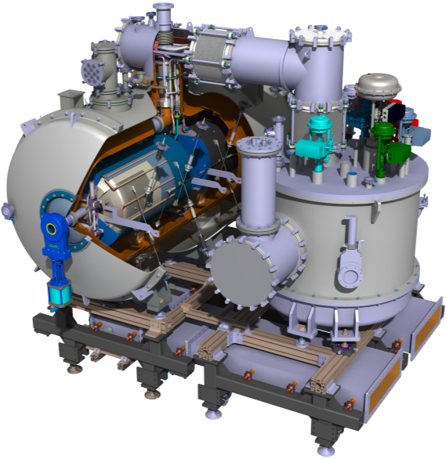
PROTOTYPING
Prototypes
CRYOGENIC JUMPERS
VALVE BOX
SPOKE CRYOMODULE

Slide 24
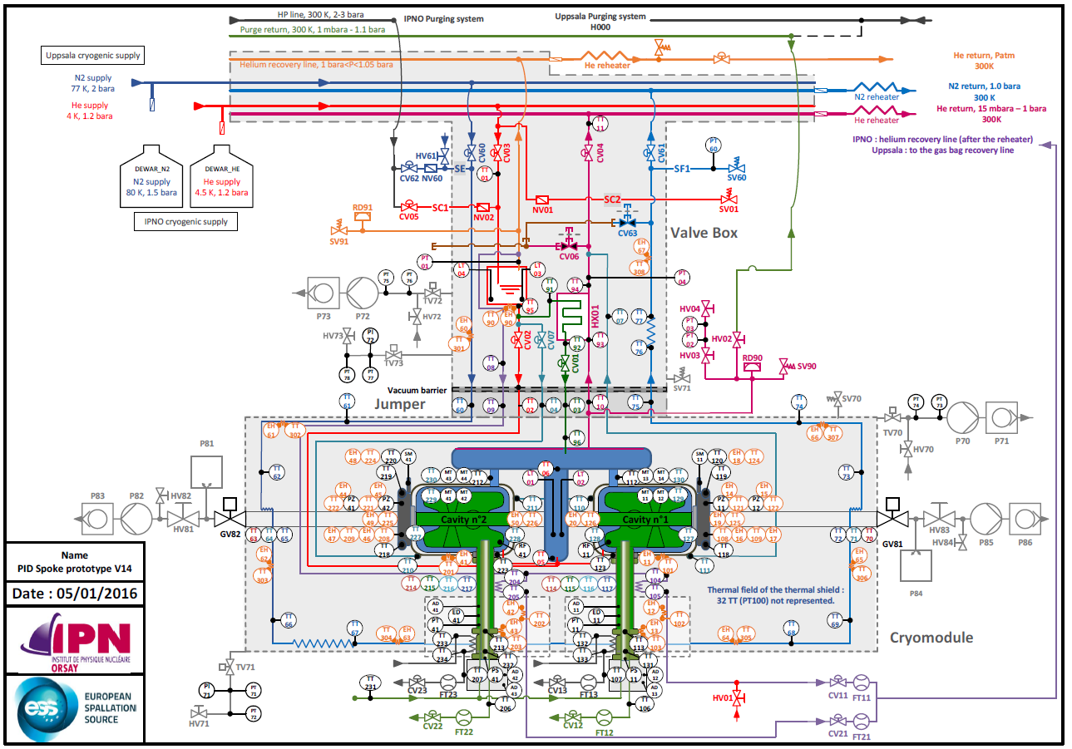
Prototyping the Spoke section
Flow scheme (PID): prototype version
Main differences with machine:
Instrumentation
Saturated LHe supply
Saturated LN₂ supply
  ⇨ phase separator in the VB
  ⇨ same subcooler
  ⇨ RF coupler heat intercept
  cold sat vapours used (instead of SHe)
⇨ Interfaces with the infrastructures

Slide 25
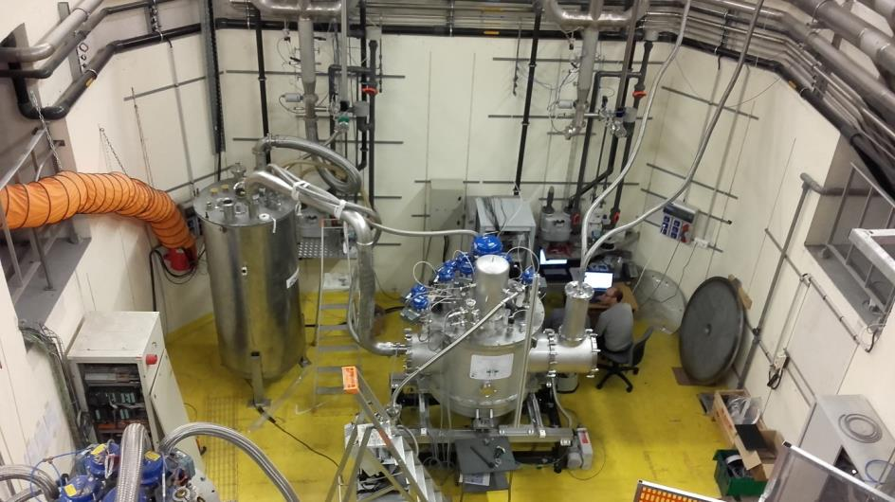
Prototyping the Spoke section
Valve Box
Delivered in September 2016 (delay = 9 months)
But not the cryogenic jumpers…
Cool-down and operation at 4 K ⇒ some minor problems detected but tests were OK

Slide 26
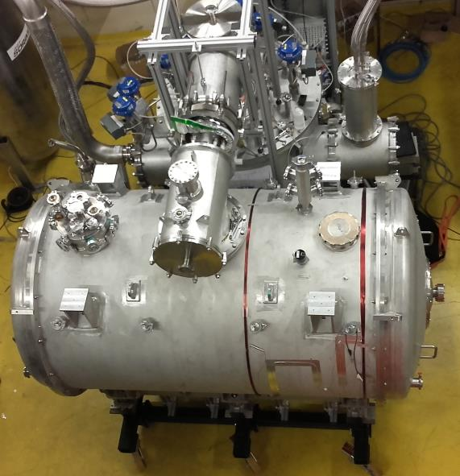
Prototyping the Spoke section
Cryogenic jumpers
After delivery of the cryogenic jumpers in November
Connection of the cryomodule and… troubles with the both cryo jumpers:
- delivered bellows (inside the jumpers and covered by MLI) were not corresponding to the manufacturing drawings
- cryogenic jumpers pressure test tools were not well sized
⇒ damaged bellows ⇒ leaks
Everything was done (and tried) to perform a cryo test
some components changed and repair at IPNO
(with on-stock components)
but VB jumper finally repaired by the manufacturer
CM jumper modified by IPNO (to use in-stock components):
VLP branch line was modified (DN40 inside a DN100 !)
Exhaust burst disk line modifed: DN100 ⇒ DN40 (use of mock-up cavities so beam
vacuum loss incident is not considered)

Slide 27
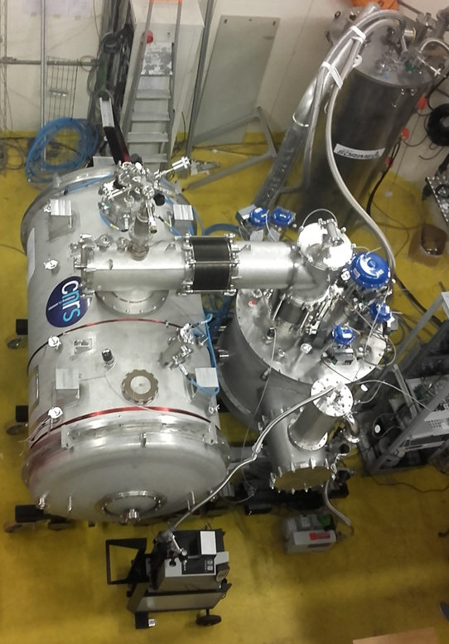
Prototyping the Spoke section
2K test
    - March: cryomodule and valve box connected
    Configuration "not optimal" (or the worst possibel configuration) as:
      1 magnetic shield not cooled
      1 power coupler double-wall installed but not cooled
      VLP branch line modified abd heat intercept suppress
      Configuration "not optimal" (or the worst
    - But 4 K and 2 K cryogenic tests were performed
    with the Spoke cryomodule and test valve box
    - Heat loads were important (but as evaluated)
    - Liquid level regulations loop were tested successfully at 4 K and 2K
    ⇒ LHe II level was correctly maintained in the cryomodule cavities

Slide 28
CNRS - WP11
The team
  P. DUTHIL
    Work Unit leader
    Cryogenics, numerical analysis, procurements WP4: same activities
  M. PIERENS
    Cryogenics, instrumentation
    WP4: instrumentation and tests
    WPxx (C&C): WP leader
  D. REYNET
    System engineer
    Mechanics, design, mechanical analysis,
    WP4: Same activities + procurements + quality
  S. BRAULT
    Design and drawings
    WP4: Same activities + procurements + tests
  F. CHATELET
    Experimental activities and cryogenic tests
    WP4: same activities
  V. POUX
    Quality Manager
    WP4: same activities
  V. LAURENCIER
    Finance management
    Procurements
  IPNO/IN2P3 support
    Equipment
  CNRS support
    Procurement

Slide 29
Thank you for your attention
Special thanks to
Matthieu Pierens
Denis Reynet
Sylvain Brault
Frédéric Chatelet
CSP12
28 Novembre 2014

