Slide 1
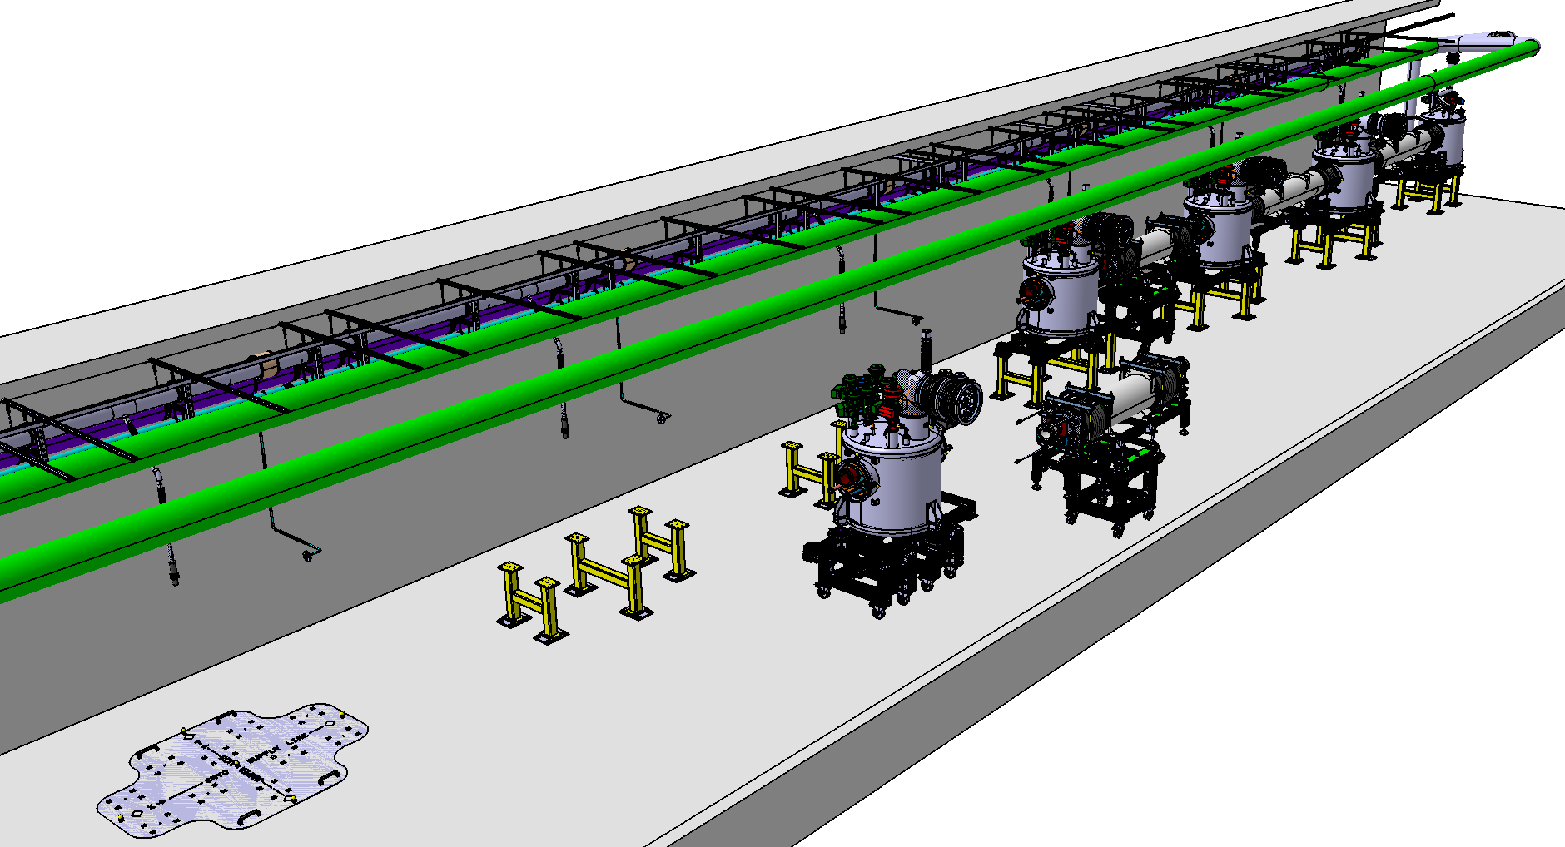
Work Unit 11.11.5.3 - AIK 11.2 CDR of the CDS-SL Installation integration
April 19th 2017

Slide 2
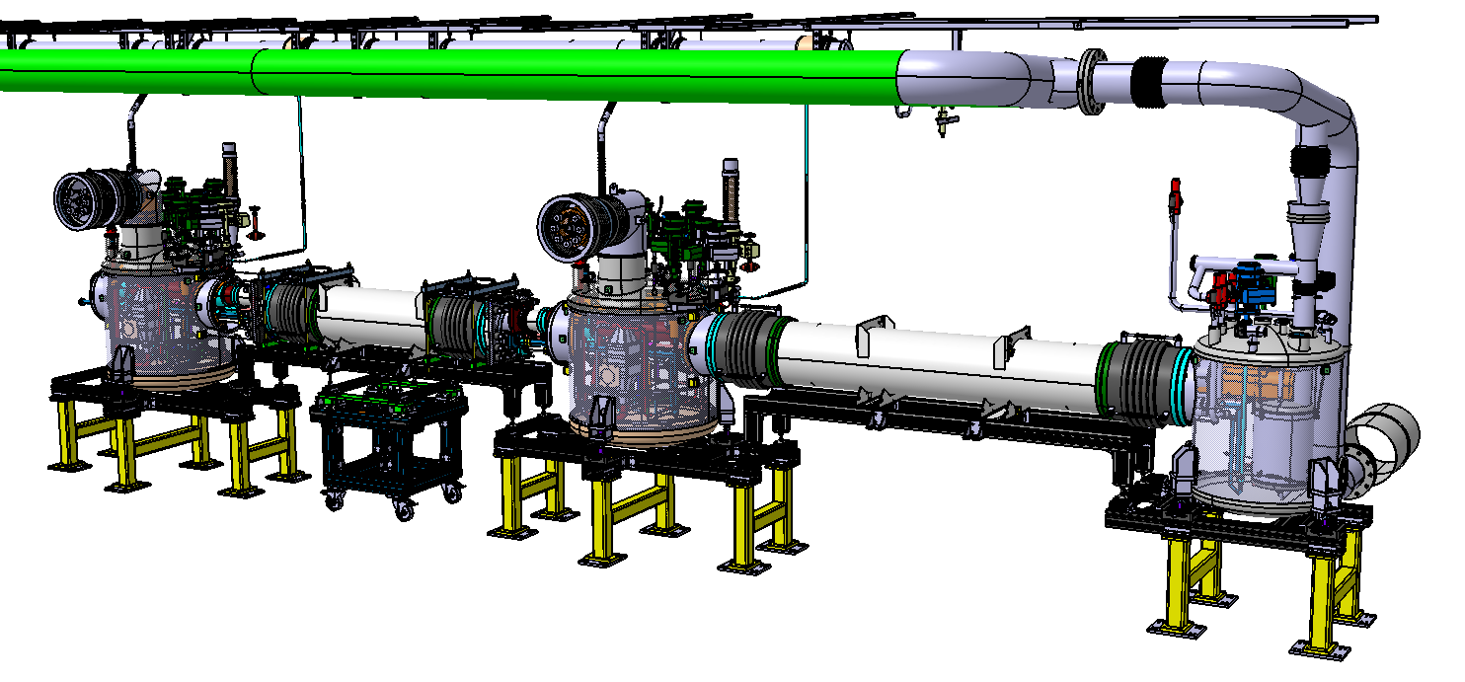
CDS-SL
Overview
Valve box
Headers unit
Part one : the valve box
Part two : the headers units

Slide 3
CDS-SL
Part one : installation of the valve boxes

Slide 4
Tunnel integration
Integration of the Valve box : support feet installation
Intermediate plates
(floor fixation by anchors bolts)
Central foot
Fiducials
External feet
Drilling jig (floor drilling)
Multiplication of holes to prevent the concrete reinforcement

Slide 5
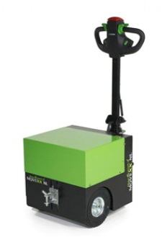
Tunnel integration
Valve box setting up
Trolleys
Electrical pulling/pushing vehicle

Slide 6
Tunnel integration
Valve box setting up
Put down and attach to the feet
Introduction between the feet

Slide 7
Tunnel integration
Valve box setting up
Remove the 2 trolleys
Ready to align

Slide 8
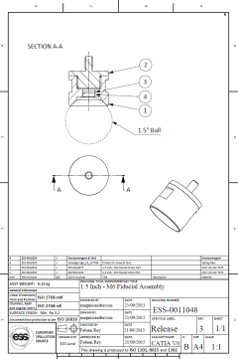
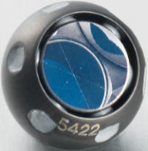
Valve box alignment
Alignment
7 fiducial marks
1,5” corner cube reflector
(Fabien REY ESS-Alignment)
3 Adjustable and lockable feet (at 120°)
Threaded shaft (fine thread)
Thrust ball bearing
Concave and convex washers
Fine (sensitive) adjustement:
- along X and Y axis : ±40mm
- along Z axis : ± 50mm

Slide 9
Valve box and wave guide interface
Space for RF distribution (wave guides)
Wall
Large free space under the support frame

Slide 10
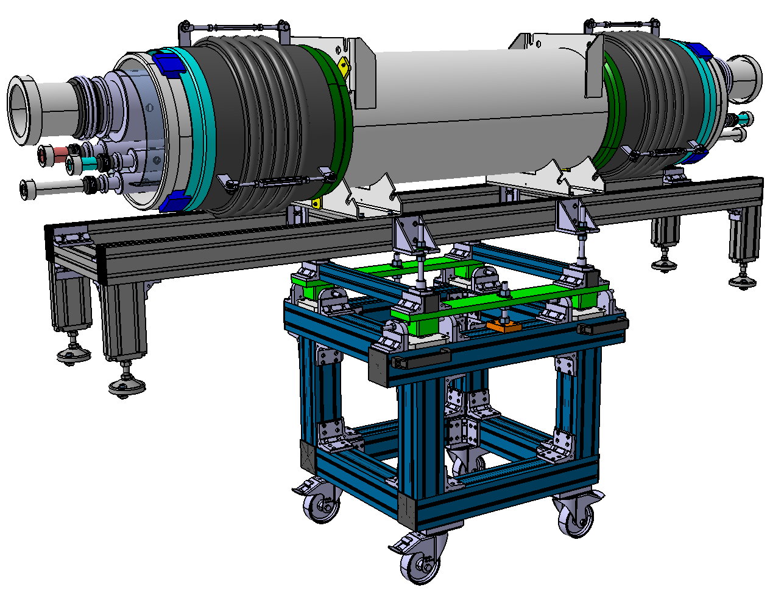
Headers unit
Part two : installation of the headers units

Slide 11
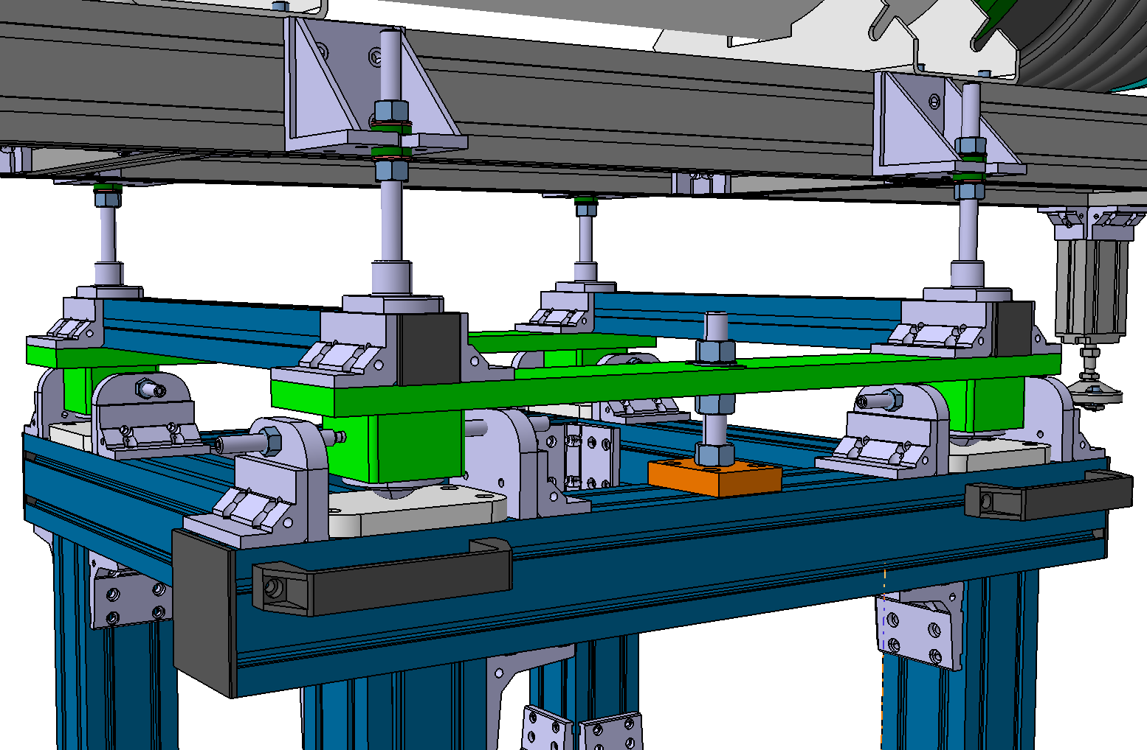
Headers unit : Handling trolley
Fine adjustement:
- along X and Y axis : ±40mm
- along Z axis : ± 50mm
Threaded shaft (fine thread)
Concave and convex washers
Useful for:
- transportation inside the tunnel
- positioning
Removable and reusable
Adjusting screw
Carrier ball

Slide 12
Tunnel integration
Insertion of the header between two valve boxes
Compression tooling
Compression tooling
4 independant blocks
The compression of the cryolines is required during installation
(→ goal: free position of the bellows at cold T°)

Slide 13
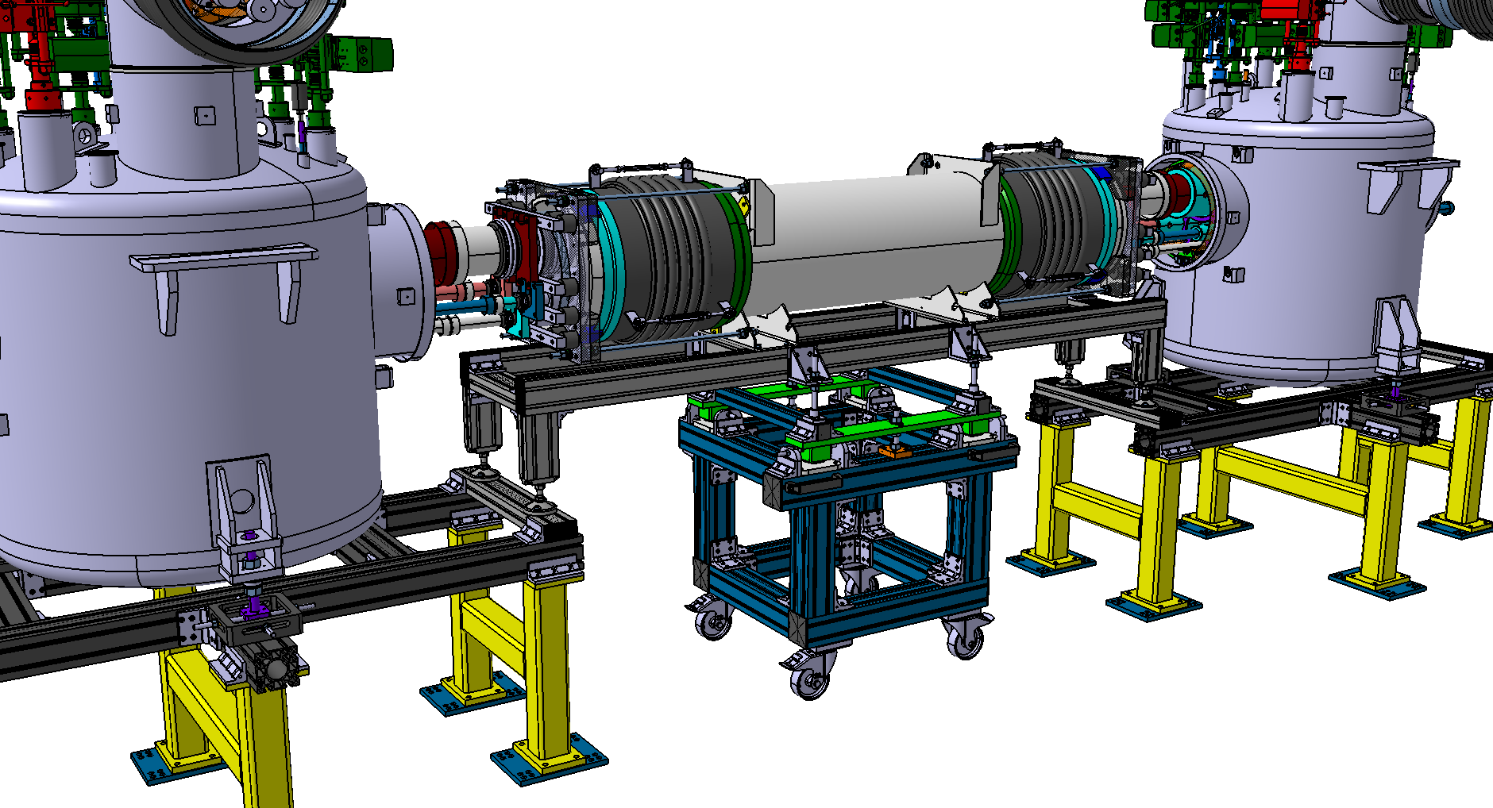
Tunnel integration
Insertion of the header between two valve boxes
5 mm gap
(compression)
5 mm gap
(compression)
insertion
Ajustment / Alignment
Fixation and removal of the trolley

Slide 14
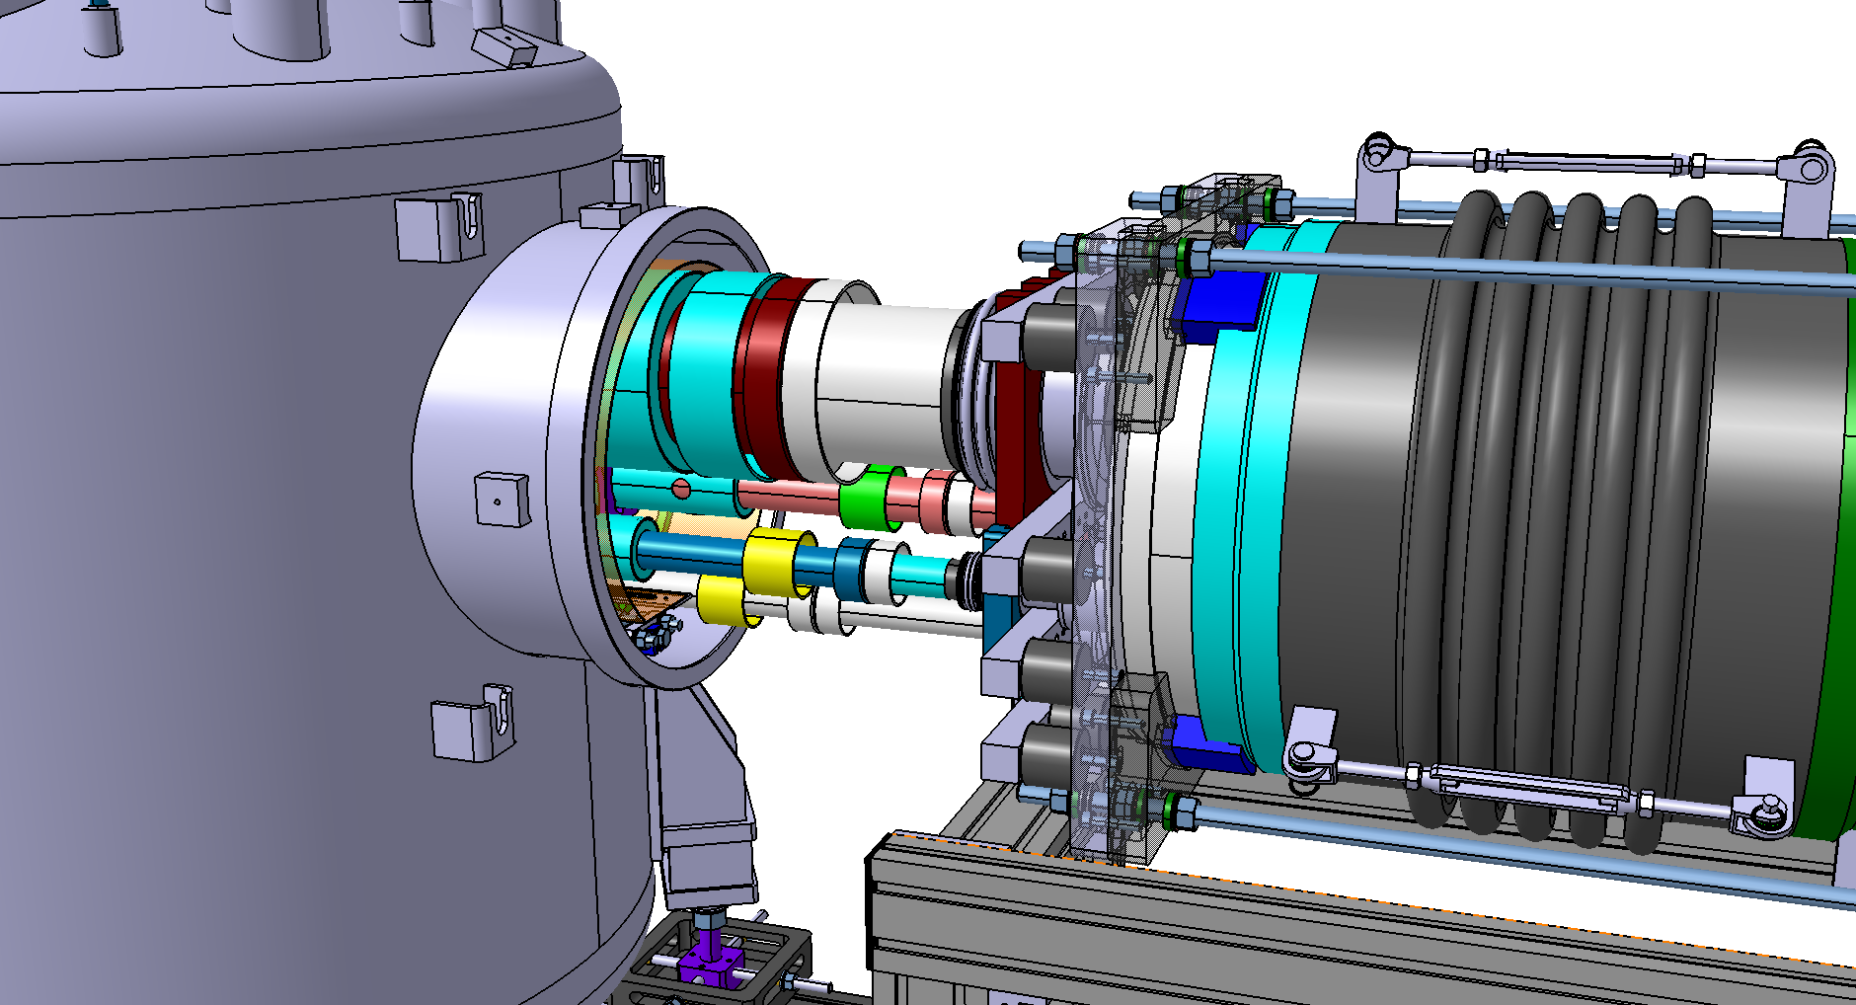
Tunnel integration
Welding of the cryolines sleeves
Relaxation of the bellows until contact between flanges
Sleeves

Slide 15
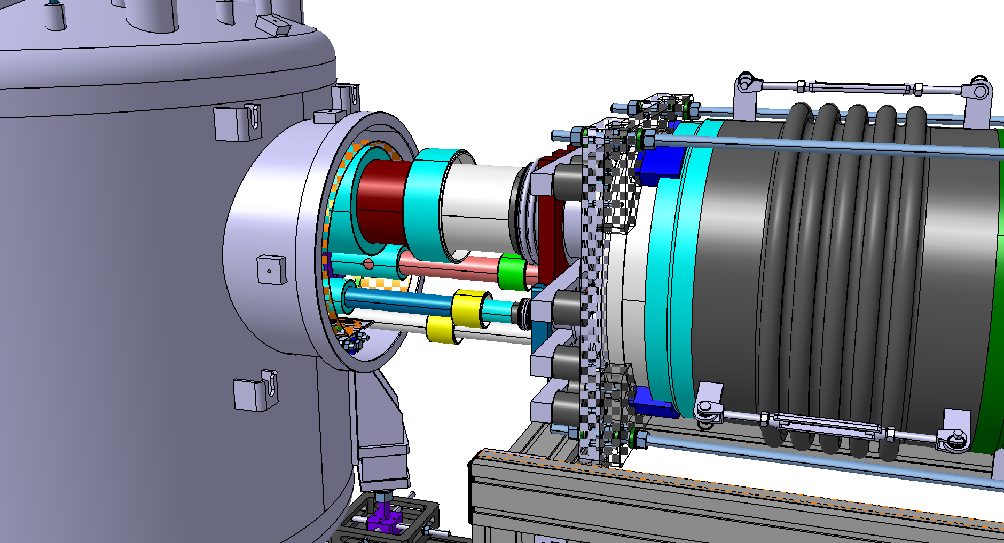
Tunnel integration
Welding of the cryolines sleeves
Weld
Weld
Weld
Weld

Slide 16
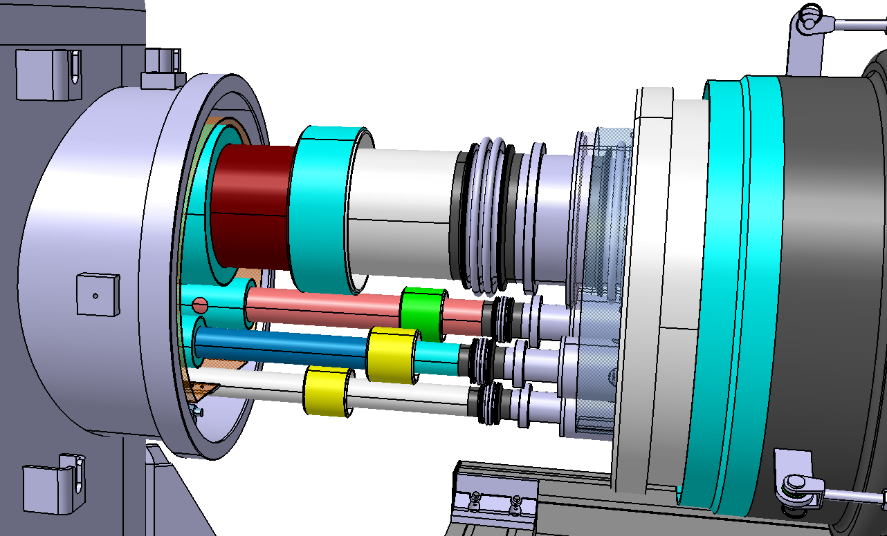
Tunnel integration
Welding of the cryolines sleeves
Removal of the compression tooling

Slide 17
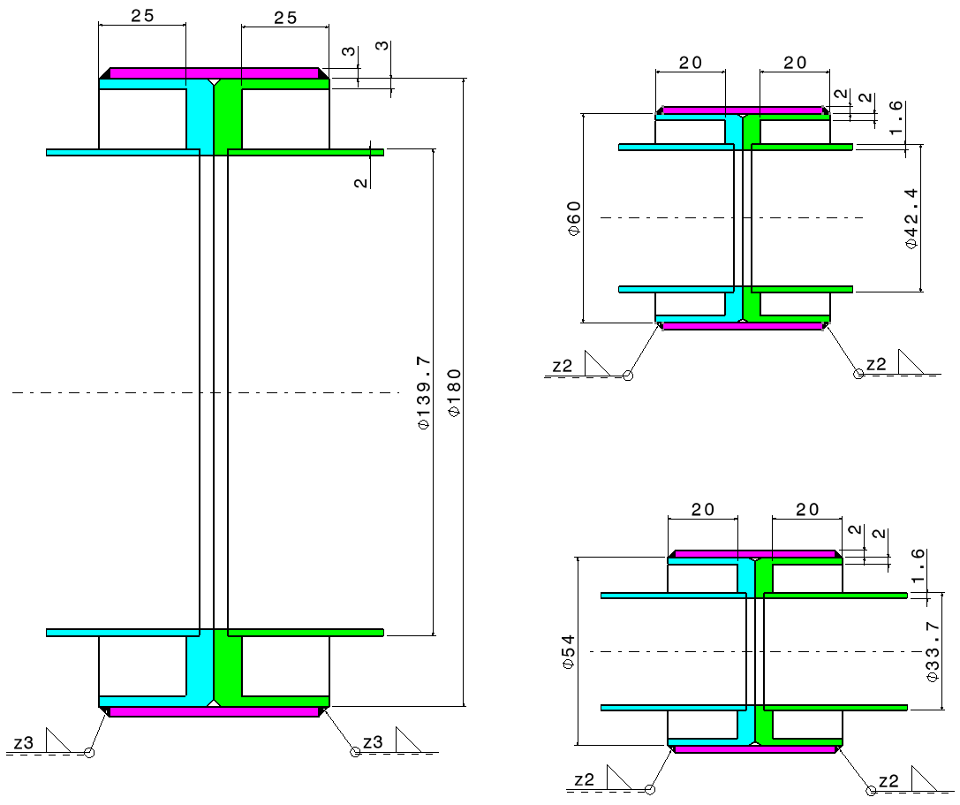
Tunnel integration
Welding of the cryolines sleeves
Sleeve
He Supply line
Easier to ensure the junction
4 times cut off
TS lines
2 welds per sleeve
VPL line

Slide 18
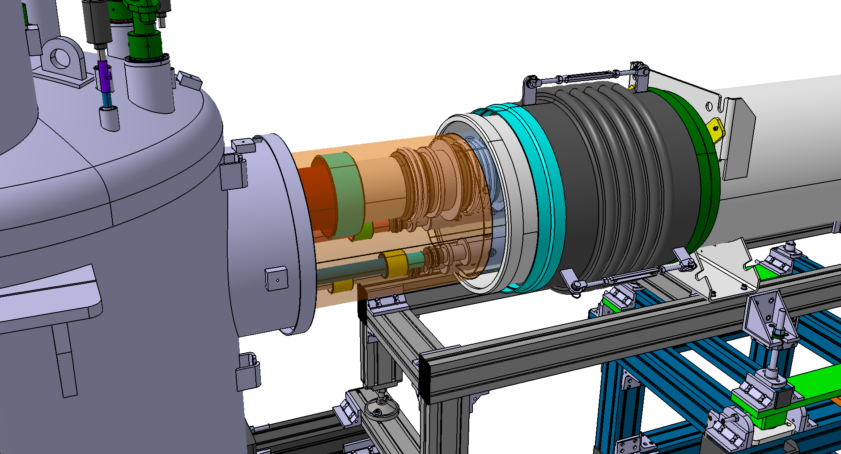
Tunnel integration
Closing after global pressure test
Thermal shield and MLI implementation

Slide 19
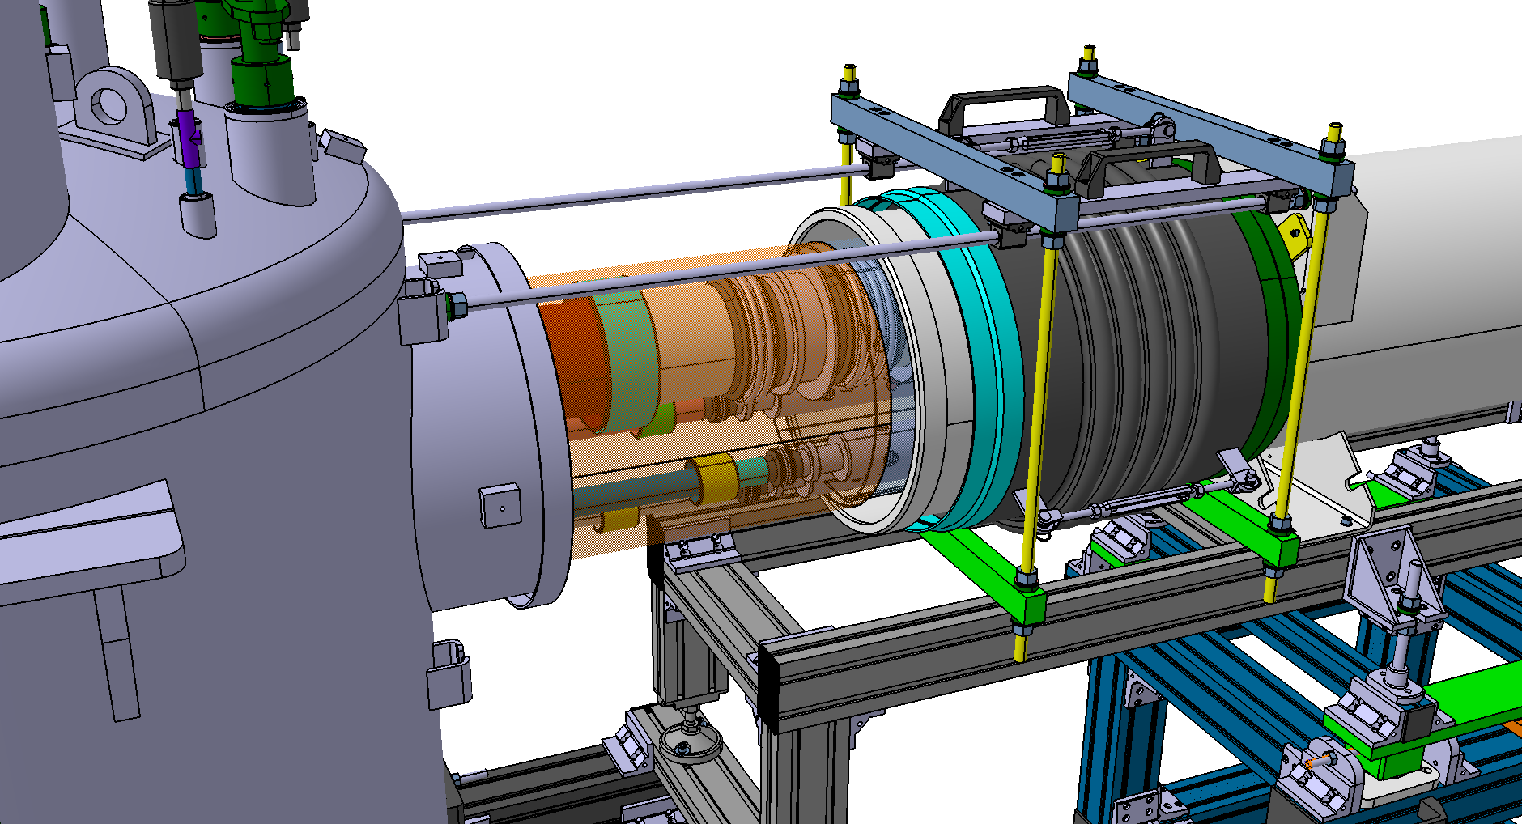
Tunnel integration
Closing
Dedicated tooling for sleeve translation

Slide 20
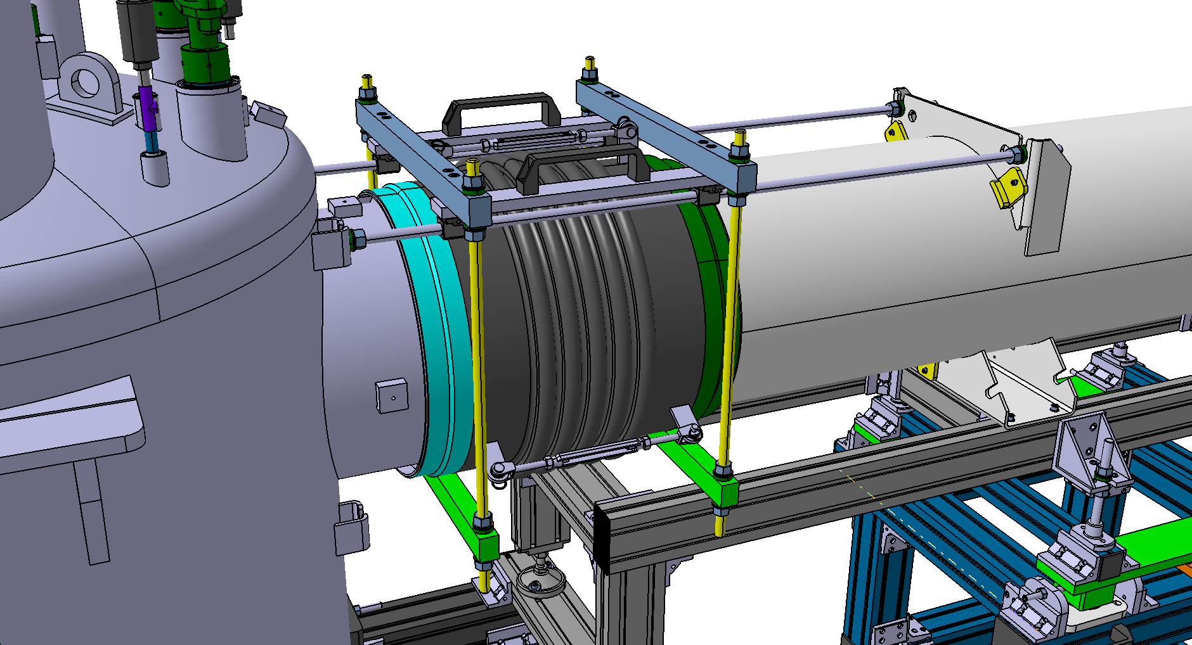
Tunnel integration
Closing

Slide 21
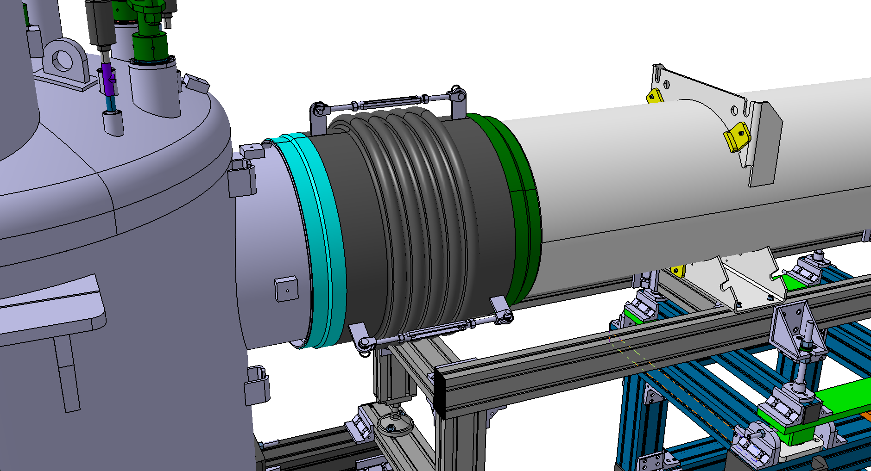
Tunnel integration
Closing
Removal of the tooling
Adjust
weld
weld

Slide 22
Tunnel integration
Closing
Removal of the tooling
1 m
2,2 m

Slide 23
Tunnel integration
Continue with the installation…

Slide 24
Thank you for your attention Special thanks to Syvain Brault (chief designer)
CSP12
28 Novembre 2014

