Slide 1
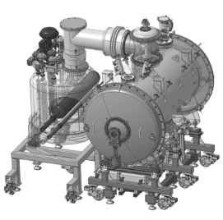
WP11: CDS-SL CDR Transport and instllation
April 20th 2017

Slide 2
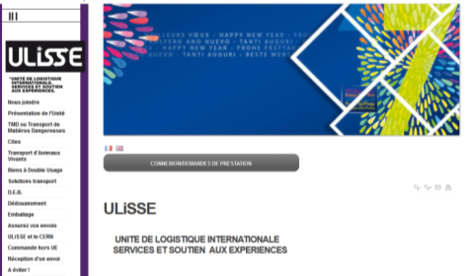
Transport
Transport operator
CNRS has a dedicated service for transport: ULISSE
http://ulisse.cnrs.fr/
Standard or customized packaging
Design of mechanical supports with dampers…
National/International transports (air, road, boat…)
Insurance. 3 (or 4) weeks after delivery for claiming for damages

Slide 3
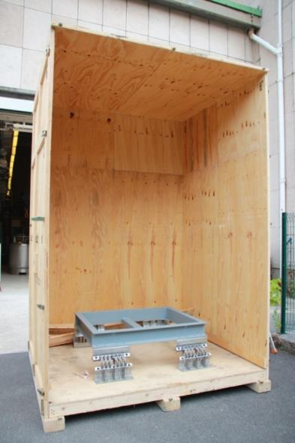
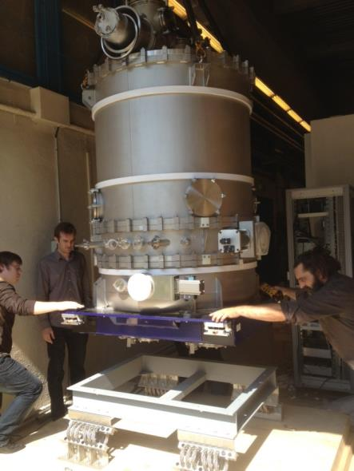
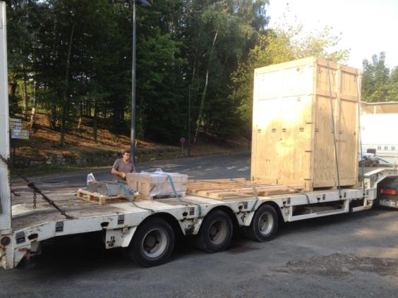
Transport
Transport operator
Our (IPNO) experience with ULISSE: SIRAL 2 (GANIL – Caen)
⇒ Transport of 7 cryomodules from Orsay to Caen (250 km by road)

Slide 4
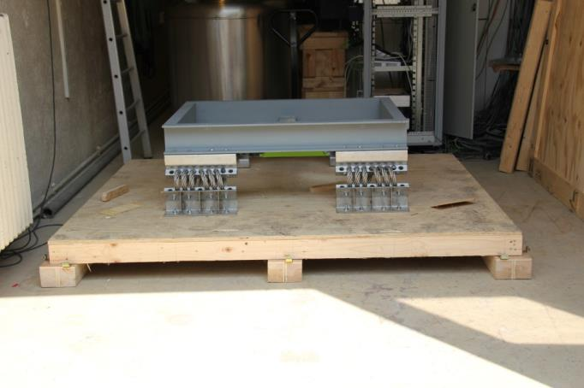
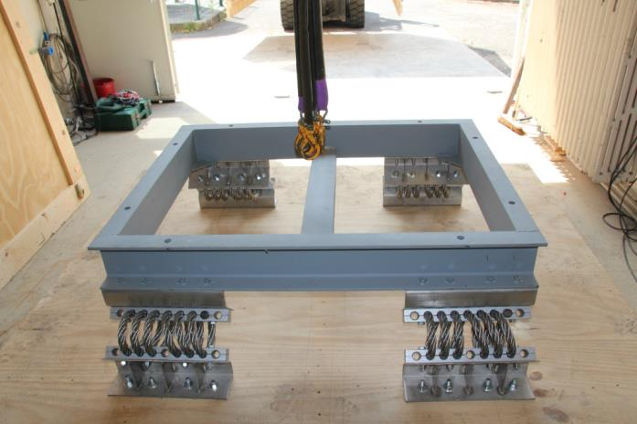
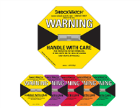
Transport
Transport operator
Our (IPNO) experience with ULISSE:
SIRAL 2 (GANIL – Caen)
Shock absorber mechanical frame
Data logger (MSR165) for shocks recording, P, T and H
⇒ frequencies > 20Hz were damped (coupler window is the weak part)
⇒ accelerations in X and Y directions (Horizontal) < 6g

Slide 5
Transport
Prototyping the transport
WP4:
Spoke cryomodule and test valve box have to be transported to Uppsala Univ.
ULISSE is in charge of the transport
ULISSE (sub contractor) is in charge of designing and providing the transport frame and box
This operation will be a test for the delivery of the Spoke series components (cryomodules and valve boxes)

Slide 6
Thank you for your attention
CSP12
28 Novembre 2014

