Slide 1
PDR of Master Oscillator
Anders Svensson 2017-04-28

Slide 2
Outline
Introduction
Concept and interfaces
Requirements
Reliability (Redundancy)
Rack layout and location
Design and implementation
Prototype Results
Benchmark
Project Plan

Slide 3
MO - Introduction
Primary timing and frequency source for ESS
Accurate timing information to the ESS timing system (EVG) based on 88.0525 MHz clock, 1 PPS and UTC information from GPS
Highly stable RF signals to LLRF and BPM, Syncronized to GPS
Located in the Gallery next to EVG and distributes reference to Phase Reference Line
High availability

Slide 4
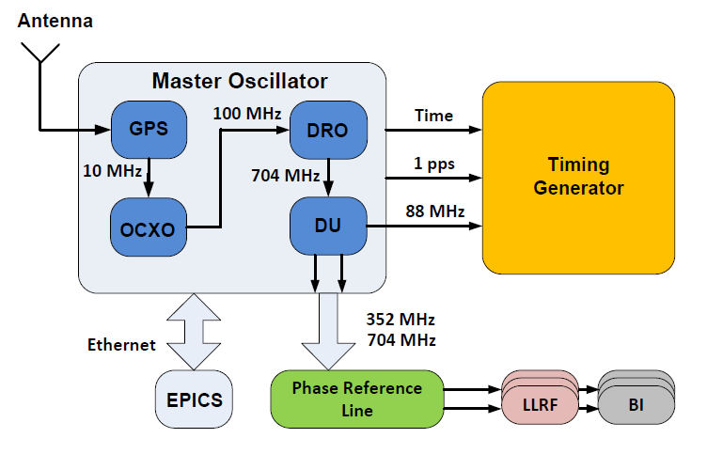
Concept
GPS disciplined Rubidium source
Crystal Oscillator (OCXO) with low close in phase noise
DRO running at 704 MHz for best phase noise performance
Distribution Unit (DU) delivers clock and RF signals
EPICS interface for monitoring and control

Slide 5
External interface
Interface | Type | Level | Details
GPS antenna input | 50 Ω coaxial | See x.xx | TNC jack, L1:1575.42 MHz
GPS Ref output | 50 Ω, BNC female | +13 dBm ± 2 dB | 10 MHz sinusoidal
AC supply | AC, 50 Hz | 230VAC | AC with UPS
RF signals 704.42 MHz 352.21 MHz | 50 Ω, N female 50 Ω, N female | +10 dBm +10 dBm | sinusoidal sinusoidal
Timing Generator 1 PPS 88 MHz UTC | 50 Ω, BNC female 50 Ω, N female IPv4/IPv6, RJ-45 | Positive TTL pulse + 10 dBm TBD - | 20 us, 1 ms, 100 ms or 500 ms widths sinusoidal or square Time and date information
Ethernet | IPv4/IPv6, RJ-45 | - | For monitoring and control

Slide 6
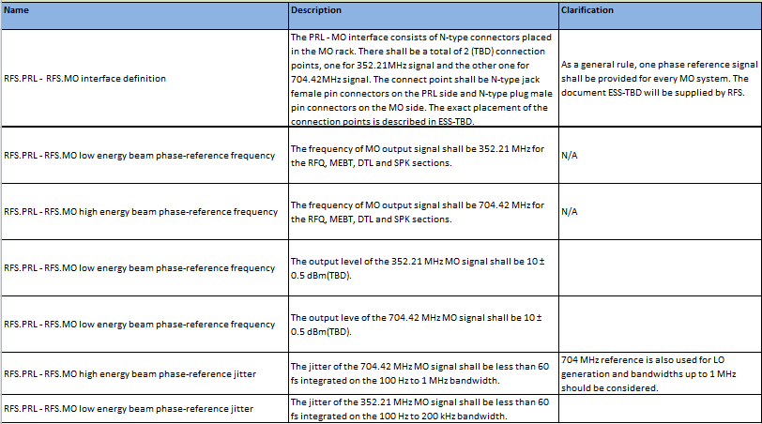
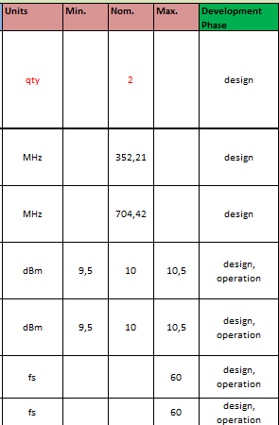
MO – PRL interface
Interface requirements to PRL:

Slide 7
MO performance requirements
Trade off between cost, complexity and performance
SNS performance comparison
System impact: LLRF and BPM
LO generation
PA noise

Slide 8
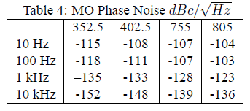

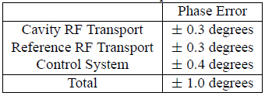
SNS performance
Phase noise performance:
Phase drift:
Part of MO phase drift
Reference Line:
Long term phase drift:
Source: THE SPALLATION NEUTRON SOURCE RF REFERENCE SYSTEM, M. Piller, M. Champion, M. Crofford, H. Ma, ORNL/SNS, Oak Ridge, TN 37831, USA
L. Doolittle, LBNL, Berkeley, CA 94720, USA

Slide 9
MO impact of LLRF performance
  MO reference jitter degrades LLRF stability performance
  Reference also used by LO generation units
REF to Cavity
LO to Cavity
1 MHz

Slide 10
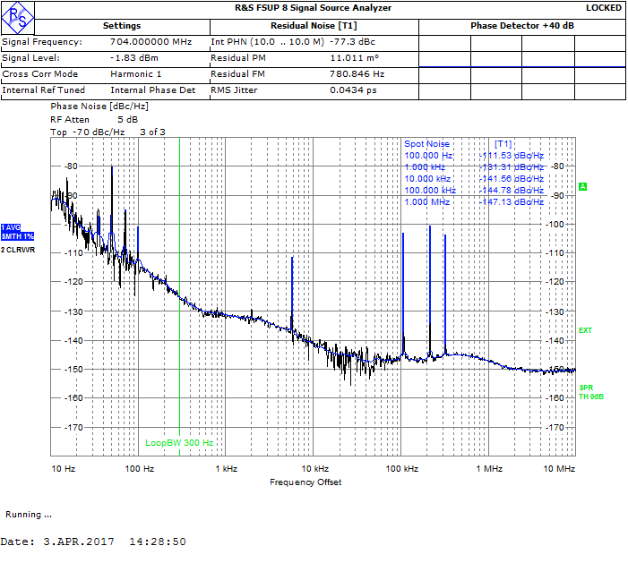
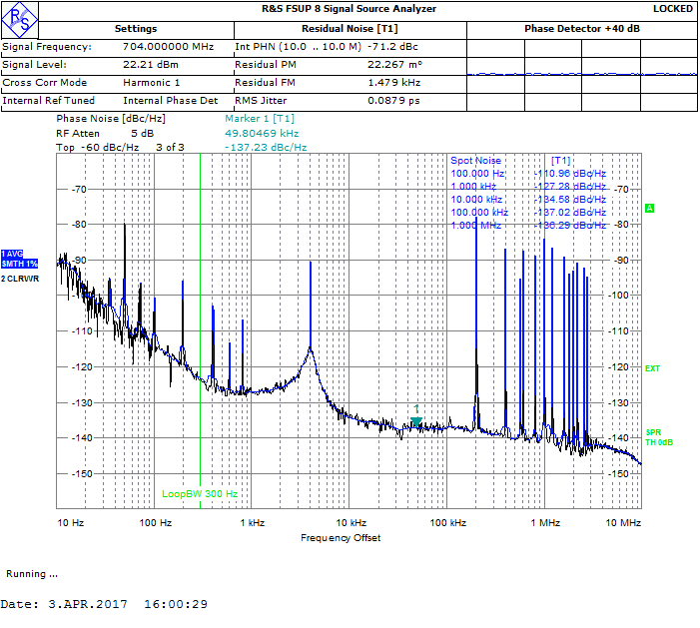
PRL Amplifier impact
MO output: +10 dBm (10mW)
PRL-line input power: ~+53 dBm (200W)
Amplifier adds spurious and noise, R&S BC500
Input
Output: 56 dBm

Slide 11
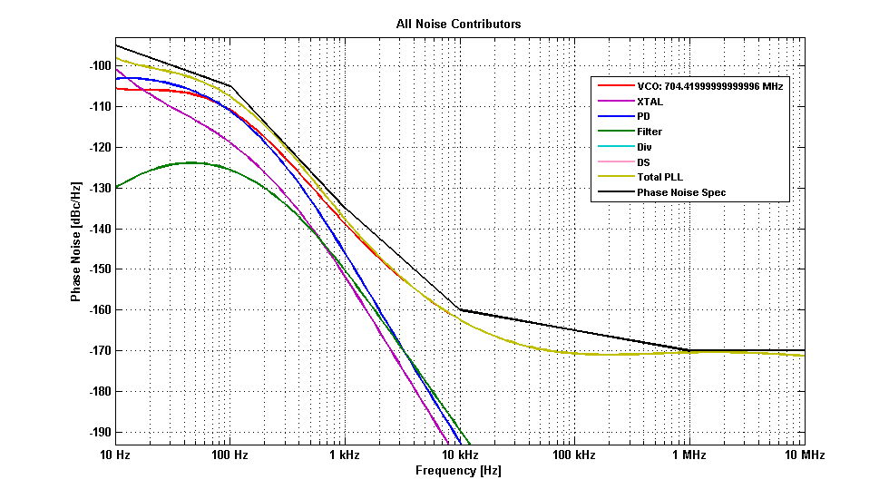
ESS performance
Target values:
Offset [Hz] | Phase Noise [dBc/Hz]
 | 88 MHz | 352 MHz | 704 MHz
10 | -110 | -98 | -92
100 | -123 | -111 | -105
1k | -148 | -137 | -135
10k | -156 | -150 | -155
100k | -162 | -156 | -160
1M | -162 | -158 | -165
DRO performance
BW | 88 MHz | 352 MHz | 704 MHz
10 Hz.. 1 MHz | 42 fs | 37 fs | 35 fs
100 Hz.. 1 MHz | 26 fs | 17 fs | 13 fs
Jitter RMS:
MO phase drift target:
between 352 and 704 MHz: < ± 0.05° (normalized to 704 MHz)

Slide 12
SNS performance (ESS)
Offset [Hz] | Phase Noise [dBc/Hz]
 | 88 MHz | 352 MHz | 704 MHz
10 | -110 | -98 | -92
100 | -123 | -111 | -105
1k | -148 | -137 | -135
10k | -156 | -150 | -155
100k | -162 | -156 | -160
1M | -162 | -158 | -165
Phase noise performance:
Part of MO phase drift
Phase drift:
Reference Line:
Long term phase drift:
Source: THE SPALLATION NEUTRON SOURCE RF REFERENCE SYSTEM, M. Piller, M. Champion, M. Crofford, H. Ma, ORNL/SNS, Oak Ridge, TN 37831, USA
L. Doolittle, LBNL, Berkeley, CA 94720, USA

Slide 13
Reliability
Redundancy -> high availability
Preventive maintenance
Design considerations
Analysis including amplifiers (PRL)

Slide 14
Rack location and layout
3 racks located in MBL-070 to get balanced power distribution of PRL
Two identical racks for reliability reasons, and third for EVG and switch panel
Rack1
Rack2
Rack3

Slide 15
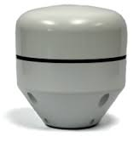
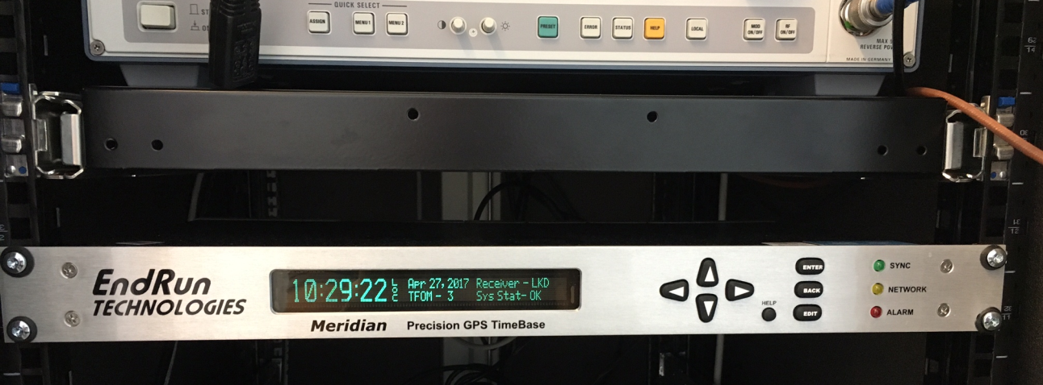
GPS
GPS disciplined Rb source
Ethernet and 1 PPS
Antenna outside the Gallery building and RF coax to receiver input

Slide 16
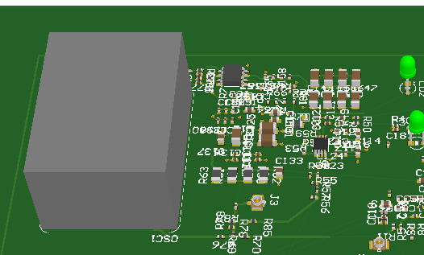
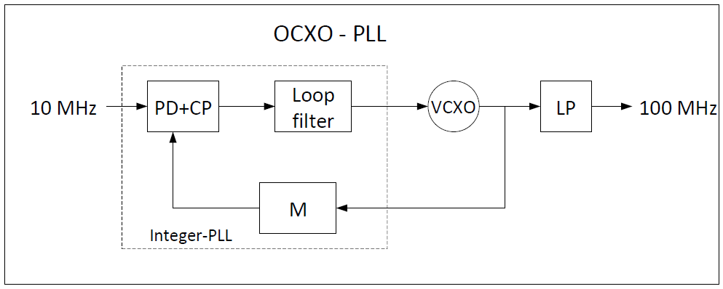
OCXO PLL
Generates 100 MHz from 10 MHz reference provided by Rb source
OCXO PLL design

Slide 17
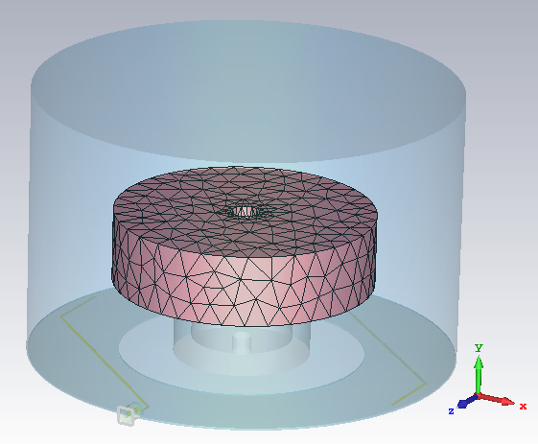
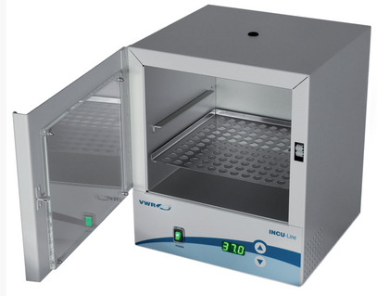
DRO PLL
Generates 704.42 MHz from 100 MHz reference provided by OCXO
DR in cavity
Stabilized temperature

Slide 18
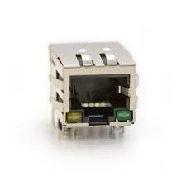
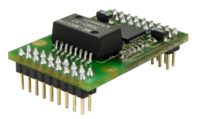
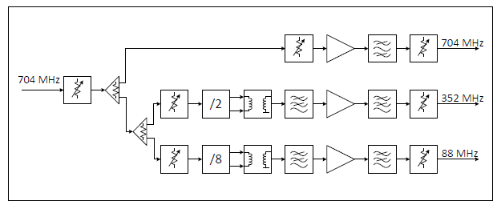
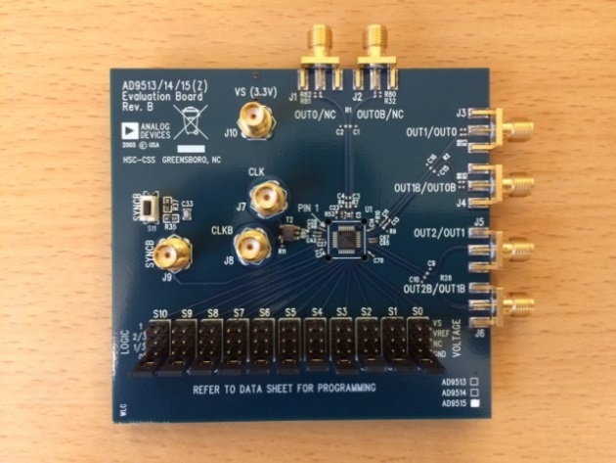
Distribution Unit (DU)
Provides 352 MHz and 88 MHz signals
Ethernet interface to EPICS using XT-Pico module
RF levels and temperature monitoring
XT-Pico
Serial number on chip
Connector
15 IO’s TTL
Distribution Unit
Voltage monitor
I2C bus
LEDs
5V, 1A
Divider AD9515

Slide 19
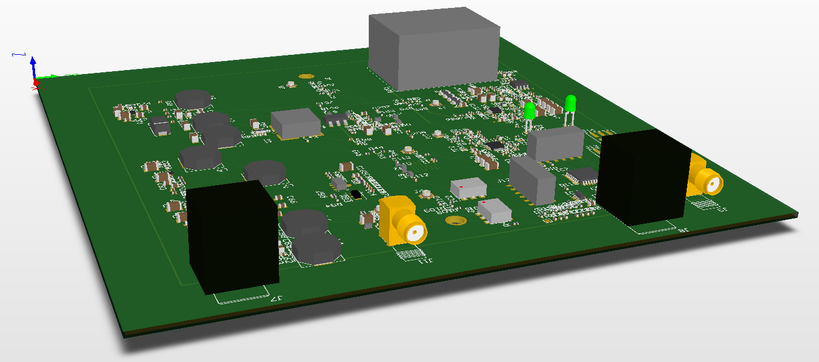
OCXO and DRO PCB
Same PCB for simplicity
  size 155 x 155 mm
  4-layers
Voltage regulators
Cavity feeds
DRO PLL
OCXO
µ-controller
10 MHz
Monitoring
704 MHz
DC input

Slide 20
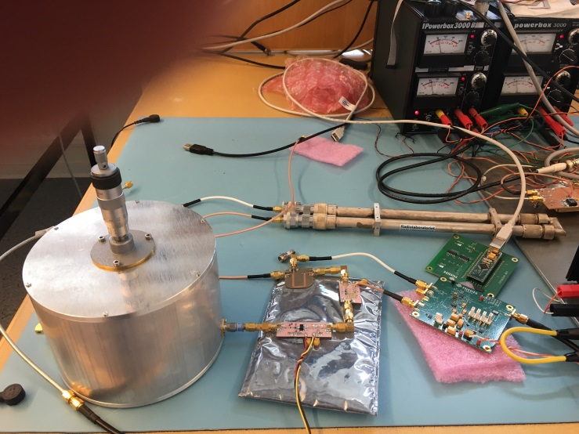
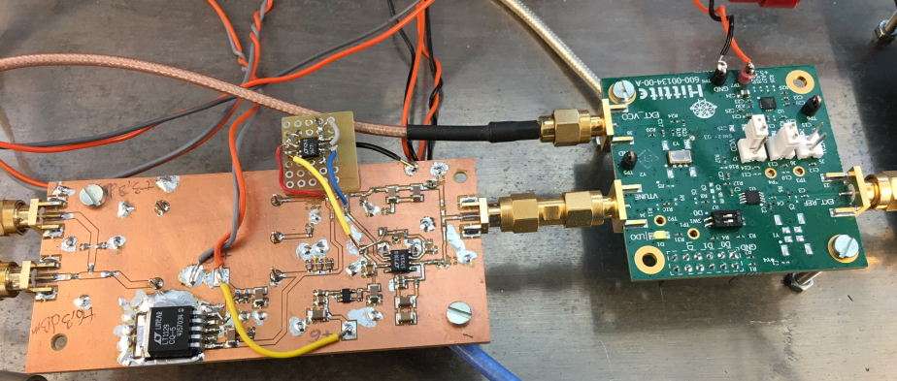
Prototype results
OCXO PLL
DRO PLL

Slide 21
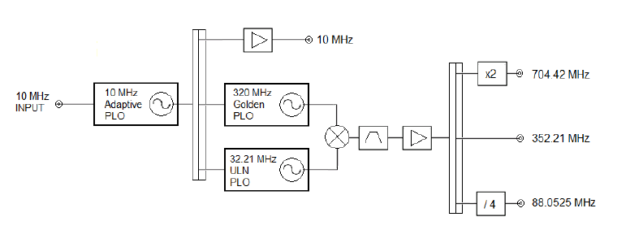
Benchmark - overview
Frequency generation provided by Wenzel
  SNS MO provided by same vendor
  3U standard 19” rack mount
  Monitoring over EPICS not supported

Slide 22
Benchmark – performance and cost
Performance sligthly better than ESS design
Frequency | 88 MHz | 352 MHz | 704 MHz
Offset [Hz] | Phase noise [dBc/Hz] | Phase noise [dBc/Hz] | Phase noise [dBc/Hz]
100 | -125 | -121 | -115
1k | -153 | -149 | -143
10k | -165 | -166 | -160
100k | -165 | -171 | -165
HW cost
GPS and switch panel monitoring not included
HW cost | Wenzel | ESS design
3 units | $134.000 | €20.000

Slide 23
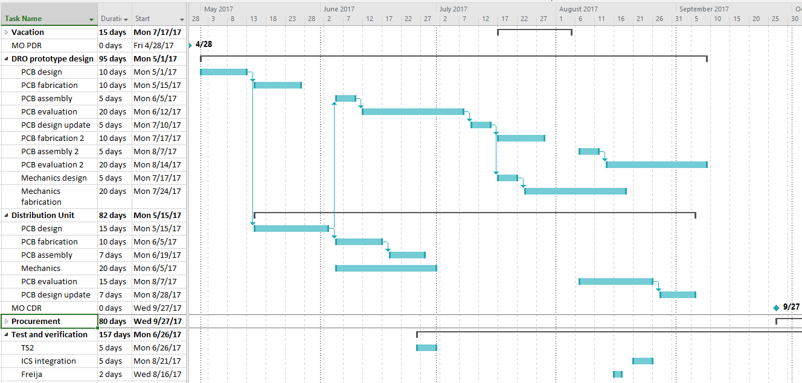
Project Plan - Design
PDR: 28-April
CDR: 27-Sep

Slide 24
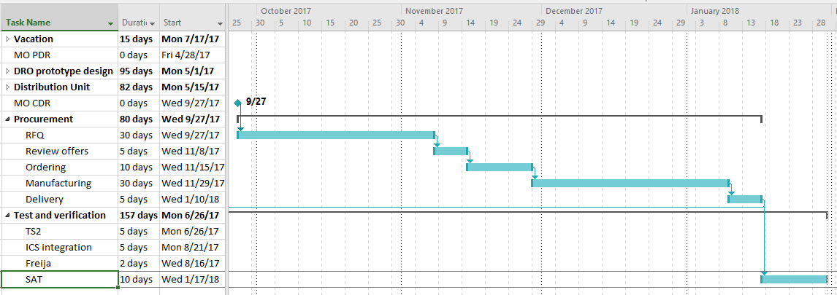
Project Plan - Procurement
Procurement: starts after CDR and ends 10-Jan
SAT: end of January 2018

