Slide 1
SULF - user lab facilities - now and in operation Monika Hartl
www.europeanspallationsource.se
STAP Users and Samples
December 12-13, 2016

Slide 2
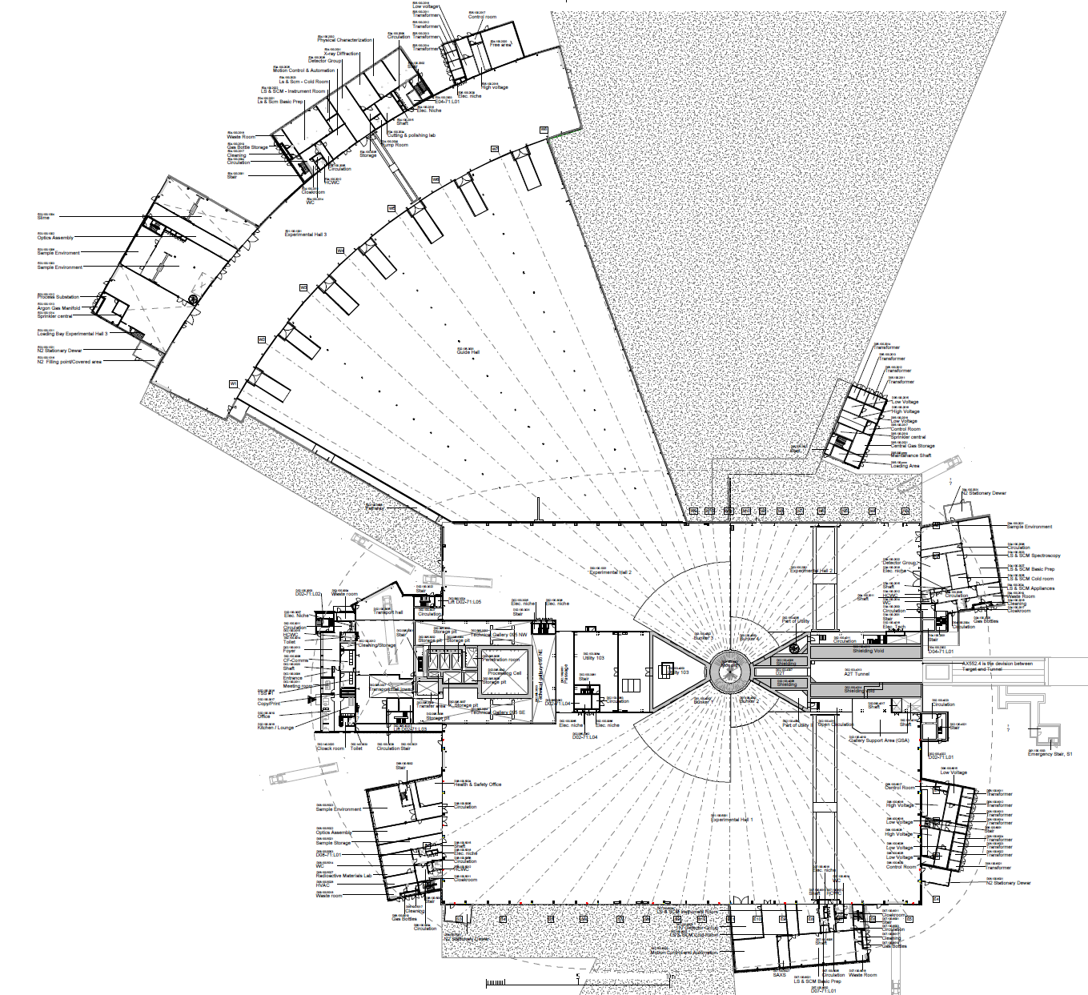
2019/2020: NSS Proposed Access Dates
1
D08 RML Lab – Early Access 10-Jan-19 (Level 1b MS)
May 2019
E05
2a
E01 – Full Access 27-Apr-19 (Level 1 MS)
E04
2b
E02 Area 1 – Partial Access 27-Apr-19 (Level 1 MS)
3
D03 Bunker – * Early Access 03-Jun-19 (Level 1 MS)
May 2019
E01
2a
4
D01 Bunker – * Early Access 14-Aug-19 (Level 1 MS)
E03
5
E02 Area 2 – Partial Access 15-Oct-19 (Level 1b MS)
2b
6
D03 Main Hall – Partial Access 01-Nov-19 (Level 1b MS)
E02
7
D01 Main Hall Ph 1 – Partial Access 06-Jan-20 (Level 1b MS)
5
8
D01 Main Hall Ph 2 – Partial Access 02-Mar-20 (Level 1b MS)
D05
D04
Aug. 2019
6
3
4
D06
D08
Early acess: Jan 2019
Complete: Dec. 2019
8
1
7
Dec. 2019
D07

Slide 3
VALUE ENGINEERING
ONLY D07 delayed by 18 months
Remaining lab buildings will be completed as planned
Priority issue:
Level 100: LS&SCM prep lab + appliance/instrument was no. 3 on list to serve instruments in D02
Try to keep “cash” to fit it out as soon as it is ready

Slide 4
Priority list – this is what we should be able to afford
D08, level 100 – RML
E04, level 100 – Basic chem. prep lab + (instrument + appliance room)
D07, level 100- LS&SCM prep lab + instrument +_appl. + walk-in freezer
D04, level 100 – LS&SCM Basic Prep lab + appliances + cold room
D08, level 110 - Basic chem. prep lab
E04, level 100 – Physical characterization lab (could be basic prep)

Slide 5
Priority list – this is what we are likely not to be able to afford
D08, level 110 – furnace room
D08, level 110 – Glass sealing
------------------------------------------------
D04, level 100 – instr. Room for LS & SCM prep lab,
D08, level 110 – Thin film, appliances, instruments
D04, level 110 – Chem. Basic prep
E04, level 100 – Cold room for the LS&SCM
E04, level 110 – Basic Chem. Lab
E04, level 100 – X-ray Lab (+2 rooms)
---------------------------------------------
D07, level 100- LS&SCM prep lab + instrument +_appl. + walk-in freezer
D07, level 100 – SAXS

Slide 6
Comments to general lab drawing
More shelves, less cabinets up top
Some long (double) cupboards
More cabinets than drawers, 1 set of drawers per bench at least
Drawers of several heights, deep drawers very useful
Some chairs not too many
Wheels with locks would be preferred
Scratch chemical cupboards, glass cabinets instead for glassware
Eye-wash on sinks are missing, safety shower missing
D07, level 100 – SAXS

Slide 7
Comments to general lab drawing
Gas lines, vacuum, power points are missing outside of hoods
Overhead exhaust: possibly reduce to 2 instead of 3
one acid fume hood/general lab
Mili-Q in main labs at the sink, DI water in appliance room for dish washers (see house DI system for all buildings)
Make sure there is room for user equipment
Leave one double bench open for equipment (center, close to door)
Figure out how to clean lab coats (survey? autoclave?)

Slide 8
Comments to general lab drawing
Lockers for users in the coat area
Do the windows open?
One balance bench/prep lab enough
Fire extinguisher/blanket will be decided by ESH
Dishwashers are in the main lab => need to be on separate fuse
Appliance room: fridge/freezer/sonicator/centrifuge; Lab: dishwasher/ice maker;

Slide 9
RML (D08, 100)
Change-over area: Possibly removable barrier in form of seat
Glove boxes: sizes unknown, but should provide for largest possible
Switch glove box position,
Half-height wall between GB and door, use for hooks/ containers for PPE
Mobile island,
Think about nuclear storage
One acid –fumehood
Additional shelving on top of benches
Fire escape route needs to be discussed with ESH
Need sink in RML, but on bench
Gases in fumehood
Space for Ar gas cylinder for glove boxes
Ceiling power panel in middle of room
Oxygen-alarm (gamma spec – detector cooling), move gamma spec to bench
HVAC system and negative air

Slide 10
Furnace room (D08, 110)
Need to figure out how to remove the gases (point extraction, walkable hoods, …?)
One side: walkable hood, only 50% benches, rest empty
Gas monitoring system needed in this room;
4 overhead extraction points available – how many “walkable hoods”?

Slide 11
Thin Film Lab (D08, 110)
Missing: lab sink at end of bench
Discuss storage space at a later point

Slide 12
Glas Sealing(D08, 110)
Missing: 1 fume hood (regular)
Need flammable/extracted cabinets for gas cylinders (O2, CH4, H2)
No benches on side of hood
Potentially ATEX rated exhaust.

Slide 13
E04, level 100, LS&SCM + instr/appliance
Here instrument/appliance room are one room
Window is dark for spectroscopy
Light for room will be regular
Cold room will come later, D04 cold room first.
Under-bench ice maker next to under-bench dishwasher
Get rid of biosafety cabinets – put glassware cabinets
Need: furnace, MQ water, drying cabinet for glass,
Middle bench should not have hanging cabinets at the end
DSC/TGA goes into glass blowing lab
O3 cleaner for substrates goes into ThinFilm lab
Instr.room: put lab sink, move -80 freezer to wall to cold room, just have a straight bench along the wall,

Slide 14
Basic Prep (D04, 100)
Remove biosafety cabinet.
Rheometer/will come later
Remove overhead exhaust at bench right
Appliance room: move benches to right side, 24/25/26 to the left side. No benches opposite of the freezer.
Spectroscopy room: benches with one sink in corner, shelves as in picture

Slide 15
Basic Prep (D08, 110)
Overhead fume hood extraction (-2?)
NEED more fridge/freezer space – move SQUID to ?? Put in one fridge, one freezer
Need ice machine
Replace one of hand sinks with emergency shower

Slide 16
Phys Charac (E04, 100)
Keep wall free for glove boxes
Keep right half on wall empty for SQUID or other large equipment.

