Slide 1
Accelerator Technologies
SRF Proton Accelerator
Christine Darve
Nordic Particle Accelerator School, NPAS2017
https://npap.eu/
Lund University
August 18, 2017

Slide 2





References
ESS SRF Collaborations:
US-Particle Accelerator School, http://uspas.fnal.gov/materials/materials-table.shtml
CERN Accelerator School, http://cas.web.cern.ch/cas
JUAS, https://espace.cern.ch/juas/SitePages/Home.aspx
Few books
RF Linear Accelerators, T.P. Wangler, Wiley, 2008
RF Superconductivity for Accelerator, H. Padamsee, J. Knobloch, T. Hays, Wiley, 2011
An introduction to particle accelerators, E.J.N. Wilson, Oxford Univ. Press, 2001
An introduction to the physics of high-energy accelerators, D.A. Edwards & M.J. Syphers, Wiley, 1993
Project example: ESS SRF Linac Collaborative Space: https://confluence.esss.lu.se/display/CRYOM

Slide 3
Outline
  Accelerator ingredient
  Accelerator Environment: Superfluidity and Superconductivity
  Application to Cavity:
    Cavity model
    SRF cavity fabrication
    Cryomodules function
    Cavity package
    Cryomodules
  Application to Magnet: cryo-magnets at LHC
Notes:
Zoom in ( previous talk on magnets and cavity)

Slide 4
Proton Accelerator Main Ingrédients
    1- Ion Source to produce the charged particles to be accelerated
    2- Accelerating structures to accelerate charged particles –
    see Anders &Mamad’s talks
    3- Magnets are used to bend and focus the particle trajectories –
    see Sverker and Franz’s talks
    4- Vacuum chamber to minimize scattering of the beam particles by gas particles – see Pauli’s talk
    5- Cooling systems to remove the heat dissipated in accelerator components; use of superconducting magnet and cavity – see this talk
    6- Beam diagnostics to provide information about the beam intensity (current), position, beam profile and beam loss – see Maja’s talk
    7- Control system to record and control each equipment – see this talk

Slide 5
Example of Linear Accelerator design
NC FE
Spoke
M-β
H-β
352.21 MHz
704.42 MHz
2.4 m
4.6 m
3.8 m
39 m
56 m
77 m
179 m
Target
Source
LEBT
RFQ
MEBT
DTL
Spokes
Medium β
High β
HEBT & Contingency
75 keV
3.6 MeV
90 MeV
216 MeV
571 MeV
2000 MeV
Key parameters:
    → 5 MW average beam power
    2.86 ms long pulses
    2 GeV
    62.5 mA peak
    14 Hz
    4 % duty cycle
    Protons (H+)
    Minimize and recycle energy use
    Flexible design for mitigation & future upgrades
Style | Spoke | Medium-β | High-β
Frequency (MHz) | 352.21 | 704.42 | 704.42
Number | 26 | 36 | 84
Acc. gradient (MV/m) | 9 | 16.7 | 20
β_geo | 0.5 | 0.67 | 0.86
Velocity range | 0.42 to 0.58 | 0.58 to 0.78 | 0.78 to 0.95
Distance (m) | 56 | 77 | 179
[SRF2013 – “The ESS Superconducting Linear Accelerator”, C. Darve, M. Eshraqi, M. Lindroos, D. McGinnis, S. Molloy, P. Bosland and S. Bousson]
Notes:
312 m SC+ 50 m NC
400 m/ 600 m tunnel = SRF
CO2 neutral..

Slide 6
A cold technology environment
More than 95 % of the ESS accelerator depends on the success of Superconducting RF (SRF) Cavity technology !!
Cryogenics environment is needed to achieve larger SRF cavity gradients, hence shorter Linac and lower operating cost (effective at long term).
20 tons of “cold mass” to lower to 2 K: i.e. SRF cavities housed in cryomodules
Helium cryoplant capacity: 3 kW at 2 K, 11 kW at 40 K plus liquefaction
LHe and LH₂ main risk: expansion of a factor 700 !
Notes:
3kW at 2 K, 10.8 kW at 40 K and 9 g/s
liquefaction capacity for power coupler cooling.
Energy storage – magnet …. Gjoule, LHC example,

Slide 7
Outline
  Accelerator ingredient
  Accelerator Environment: Superfluidity and Superconductivity
  Application to Cavity:
    Cavity model
    SRF cavity fabrication
    Cryomodules function
    Cavity package
    Cryomodules
  Application to Magnet: cryo-magnets at LHC
Notes:
Zoom in ( previous talk on magnets and cavity)

Slide 8
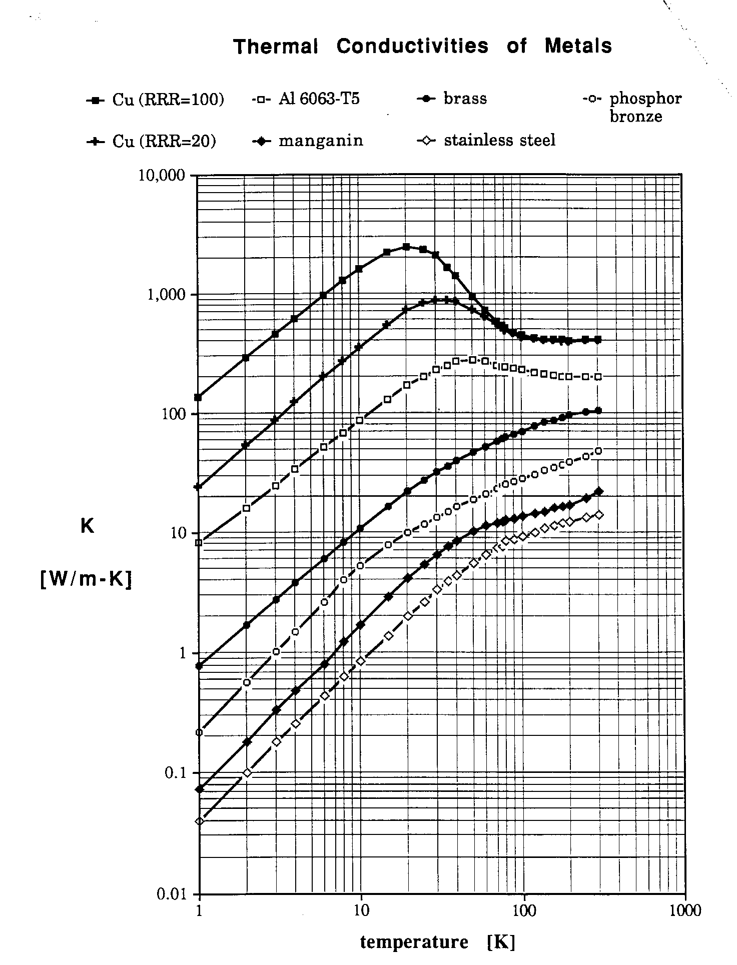
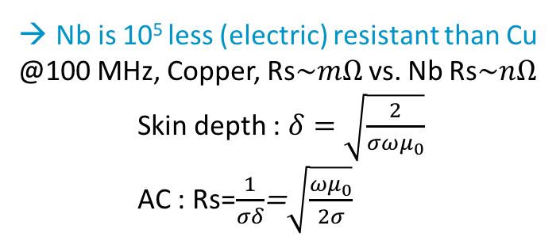
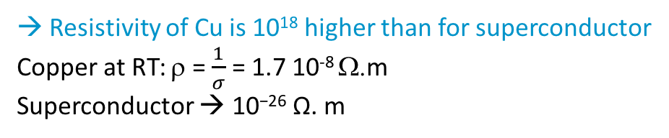
Why SC cavity and magnet ?
→ @ 2 K, He is 2.10³ more (heat) conductive than Cu
→ Resistivity of Cu is 10¹⁸ higher than for superconductor
Copper at RT: ρ = $\frac{1}{σ}$ = 1.7 10⁻⁸ Ω.m
Superconductor → 10^{﻿−﻿26} Ω. m
Nb is 10⁵ less (electric) resistant than Cu
@100 MHz, Copper, Rs$\sim mΩ$vs. Nb Rs$\sim nΩ$
    Skin depth : $δ=\sqrt{\frac{2}{σ{ωμ}_{0}}}$
    AC : Rs=$\frac{1}{σδ}$=$\sqrt{\frac{{ωμ}_{0}}{2σ}}$

Slide 9
Cooling with Helium
➔ Helium (25 %) is the most common element in Universe after Hydrogen (73 %)
➔ Two isotopes: ³He (fermion) & ⁴He (boson)
Boiling helium I (normal helium)
  1 W/cm² in nucleate boiling with 0.5 K temperature rise to the object surface so equivalent to 2 W/cm²K
Forced convection helium I
  Convection coefficients on the order of
  0.1 W/cm²K
Saturated helium II (superfluid helium)
  1 W/cm² heat transport to the surface without bubbles
Pressurized helium II
  Kapitza conductance about 0.6 W/cm²K
Tevatron operation
LHC operation

Slide 10
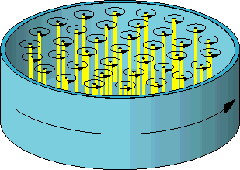

Superfluidity Helium- The two-fluid model
Normal-fluid fraction:
excited states atom (phonons & rotons)
➔ like a conventional viscous fluid
finite density , r_{n}
finite viscosity, η
entropy, s
Superfluid fraction:
- atoms that have undergone BEC
➔ like an ideal inviscid liquid resulting in the absence of classical turbulence.
finite density, r_{s}
NO viscosity
carry NO entropy
irrotational behavior for an inviscid fluid
but vortices can be generated in the superfluid component
Macroscopic quantum physic system simplification
The two-fluid model is only a phenomenological model !
Quantized vortices
Counter-flow turbulence

Slide 11
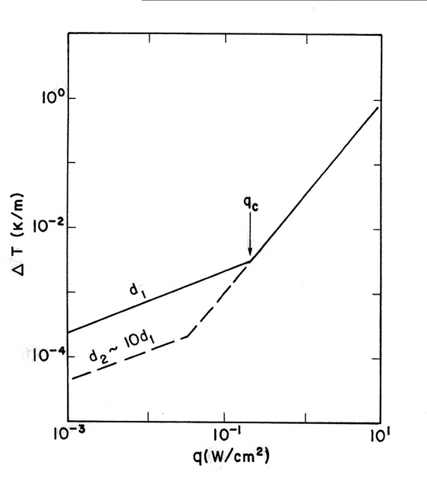
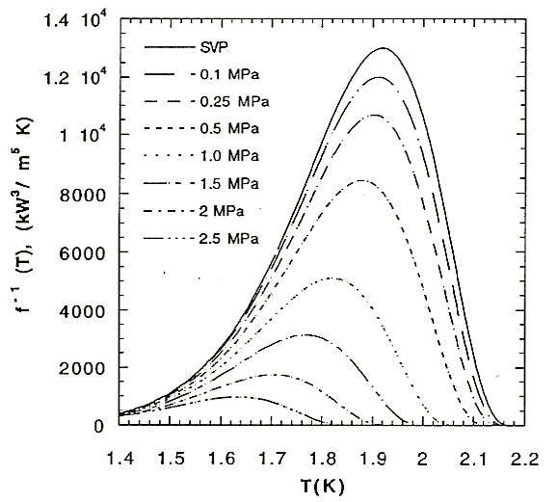
Thermal conductivity of helium II
Heat transport regimes at 1.9 K
Thermal resistivity function
e.g. d > 1 mm, q > 10 mW/cm²
Low flux regime dT/dx ~ q
In mutual friction regime:
Mutual- friction regime
Laminar
High flux regime
dT/dx ~ q³
Turbulent
A_{GM} Gorter-Mellink mutual friction parameter
Internal convection of the super-fluid and normal-fluid components
Counter-flow mechanics
No bulk flow
Heat flux
Notes:
D1~ 10 micron for 10-4K/m
Cu (@3.6 K) = 1.2 W/cm^{2 ;} He I (@3.6 K) = 3.6 e-6 W/cm²
Cu (@1.9 K) = 1.6 W/cm^{2 ;} He II (@ 1.9 K) = 24 W/cm²
Heater changes super fluid
into normal. More super
flows through plug
increasing pressure in
container, and fluid squirts
out top in a fountain

Slide 12
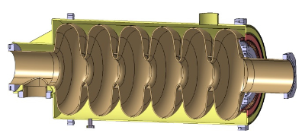
Perfect cooling for Magnets & SRF
Superconducting magnets are often cooled with subcooled liquid
  Typically working near the limit of the superconductor with large stored energy
  Ensure complete liquid coverage and penetration
Superconducting RF cavities are generally cooled with a saturated bath
  Large surface heat transfer in pool boiling for local “hot spots”
  Stable pressures, avoid impact of pressure variation on cavity tune (vs. He I)

Slide 13
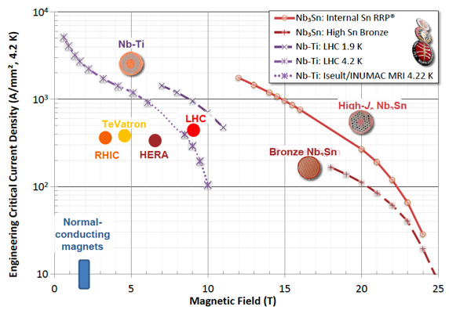
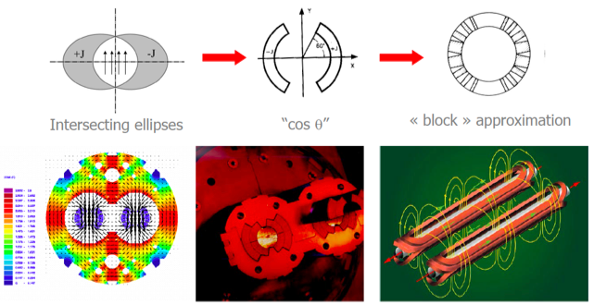
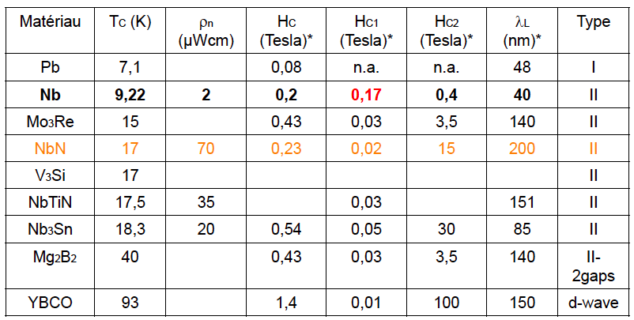
Superconducting magnets

Slide 14
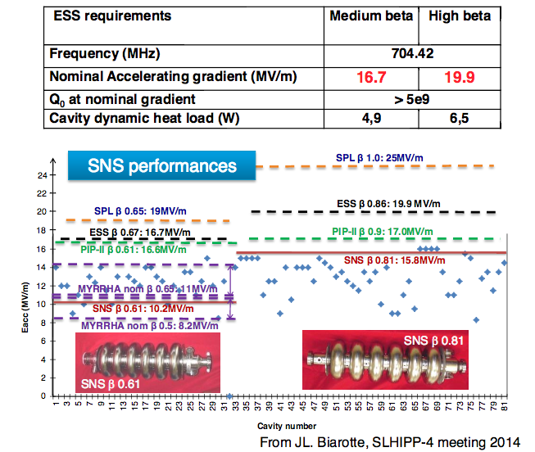
Superconducting cavities

Slide 15
Outline
  Accelerator ingredient
  Accelerator Environment: Superfluidity and Superconductivity
  Application to Cavity:
    Cavity model
    SRF cavity fabrication
    Cryomodules function
    Cavity package
    Cryomodules
  Application to Magnet: cryo-magnets at LHC
Notes:
Zoom in ( previous talk on magnets and cavity)

Slide 16
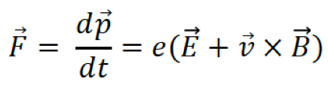
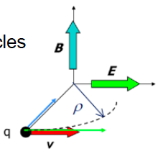
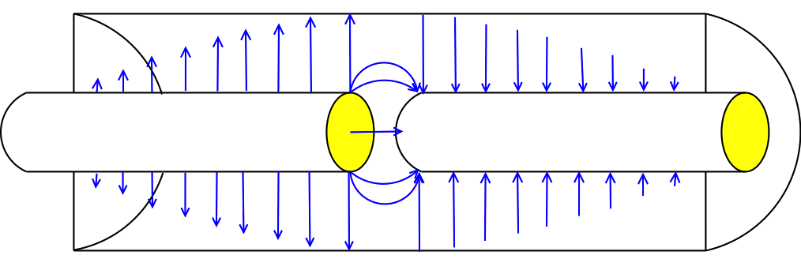
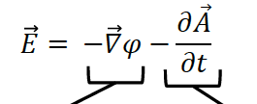
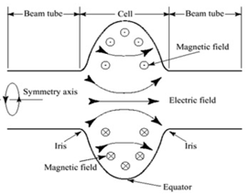
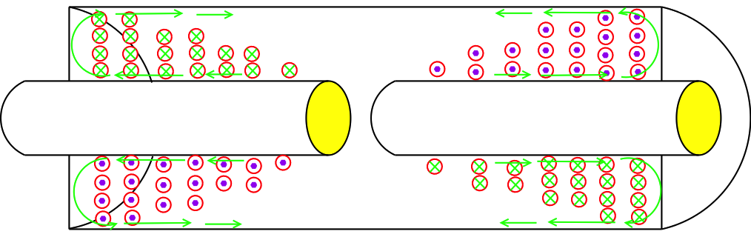
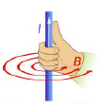

Particle Accelerators need RF Cavity
(see Anders’s talk)
ElectroMagnetism – Lorentz and Maxwell
Cavity
Magnet
Electric Field
DC
AC
Magnetic Field
Out
In
Wall Current
(For the fundamental mode at one instant in time)
Notes:
ADD 3 FINGERS..

Slide 17
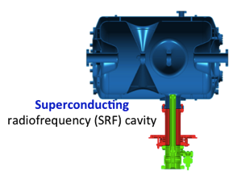
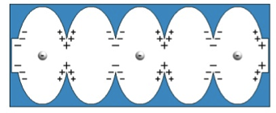
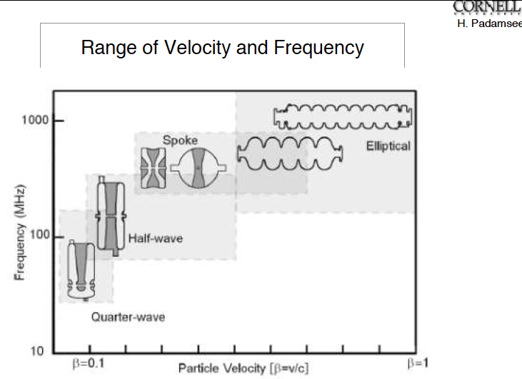


Recall: RF Cavity shape
352.21 MHz
704.42 MHz
2.4 m
4.6 m
3.8 m
39 m
56 m
77 m
179 m
Target
Source
LEBT
RFQ
MEBT
DTL
Spokes
Medium β
High β
HEBT & Contingency
75 keV
3.6 MeV
90 MeV
216 MeV
571 MeV
2000 MeV
Small β
Spoke cavity
High β: Elliptical cavity
Electrical field line of a pi mode
Equivalent circuit for a 4 cell cavity with beam pipe

Slide 18
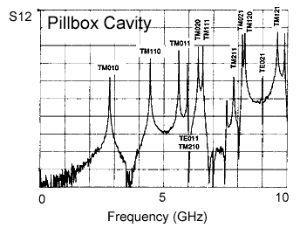
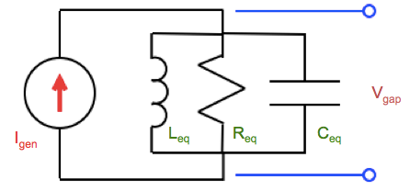
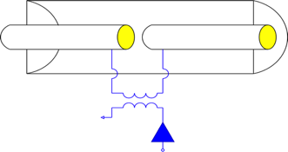
RF Cavity - RLC Model for Cavity Mode
Around each mode frequency, we can describe the cavity as a simple RLC circuit.
EM fields enclosed in a cavity with resonant frequency matching that of RF generator
Gap
Beam
Waveguide
R_{eq} is inversely proportional to the energy lost
L_{eq} is proportional to the magnetic stored energy
C_{eq} is proportional to the electric stored energy
Power Coupler
RF Input
Power Amplifier
(Klystrons)
Position:
Amplitude:
Width
Function of geometry and cavity material
Function of geometry

Slide 19

RF Cavity
RLC Parameters for a Transmission Line Cavity
For the fundamental mode of the transmission line cavity:
The transfer impedance of the cavity is:

Slide 20
Cavity Quality factor
If the cavity walls are lossless, then the boundary conditions for a given mode can only be satisfied at a single frequency.
The Quality factor is defined as:
Normal conducting → 10⁴
Superconducting → 10¹⁰

Slide 21
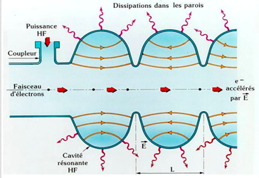
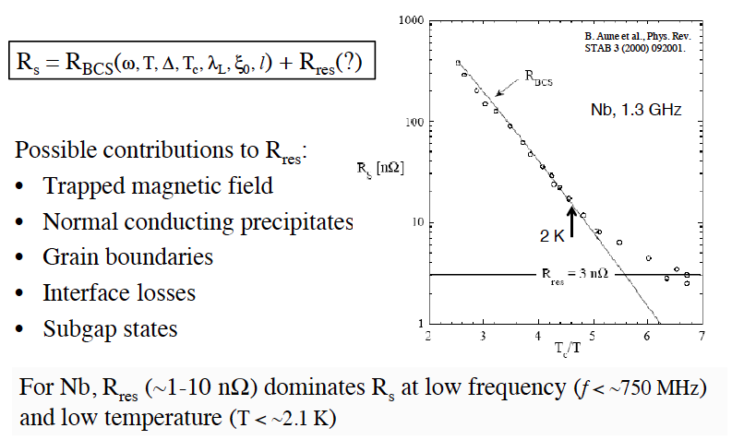

SRF Cavities Performances
Courtesy Ciovati
Few limitations of performance:
Thermal Breakdown, alias quench
Field Emission: Electron induced by an electrostatic field
Multipacting: secondary electron emission in resonance avalanche
How to limit power loss in the cavity wall ?
By using low-resistant material or superconductors
By rounding the shape to optimize the field distribution
Limit shape edge to prevent field emission
Good vacuum to limit breakdown
Notes:
Shunt impedance – R/Q = Vˆ2 / wW
W is the maximum energy stored.

Slide 22
Outline
  Accelerator ingredient
  Accelerator Environment: Superfluidity and Superconductivity
  Application to Cavity:
    Cavity model
    SRF cavity fabrication
    Cryomodules function
    Cavity package
    Cryomodules
  Application to Magnet: cryo-magnets at LHC
Notes:
Zoom in ( previous talk on magnets and cavity)

Slide 23
ESS Requirements and RF Parameters
Spoke cavities
Elliptical cavities
Frequency (MHz) | 352,2
Optimum beta | 0,50
Operating temperature (K) | 2
Nominal Accelerating gradient (MV/m) | 9
Lacc (βopt.x nb gaps x λ/2) (m) | 0,639
Bpk (mT) | 79 (max)
Epk (MV/m) | 39 (max)
Bpk/Eacc (mT/MV/m) | <8,75
Epk/Eacc | <4,38
Beam tube diameter (mm) | 50
RF peak power (kW) | 335
G (Ω) | 130
Max R/Q (W) | 427
Qext | 2,85 10⁵
Q0 at nominal gardient | 1,5 10⁹
 | Medium | High
Geometrical beta | 0.67 | 0.86
Frequency (MHz) | 704.42
Number of cells | 6 | 5
Operating temperature (K) | 2
Epk max (MV/m) | 45 | 45
Nominal Accelerating gradient (MV/m) | 16.7 | 19.9
Q₀ at nominal gradient | > 5e9
Q_{ext} | 7.5 10⁵ | 7.6 10⁵
Iris diameter (mm) | 94 | 120
Cell to cell coupling k (%) | 1.22 | 1.8
p,5p/6 (or 4p/5) mode sep. (MHz) | 0.54 | 1.2
Epk/Eacc | 2.36 | 2.2
Bpk/Eacc (mT/(MV/m)) | 4.79 | 4.3
Maximum. r/Q (W) | 394 | 477
Optimum β | 0.705 | 0.92
G (Ω) | 196.63 | 241
RF peak power (kW) | 1100

Slide 24
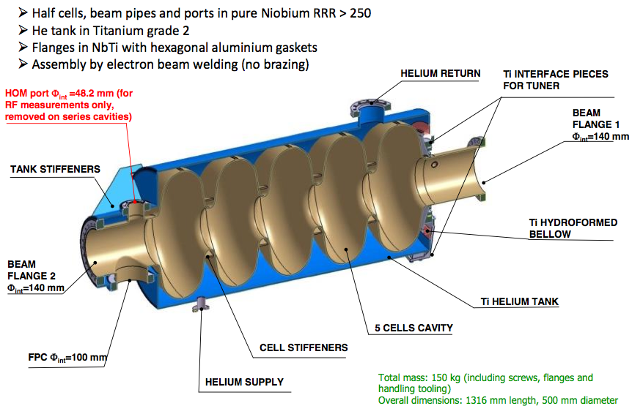
Design: ESS High-beta cavity

Slide 25
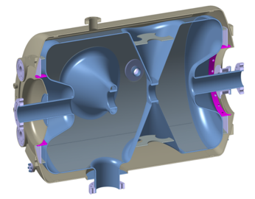
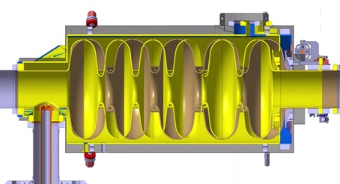
Design: SRF Cavities Development
Spoke cavity
Elliptical cavities
→ Stiffeners on the Spoke bars
(vacuum pressure)
→ No HOM power couplers
Hydroformed Ti bellows
(+/- 3mm range)
994 mm
Stiffeners (LFD compensation)
NbTi flange
(w/bore holes for alignment & assembly tool)
+Al hex. gaskets
550 mm
418 mm
Power coupler port
Ti He vessel
Medium beta:
6 cells – beta=0.67
Length 1259,40mm
High beta:
5 cells – beta=0.86
Length 1316,91mm

Slide 26
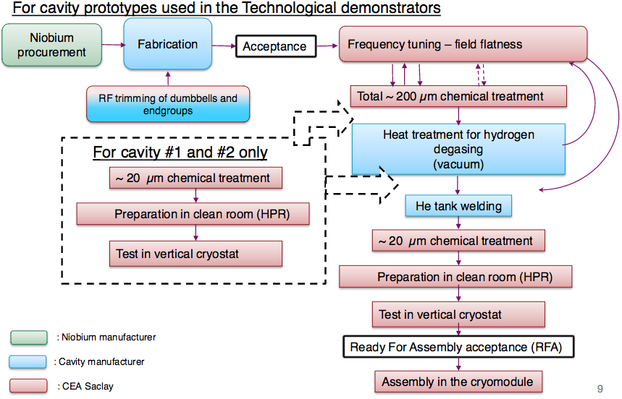
How to fabricate a SRF cavity…
F. Peauger

Slide 27
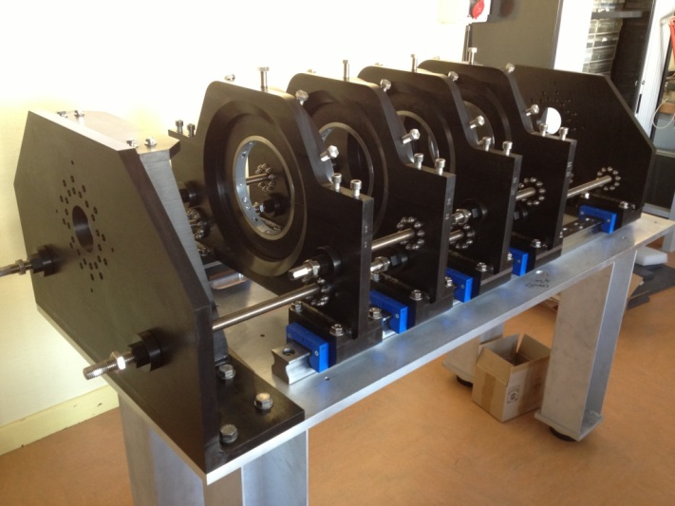
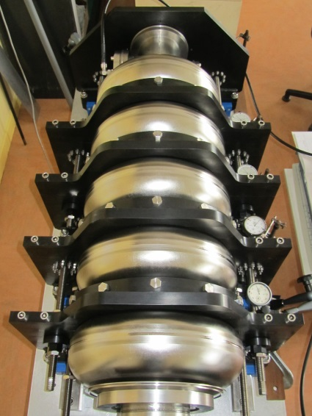
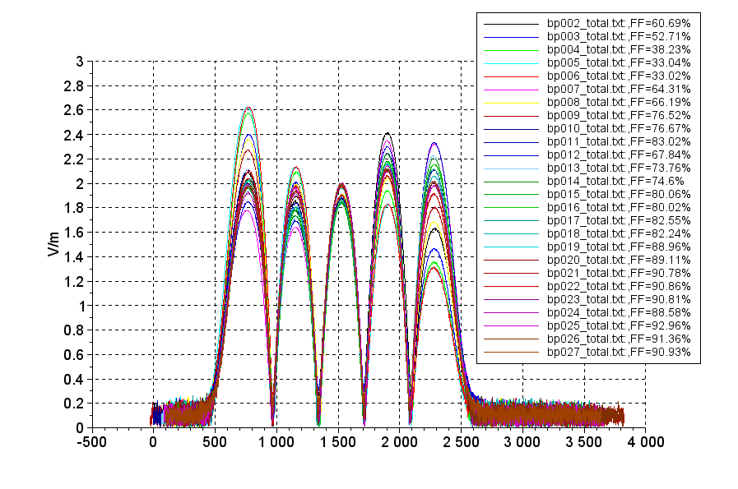
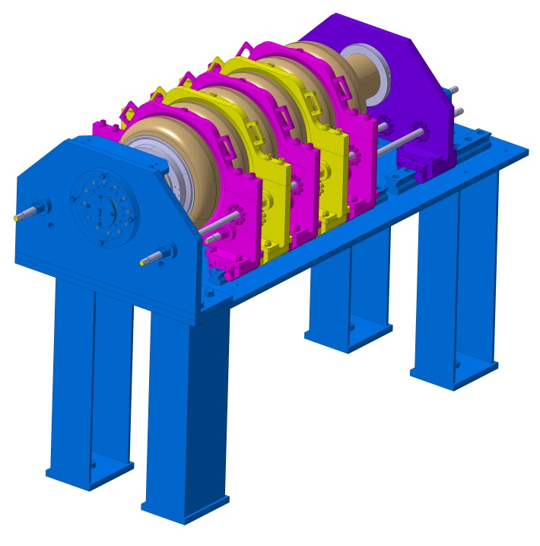
Fabrication: Field flatness tooling at CEA
Exemple of cavity tuning (High beta Prototype n°2 from RI)
D. Roudier

Slide 28
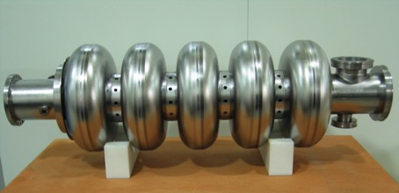
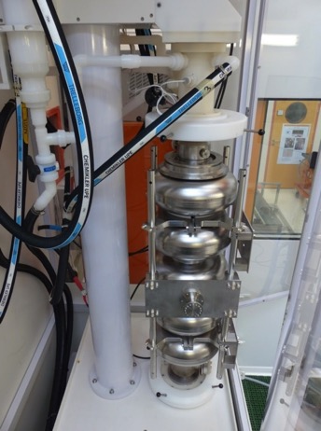
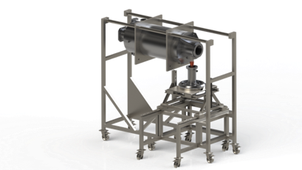
Elliptical Cavity Preparation
High-beta cavity fabrication (Zanon and RI)
Vertical Electropolishing system@ CEA
    Example of the tooling for the assembling of the coupler on the cavity in clean room

Slide 29
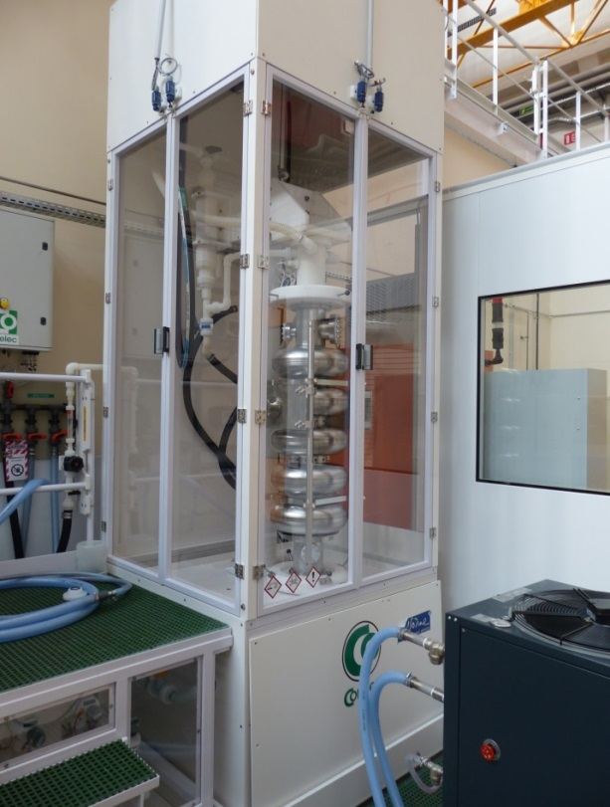
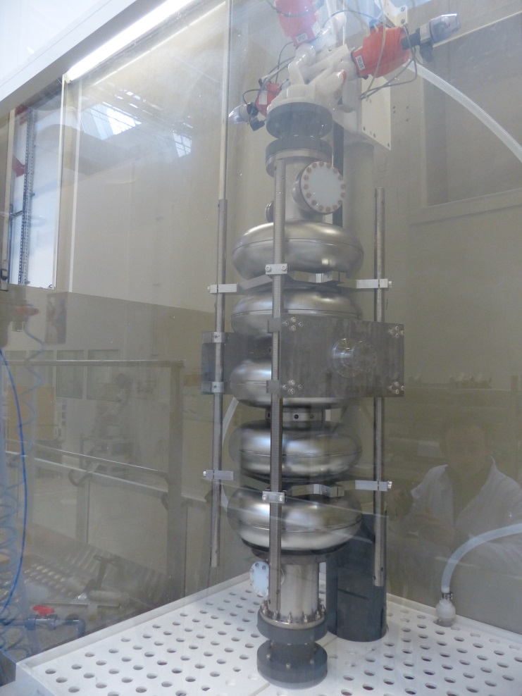
Chemical treatment set-up
F. Eozenou, C. Servouin
Electro-Polishing: EP
Buffer Chemical Polishing: BCP

Slide 30
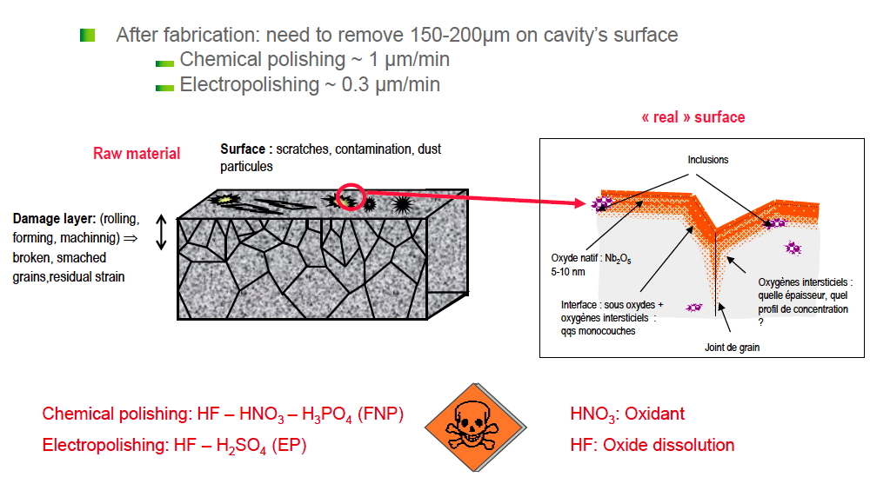
Why Surface Polishing ?
    Courtesy Claire Antoine

Slide 31
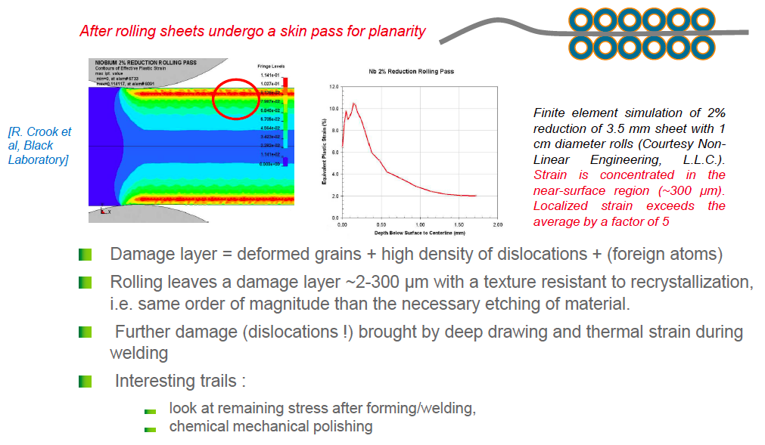
Why Surface Polishing ?

Slide 32
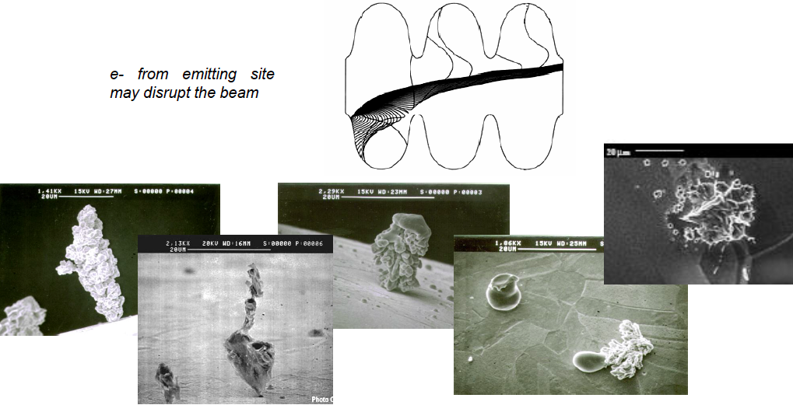
Why do we need clean-room ?
Dust particles and scratches are at the origin of field emission
Courtesy Claire Antoine

Slide 33
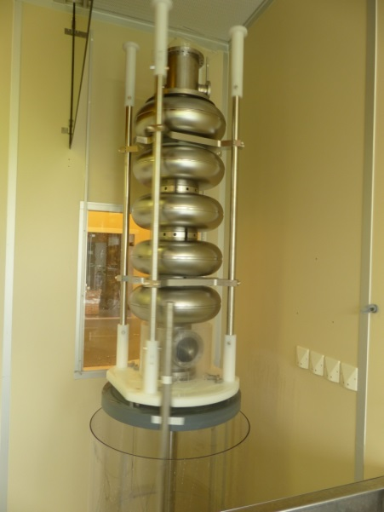
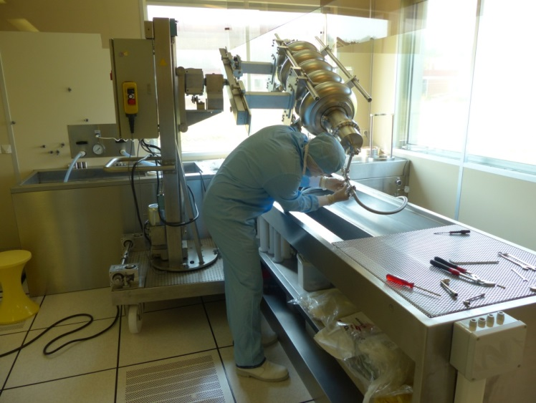
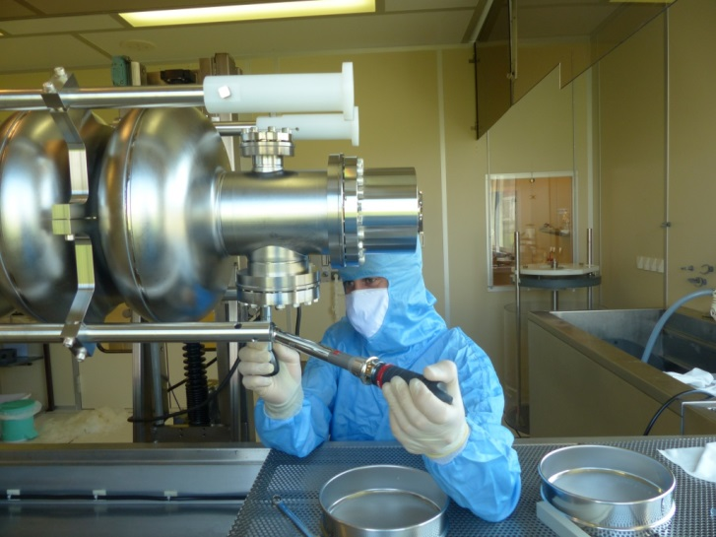
Cavity clean room assembly with High Pressure Rinsing
Flanges and antenna pick-up assembly under class 100 laminar flow
HPR 100 bars - Ultra pure water
F. Eozenou, C. Servouin

Slide 34
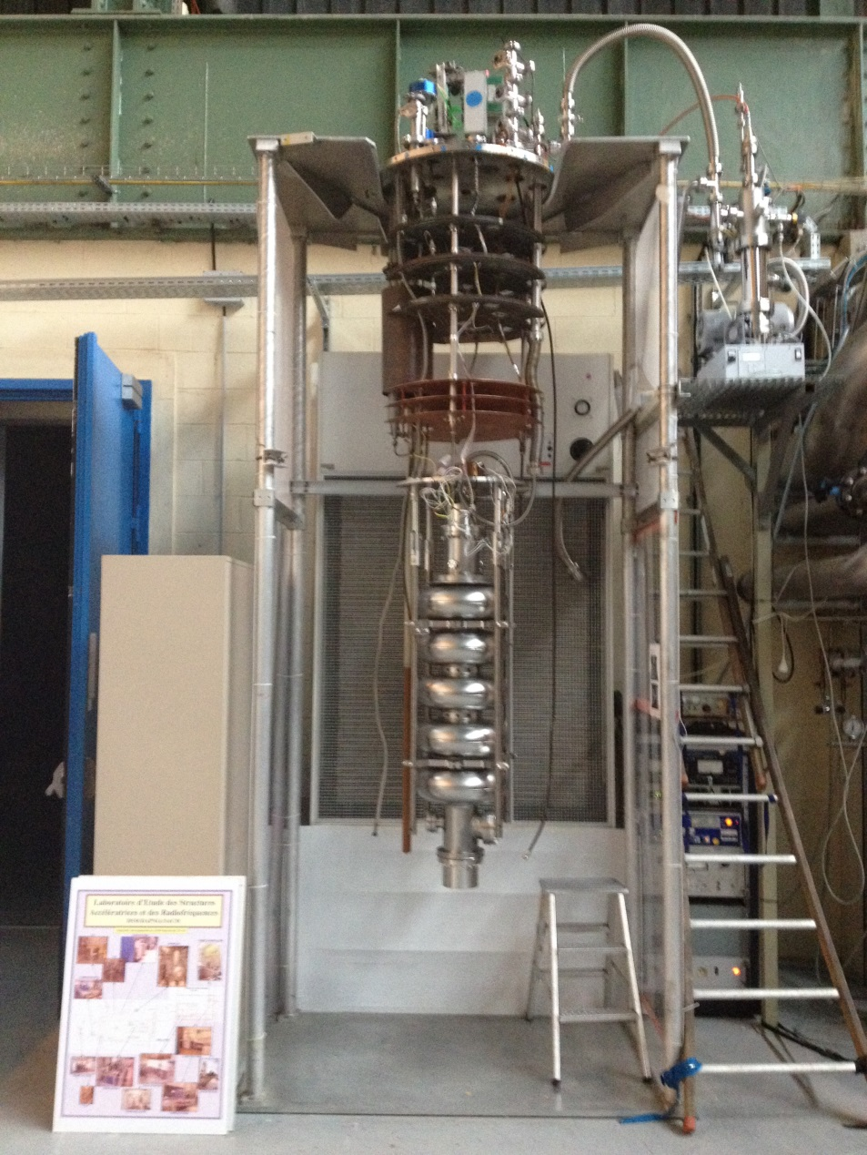
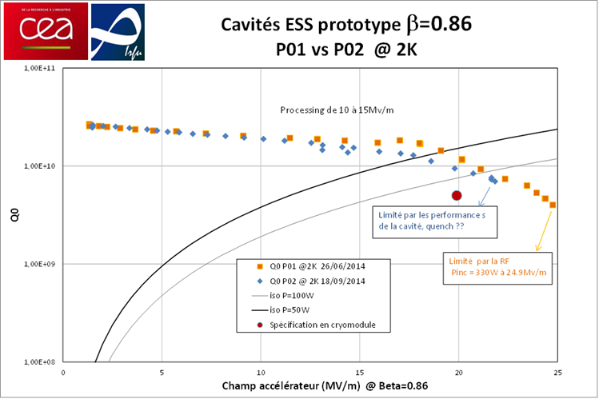
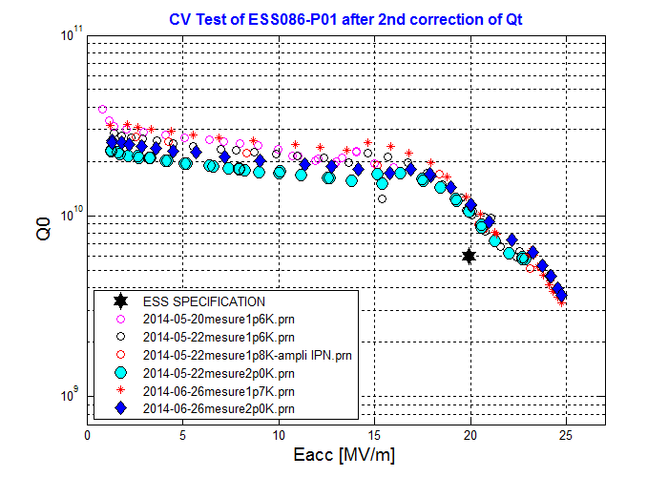
Vertical test results
High beta prototype cavity n°1 from ZANON
Mounting on vertical insert , Connexion to RF system and vacuum pumping station

Slide 35
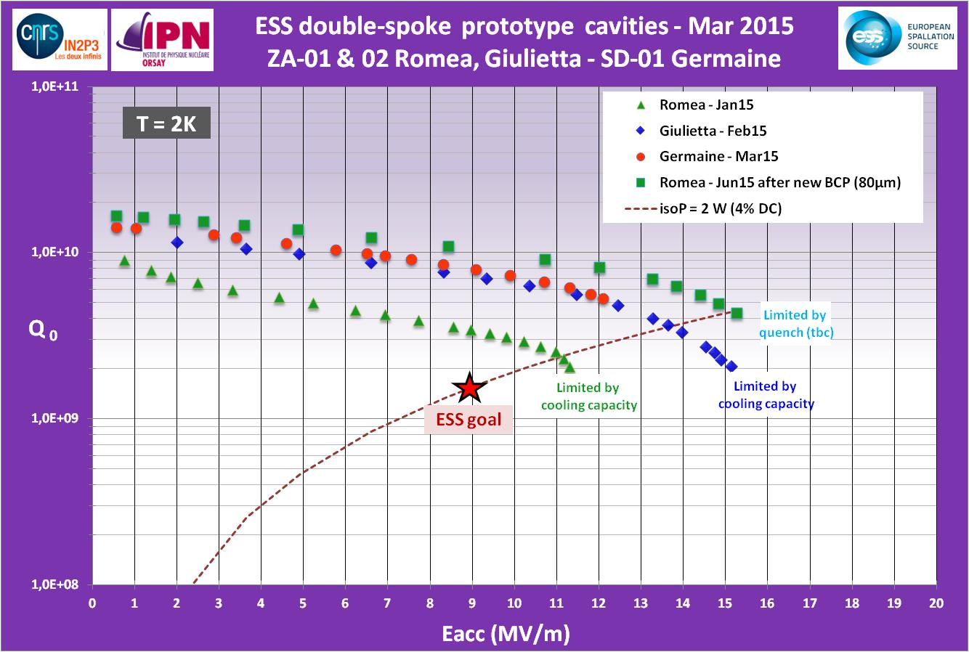
Spoke cavity Performances
(Jan-June 2015)
Spoke cavity exceeding ESS requirements in vertical test on both Eacc and Qo
Eacc_max=15.3 MV/m achieved with “Romea”
Several MP barriers but easily processed.
Qo > 1.6 10¹⁰
Strong FE at max gradient
Limitation is the cooling capacity (unstable conditions, cavity in vertical position)

Slide 36
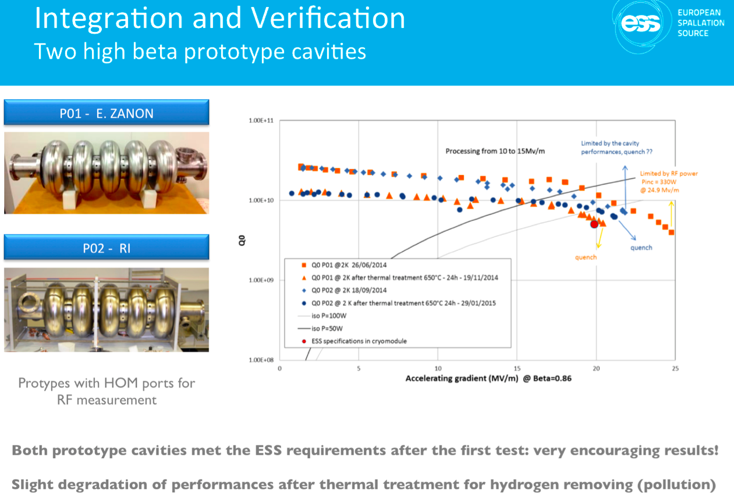

Slide 37






Radioprotection improvement for CV tests
Vertical cryostat
Eucard / SPL beta=1 704 MHz cavity
at 19 MV/m, radiation level decreased from 50 to 0.25 µSv/h close to workstation (public limit < 0.5 µSv/h)
Concrete block - RP
Courtesy Franck Peauger

Slide 38
Outline
  Accelerator ingredient
  Accelerator Environment: Superfluidity and Superconductivity
  Application to Cavity:
    Cavity model
    Cryomodules function
    SRF cavity fabrication
    Cavity package
    Cryomodules
  Application to Magnet: cryo-magnets at LHC
Notes:
Zoom in ( previous talk on magnets and cavity)

Slide 39



Cavities package to Cryomodules
RF cavities housed in cryomodules, which keep the SRF cavities working in a superconducting state, without losing energy to electrical resistance

Slide 40








Spoke cryomodule
Courtesy Patxi Duthill
A cryomodule: what is it and what for?
Room T°
Vacuum
Vessel
Thermal conduction
Thermal shield
T°≤ -200°C
Supports
Vacuum
T°≤-269°C
Thermal radiation
Superconducting radiofrequency (SRF) cavity
RF electro magnetic wave (352 MHz)
1/ To provide a cryogenic environment to the cold mass (cavity) = cryostat:
- distributing the cryofluids to cool-down and maintain at cold T° (LHe, LN₂)
- limiting the heat transfers

Slide 41
Spoke cryomodule
A cryomodule: what is it and what for?
Vacuum vessel
Supports
Supports
Cryomodule
Diag
Tunnel
2/ To support the cavities and perform accurate alignment
- with respect to the beam axis
- with respect to other linac components (cryomodules, diagnostics, tunnel)
NB: alignment must be preserved during thermal and pressure cycles

Slide 42



Spoke cryomodule
A cryomodule: what is it and what for?
Vacuum vessel
Magnetic shield
3/ To offer magnetic shielding
- from the local magnetic sources
- from the earth magnetic shield
NB: the magnetic shield might be cooled (for better performances)

Slide 43
Spoke cryomodule
A cryomodule: what is it and what for?
Vacuum vessel
4/ To provide all interfaces between the cavity and the tunnel:
- beam pipe
- RF
- cryogenic
- vacuum
- diagnostic (instrumentation)
- mechanical (support and alignment)

Slide 44











The Spoke cryomodule prototype
Other components
✓ Cold warm transitions
✓ Gate valves
✓ Assembly tests
Thermal optimization
Smaller/less parts inside the clean room

Slide 45











The Spoke cryomodule
Other components
    Supporting system :
    rods based solution
    ⇨ possibility of adjusting the alignment under vacuum and cryogenic working conditions
    ✓ Optical monitoring system for alignment diag. inside the cold CM
    Thermal and thermo-mechanical optimization
    Support rods fabricated
    Support tested
    Easier assembly (simpler tooling)
    Rod made of two parts for easier cryostating
Outer rod
Inner rod

Slide 46










The Spoke cryomodule prototype
Cryomodule thermal shield
He 20 bars
(machine)
    Material: Al6062
    Thickness: 2 mm
Sat N₂
(Proto)
    Thermal shield fabricated
    Assembled and supported (rods)
    Instrum. and cool-down test

Slide 47




The Spoke cryomodule prototype
Cavities magnetic shield
Cooling circuit
Internal shield
Tuner side ends
External shield
Shrim
Cavity bellow side ends
Material: Cryophy®
Actively cooled (better performances)
Shield support
Coupler shield
    Magnetic shields fabricated
    Assembly test performed
    To be tested within the cryomodule

Slide 48
Outline
  Accelerator ingredient
  Accelerator Environment: Superfluidity and Superconductivity
  Application to Cavity:
    Cavity model
    SRF cavity fabrication
    Cryomodules function
    Cavity package
    Cryomodules
  Application to Magnet: cryo-magnets at LHC
Notes:
Zoom in ( previous talk on magnets and cavity)

Slide 49

Cavity package
Double Spoke Cavity
Heat exchanger necessary to make
the transition from 300 K to 2 K
Integrating a mechanical system
to compensate efforts
RF Power Coupler
Doorknob – Transition between
the coaxial power coupler and
the WR2300 rectangular waveguide

Slide 50




Cavities tuning: Lorentz De-tuning
ESS and long pulse: 2.86 ms
Because of the enormous gradients in superconducting cavities,
  the radiation pressure deforms the cavities
We expect over 400 Hz of detuning in the ESS cavities
  Unloaded cavity bandwidth = 0.07 Hz
  Loaded cavity bandwidth = 1 kHz
The mechanical time constant of the cavities is about 1 ms compared to the pulse length of 3 ms
  Static pre-detuning as done in SNS will not be sufficient
  Dynamic de-tuning compensation using piezo-electric tuners is a must!
  Or else pay for the extra RF power required

Slide 51



Cold Tuning System
Spoke CTS
Elliptical CTS
Type V ; 5-cell prototype
+/- 3 mm range on cavity
Stepper motor and planetary gearbox (1/100e) at cold and in vacuum
2 piezo stacks
Slow tuner
Main purpose : Compensation of large frequency shifts with a low speed
Actuator used : Stepper motor
Fast tuner
Main purpose : Compensation of small frequency shifts with a high speed
Actuator used : Piezoelectric actuators
&

Slide 52




Cold Tuning System

Slide 53


Fundamental Power Coupler
Antenna
Vacuum
Outer conductor
(LHe-cooled)
Spoke:
335 kW
Elliptical:
1.1 MW
Inner conductor
(water-cooled)
Al₂O₃
ceramic disc
WR2300
Short circuit
RF input
Doorknob

