Slide 1


ROADMAP
ESS proposal
Henrik Carling

Slide 2


EPICS AT THE EUROPEAN SPALLATION SOURCE
ESS will launch a large-scale EPICS 7 deployment
  We want to see long term support for EPICS 7
  We want to see good device support
  We want to see support for current and future platforms
  -> This is only possible through an active, vivid community
  -> ESS will invest in the community
EPICS ROADMAP - ESS proposal

Slide 3

OVERALL EPICS ROADMAP GOAL
Grow community volume
  Double community size over 5 years
  More users = more testing, more devices, bigger market
  Larger community = more developers
  More developers = better support, shared cost, more fun
  -> More developers need governance
  -> Expand EPICS outside “usual“ community
EPICS ROADMAP - ESS proposal

Slide 4
THREE FOCUS AREAS TO ACHIEVE GOAL
Documentation
Acessibility and openness
Streamlined codebase
EPICS ROADMAP - ESS proposal

Slide 5
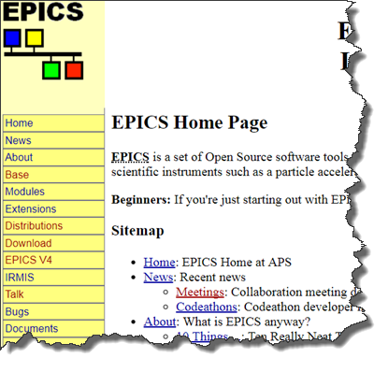
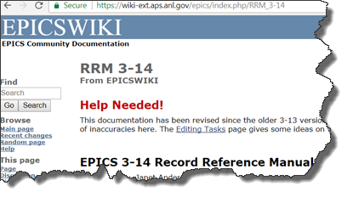
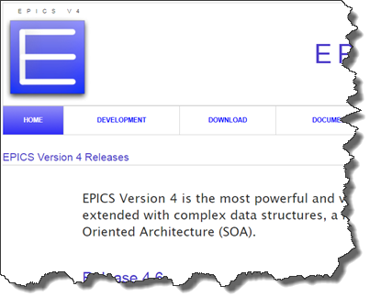
DOCUMENTATION
Improve structure of documentation
Update and keep updated
Welcoming package ”get started” and ”howtos”
Marketing: Whitepapers and use cases
EPICS ROADMAP - ESS proposal

Slide 6
ACCESSIBILITY AND OPENNESS
Improve EPICS GitHub/Launchpad usage
Create a technical governance
Invite and encourage developers
Expand outside the “normal boundaries“
EPICS ROADMAP - ESS proposal

Slide 7
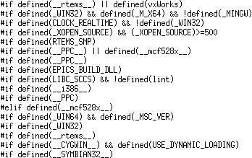
STREAMLINED CODEBASE
Clean up platform support
Simplify builds - optimize success rate
Be careful with library usage and dependencies
Use static review tools
EPICS ROADMAP - ESS proposal

Slide 8
ESS CONTRIBUTION AMBITIONS
Control system studio
  1MY/year
Expand into documentation
  1MY/year
  Already provided prototype website
Expand into EPICS core
  2MY/year
Support commercial players in the community
  2MY/year until 2023 on average
EPICS ROADMAP - ESS proposal

Slide 9

Thank You for Your Attention!

